Slide 1

Tolerance studies and coupling for extreme low emittance in the Future Circular Collider FCC-ee (TLEP)
Sandra Aumon
CERN
On behalf of the FCC-ee Lattice Design team

Slide 2

FCC-ee lattice: 1m/2mm beta*
Circumference: 100km
12 folds lattice
12 arcs (~6.8 km)
12 RF sections
4 and 2 IPs lattices with
0.5/1mm, 1m/2mm beta*
L*=2m
Priority on 2IP lattices, 1m/2mm
120 and 175GeV
RF
RF
RF
RF
IR
RF
RF
IR
IR
RF
RF
IR
RF
RF
RF
RF

Slide 3
FCC-ee lattice
Interaction Region
120 GeV
1m/2mm beta*, 2 Ips
Tool: MADX
Qx=419.08/ Qy=333.14
DQx = -573.6506369
DQy = -852.4978106
Any errors are amplified
3km
FODO cell
Notes:
Ideal lattice for electron
racetrack

Slide 4
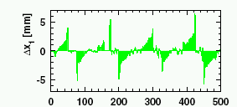
Method for tolerances and correction up to 120 GeV
Errors in lattice (up to 0.150mm for misalignments, 0.1mrad for rolls)
Orbit correction
-> Correct the orbit and H.&V dispersions
Chromaticity correction with sextupoles of the arcs (large strength)
Tune corrections
Re-matching of the optics due to beta-beating
Coupling correction & V. dispersion correction
Switch the synchrotron radiation in MADX:
- compute equilibrium emittances, final orbit with sawtooth effect
Work in progress
„Sawtooth Effect“ at LEP
BPM Number

Slide 5
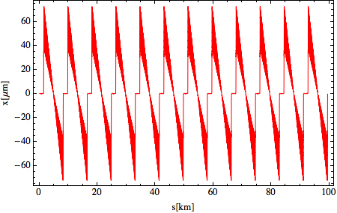
Sawtooth Effect in TLEP (120GeV)
Correction of the linear lattice before switching the radiation.
(only Sawtooth effect remains)

Slide 6
120GeV-1m/2mm-2IPs
Emittance before coupling correction
Misaligned Quadrupoles
Beta-beating introduced by sextupoles
2pm
The coupling comes from off center orbit in the sextupoles for the chromaticity correction (first order)

Slide 7
Preliminary results for coupling correction
Correct non-diagonal element of the transport Rmatrix Re13 at the BPMs (given by MADX) – the others (Re23 etc..) are going down automatically.
Building a Response matrix 3990x(2x3990)
Computation of the response matrix parallelized+inversion (20 hours CPU)
J₁
…
J_{n}
…
J₃₉₉₀
bpm₁
.
.
.
M =
bpm_{n}
.
.
.
bpm_{2x3990}
To be inverted
To correct
Javier Alabau Gonzalo
for CLIC damping ring

Slide 8
Preliminary results for coupling correction
120 GeV -1m/2mm beta*
15% beta-beating
Displacement (microm)
0.060 mm tolerance for quadrupole tolerance
Above 0.060mm, coupling correction counter-productive

Slide 9
120GeV-1m/2mm-2IPs
Horizontal Emittance

Slide 10
Preliminary results for coupling correction
Very likely explanation:
optics mismatch, vertical dispersion mismatch,
skews combination/optimization

Slide 11
SVD decomposition
Eigen values
Optimization of the number of eigenvalues & skews & places
Work in progress

Slide 12
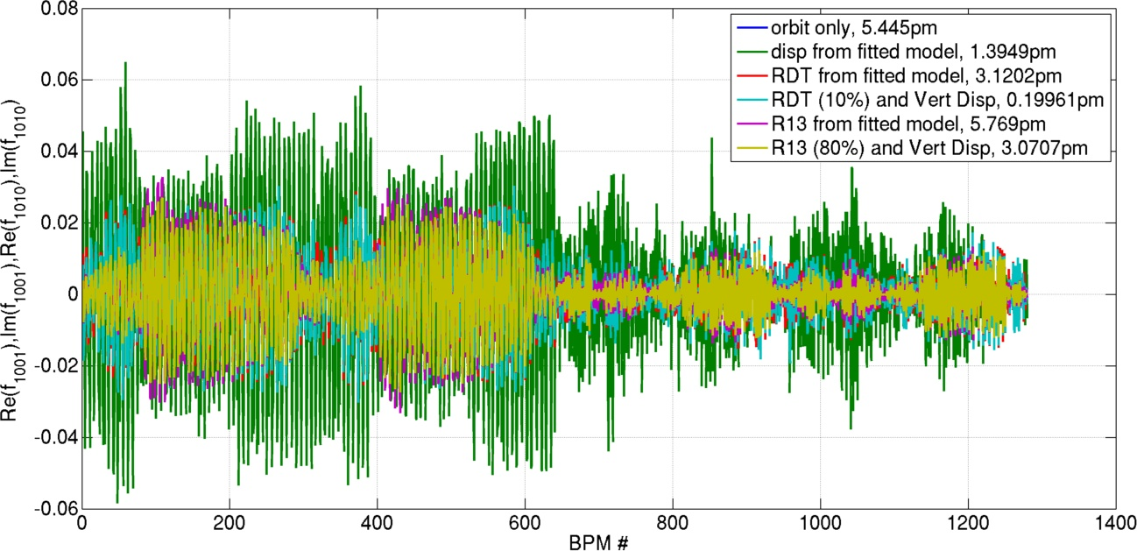
Resonance Driving Term method from ESRF
Linear!
Courtesy S. Liuzzio

Slide 13
Rolls angle in quadrupoles
120 GeV – 1m/2mm beta*
Before coupling correction
More relax situation than quadrupole misalignments

Slide 14
Matching of FCC-ee optics
Use Dispersion suppressor/matching sections to rematch in straight sections and arcs. (ARC- Dispersion Suppressor – Matching section -SS – FF – IP)
Do not touch the quads of the arcs (4000 quads in the machine)
Work in progress
Arc
Straight Section
Arc
Matched
Arc
Mismatched
Arc

Slide 15
Racetrack lattice 120GeV – no tapering
Non linear beta_beat
120GeV -2 Ips – 2mm beta* - 2RF sections
Strong beta beat sur sawtooth – need to be tapered

Slide 16
Conclusions – Next steps
Challenging machine in terms of tolerances
toward linear collider requirements for tolerances
Beta-beating and vertical dispersion spoil the vert. emittance during the coupling correction
- Re-matching of the machine (Resp. matrix based on ideal machine)
- Improve SVD decomposition for response matrix
(exclude certain eigenvalues)
- skews in Dispersion Suppressor section less efficient.
Comparison with RDT method (A. Franchi et al., PRSTAB 14.0034002) – Able to measure
Tolerance for a Racetrack lattice - local chromaticity correction at the IPs (Katsunobu Oide) – Tunnel fitting with the FCC-hh machine

Slide 17
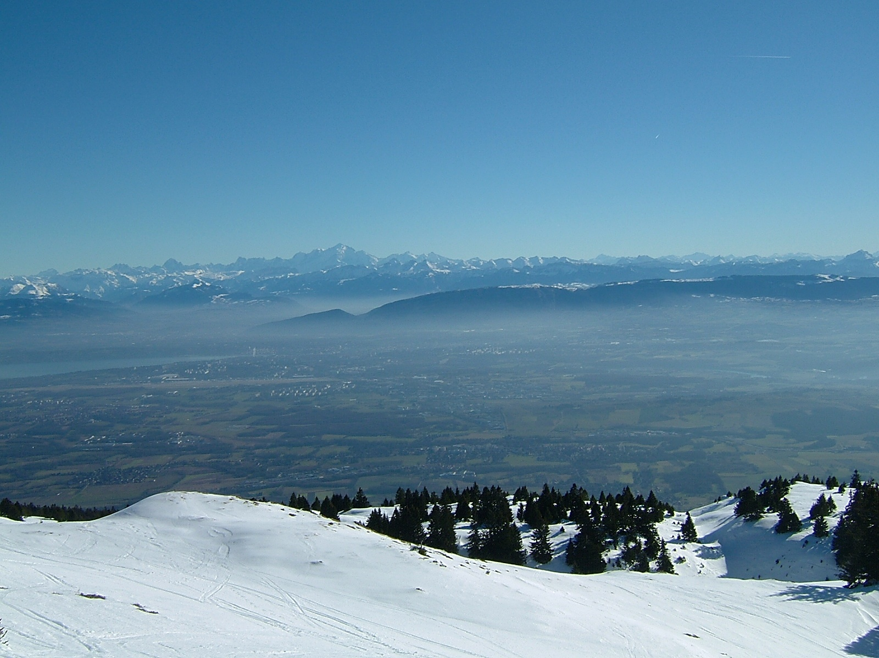
Thank you for your attention!

Slide 20
Courtesy Katsunobu Oide

Slide 21
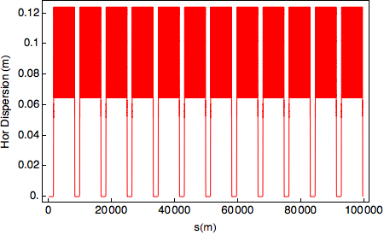
Optics at the IR
Optics for 120GeV (H) and 175GeV (ttb)
From Bastian Haerer’s presentation, tuning of the cell length and phase advance to get the correct emittances.
2 lattices with 2 scheme of chromaticity correction (in the arc or around the IPs)
Chromaticity correction in the arcs (stronger sextupoles)
Bastian’s lattice
Beta*=1mm
Betaymax= 5km

Slide 22
Only Coupling

Slide 23
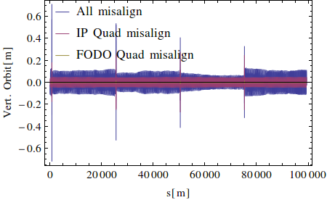
Influence quadrupoles of IPs

Slide 24
Main challenges: parameter list
 | Z | W | H | tt
Beam energy [GeV] | 45.5 | 80 | 120 | 175
Beam current [mA] | 1450 | 152 | 30 | 6.6
Bunches / beam | 16700 | 4490 | 1330 | 160
Bunch population [10¹¹] | 1.8 | 0.7 | 0.46 | 0.83
Transverse emittance ε Horizontal [nm] Vertical [nm] | 29.2 0.06 | 3.3 0.007 | 0.94 0.0019 | 2 0.002
Momentum comp. [10⁻⁵] | 18 | 2 | 0.5 | 0.5
Betatron function at IP β* Horizontal [mm] Vertical [mm] | 500 1 | 500 1 | 500/1000 1/2 | 1000 1/2
Energy loss / turn [GeV] | 0.03 | 0.33 | 1.67 | 7.55
Total RF voltage [GV] | 2.5 | 4 | 5.5 | 11
Lattice design & optimization for 4 different energies
Lattices with 2 and 4 IPs
Coupling ratio
V.emit/H.emit ~0.2 & 0.1%
Challenging chromaticity correction scheme (chromaticity carried 90% by IR, 10% Arc) – B. Haerer and A. Bogomyakov
Average synchrotron radiation power per turn
Notes:
8 gev /turn/beam

Slide 25
Emittance tuning in electron storage rings
L.C. Teng “Minimizing the Emittance in Designing the lattice of an Electron Storage Ring”, 1984.
L: cell length
l_{B}: dipole length
: phase advance/cell
To match the baseline parameters, Bastian Haerer tuned cell length- phase advance per cell (90/60 degrees)
Energy (GeV) | Cell length (m)
45 | 300
80 | 100
120 | 50
175

Slide 26
Emittance tuning in electron storage rings
Alignment errors, rolls angle and coupling spoil the vertical emittance and compromise the coupling of 1/1000 (2/1000)
-> Coupling and Dy should be under control.

