Slide 1
Review of the suggested evaporator design and results of performance measurements
Jan Buytaert, CERN
Pawel Jalocha, University of Oxford

Slide 2
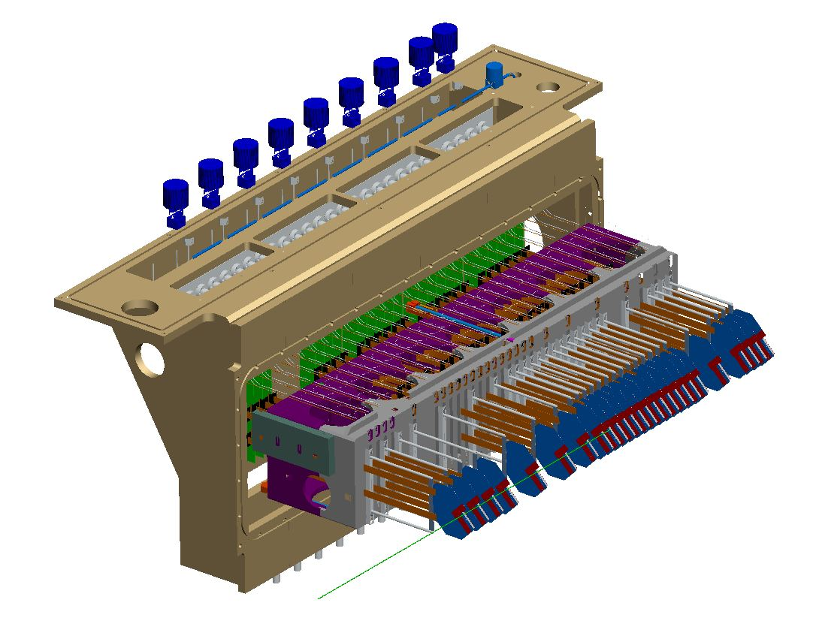
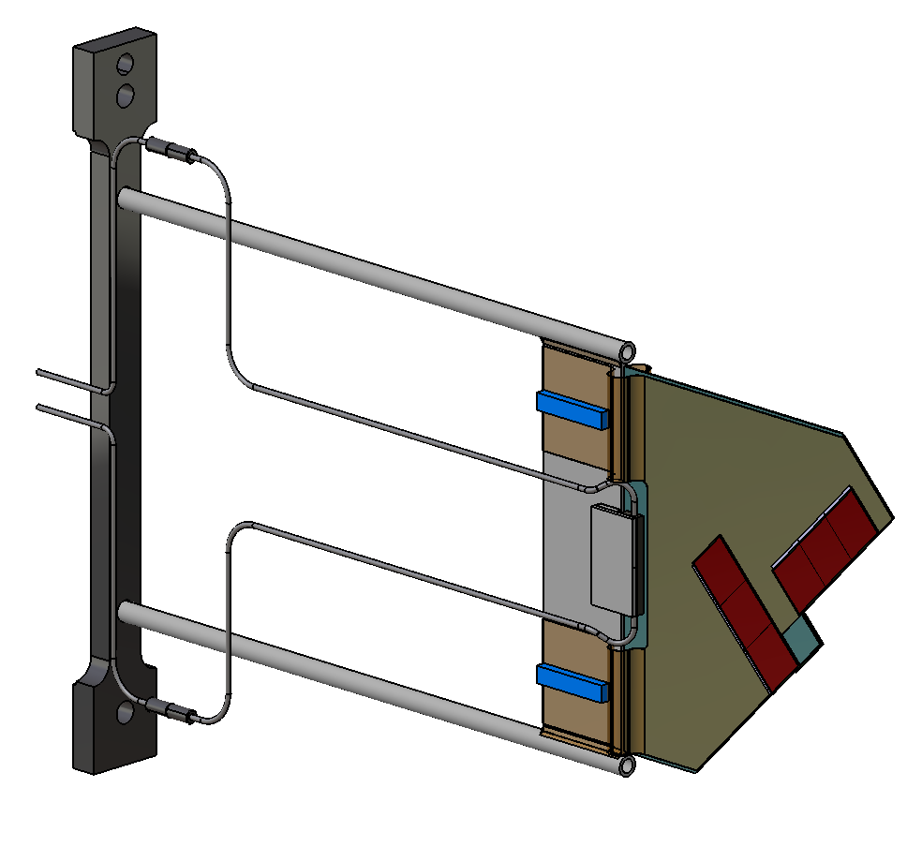
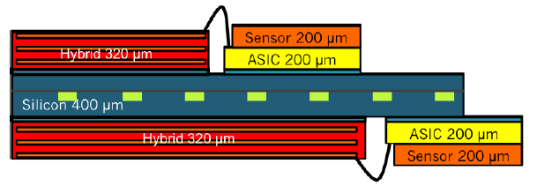
2018 LHCb VELO upgrade:
52 pixel modules,
1.6 kW power dissipated.
26 modules
on two VELO sides
Si sensor
Bonds
Readout chip
Signal routing
Microchannel wafer
CO₂
12 pixel ASIC’s
+ 4 Si. pixel sensors = 30W
Notes:
LHCb VELO is soon to be upgraded to cope with increased luminosity. Strip readout is to be replaced by pixel readout, and readout chips will sit directly on top of the sensors. More power will be dissipated and it has to be taken directly from the ASICs and silicon sensors. We are going to use thin silicon wafers with etched microchannels, where liquid CO2 would be circulated.

Slide 3
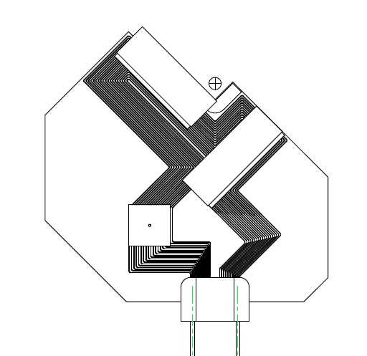
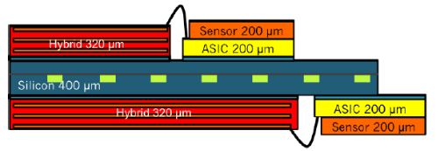
Current design channel layout
Sensor+ASIC
Beam spot
400 micron thick silicon wafer
19 channels 120x200 micron
CO₂ flow: 0.3 g/s
30W heat load
Cooling block connects the CO₂ pipes
CO₂
Notes:
The layout is chosen to cool all the ASICS.
CO2 enters from the right, passes though a 40mm restriction, boils at the orifice just before the first ASIC, flows through a 200-300mm channel under all 4 ASICS and the GBT chips and exiting on the left.
There are 19 channels and every bend has the same radius (0.5 inside radius) so that pressure drop on bending is the same for all channels.

Slide 4
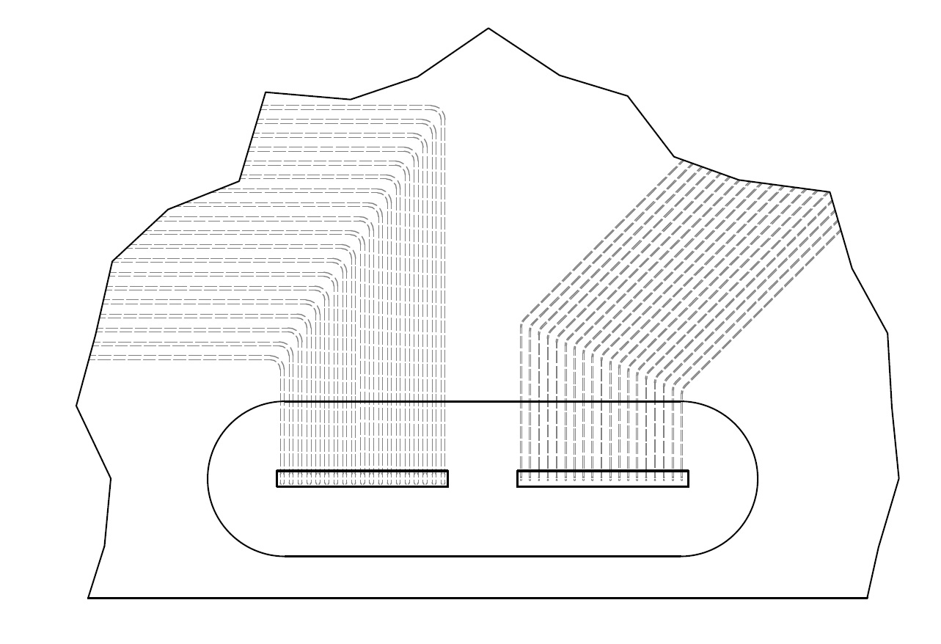
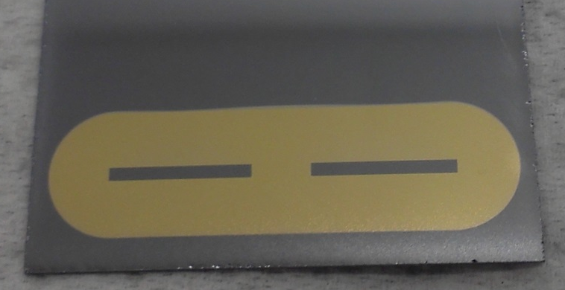
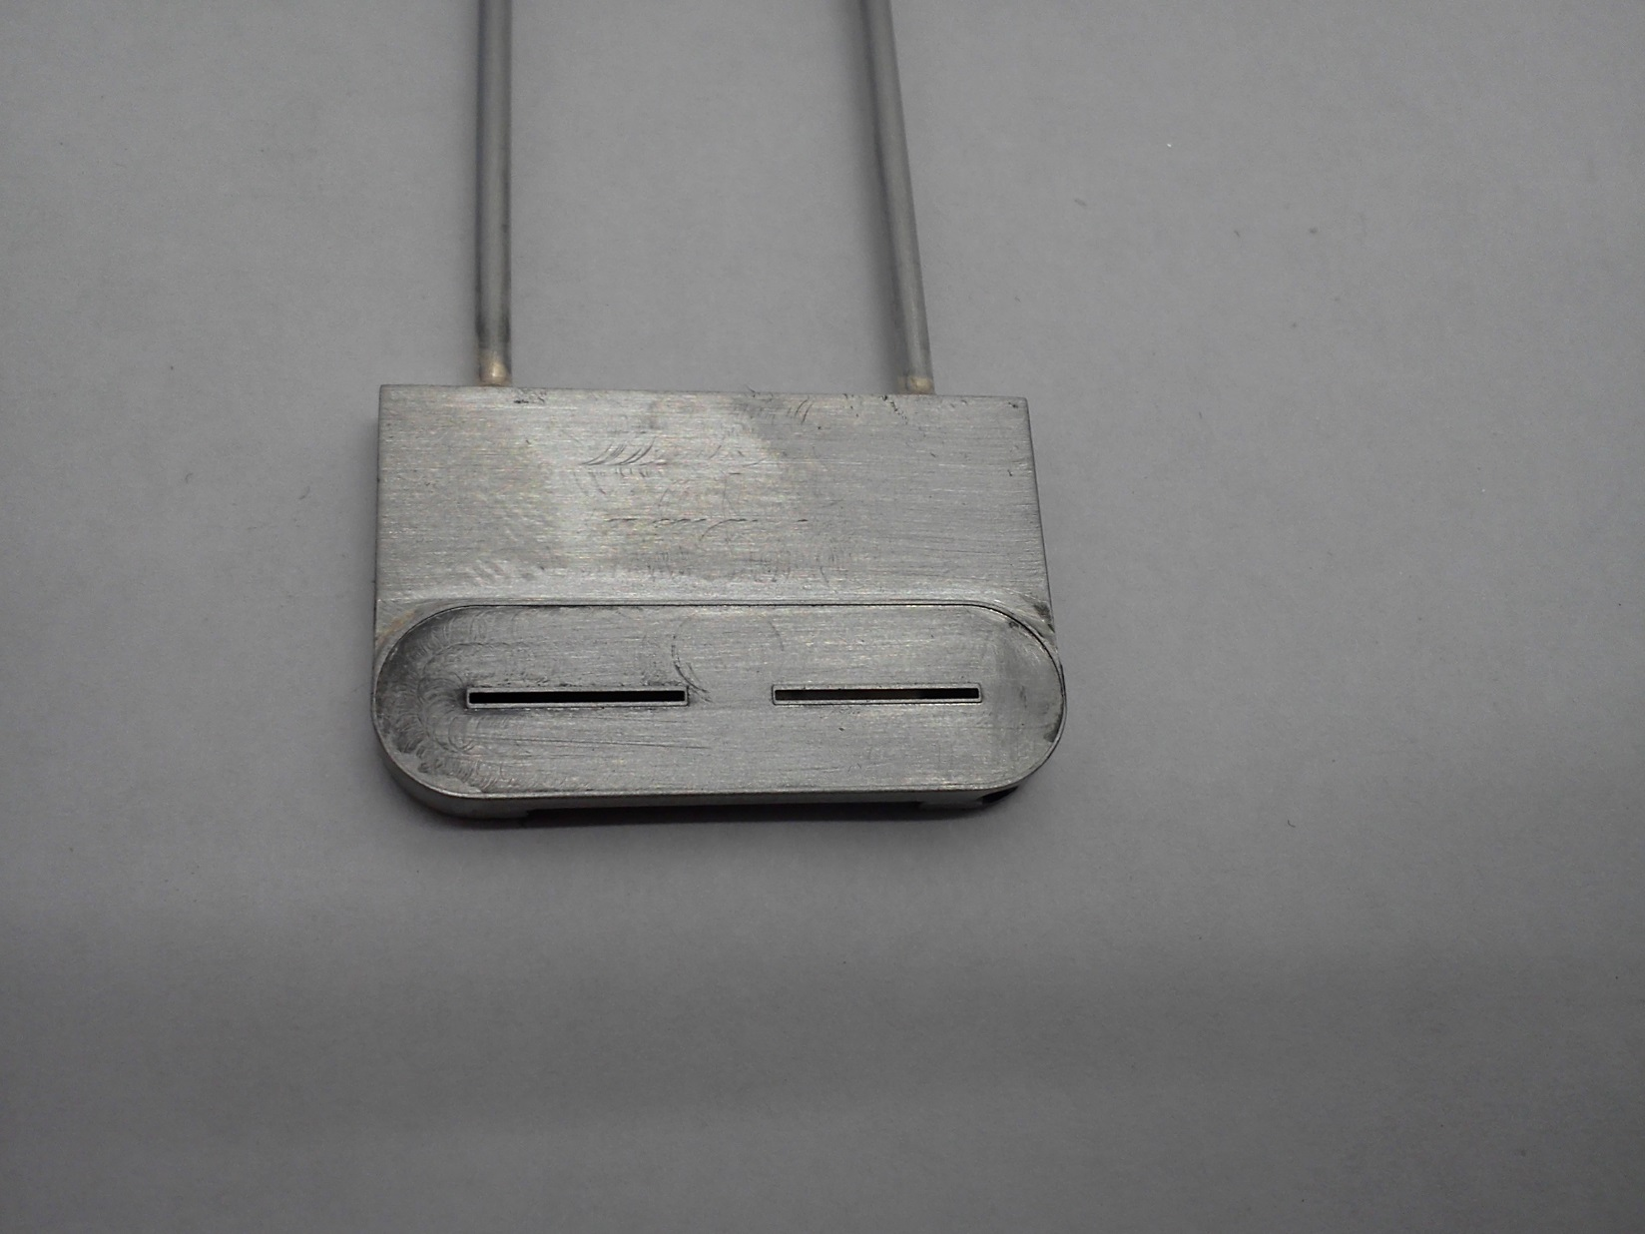
Current design metallisation, soldering footprint, CO₂ connector
Notes:
You can see the slot positions relative to the metallisation here so no solder should cover a slot.

Slide 5
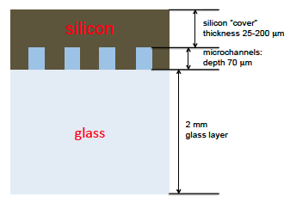
Microchannel prototypes to measure flow and thermal characteristics
Proof of concept
Measure flow and heat characteristics
Test microchannel geometry
One side is silicon, like the final design.
The other side is much thicker pyrex (glass)
Silicon-to-glass (pyrex) anodic bonding technology is available in EPFL/Lausanne and suitable to produce prototypes
Not ideal but close thermal expansion match: 2.3 vs 3.3 ppm/K
Unfortunately not a good match for thermal conductivity: 130 vs 1 W/mK
Heat load can only be applied on the silicon side
Difficult to solder the fluidic connector: quick heating and cooling creates internal stresses.
Glass makes it possible to visually inspect the CO₂ flow
Dummy heaters
Sensor
Sensor
Silicon 380µm
ASIC
ASIC
Pyrex 2 mm

Slide 6
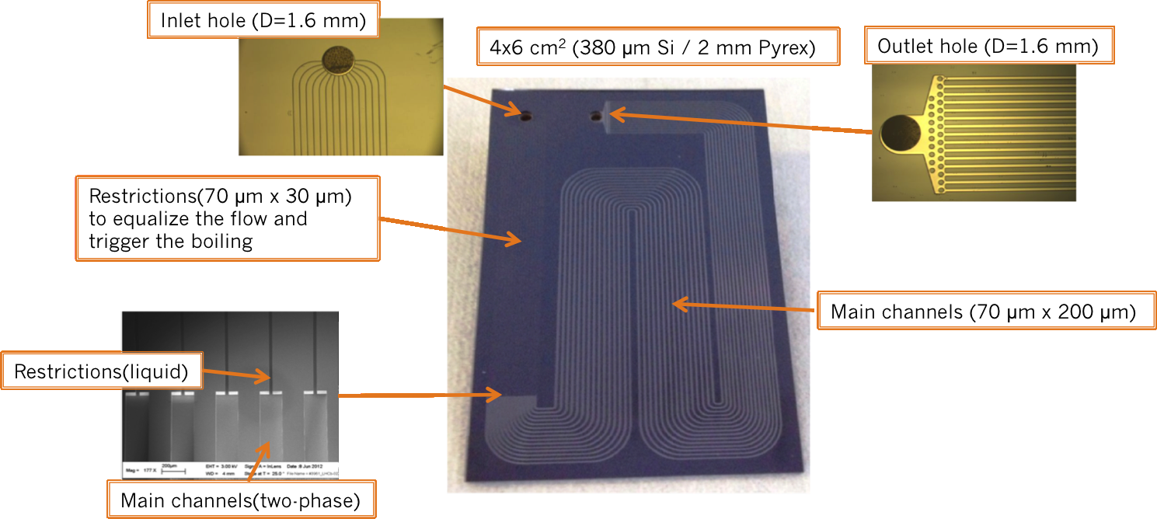
1st prototype: „Snake I”
Simple round holes as inlet and outlets for the liquid CO₂
Very thin restrictions: turn out to be too thin.
Microchannel geometry and active surface designed to represent half the thermal capacity of the VELO module
Notes:
To prove the concept a prototype named „Snake I” was made. The microchannel shape, inlet and outlet are simple round holes. Think film heaters are used to generate heat load similar to the ASICs and irradiated sensors

Slide 7
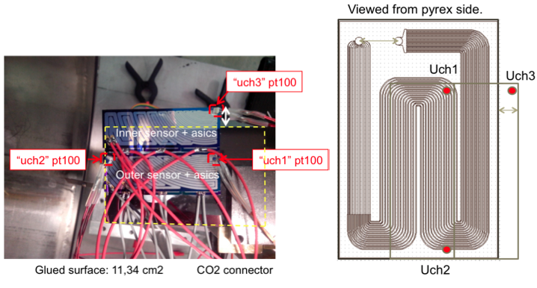
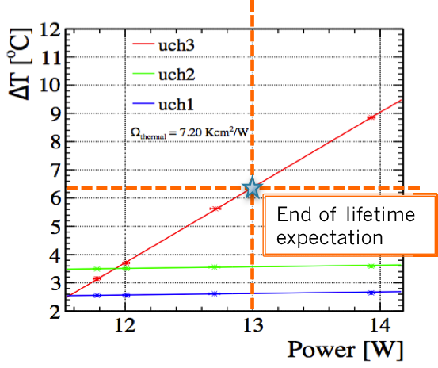
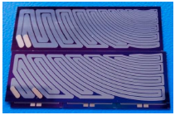

1st prototype: Snake I
5 mm
Sensor heaters
Simple round holes as inlet and outlets for the liquid CO₂
Microchannel geometry and surface designed to represent half the thermal capacity of the VELO module
Thin-film heaters are used to generate heat load similar to the ASICs and irradiated sensors.
Measurements show the tip of the sensor gets no higher than 7 ºC above the flowing CO₂ temperature.
ASIC heaters
Notes:
To prove the concept a prototype named „Snake I” was made. The microchannel shape, inlet and outlet are simple round holes. Think film heaters are used to generate heat load similar to the ASICs and irradiated sensors

Slide 8
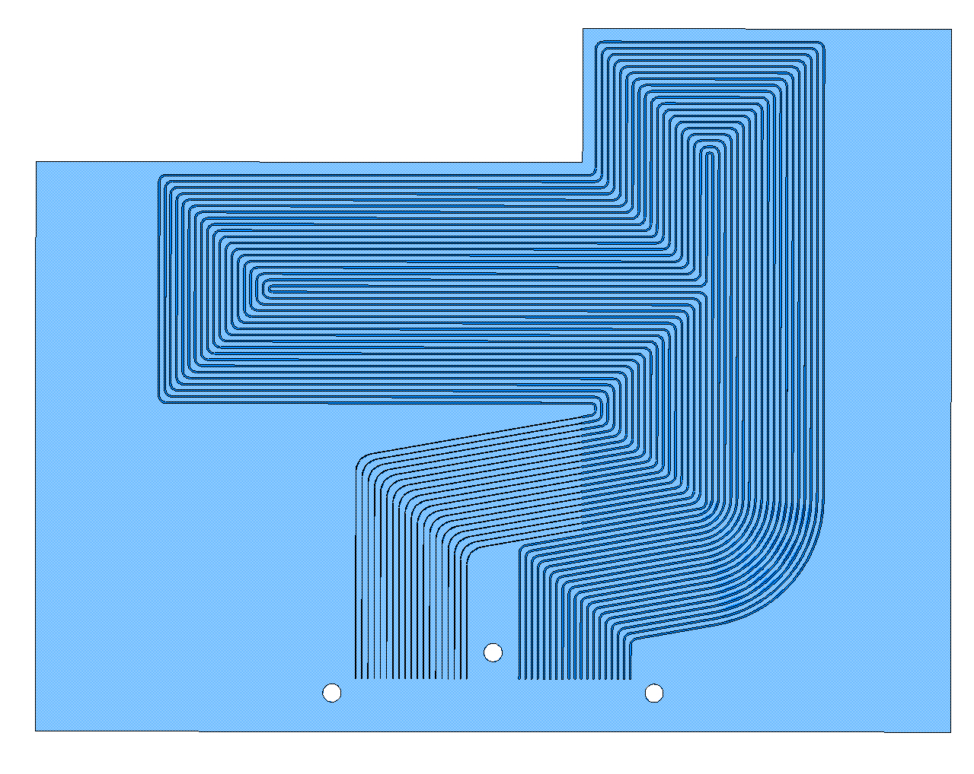
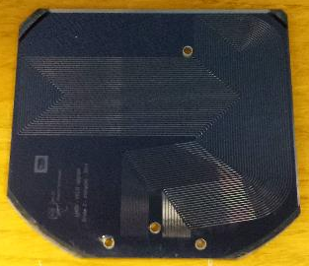
2nd prototype: SNAKE II/III.
Si–Pyrex prototype
All 19 channels have nearly the same length and fluidic resistance.
2 new samples were produced at EPFL by PH/DT. Adrien Toros & Alessandro Mapelli.
1 sample has a small perforation in a channel, but can be repaired.
See first CO2 circulation in :
https://www.youtube.com/watch?v=8tzuo8y78y4

Slide 9
Snake I vs II: channels dimensions
Designed to reduce fluidic resistance (by a factor ~4) while maintaining resistance to pressure:
Main channels have the same width (200 µm) but increased depth (120 µm)
Restrictions made square (60 µm x 60 µm) to minimize clogging
Considering the CO₂ is at -20˚C and assuming 30% vapor quality, we need a flow of 0.52g/s to dissipate 43 W/module. The pressure drop will be ~ 3 bar.
Old layout
New layout
Restriction
Main Channel
Restriction
Main Channel
70 µm
60 µm
120 µm
400 µm
30 µm
200 µm
60 µm
200 µm
Notes:
First the channels dimensions were optimized to reduce the fluidic resistance of the system while maintaining he resistance to pressure. The main channels have the same width but increase depth. The restrictions made squared (60x60 µm) to avoid clogging. On this picture, there a comparison between the old and the new dimensions design.

Slide 10
Fluidic characterisation
Measure the CO₂ flow through the microchannel
Measure fluidic „resistance” or dependency on the pressure
Not a trivial task considering low flow levels: 0.05-0.5 g/s
Important input for further geometry refinements and to the cooling factory design
Needs the TRACI with a strong pump (up to 8bar) to achieve full differential pressure range
Connection to inlet/outlet is realized with clamps and o-rings.

Slide 11
Fluidic characterisation: system setup
TRACI2
Vacuum tank
Mass Flow
meter.
Pressure
Gauge P1
Heat
F_{m}
F_{m1}
F_{m2}
F_{m1} = ~5 x F_{m2}
Needle
Valve.
‘bypass’
?
Micro
channels
pump
F_{m2}=f(dP,T,Heat) ?
Manual valve
Pressure
Gauge P2
dP=P1-P2
Environment
heat
Bypass valve is required as otherwise the CO₂ flow would be too low to absorb all the environment heat and for the TRACI to stabilize.
About 80% flow is through the bypass
Notes:
About 1/5 of the flow goes throught the microchannel.
Mass flow meter is a very sensitive corriolis force type.

Slide 12
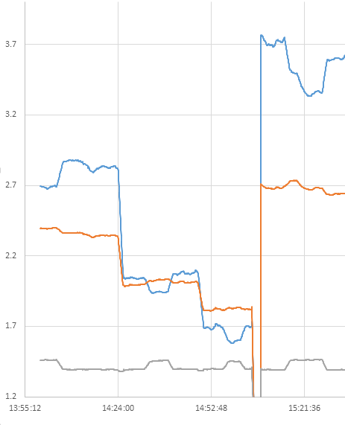
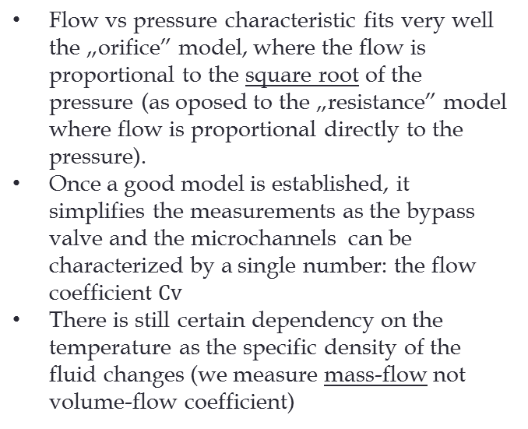



Fluidic characterisation: Snake I
Flow vs pressure characteristic fits very well the „orifice” model, where the flow is proportional to the square root of the pressure (as oposed to the „resistance” model where flow is proportional directly to the pressure).
Once a good model is established, it simplifies the measurements as the bypass valve and the microchannels can be characterized by a single number: the flow coefficient $Cv$
There is still certain dependency on the temperature as the specific density of the fluid changes (we measure mass-flow not volume-flow coefficient)
$$Pressure$$
Cv units (arbitrary for pressure and flow)
$$Flow$$
$$Cv=Flow/√Pressure$$
Time
uChannel turned on/off
(manual valve)
Notes:
The flow through Snake I fit s very well the restriction model: flow is porpotional to the square root of the pressure.

Slide 13
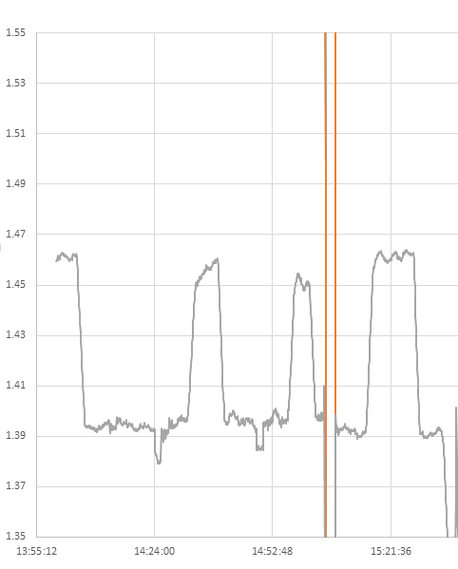
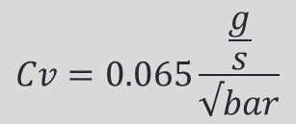


Fluidic characterisation: Snake I
Flow coefficient of the Snake I prototype was measured, thus knowing the differential pressure the flow can be easily calculated. E.g. at 4 bars the flow is 0.13 g/s
Cv units (arbitrary for pressure and flow)
$$Cv=0.065\frac{\frac{g}{s}}{√bar}$$
Time
$$Cv [valve]$$
$$Cv [valve+microchannel]$$
Flow coefficient measurement is now trivial: turn on and off the bypass valve and that’s it !
Notes:
The diffrence of the measured flow coeff. Between the microchannel included and excluded is the flow coeff. Of the microchannel

Slide 14
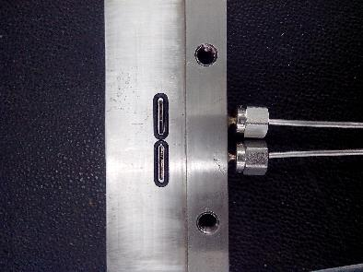
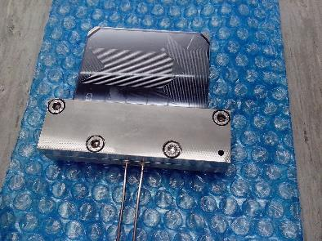
Fluidic „clamp” connector for Snake II
Metallic clamp with O-rings.
Sample is in contact with the metal block only on the pyrex side (good heat isolator) and not on the Si side.
The cooling tubes are in contact with the metal block.

Slide 15
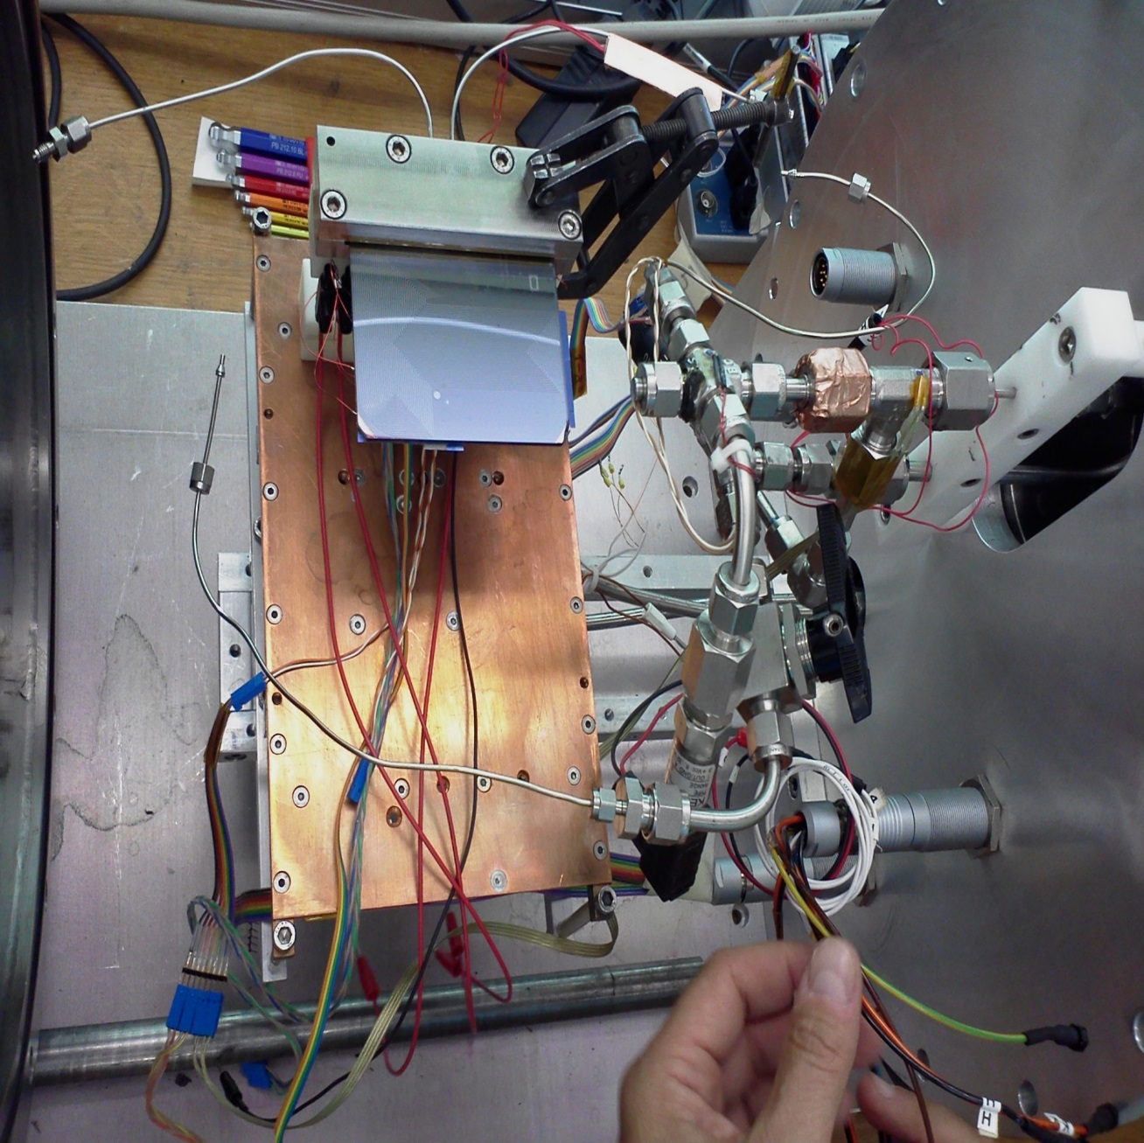
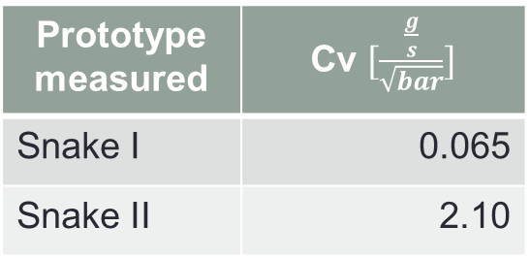
Snake II in the TRACI cooling system
Pre-heater on the CO₂ inlet tube: 5-10W
Snake II flow coeff. is three time the Snake I – designed factor was 4, thus a good match.
Prototype measured | Cv $[\frac{\frac{g}{s}}{\sqrt{bar}}]$
Snake I | 0.065
Snake II | 2.10

Slide 16
Heat load tests
Prototype wafer is heated on the silicon side
Heaters are made of silicon (like ASICs and sensor) with a thin film deposit working as the actuall electric heater.
Temperature is recorded at two different points on the heaters and at the wafer close to the outlet.
Heating power is applied in steps
As larger and larger part of CO₂ evaporates, eventually there is no cooling power left and the outlet temperature shoots up.
We don’t go beyond this point

Slide 17
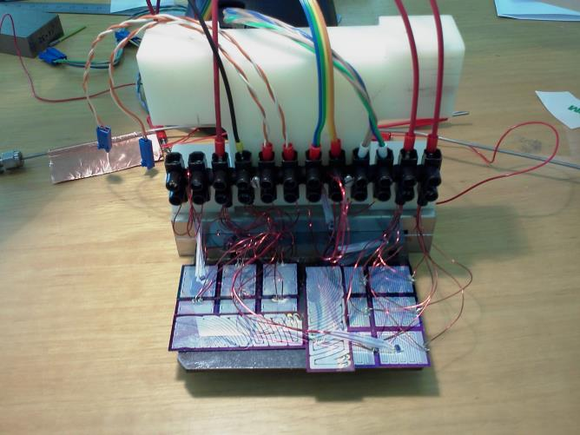
Heat load tests of Snake II – fitting the heaters
Heaters attached on the silicon side to cover completely the surface above microchannels
3M tape used for the attachment
ASIC heaters wired in parallel and split into two groups.
Four temperature probes strategically placed:
  on a heater closest to the inlet
  on a heater half-way
  on silicon close to the outlet
  on the mounting block
Note the pre-heater on the inlet tube
Preheater on inlet tube
T_clamp
T_uch3
T_uch1
CO2 flow
T_uch2
All heaters are mounted on Si side

Slide 18
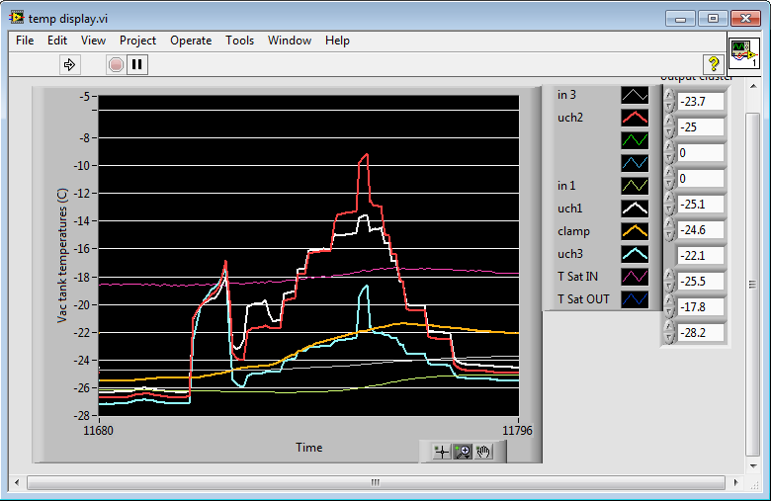
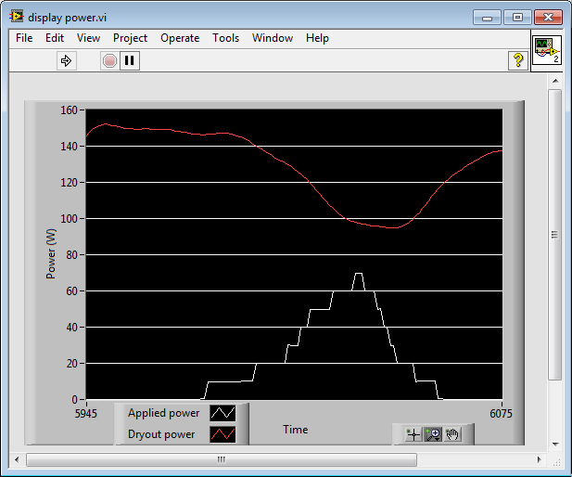
Sample heating test at -30 ºC and 6 bar diff. pressure
Applied power (white) and max. theoretical power (red) derived from CO2 flow and latent heat. Note that the red curve is delayed as it is based on averaged CO2 flow coeff.
At 70W the outlet temperature jumps up – we stop here
At 60W white and red start to separate
Pre-heater applied again and sustained, as some channels stop to boil
Pre-heater applied to trigger the boiling
10W applied but all temperatures go up and follow each other

Slide 19
Maximum cooling power at dP ~4 bar
T_traci | Tin1 | Tuch3 | Max power | Vapor quality | Flow @no load | Flow @ max load | ∆P
-25 | -22.8 | -23.6 | 60 | 0.76 | 0.42 | 0.26 | 4.07
-15 | -12.8 | -13.6 | 66 | 0.77 | 0.42 | 0.30 | 4
-5 | -2.8 | -3.6 | 66 | 0.8 | 0.42 | 0.32 | 4
5 | 6.1 | 6.6 | 58 | 0.84 | 0.42 | 0.34 | 3.95
15 | 16.6 | 16.1 | 57 | ? | 0.38 | 0.32 | 4
Obtained at ∆P=~4bar . Flow = 0.3÷0.4g/s
Required maximum module cooling power = 40W.
Expected module cooling power = 30W
  Factor 2 margin.

Slide 20
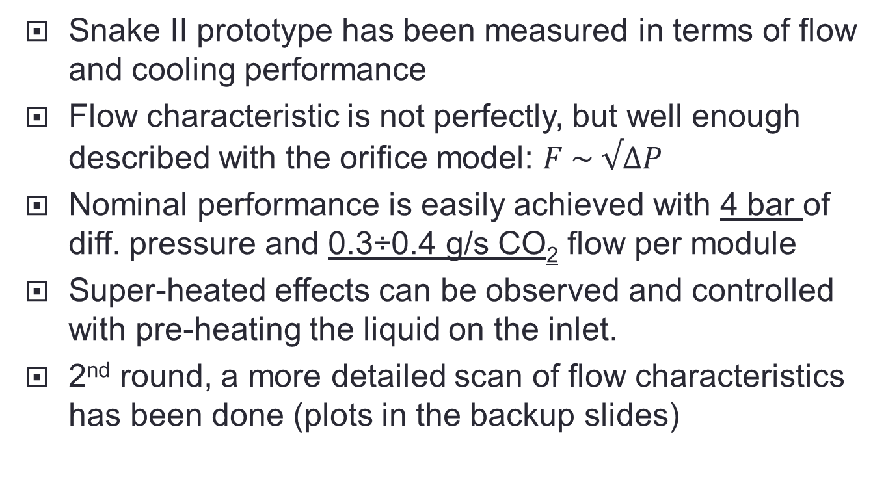
Summary of the flow and heat tests
Snake II prototype has been measured in terms of flow and cooling performance
Flow characteristic is not perfectly, but well enough described with the orifice model: $F \sim √∆P$
Nominal performance is easily achieved with 4 bar of diff. pressure and 0.3÷0.4 g/s CO₂ flow per module
Super-heated effects can be observed and controlled with pre-heating the liquid on the inlet.
2nd round, a more detailed scan of flow characteristics has been done (plots in the backup slides)

Slide 21
VELO cooling plant requirement.
Maintain 4 bar of differential pressure on micro-channel wafers.
Provide ~0.4 g/s CO₂ flow per module
  at ~60W maximum cooling power (factor 2 margin vs nominal) and ~80% vapour quality the flow would fall to ~0.3 g/s
Provide ~20 g/s total CO₂ flow for 52 modules
  nominal cooling capacity needed is 1.6kW
  max. cooling capacity would be ~3kW at ~80% vapour quality.

Slide 22
Backup slides

Slide 23
Heat load test summary
Data recorded at 4 bar diff. pressure
Well over max. expected heat load (40W/module) can be achieved
Vapor quality ~75÷80% - thus good part of CO₂ is actively absorbing the heat.
At low temperatures the flow coeff. drops significantly when boiling starts: by as much as 1/3
At chosen diff. pressure the max. power does not depend very much on temperature. But we have seen with Snake I this is not true for all operating points.
Temp [ºC] | Cv @ no heat load | Cv @ max. heat load | ΔCv | Pmax. [W]
-25 | 0.206 | 0.13 | 0.076 | 60
-15 | 0.210 | 0.15 | 0.060 | 66
-5 | 0.216 | 0.16 | 0.056 | 66
+5 | 0.212 | 0.17 | 0.042 | 58
+15 | 0.189 | 0.16 | 0.029 | 57

Slide 24
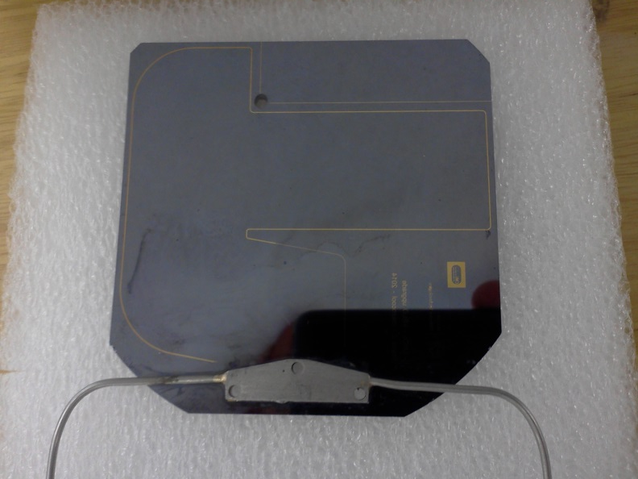
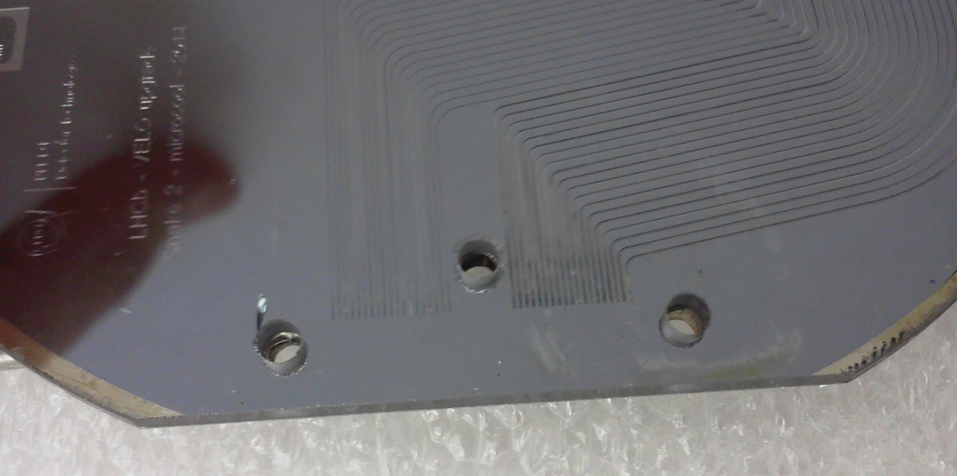
Soldered fluidic connector for Snake II
Flows water and withstands at least 90 bar of pressure (not tested higher)
Cracks in pyrex develope around the holes and seem to follow the connector shape
Not tested (yet) with liquid CO₂
This far all measurements of flow and thermal performance done on the clamped Snake II prototype.

Slide 25
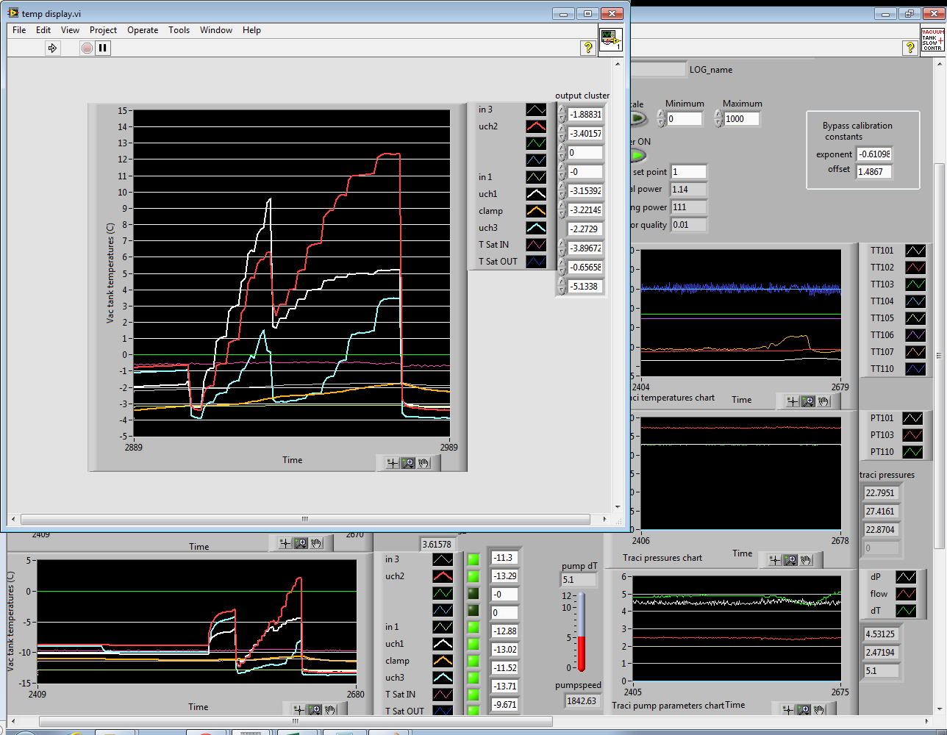
Super-heated states: heating test at -5 ºC
Notice how the temperatures were rising quickly in the first part of the test. Some channels were not boiling. When pre-heater power was applied, all channels began to boil, cooling became more efficient and the temperatures fell by more than half.
It was observed that CO₂ enters the super-heated state very easily and triggering it to boil is not trivial. Heater on the inlet pipe is best method found this far.
Pre-heater power (6W) applied.
Heating power was already 35W.

Slide 26
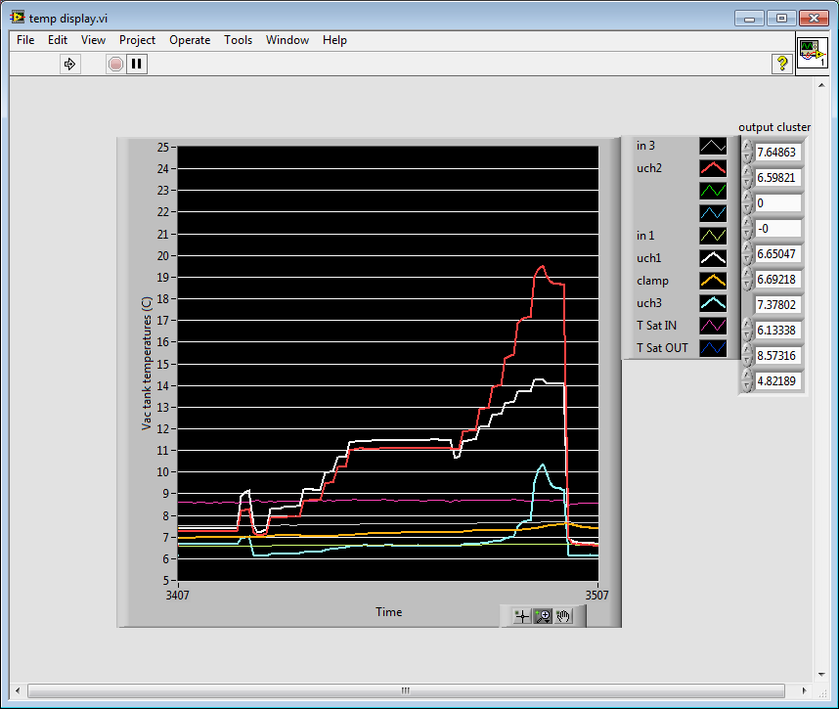
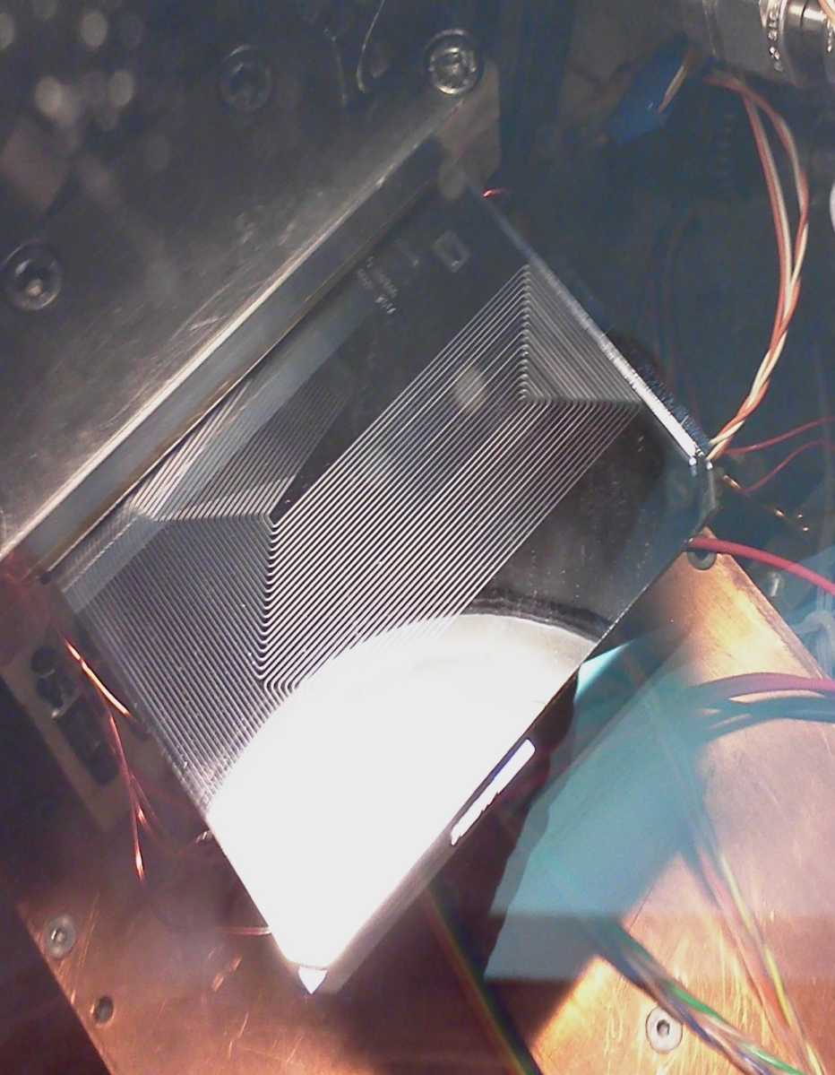
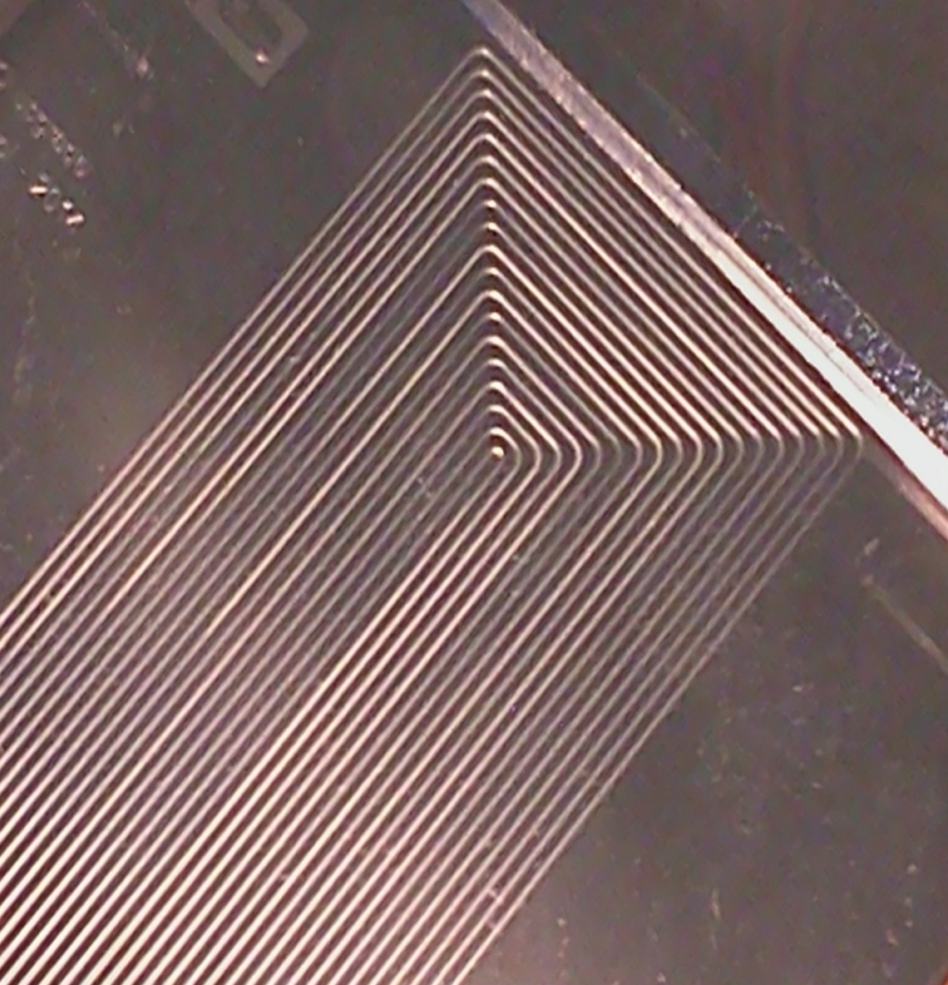
Super-heated states: heating test at +5 ºC
Pre-heater power applied
Channel picture (on the right)
Do different channels start boiling at different points ?

Slide 27
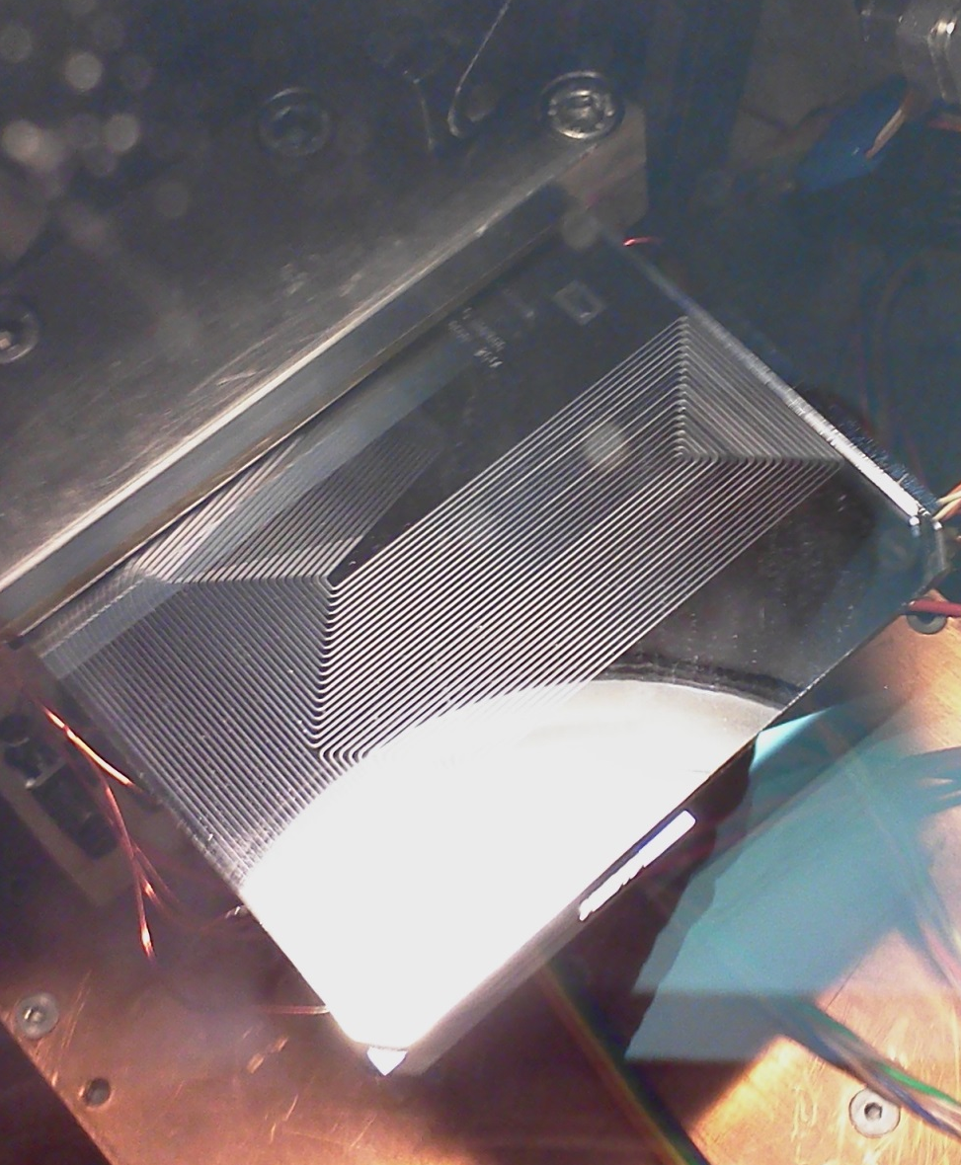
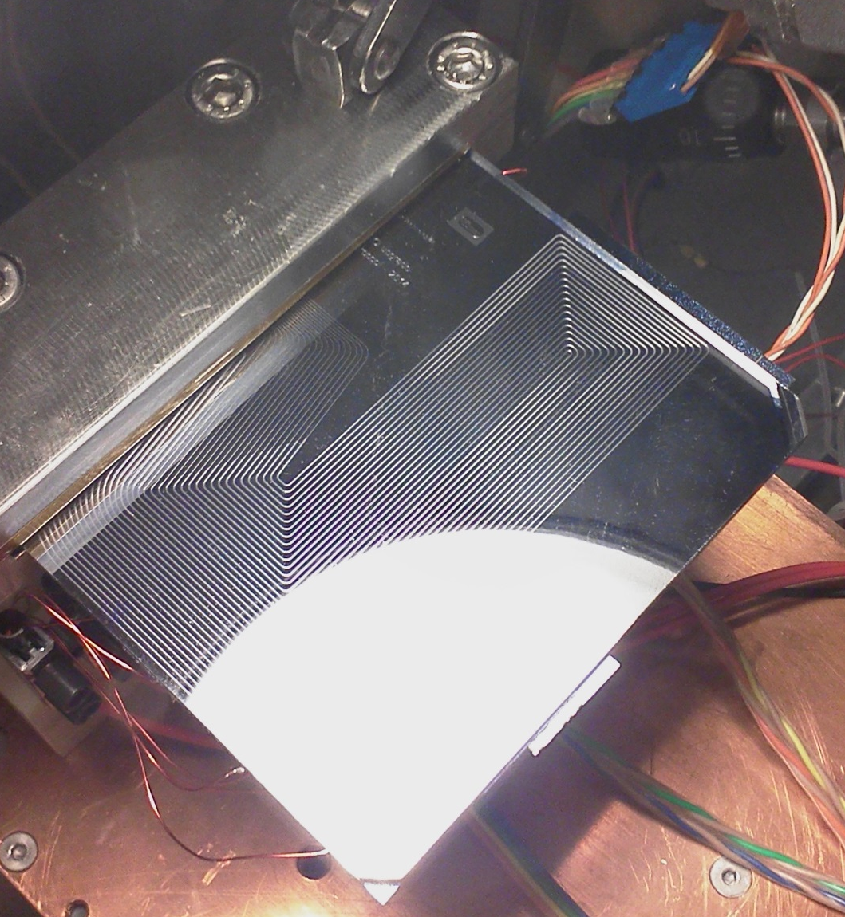
Partial boiling states

Slide 28
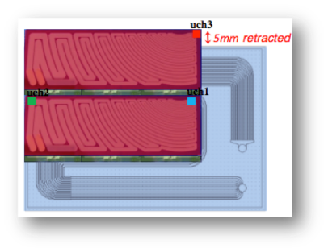
Cooling test using dummy heaters.
5 mm
Sensor heaters
ASIC heaters
Thermal mockups made of 300 µm Si metallized to simulate the heat density
uch1, uch2
uch3
Sensor
Sensor
Silicon 380µm
ASIC
ASIC
Stay stick 672
75µm, 1W/m.K
Thermal paste
Pyrex 2 mm
5 mm
Notes:
To evaluate the cooling performance of this cooling tecnique. We used thermal mockups made of 300µm Si metallized to simulate the heat density produced produced by the ASIC and the sensor.
We also put probes to monitor the temperature on 3 different points. That are shown on this 2 pictures on the middle. Show uch123. One can notice, that the uch3 is the probe that should show the highest variation of temperature because it is on the region that is overhanging.
On the right, one can see a picture of the real system.

Slide 29
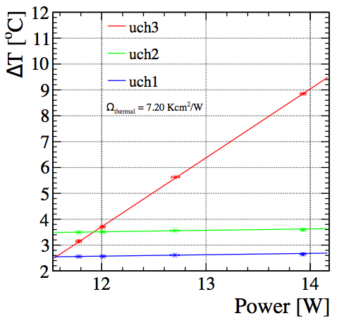
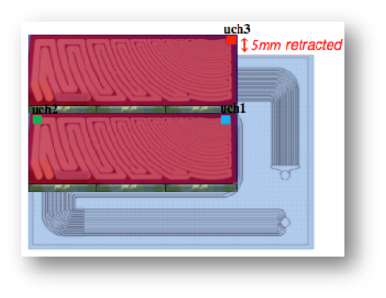
Cooling performance.
End of lifetime expectation
The end of lifetime expectation for half of a module corresponds to ~13W (12W ASIC and 1W on inner sensor) and in this condition the ∆T < 7˚C across the module.
{It was not possible to test up to maximum power of 21.5W because of the insufficient CO₂ flow}
Proof of principle. Not exhaustive !
Notes:
This is the result. This plot shows the variation the temperature on the sample in function of the power applied. The realistic end of lifetime expectation for half of a module corresponds to ~13 W and on this condition the variation of temperature was less than 7˚C across the whole module. On this test, it was not possible to 21.5W, half of the maximum power, because of the insufficient CO2 flow on the sample.

Slide 30
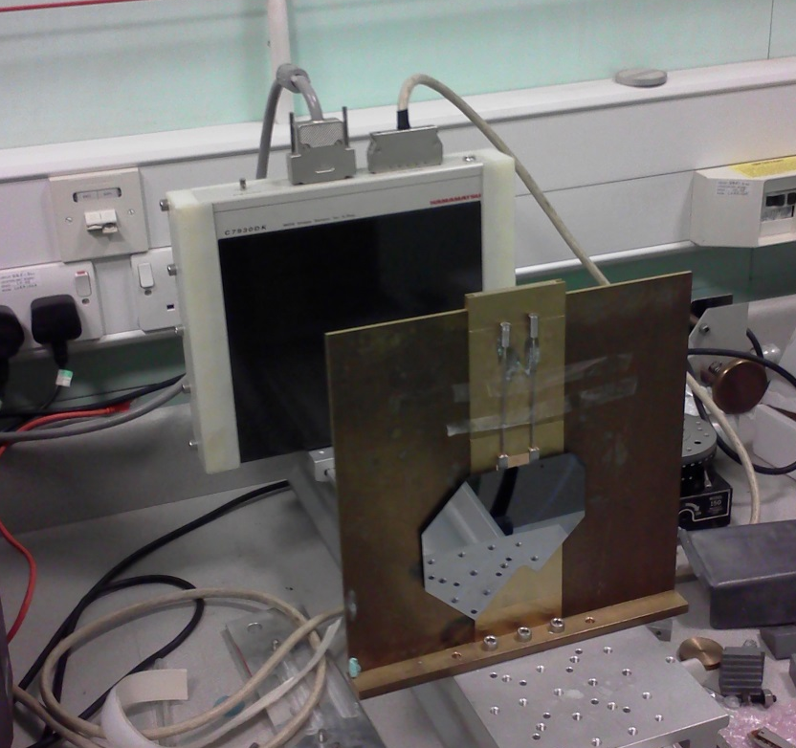
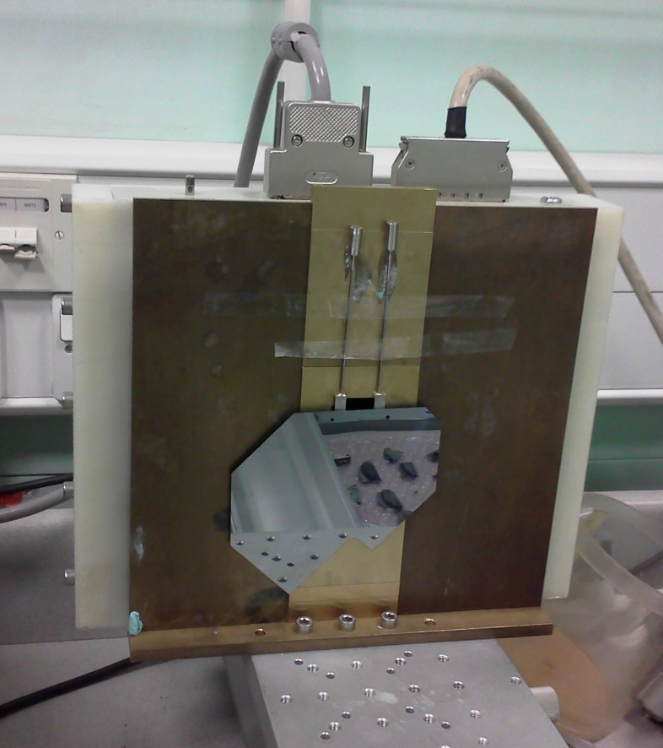

X-ray’ing the fludic connector solder joint
X-ray imaging
detector
Joint being
examined
Microchannel
wafer

Slide 31
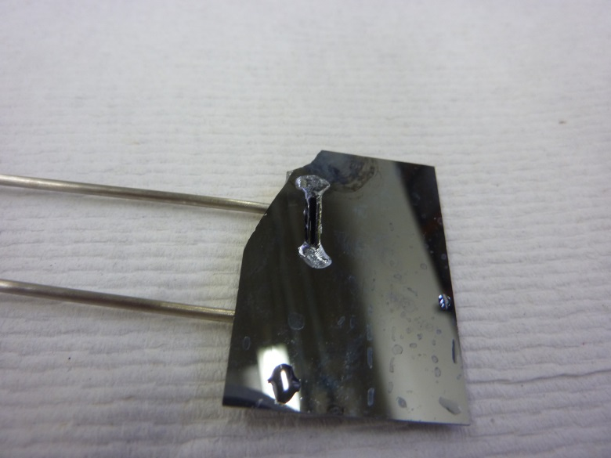
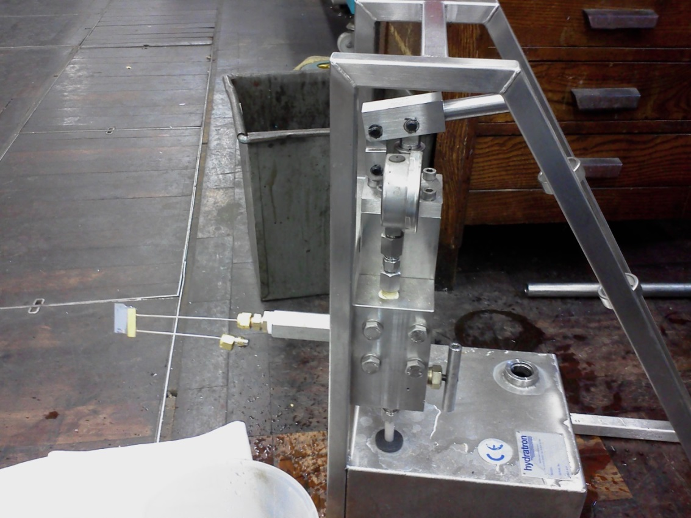
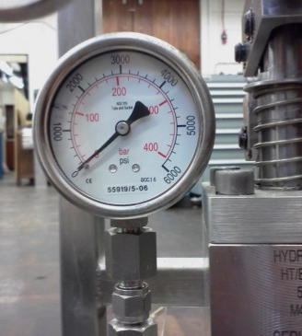
Pressure testing
Typical breaking pressure is 200bar and typical „breaking mode” is as on the above photo: silicon under the slit gives in to the pressure of the liquid
This is bare silicon plate (no micro-channels) and a bit thicker than final design
Reinforcing the back should increase the breaking pressure by a significant factor
Never a solder joint broke – it is always silicon which breaks

Slide 32

Flowing microchannel sample manufactured at Southampton
30.5x30.5mm size
No metallization: but can be done in Oxford thin-film facility.
Channels are very short but inlets/outlets configuration is like for the final wafer design
When metallized and soldered can be used for various tests: TRACI circulation, cooling capacity, etc.

Slide 33
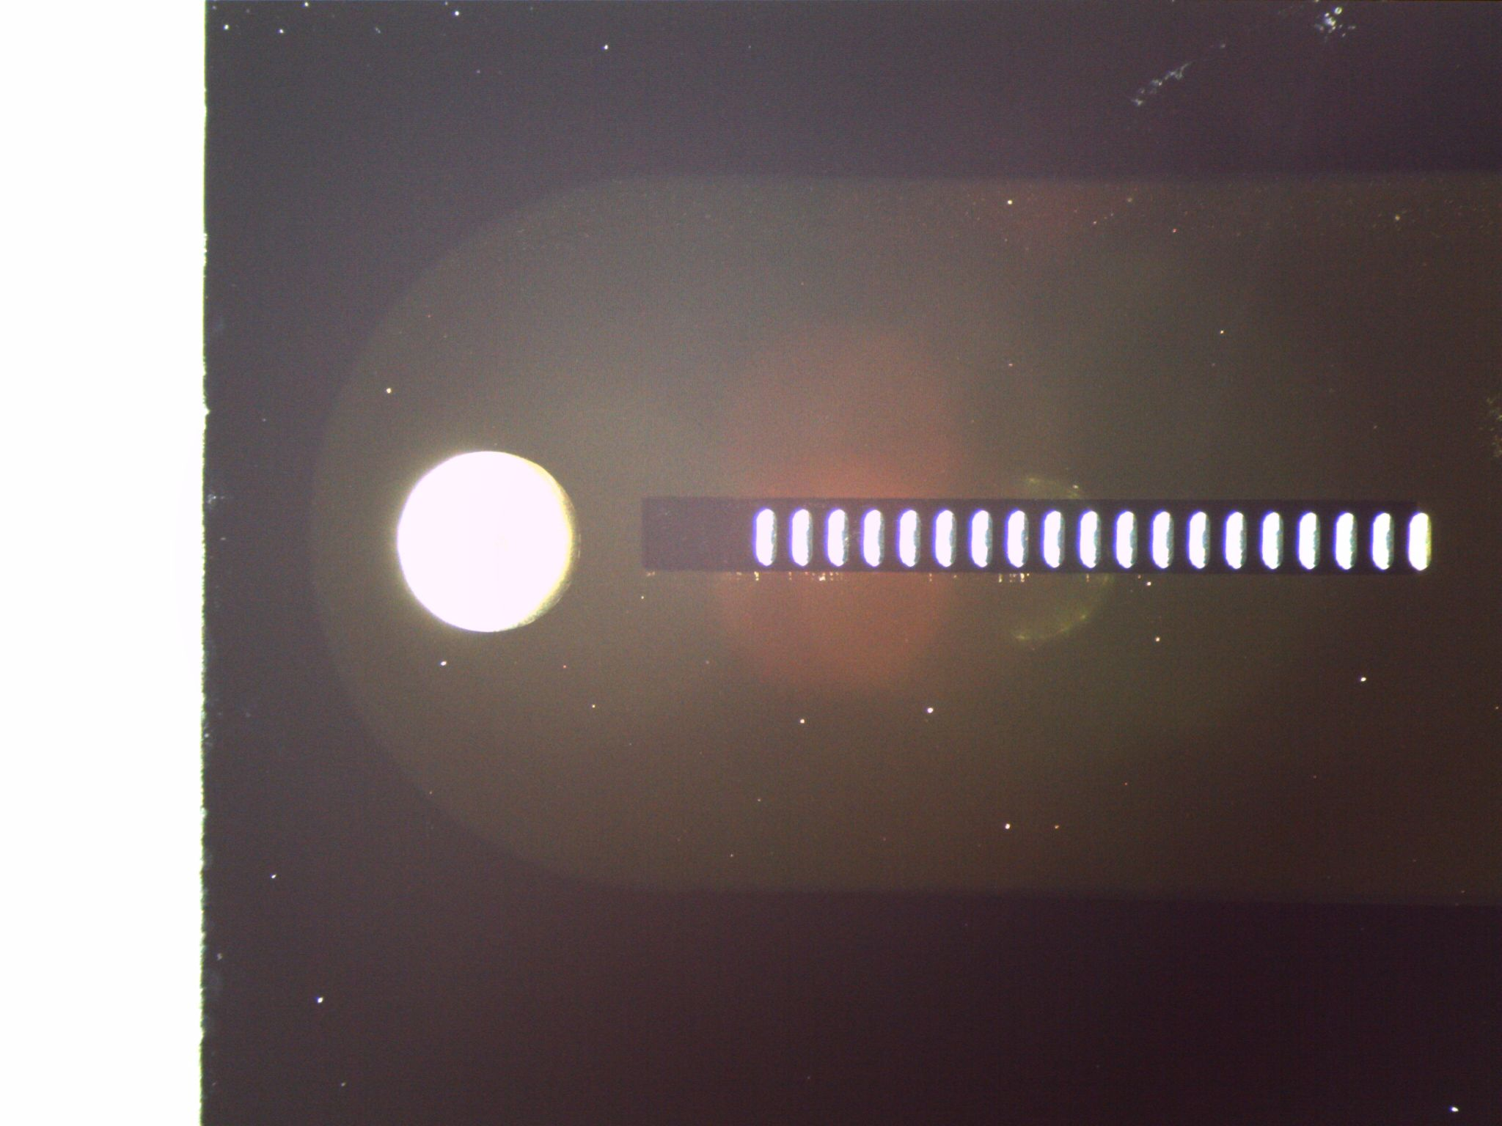
Southampton sample metallized

Slide 34
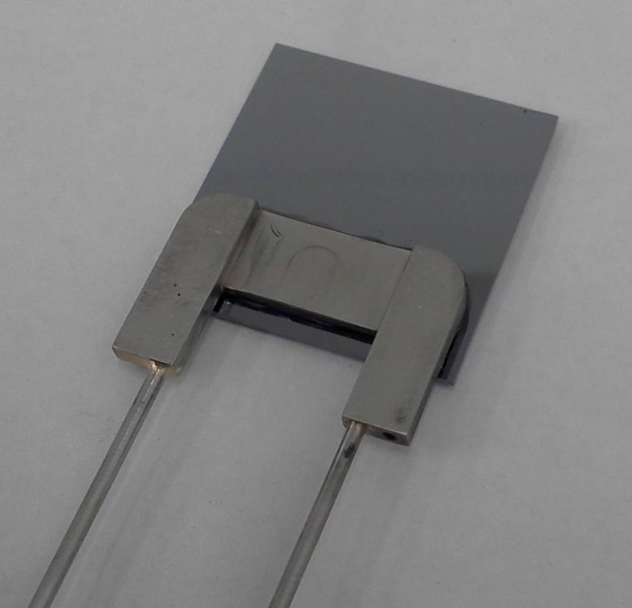
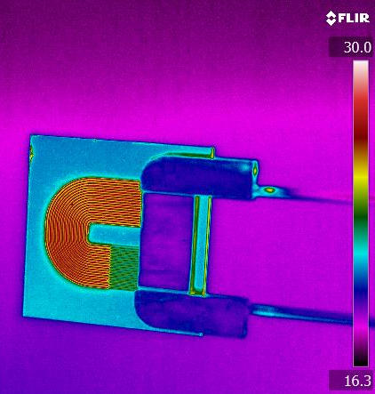
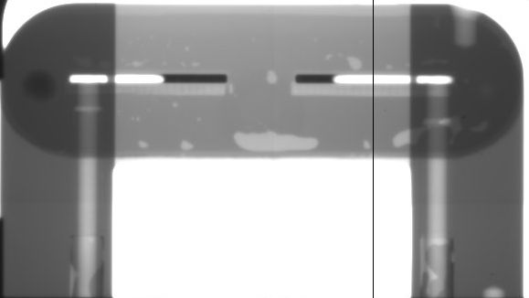
Soldered Southampton sample in diffferent wavelegths
Vis
IR
X-ray
The sample is filled with water and warmed up: warm water becomes clearly visible, as silicon is very transparent to infrared

Slide 35
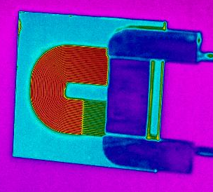
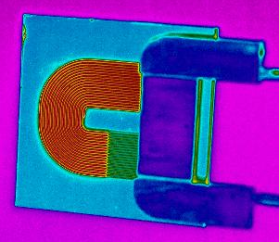
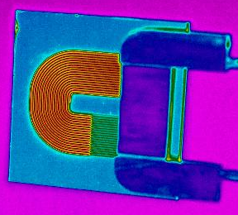









IR picture: microchannel (filled with water) is warmed up by hot air, then (cold) water is re-circulated

Slide 36


Snake II heat load test at -15 ºC
Differential pressure in the system [bar]:
Red = measured
White = averaged
Flow through the system [g/s]:
Red = measured
White = averaged
Microchannel flow coefficient calculated after subtracting the bypass valve contribution to the total flow $[\frac{g}{s}/√bar]$
Temperatures measured at various points:
White = heater close to inlet
Red = heater half-way
Cyan = silicon near the outlet
Orange = clamping block

Slide 37
Snake II heat load test at -15 ºC – cont.
Notice the flow coefficient drop (by about 0.06) when power is applied. This drop is relatively small at room temperature but becomes significant below zero, most likely due to rising viscosity. CO₂ viscosity has strong dependence on temperature
ΔCv
Notice how white and red follow each other for certain time and then white and red start to separate: this is when the 2nd part is not getting same quality cooling as the 1st part due to CO₂ dry out
At power close to the capacity the silicon temperature at the outlet (cyan) begins to rise: liquid and gas are no longer at equilibrium.

Slide 38

Flow coeff. changes just becasue the CO₂ begins to boil
Pressure: rises when the CO₂ starts to boil. It is only triggered by the pre-heater – there is no other thermal load applied here
Red = measured diff. pressure
White = averaged diff. pressure
Flow through the system: drops when boiling starts
Red = measured flow (bypass + microchannel)
White = averaged flow
Microchannel flow coeff. drops by 0.06 when boiling starts.
Temperatues: drop, when CO₂ exits super-heated state, begins to boil and cools down

Slide 39

Heating test at -30 ºC and 6 bar diff. pressure
Diff. pressure rises by 0.3 bar as the flow coeff. drops.
Flow coeff. of the microchannel drops by 1/3 as the boiling starts.
After the first 10W of load is applied all three temp. sensors go up in exact same pattern: CO₂ is superheated and does not want to boil. Pre-heater has to go into action.

Slide 40
Maximum cooling power at dP ~4 bar.
0.3 gr/s flow.
T_traci | Tin1 | Tuch3 | Max power | Vapor quality | Cv uch @no load | Cv uch @ max load | dCv uch | dP
-25 | -22.8 | -23.6 | 60 | 0.76 | 0.206 | 0.13 | 0.076 | 4.07
-15 | -12.8 | -13.6 | 66 | 0.77 | 0.21 | 0.15 | 0.06 | 4
-5 | -2.8 | -3.6 | 66 | 0.8 | 0.216 | 0.16 | 0.056 | 4
5 | 6.1 | 6.6 | 58 | 0.84 | 0.212 | 0.17 | 0.042 | 3.95
15 | 16.6 | 16.1 | 57 | ? | 0.189 | 0.16 | 0.029 | 4
Obtained at dp=~4bar . Flow = 0.3g/s
Required maximum module cooling power = 40W.
expected module cooling power = 30W
  Factor 2 margin.

Slide 41
Full VELO cooling plant requirement.
Need ~0.3g/s flow per module for ~60W max. cooling power at ~80% vapour quality.
Need ~15.6 g/s flow for 52 modules: max. cooling capacity is ~3kW at ~80% vapour quality.
Obtained at 4 bar pressure on micro-channels.

Slide 42
Detailed fluidic performance.

Slide 43
Fluidic system setup
TRACI_V3
Vacuum tank
Mass Flow
meter.
Pressure
Gauge P1
F_{m}
F_{m1} = ~5 x F_{m2}
F_{m1}
F_{m2}
Heat
Needle
Valve.
‘bypass’
?
Micro
channels
pump
F_{m2}= f(dP, T, Heat) ?
Manual valve
dP=P1-P2
Pressure
Gauge P2
Manual valve is used to exclude micro channels from the flow.
-> Only bypass needle valve

Slide 44
Method for measuring the flow in the u-channels.
F_{m2} = f(dP,T,Heat) = F_{m} – C_{v}(T)*sqrt(dP).
    F_{m} ,dP, T and Heat are measured
    C_{v}(T) of needle valve must be calibrated precisely.
      It is Independent of pressure and flow .
      Only depends on temperature and type of fluid.
      temperature calibration has been done in our setup
flow in uchannels
total flow
flow in bypass

Slide 45
New temperature calibration of bypass.
Cv_cal1(T)=37.807 x T^(-0.646) “linear”
Cv_cal2(T)= -0.00242 * T + 1.672 “power law”
The ‘power law’ fit is used.

Slide 46
Verification of F=√dP of bypass.
Two fits to data:
Amplitude and exponent free in fit:
Ampl=1.054
Exp=0.497
Exponent not free (=0.5)
Amplitude= 1.049
At -20C
The fit error(min/max ) is < +/- 2%

Slide 47

dP & flow measurements of SNAKE2.
Previously assumed ‘orifice’-like:
  F_{m} = C_{v}*sqrt(dP)
dP : 2.5 to 6.5 bar
Cv ~ 0.2 gram/s/sqrt(bar).
Not strictly flat ….

Slide 48
dP & flow SNAKE2
measurement of dp & flow
  over range 2 bar < dP < 5.5 bar. (Typical operation will be at 4 bar).
  At temperature = 0C, -20C, -25C, -30C
  Each temperature with heat load = 0W, 5W, 30W.
  i.e. 12 curves each with ~12 points.
  Thanks for help from students Karolina Przybyło and Nicola Spadavecchia.

Slide 49


dP & flow SNAKE2
Typical measured data and fitted curves Flow= A*(dP) ^{B}
= expected operation point dP~4 bar
(at lower temperature less flow, but higher evaporation heat).

Slide 50

0 C. fitted curves

Slide 51

-20C. fitted curves

Slide 52

-25C. fitted curves

Slide 53

-30C. fitted curves

Slide 54

0 Watt. fitted curves

Slide 55

5 Watt. fitted curves

Slide 56

30 Watt. fitted curves

Slide 57

dP & flow SNAKE2. Summary.
Flow= A*(dP) ^{B} . A and B values at different temperatures and heat loads.

Slide 58
Conclusions.
Snake2 cooling performance is very good:
  Can cool up to ~60W with vapour quality ~80% at flow rate ~0.3g/s and dp=4bar
Micro-channel design has good hydraulic characteristic. :
  Required flow (0.3g/s) can be reached with low dP (~4bar).
Rough cooling plant specification: ~15g/s flow rate for and ~4bar differential pressure.
There are issues with super-heated state of the liquid CO₂ in the channels.
  Preheater on common inlet tube is very effective to trigger boiling.

