Slide 1
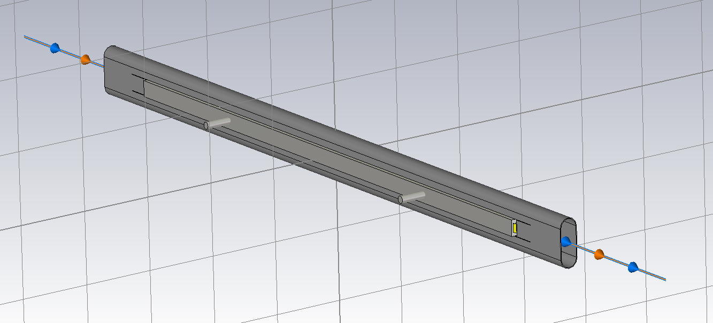
OLD MODEL FOR SIMULATION

Slide 2
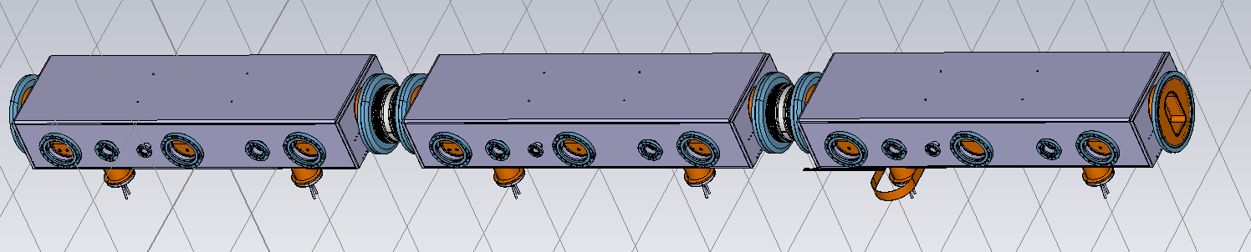
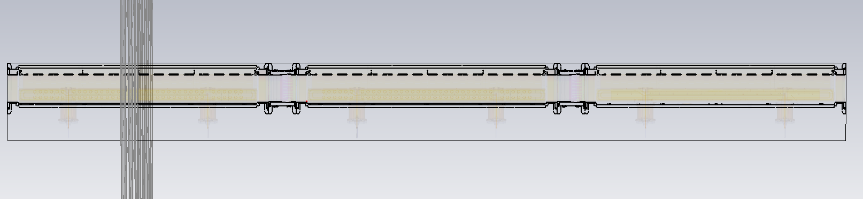
NEW GEOMETRY

Slide 3
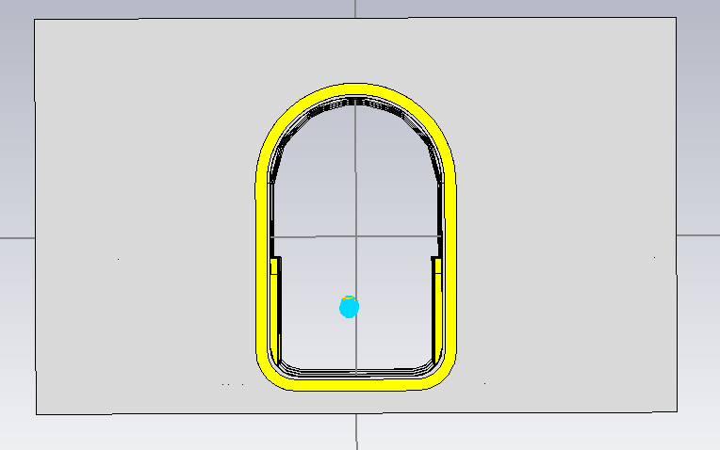
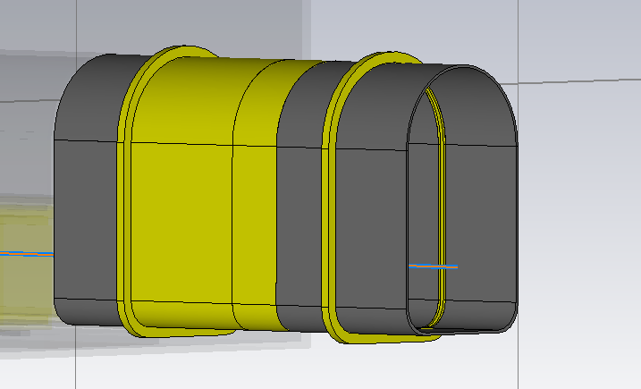
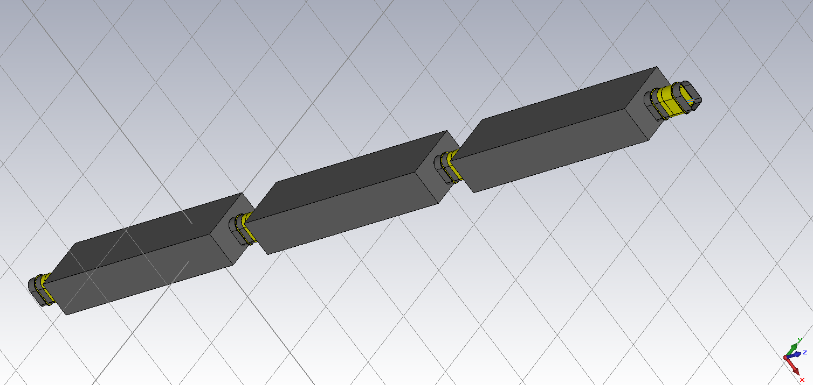
MODEL USED FOR SIMULATION

Slide 4
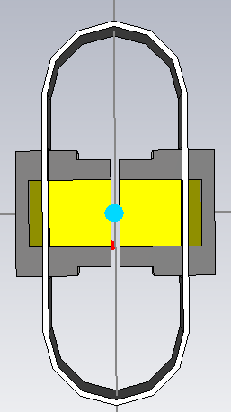
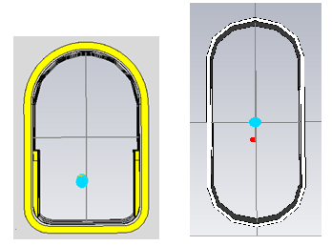
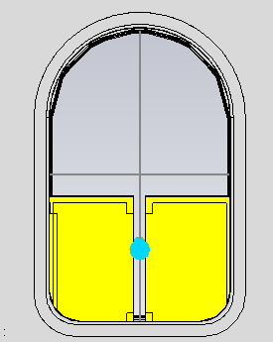
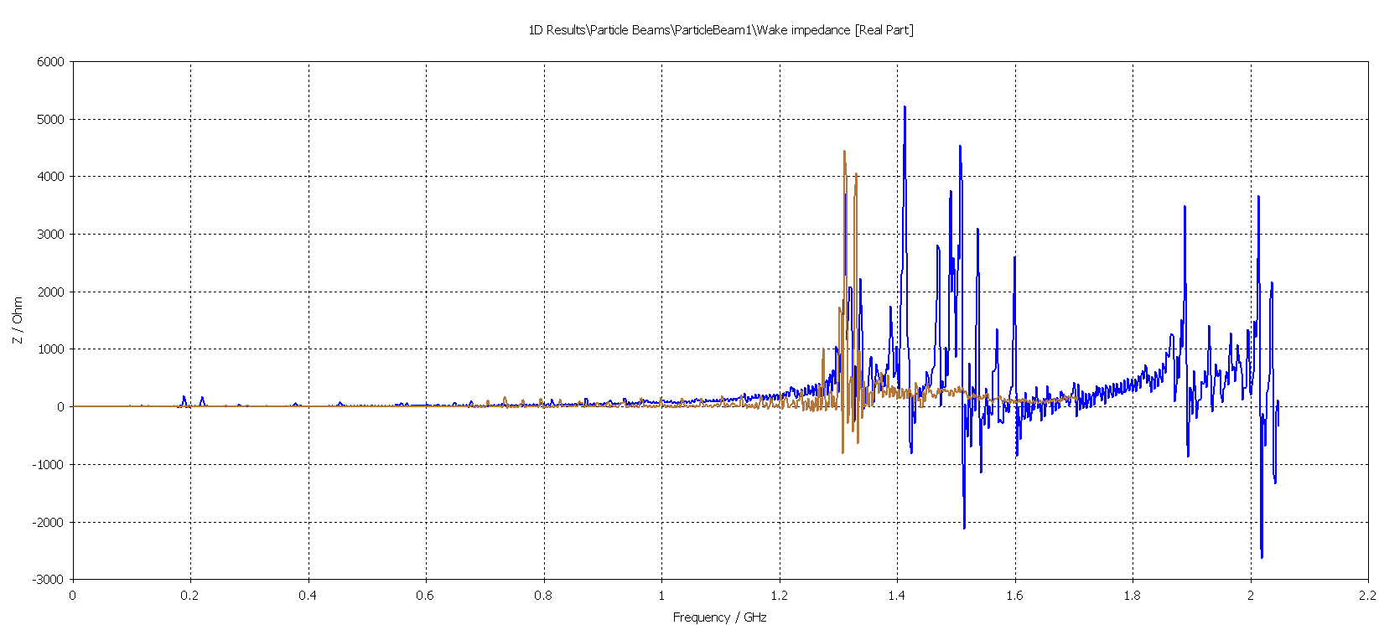
z
y
Impedance along Z-axis real part
x
NEW
OLD

Slide 5
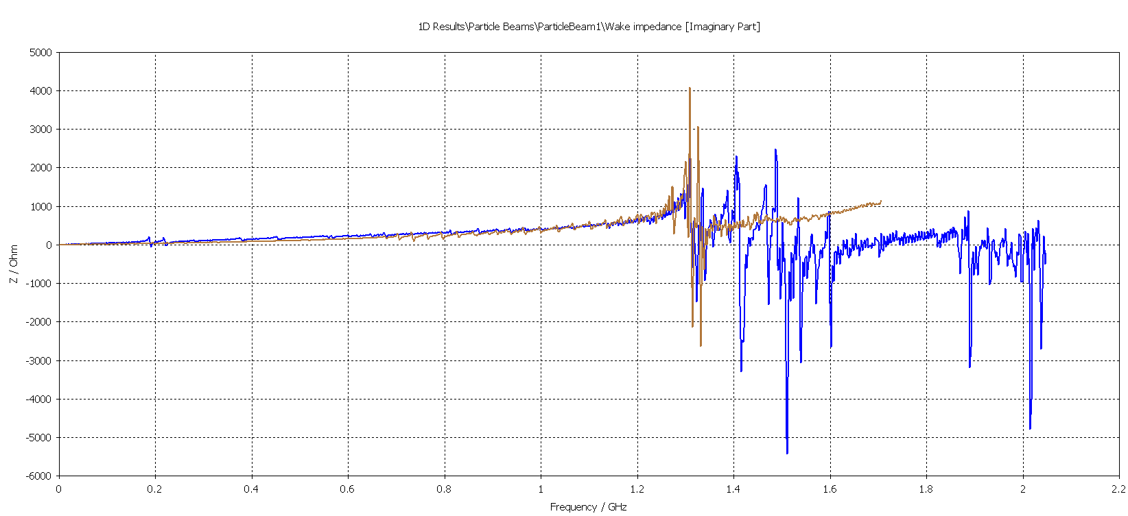
z
y
Impedance along Z-axis imaginary part
x
NEW
OLD
NEW
OLD
Zlong = 5.1*10^-3 Ohm
Zlong =3.54*10^-3Ohm/m

Slide 6
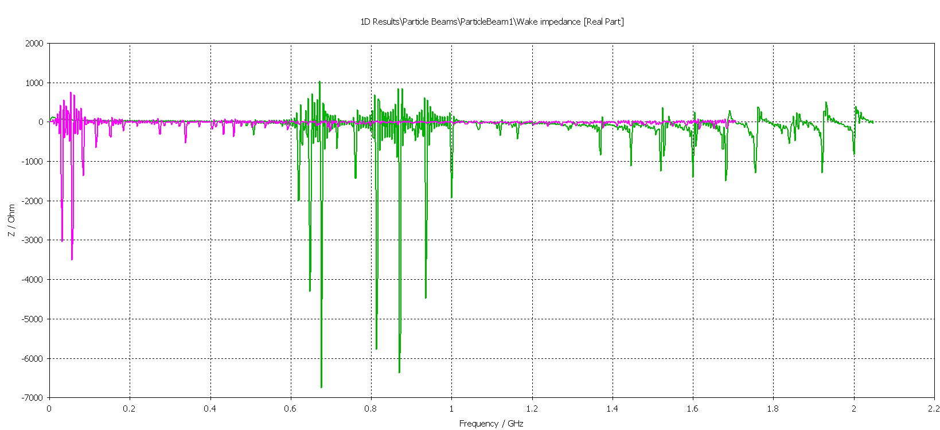
z
y
Impedance along Y-axis Real part
x
NEW
OLD

Slide 7
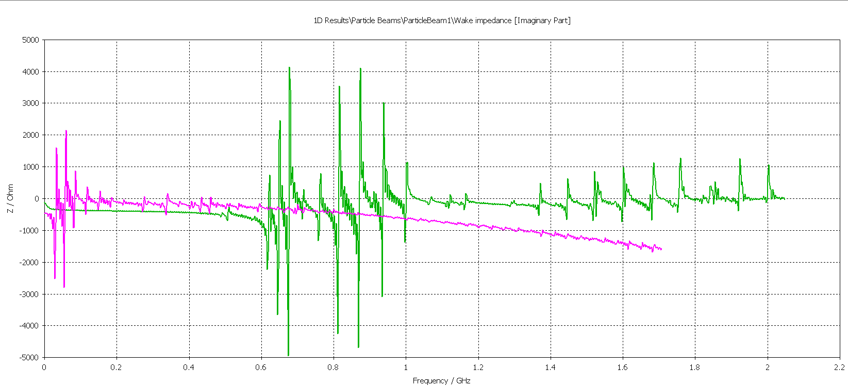
z
y
Impedance along Y-axis imaginary part
x
NEW
OLD
Ztrans = 0.4 Mohm/m
Ztrans =0.13 Mohm/m

Slide 8
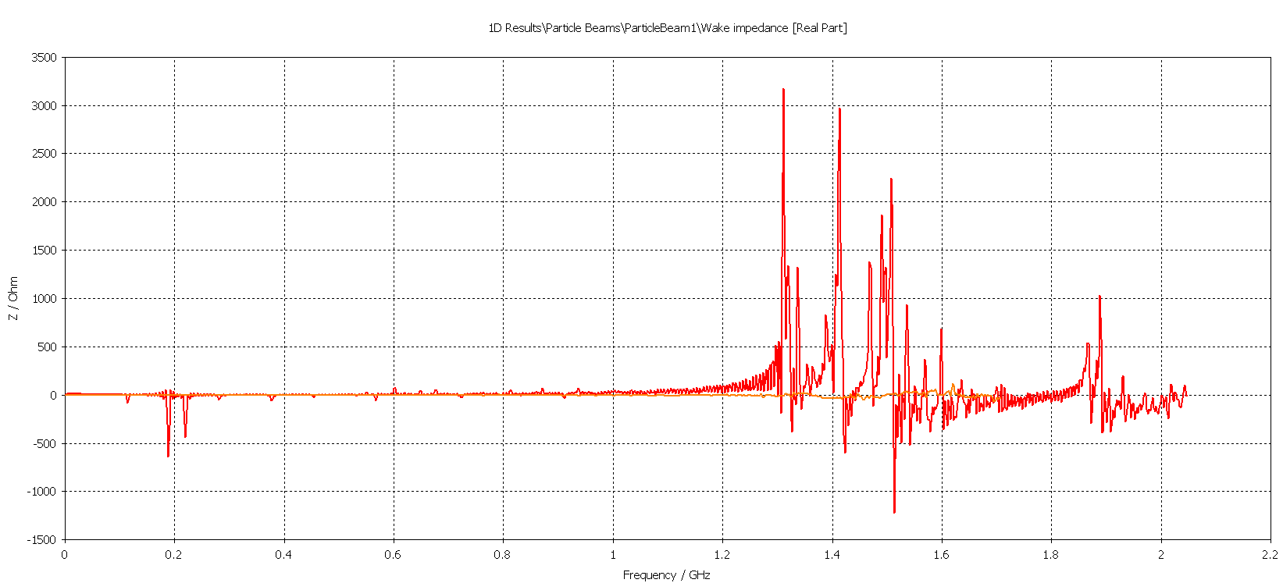
z
y
Impedance along X-axis real part
x
NEW
OLD

Slide 9
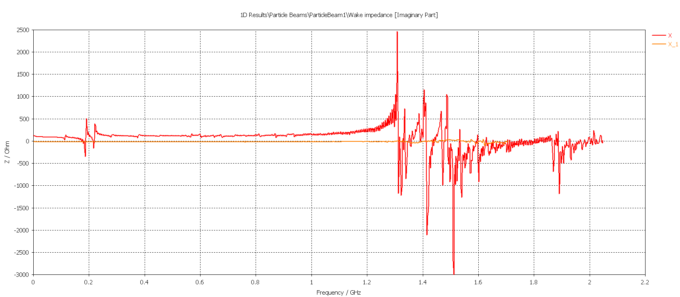
z
y
Impedance along X-axis imaginary part
x
NEW
OLD

Slide 10
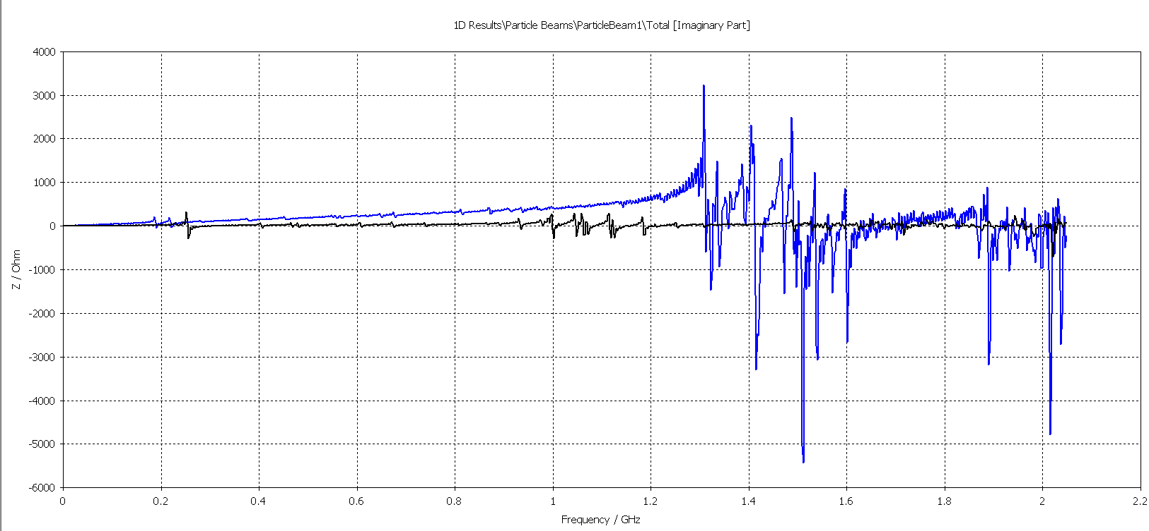
Comparison between 8 mm and 110 mm gap
Impedance along Z direction
8 mm
110 mm

