Slide 1

Bert Quint
CERN-Open Lab Innovation 2015
Healthcare
Espresso Format
Notes:
----- Meeting Notes (22/11/15 20:38) -----
Good morning everyone. Amazing to be at CERN for me.
Healthcare, the change, the uniqueness of time we are living in.
Opportunities, needs: take the opportunity and step into health

Slide 2

Global Issue, requiring multidisciplinary approach

Slide 3
Healthcare:
Procedures
Cost
Outcomes
Value

Slide 4

Healthcare undergoes now the most dramatic change in history
Notes:
At the macro level; the aging of population, the rise of chronic disease, growing prosperity in emerging economies are putting new demands on the healthcare system but the growth on annual spending is slowing down global. This leads towards an unsustainable level forcing governments to rethink how healthcare is paid and what is delivered.

Slide 5
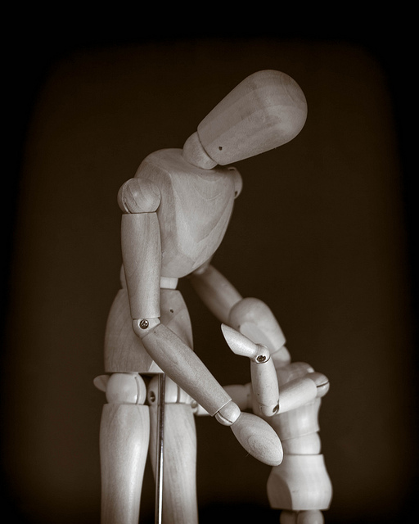
Plenty to worry about

Slide 6
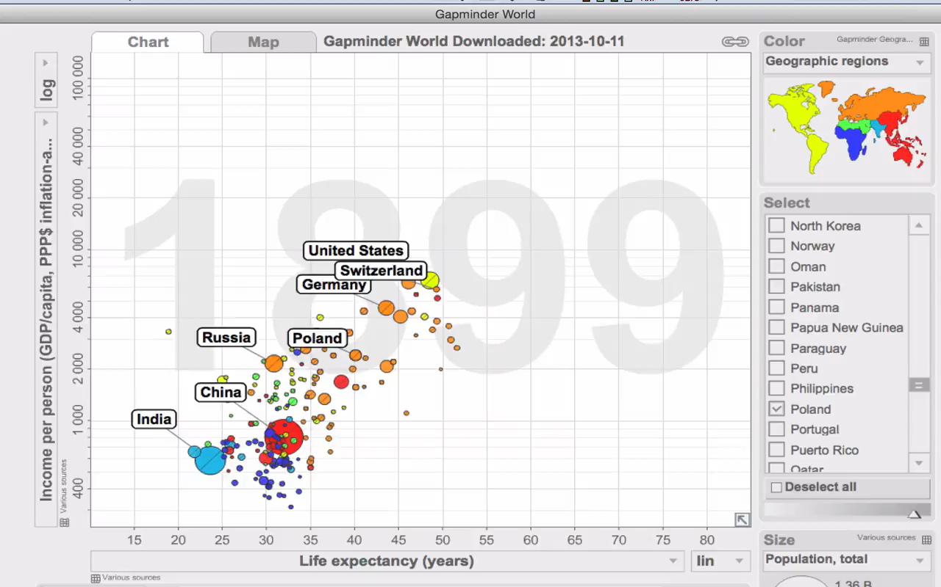
Karolinska Institute for International Health
Prof. Hans Rosling

Slide 7

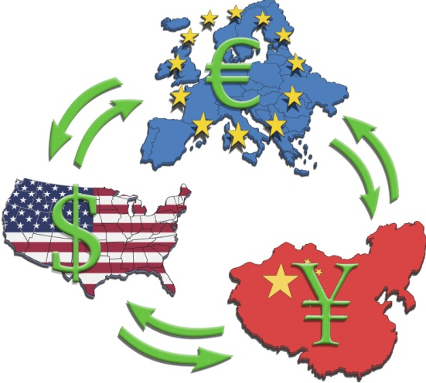
International
Eurozone economy declines
Nine of 17 Eurozone countries in recession
German economy: will grow at a slower pace
than previously expected this year and next
China’s economic data doubtful: “Officials do not belief their own data”
(The Economist 10/15)
Turmoil and political uncertainty in the Middle East, Africa & Europe
Austerity is still the watchword of the day

Slide 8


“Legal bid to stop CERN atom smasher from 'destroying the world’
(2008)

Slide 9






Countries Increase Investment in Innovation
Poland: Powerhouse, remarkable growth 25 year: €7B investment in R&D, healthcare and production (EU)
Canada announces Venture Capital Action Plan
to support commercialization of R&D
China’s 12th Fifth Year Plan targets biotech sector
– allocates $1.9 billion toward R&D for innovative drug development
Russian Federation Bio 2020 commits $12 billion to grow
domestic drug industry – goal of 20 new drugs by 2020
South Korea Bio-Vision 2016 has aims to make country
biotechnology leader – strong focus on biosimilars
Singapore Research, Innovation, and Enterprise Plan seeks to make biomedical sector a pillar of the economy – funds public/private R&D, provides incentives to private companies

Slide 10


Slide 11

Paradigm of Change:
World Wide Phenomena

Slide 12
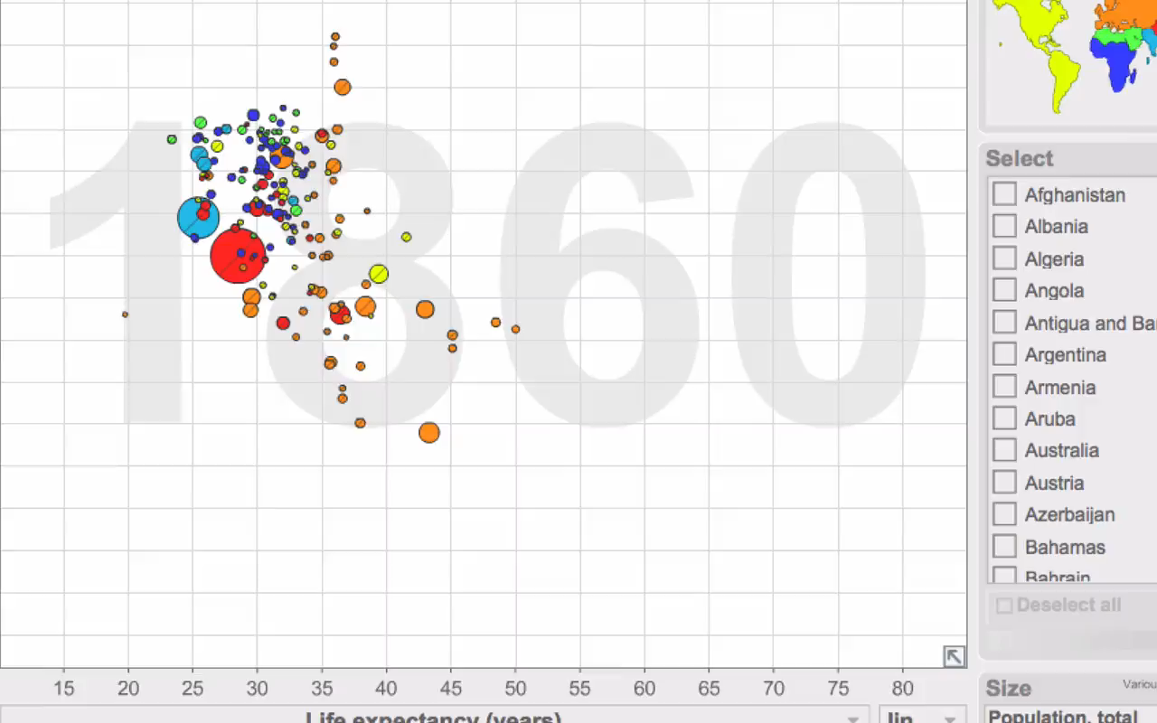
1860 – 2012
Kids & Life Expectance

Slide 13
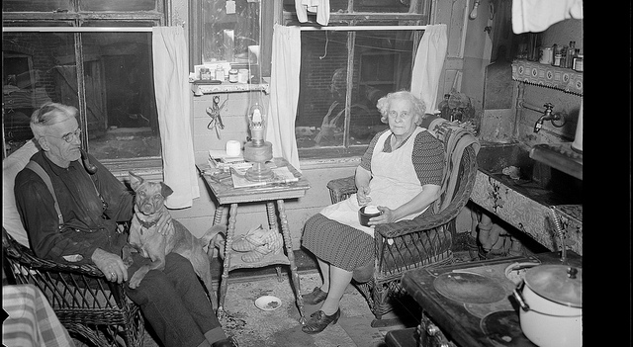
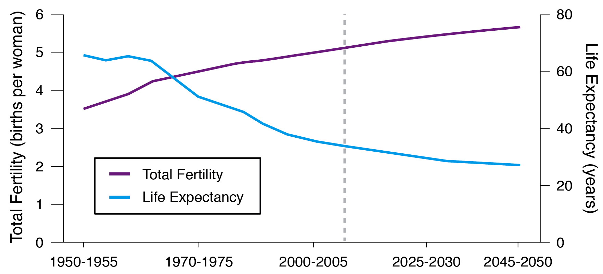
A Financial Crunch
As people live longer and birthrates fall, the ratio of working people paying into healthcare system to those using the public benefits —
the elderly — shrinks
Total world fertility rate and life expectancy at birth 1950-2050
Life Expectancy
Total Fertility
Source: United Nations

Slide 14
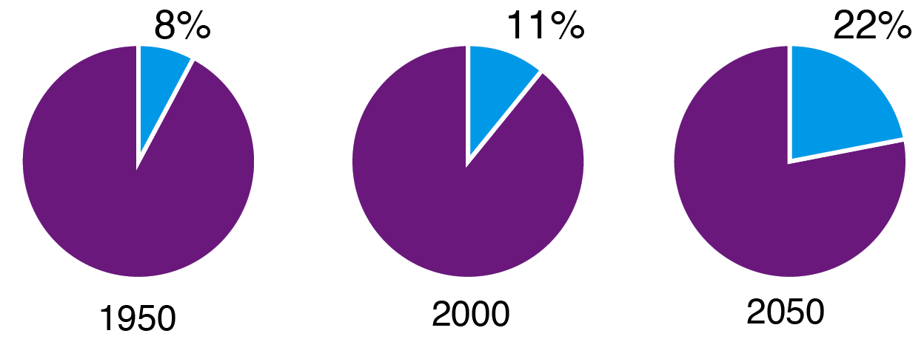
Worldwide Phenomenon
“Population aging is unprecedented, a process without parallel in the history of humanity.”
  World Population Ageing 2013
  United Nations
Proportion of world population 60 years or over, 1950-2050
Source: United Nations

Slide 15
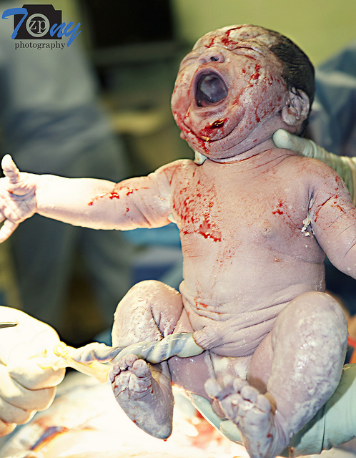

People Are Living Longer:
1 in 3 Babies born today will live to 100

Slide 16
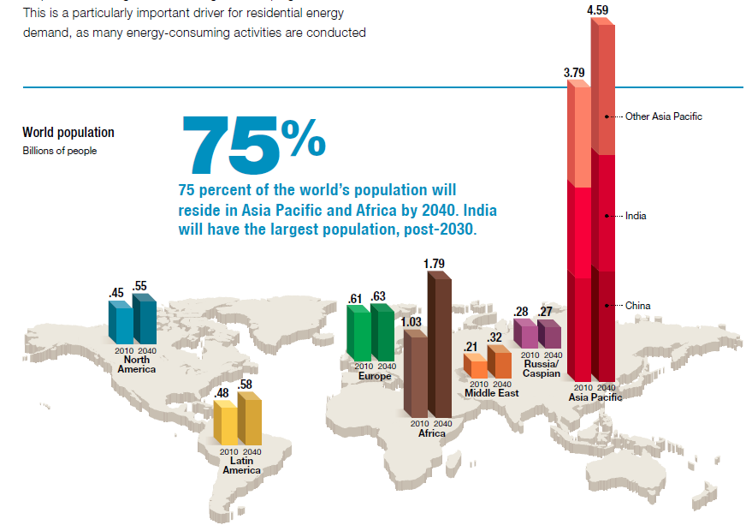
Africa and Asia Project Largest Growth for 2040
World Population in Billions of People
Other Asia Pacific
India
China
Source: Exxon Energy Outlook, 2013

Slide 17


Slide 18
Prosperity Is Spreading
Annual change in GDP, adjusted for inflation
By 2020,
900 million people will move from poverty into the middle class in Asia,
according to Mckinsey
Emerging Economies
Advanced Economies
Year
Source: IMF

Slide 19

Healthcare costs rising:
unsustainable levels

Slide 20
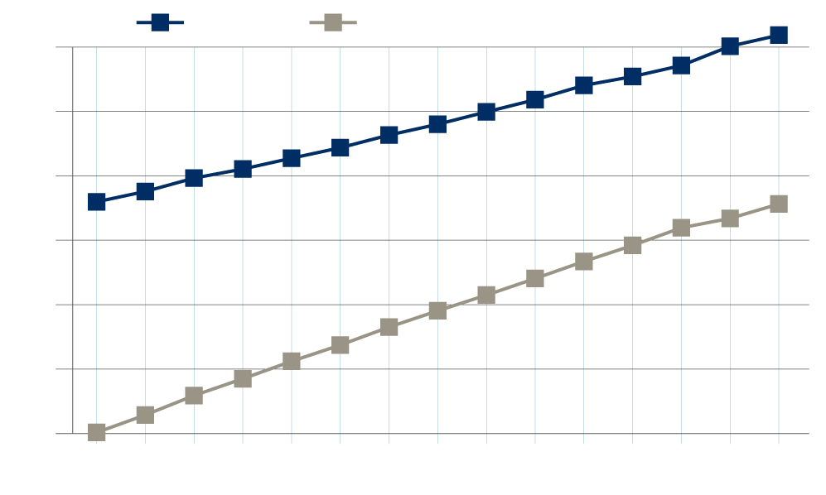
Healthcare Cost Rapidly Increasing not Only in the U.S.
Health Costs as a Percent of GDP
U.S.
OECD outside of the U.S.
21
19
17
15
13
11
9
2006
2008
2010
2012
2014
2016
2018
2020
Source: PricewaterhouseCoopers Health Research Institute

Slide 21



..but Changing Lifestyles Fuel Chronic Disease…

Slide 22
Non-Communicable Diseases Takes a Growing Toll Worldwide
Account for 63% of deaths worldwide
Cost more than $30 trillion over the next 20 years
Cause nearly 80% of deaths in low- and middle-income countries
Source: World Economic Health Forum and the Harvard School of Public Health; World Health Organization

Slide 23
Diseases of Aging Push System to the Brink
The direct annual costs of diseases of aging in the United States:
Cost in Billions
Source: National Cancer Institute, American Lung Association, American Alzheimer’s Association, The Hastings Center, American Diabetes Association

Slide 24
The Impact of Urbanization, Longevity and Better Lifestyles
More than 371 million people have diabetes.
Source: International Diabetes Foundation

Slide 25
China
…if China could reduce cardiovascular risk by 1% - 30 years period:
Economic value of $ 10,7 trillion – equivalent to 68% GDP 2010
(Julian Chang – Hong Kong Inst of Diabetes & Obesity)

Slide 26

Billions Wasted On Ineffective Therapies
$380 billion wasted in 2013
Some 90% of drugs only work
in 30% to 50% of the population
Global drug sales estimated at
$956 billion in 2011

Slide 27
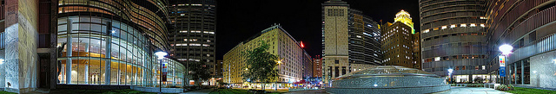
Patients & Hospitals have conflicting interests
Surgical complications can yield 330% profits for hospitals.
“Evidence based: reducing harm and improving quality is perversely penalized”
(A.Gawande: Harvard Health – JAMA 2013)

Slide 28

Big Questions Without Easy Answers
Who should pay?
Who should decide on care?
Individual responsibility & societal costs?
Should safety and efficacy alone be the standard?
What does innovation mean today?
How do we determine value?

Slide 29

Move towards value-based healthcare

Slide 30

KEEP CALM the
OPPORTUNITY is here

Slide 31

Future
  Better access
  Improved outcomes
  Lower cost
transition from our dysfunctional sickness care

Slide 32

Patients:
value conscious
&
informed
(Dr. Google…)

Slide 33


Slide 34
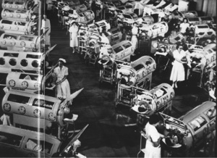
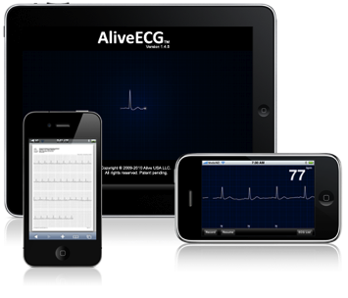
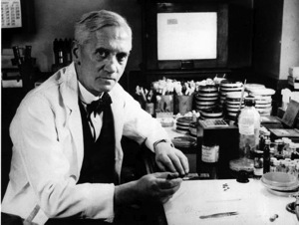

The Big Paradigm Change in Healthcare & Wellness
Antibiotics
Vaccinations
Genomics
Digital & mobile health
1920s
1950s
2000s
2010s
Personalized, genomics….

Slide 35






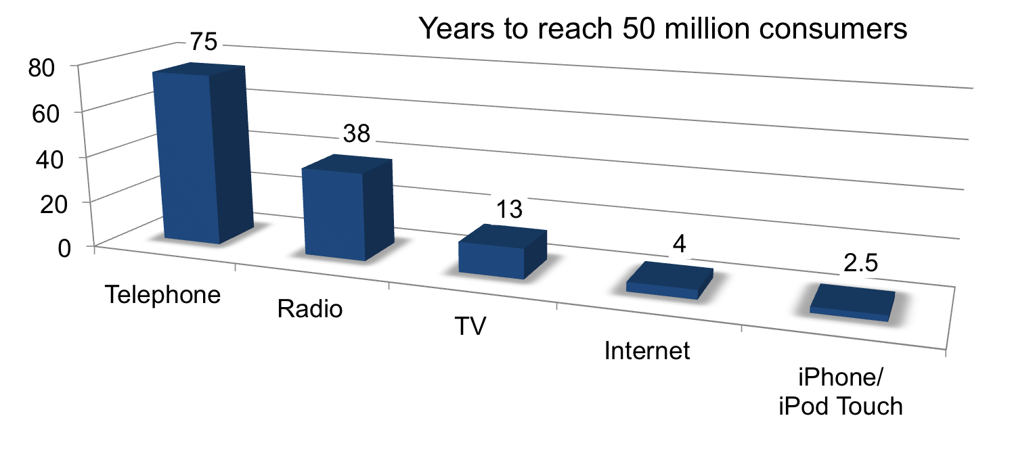
We Are Living in Exponential Times
35 days

Slide 36




Healthcare Shopping

Slide 37
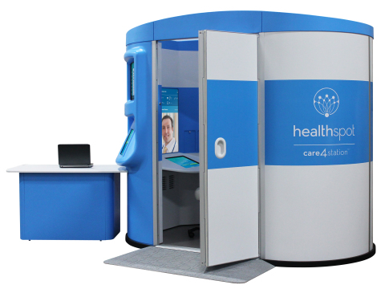
Telehealth Comes to You
HealthSpot Care4 Station – 1.000 locations
Walk-in kiosk provides acute via high-definition videoconferencing
Automatically captures height and weight
Booth is wiped down between visits
and automatically disinfected

Slide 38
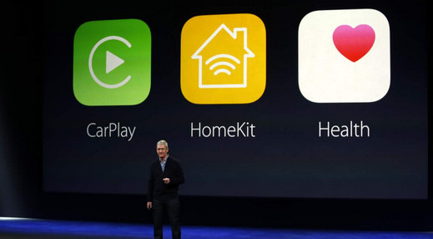
Innovation solve the issue?
Notes:
Tim Cook

Slide 39
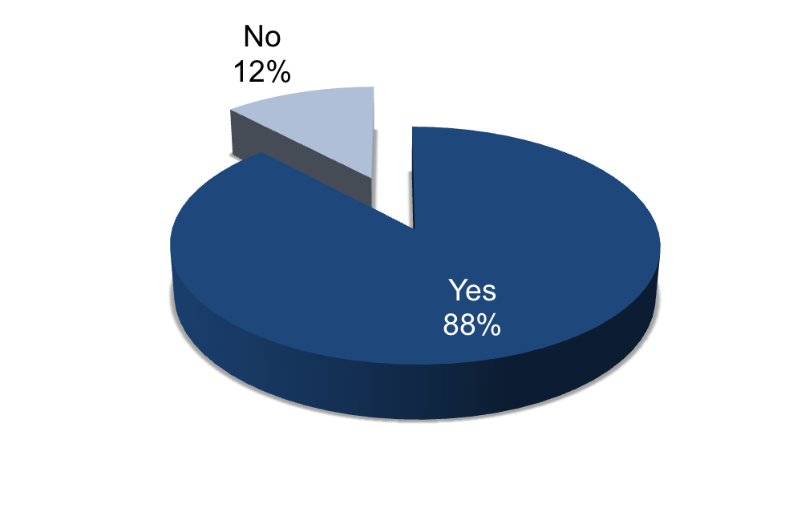
Physicians Embrace Mobile Monitoring
Percentage of physicians wanting to monitor patients at home
65% - Weight
61% - Blood sugar
57% - Vital signs (e.g. blood pressure,
heart rate, respiratory rate)
54% - Exercise/physical activity
36% - Calories/fat content taken in
36% - Pain level
35% - Sleep patterns
28% - Cardiac rhythm
17% - Bladder control
16% - Acid reflux/indigestion
13% - Digestive health
Source: PricewaterhouseCoopers HRI Physician Survey, 2010

Slide 40
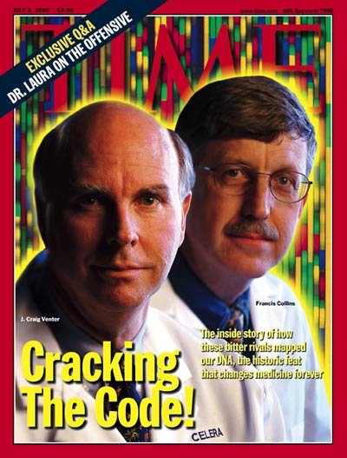
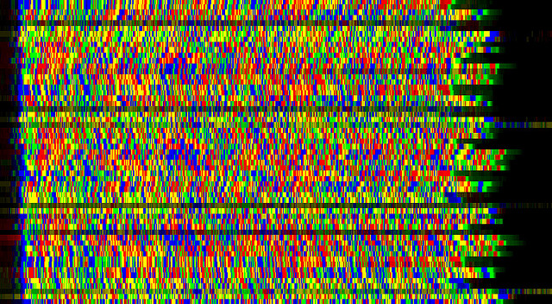
Human Genome – April 2003

Slide 41
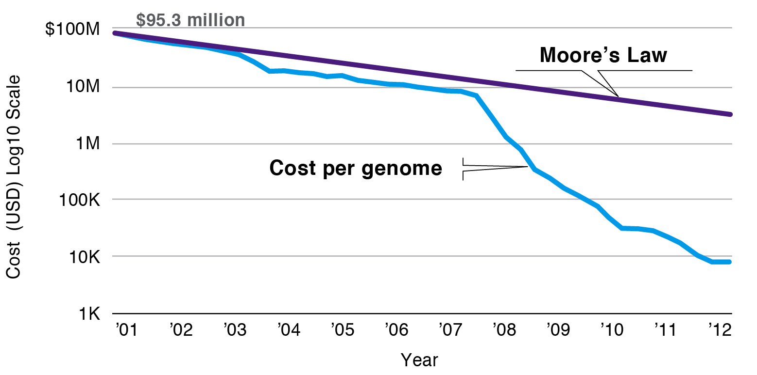
Rapidly Falling Cost of Sequencing Transforms Medicine
Baseline information
Cost of genome sequencing compared with Moore’s Law for computers
Source: Broad Institute

Slide 42
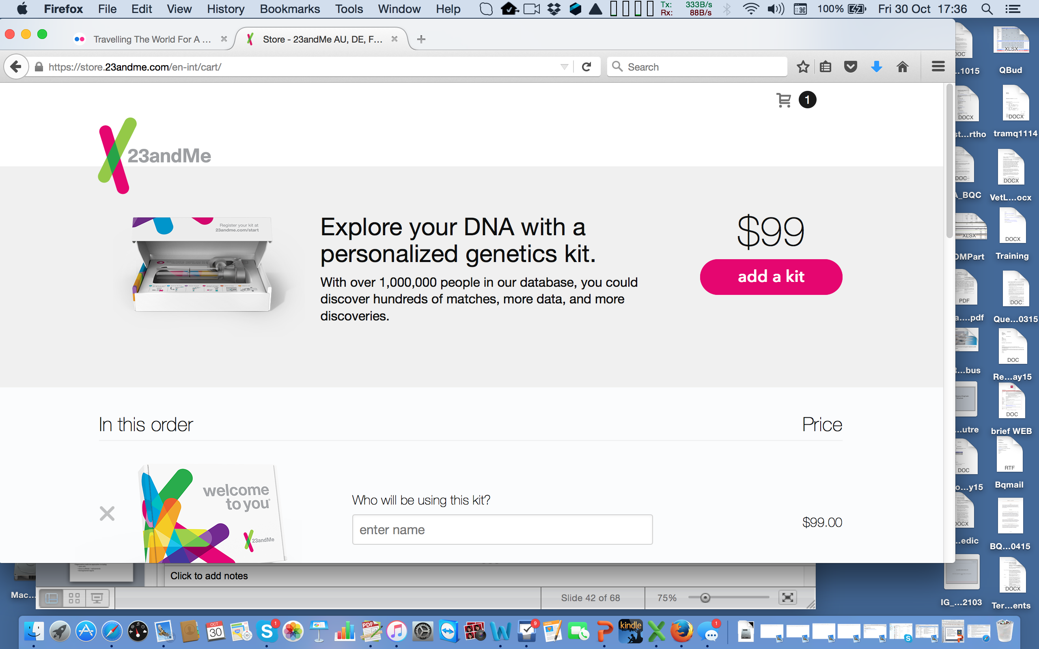
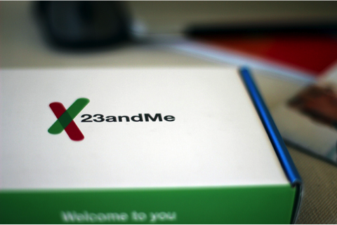

Slide 43
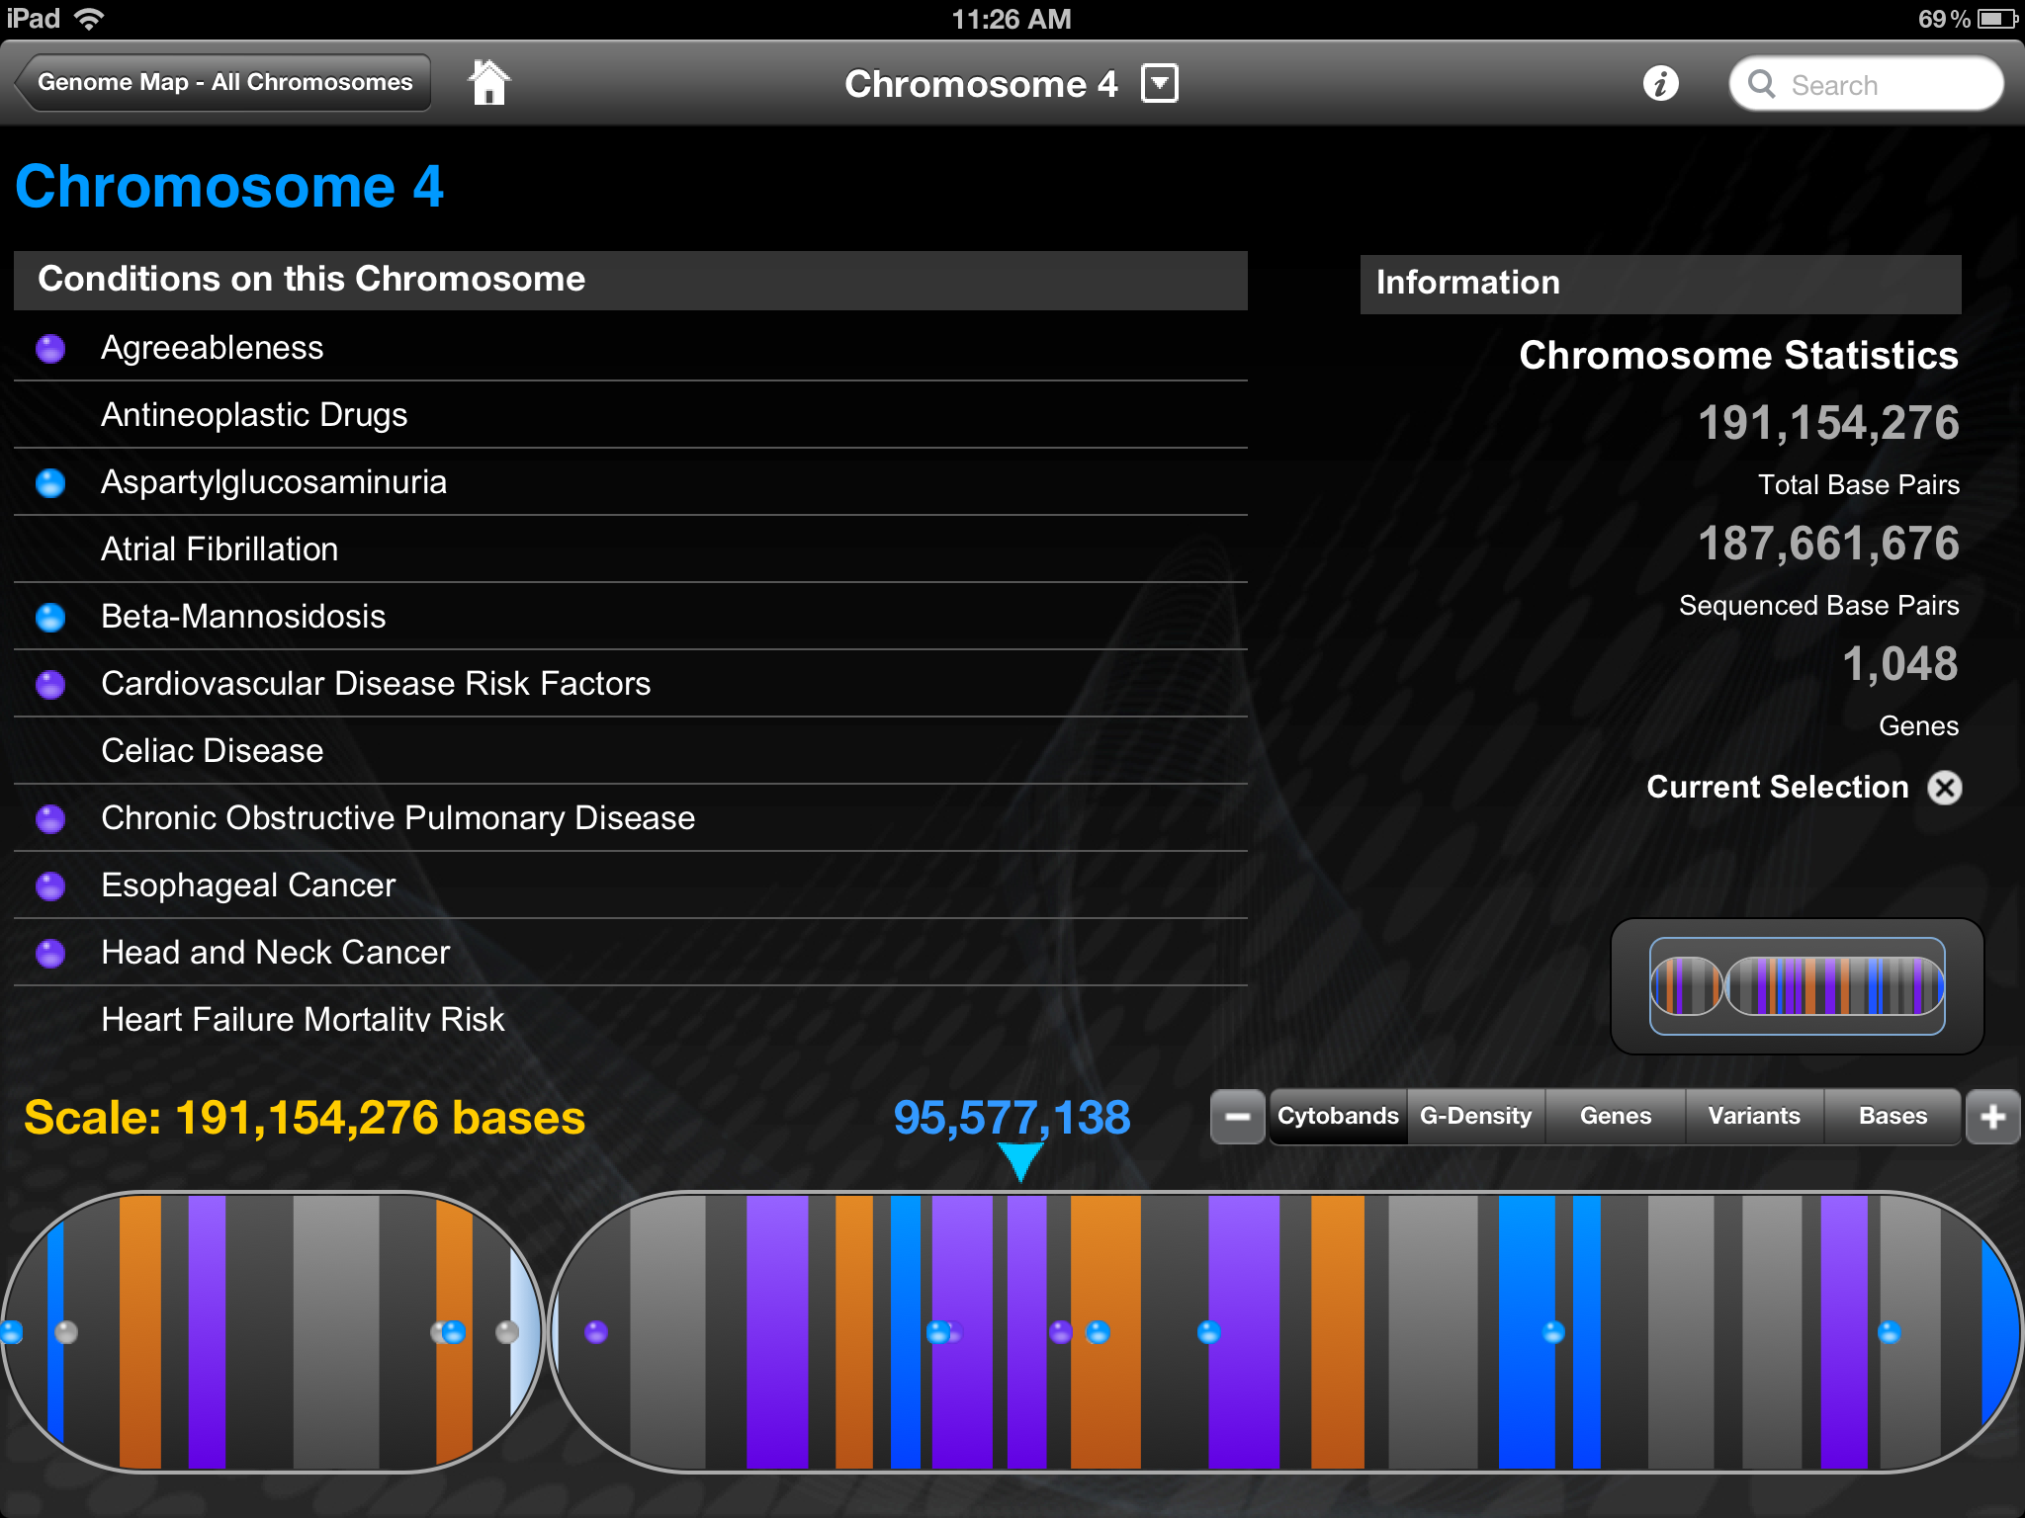
Uncovers a Potential Hazardous Condition (now on your smart phone)
Agreeableness

Slide 44
Personalized Medicine Omics Are Here…
Genome
All the genetic information in an organism
Transcriptome
All the RNA transcripts formed from a genome
Proteome
The locations and functions of all the proteins in the body
Metabolome
All the metabolites produced by a person
Connectome
The locations and functions of all the proteins in the body
Source: Popular Science

Slide 45
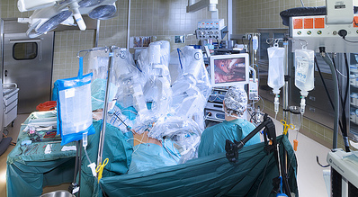
Robotics: soon portable

Slide 46
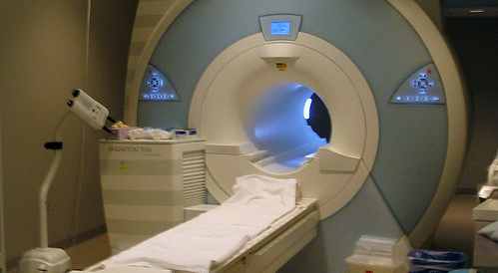

Slide 47
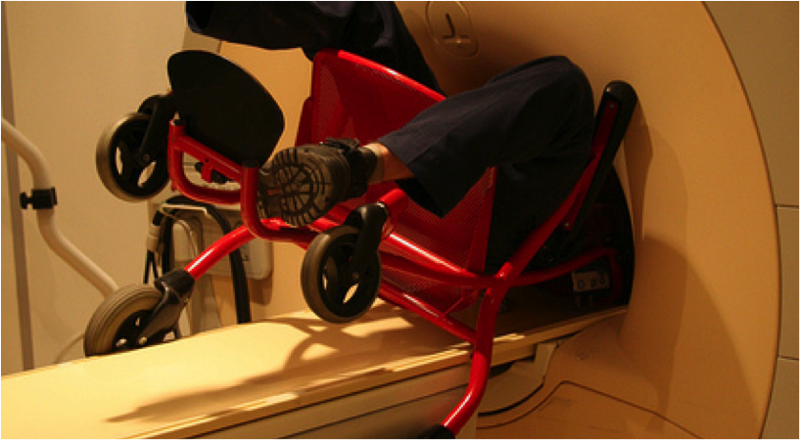
Don’t play with magnets!

Slide 48
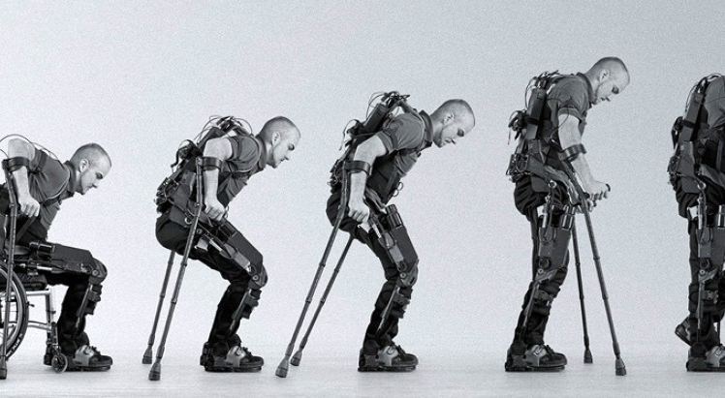
Bionics: paraplegics

Slide 49
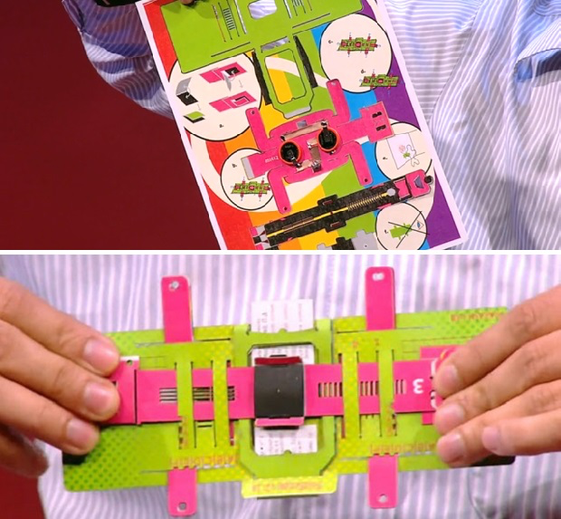
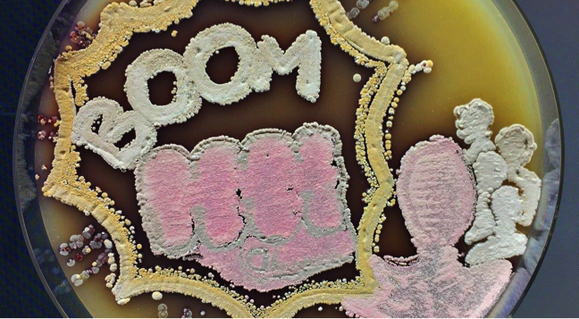
1$ Origami Scope
Scalable & Accessible

Slide 50
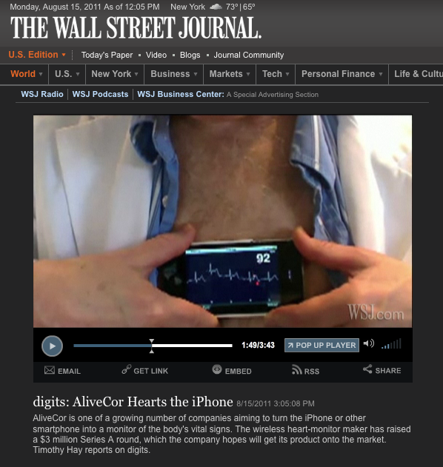

Products Are Merging into Consumer Retail
  Alivecor’s iPhone ECG
Notes:
25/11/15
50

Slide 51
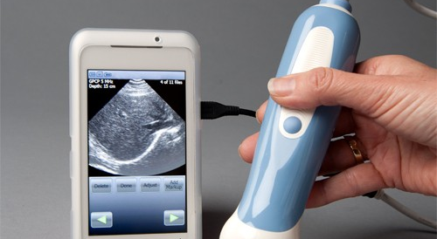

Slide 52
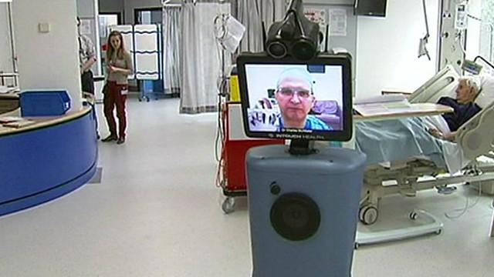


Slide 53
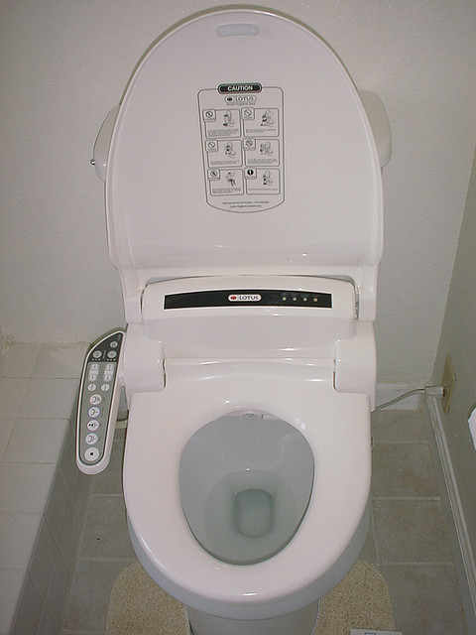

Home Diagnostics

Slide 54



Slide 55

Social Networks & Flue
Source: JESS3 via TechCrunch, May 2011

Slide 56
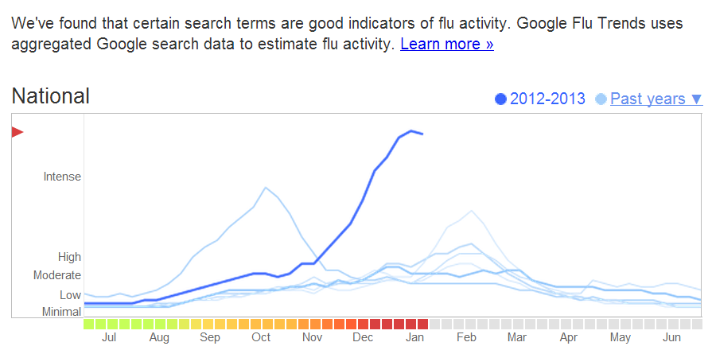
Real-Time Data Will Influence Behavior
The U.S. Centers for Disease Control sees a moderately severe flu season while Google warns of one of the worst flu seasons on record

Slide 57



Slide 58
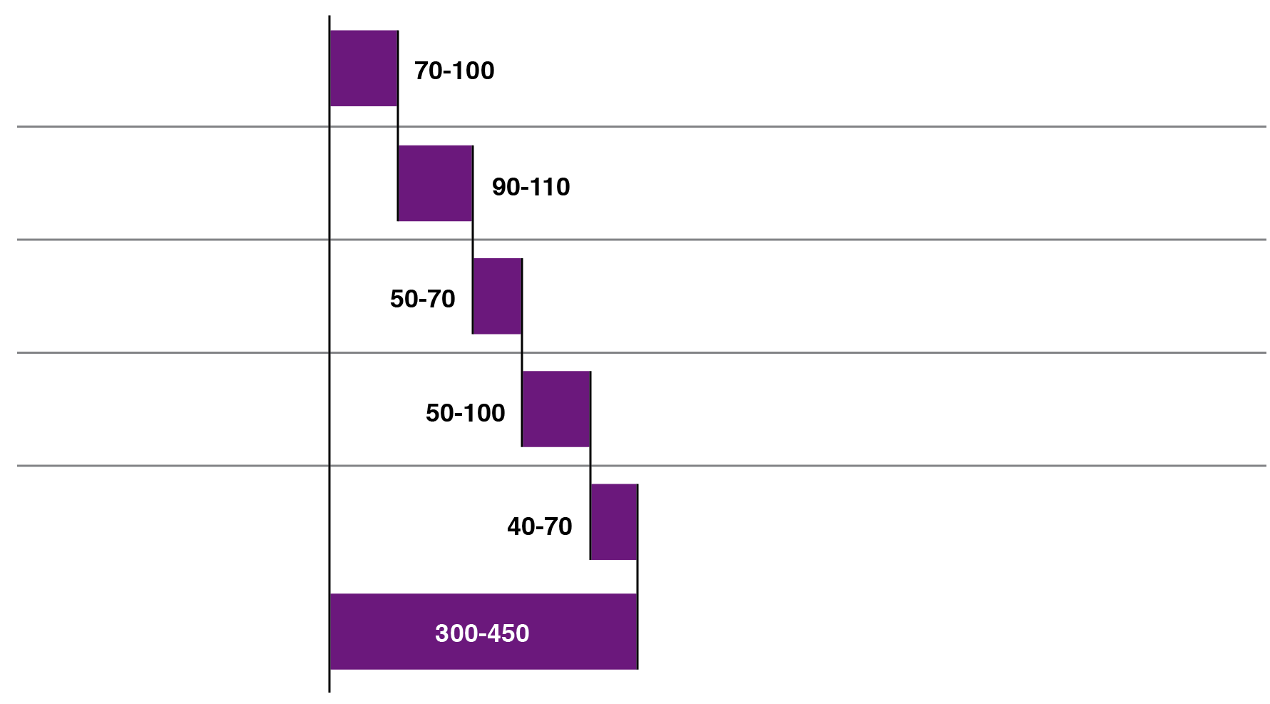
Using Big Data to Drive Value: Potential $300M to $450M Savings
Value at Stake
Value (USD B)
Key drivers of value
Right living
Right care
Right provider
Right value
Right innovation
Targeted disease prevention
Data-enabled adherence programs
Alignment around proven pathways
Coordinated care across providers
Shifting volume to the right setting
Reducing ER/readmit rates
Payment innovation and alignment
Provider-performance transparency
Accelerating discovery in R&D
Improving trial operations
Source: American Diabetes Association; American Hospital Associationl HealthPartners Research Foundation, McKinsey Global Institute; National
Burea of Economic Research, US Census Bureau.

Slide 59
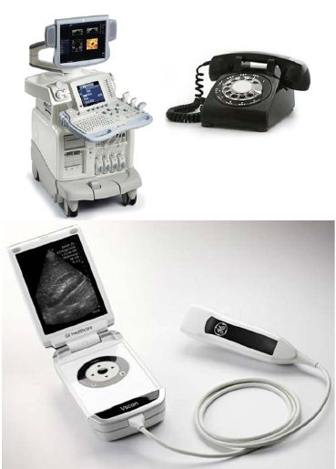



Strictly Private and Confidential
Leading to New Markets for Healthcare IT/Digital Health
The Present
Hospital
Information
Web of Care
Systems
(HIS)
Digital
Health
Market
Personal
Health
Records
(PHR)
Smart
eHomes
Electronic
Medical
Records
(EMR)
Virtual
Health
Teams
The Future
Tele/Mobile-
health
Source: Frost & Sullivan
Tele/Mobile-
care
77
7

Slide 60


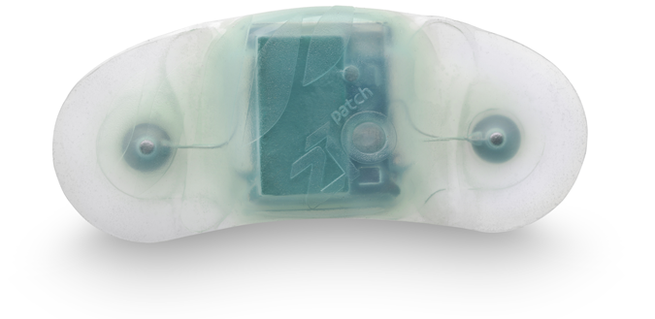
Bigger Impact: Connecting Patient Data to Doctor
Improve compliance, provide early interventions,
collect better quality data
Glow Caps
Zio Patch
Care Innovations
Long-term
cardiac monitors
Monitoring elderly
at home
Compliance

Slide 61
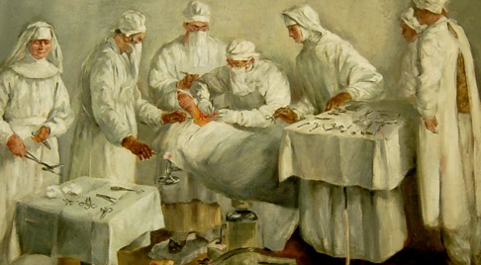
Doc: are you ready for all this?

Slide 62


Pricing Pressure on Drugmakers Increases
Personalized Medicine
Gen therapy
Anti body conjugates
Cancer vaccines
Rare disease
Regenerative medicine

Slide 63


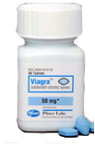
Turning Failures into Success
DRUG | FAILED | SUCCEEDED
AZT | Cancer | AIDS
Rogaine | High blood pressure | Promote hair growth in balding men
Viagra | Angina | Erectile dysfunction

Slide 64

Where are we heading?

Slide 65
Healthcare Systems Change
Past
Future
Treat Illness
Acute care
Place: Hospital
Targeted therapies
Payment:
Cost based care
Promote wellness
Prevent onset
Early intervention
Place: Home
Behavior modification
Financing:
Value-based-care

Slide 66
Robotics
Genomics
Diagnostics
Digital health
Bioinformatics

Slide 67
Changing Roles of Doctors
Past
Future
Unquestioned authorities
Trial and error
Treat disease
Disconnected from others in the healthcare system
Health advisors
Data driven decisions using health IT and diagnostics
Focus on prevention and wellness
Integrated with specialists, labs, and pharmacists

Slide 68
Changing Roles of Patients
Past
Future
Passive about their
healthcare
Armed with family history
Relied on doctors to maintain health records
Relied on doctors as primary source of medical information
Received annual check-up
Active managers of their healthcare
Armed with knowledge of genetic risks
Have access to their own digital health records
Rely on Internet, social networks, for medical information
Monitor health and wellness with digital devices

Slide 69
Where Are the Biggest Opportunities
Transformational healthcare delivery
Disruptive therapeutics / vaccines / diagnostics…each with a special pathway to market
Personalized and predictive medicine
Medical devices / platforms / tools
Data analytics
Significant opportunity to address global needs for food, energy, fiber
Emerging market opportunities

Slide 70
Healthcare:
Procedures
Cost
Outcomes
Value

Slide 71
= NOW!
Scientific advances continue to fuel the life sciences industry
Disruptive technologies are radically changing healthcare
Emerging economies can leverage advances to improve
healthcare delivery in underserved areas
The patient at the center of healthcare & in control

Slide 72
The message:
It’s a fabulous time…

Slide 73
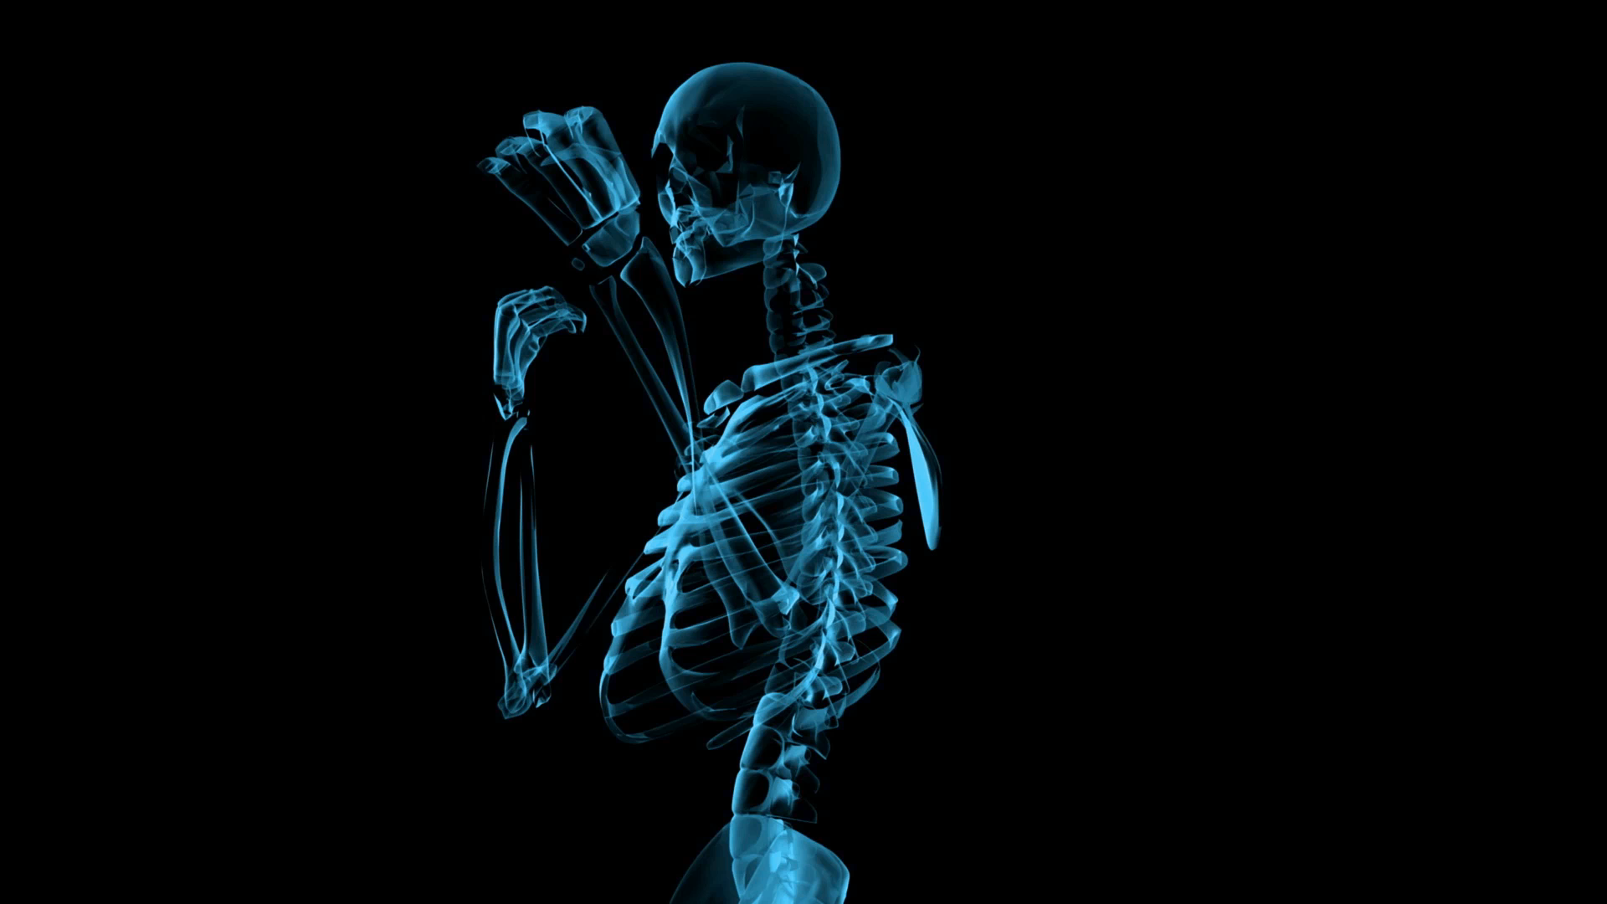
Thanks & Enjoy Lunch!

