Slide 1


FCC status
F. Zimmermann on behalf of the FCC Collaboration
LHeC Coordination Group
2 October 2015
many thanks to
M. Benedikt and J. Gutleber

Slide 2
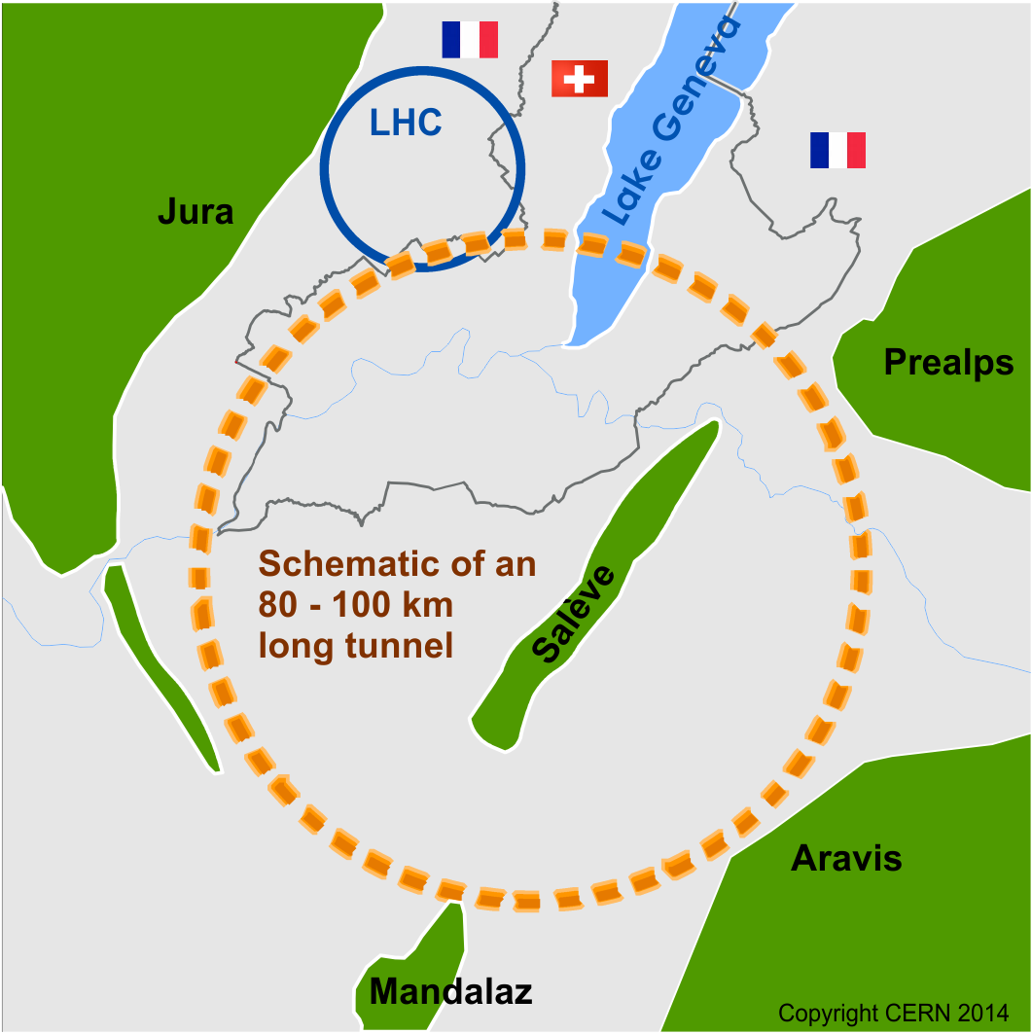
Future Circular Collider Study
GOAL: CDR and cost review for the next ESU (2018)
International FCC collaboration (CERN as host lab) to study:
pp-collider (FCC-hh) → main emphasis, defining infrastructure requirements
80-100 km infrastructure in Geneva area
e⁺e⁻ collider (FCC-ee) as potential intermediate step
p-e (FCC-he) option
HE-LHC with FCC-hh technology
~16 T ⇒ 100 TeV pp in 100 km

Slide 3

Hadron collider parameters
Parameter | FCC-hh |  | SPPC | LHC | HL LHC
collision energy cms [TeV] | 100 |  | 71.2 | 14
dipole field [T] | 16 |  | 20 | 8.3
# IP | 2 main & 2 |  | 2 | 2 main & 2
bunch intensity [10¹¹] | 1 | 1 (0.2) | 2 | 1.1 |  | 2.2
bunch spacing [ns] | 25 | 25 (5) | 25 | 25 |  | 25
luminosity/Ip [10³⁴ cm⁻²s⁻¹] | 5 | 25 | 12 | 1 |  | 5
events/bx | 170 | 850 (170) | 400 | 27 |  | 135
stored energy/beam [GJ] | 8.4 |  | 6.6 | 0.36 |  | 0.7
synchr. rad. [W/m/apert.] | 30 |  | 58 | 0.2 |  | 0.35

Slide 4
FCC-hh luminosity goals & phases
Two parameter sets for two operation phases:
  Phase 1 (baseline): 5 x 10³⁴ cm⁻²s⁻¹ (peak),
  250 fb⁻¹/year (averaged)
    2500 fb⁻¹ within 10 years (~HL LHC total luminosity)
  Phase 2 (ultimate): ~2.5 x 10³⁵ cm⁻²s⁻¹ (peak),
  1000 fb⁻¹/year (averaged)
  ➔ 15,000 fb⁻¹ within 15 years
  Yielding total luminosity O(20,000) fb⁻¹ over ~25 years of operation

Slide 5
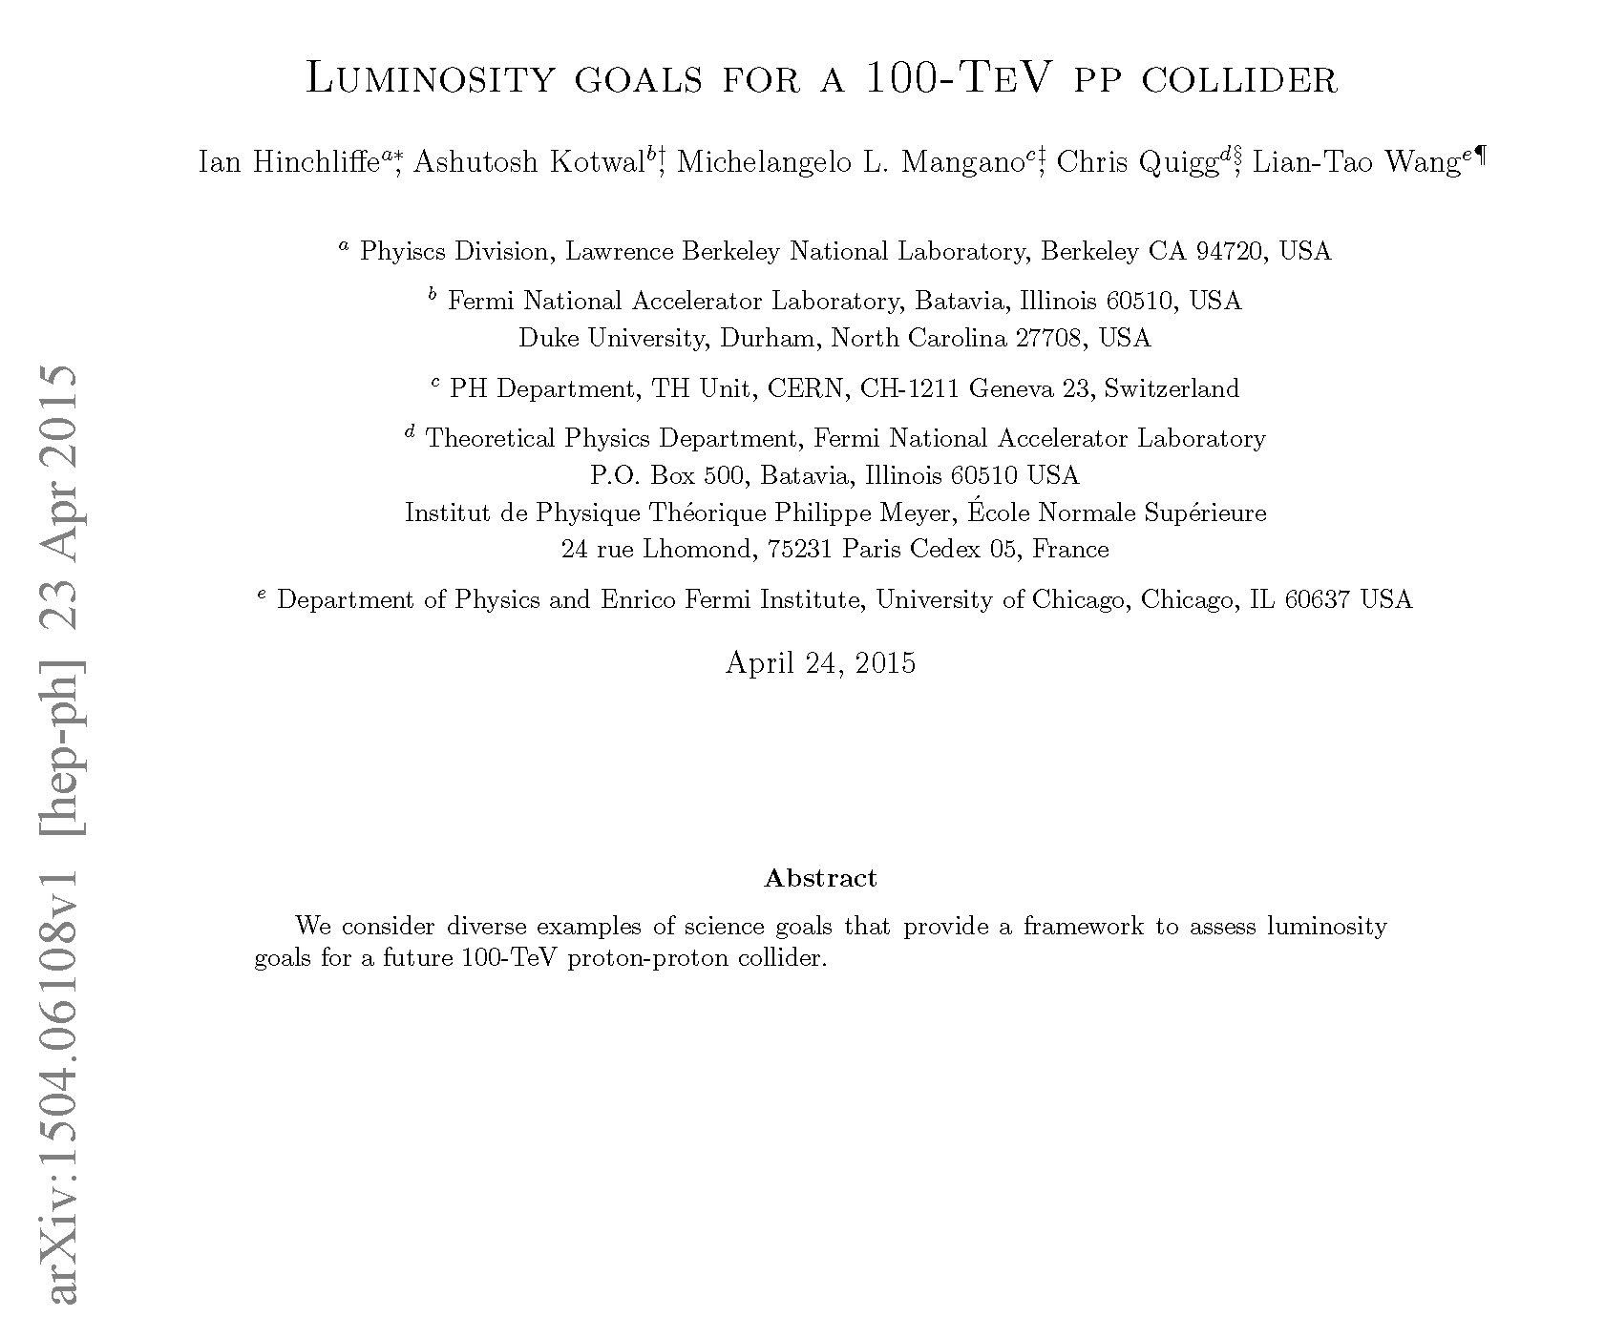
20 ab⁻¹ OK for physics

Slide 6
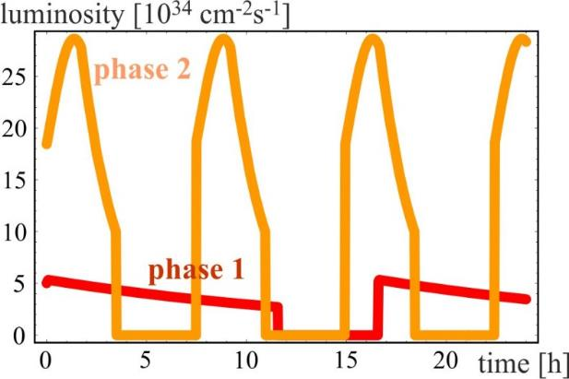
Luminosity evolution
radiation damping: τ~1 h
  for both phases:
  beam current 0.5 A unchanged!
  total synchrotron radiation power ~5 MW.
phase 1: β*=1.1 m, ΔQ_{tot}=0.01, t_{ta}=5 h
phase 2: β*=0.3 m, ΔQ_{tot}=0.03, t_{ta}=4 h

Slide 7
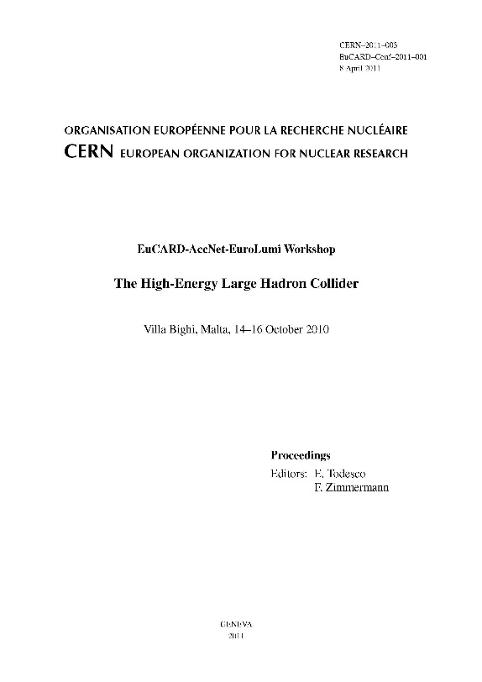
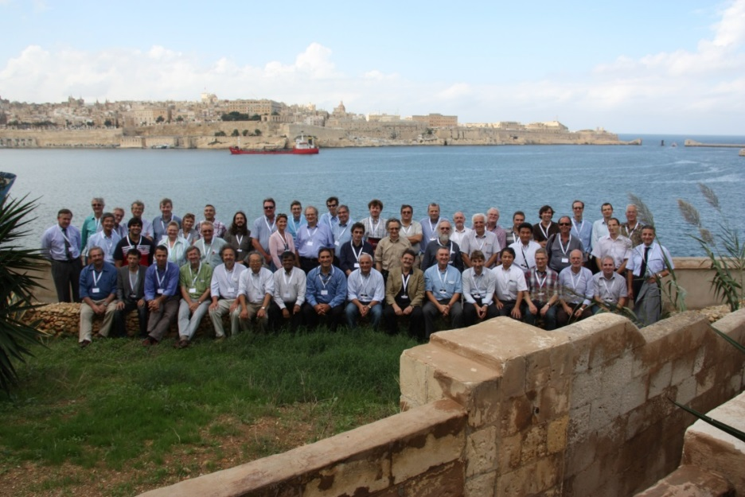
High-Energy LHC
FCC study continues effort on high-field collider in LHC tunnel
2010 EuCARD Workshop Malta;
Yellow Report CERN-2011-1
based on 16-T dipoles developed for FCC-hh
extrapolation of other parts from the present (HL-)LHC
and from FCC developments
EuCARD-AccNet-EuroLumi Workshop: The High-Energy Large Hadron Collider - HE-LHC10,
E. Todesco and F. Zimmermann (eds.), EuCARD-CON-2011-001; arXiv:1111.7188; CERN-2011-003 (2011)

Slide 8
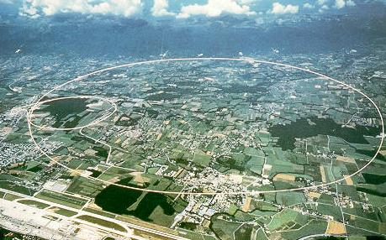
LEP – highest energy e⁺e⁻ collider so far
circumference 27 km
in operation from 1989 to 2000
maximum c.m. energy 209 GeV
maximum synchrotron radiation power 23 MW

Slide 9
Lepton collider key parameters
parameter | FCC-ee |  |  | CEPC | LEP2
energy/beam [GeV] | 45 | 120 | 175 | 120 | 105
bunches/beam | 13000- 60000 | 500- 1400 | 51- 98 | 50 | 4
beam current [mA] | 1450 | 30 | 6.6 | 16.6 | 3
luminosity/IP x 10³⁴ cm⁻²s⁻¹ | 21 - 280 | 5 - 11 | 1.5 - 2.6 | 2.0 | 0.0012
energy loss/turn [GeV] | 0.03 | 1.67 | 7.55 | 3.1 | 3.34
synchrotron power [MW] | 100 |  |  | 103 | 22
RF voltage [GV] | 0.2-2.5 | 3.6-5.5 | 11 | 6.9 | 3.5
FCC-ee: 2 separate rings CEPC baseline: single beam pipe like LEP
Dependency FCC-ee: crab-waist vs. baseline optics and 2 vs. 4 IPs

Slide 10
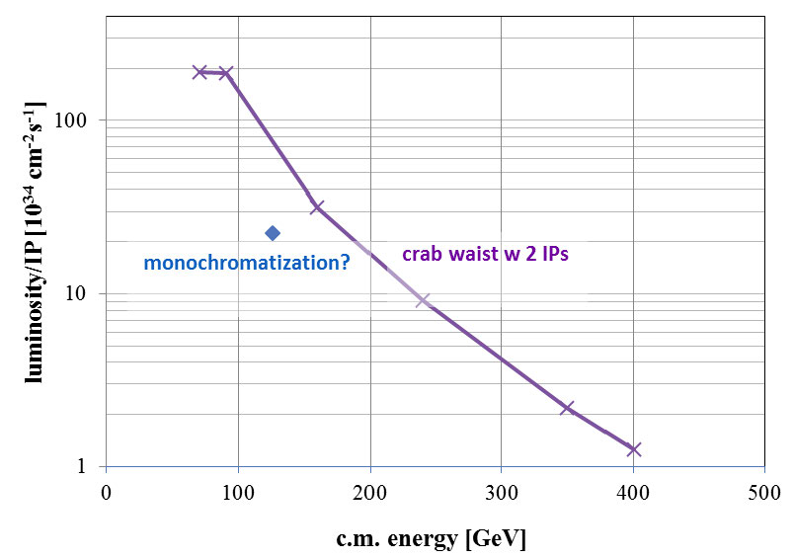

e⁺e⁻ luminosity vs. c.m. energy
FCC ee
α_{QED}
Z
H?
WW
HZ
$$t\overline{t}$$
?
CEPC

Slide 11
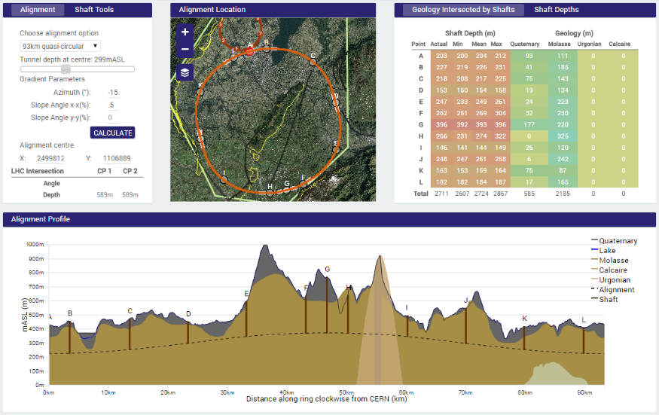
Site investigations
90 – 100 km fits geological situation well
LHC suitable as potential injector

Slide 12

IP
30 mrad
“Middle straight”
∼1570 m
FCC-hh
∼12 m
9 m
FCC layout
compatible layouts
for hh and ee
0.8 m
“90/270 straight”
∼4.7 km
Common
RF
Common
RF
As the separation of 3(4) rings is within 15 m,
one wide tunnel may be possible around the IR.
K. Oide
IP

Slide 13
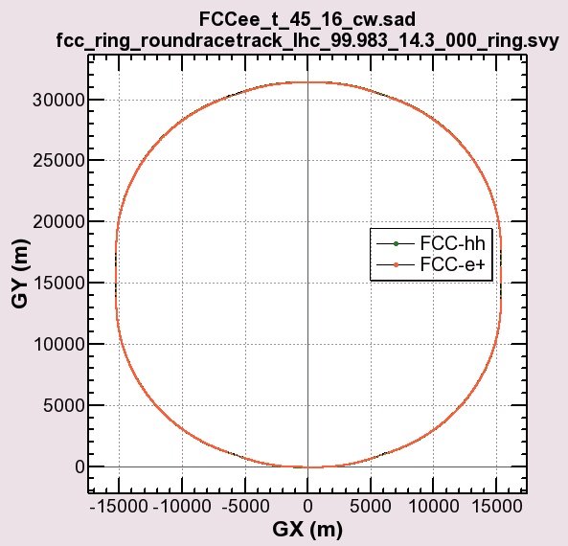
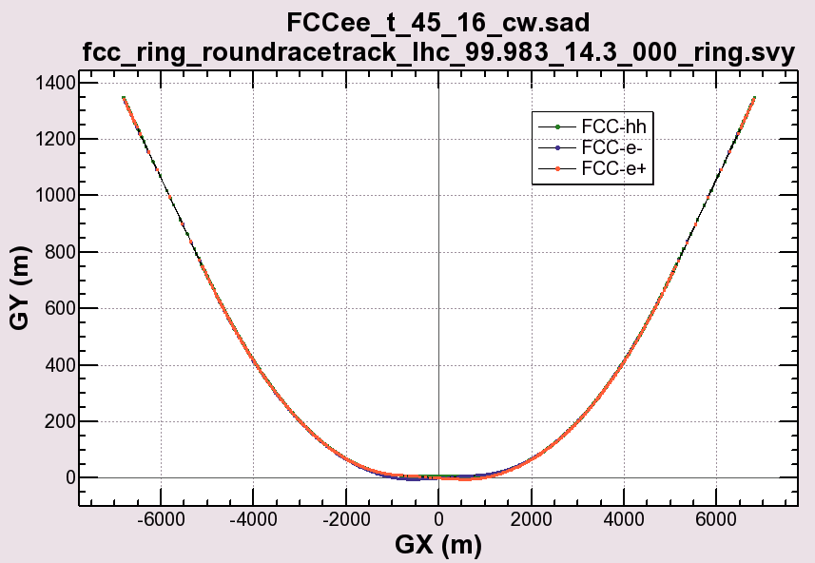
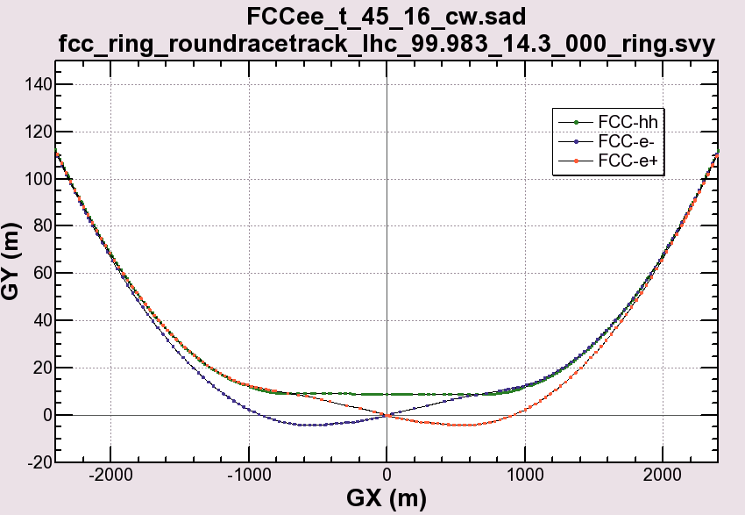
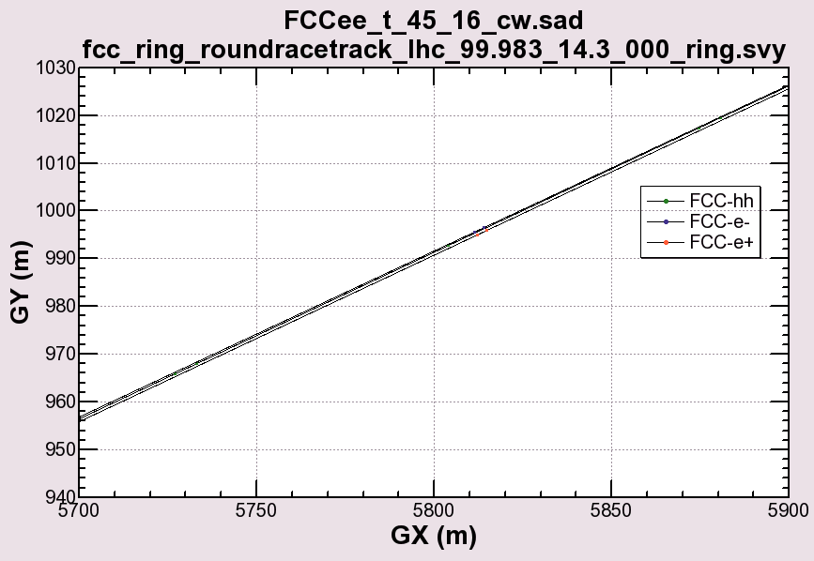
zoomed view
around the IP
K. Oide

Slide 14
Superconductor performance
Nb3Sn T = 4.5 K
Critical surface FCC
LHC at 1.9 K
16 T
HL-LHC
5400 mm²
3150 mm²
Different technology
~1.7 times less SC
Nb-Ti
Not possible
~10% margin
HL-LHC
~10% margin
FCC ultimate

Slide 15
FCC magnet technology program
Main Milestones of the FCC Magnets Technologies
Milestone | Description | 15 | 2016 |  | 2017 |  | 2018 |  | 2019 |  | 2020 |  | 21
M0 | High J_{c} wire development with industry
M1 | Supporting wound conductor test program
M2 | Design & manufacture 16T ERMC with existing wire
M3 | Design & manufacture 16 T RMM with existing wire
M4 | Procurement of 35 km enhanced wire
M5 | Design & manufacture 16T demonstrator magnet
M6 | Procurement 70 km of enhanced high J_{c} wire
M7 | EuroCirCol design 16T accelerator quality model
 | Manufacture and test of the 16 T EuroCirCol model
ERMC (16 T mid-plane field) RMM (16 T in 50 mm cavity) Demonstrator (16 T, 50 mm gap)

Slide 16
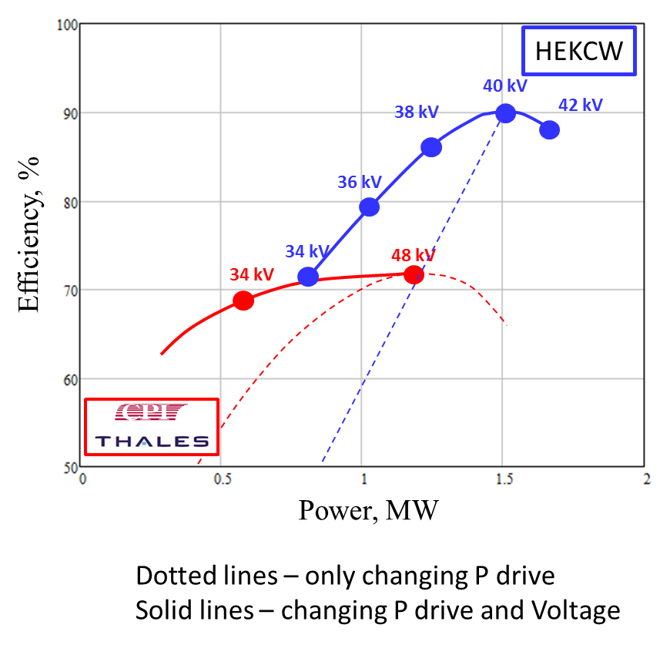
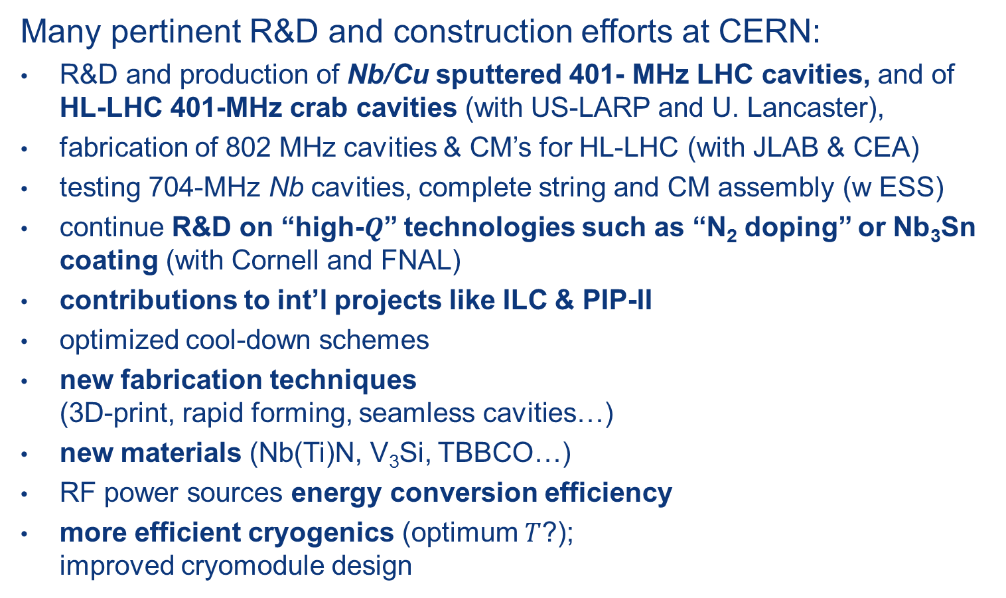
SC RF R&D towards FCC
Many pertinent R&D and construction efforts at CERN:
R&D and production of Nb/Cu sputtered 401- MHz LHC cavities, and of HL-LHC 401-MHz crab cavities (with US-LARP and U. Lancaster),
fabrication of 802 MHz cavities & CM’s for HL-LHC (with JLAB & CEA)
testing 704-MHz Nb cavities, complete string and CM assembly (w ESS)
continue R&D on “high-$Q$” technologies such as “N₂ doping” or Nb₃Sn coating (with Cornell and FNAL)
contributions to int’l projects like ILC & PIP-II
optimized cool-down schemes
new fabrication techniques (3D-print, rapid forming, seamless cavities…)
new materials (Nb(Ti)N, V₃Si, TBBCO…)
RF power sources energy conversion efficiency
more efficient cryogenics (optimum $T$?); improved cryomodule design
I. Syratchev

Slide 17
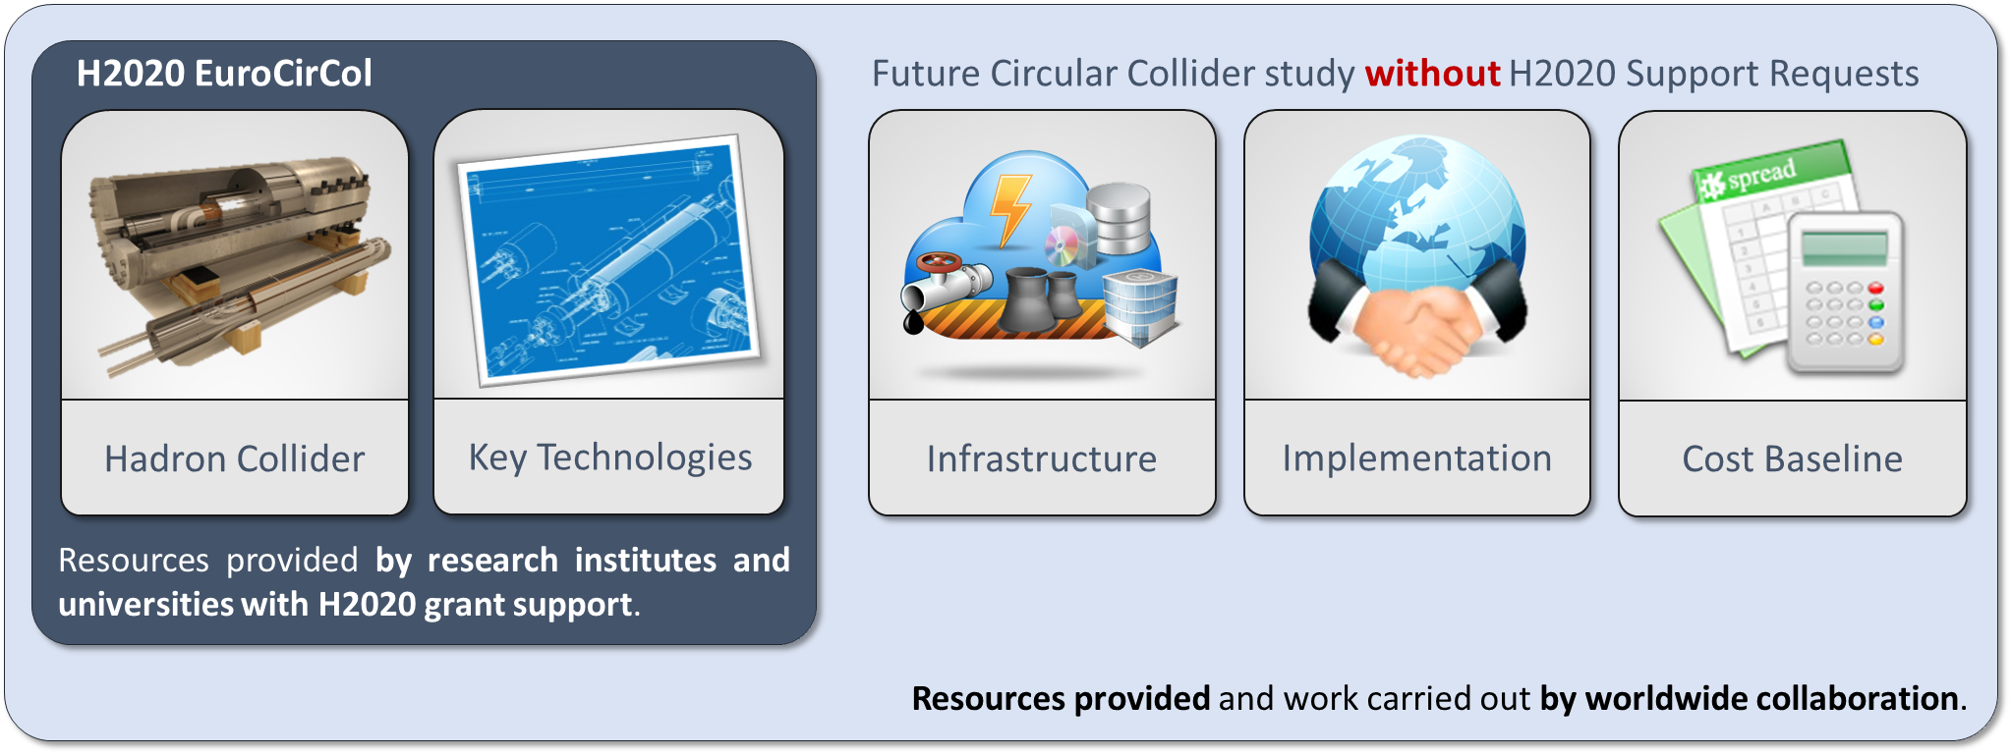
EuroCirCol EU Horizon 2020 Grant
EC contributes with funding to FCC-hh study
Core aspects of hadron collider design: arc & IR optics design, 16 T magnet program, cryogenic beam vacuum system
Recognition of FCC Study by European Commission.

Slide 18
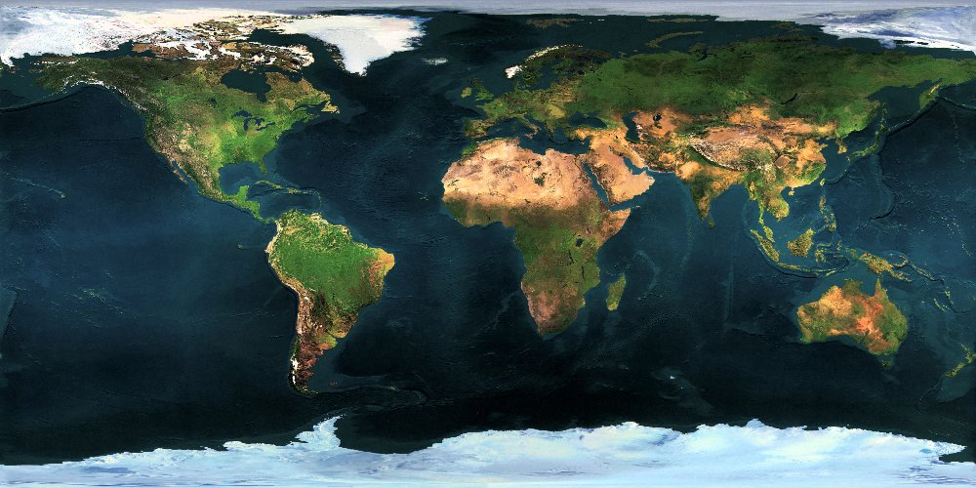























Collaboration Status
FCC International Collaboration
62 institutes
23 countries + EC
Status: 28 September 2015

Slide 19
FCC Collaboration Status
62 collaboration members & CERN as host institute, 28 September 2015
ALBA/CELLS, Spain
Ankara U., Turkey
U Belgrade, Serbia
U Bern, Switzerland
BINP, Russia
CASE (SUNY/BNL), USA
CBPF, Brazil
CEA Grenoble, France
CEA Saclay, France
CIEMAT, Spain
CNRS, France
Cockcroft Institute, UK
U Colima, Mexico
CSIC/IFIC, Spain
TU Darmstadt, Germany
TU Delft, Netherlands
DESY, Germany
TU Dresden, Germany
Duke U, USA
EPFL, Switzerland
GWNU, Korea
U Geneva, Switzerland
Goethe U Frankfurt, Germany
GSI, Germany
U. Guanajuato, Mexico
Hellenic Open U, Greece
HEPHY, Austria
U Houston, USA
IIT Kanpur, India
IFJ PAN Krakow, Poland
INFN, Italy
INP Minsk, Belarus
U Iowa, USA
IPM, Iran
UC Irvine, USA
Istanbul Aydin U., Turkey
JAI/Oxford, UK
JINR Dubna, Russia
FZ Jülich, Germany
KAIST, Korea
KEK, Japan
KIAS, Korea
King’s College London, UK
KIT Karlsruhe, Germany
Korea U Sejong, Korea
MEPhI, Russia
MIT, USA
NBI, Denmark
Northern Illinois U., USA
NC PHEP Minsk, Belarus
U. Liverpool, UK
U Oxford, UK
PSI, Switzerland
U. Rostock, Germany
Sapienza/Roma, Italy
UC Santa Barbara, USA
U Silesia, Poland
TU Tampere, Finland
TOBB, Turkey
U Twente, Netherlands
TU Vienna, Austria
Wroclaw UT, Poland

Slide 20
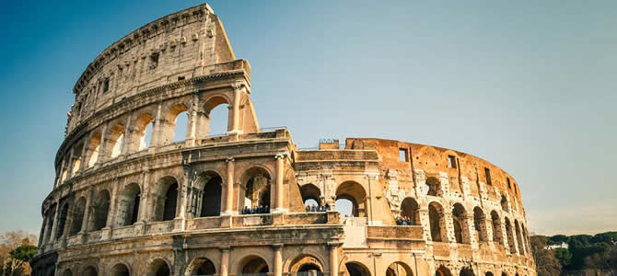





FCC Week 2016
Rome, 11-15 April 2016

