Slide 1
Continuous Integration: How can it Help?
Joshua Wyatt Smith
Georg-August-Universitӓt Gӧttingen, Germany
Inverted CERN School of Computing, 29 February – 2 March 2016

Slide 2
Outline
The challenge
Continuous Integration
  What?
  Why?
  How?
  Who?
CI General Concepts
  slave/master model
  schedulers, Build steps, Testing, Feedback
CI Examples
  Jenkins and Buildbot
Conclusions

Slide 3
The Challenge
As the project grows, complexity grows:
  Physical code size
  Dependencies
  Number of developers
  Package versions
2 OpenSource examples that show code complexity:
  ROOT
  Geant4

Slide 4
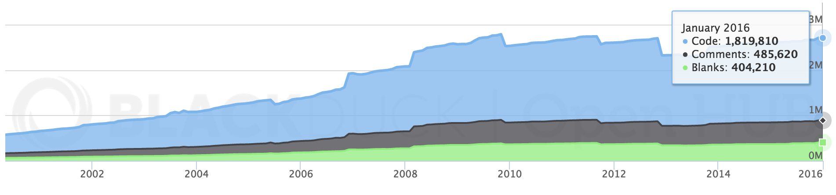
The challenge - ROOT
HEP analysis framework
  Data + event reconstruction, data analysis, detector simulation and tracking etc
Just under 2 million lines of code
  Mostly C++ and C
LOC

Slide 5
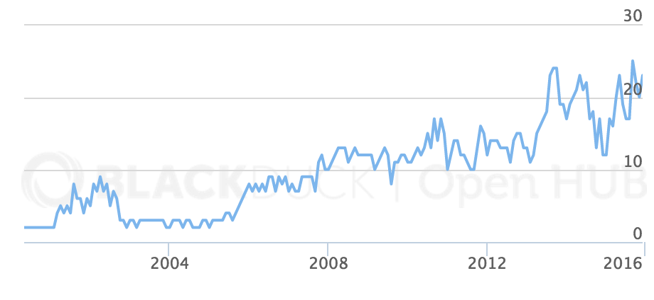
The challenge - ROOT
# of contributors
524 person- years
  Estimated cost: ~ €29 million*
48,444 commits from 131 developers
* All cost estimates calculated using basic COCOMO model

Slide 6
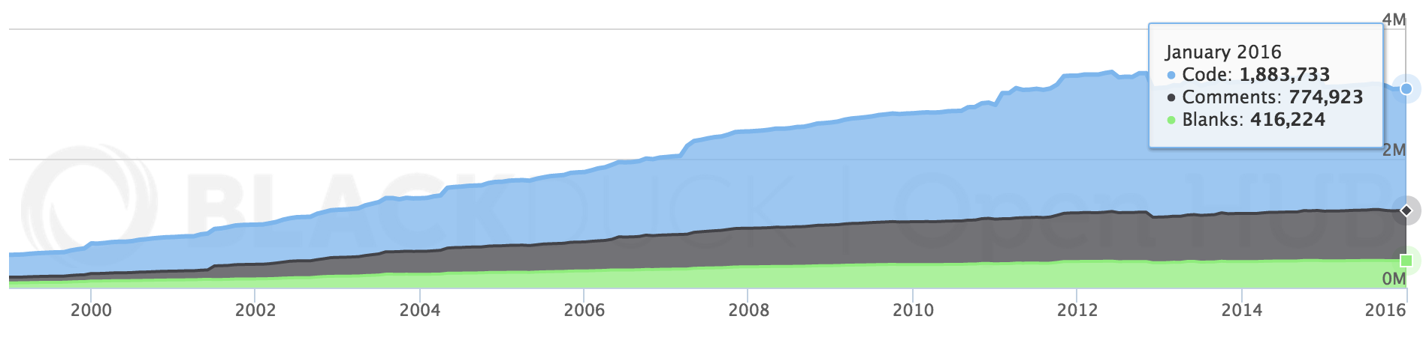
The challenge - Geant4
A framework for the simulation of the passage of particles through matter.
  Used in HEP, medical and space physics
Just under 2 million lines of code
  Mostly C++
LOC

Slide 7
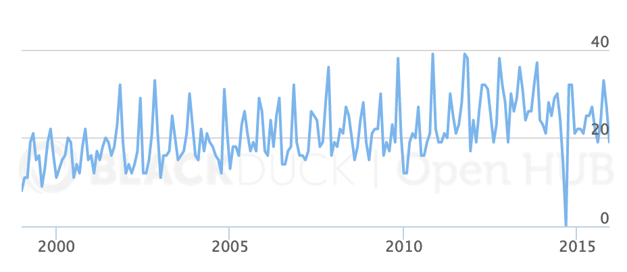
The challenge - Geant4
# of contributors
537 person-years
  Estimated cost: ~ €29 million
58,683 commits from 160 developers

Slide 8
The challenge - Architectures
Different environments: computer architectures, compilers
x86_64-mac-10XY-clang70 aarch64-ubuntu14-gcc49
x86_64-slc6-gcc4X x86_64-slc6-clang35
x86_64-centos7-gcc4X x86_64-fedora2X-gcc4Y
…
architecture-OS-compiler

Slide 9
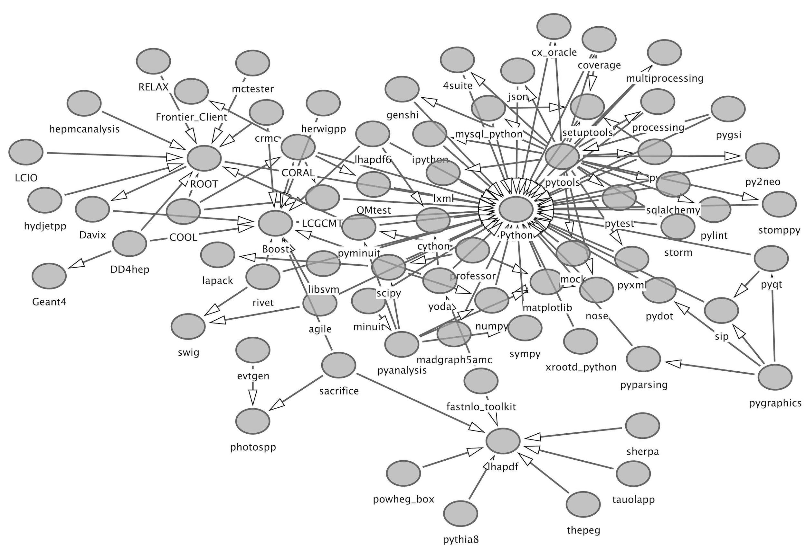
The challenge - Dependencies and versions
i.e. LCG packages
Version #’s CRUCIAL!
Huge dependencies

Slide 10
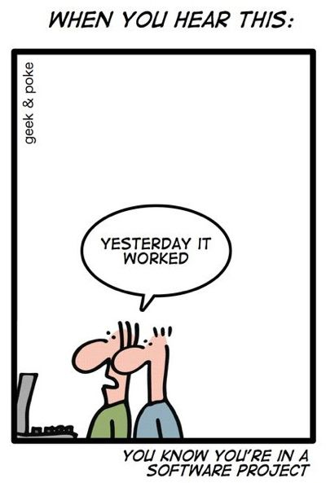
The challenge
How do we handle increasing code-base sizes?
How do we handle an increasing number of developers?
  How can developers interact with each other?
How do we build across multiple platforms?
How do we build multiple versions?
How can we make sure we don’t break things!

Slide 11
Continuous Integration (CI) - What?
“. . . a software development practice where members of a team integrate their work frequently, usually each person integrates at least daily—leading to multiple integrations per day. Each integration is verified by an automated build (including test) to detect integration errors as quickly as possible.”
- Martin Fowler

Slide 12
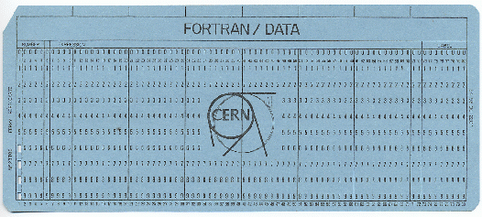
In a nutshell...
Use various existing tools to:
  Combine changes often
  Build often
  Test often
  Deploy often
CI Software oversees this
Utilize resources. The days of punch-cards are over (phew!)

Slide 13


Components
Code Repository
(SVN, Git, CVS, …)
Commits
Developers
Slaves
Poll
CI Server
Feedback

Slide 14
CI - Why?
Early/rapid feedback!
  Do all components/projects compile?
  Coding standards?
  Are tests successful?
  Performance requirements?
  Problems archiving or deploying?
Better project visibility
  Possible to notice trends
  What features are needed/being added

Slide 15

Why? (cntd)
Insures clean environments
Manual tasks automated
  Speedup of working software turnover
No large integration steps
  Much less likely to break something
A full working/deployable version at ANY POINT IN TIME
Complete documentation of who did what

Slide 16
CI - How?
In order for CI to work, individual developers should:
Commit frequently
  Many small commits
Run local build first (if possible)
  Huge code repos may make this difficult
  Only commit working code
Fix broken builds immediately
Write automated tests

Slide 17
CI - Who?
Who should CI?
Your code that builds your thesis?
  Probably not
A project with more than 2 developers?
  Yes
Analysis/hardware groups within CERN?
  ABSOLUTELY!
  Why don’t they????

Slide 18
CI - General Concepts
Hopefully you’re convinced that CI is useful
What do we need to CI?
  Hardware
    CI Server + CI Slaves
  Software
    What do we build?
    When do we build?
    How do we build?
    How do we test?
    How do we get feedback?

Slide 19
CI General Concepts: Master - slave
Everything on 1 server
  Possible, not ideal unless for special projects
Distributed builds
  faster, safer, scalable, multiple platforms, more expensive
CI Server:
Poll version control repo
Perform actions on scheduled basis
Send emails
Host web accessible dashboard
Store and display history of builds
CI Slaves:
Pure workhorse
Various architectures
Reduces build time
Communication through built in ssh-client (or similar)
Receives action from server
Carries out action

Slide 20

CI General Concepts: Schedulers
When should we build?
Polling scheduler
  If changes in repo, build
Periodic scheduler
  Build will start after x seconds
Nightly scheduler
  Build at particular time of day/month/year
Try scheduler
  Build non-committed code within the CI framework
Instant gratification scheduler
  “I want this built now!”

Slide 21
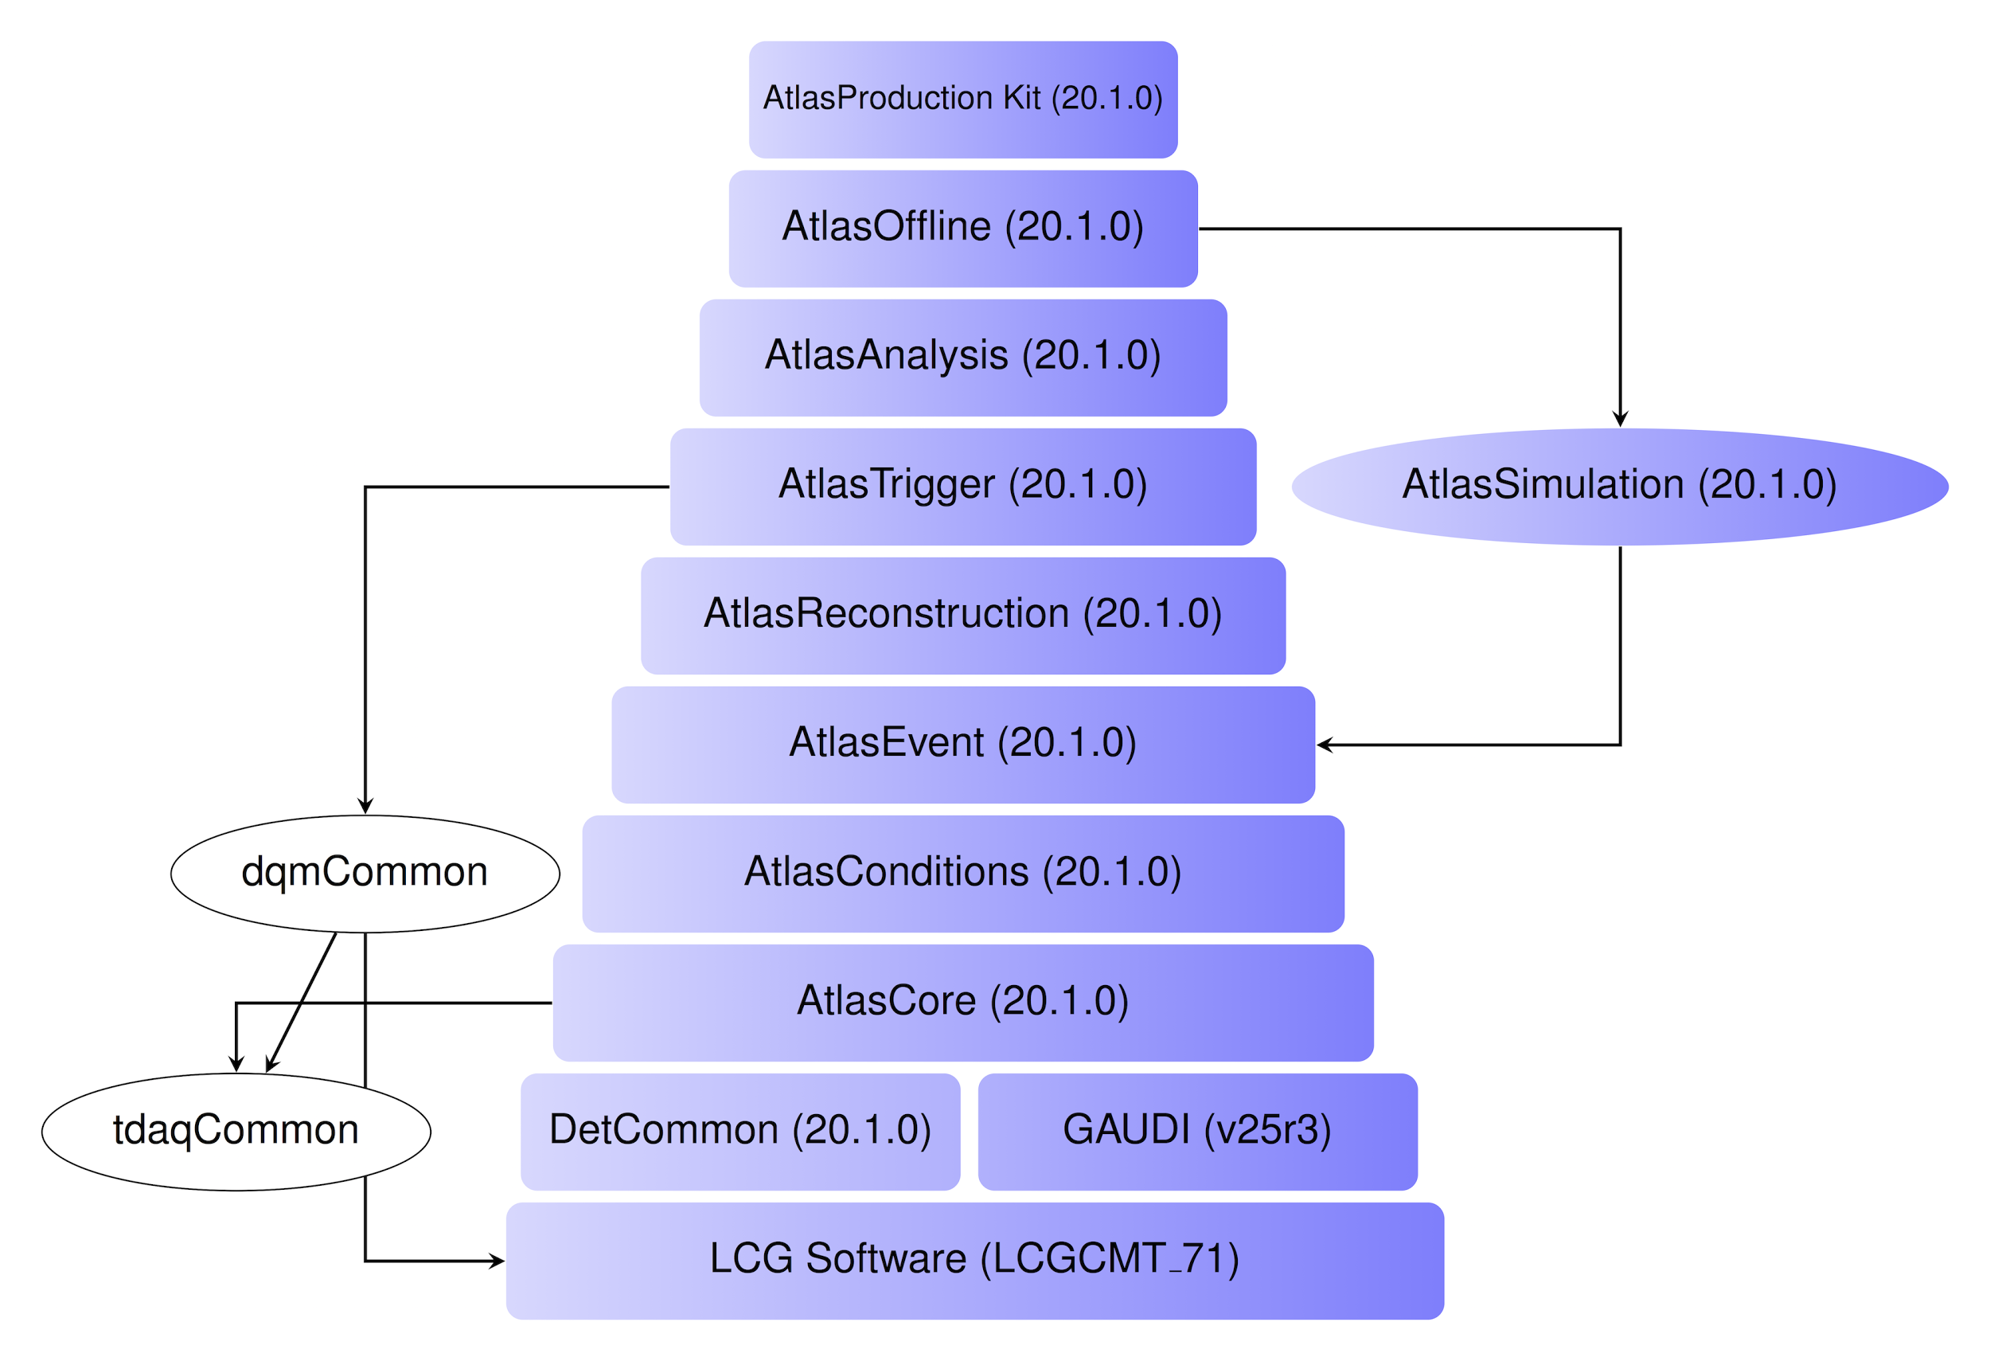
Schedulers (cntd)
Dependent or Triggerable scheduler
  I.e. a packaging step. Only package if all previous builds and tests were successful
  Atlas software stack: Each level is dependent on the other. Or, each level triggers the next

Slide 22

CI General Concepts: Build steps
How does the project get built?
Ideally, one command should build whole project
  Not always possible.
What tools/software are needed to build project?
  Cmake, make, java compiler etc.
How long does each build take?
  Can it be broken up into smaller projects?
    Even smaller projects?

Slide 23
CI General Concepts: Testing
Absolutely crucial for CI!
Several forms of testing:
UnitTests
  First step of testing
  Can be run on all commits
  During build
  Or after build
Integration tests
  Does my new code/changes break the rest of the build?
  Probably after build

Slide 24
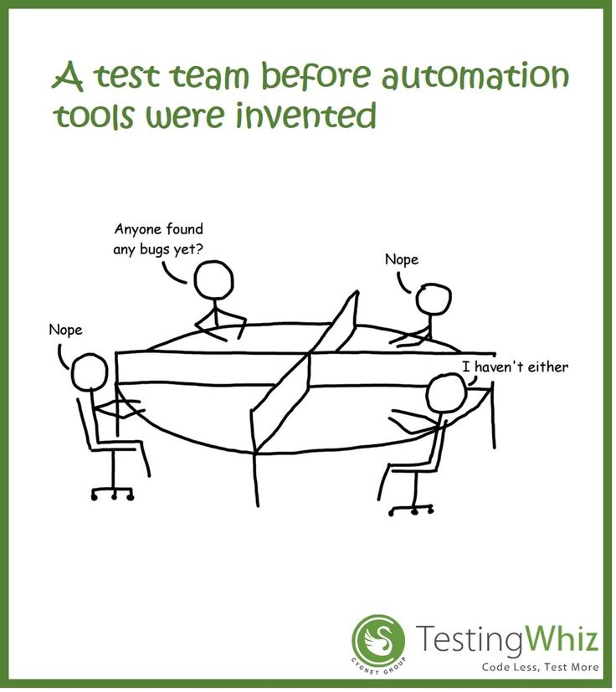
Testing (cntd)
Custom tests
  Often much more lengthy, performed less often
  Software validation
    Errors? Segfaults?
  Physics validation (LHC)
    Correct output?
  Possibly a dedicated slave
All should be automized!
Performance profiling is also important

Slide 25


CI General Concepts: Feedback
Feedback can be many things
Website widget
Email notifications
IRC bot
Extreme feedback
  Lamps
  Ambient orbs
  Retaliation - Foam missiles (seriously)

Slide 26
CI Tools
Code repositories
  BitKeeper, Bzr, CVS, Darcs, Gerrit, Git, Mercurial, Monotone, P4, SVN ...
Test frameworks
  CppUnit, Valgrind, JUnit, Unittest, TestNg ...
Continuous Integration
  Bamboo, Buildbot, CruiseControl, Jenkins, Gitlab CI …
Wikipedia has a great comparison table: https://en.wikipedia.org/wiki/Comparison_of_continuous_integration_software

Slide 27


Jenkins and Buildbot
Why?
  Two CI tools at “opposite end of the spectrum”. I.e. one is well known the other is not
  Both OpenSource!
  Similar concepts, executed differently
  Both easy to use! (spoiler: Jenkins is easier)
  They are fun to use! (especially Buildbot, but maybe that’s just me)

Slide 28

Jenkins
Created as Hudson in 2004
  Due to a dispute with Oracle, Hudson was branched to create Jenkins in 2011. Both are still ongoing
  Both claim the other are branches
In the last 12 months:
  Hudson (still Oracle owned) has: 101 commits with 7 contributors
  Jenkins has: 4668 commits with 292 contributors
  Good job Oracle!
Written in Javascript
A plugin for just about anything (JIRA, UIs, Authentication, CI Game etc.)
Can be configured entirely from web GUI
Large support community

Slide 29






Jenkins
Has won multiple awards and accomplishments
  Bossie Awards 2014: The best open source application development tools
  Geek Choice Award 2014
  DevOps & SCM, SDTimes 100, 2014
  etc...
Used by many high profile organizations/companies

Slide 30
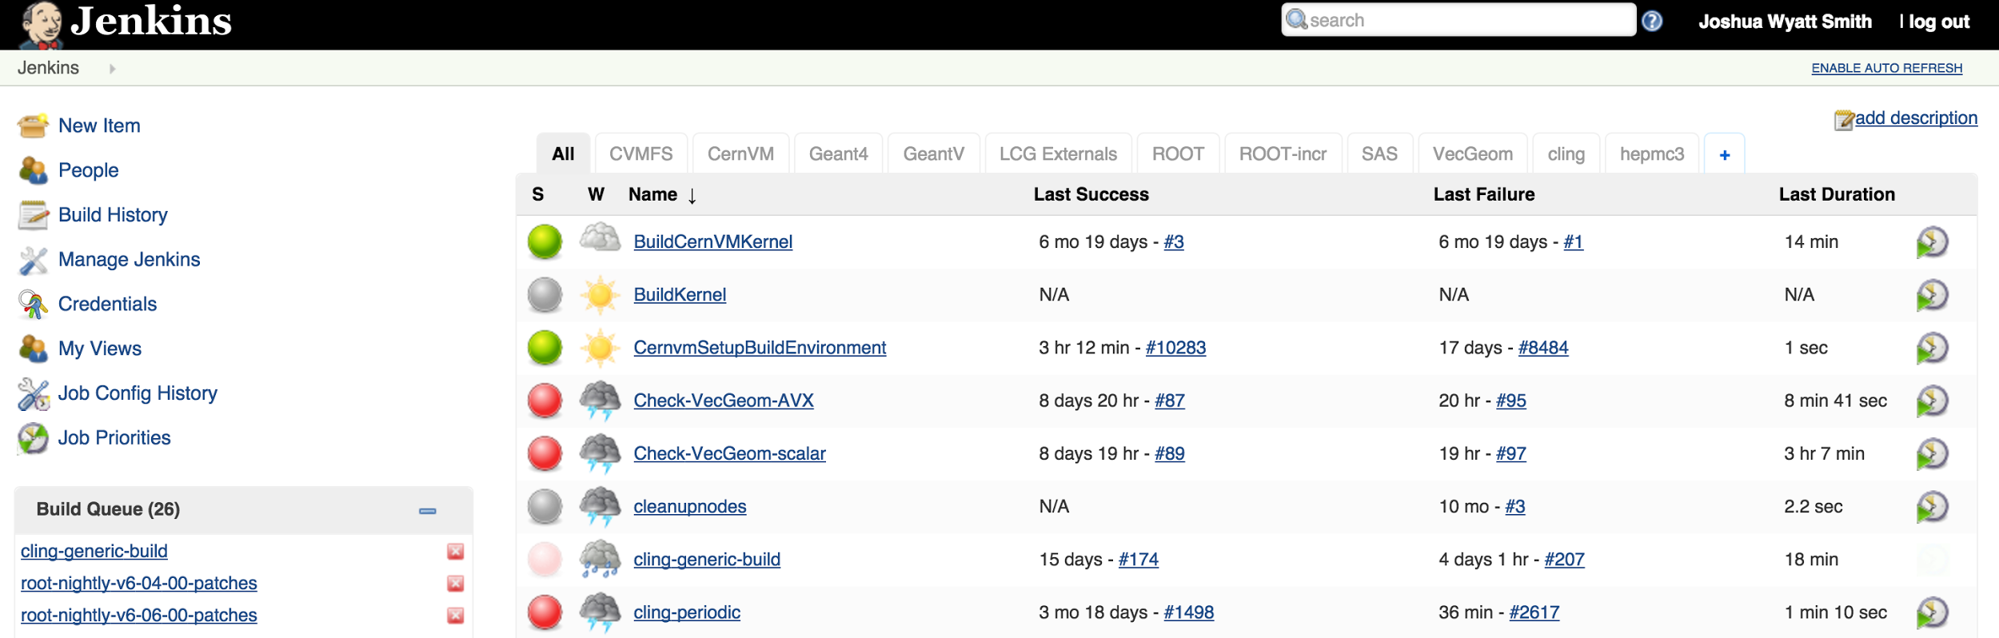
Jenkins - Main page
Quick overview of builds
“Weather” notification system
Everything can be managed through this page
(Demo)

Slide 31
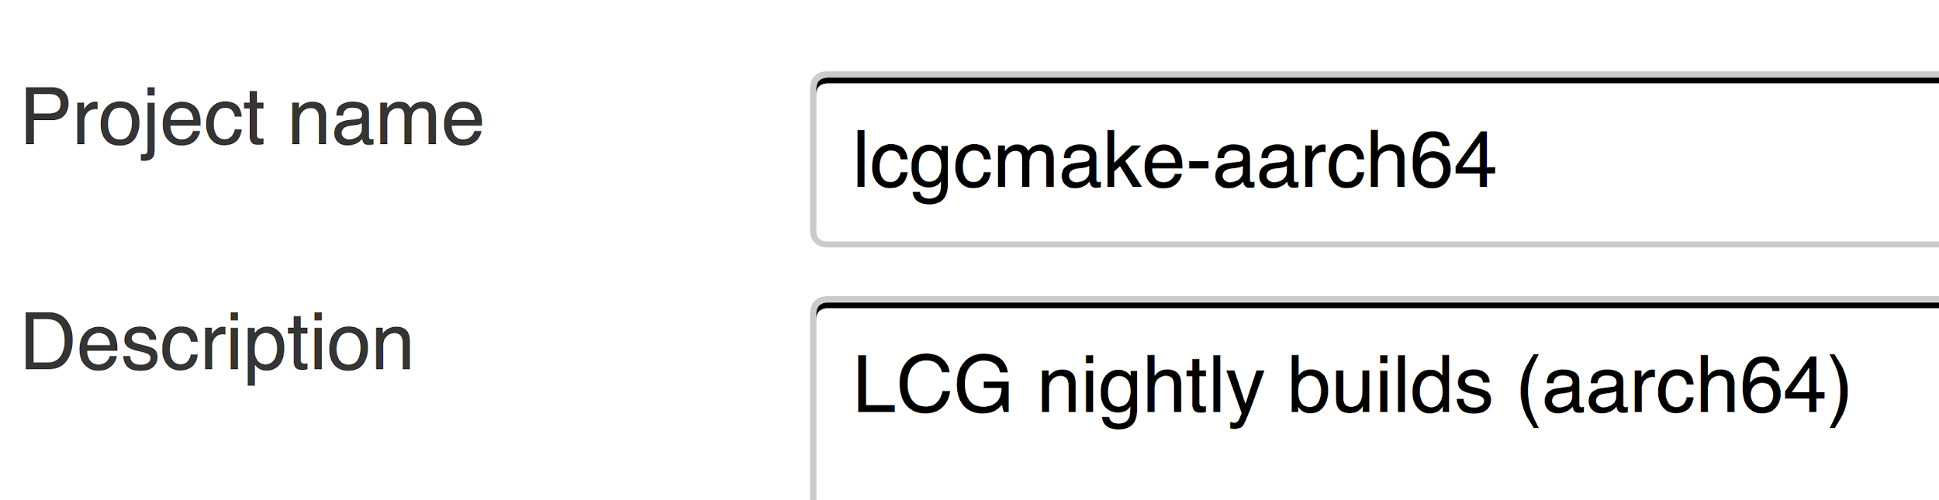
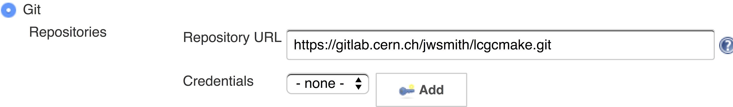
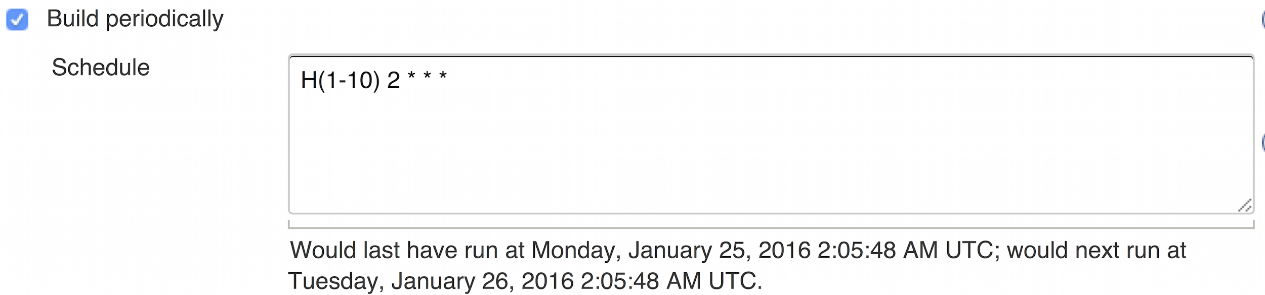
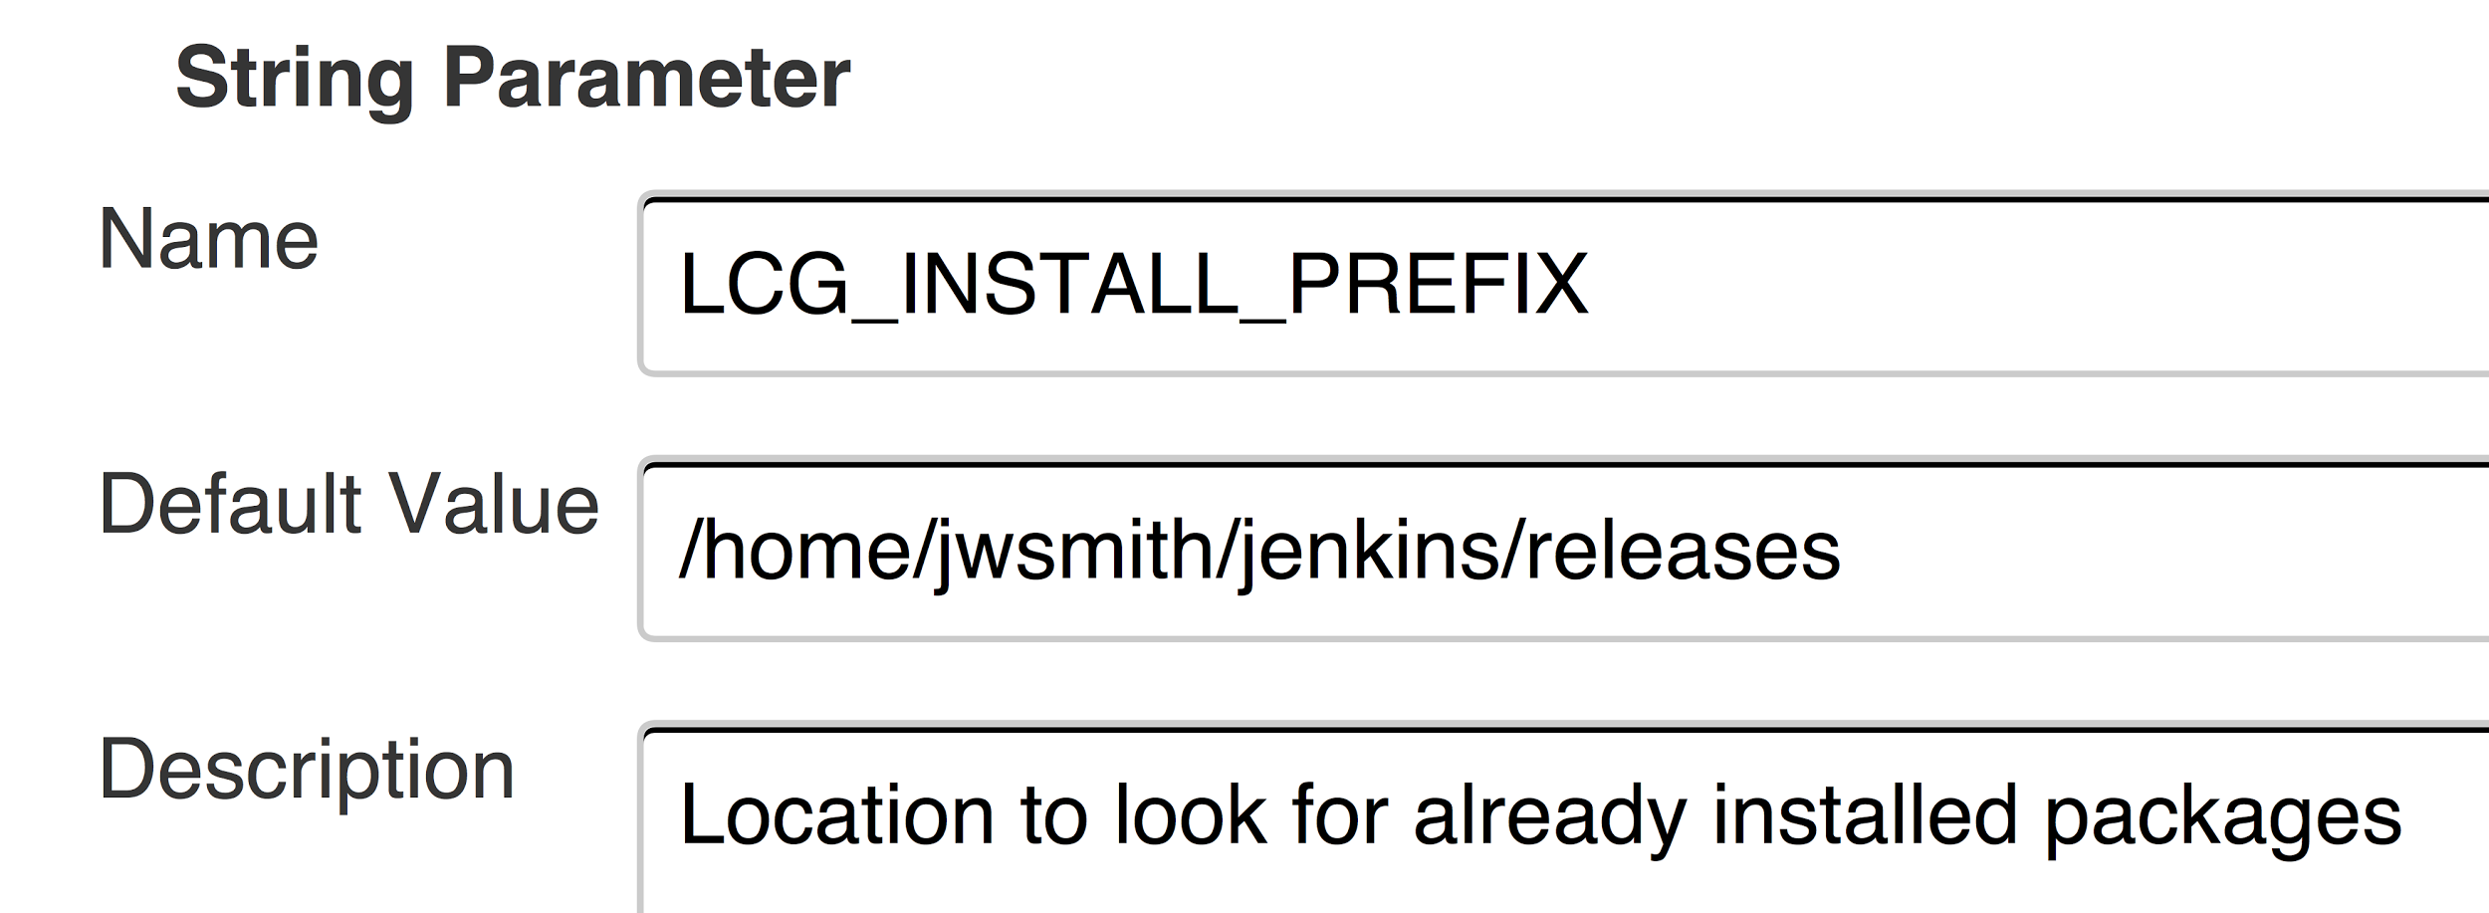
Jenkins - Example
(Demo)

Slide 32
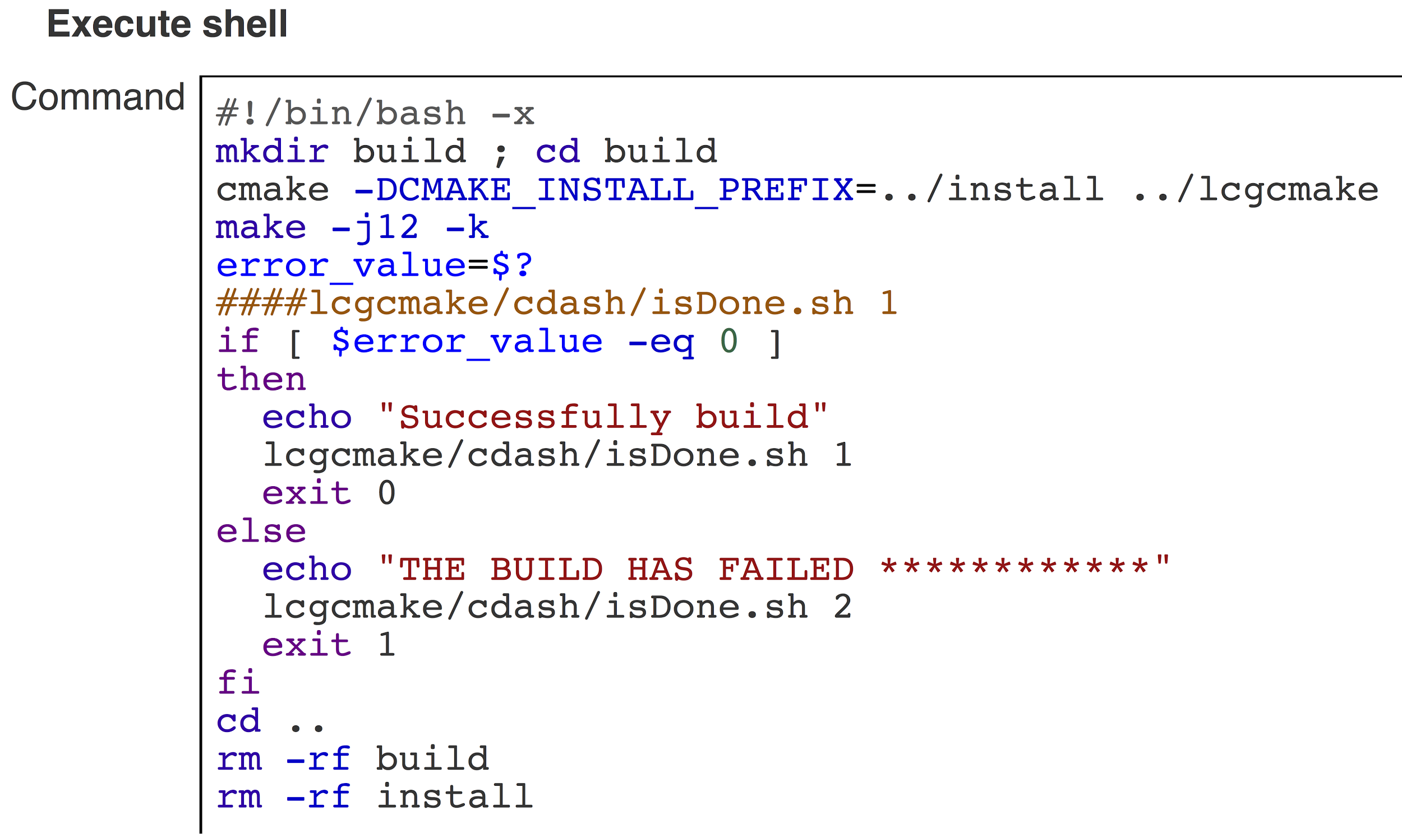
Jenkins - Example
(Should be in a script, in the project)
Testing scripts can be added here
(Demo)

Slide 33
Buildbot
Written in Python, on top of Twisted libraries
  Twisted = an event driven network program framework
  Heavily configurable!
Really more of a CI framework as opposed to a CI program
Heavily focused around buildslaves
  Designed to require minimal setup
GUI is an html “Waterfall”
  Can control builds from this page, but there are limitations

Slide 34
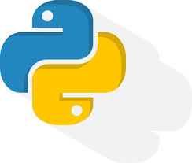




Buildbot
Also has a lot of high profile Organizations/companies

Slide 35
Buildbot - master.cfg
Everything specified in this Python file
  Buildslaves
  Schedulers
  Builders
  Status targets
A dictionary that Buildbot knows how to handle
  How you create that dictionary is up to you!
Initially launch Buildbot daemon from command line
c = BuildmasterConfig = { }
c [ ‘slaves’ ] = [ ... ]
c [ ‘schedulers’ ] = [ ... ]
c [ ‘builders’ ] = [ ... ]
c [ ‘status’ ] = [ … ]
...

Slide 36
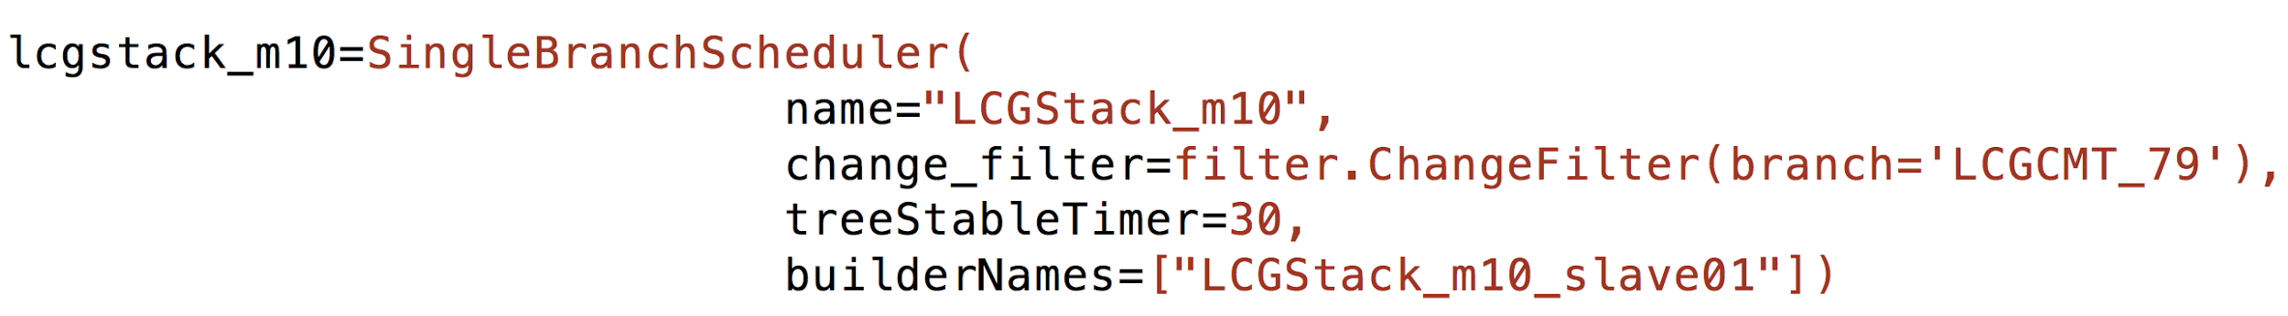
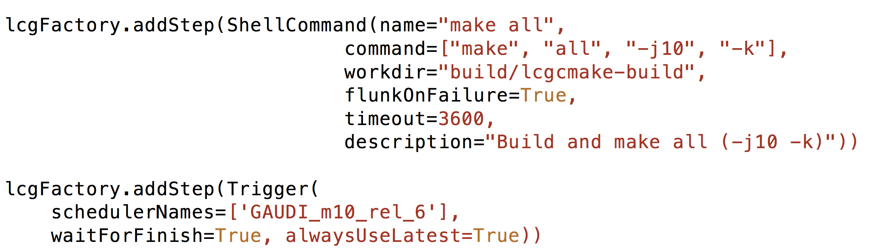
BuildBot - Example
Schedulers
Buildsteps

Slide 37
Buildbot - Customisation example
Subclassing ShellCommand
class setEnvironmentStep(ShellCommand):
def __init__(self, command='', **kwargs):
if Project == "tdaq-common":
kwargs['command'] = ['bash', '-c', 'source %s ; source %s ; %s' %(environmentString, tdaqSetup, command)]
ShellCommand.__init__(self, **kwargs)
elif Project == "dqm-common":
kwargs['command'] = ['bash', '-c', 'source %s ; source %s ; %s' %(environmentString, dqmSetup, command)]
ShellCommand.__init__(self, **kwargs)

Slide 38
Customisation (cntd)
FactoryName defined in “for loop” for many projects
FactoryName.addStep(setEnvironmentStep(name="cmt broadcast make ",
command="cmt broadcast make -j10 -i",
workdir=workdirPath,
haltOnFailure=True,
description="cmt broadcast make"))
http://docs.buildbot.net/latest/manual/customization.html

Slide 39
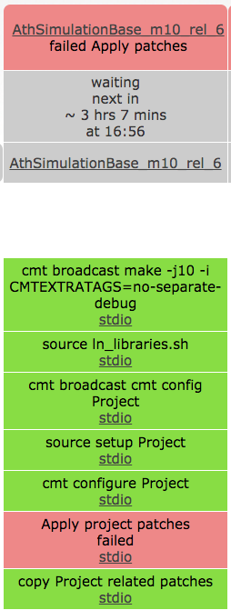
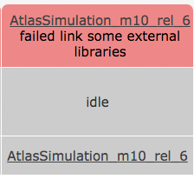
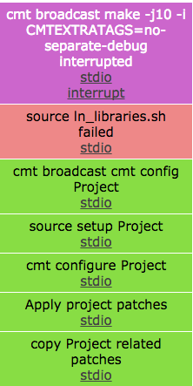
Buildbot - Waterfall
Build name
A couple of different views
  Waterfall
  Grid
  T-Grid
  Console
  BuildSlaves
Scheduler
Builder steps

Slide 40
CI Tools
Above examples show that different CI tools can have different approaches to same problem:
Jenkins is good, very user friendly etc.
  Makes use of a plugins model
Buildbot is an attempt at “something new”
  Can design own interface to suit your needs
  You might need to change less when converting a project to CI
  Very configurable
Keep these things in mind when selecting CI tool!

Slide 41
Conclusions
Remember The Challenge?
As project sizes grow, so too does complexity
  The risk for errors in code increases
  The difficulty of integrating changes increases
Continuous Integration solves this!
  Early feedback, automation, reduce release time etc.
How can we CI?
  Commit, build and test often
There are many CI tools out there. What fits into your project best?

Slide 42
Sources
BlackDuck | OpenHub
  https://www.openhub.net/
Continuous Integration - Martin Fowler
  http://www.martinfowler.com/articles/continuousIntegration.html
Jenkins Continuous Build system - Jesse Bowes
  https://www.cs.colorado.edu/~kena/classes/5828/s12/presentation-materials/bowesjesse.pdf
Jenkins
  https://jenkins-ci.org/
Buildbot
  http://buildbot.net/
GitLab CI
  https://about.gitlab.com/gitlab-ci/

Slide 43
Thank you for your attention!

