Slide 1
Continuous Delivery
and Quality Monitoring
Kamil Henryk Król
CERN
Inverted CERN School of Computing, 29 February – 2 March 2016

Slide 2
Outline
Continuous Delivery
Quality Monitoring

Slide 3
Software challenges
Team work
  Multiple people
  Different backgrounds
  High turnover
Growing complexity of project
Quality degradations
Notes:
Example for quality degradations: Leave the project for half a year, what happens with quality?

Slide 4
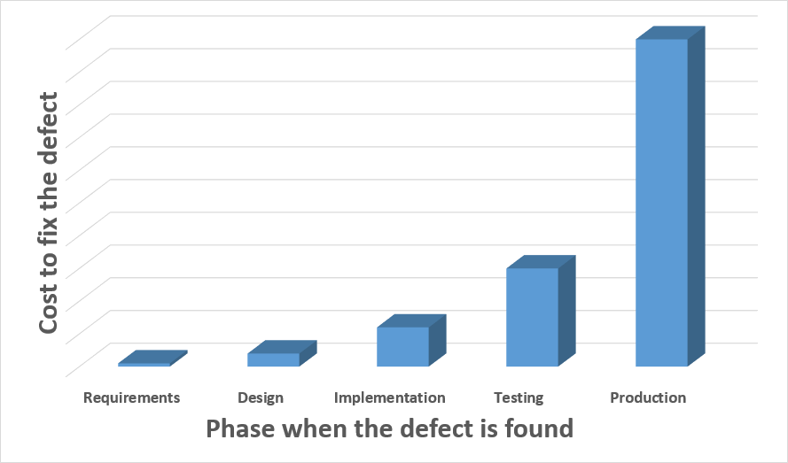
Software challenges
The cost of fixing the defect grows exponentially in time!

Slide 5



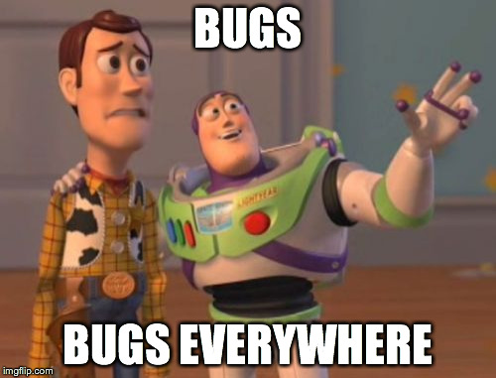



Software challenges
Brian Foote
Joseph Yoder
“Big Ball of Mud”

Slide 6
Outline
Continuous Delivery
Quality Monitoring

Slide 7
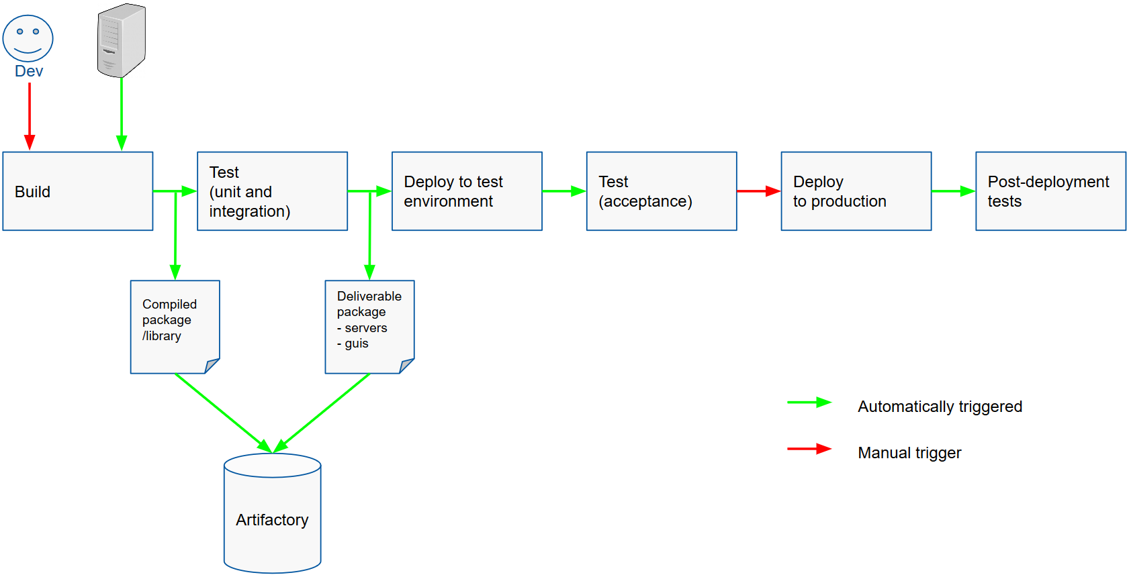
Continuous Delivery
Continuous Integration

Slide 8

Continuous Delivery
The challenge
PRO servers
Backup servers
DEV servers
Cloud
Reference servers

Slide 9
Continuous Delivery
Release
Release == Risk
Release == Fear
Release == Working over time - frequent calls
Release == Working during weekends
Release == Long preparations
Release == Boring repeatable tasks
Can we do something with it?
Notes:
Question to the audience to raise hands!

Slide 10
Continuous Delivery
The Agile Manifesto
….
We follow these principles:
Our highest priority is to satisfy the customer
through early and CONTINUOUS DELIVERY
of valuable software.
....
@see: Agile Manifesto

Slide 11
Continuous Delivery
Incremental development
TEST
?
REFACTOR
IMPLEMENT

Slide 12
Continuous Delivery
The definition
“Continuous Delivery is a software development discipline where you build software in such a way that the software can be released to production at any time.“
@Martin Fowler

Slide 13

Continuous Delivery
Principles
Continuous Delivery needs to be built on the solid Continuous Integration
  Frequent integration with others - (ideally) one main trunk
  Confident tests protecting our development
  Easy rollback should be possible
Notes:
“it works on my machine” / “in my case it works”

Slide 14

Continuous Delivery
Principles
Introduce as much automation as possible
Test close to the production
  Test environments and testing approaches should be similar to real life use cases

Slide 15
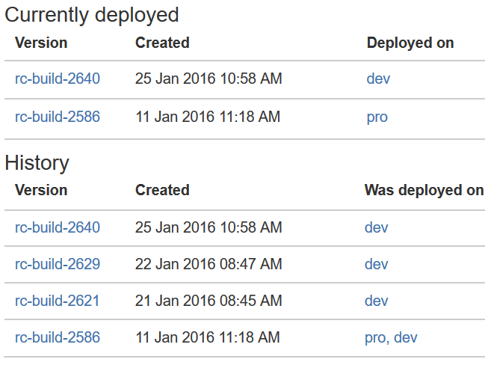
Continuous Delivery
Principles
Avoid:
  unofficial releases
  hot fixes without releasing
  patches sent via e-mail
Full history of releases
Notes:
“it works on my machine” / “in my case it works”

Slide 16
Continuous Delivery
Principles
More releases => smaller releases
Avoid release chains
ALFA
BETA
RC
PRODUCTION
2012
2013
2014
2015

Slide 17
Continuous Delivery
Why?
Small release v. big release?
  Lower the deployment risk
As a developer, when do you consider the functionality done (completed)?
  Sense of progress
How do you validate/test application functionalities?
Do we work on the right thing?
  Quick user feedback
Notes:
Questions to the audience?
How easy is to find the bug? Small release v. big release?
How often do you hear the task is done?
We cannot see what is important/how good is the functionality until the user starts using it

Slide 18
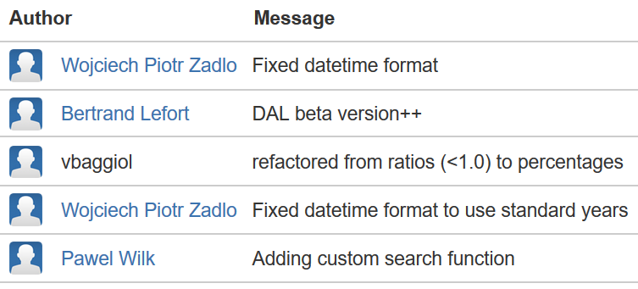

Continuous Delivery
Why?
RELEASE A - 5 changes
RELEASE B - 1 change
Something goes wrong during the release...
V.
In case of which release
is easier to locate
the problem?

Slide 19
Continuous Delivery
Why?
“50% or more of functionality delivered is rarely or never used.“
@Jim Highsmith, Adaptive Leadership

Slide 20
Continuous Delivery
Why?
We can do the same work, but:
  Working less
  In more relaxed environment
  Avoiding risk
  Having more constant workload
  With level of confidence
“I wish we did it the old way”
  @noone

Slide 21
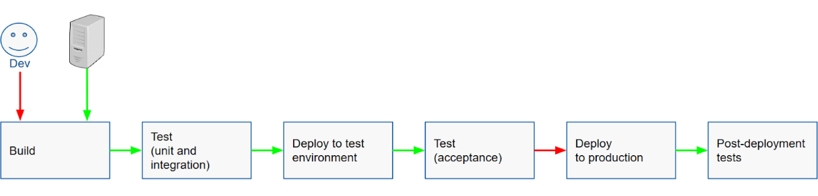
Continuous Delivery
How?
Continuous Delivery is the natural continuation of the Continuous Integration processes
Continuous Integration
Continuous Delivery

Slide 22





Continuous Delivery
How?
Continuous Delivery can be implemented using most build servers (both open source and commercial tools available)

Slide 23

Continuous Delivery
How?
Continuous Delivery is not a complete set of tools which needs to be used
It more a way of thinking about the development!

Slide 24
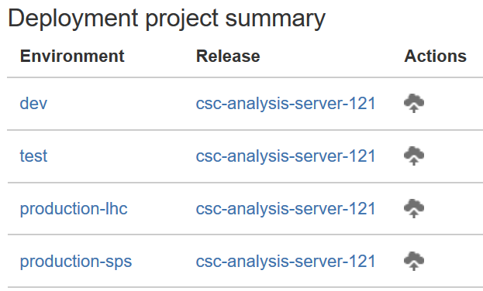
Continuous Delivery
Do we do it right?
The ‘deploy’ button
How confident are you?
Answer these 3 questions
Is it easy to deploy?
Is it easy to rollback?
Clients not affected?
If you answer yes to all questions, you are doing the Continuous Delivery right!

Slide 25
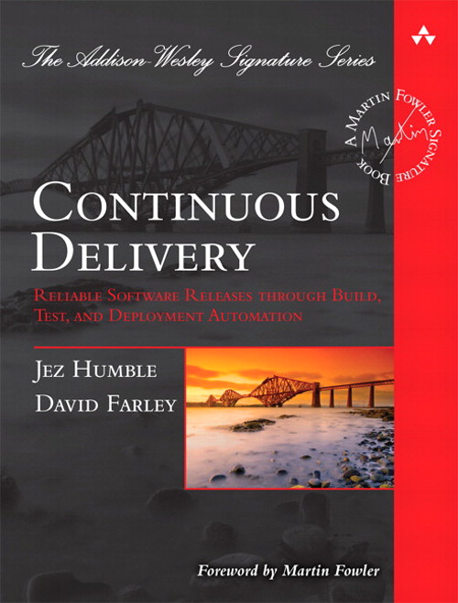
Continuous Delivery
Summary
Continuous Delivery can give us high level of confidence
It imposes the incremental development
  We build the right thing
  It’s easy to locate problems
  It helps developers see the progress
  Clients receive functionalities quickly
It’s fashionable
It’s a standard

Slide 26
Outline
Continuous Delivery
Quality Monitoring

Slide 27

Quality Monitoring
Quality?
“the standard of something as measured against other things of a similar kind; the degree of excellence of something”

Slide 28

Quality Monitoring
Monitor? Monitoring?
“observe and check the progress or quality of (something) over a period of time; keep under systematic review”

Slide 29
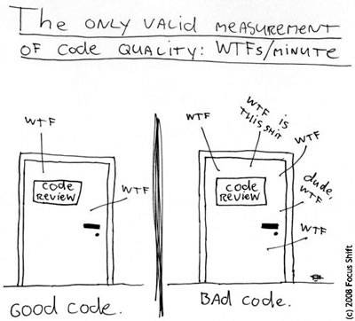

Slide 30
Quality Monitoring
How do we check the quality?
Manual
  Manual testing
  Conventions within the team
  Definition of done
  Pair programming
  Code reviews
Automatized
  Good coverage of good tests
  Static code analysis

Slide 31


Quality Monitoring
Manual testing
Tests which are carried manually by a person or the testing team
Easy to define
Expensive to run on daily basis
Prone to human errors
Boring ...

Slide 32

Quality Monitoring
Code conventions
Common way of producing the code
Shared within the team / within the organisation
Should be as close as possible to industry standards

Slide 33
Quality Monitoring
Code conventions
Naming conventions
  Variables
  Constants
  Classes
  Enums etc...
Method parameters conventions
Layout conventions
Project structure conventions
Documentation conventions
Notes:
Example with: experiment documenteation etc...

Slide 34
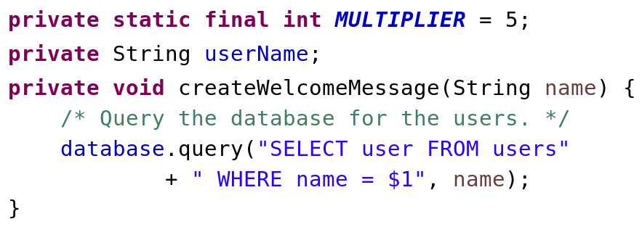
Quality Monitoring
Code conventions
Examples:
  Java Code Conventions
  Python Style Guide
  C++ Programming Style Guidelines
Notes:
Example with: experiment documenteation etc...

Slide 35
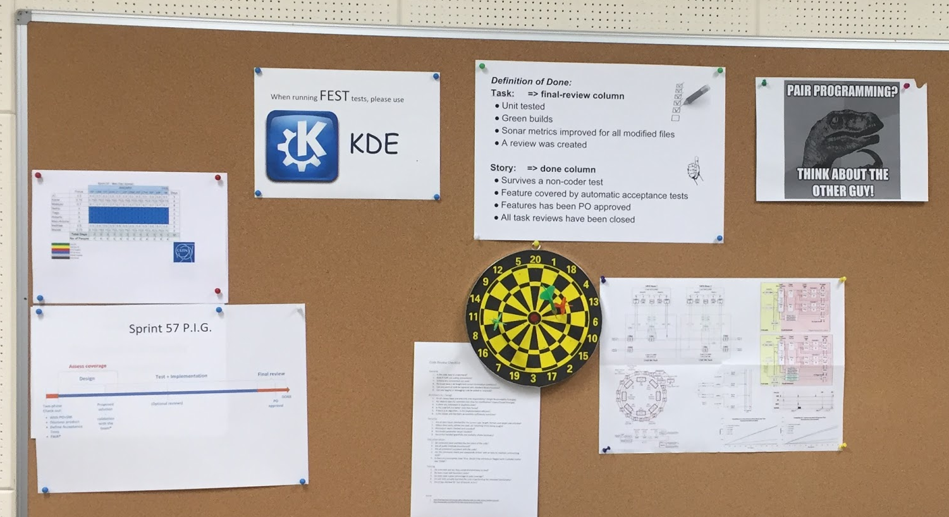
Quality Monitoring
Definition of done
List of conditions which need to be completed before the functionality is considered as DONE.
Notes:
//TO BE REMOVED FROM THE PRINTABLE VERSION

Slide 36
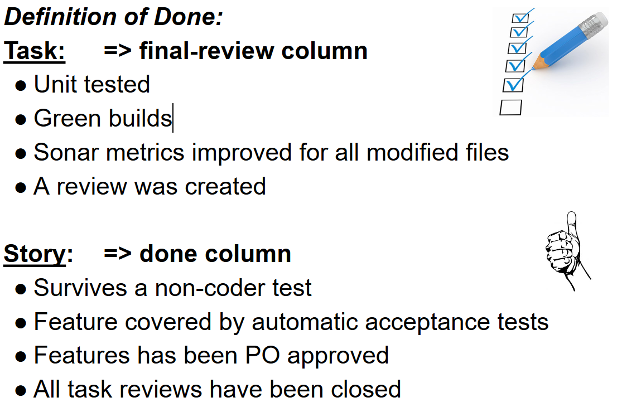
Quality Monitoring
Definition of done

Slide 37

Quality Monitoring
Pair programming
2 people - 2 different opinions
Driver + Navigator
Often change roles
Immediate feedback
On-spot bug fixes
Synergy effect

Slide 38

Quality Monitoring
Code reviews
Knowledge
Systematic review with
  Co-worker
  Team
  External people
Face 2 Face v. ‘Online’
Fresh mind reviewers
Improvement ideas
Great way of sharing knowledge
Notes:
//TODO: Find a better word than ‘online’

Slide 39
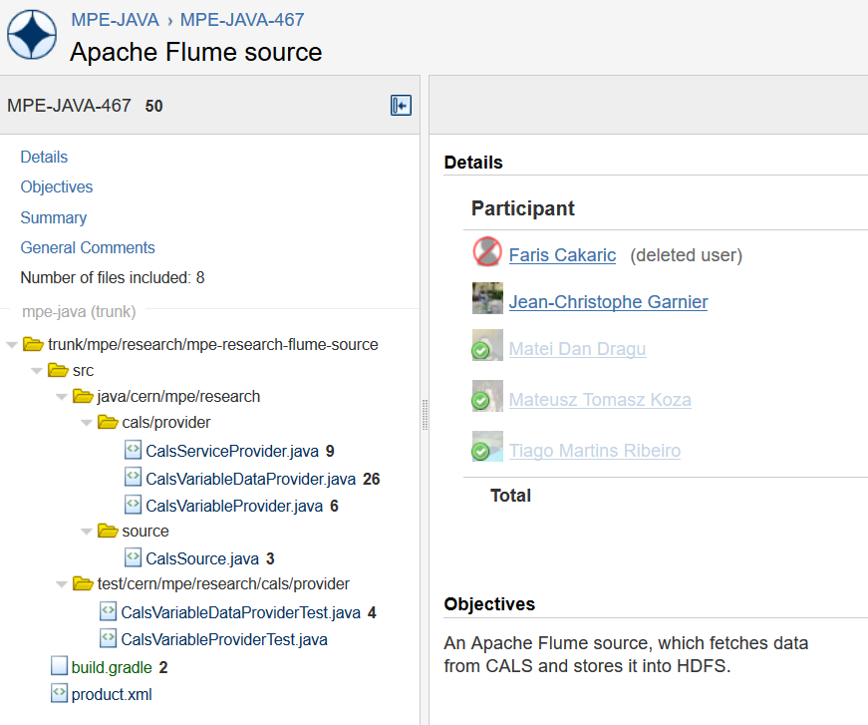
Quality Monitoring
Code reviews
Review participants
Files under review
Review objectives

Slide 40
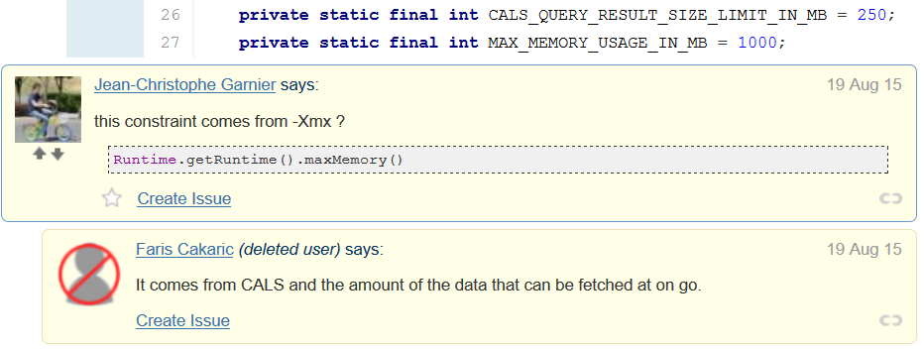
Quality Monitoring
Code reviews
Code snippets
Discussions

Slide 41
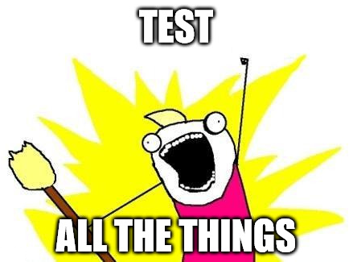
Quality Monitoring
Good coverage of good tests
We can (should) test at different levels
  Unit testing
  Integration testing
  Acceptance testing
  System testing
Automatic tests
  Quick
  Repeatable
  Easy to maintain
  Need to be executed continuously

Slide 42
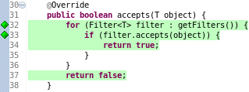
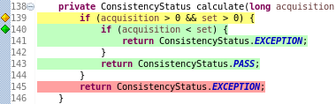
Quality Monitoring
Good coverage of good tests
How much do we cover with tests?
Test coverage
Legend:
instruction covered
instruction partially covered
instruction uncovered
Notes:
Question to the audience: Which code is better tested?

Slide 43

Quality Monitoring
Static code analysis
Tools which help you to find bugs Are there any?
Static = without running software
Can (or even should!) be automatized
Find errors which are hard to spot by a human
Easy shortcut to the better quality

Slide 44








Quality Monitoring
Static code analysis

Slide 45
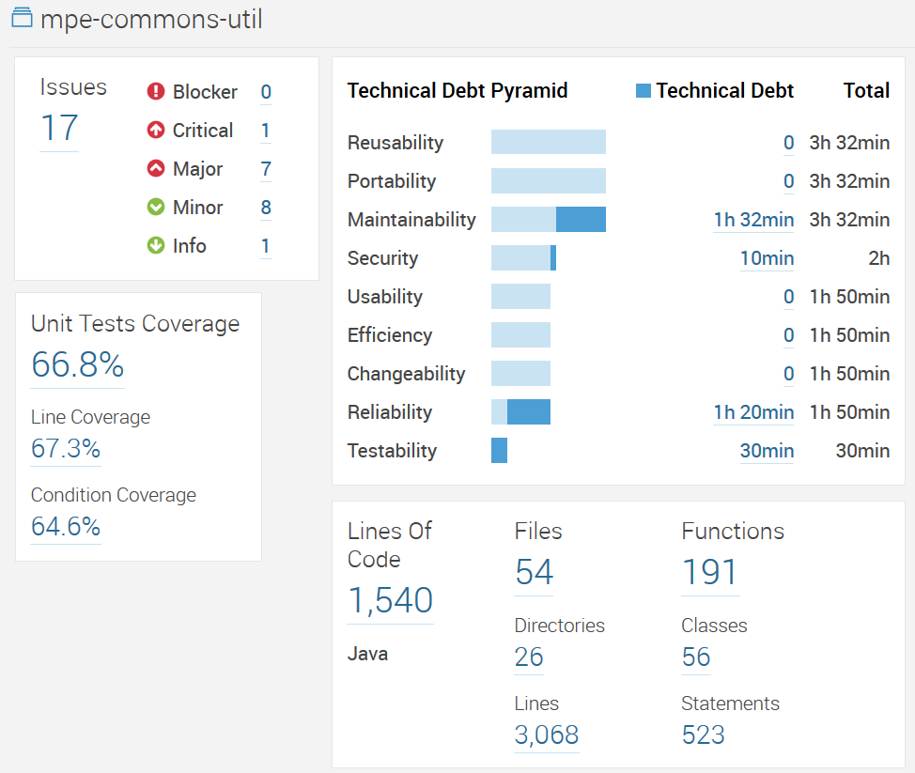
Quality Monitoring
Static code analysis
Complexity metrics
Code quality issues
Test coverage
Project statistics

Slide 46
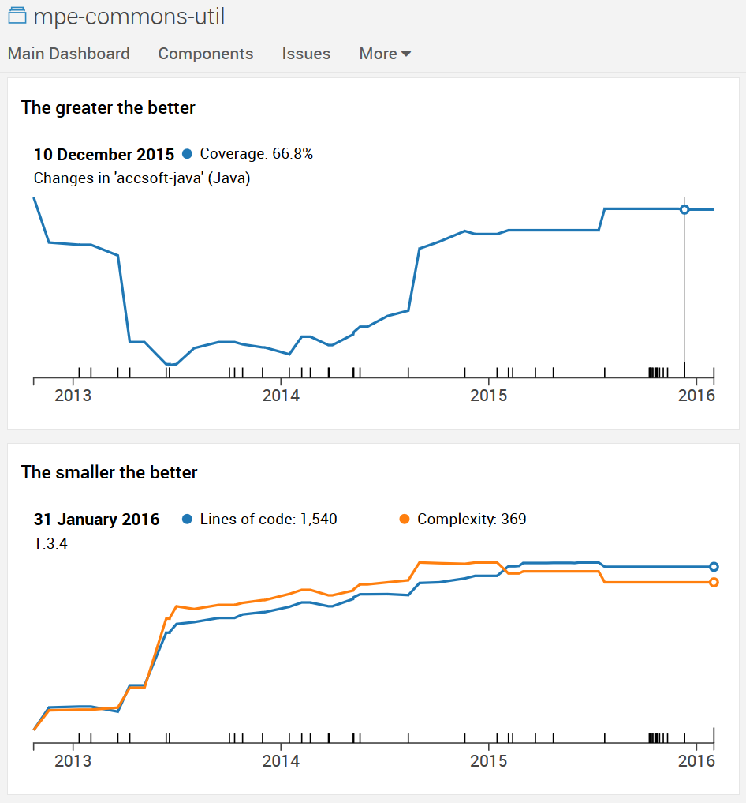
Quality Monitoring
Static code analysis
Project statistics (quality metrics) over the time

Slide 47

Quality Monitoring
Static code analysis
Life demo time!
You can play on your own at: http://sonar.cern.ch

Slide 48

Quality Monitoring
Quality Monitoring - Summary
Code is read much more often than it is written!
Keep an eye on the code quality - continuous monitoring can help you a lot.
Variety of tools available - choose your own set and take advantage of them.
QUALITY

Slide 49
Thanks a lot!
Any questions?

