Slide 1
Formal Verification – Robust and Efficient Code
Lecture 2
Why FV?
Kim Albertsson
Luleå University of Technology
Inverted CERN School of Computing, 29 February – 2 March 2016

Slide 2
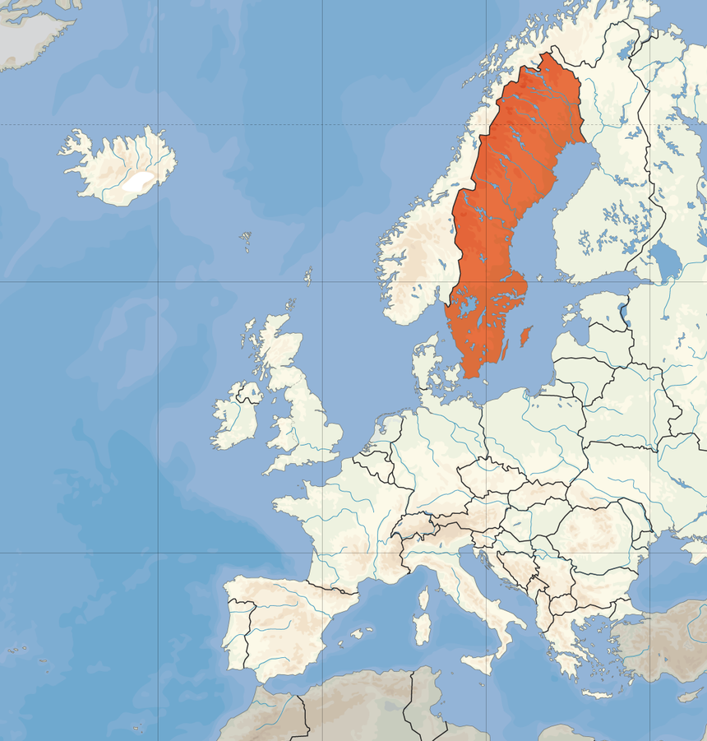

Introduction
Kim Albertsson
  M.Sc. Engineering Physics and Electrical Engineering
  Currently studying for M.Sc. Computer Science
Research interests
  Automation
  Machine learning
Formal methods
  Great way to automate tedious tasks
Luleå
You are
here
Image from Wikimedia Commons, the free media repository

Slide 3
Formal Methods
Managing complexity
“…mathematically based languages, techniques, and tools for specifying and verifying … systems.”
Edmund M. Clarke et al.
Reveals inconsistencies and ambiguities

Slide 4
Formal Methods
Specification + Model + Implementation
enables verification
Proving properties for a system
  Will my algorithm sort the input?
  Will my soda pop be delivered in time?
  Can the LHC interlock system end up in an inconsistent state?

Slide 5
Overview Series
Approaches
  Model Checking and Theorem Proving
  Logic and automation
  How to build an ecosystem
Application
  Robust code
  Robust and Efficient code

Slide 6

Recap of Lecture 1
FV manages complexity
Finds errors early
  Save money, time and possibly life
Proof is a demonstration
  Consistency of specification and implementation
Image from Wikimedia Commons, the free media repository

Slide 7
Recap of Lecture 1
Proving properties about your system
Model Checking
  Exhaustive search of state space
Theorem Proving
  Deductive approach

Slide 8
Recap of Lecture 1
Theorem Proving
  Based on First Order Logic
  Satisfiability Modulo Theories (SMT) solvers to find application of rules
  IVT platforms front-end with many SMT backends

Slide 9
Introduction Lecture 2
Robust
Code verification
Code synthesis
Robust and Efficient
Verified tool-chain
Proof carrying code
Bonus!
Concolic Testing

Slide 10
Introduction Lecture 2
Errors discovered late
  Expensive
FV requires
  More effort for specification
FV gives
  Feedback on inconsistencies
  Reduces late errors
  Reduces total time

Slide 11

Introduction Lecture 2
FV and static analysis related
  Discovering bugs at compile-time rather than run-time
Mainstream tools slowly developing
  Free candy!
Can we do better while minimising effort?
Image from Wikimedia Commons, the free media repository

Slide 12
Introduction Lecture 2
Trust, correctness and code
First order logic and SMT solvers
  Tedious to use for non-trivial problems
What tools are available today?

Slide 13
Overview
Robust
Code verification
Code synthesis
Robust and Efficient
Verified tool-chain
Proof carrying code
Bonus!
Concolic Testing

Slide 14
Robust
High-level verifiers
  VCC, Frama-C, … many more
  Code compilation is separate
Integrate with IVT Platforms
  Uses specialised solvers
Annotations directly in code

Slide 15
Code Verification
VCC, Verifier for Concurrent C
http://research.microsoft.com/en-us/projects/vcc/
Verification of Microsoft Hyper-V
  As of 2009 partially complete
  Moderately large ~100 kloc
  Must guarantee no leakage between host and guest

Slide 16
Code Verification
#include "vcc.h"
int max(int a, int b)
_(ensures \result == (a > b ? a : b))
{
if (a > b) return a;
return b;
}

Slide 17
Code Verification
Frama-C
  Framework for Modular Analysis of C programs
  http://frama-c.com/
Modular framework for static analysis
  Focus on correctness
Provides verification of C programs
  Through the Jessie plug-in
Uses specification to analyze code
  More than just verification
  e.g. value analysis, impact analysis.

Slide 18
Code Verification
/*@
  @ requires a < 100 && b < 100
  @ ensures \result >= a && \result >= b;
  @ ensures \result == a || \result == b;
*/
int max (int a, int b)
{
if (a > b) return a;
return b;
}

Slide 20
Code Synthesis
Is code redundant?
Synthesise implementation from specification
  Requires completeness
  Implementation is constructive proof
Security focus
Requires more power than first order logic

Slide 21
Code Synthesis
Coq, the proof assistant
https://coq.inria.fr
  From french word for rooster
  Successor to Calculus of Constructions (CoC)
Proof management system
  Based on higher order logic
  Functional programming language
  with sophisticated type system

Slide 22
Overview
Robust
Code verification
Code synthesis
Robust and Efficient
Verified tool-chain
Proof carrying code
Bonus!
Concolic Testing

Slide 23
Robust and Efficient
Efficient code is always desirable
Specification allows specific optimisations
But the bigger issue is, your tool-chain has bugs
Even if you trust your source code, you can’t trust the byte code
Verify the tool-chain!

Slide 24
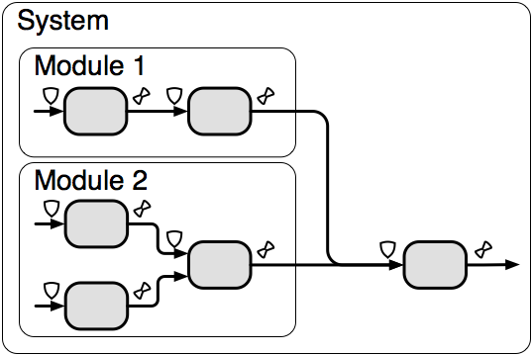
Robust and Efficient
Explicit assumptions leveraged for better byte-code
  Array out-of-bounds checks unnecessary
  Automatic parallelisation of loops
  Dereferencing null-pointers is ok!
Similar to whole module optimisations but locally!

Slide 25
Robust and Efficient
Efficient code is always desirable
Specification allows specific optimisations
Another issue; Your tool-chain has bugs
Even if you trust your source code, you can’t trust the byte code
Verify the tool-chain!

Slide 26
Verified tool-chain
Tool-chain of today
  No absolute guarantee of correctness
  Trust each tool in tool chain (verified with testing)
  Each tool by different programmers
  Each tool must be trusted!

Slide 27
Verified tool-chain
A verified tool chain
  Still requires trust
  Reduces number of places where you have to put it
  Provides consistency guarantees

Slide 28
Verified tool-chain
CompCert, a verified C Compiler
http://compcert.inria.fr/
Guarantees optimised AST retains equivalent semantics
  Can be extended to provide byte code guarantees
Requires a model of memory management (language semantics)

Slide 29
Verified tool-chain
Covers a language very close to C called CLight
  Does not support variable length arrays, unstructured switch-statements and longjmp/setjmp
  No immediate plans for c++
Verified by automatic + interactive methods + Correct-by-construction
Performs consistently worse than gcc -O1, but surprisingly close to
  10% worse than -O1, 15% worse than -O2, 20% worse than -O3
  Cannot handle matrix multiplications very well as of 2016-01-29

Slide 30
Verified tool-chain
No example, it works as-is on your code!

Slide 31
Proof Carrying Code
Extends verification
  Cover external code
Proof delivered alongside code
  Secure and performant
  Tampering leads to invalidated proofs

Slide 32
Proof Carrying Code
Verification before execution
  Clear safety policy
  Model of language semantics
Language models are collaborative effort
Proof language
  First order logic
  Higher order logic

Slide 33
Proof Carrying Code
G. Necula and P. Lee 1996
Safe packet filters
  Time critical application
  High security
  Customisability
User-space code run in kernel space

Slide 34
Proof Carrying Code
Safe sharing of code without encryption
  OS kernel
  Across the Internet
  XSS, grid-like applications
Minimal to no performance hit

Slide 35
Overview
Robust
Code verification
Code synthesis
Robust and Efficient
Verified tool-chain
Proof carrying code
Bonus!
Concolic Testing

Slide 36
Concolic Testing
Concolic, concrete + symbolic
  Proofs reason about area, tests about points
  Specification used for white-box testing
    i.e. generating test cases
Not perfect, but efficient
  Achieves high code coverage quickly

Slide 37
Concolic Testing
Execution splits at branches
  Constraints updated for new paths
Symbolical path is resolved
  When “exception” happens
  Yields concrete example
To figure out concrete path
  Use constraint solver (SMT)

Slide 38
Concolic Testing
int get_sign(int x) {
if (x == 0)
return 0;
if (x <= 0)
return -1;
else
return 1;
}

Slide 39
Concolic Testing
KLEE, from the painter Paul Klee
https://klee.github.io/
Applied to unix’ coreutils in 2008
  Found several serious bugs
  Coreutils is thoroughly tested through exposure
  Successfully handled programs of up to 10 kloc in ~1h per program
  Beat hand constructed test-suites built over 15 years
Integrates well with standard tools (llvm)

Slide 40
Concolic Testing
$ llvm-gcc --emit-llvm -c -g get_sign.c
$ klee get_sign.o
int get_sign(int x) {
if (x == 0)
return 0;
if (x < 0)
return -1;
else
return 1;
}
int main() {
int a;
klee_make_symbolic(&a, sizeof(a), "a");
return get_sign(a);
}

Slide 41
Concolic Testing
$ ktest-tool --write-ints klee-last/test000001.ktest
ktest file : 'klee-last/test000001.ktest'
args : ['get_sign.o']
num objects: 1
object 0: name: 'a'
object 0: size: 4
object 0: data: 1
$ ktest-tool --write-ints klee-last/test000002.ktest
...
object 0: data: -2
$ ktest-tool --write-ints klee-last/test000003.ktest
...
object 0: data: 0

Slide 42
Recap Lecture 2
Robust
Code verification
Code synthesis
Robust and Efficient
Verified tool-chain
Proof carrying code
Bonus!
Concolic Testing

Slide 43
Recap Lecture 2
Robust
Code verification
Code synthesis
Robust and Efficient
Verified tool-chain
Proof carrying code
Bonus!
Concolic Testing

Slide 44
Recap Lecture 2
Robust
Code verification
Code synthesis
Robust and Efficient
Verified tool-chain
Proof carrying code
Bonus!
Concolic Testing

Slide 45
Recap Lecture 2
Formal methods, applied where correctness is important
  Large collaborative projects
  Verified tool-chains
  …
Benefits for all
  Robustness and quality
Taught in school?

Slide 46
Thank you

