Slide 1


Welcome – Hoşgeldiniz
Prof. Emmanuel Tsesmelis
Deputy Head of International Relations
CERN
Accelerating Science and Innovation
Notes:
1

Slide 2
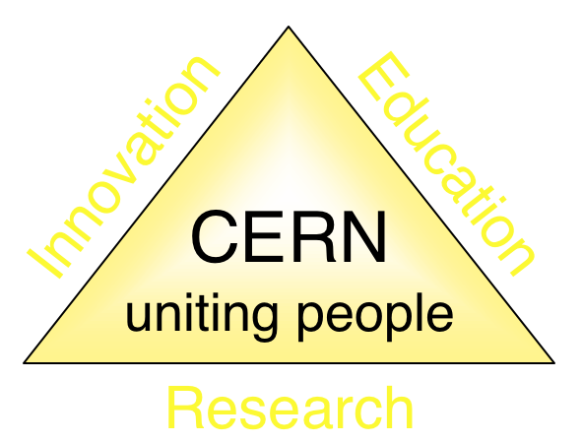
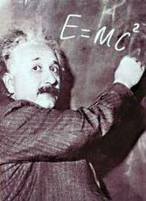
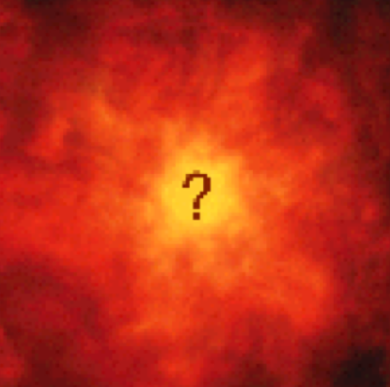


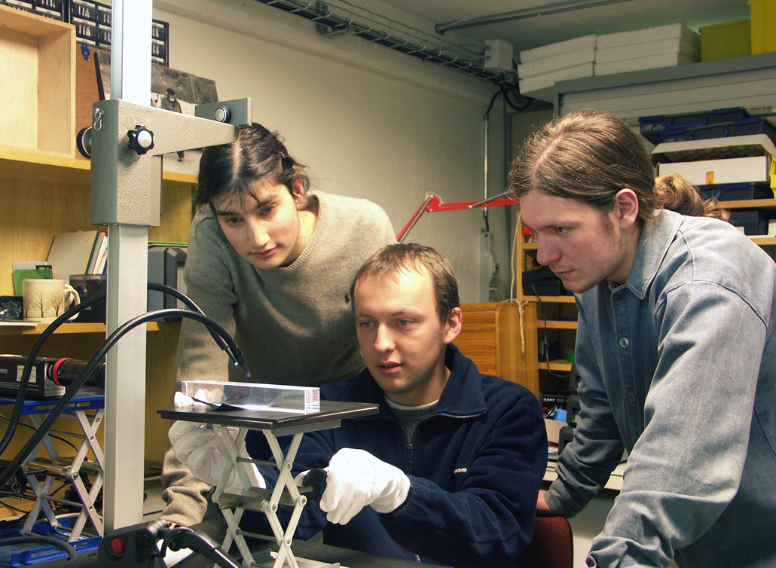
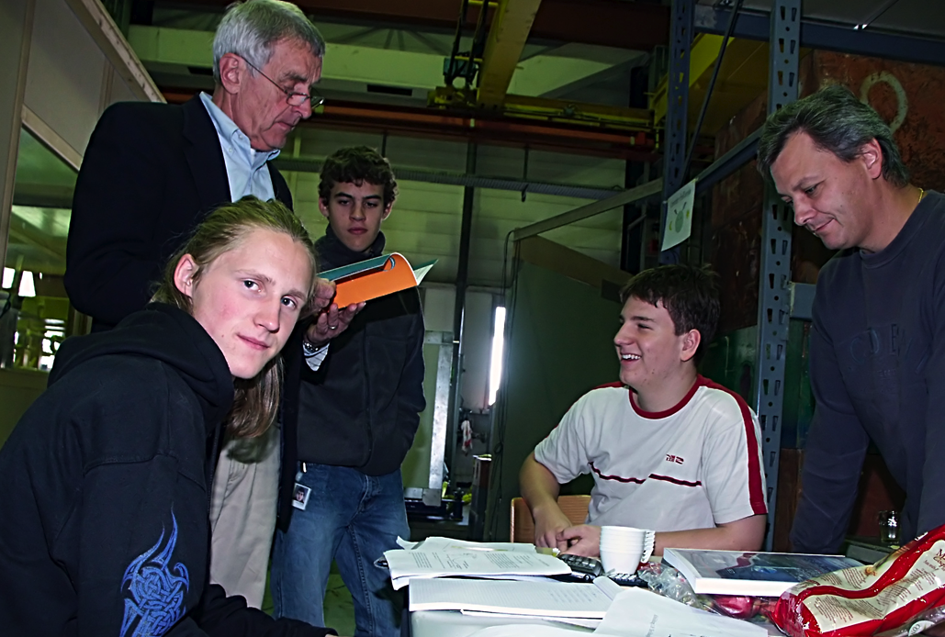
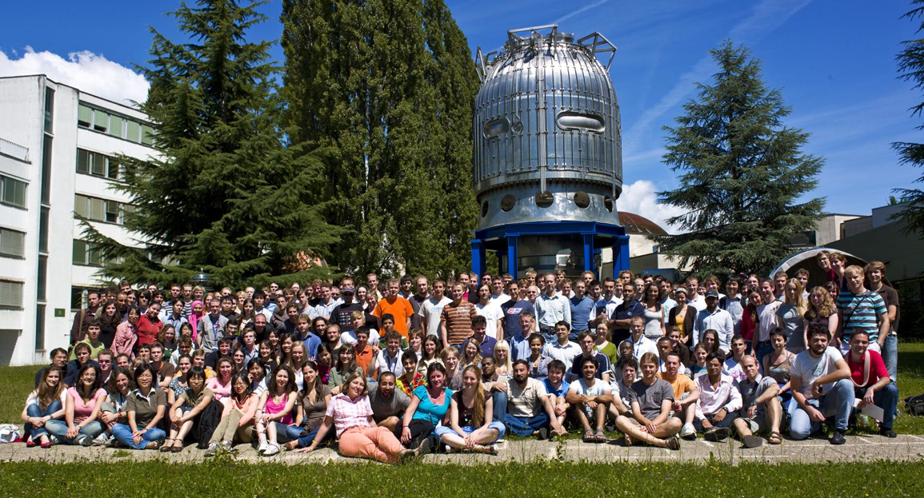
The Mission of CERN
Push back the frontiers of knowledge
E.g. the secrets of the Big Bang …what was the matter like within the first moments of the Universe’s existence?
Develop new technologies for accelerators and detectors
Information technology - the Web and the GRID
Medicine - diagnosis and therapy
Train scientists and engineers of tomorrow
Unite people from different countries and cultures
Notes:
2

Slide 3
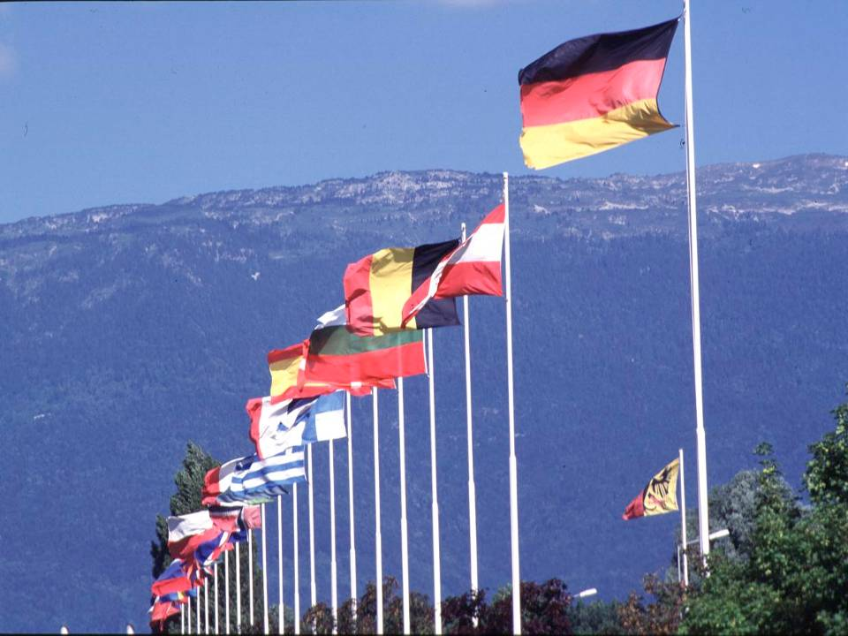

CERN: founded in 1954: 12 European States
“Science for Peace”
Today: 21 Member States
~ 2500 staff
~ 1300 other paid personnel
~ 12100 scientific users
Budget (2015) ~1000 MCHF
Member States: Austria, Belgium, Bulgaria, Czech Republic, Denmark, Finland, France, Germany, Greece, Hungary, Israel, Italy, Netherlands, Norway, Poland, Portugal, Slovak Republic, Spain, Sweden, Switzerland and
United Kingdom
Associate Member States: Pakistan, Turkey
States in accession to Membership: Romania, Serbia
Applications for Membership or Associate Membership:
Azerbaijan, Brazil, Croatia, Cyprus, India Russia, Slovenia, Ukraine
Observers to Council: India, Japan, Russia, United States of America; European Union, JINR and UNESCO
3
Notes:
3
----- Meeting Notes (09/01/2013 14:16) -----
nnn

Slide 4
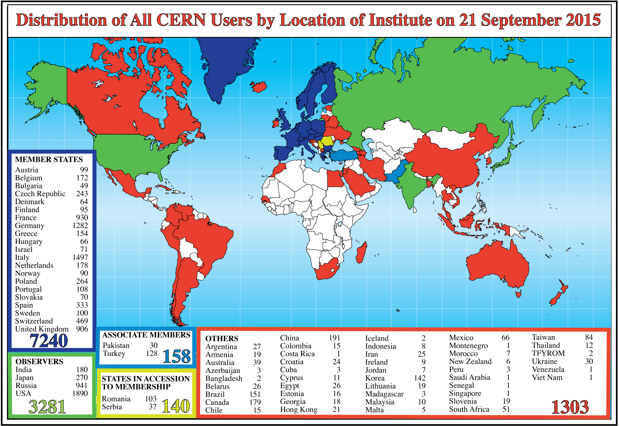
Science is getting more and more global
Notes:
4
4

Slide 5

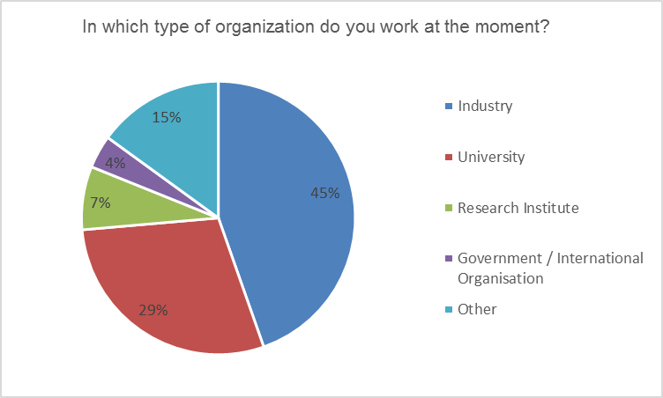
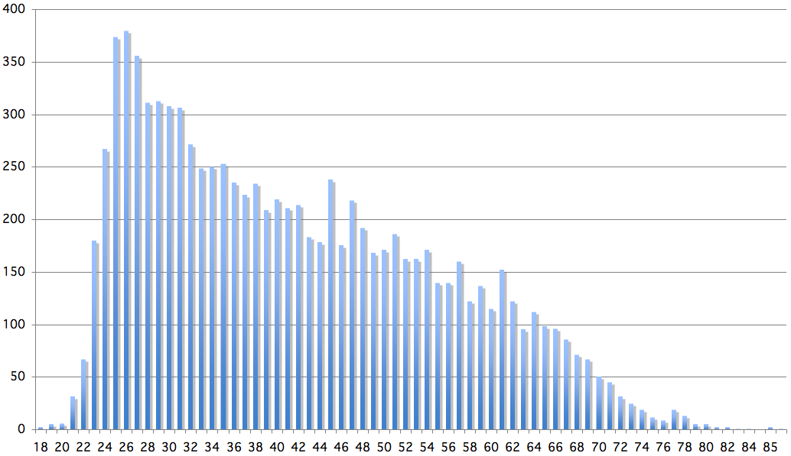
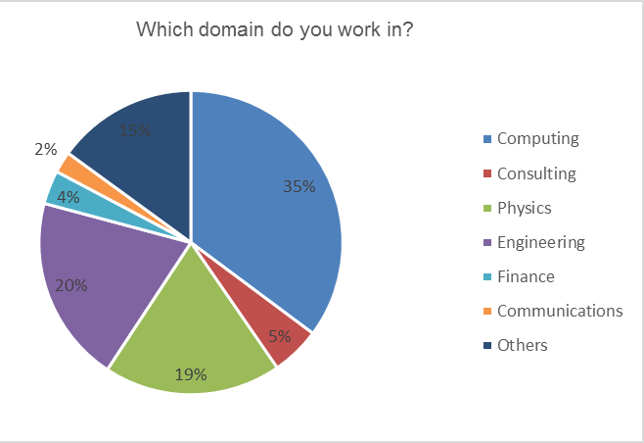
Age Distribution of Scientists
- and where they go afterwards
26
Today:
>2500 PhD students
in LHC experiments
65
They do not all stay: where do they go?

Slide 6
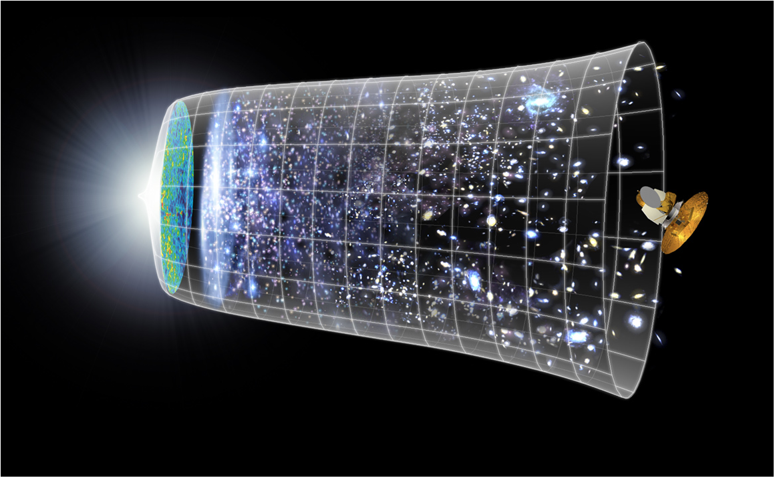
Next Scientific Challenge:
to understand the very first moments of our Universe after the Big Bang
Big Bang
WMAP
13.8 Billion Years
Today
10²⁸ cm

Slide 7
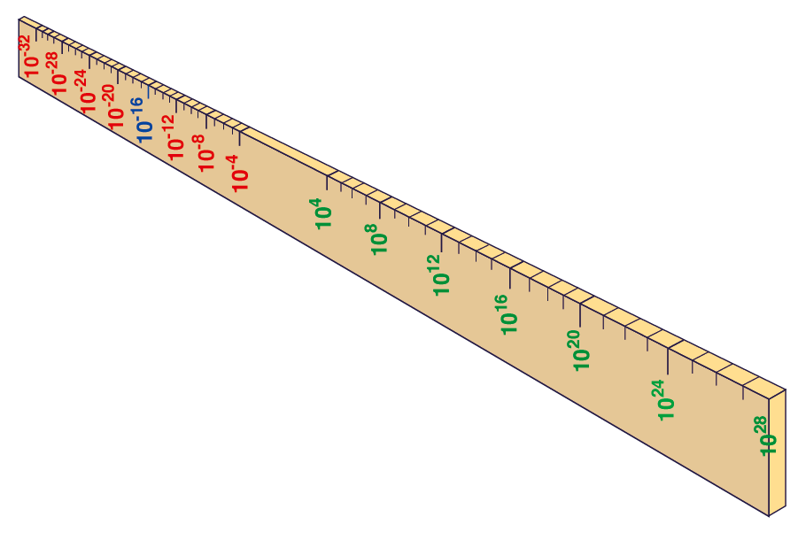
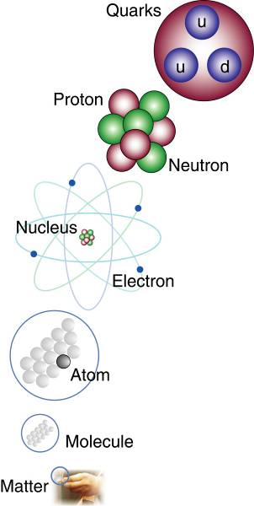
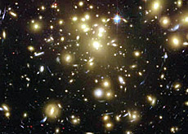
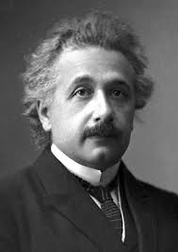

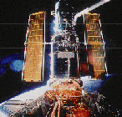
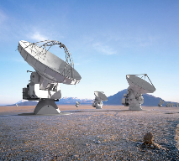
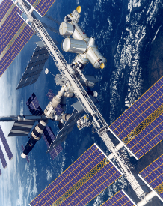
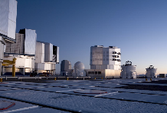
Big Bang
Proton
Atom
Radius of Earth
Earth to Sun
Radius of Galaxies
Universe
LHC
Super-Microscope
Hubble
ALMA
cm
Study physics laws of first moments after Big Bang
increasing Symbiosis between Particle Physics, Astrophysics and Cosmology
AMS
VLT
Notes:
7
60 Grössenordnungen

Slide 8
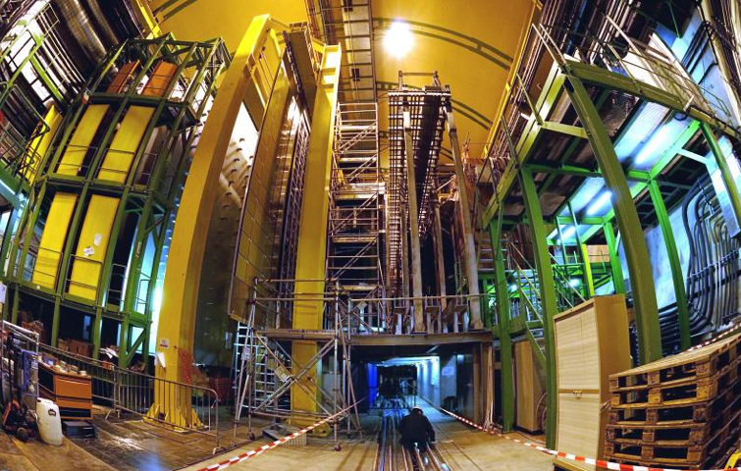


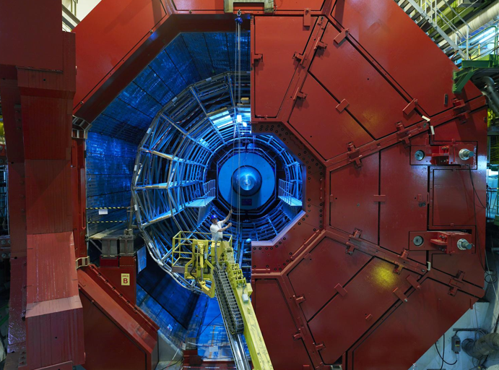

2010: a New Era in Fundamental Science
LHCb
CMS
ATLAS
Exploration of a new energy frontier
in p-p and Pb-Pb collisions
ALICE
LHC ring:
27 km circumference
Notes:
8

Slide 9
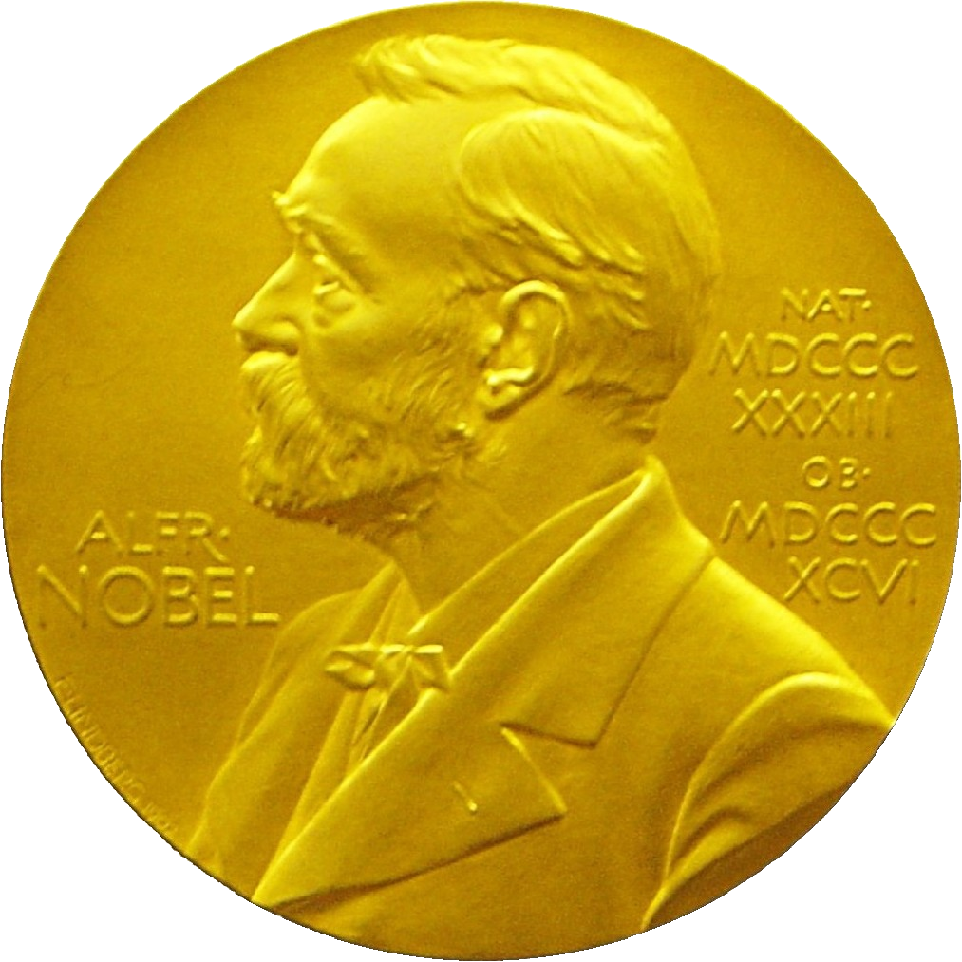
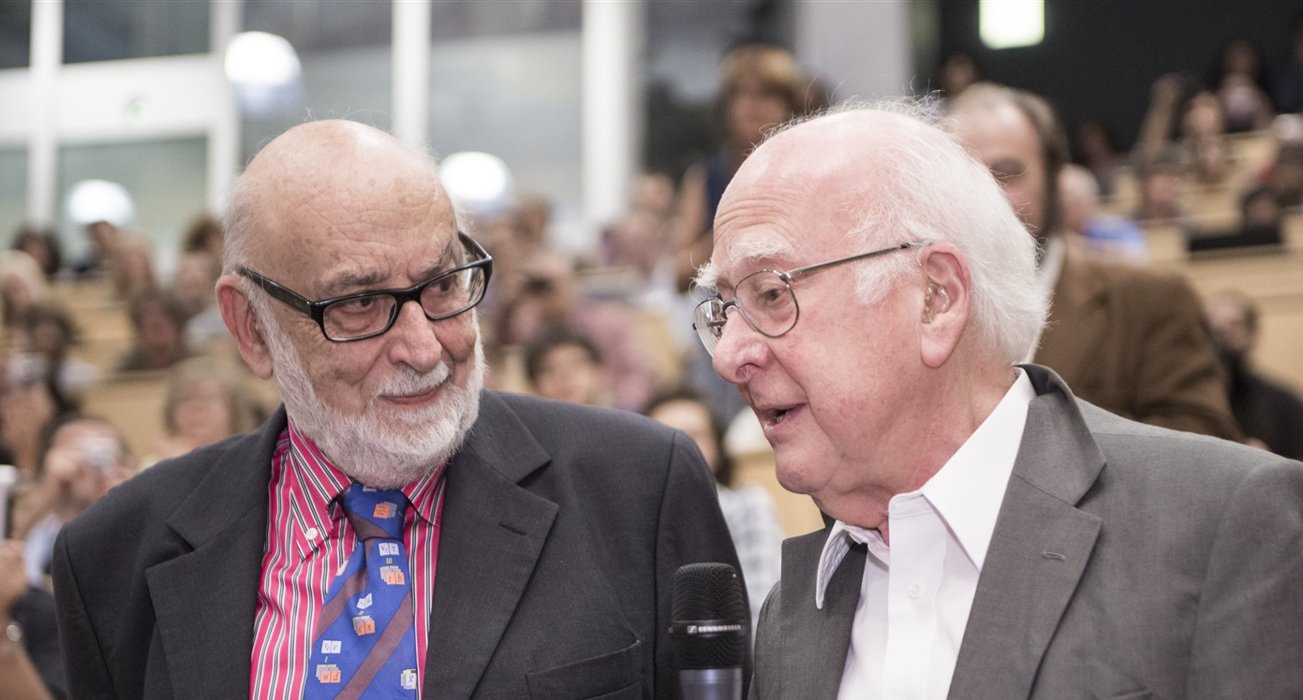
Nobel Prize in Physics 2013
The Nobel Prize in Physics 2013 was awarded jointly to François Englert and Peter W. Higgs "for the theoretical discovery of a mechanism that contributes to our understanding of the origin of mass of subatomic particles, and which recently was confirmed through the discovery of the predicted fundamental particle, by the ATLAS and CMS experiments at CERN's Large Hadron Collider”.

Slide 10
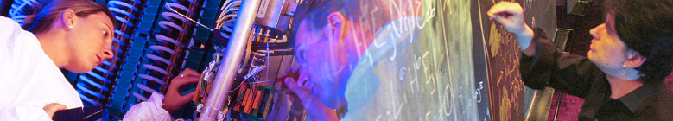

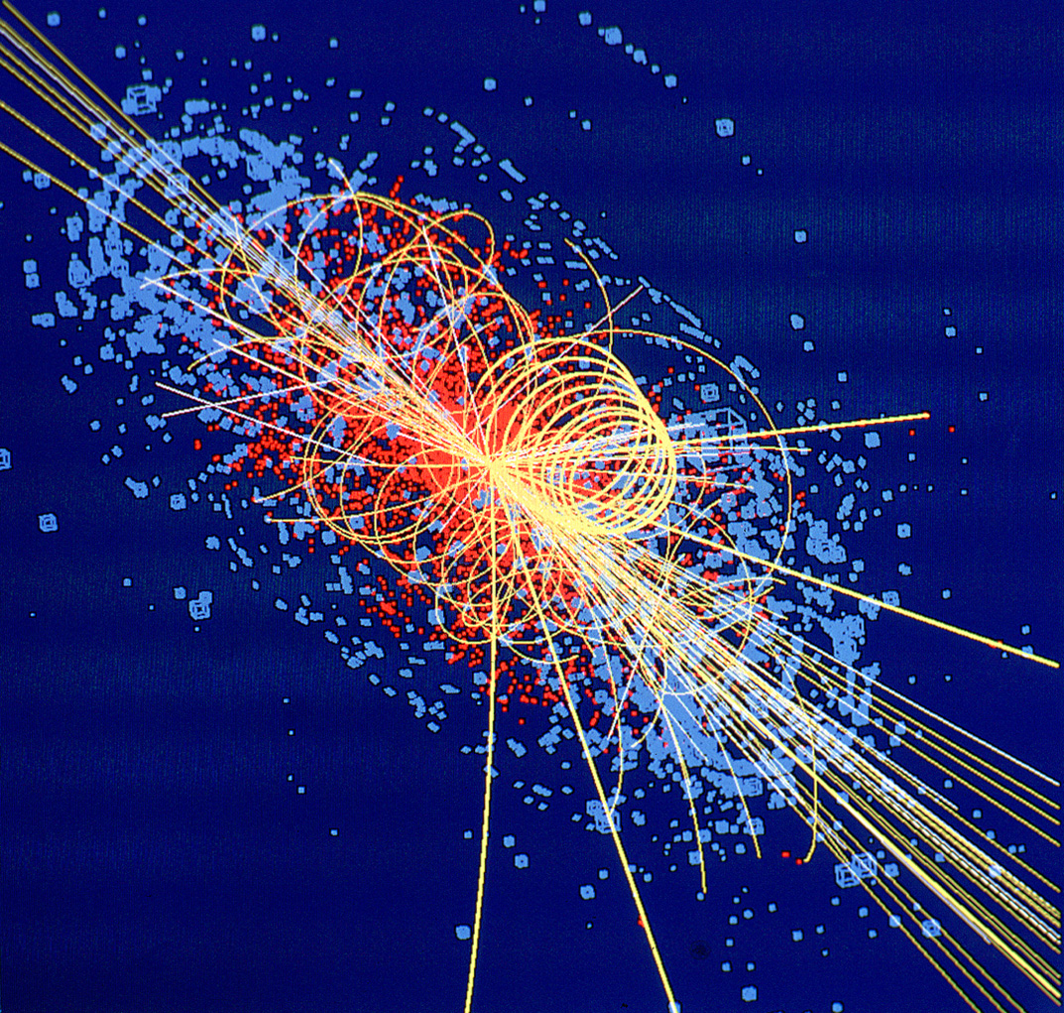
CERN: Particle Physics and Innovation
Interfacing between fundamental science and key technological developments
CERN Technologies and Innovation
Accelerating particle beams
Detecting particles
Large-scale computing (Grid)
Notes:
10

Slide 11
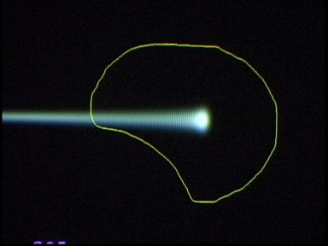
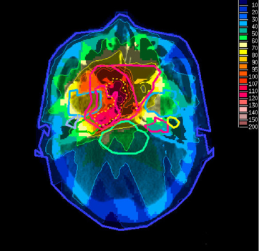
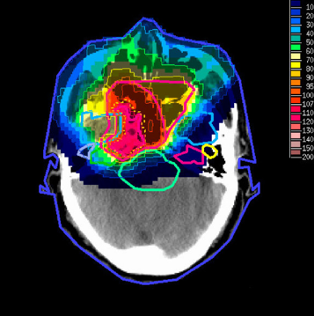
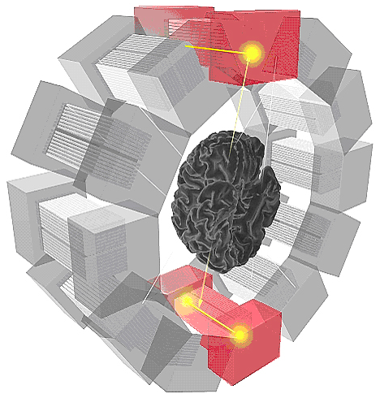
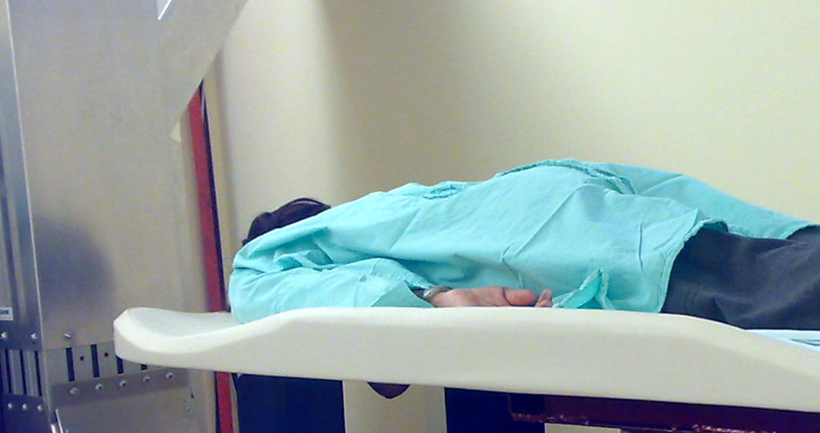
Medical Application as an Example of Particle Physics Spin-off
Combining Physics, ICT, Biology and Medicine to fight cancer
Hadron Therapy
Tumour Target
Leadership in Ion Beam Therapy now in Europe and Japan
Protons
light ions
Accelerating particle beams
~30’000 accelerators worldwide
~17’000 used for medicine
X-ray
protons
>100’000 patients treated worldwide (45 facilities)
>50’000 patients treated in Europe (14 facilities)
Imaging
PET Scanner
Clinical trial in Portugal, France and Italy for new breast imaging system (ClearPEM)
Detecting particles
Notes:
11

Slide 12
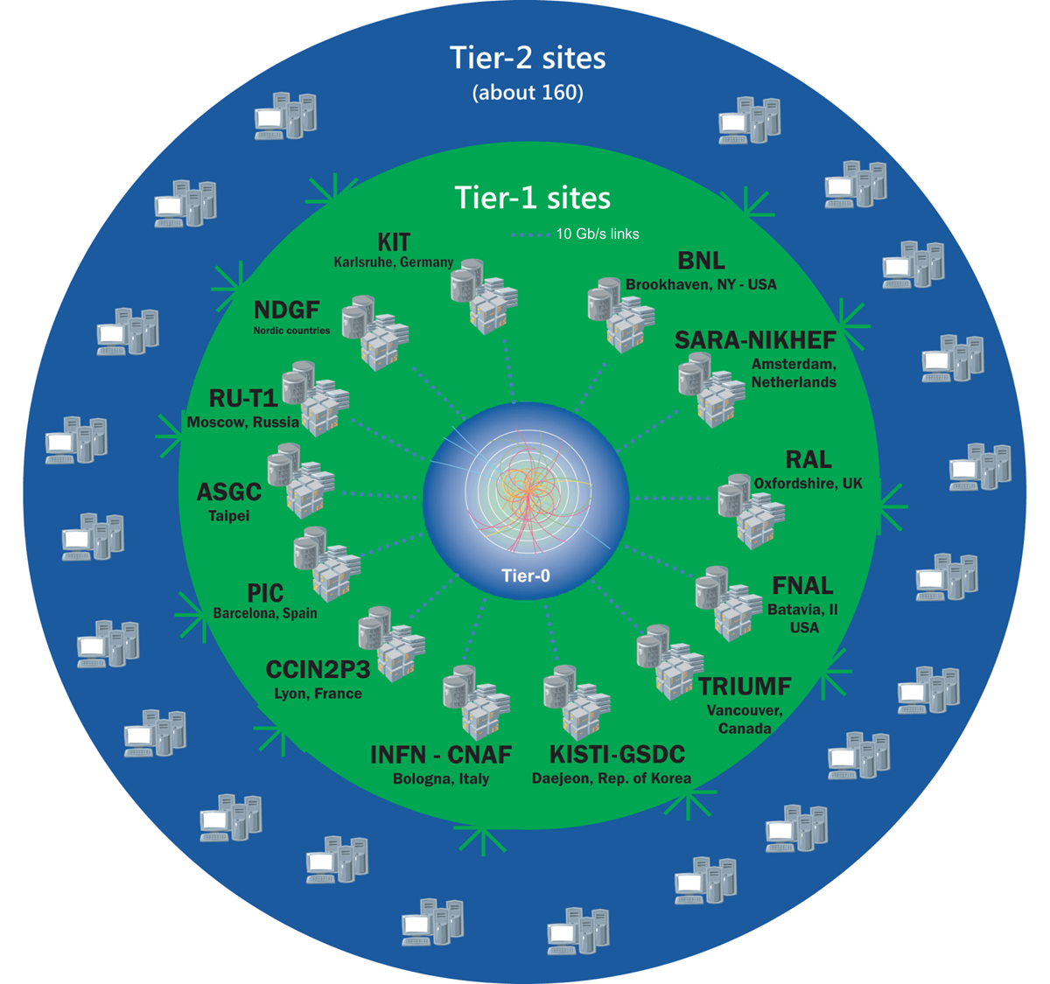
The Worldwide LHC Computing Grid
Tier-0 (CERN&Wigner): data recording, reconstruction and distribution
Nearly 170 sites,
40 countries
~350’000 cores
Tier-1:
permanent storage, re-processing,
analysis
500 PB of storage
> 2 million jobs/day
Tier-2:
Simulation,
end-user analysis
10-100 Gb links
WLCG: An International collaboration to distribute and analyse LHC data
Integrates computer centres worldwide that provide computing and storage resource into a single infrastructure accessible by all LHC physicists

Slide 13

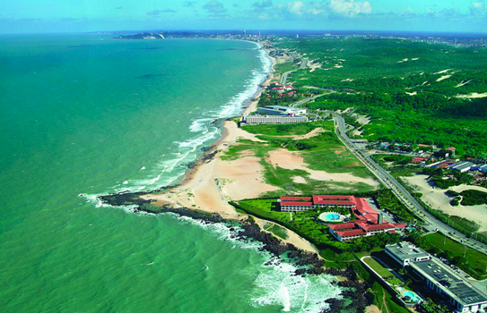
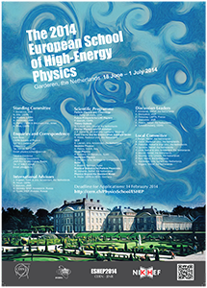
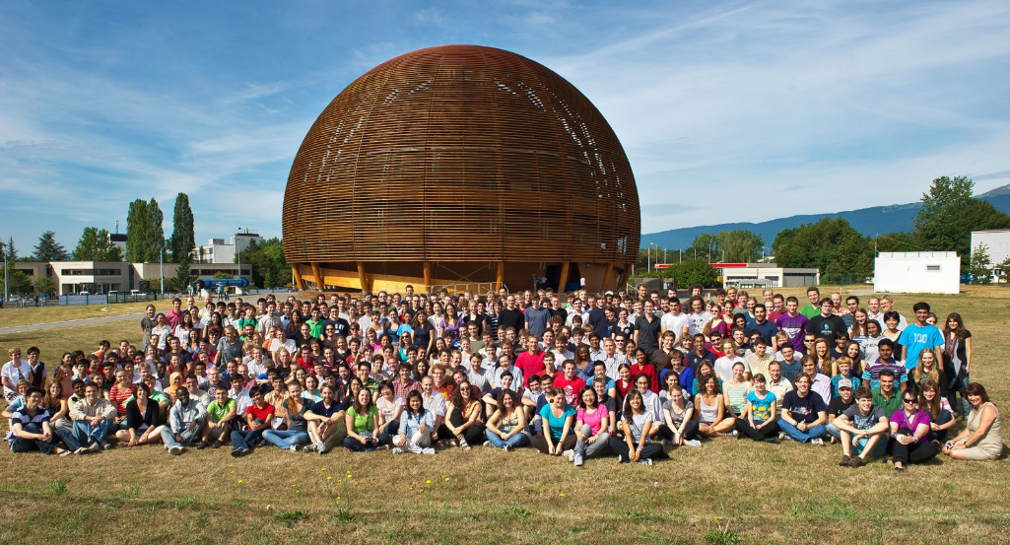
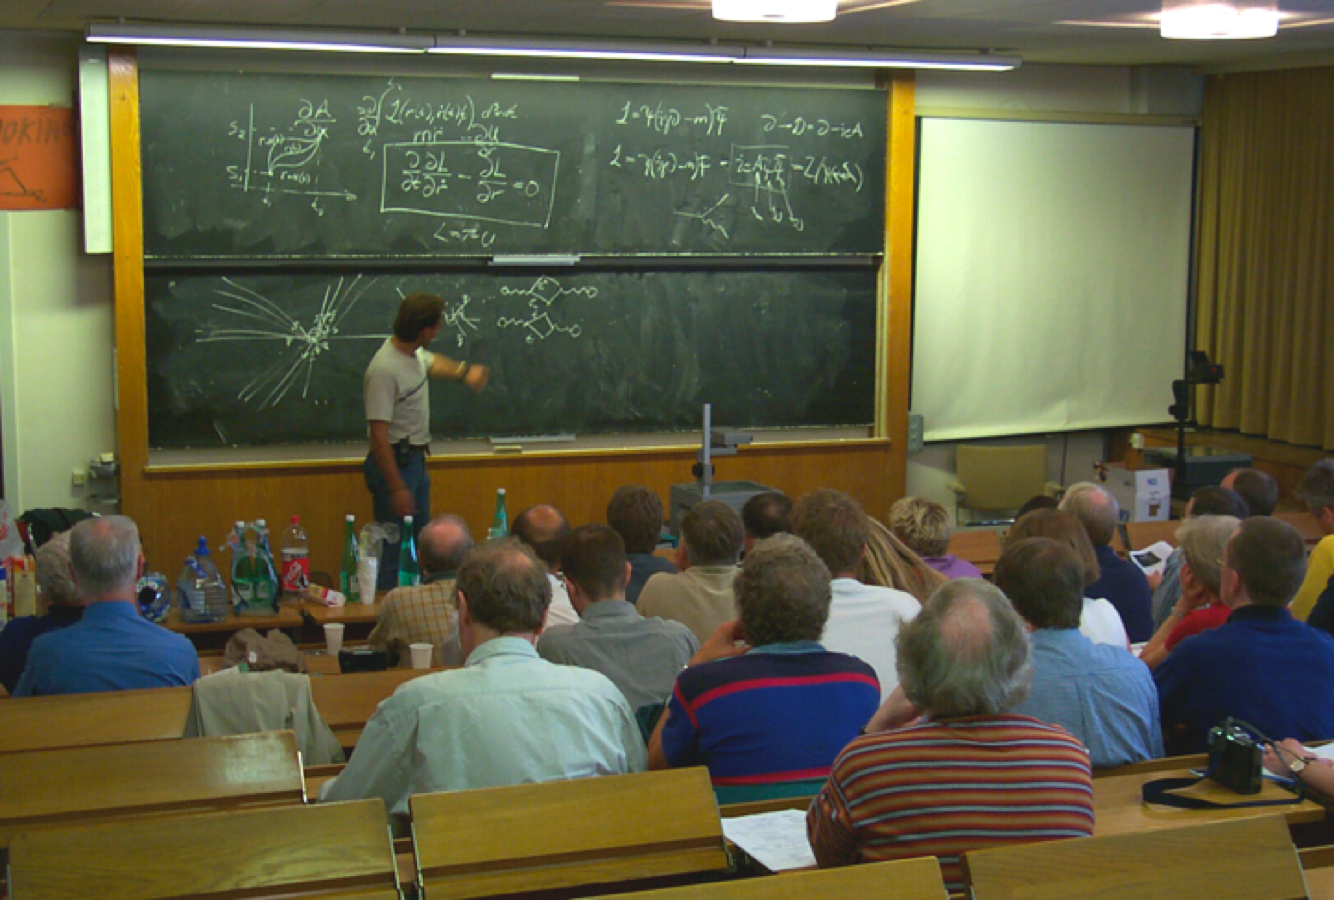
CERN Education Activities
Asia-Europe-Pacific School of High-Energy Physics
Fukuoka, Japan, 2012
Puri, India, 2014
China, 2016
Latin American School of High-Energy Physics
Natal, Brazil, 2011
Arequipa, Peru, 2013
Ibarra, Ecuador, 2015
Scientists at CERN
Academic Training Programme
Young Researchers
CERN School of High Energy Physics
CERN School of Computing
CERN Accelerator School
CERN School of Physics
Bulgaria, June 2015
Physics Students
Summer Students
Programme
CERN Teacher Schools
International and National Programmes

Slide 14
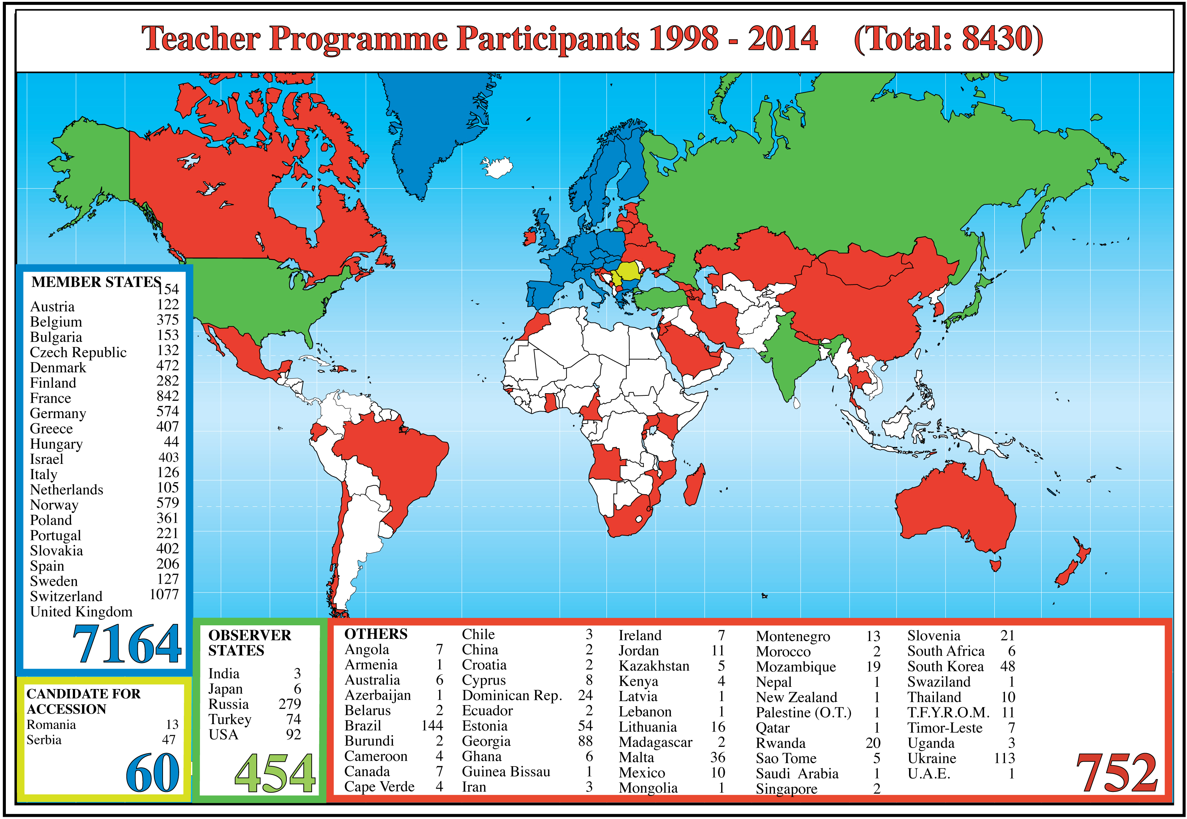
CERN Teacher Programme

Slide 15
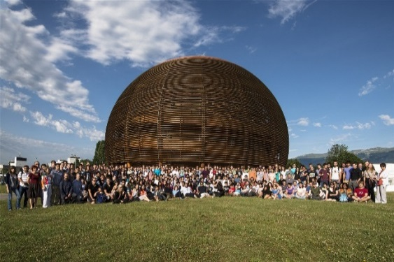
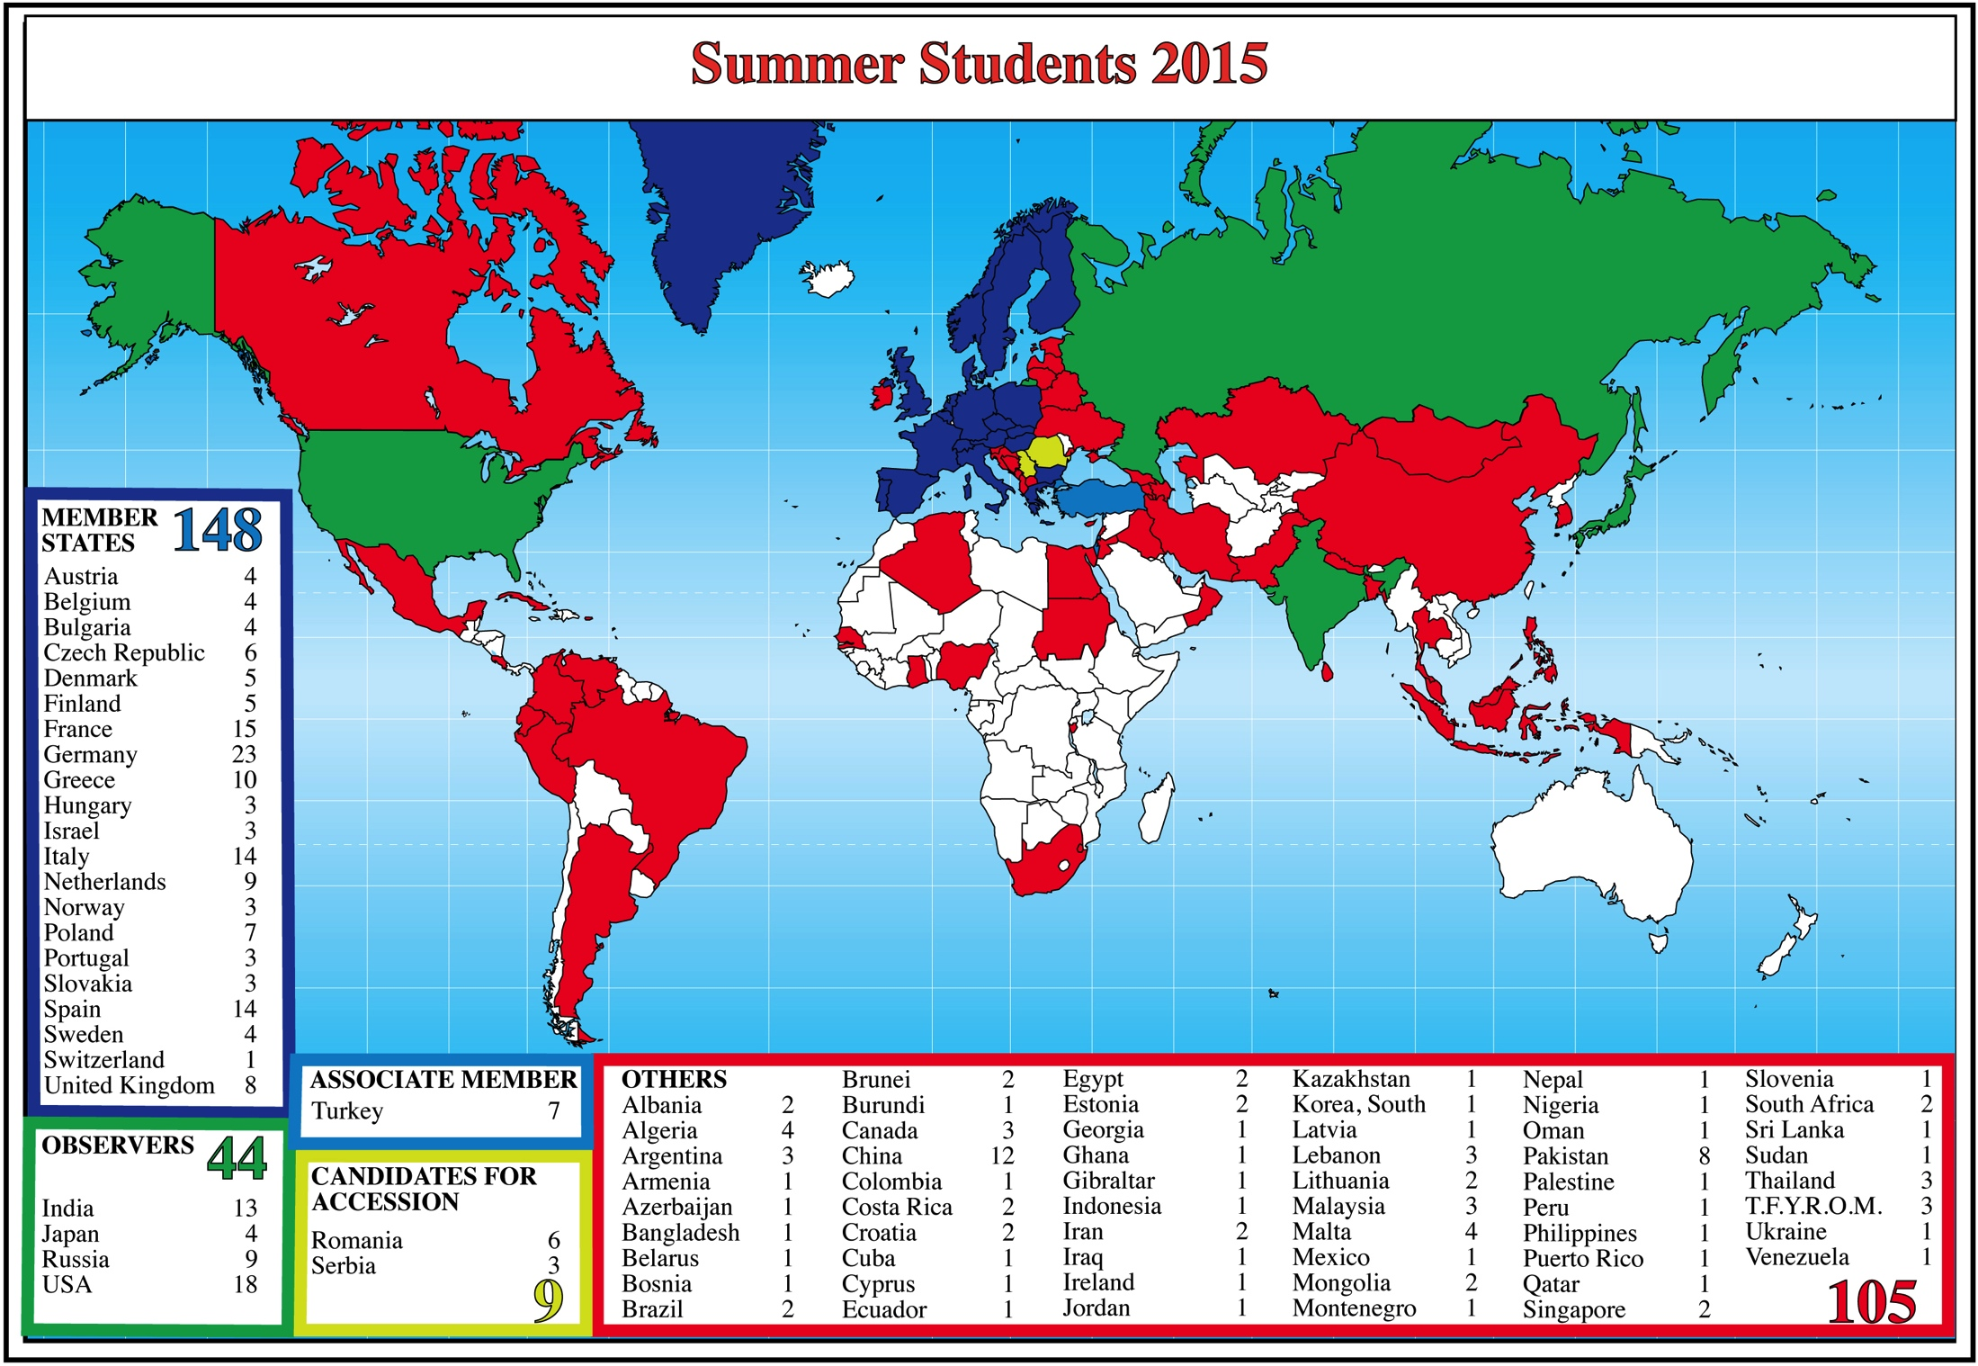
Summer Students 2015

Slide 16

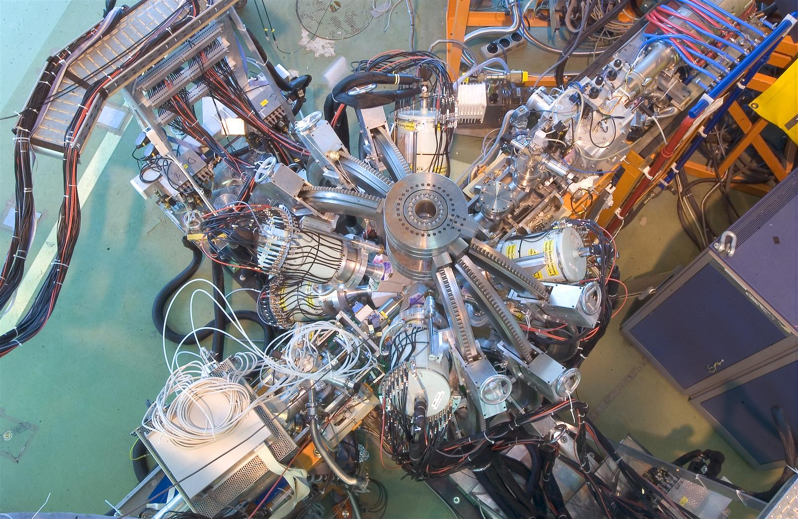
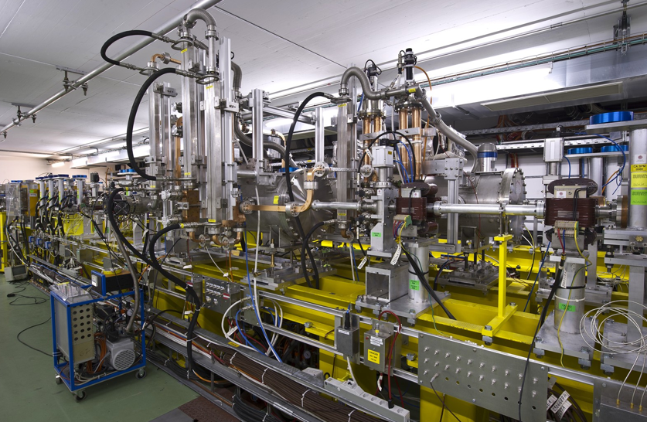
Turkey and CERN
Turkey had Observer Status at CERN since 1961
International Cooperation Agreement signed in 2008
Application to join CERN made in 2009
Turkey became an Associate Member State on 6 May 2015
Involvements of Turkish Physicists in CERN Programme
Participation in experiments at CERN:
  LHC: ATLAS and CMS
  non-LHC: involvements in OPERA,
  ISOLDE, CAST
Collaboration in advanced accelerator R&D for CLIC
CMS
ATLAS
Notes:
16

Slide 17


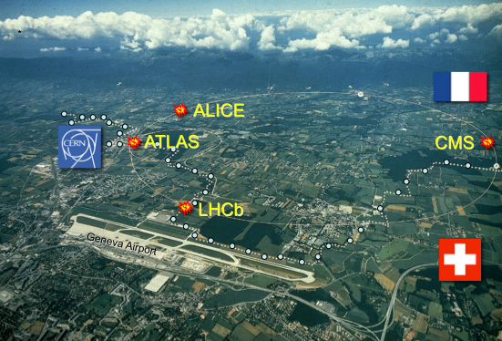
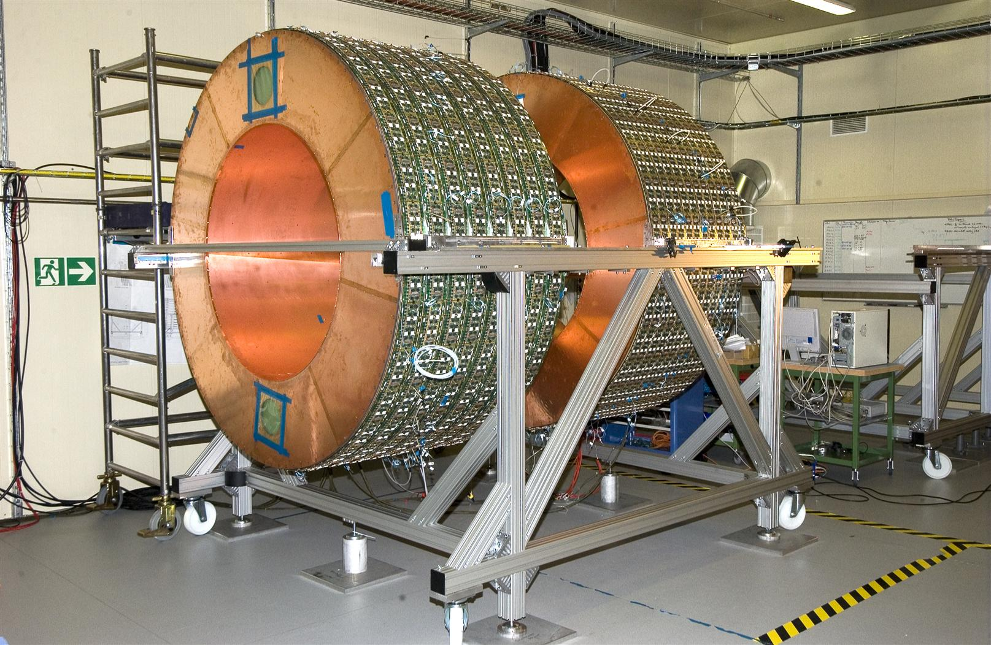
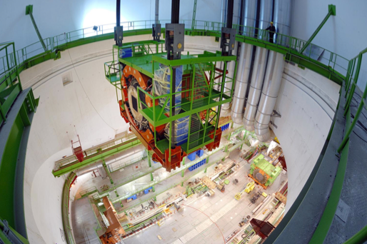
Turkey and CERN
Strong involvement in the LHC experiments ATLAS and CMS
ATLAS
2 Institutions
Ankara University¹
Bogazici University²
CMS
3 Institutes
Cukurova University, Adana
Middle-East Technical
University, Ankara
Bogazici Univerity, Istanbul
Contribution to the Inner Detector (TRT)
Innovative technologies developed
Mechanics for forward hadron calorimeter
¹ includes also physicists from Dumlupinar University, Gazi University, TOBB University of Economy
and Technology, TAEA Ankara
² includes also physicists from Dogus University Istanbul, Gaziantep University, Istanbul Technical Univ.
Notes:
17

Slide 18
Thank You!
Teşekkürler !
Accelerating Science and Innovation
Notes:
18

