Slide 1

Knowledge Transfer at CERN
David Mazur
IP Dissemination Section Leader
Knowledge Transfer Group
CERN
Turkey – CERN Industry Day
Ankara, October 5th 2015

Slide 2
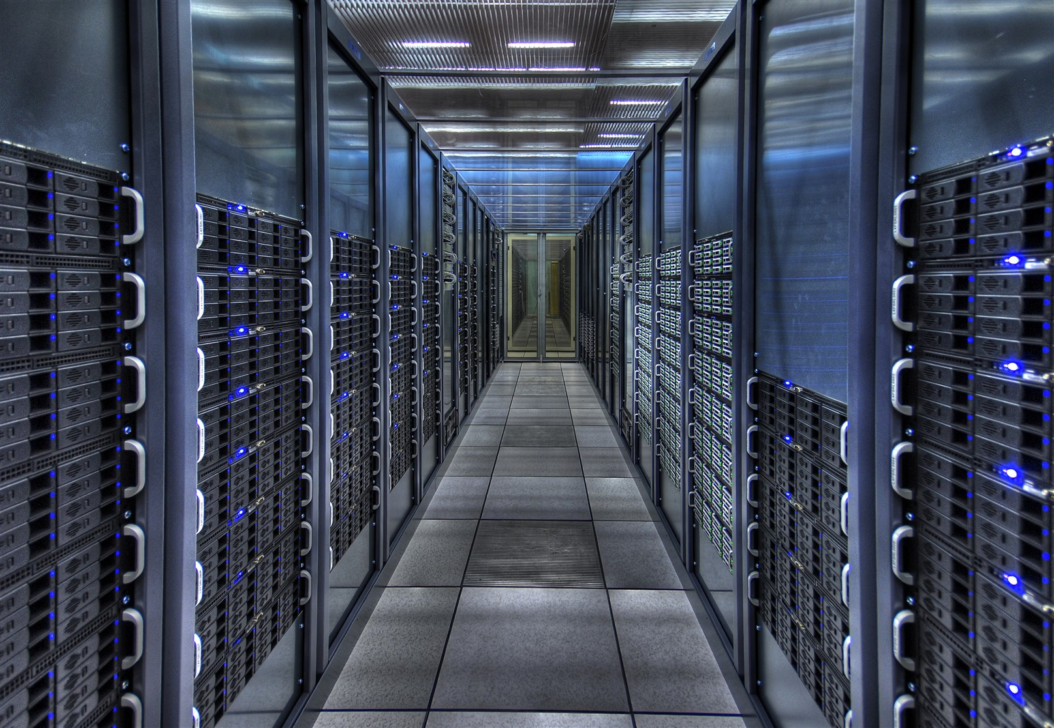
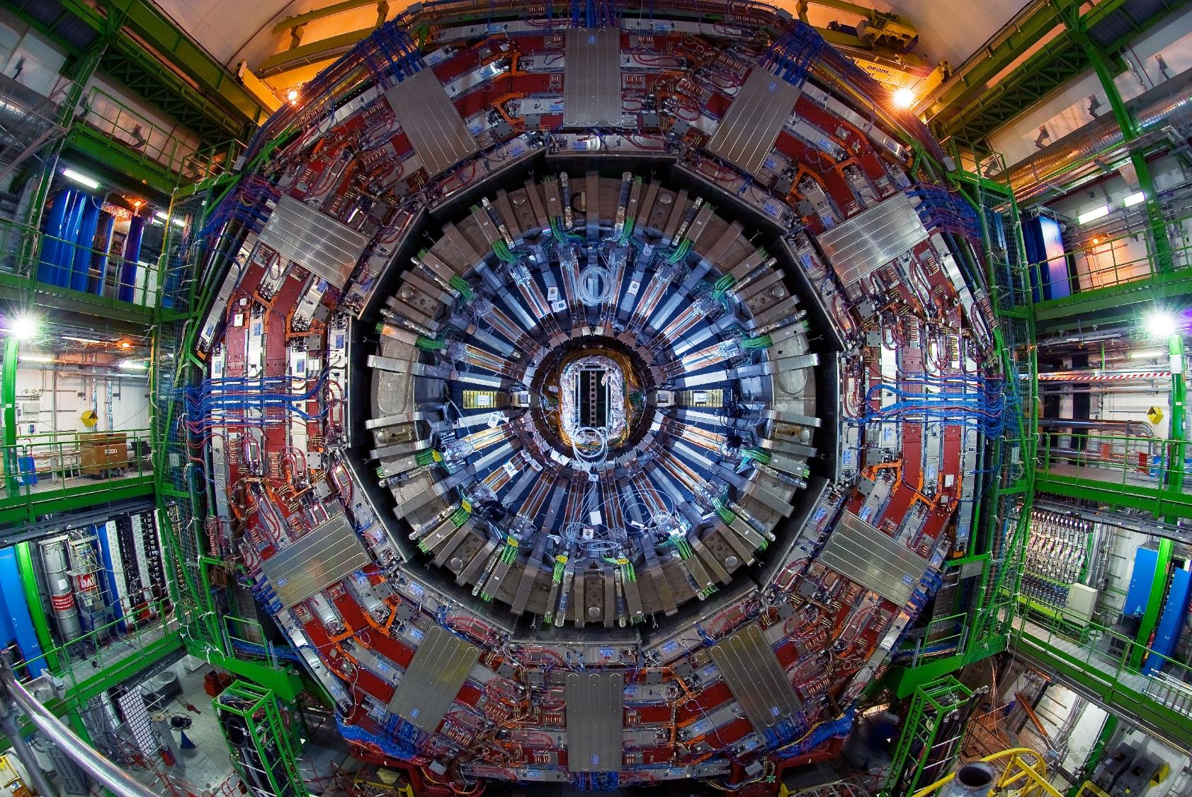
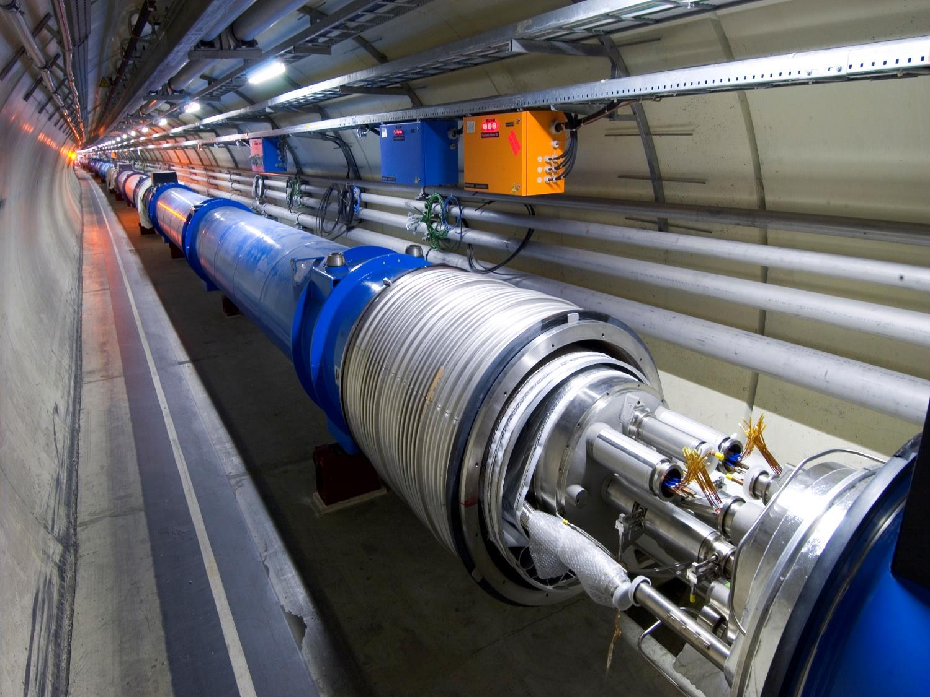
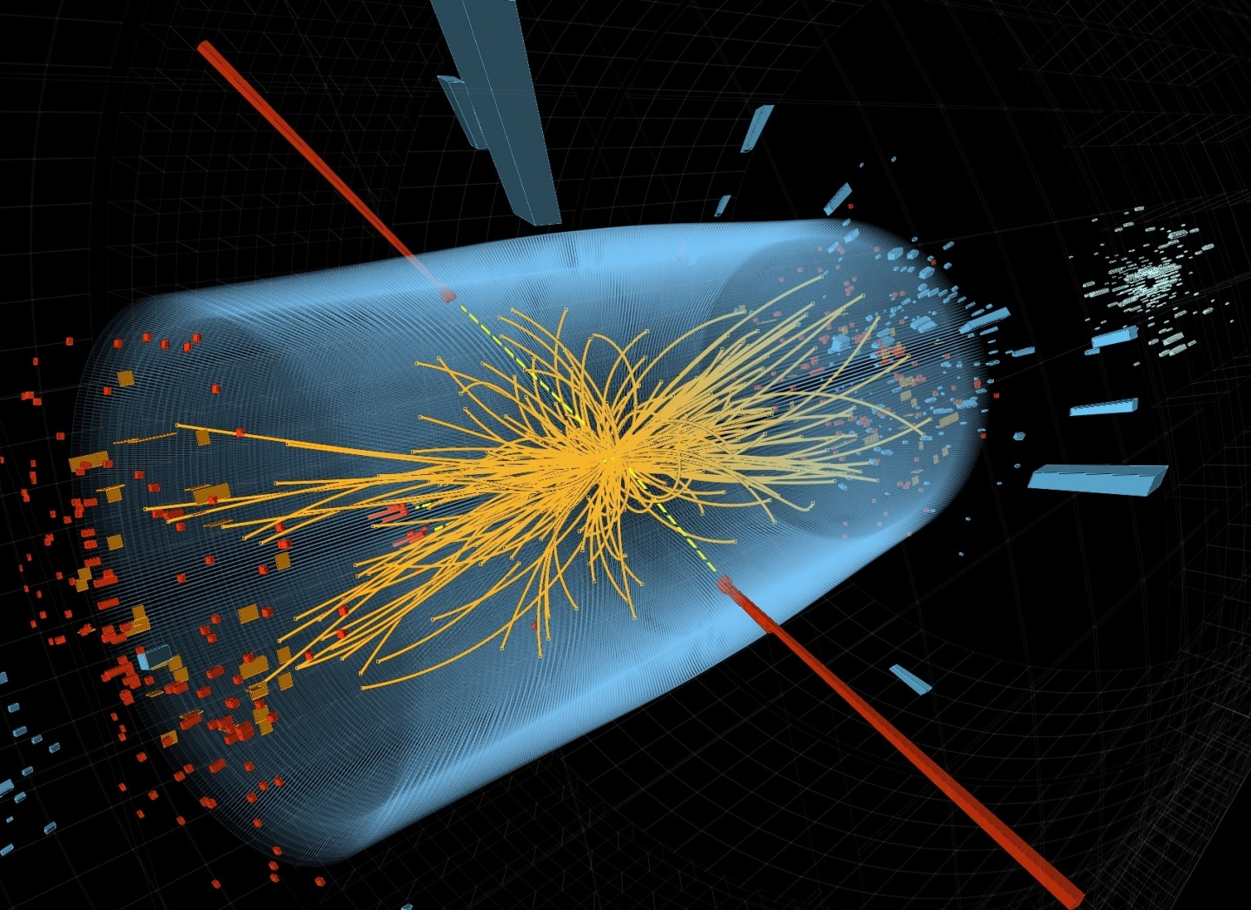
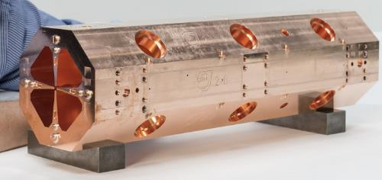
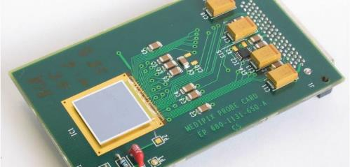
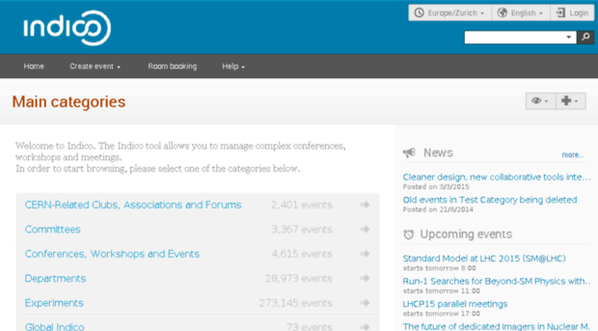
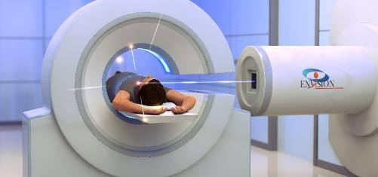
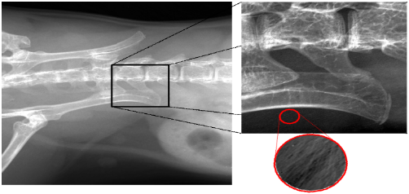
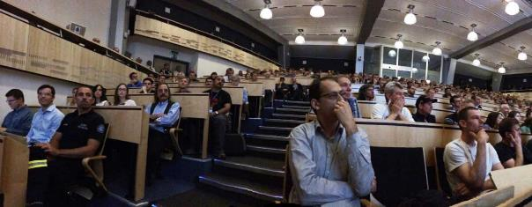
Accelerators
Detectors
Computing

Slide 3
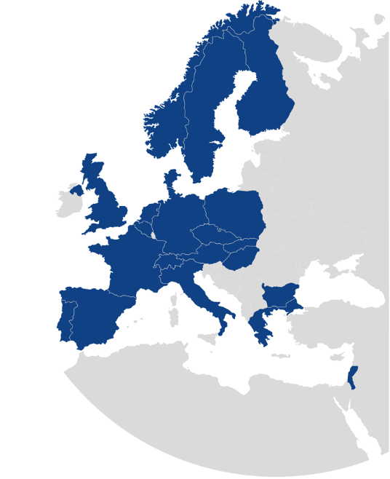

KT Mission
Maximize the technological and knowledge return to Society, specially in the Member States
Promote CERN’s image as a center of excellence for technology
Key words: dissemination and impact!

Slide 4

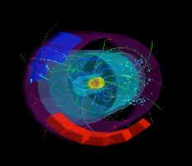
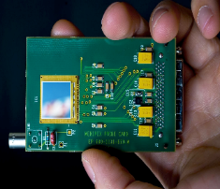
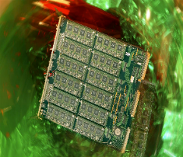
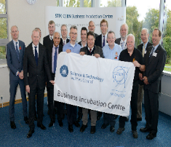

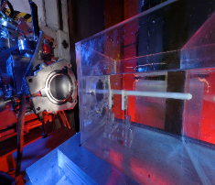
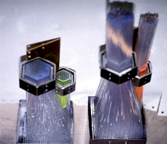
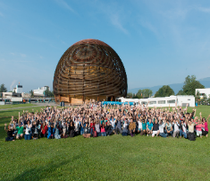

KT Modes
Easy Access IP
Licensing
Business Incubation
Open Source Software
Open Hardware
Procurement
Service and Consultancy
EU Projects
Training
R&D Collaborations

Slide 5
Crossing the bridge to industry
Technology Push
Health
Education
CERN
Industry
Economy
Quality of life
Market Pull

Slide 6
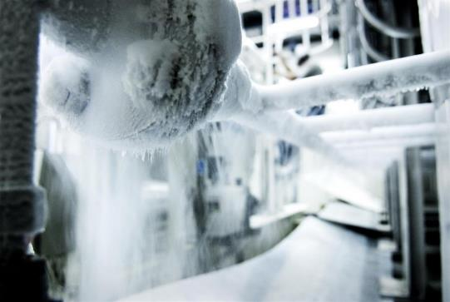
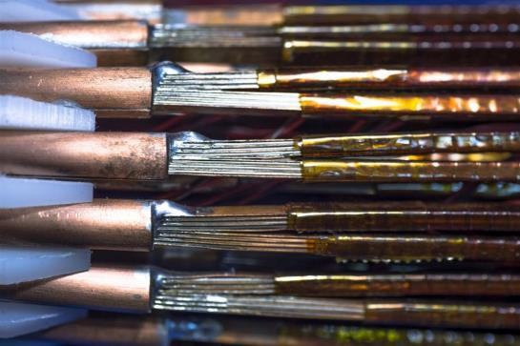
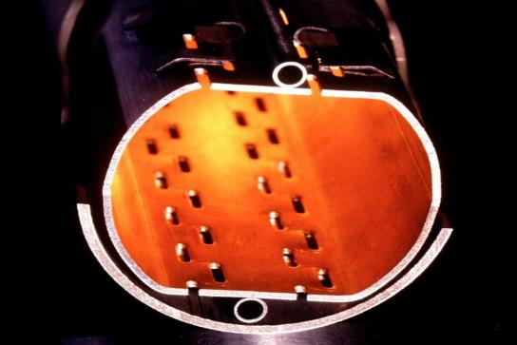
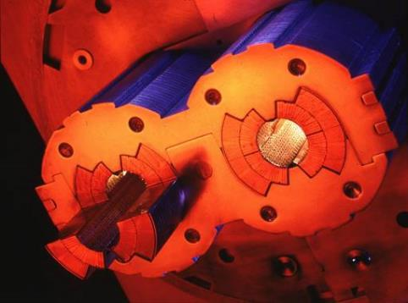
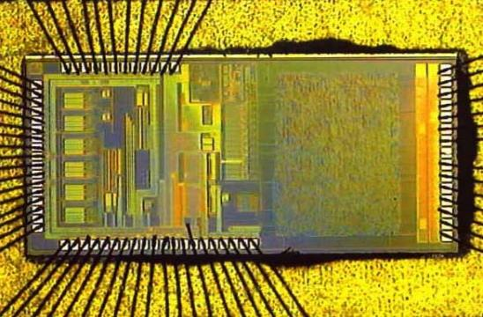
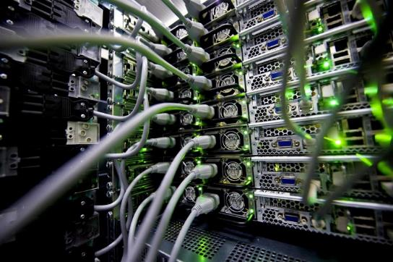
CERN Core Competences
Cryogenics
Superconductivity
Vacuum
Magnets
Microelectronics
Data Processing

Slide 7
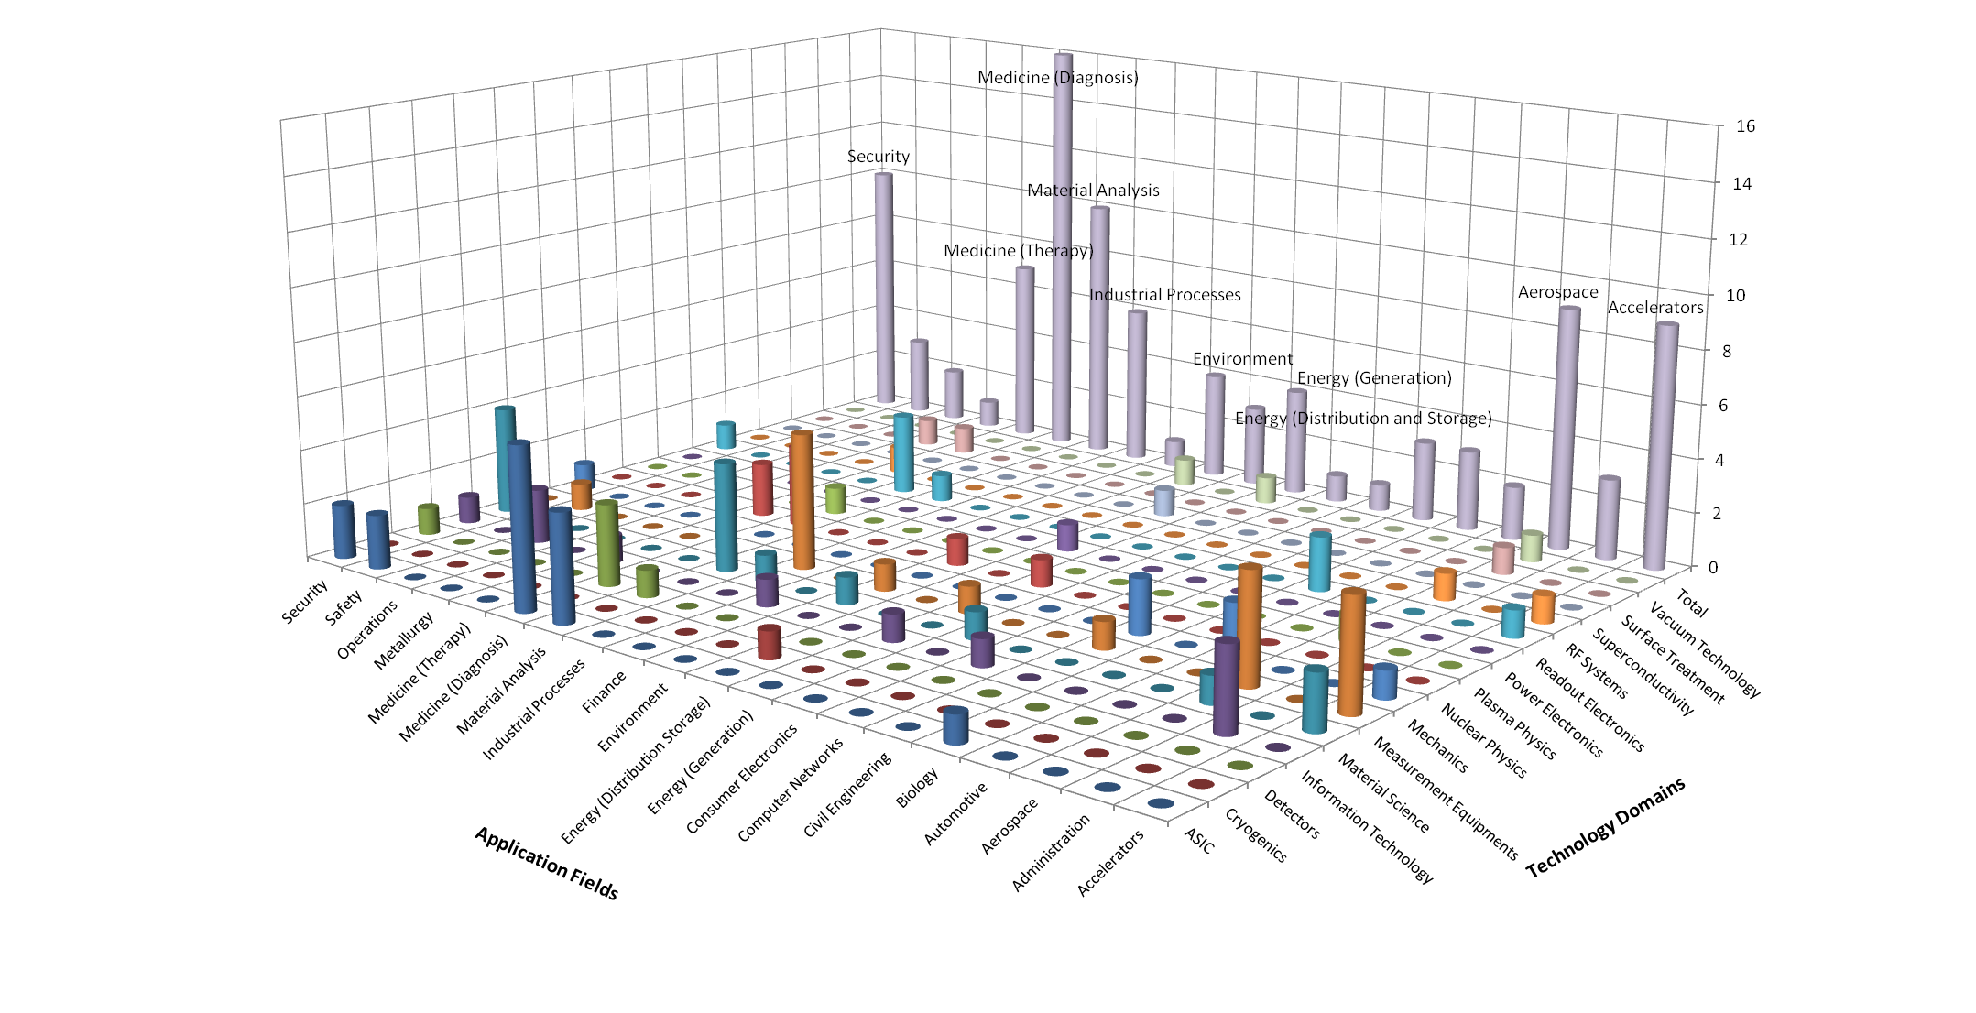
CERN’s Technology Portfolio

Slide 8
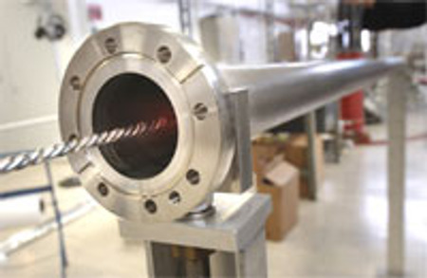
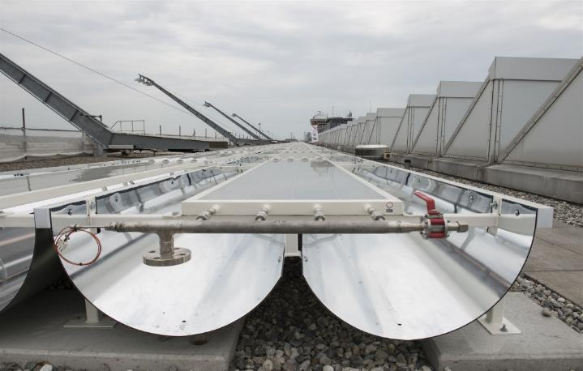
From high vacuum… to solar energy
CERN Technology
Non-Evaporable Getter Coating
Industry (spin-off):
High Efficiency Solar Collectors

Slide 9
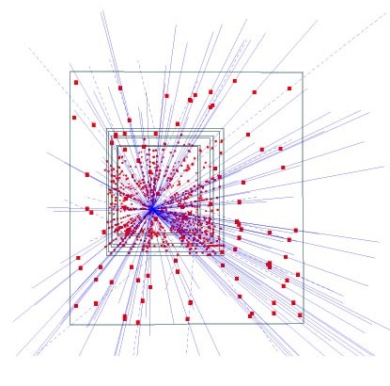
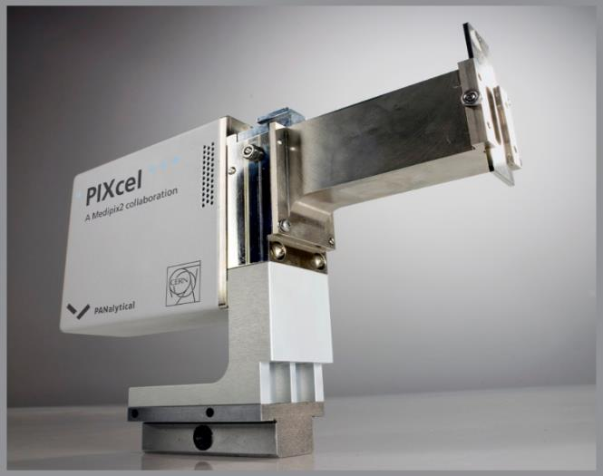
From silicon pixel detectors to X-Ray diffractometers
CERN Technology
Hybrid silicon pixel detector
Industry (license):
X-Ray Diffractometer

Slide 10
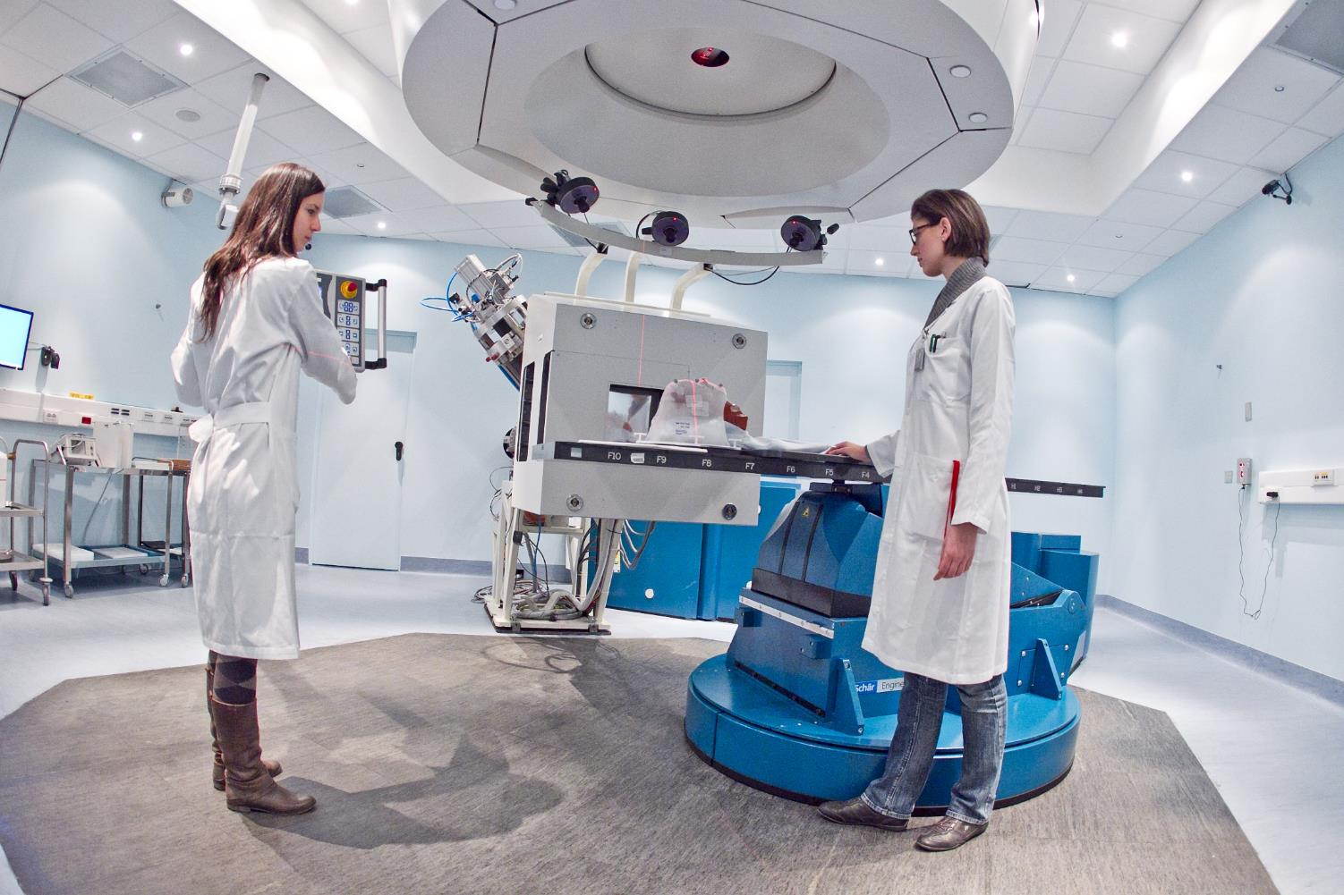
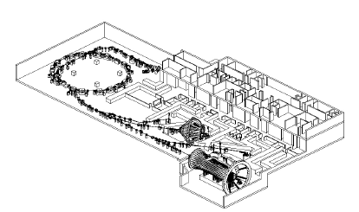
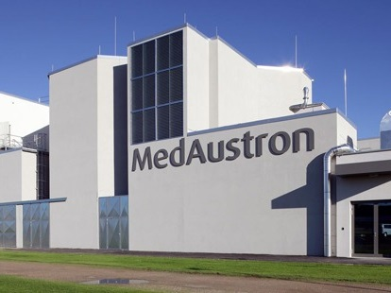
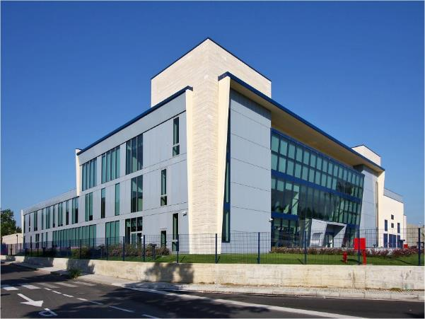


PIMMS Study 2000
CERN in collaboration with
INFN and TERA
has led to:

Slide 11


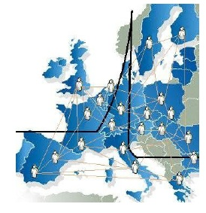
ENLIGHT
CERN philosophy into health field
  Common multidisciplinary platform
  Identify challenges
  Share knowledge
  Share best practices
  Harmonise data
  Provide training, education
  Innovate to improve
  Lobbying for funding
  Coordinated by CERN
> 150 institutes
> 400 people
> 25 countries
(with >80% of MS involved)
Notes:
11

Slide 12

cern.ch/ictr-phe16

Slide 13

Business Incubator Centres (BIC) of CERN Technologies
Established incubators:
UK STFC-CERN BIC
Netherlands NIKHEF-CERN BIC
Norway NTNU-CERN BIC
Greece Technopolis-CERN BIC
Austria accent-CERN BIC
France InnoGex
Finland Finnish BIC of CERN Technologies

Slide 14
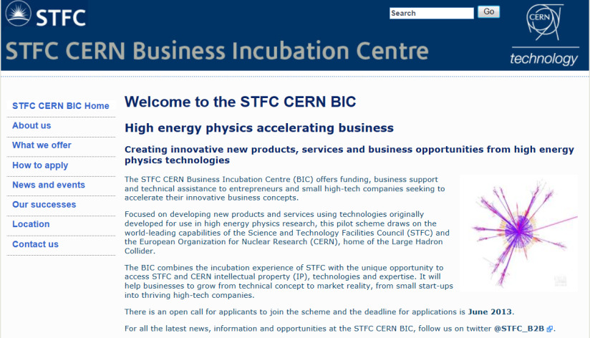
Turning CERN technologies into new business opportunities

Slide 15
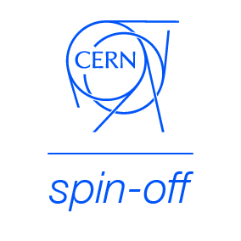




Slide 16
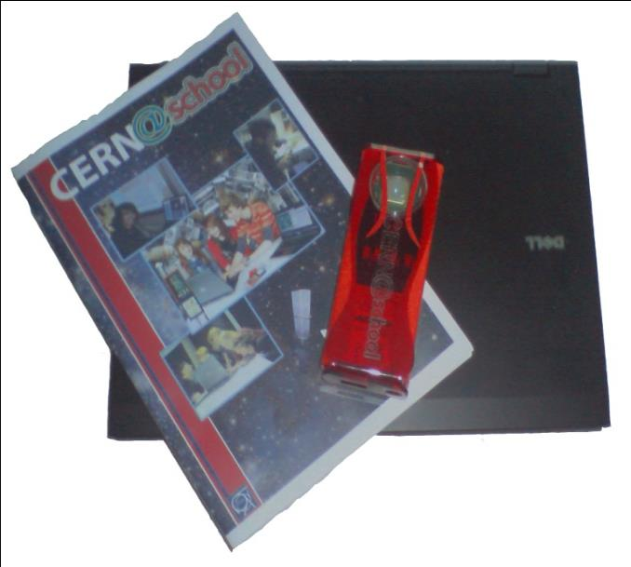
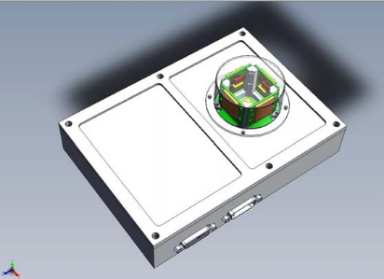

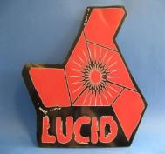
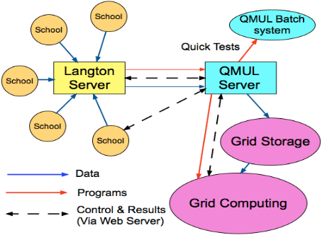
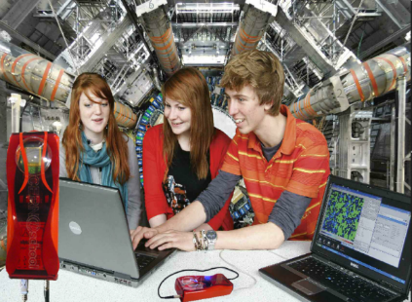
Langton Ultimate Cosmic ray Intensity Detector uses 5 Timepix chips to monitor the radiation environment in Space
CERN@school allows students to use a Timepix chip in the lab to visualise radiation
Data from LUCID and CERN@school detectors will be uploaded to the Grid and made available for students to analyse

Slide 17




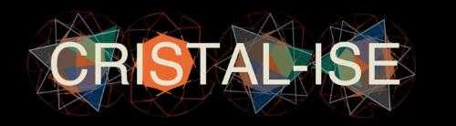

Open Source Software
Originating from CERN | Contributed to by CERN
And many more

Slide 18
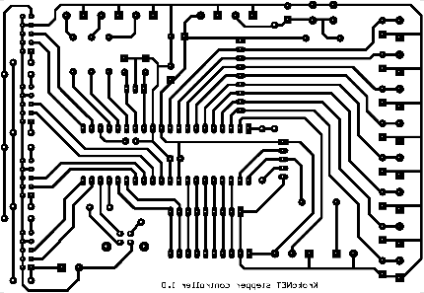

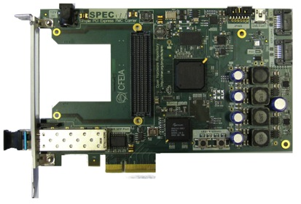
Open Source Hardware and CERN Open Hardware Licence (OHL)
A legal framework to facilitate knowledge exchange across the electronic design community.
Governs the use, copying, modification and distribution of hardware design documentation, and the manufacture and distribution of products.
www.ohwr.org

Slide 19
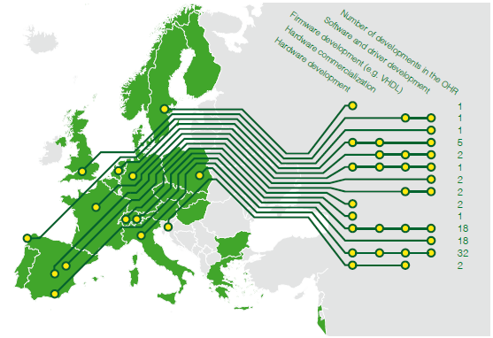
CERN OHL: it is making an impact!

Slide 20
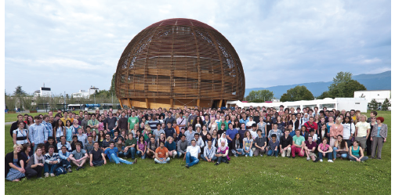
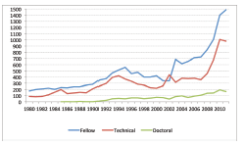
Knowledge Transfer through People
Every year, hundreds of students come to CERN to contribute to our research programs
An opportunity for young people to learn in a multicultural environment
Not only for physicists! Also engineers, computer scientists, administrative students…

Slide 21





European KT Networks
Forum for European Intergovernmental Research Organisations
EEN, Enterprise Europe Network
TTN, Technology Transfer Network (aka HEPTech)
TTO Circle - European Technology Transfer Offices Circle
The European Network for LIGht ion Hadron Therapy

Slide 22

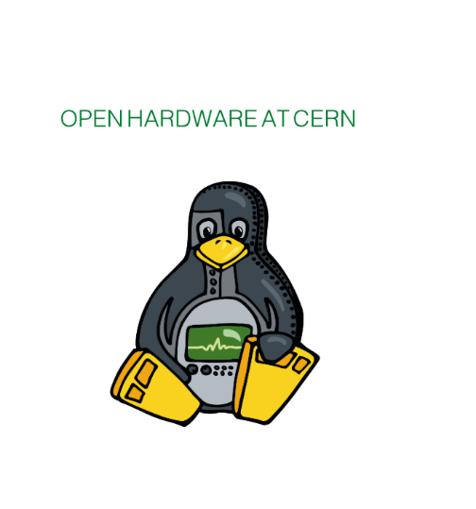
Publications
cern.ch/kt

Slide 23
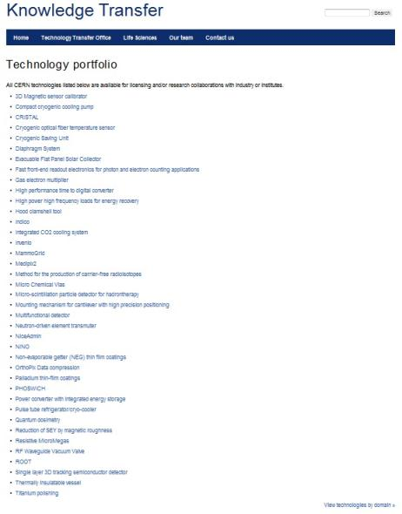
Visit our website to have a look at our technology portfolio in detail
cern.ch/kt

Slide 24

CERN Knowledge Transfer Group
cern.ch/kt
Mail-KT@cern.ch
David.Mazur@cern.ch
Tel. +41 22 767 2623

