Slide 1
FCC-hh 16 T, 1.9 K
INFN Team
October 2015

Slide 2
Why 1.9 K ?
At 4.5 K the volume of conductor is quite large , cables have extreme dimensions, ratio Cu/Sc is 1/1, no margin left
At 1.9 K is feasible owing to the large increase of critical current respect to 4.5 K
B (T) | Jc ( A/mm2) 4.5 K | Jc ( A/mm2) 1.9 K | ratio (1.9/4.5)
14 | 2031 | 3005 | 1.48
16 | 1251 | 2048 | 1.64
18 | 695 | 1326 | 1.91
Based on the formula given in EuroCircCol-P2-WP5-04-09-2015

Slide 3
A conceptual design at 1.9 K
Based on a design presented by Zlobin ( FERMILAB) at the FCC week 2015
Assumed peak field of 18 T on conductor giving 17.6 T bore field ( 10% margin)
Assumed 4 layers i.e 2 double pancakes
Two cables
Insulation 0.2 mm /face
Iron yoke far apart ( from 120 to 250 mm)
Cables | Strands/φ | Cu/nonCu | Width (mm) | Mid thickness (mm)
Inner | 28 / 1.0mm | 1/1 | 14.7 | 1.80
Outer | 40 / 0.7 mm | 1.5/1 | 14.7 | 1.25

Slide 4
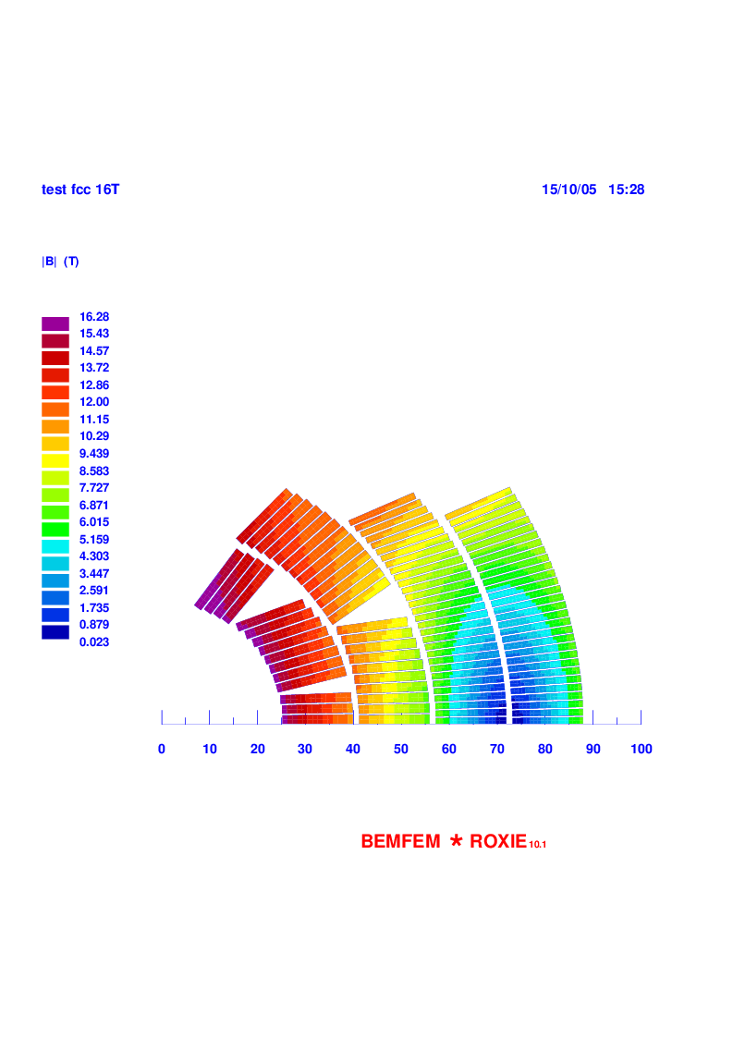
The layout
I= 12.0 kA Bo = 16 T ( I=13.4 kA for Bo=17.6 T)
Layer 1-2 15+23 turns
Layer 3-4 31+31 turns
Total 100 turns Total width of the layers 60.4 mm

Slide 5
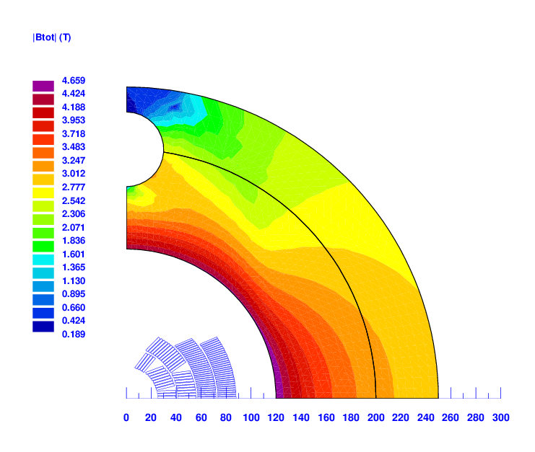
Field in the iron at Bo=16 T
Strong saturation
Field on the iron midplane By= 4.5-3.0 T
Fringing field ( x=300 mm,y=0) By= 0.5 T

Slide 6
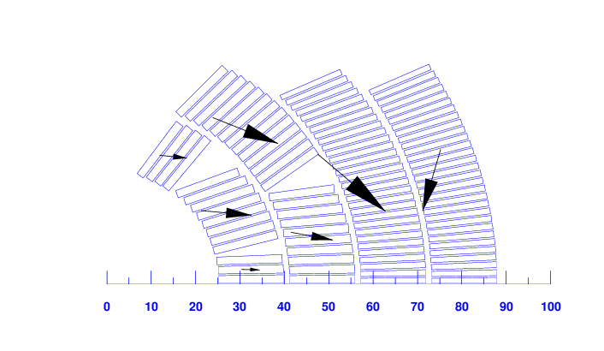
Forces at Bo=16 T
Fx = 6.5 MN/m
Fy = -4.1 MN/m

Slide 7
Field quality
Not pursued, pending many unknows on cables dimensions, insulation thickness,
position iron yoke ( i.e collar thickness)
I = 12.0 kA
MAIN FIELD (T) ..................................... 15.9167
NORMAL RELATIVE MULTIPOLES (1.D-4):
b 1: 10000.00000 b 2: 0.00000 b 3: -4.82026
b 4: 0.00000 b 5: -0.54876 b 6: 0.00000
b 7: 0.43971 b 8: 0.00000 b 9: -1.86855
b10: 0.00000 b11: 1.60804 b12: 0.00000
Inductance 20 mH/m
Stored energy 1.28 MJ/m

Slide 8
Conclusion
A 16 T dipole at 4.5 K with a 10% margin has been envisaged at the limit of feasibility (with a low Cu/Sc ratio 1/1 for the outer layers)
A conceptual design of a 16 T dipole at 1.9 K with a 10% margin is proposed
At 1.9 K, a further margin increase of 5% look feasible possibly, with the same volume of superconductor since in this design the outer cable has more strands (40) than needed (30)
A reduction of the insulation thickness from 0.2 mm to 0.15-0.125 mm could give a 2-3% margin increase owing to the better filling factor of the conductors in the layers
A comparison of the dipole design at 4.5 K and 1.9 K is very useful,
unless the temperature of 4.5 K is mandatory (why?)

