Slide 1
Preliminary analysis of a 16 T sc dipole with cos-theta lay-out
INFN team
October 2015

Slide 2
Basic points
We have performed some studies aimed to verifying the possibility to have on the paper a cos-theta 16 T dipole (only from magnetic point of view) with the given constrains
The dipole has been optimized at 16 T including the iron saturation
We decided to work on a lay-out with 4 conductor layers

Slide 3
Analytical models
Preliminarily to analysis with computer codes, we performed an analytical study considering a dipole done of a 60 degree sector coil.
The coil is composed of 4 layers
Only one strand is involved for composing two cables: 1) 40 strand cable for the two inner layers; 2) a 20 strand cable for the outer layers
The insulation is 0.2 mm any side. The layer to layer insulation is 0.5 mm.
The critical current density is 1350 A/mm2 at 16 T and 4.22 K reduced of 5% due to degradation. Cu/SC = 1.
The operating temperature is 4.5 K
An iron yoke surrounds the coil. The inner diameter of the yoke is 60 mm larger than the outer diameter of the coil. The outer diameter of the yoke is set to 700 mm.
On this basis we composed a coil with strands ranging from 0.8 to 1.3 mm looking at the current margin (10% on the load line).

Slide 4
Magnetic field generated by a 60 degree sector coil
We applied this formula for any layer.
The iron contribution was also included with a formula. The value of relative permeability was set to μ=2 (iron is mostly saturated).
The achievable magnetic field with 10% margin on the load line was computed vs the strand dimension. This analysis was done with a peak field of 16.4 T
One can see that in order to have 16T we need a coil done with a cable composed of 1.25 mm strand

Slide 5
Strand and cable characteristics
Following the analytical studies we developed two models with real cable. The first model (Dip1) was done only involving a 1.25 mm strand (40 strand inner cable, 24 strand outer cable). The second model (Dip2) involves the 1.25 mm strand for inner layers (40 strands) and a 0.7 mm outer layers (40 strands)
 | Inner strand/cable | Outer strand/cable
Diameter (mm) | 1.25 | 1.25/0.7
Cu/sc | 1.0 | 1.0
Jc@16T and 4.22 K (A/mm²) | 1350 | 1350
Cable dimensions (mm) (height,width_i,width_o) | 26.0, 2.05,2.50 | 15.6, 2.14,2.41 14.7, 1.15, 1.35
Number of strands | 40 | 24/40
Cable Ins.thickness | 0.20 | 0.15

Slide 6
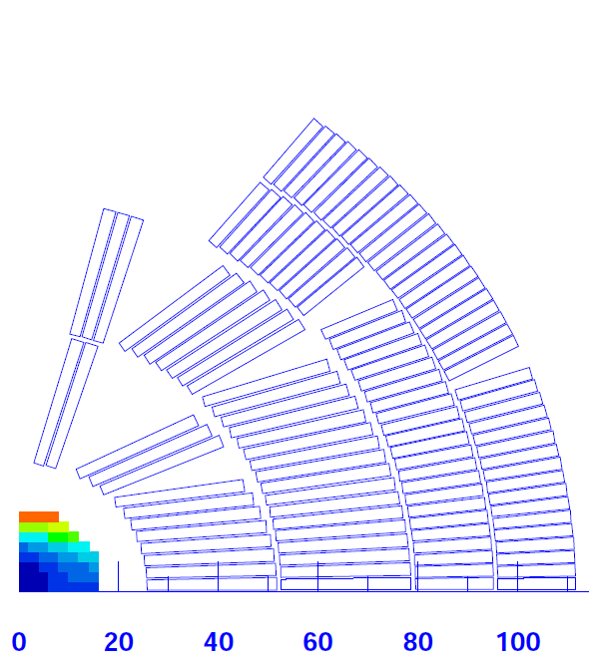
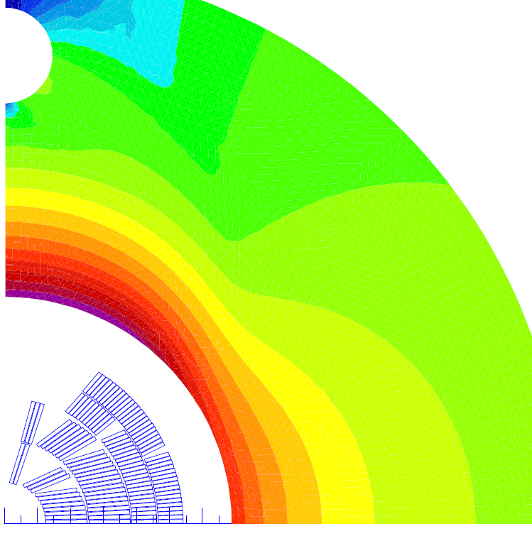
Winding Lay-out Dip1
Four layers
First layer – 13 turns; 3 blocks; 40 strand cable 1.25 mm
Second layer – 27 turns; 3 blocks; 40 strand cable 1.25 mm
Third layer – 33 turns; 2 blocks; 24 strands cable 1.25 mm
Forth layer – 40 turns; 2 blocks; 24 strands cable 1.25 mm
To be noted that we need 284 beam separation !

Slide 7
Results
With a current of 14600 A the central field is 16 T.
The peak field on the inner layer 3° block is 16.51 T
The margin on the load line is 8%
This layout does not achieve the specify margin. The maximum achievable bore field at 4.5 K for having 10% margin is 15.5 T

Slide 8
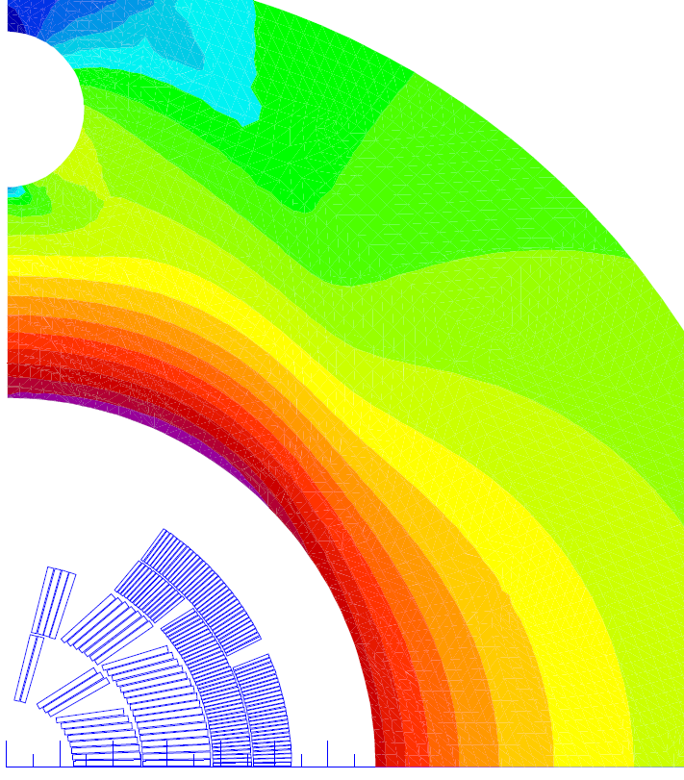
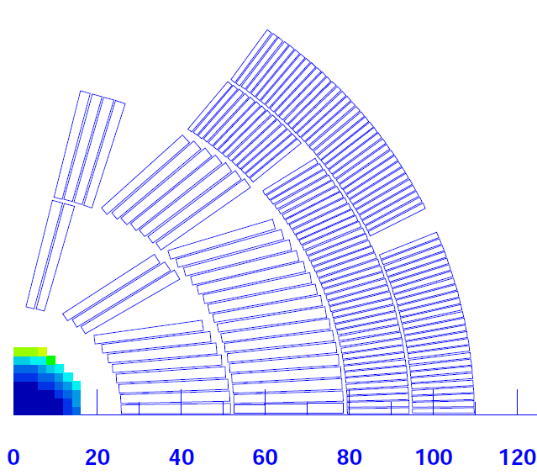
Winding Lay-out Dip2
Four layers
First layer – 13 turns; 3 blocks; 40 strand cable 1.25 mm
Second layer – 28 turns; 3 blocks; 40 strand cable 1.25 mm
Third layer – 54 turns; 2 blocks; 40 strands cable 0.70 mm
Forth layer – 62 turns; 2 blocks; 40 strands cable 0.70 mm

Slide 9
Results
With a current of 11100 A the central field is 16 T.
The peak field on the inner layer 3° block is 16.41 T
The margin on the load line is 10% for inner layer block 3 , but ...
7% for 3° layer block 2.
This layout does not achieve the specify margin because the limitation on the third layer done with a cable involving a thinner conductor. A solution can be found with a sligthly larger conductor

Slide 10
Conclusions
By involving a 1.25 m strand the 16 T in 50 mm bore could be barely achieved with a 4-layers cos-theta dipole. The thickness of the collared coils is compatible with interbeam distance of about 280 mm
A solution with two different cables done with two different strands should be preferred
The field quality should be not an issue
For a cable involving 1 mm strand the achievable magnetic field at 4.5 K is about 13 T unless the critical current density is increased of 20% .
Alternatively to an increase of the critical current density a solution with operating temperature of 1.9 K can be investigated (see next talk)

