Slide 1


Block design
CEA
C. Lorin & M. Durante
9 Oct. 2015

Slide 2
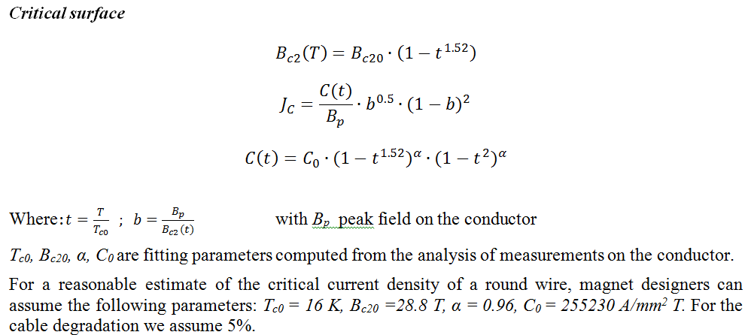
Critical current density
Bernardo Bordini CERN
Top = 4.2 K

Slide 3
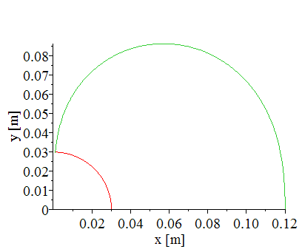
Pre-analysis
Operating current with 10% LL margin
vs
Bpeak
jo = 200 A/mm² (10000 A/21.4x2.22mm² - 5%)
Bo = 13.1 T (b3 = 0)
(approximately what is needed to reach 16 T with yoke)
X max = 119 mm
Turns = 158 (1.58e6 ampère.turn)
Aperture Φ = 30 mm (support needed for block coil)
40 strands
1 mm diameter
Cu2noCu = 1
5 % degradation
d = 0.144
λ = 0.00205

Slide 4
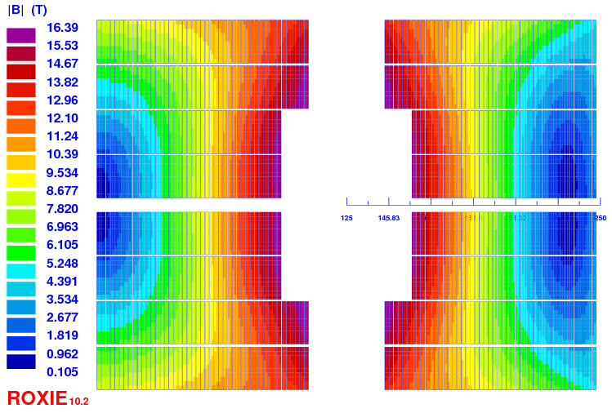
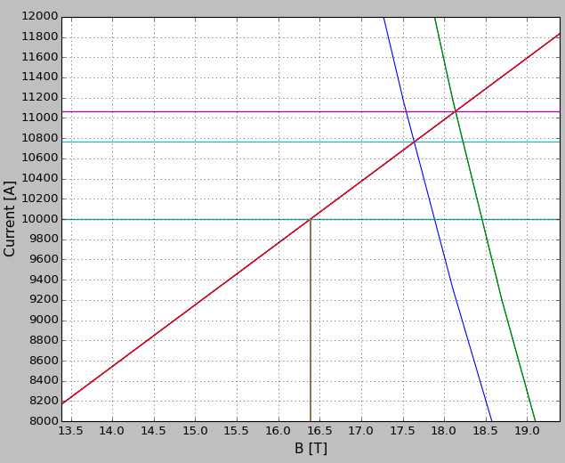
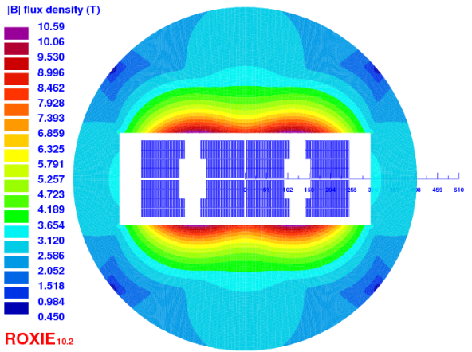
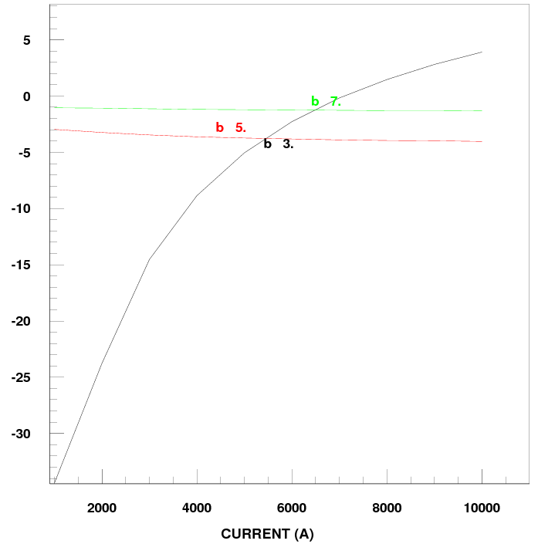
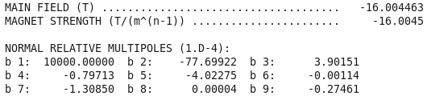
Design no-grading
Quantity | Unit | Value
H_bare | mm | 21.0
W_bare | mm | 1.82
Isol. | mm | 0.2
Cu/nonCu | . | 1.0 – 1.4
N strands | . | 40
Ф | mm | 1.0
Quantity | Unit | Value
Iop | kA | 10.0
N turns | . | 176
Bpeak | T | 16.39
Margin LL | % | 9.6 – 7.1
Cu/nonCu | . | 1.0 – 1.4
Outer dia | mm | 820
Fx per ½ coil | kN/m | 11,400
Definition of geo/sat for harmonics? 1 aperture/2 aperture/low current/operating current…?

Slide 5
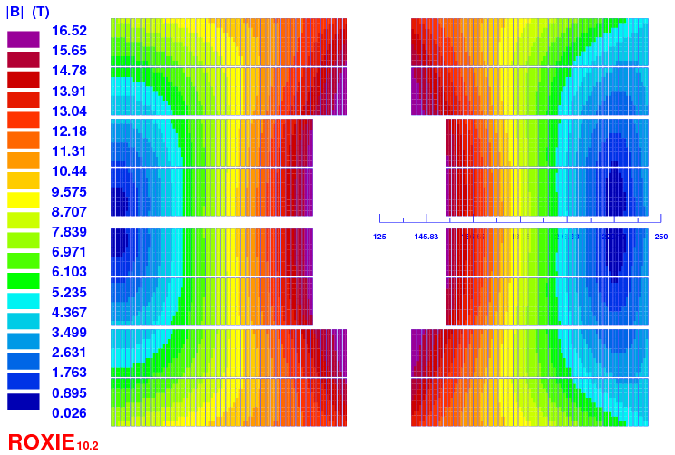
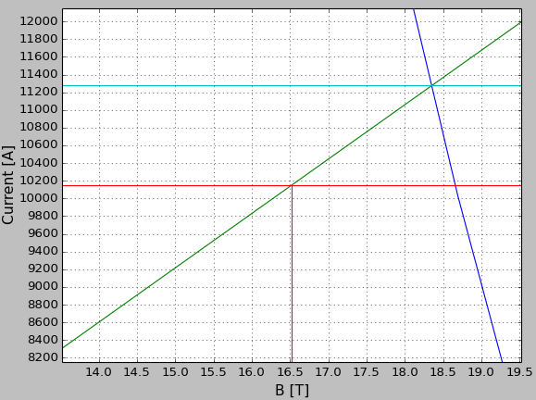
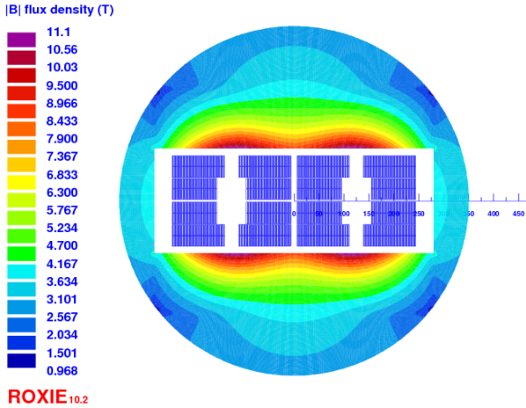
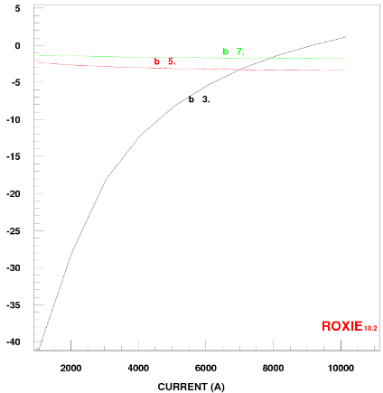
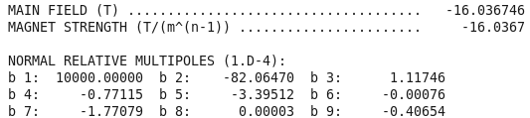
Design grading (v12)
Quantity | Unit | Value
H_bare | mm | 21.0
W_bare | mm | 2 / 1.82
Isol. | mm | 0.2
Cu/nonCu | . | 1.0 / 1.9
N strands | . | 36 / 40
Ф | mm | 1.1 / 1.0
Quantity | Unit | Value
Iop | kA | 10.15
N turns | . | 174
Bpeak | T | 16.52
Margin LL | % | 10.0
Cu/nonCu | . | 1.0 / 1.9
Outer dia | mm | 750
Fx per ½ coil | kN/m | 11,310
X1v12 = 29.5 mm
X2v12 = 119.3 mm

Slide 6
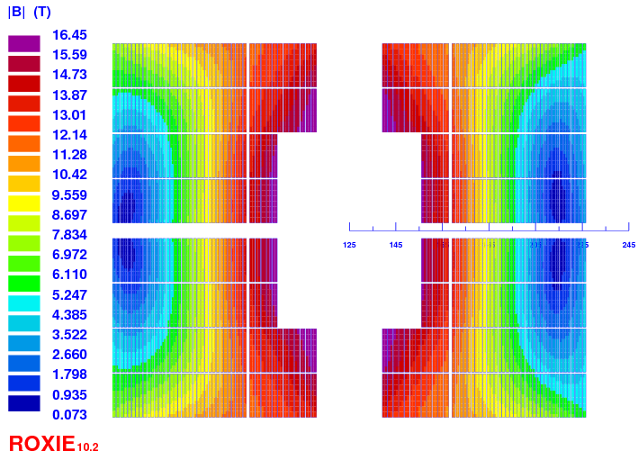
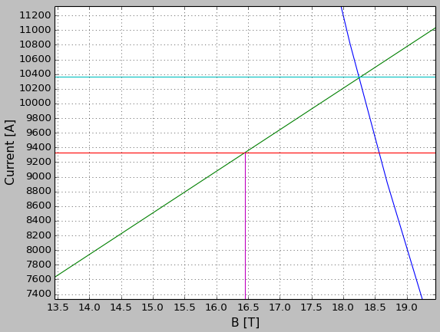
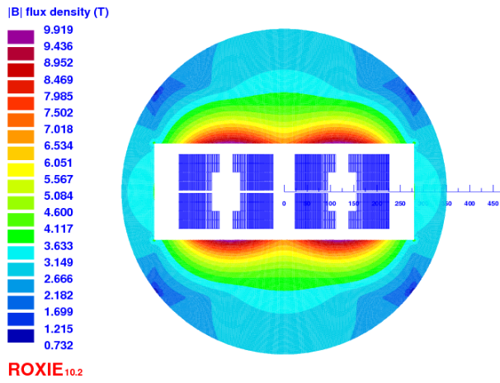
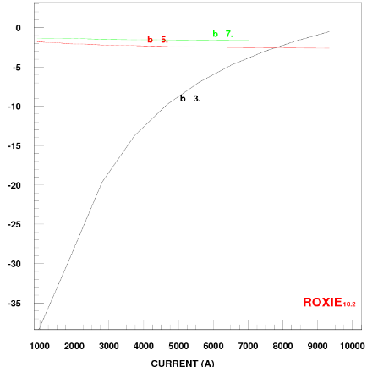
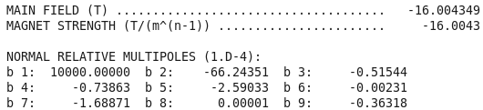
Design grading (v10)
Quantity | Unit | Value
H_bare | mm | 18.5
W_bare | mm | 2 / 1.25
Isol. | mm | 0.2
Cu/nonCu | . | 1.0 / 1.7
N strands | . | 32 / 50
Ф | mm | 1.1 / 0.7
Quantity | Unit | Value
Iop | kA | 9.33
N turns | . | 174
Bpeak | T | 16.46
Margin LL | % | 10.0
Cu/nonCu | . | 1.0 / 1.7
Outer dia | mm | 750
Fx per ½ coil | kN/m | 10,280
X1v10 = 30.8 mm
X2v10 = 101.75 mm

Slide 7
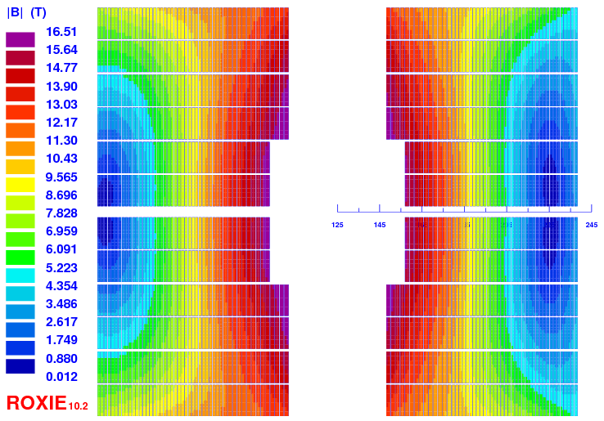
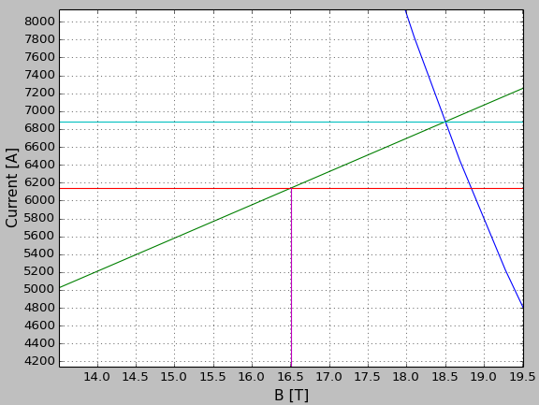
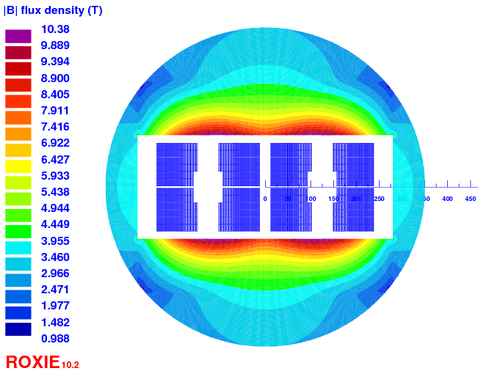
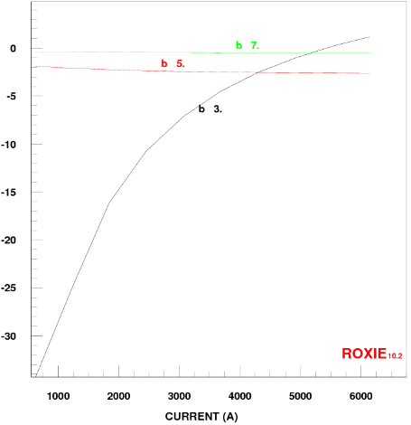
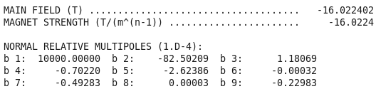
Design grading (v11)
Quantity | Unit | Value
H_bare | mm | 14.7
W_bare | mm | 1.82 / 1.25
Isol. | mm | 0.2
Cu/nonCu | . | 1.0 / 3.7
N strands | . | 28 / 40
Ф | mm | 1.0 / 0.7
Quantity | Unit | Value
Iop | kA | 6.14
N turns | . | 292
Bpeak | T | 16.51
Margin LL | % | 10.8
Cu/nonCu | . | 1.0 / 3.7
Outer dia | mm | 750
Fx per ½ coil | kN/m | 11,160
X1v11 = 31.8 mm
X2v11 = 113.4 mm

Slide 8



Conclusion - Cables
Quantity | Unit | ~cable Fresca2 | ~cable QXF | cable 1 | cable 2 | cable 3 | cable 4
# strands | - | 40 | 40 | 36 | 32 | 50 | 28
diameter | mm | 1 | 0.7 | 1.1 | 1.1 | 0.7 | 1.0
thickness | mm | 1.82 | 1.25 | 2.0 | 2.0 | 1.25 | 1.82
width | mm | 21.0 | 14.7 | 21.0 | 18.5 | 18.5 | 14.7
isolation | mm | 0.2
Bernardo’s face
Magnet version |  | no-grad v12 | v11 | v12 | v10 | v10 | v11

Slide 9




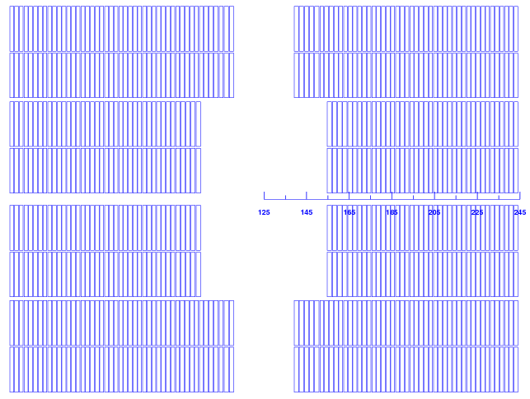
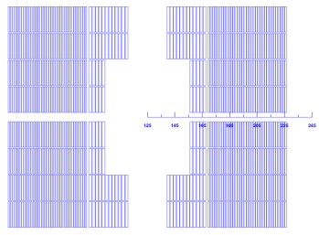
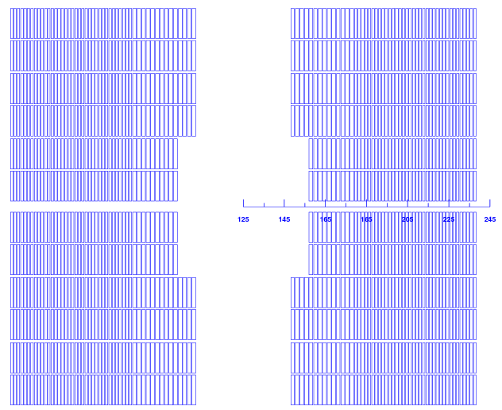
Conclusion - Magnets
Quantity | Unit | v12 | v10 | v11
Iop | kA | 10.15 | 9.33 | 6.14
Bpeak | T | 16.52 | 16.46 | 16.51
Margin LL | % | 10 | 10 | 10.8
Nturns | - | 174 | 174 | 292
NDP | - | 2 | 2 | 3
Inner coil | mm | 29.6 | 30.8 | 31.8
Outer coil | mm | 119.3 | 101.8 | 113.4
Fx | kN/m | 11310 | 10280 | 11160
Cu/nonCu | - | 1.0 / 1.9 | 1.0 / 1.7 | 1.0 / 3.7
Cable | -
Same scale

