Slide 1
HL-LHC:
Overview of the
HL-LHC Organization beyond the FP7 HiLumi project
1

Slide 2
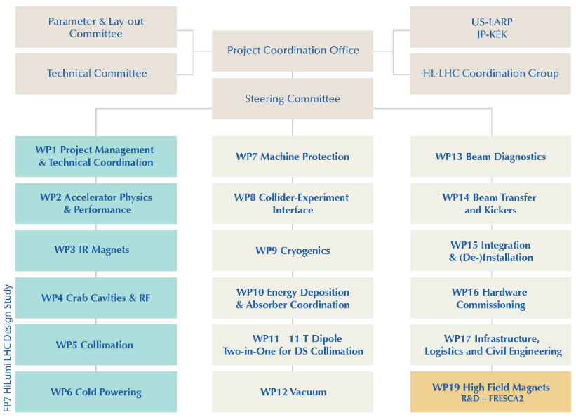
High Luminosity WP Coordination during DS:

Slide 3
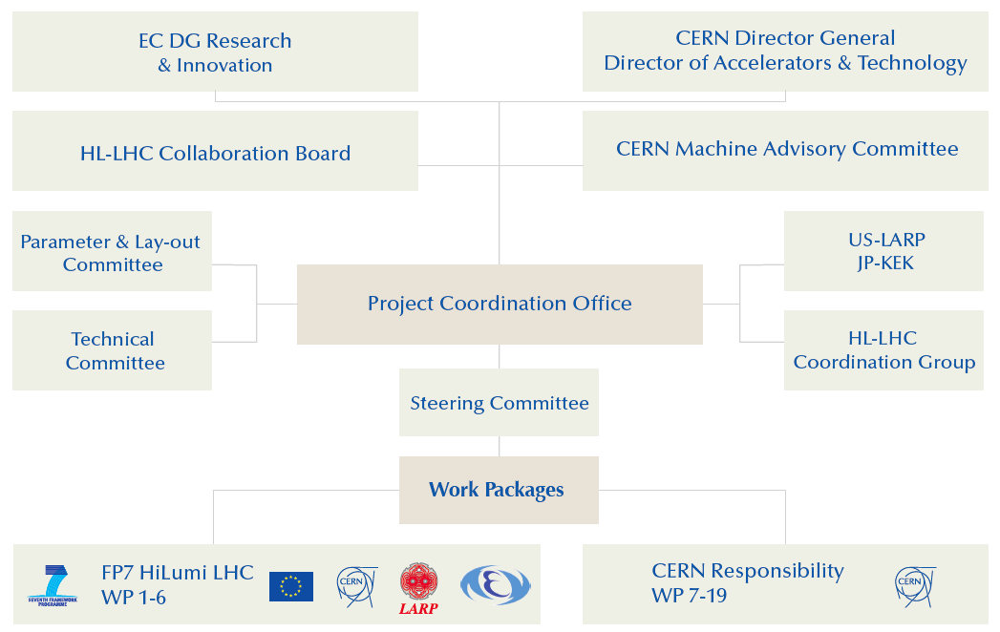
Project Governance during FP7 DS:

Slide 4
HL-LHC Technical Coordination Committee: TCC
Publication of HL-LHC TDR
  Less frequent need for approval process from Parameter & Layout Committee
  diminishing role separation between the HL-LHC PLC and TC
  increased need for integration of departmental and group management for transition to prototyping, testing and construction (resource planning and impact!)
New Technical Coordination Committee replacing the PLC and TC
  Regular (bi-?)weekly meetings
  aim for biannual review of the general HL-LHC parameters and layout
    Version release
  involvement of relevant GL and DH

Slide 5
HL-LHC Technical Coordination Committee: TCC
Mandate: The HL-TCC is the main forum for defining, in collaboration with the work package (WP) leaders and the project management, the baseline* of the HL-LHC project and establishing and maintaining coherent sets of parameters and the associated hardware lay-out for the HL-LHC. These sets will be referred to as the HL-LHC Baseline and Options in the following. The HL-TCC will monitor and recommend changes in parameters or machine layout and the required resources and work plan based on the technical discussions at the HL-TCC meetings, interim reports from the WP leaders or any other relevant bodies of the project or of the CERN A&T sector such as group leaders and department heads. When applicable, it will also request dedicated studies to solve or mitigate any possible kind of inconsistencies and interface issue between different systems or equipment and prepare the decision making process. The HL-TCC may give also recommendation on hardware equipment, especially when the HL-LHC operation and functionality is involved, without prevailing on the responsibility of the WP leaders.
    → The HL-TCC reports to the HL-LHC Project Leader.
    The HL-LHC Deputy Project Leader is the HL-TCC chair ex-officio and is
    assisted by a deputy chair(s) and a scientific secretary(s).
*) A Baseline is a set of attributes at a point in time. It serves as a basis for defining change. HL –LHC maintains
Scope, Schedule and Cost Baselines

Slide 6
Accelerator Technology Sector Committees:
BE, TE & EN DH
Accelerator & Technology Sector Management Board
LMC
IEFC
HL-LHC Project
BE, TE & EN DH and GLs
LHC experiments
Experimental areas
BE, TE & EN alt DH and alt GLs
LIU Project
WG:
FOM
MPP
LBOC
LHC Machine Coordinators
LHC related Projects
(e.g. Collimation)
Injector related Projects:
(e.g. LINAC4)
Machine Supervisors
WGs:
FOM
MSWG
Appears like two Separate Worlds that are only connected via the ATS MB!!!

Slide 7
New Executive Committees within ATS:
Accelerator & Technology Sector Management Board & EATSMB
LHC experiments
New HL-LHC & LIU
Executive Committee
C-MAC
HL-LHC Project
LIU Project
Other Projects
LMC
BE, TE & EN DH and GLs
IEFC
Working Groups
e.g
MPP
LBOC
LHC Machine Coordinators
Machine Supervisors
Working Groups
FOM
MSWG
Experimental areas

Slide 8
Post FP7 HL-LHC Project Governance:
C-MAC
CERN Directorate and
Accelerator & Technology Sector
ATSMB & EATSMB
Experiments
HL-LHC & LIU Executive Committee
HL-LHC
Collaboration Board
HL-LHC Project Office
LIU
Project
IEFC
LMC
US-LARP
KEK
HL-LHC Coordination Group
HL-LHC TCC
A&TS DH
GLs
HL-LHC
Work Packages

Slide 9
Post FP7 HL-LHC Project Office Organization:
Project Leader & Deputy
Project Definition & Strategy
Report to CERN Management and DHs
Report to Collaboration Board
Coordination technical WPs (2-14) & Collaborations
Safety officer
Budget Officer
Budget & its follow-up
Link to RC and to DAT
Project Office Manager
Coordination among officers, secretariat, interface with host states, General Planning Coordination, Safety follow up
KT, Outreach and Communication
Technical Infrastructure Officer
Civil Engineering
Impact & Environ. Studies
Electrical Distr. & CV
Access & Alarm
Logistics & link to Test Infra.
Consolidation & Operations
Configuration, Quality and Resource Officer
TDR Edition & Tech. Baseline
(PBS, interfaces, Tech. Specs, Technical documentation & ECR)
Quality and Risk management
Resource & Purchase Plan
Integration and Installation Officer
Integration study and layout
Lead (de-) installation
Survey

Slide 11
Project Governance: Managerial bodies
HL-LHC Collaboration Board
Top-level body for the HiLumi Collaboration
Has representatives of all HiLumi Partners
Meets at least once per year
HL-LHC Coordination Group
Forum for setting common and coherent set of
goals, parameters & plans for the HL-LHC project,
Forum for official information transfer
Chaired by Project Leader, representatives of all
Experiments (spokes persons); LIU, Research and
A&T Directors; HL-LHC Technical coordinator
Project Coordination Office
Meets weekly:
PL and DPL, Technical Coordinator, Safety Officer,
Budget and Resource Manager, Outreach,
FP7 HiLumi Admin Manager, Integration Officer
HL-LHC Steering Committee
Forum for information exchange between
the different Work Packages (1 / month)
All HL-LHC WP coordinators & USLARP represent.

Slide 12
Project Governance: Technical Bodies
HL-LHC TC
Defines the technical baseline of the project.
Technical Specification of the individual
HL-LHC Components & Layout and Integration
➔ Detailed technical discussions
HL-LHC PLC
The PLC establishes and maintains a coherent
and dynamic list of parameters and the associated
hardware lay-out for the HL-LHC
➔ Official approval of Layout and Parameters
LMC
The central CERN LHC Committee:
Assures transfer of operational experience from
LHC to the HL-LHC project and assures that
LHC upgrades and modifications remain
Compatible with the HL-LHC requirements.
C-MAC
External Scientific Advisory board.
Looks after all of CERN’s accelerator facilities.

