Slide 1
wg7
2015 Test Beam Activities

Slide 2
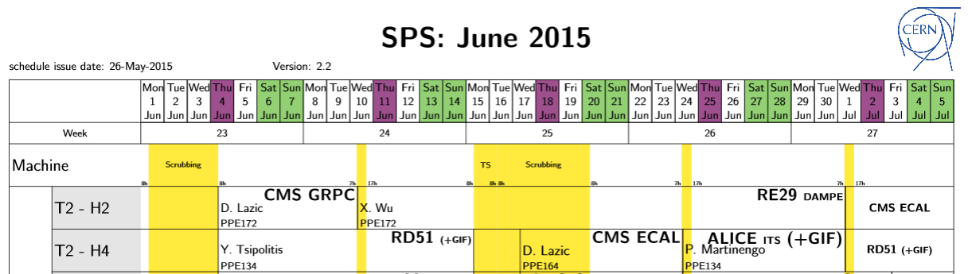
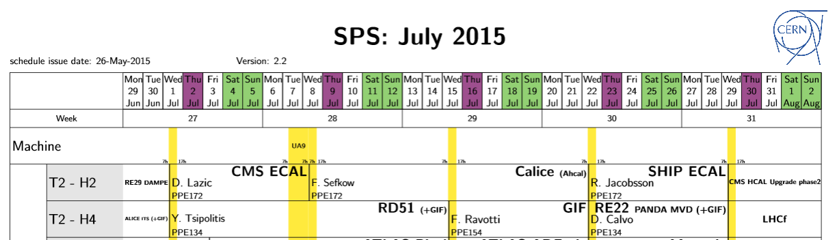
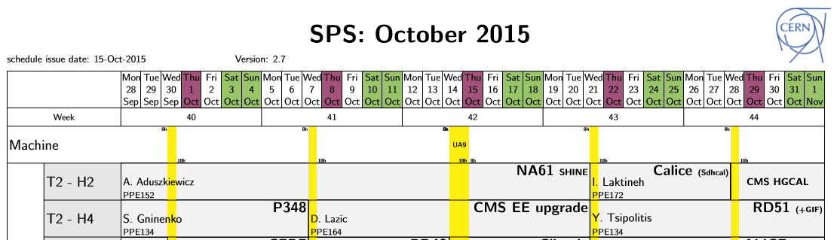
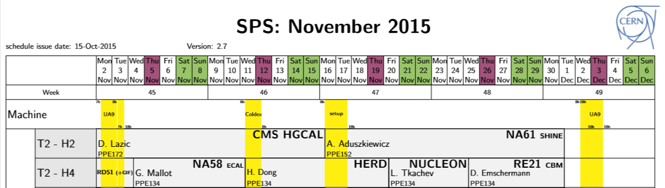
RD51 2015 Test Beam
Brief Summary of June and July Test Beam
Plans for the October/November Test beam
Test Beam 2016

Slide 3
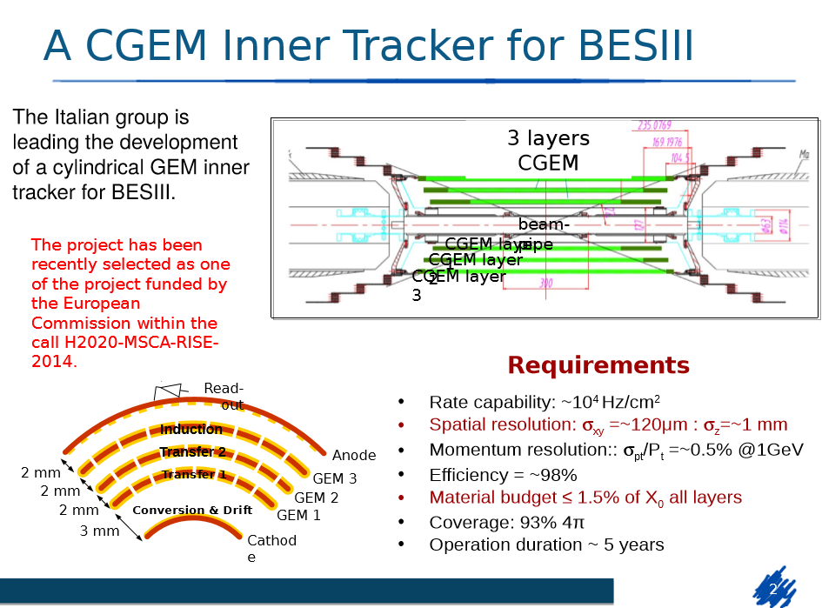
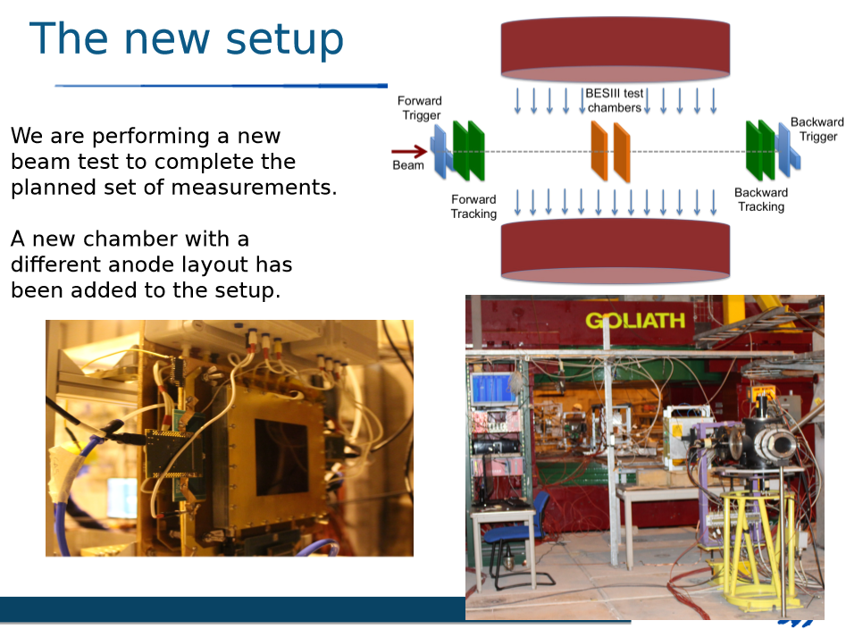
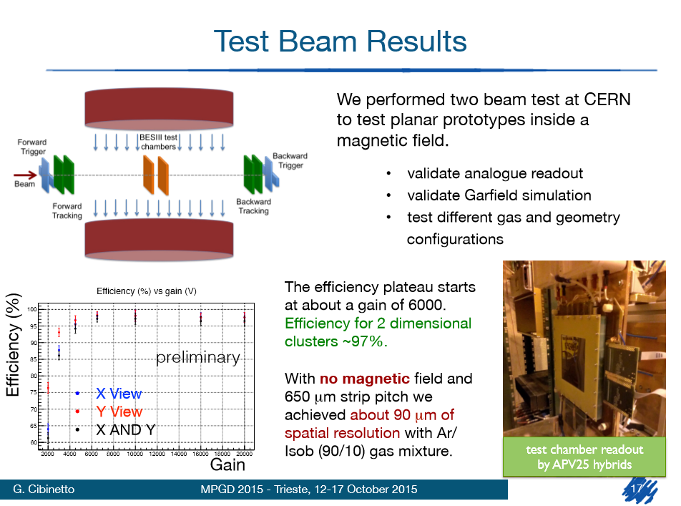
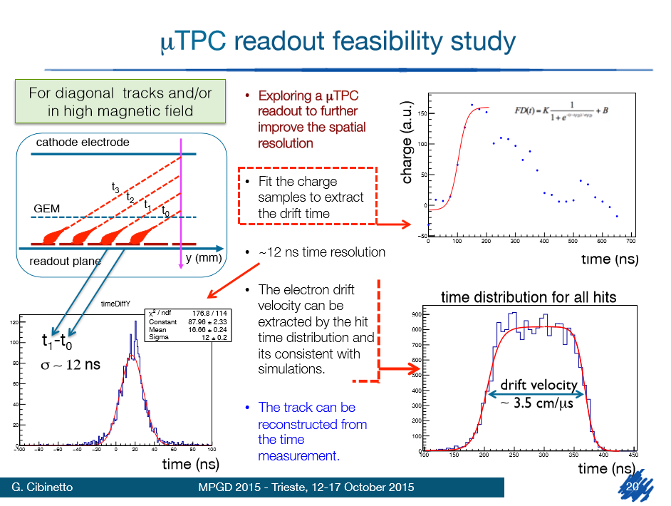
June
(LNF, Ferrara)
https://indico.cern.ch/event/392637/session/5/contribution/27/attachments/785354/1076521/RD51MiniweekMeeting2015.06.09.pdf
MPGD 2015 – RD51 Collaboration Meeting: https://agenda.infn.it/getFile.py/access?contribId=28&sessionId=2&resId=0&materialId=slides&confId=8839
June

Slide 4
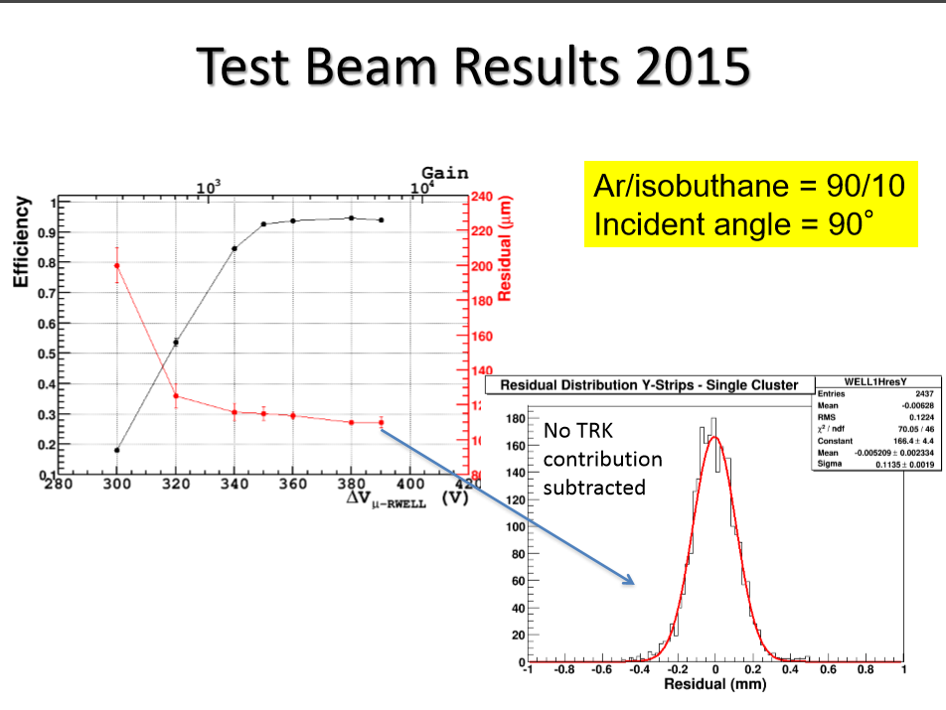
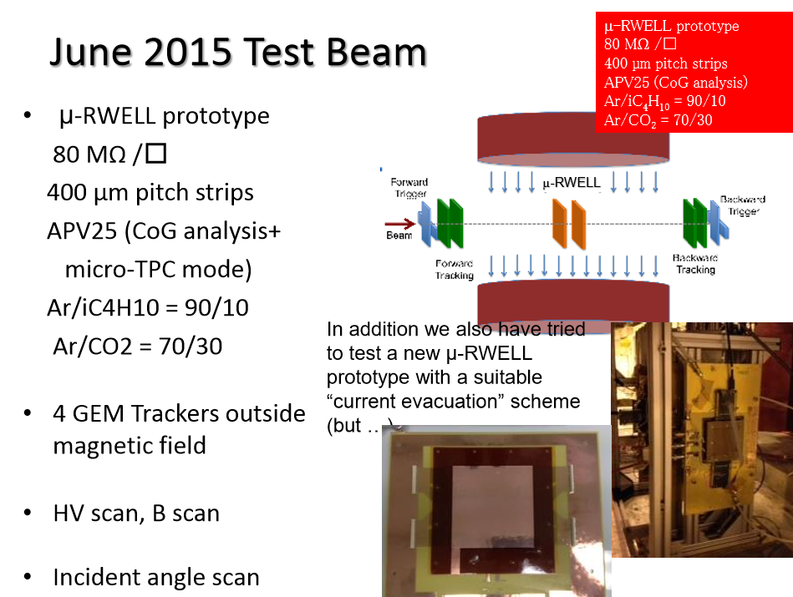
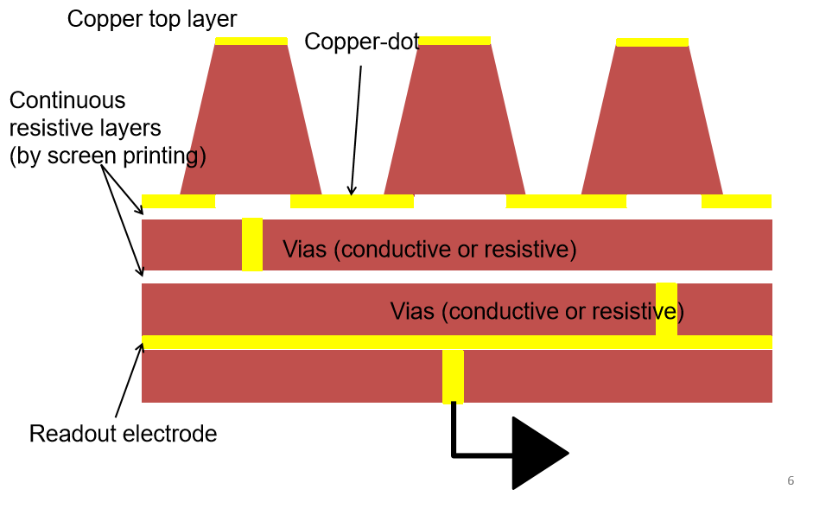
June
μ-RWELL (LNF)
https://indico.cern.ch/event/392637/session/5/contribution/28/attachments/785358/1076536/MiniWeeek_2015_test_beam.pdf
June

Slide 5
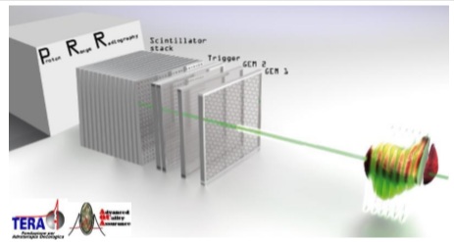
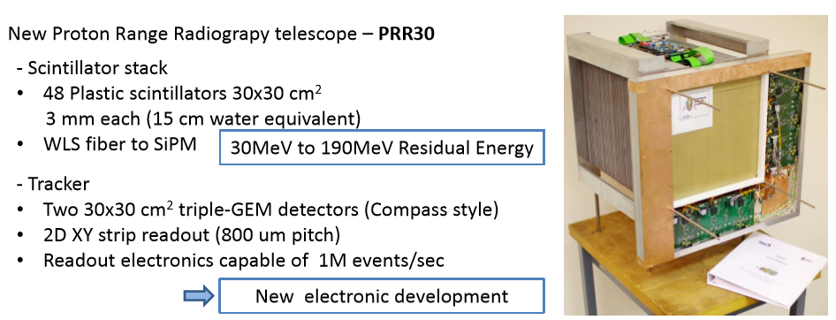
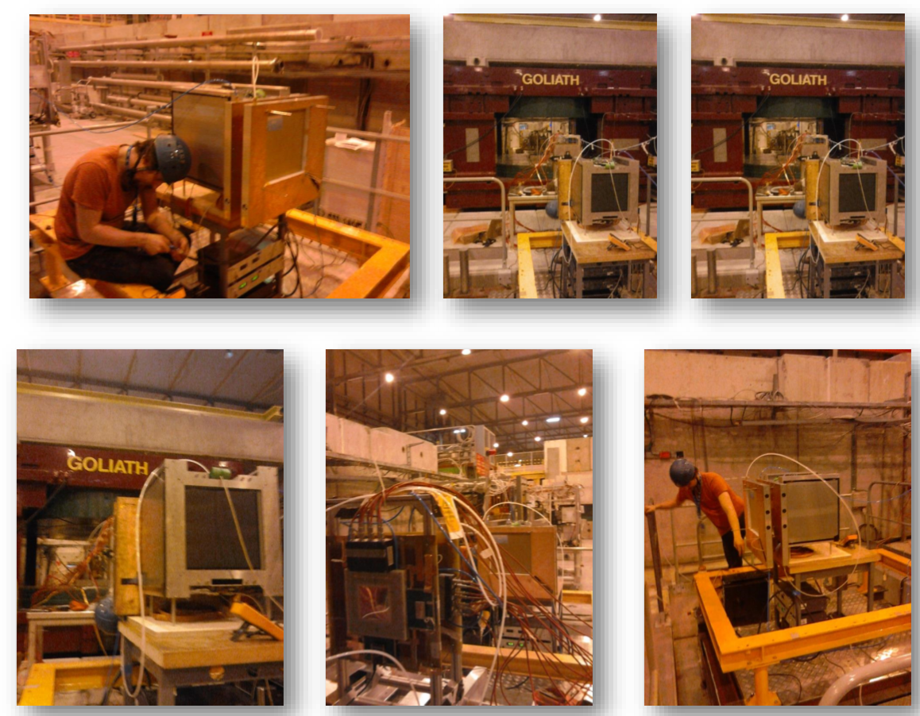
June
Proton Range Radiography (TERA)
https://indico.cern.ch/event/365380/session/6/contribution/54/attachments/726455/996903/Bucciantonio_PRR_2015_03_20.pdf
June

Slide 6
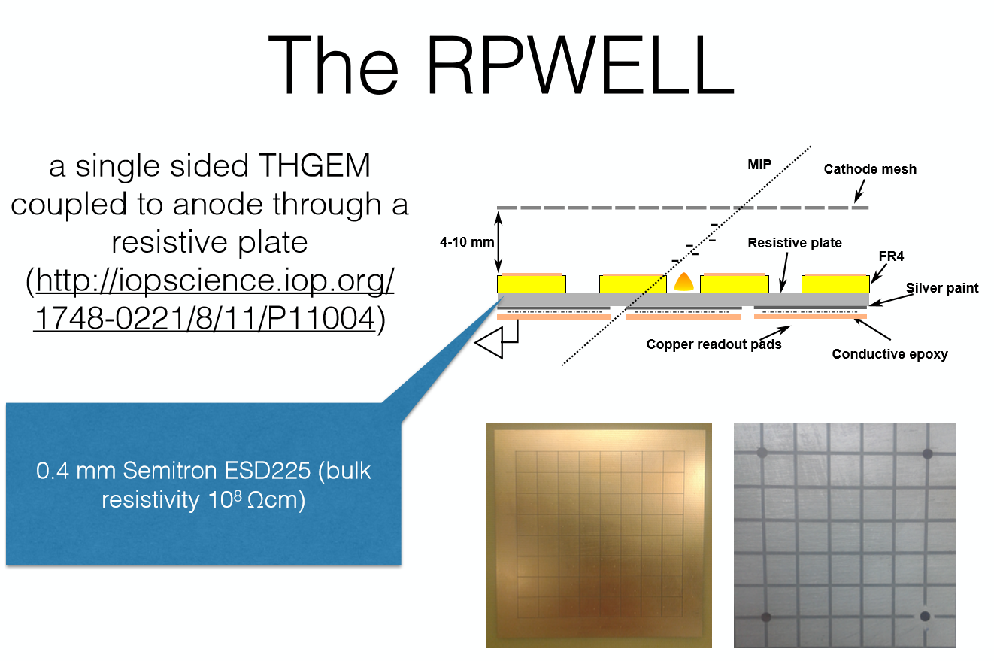
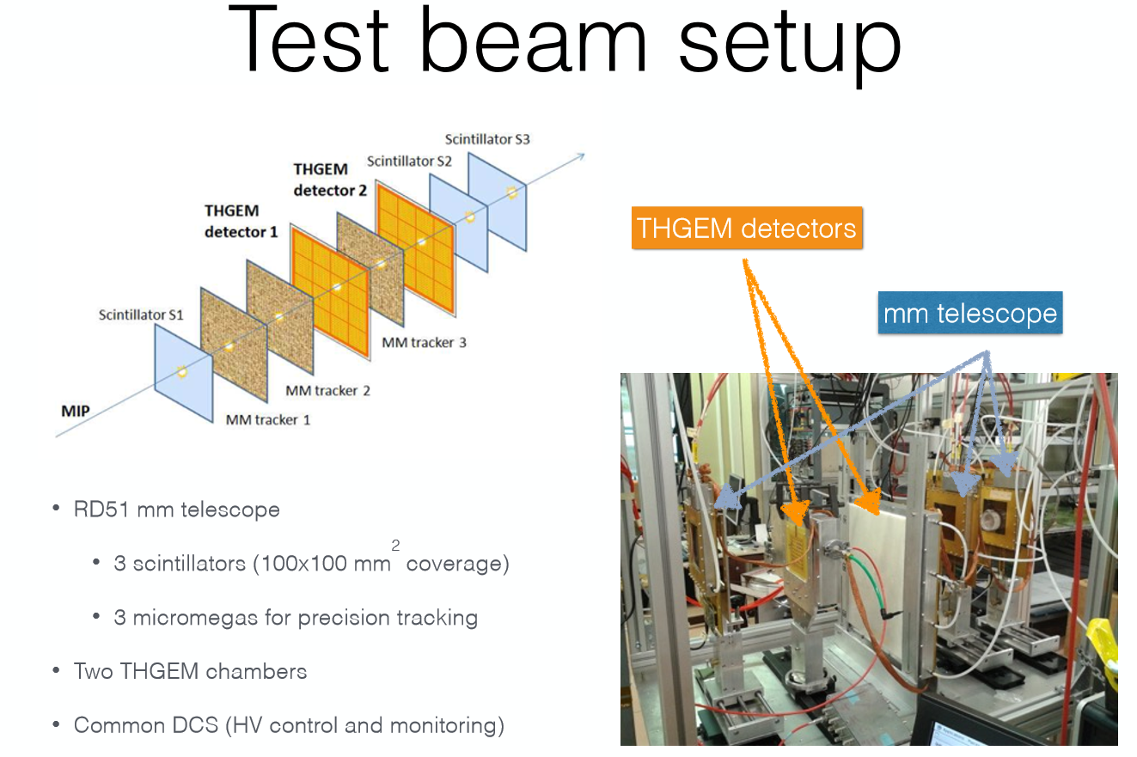
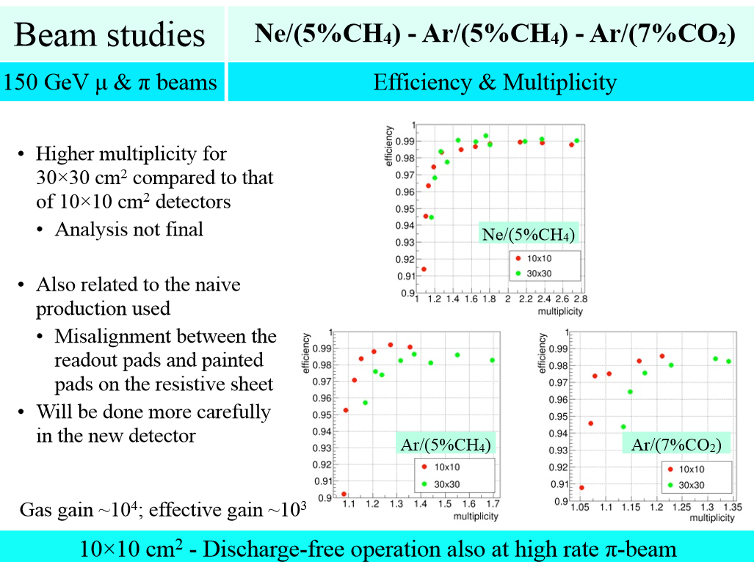
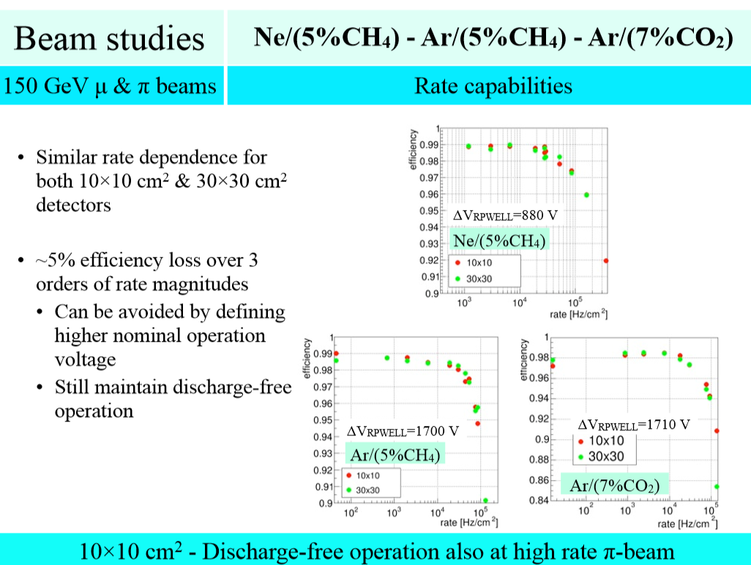
July
(WIS/Coimbra/Aveiro)
https://indico.cern.ch/event/392637/session/5/contribution/30/attachments/785380/1076571/RD51_MiniWeek-1506.pdf
MPGD 2015 – RD51 Collaboration Meeting: https://agenda.infn.it/getFile.py/access?contribId=8&sessionId=2&resId=0&materialId=slides&confId=8839
July

Slide 7

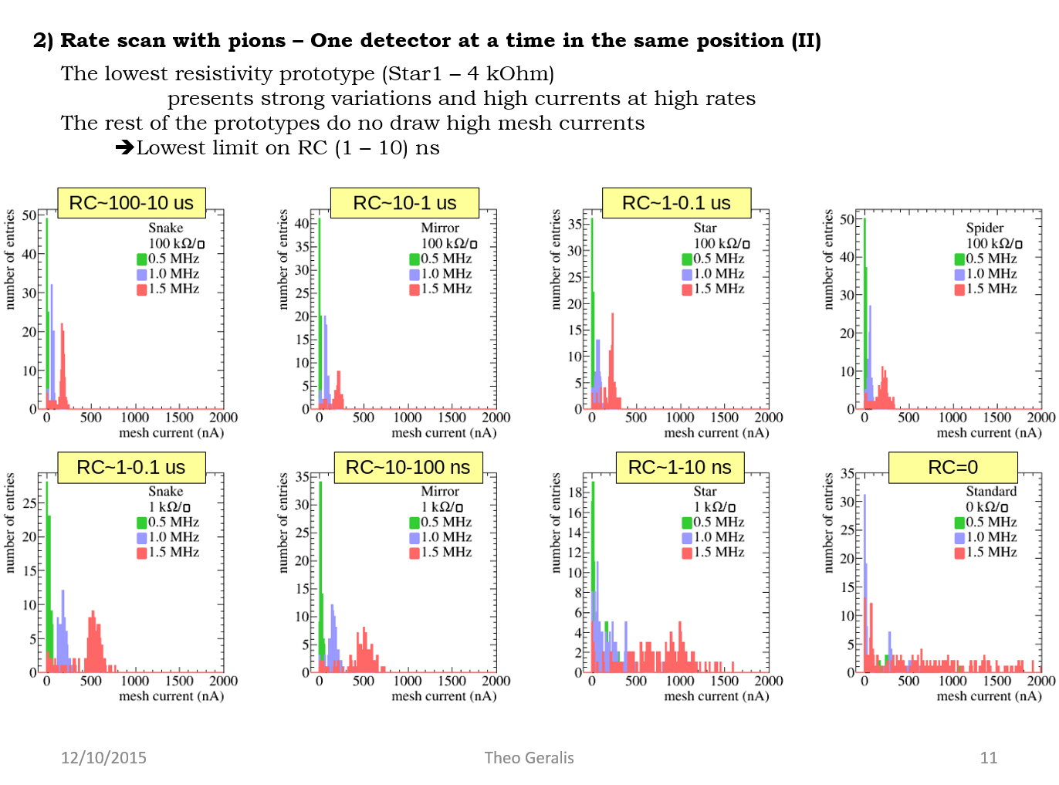
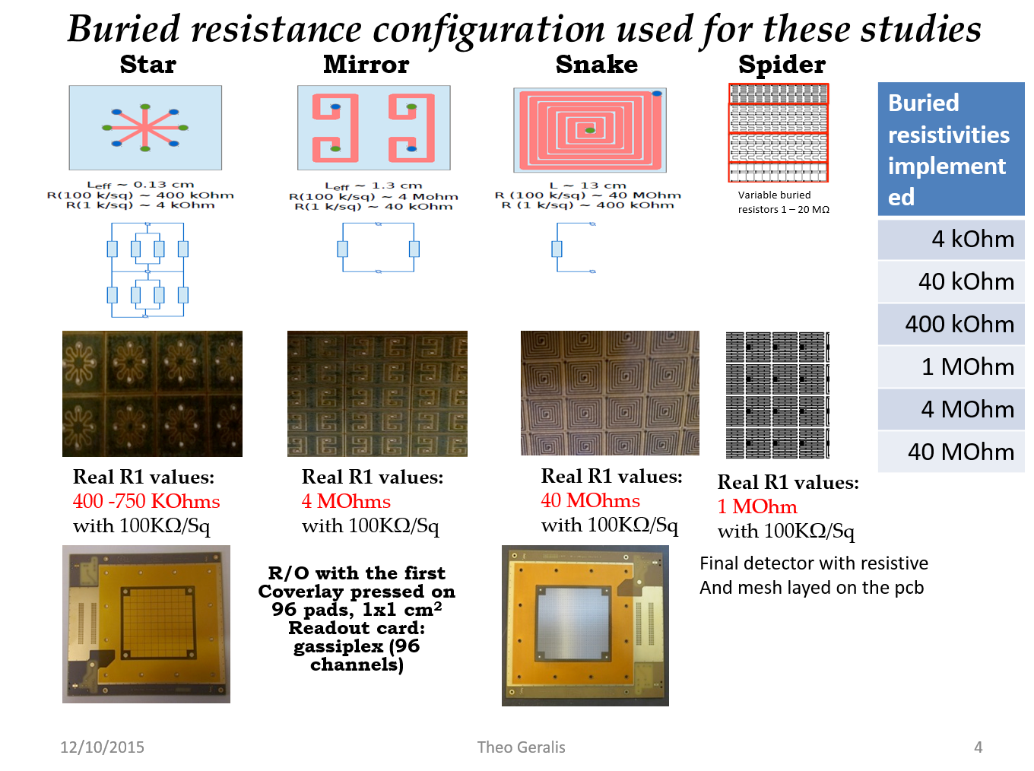
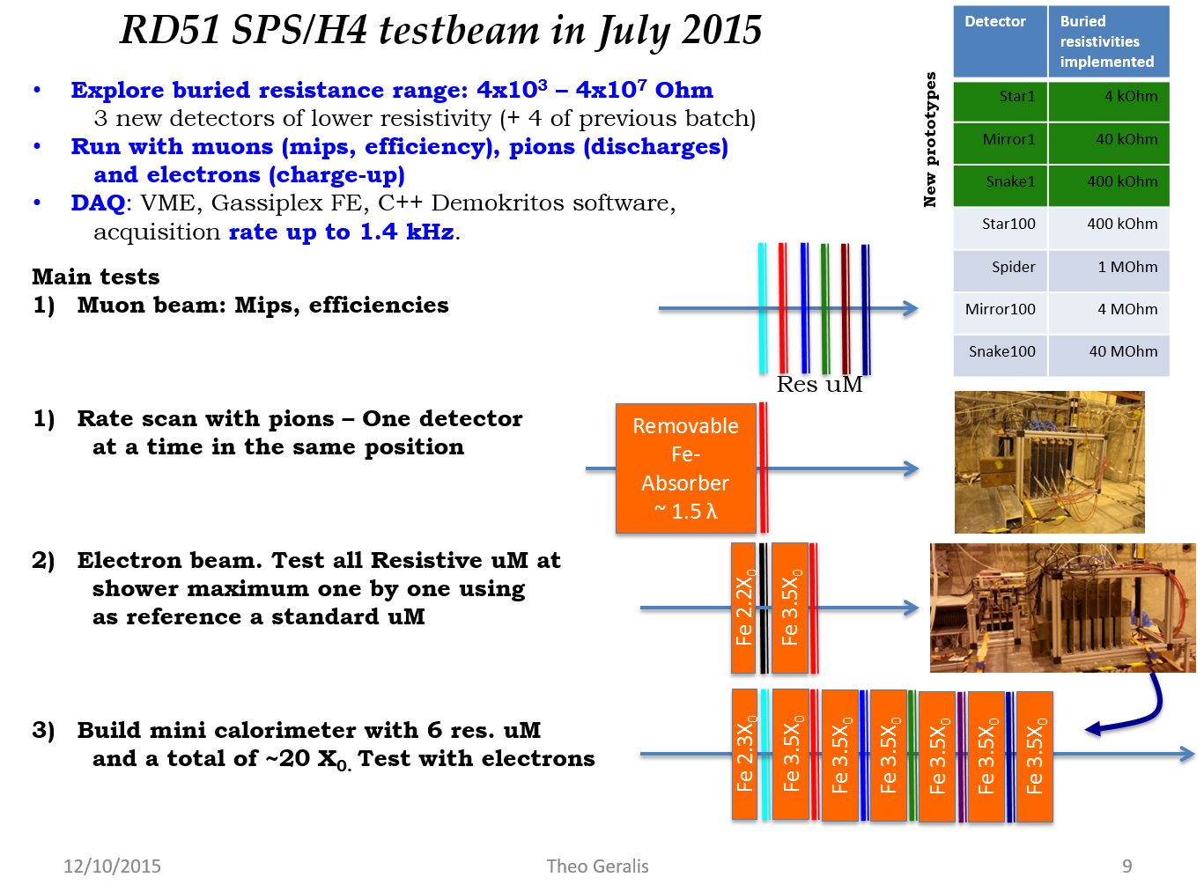
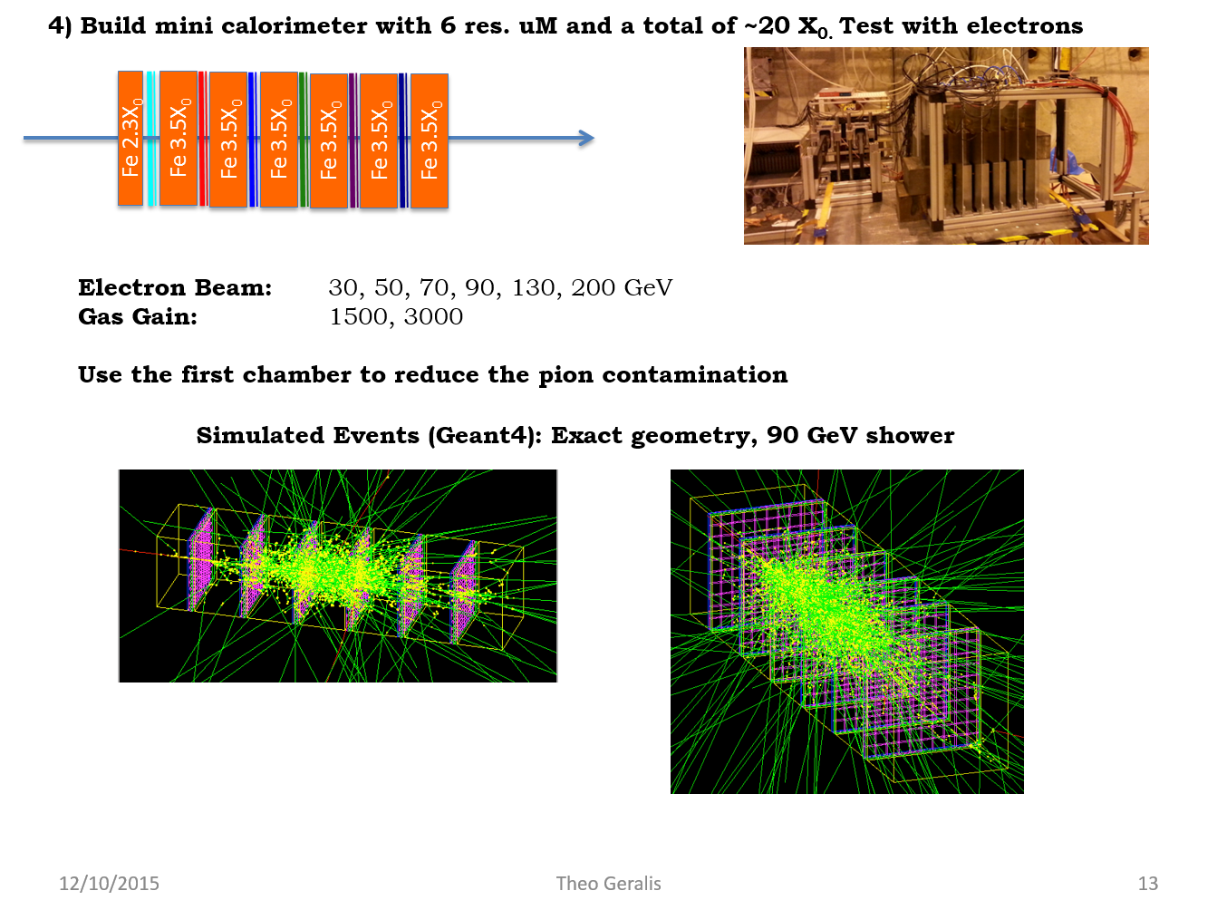
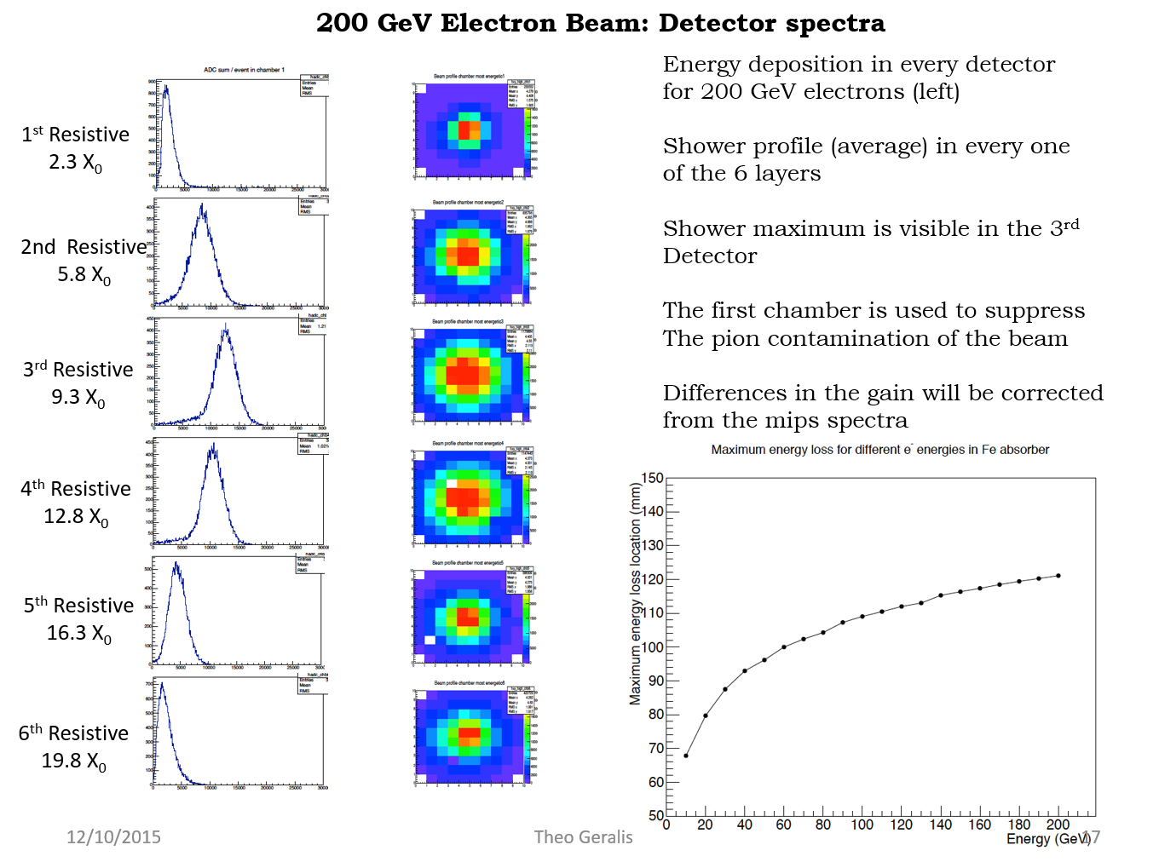
July
(LAPP/NCSR/CEA)
MPGD 2015 – RD51 Collaboration Meeting: https://agenda.infn.it/getFile.py/access?contribId=109&sessionId=2&resId=0&materialId=slides&confId=8839
https://indico.cern.ch/event/392637/session/5/contribution/31/attachments/785379/1076570/wg7_09062015.pdf
July

Slide 8
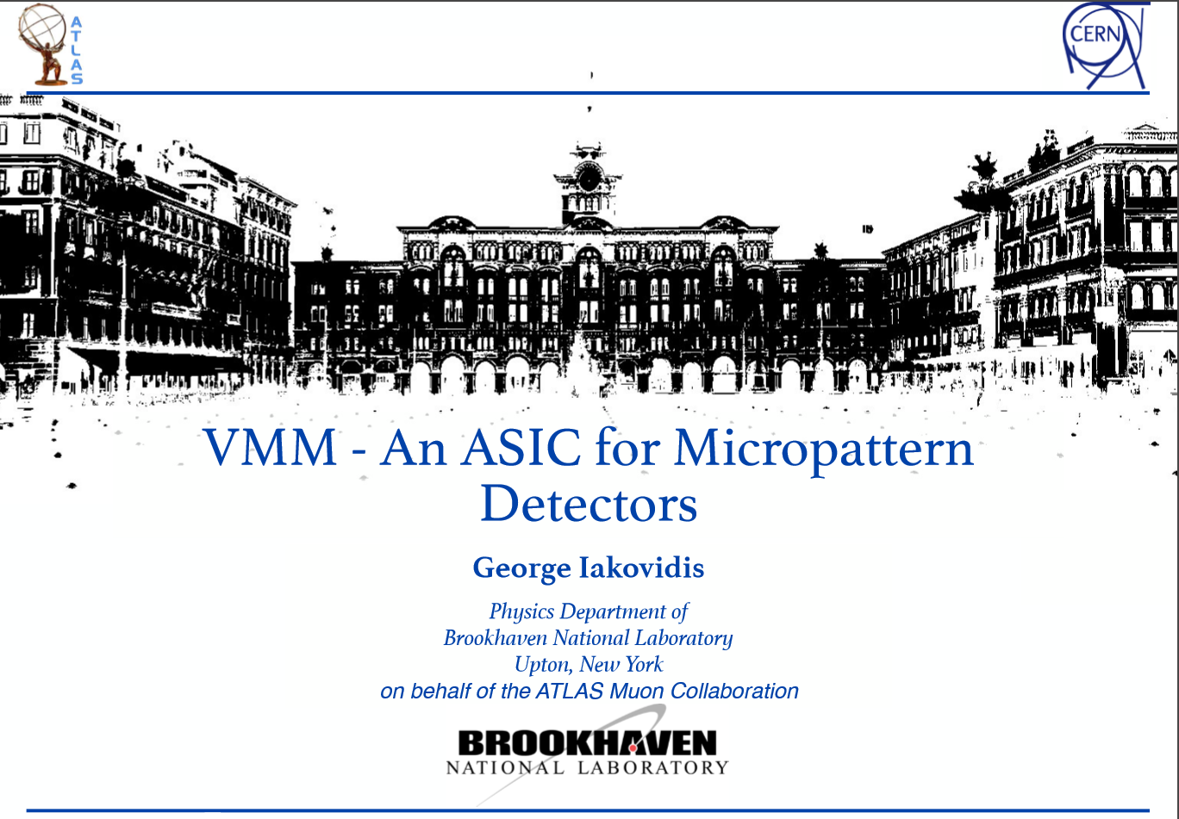
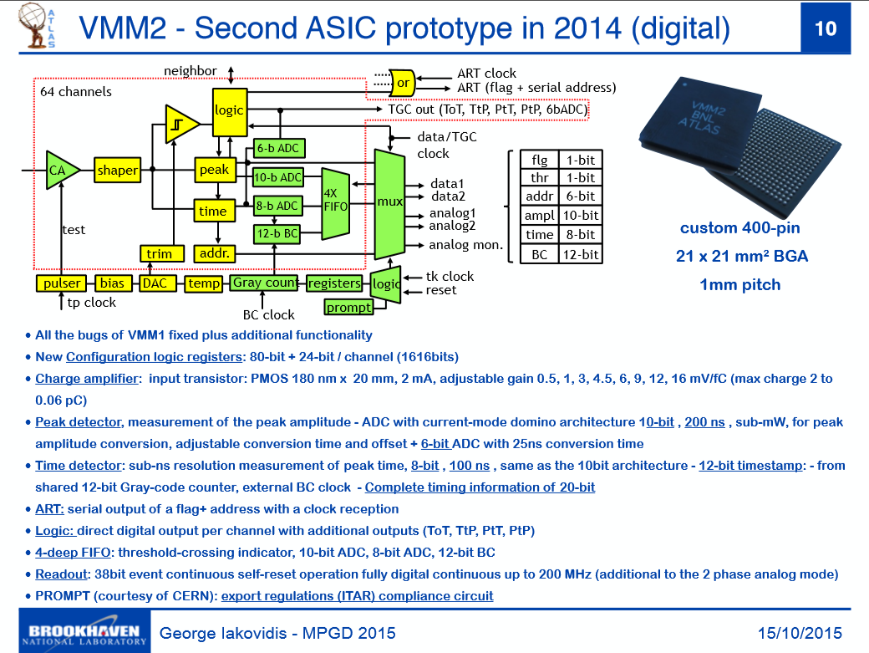
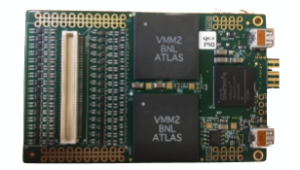
July
ATLAS & VMM (ATLAS NSW mm)
Preliminary test during the July test beam of the VMM2 on the RD51 Hybrid (SRS)
July

Slide 9

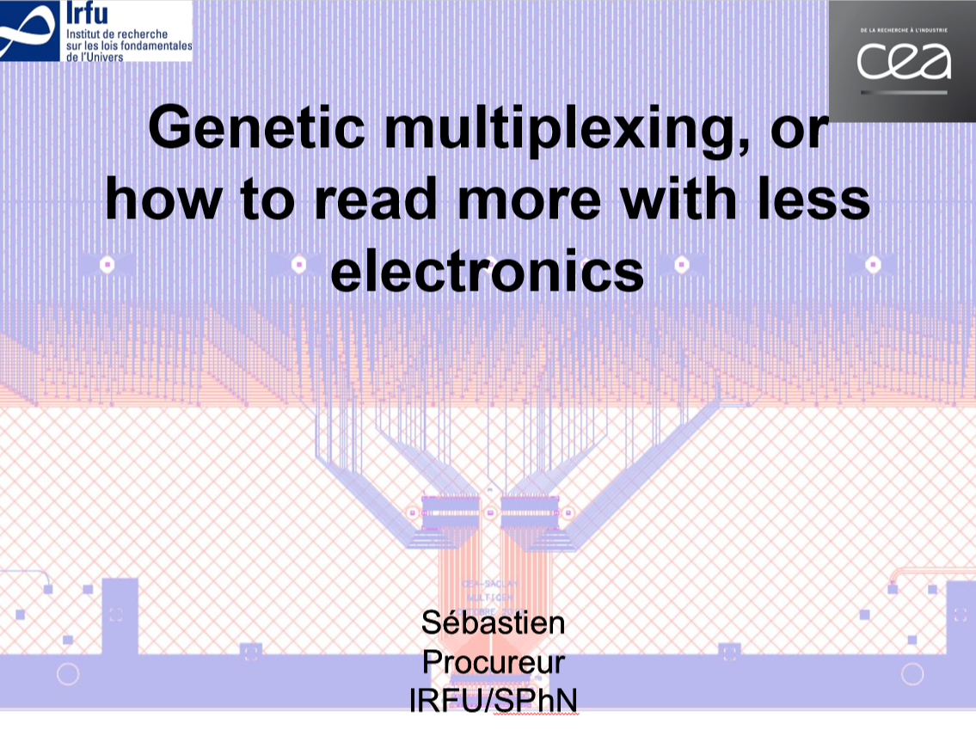
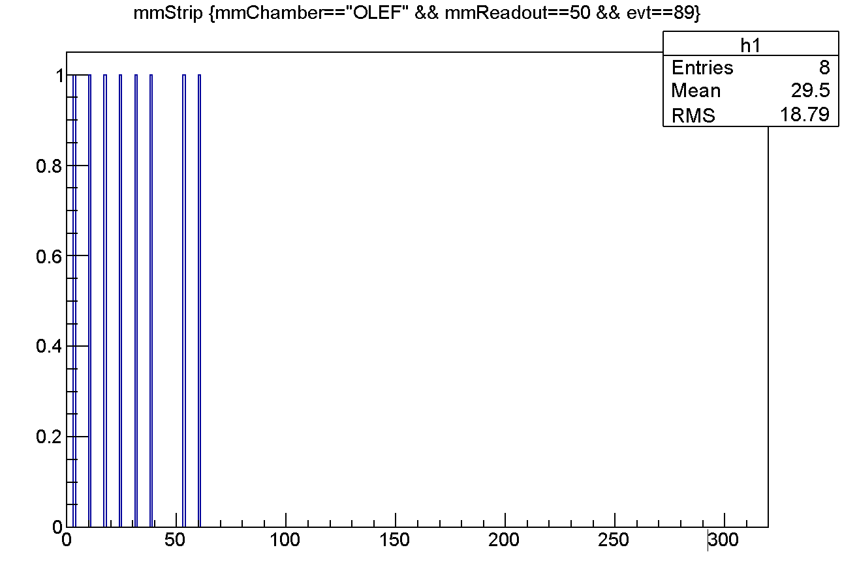
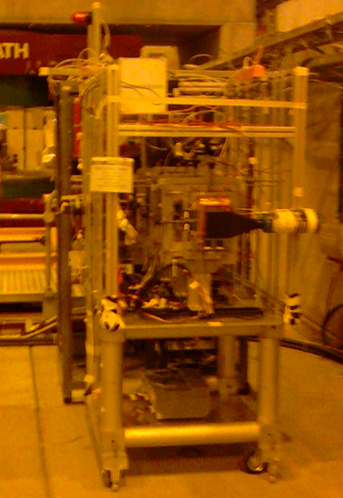
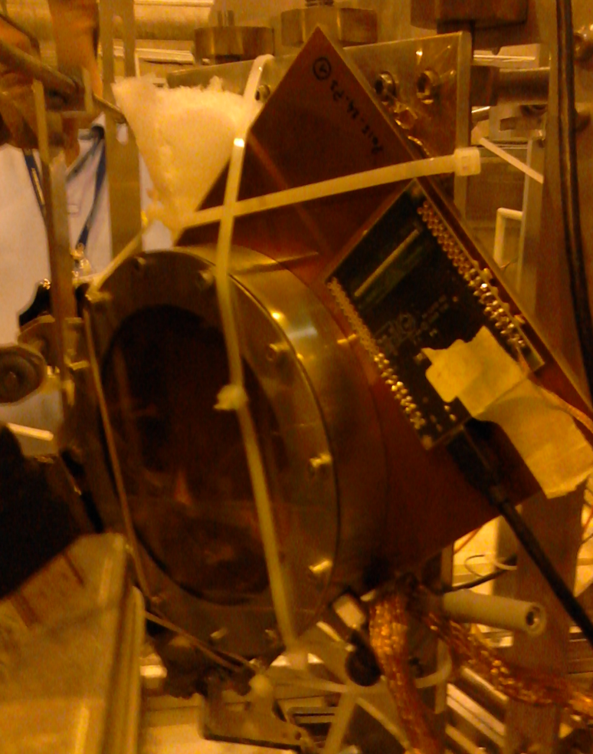
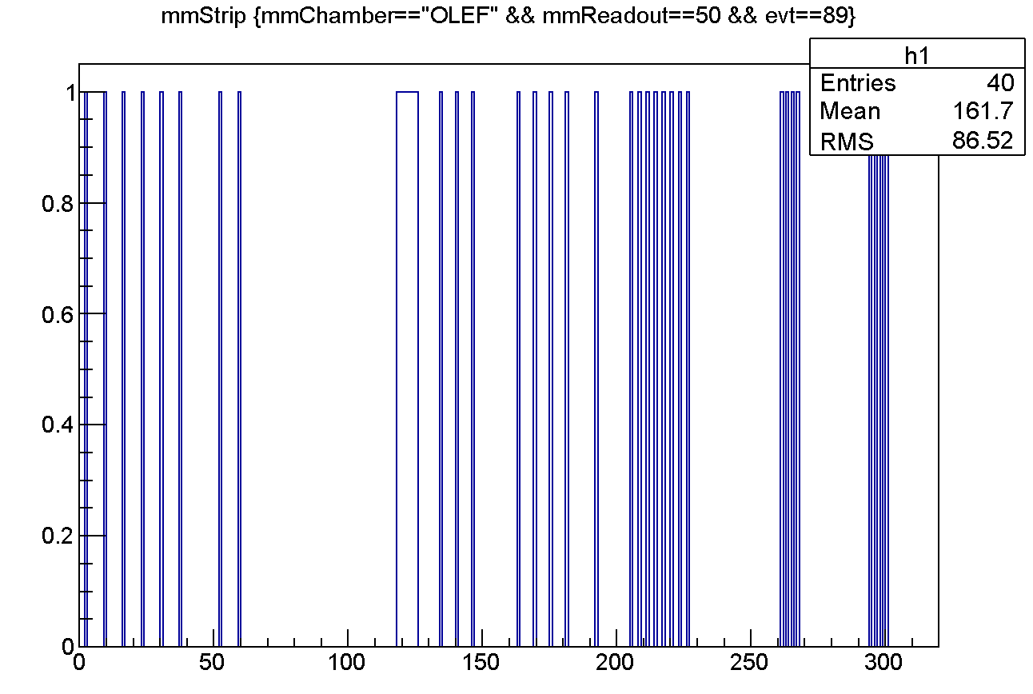
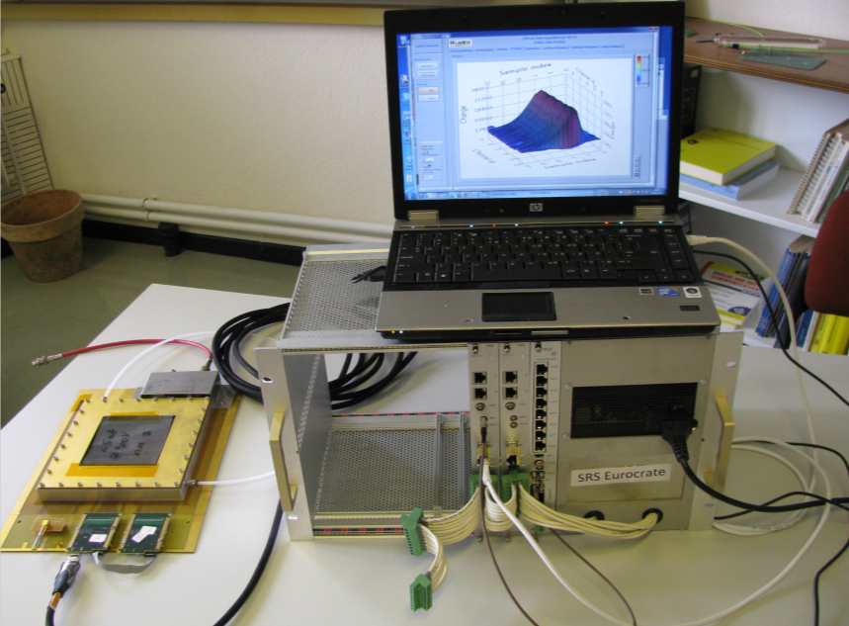
July
Essential support from the ATLAS NSW mm group for the DAQ (mmDAQ) and analysis (recomm)
P348 Test Beam Report: https://indico.cern.ch/event/385594/contribution/7/7/attachments/1171005/1690559/p348_gninenko_SPSC.pdf
D.Banerjee (ETH, Zurich)
mmDAQ & recomm
+
+
+
+
Konstantinos Ntekas
RD51 Tracker
P348 resistive mm with RD51 APV25
Preliminary test during the RD51 July test beam (few days of the full period) in view of the P348 Test Beam
July

Slide 11
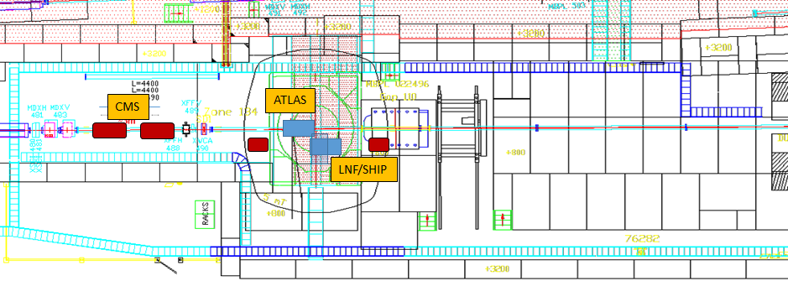
October-November 2015
ATLAS NSW micromegas upgrade: test of mm and of the new FE electronics (ATLAS VMM) in magnetic field.
CMS GEM collaboration: test of the super module detectors for the slice test, of the new electronics and DAQ and timing and efficiency test of a new prototype.
LNF(SHIP): Space resolution studies of GEM and microResistiveWELL in magnetic field. Both detectors will be coupled with emulsion bricks for a reduced part of the measurements.

Slide 12
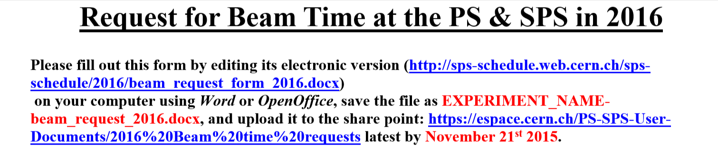
Three periods of two weeks each: Spring (May/June), Summer (July/August), Fall (October/November)

Slide 13
Summary
About 6 weeks and 9 users in total
R&D on (new) MPGD structures (RPWELL, μRWELL, embedded Pad Resistive Micromegas)
Detector (prototypes) optimization and characterization (BESIII CGEM, CMS GEM, ATLAS mm)
Detector (final design or very close) Characterization (PRR30, ATLAS NSW, CMS GEM)
FE Electronics and DAQ (ATLAS NSW mm - VMM, CMS GEM VFAT2 & DAQ, P348 genetic readout resistive micromegas and SRS/APV25)
Operation in Magnetic Field (1.5T max) – Very precious tool for the community
2016 request: 3 periods of 2 weeks each (deadline: November 21st)

