Slide 1
An autonomous system for muon densitometry
Simon bouteille
CEA/Irfu/SPhN

Slide 2
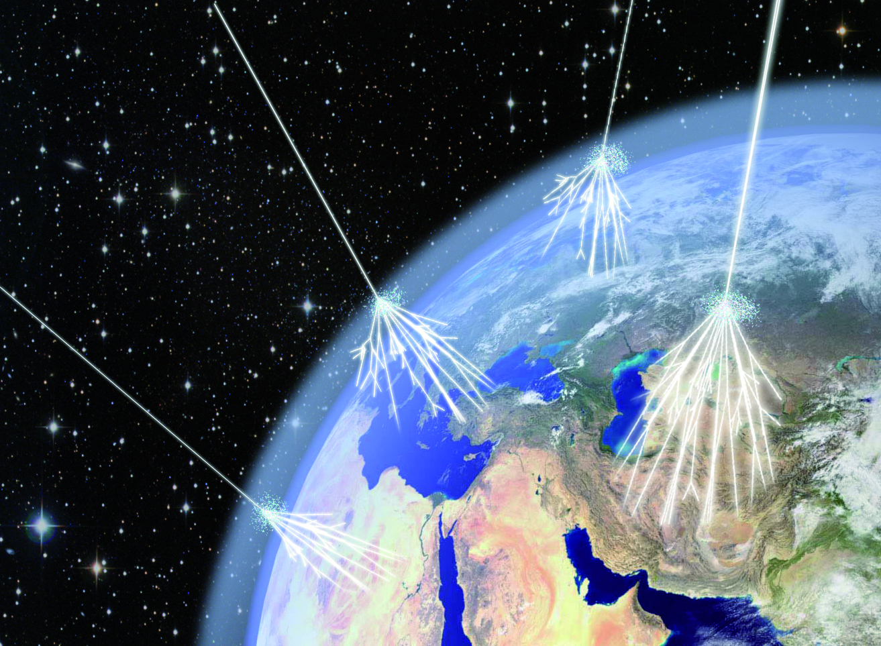
Muon tomography : Muography

Slide 3
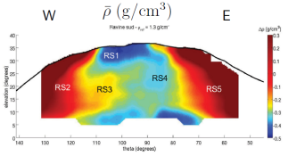
Principle
Muon absorption probability is proportional to the density of the material it crosses
A density map can be made from the muon flux
Possibility to study large objects since the cosmic muon come from everywhere in the sky
  Volcanos
  Geological prospection
These applications need the telescope to be operated in the wild
  Low power consumption
Flux : 1muon/cm²/min
  Better precision can extract the most information of each muon
Lesparre (IPG-P) ; detector resolution : 1cm

Slide 4
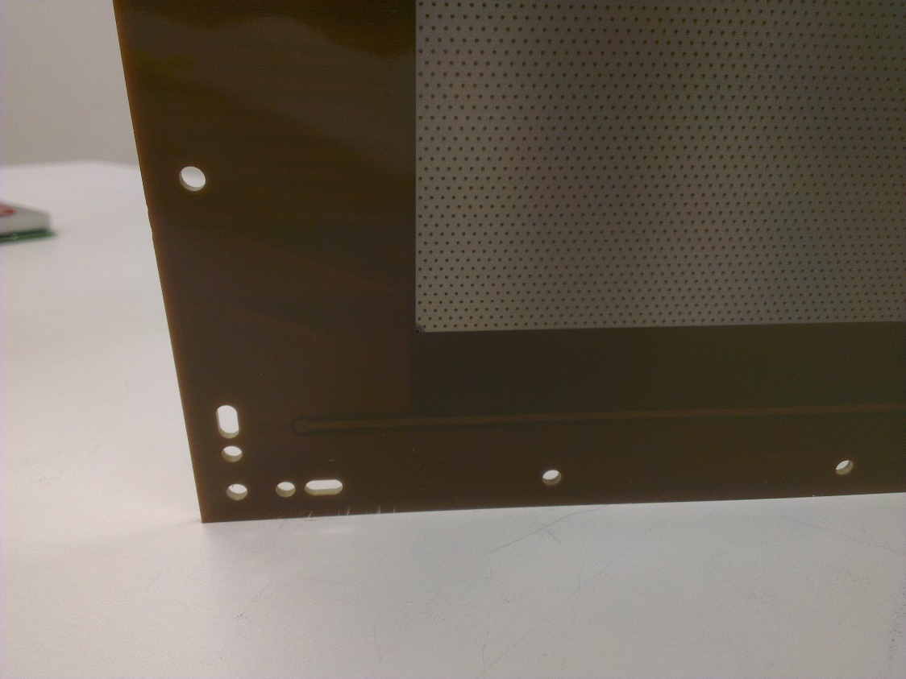
Detector Development

Slide 5
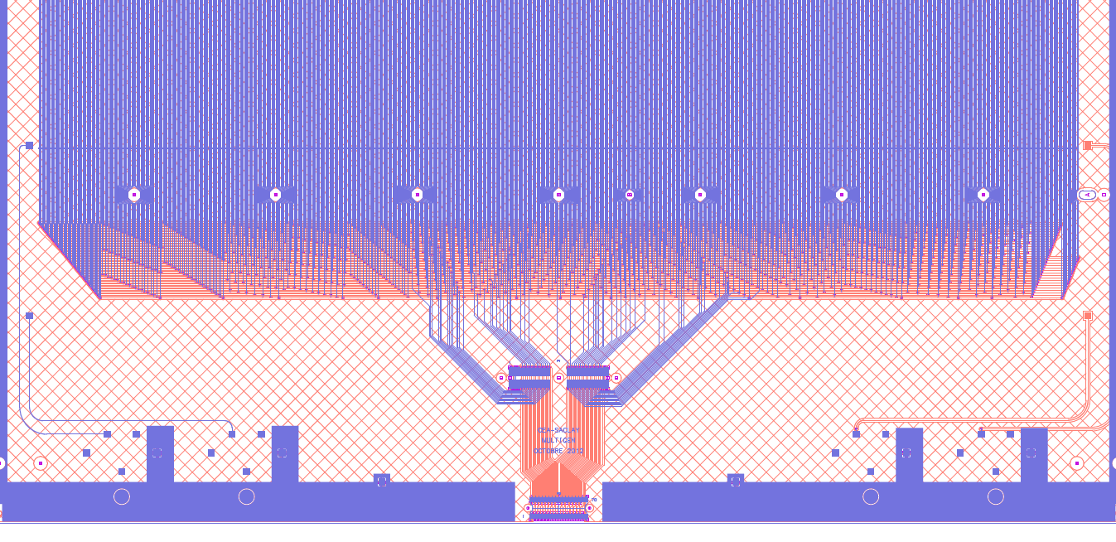
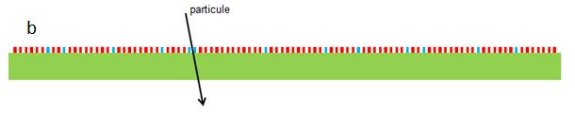
Genetic Multiplexing
Use signal spread over strips
  Detect unique k-uplets
  Doublet of channel are connected to a unique doublet of consecutive strips
1024 strips read by 61 channels
  Reduction factor > 15
Multiplexing factor is adjustable w.r.t. flux inside the detector
  Reduction factor vs ambiguities probability

Slide 6
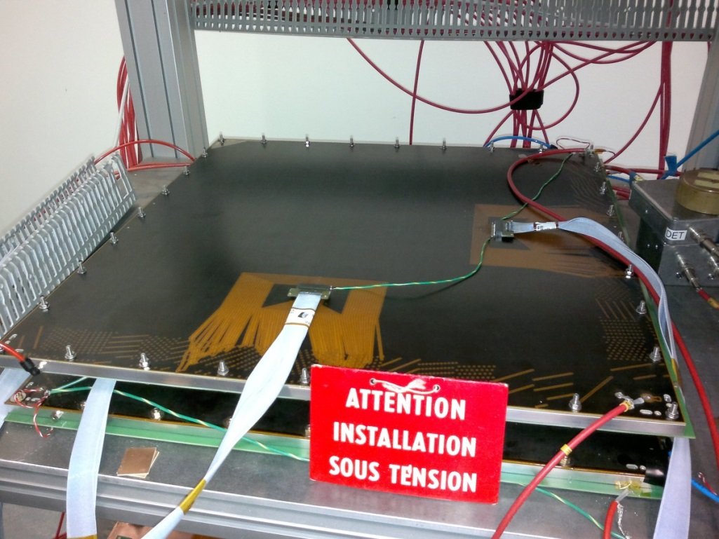
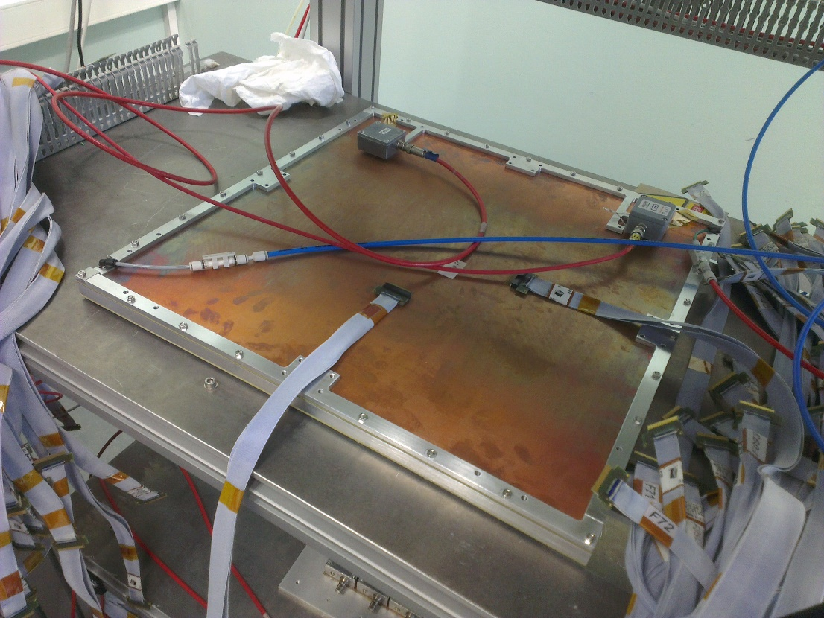
Design
50x50 cm² active area
Resistive (1MΩ/□)
2D readout
  3 strip layers : resistive (X), Y readout and X readout
V1 Prototype
  1cm drift gap
  Show good performances
  Design problem in the corner
V2 Prototype
  1.5cm drift gap
  Better mechanical integration
  Reduced dead zone
    Multiplexing bus in intern layer
    PCB size reduced, same active area

Slide 7
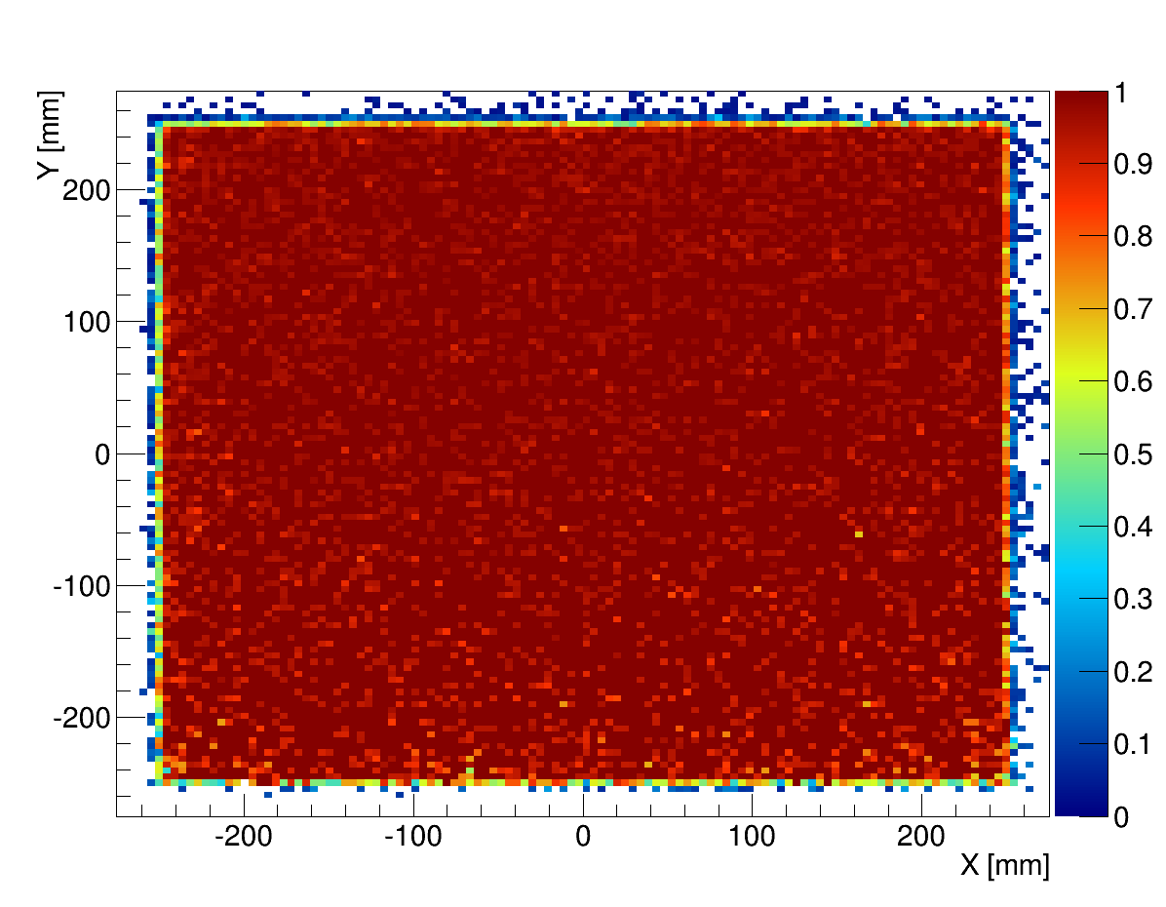
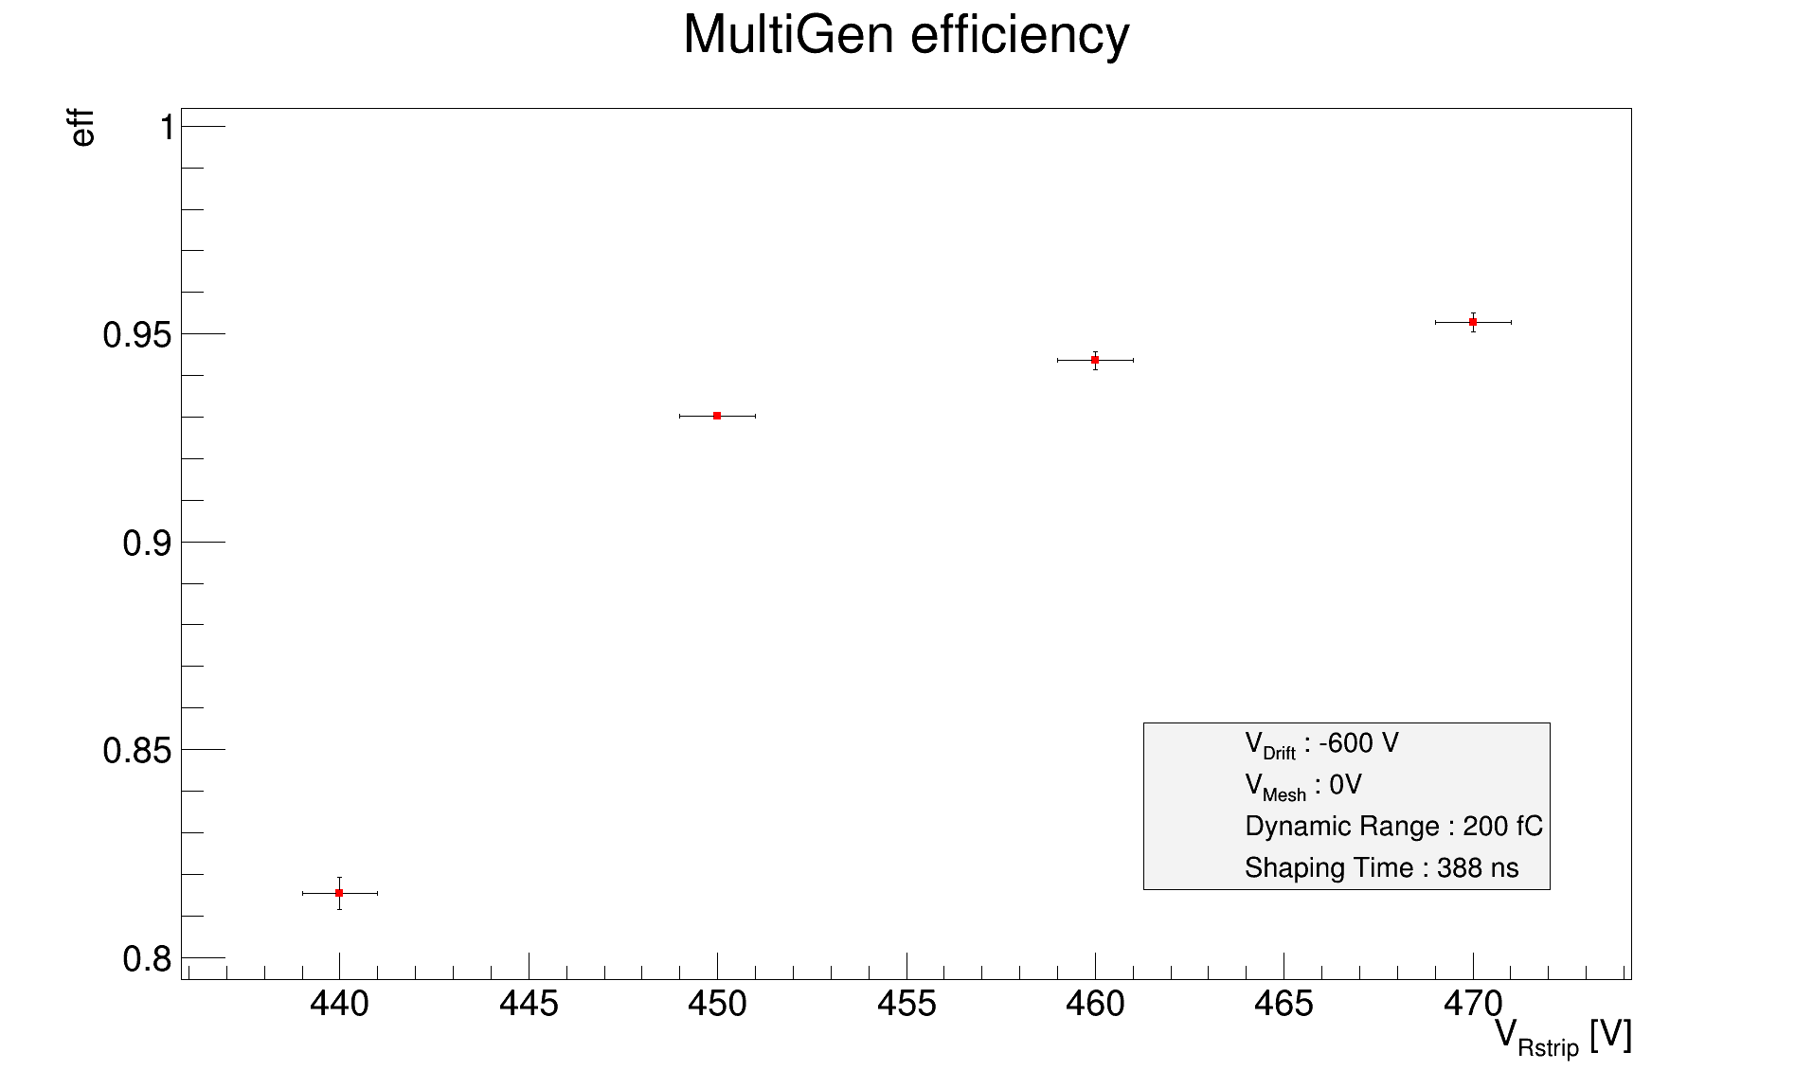
Performances
Operated in Ar-iC₄H₁₀ (95:5)
HV on resistive strips
Mesh at ground
Over 96% 2D efficiency
  Good homogeneity
20V at max efficiency
  High capacitance (1nF) because of multiplexing
300-400µm resolution

Slide 8
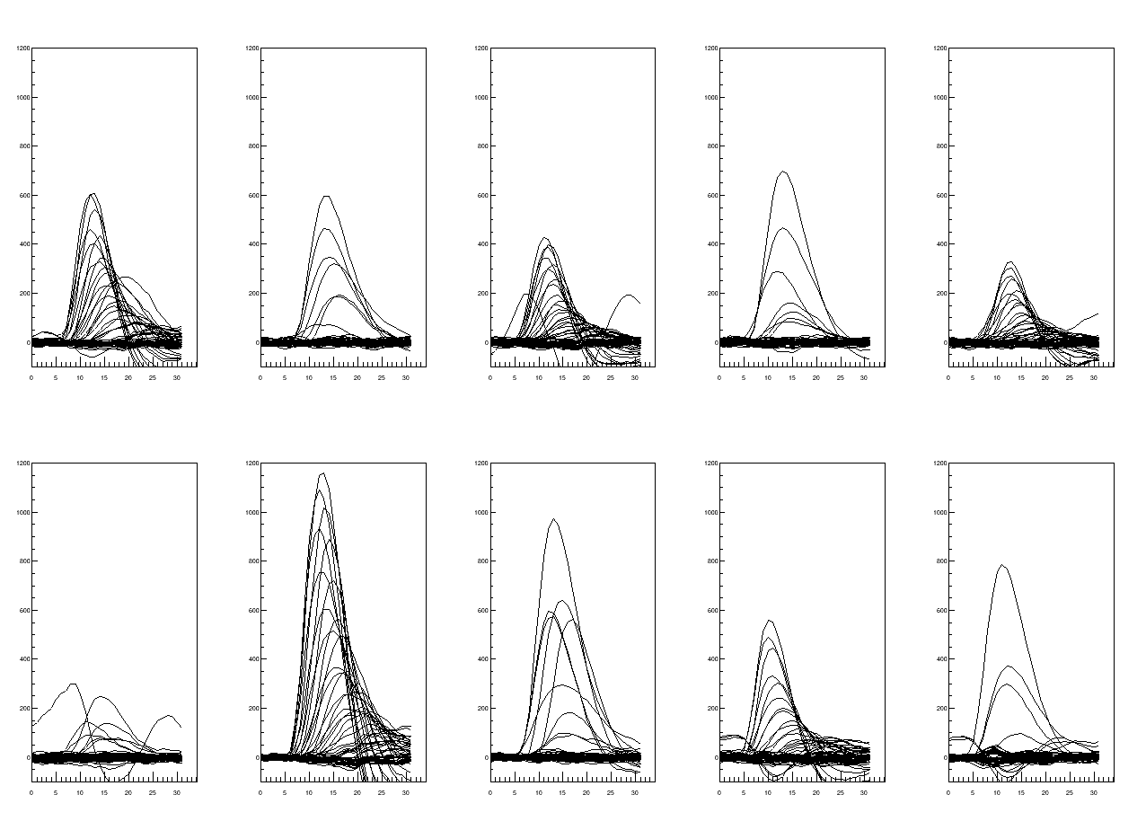
Performances
Limited resolution
  Greater than pitch/√12 = 140µm
  Charge spread for coordinate perpendicular to resistive strips
    Too much multiplicity
  Effect of undershoot
Solution
  Increase resistivity (for Y strips)
  Remove interconnection ladders (for X strips)
  µTPC algorithm
  2D de-multiplexing
    Hough transform based tracking
Y
X
Y
X
Y
X
Y
X
Y
X
Signal amplitude vs sample bin, 1 plot by projection (5 detectors)

Slide 9
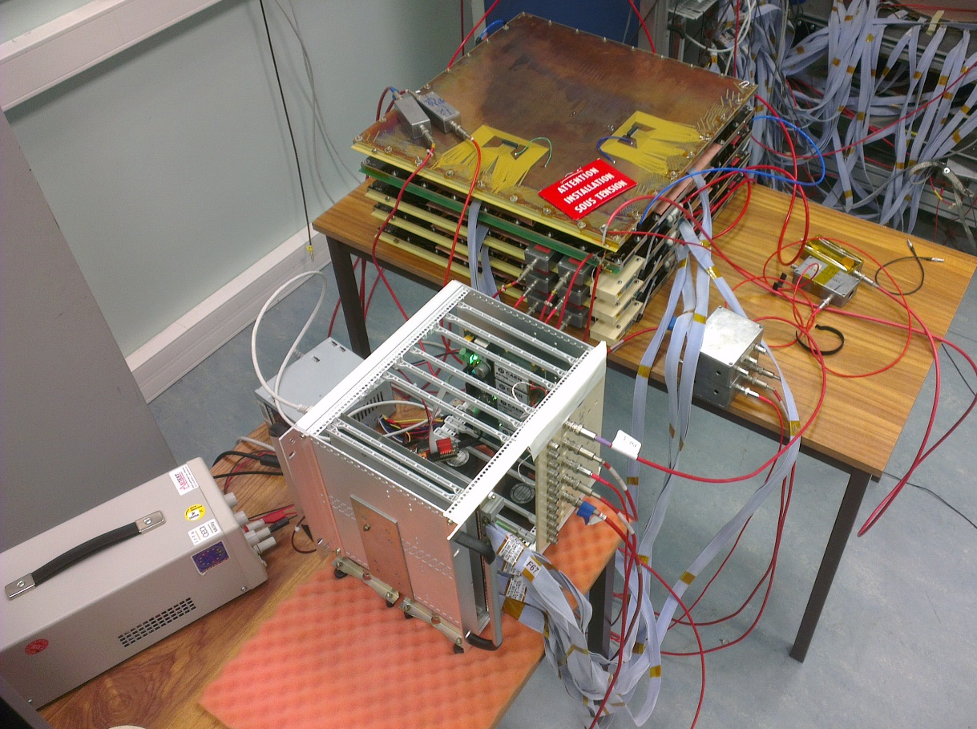
Electronics development

Slide 10
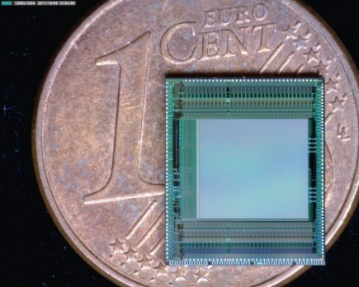
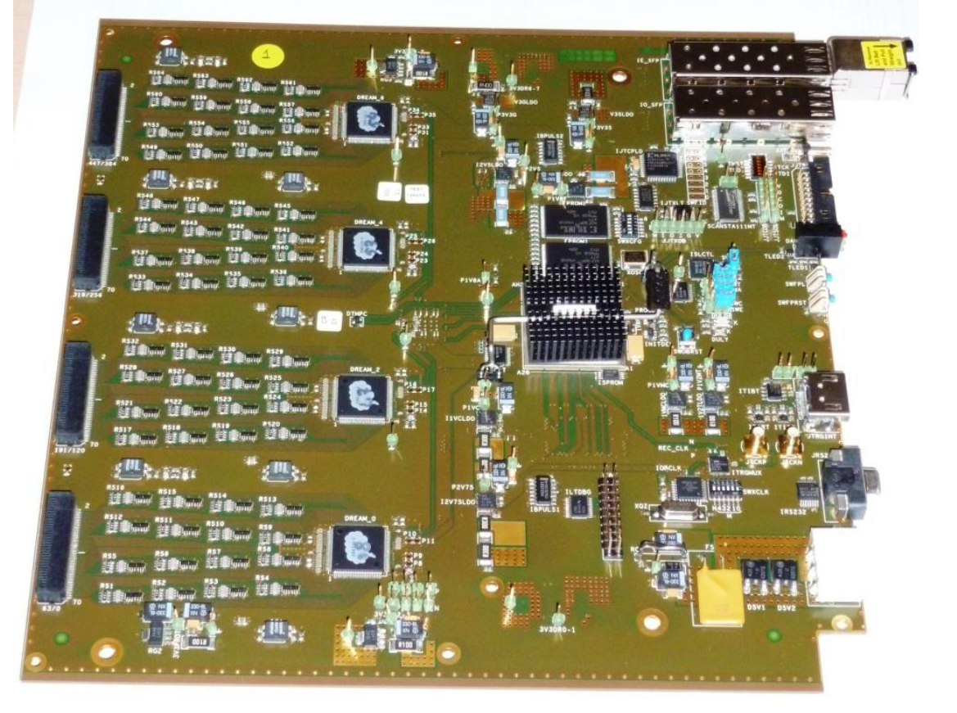
Readout Electronics
DREAM Chips in FEU Cards
  CLAS 12 electronics
  Adapted to high capacitance
  Self triggering capability
  Can read 4 prototypes

Slide 11
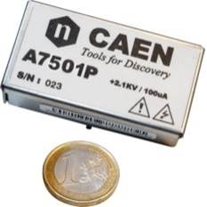
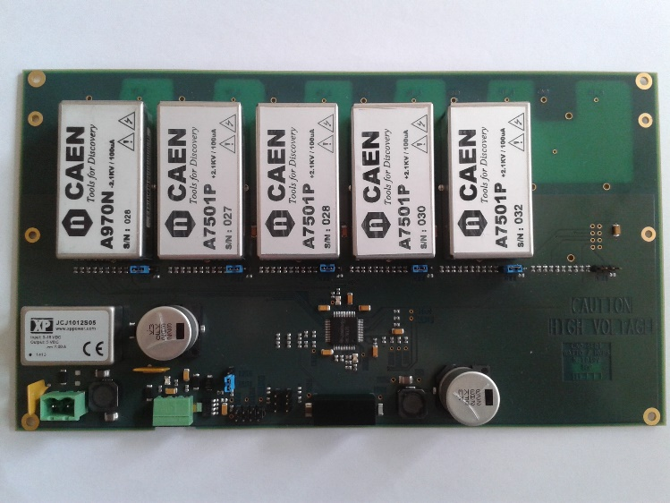
High voltage power supply
Need for low consumption power supply
CAEN modules
  Up to 2.1kV
  Powered by 12V DC
  <0.6W consumption
Dedicated control card
  Designed in CEA/Irfu
  Up to 6 HV channels
  Controlled by SPI interface
    Voltage and current monitoring
    Voltage and max current setting

Slide 12
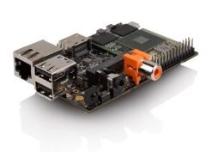
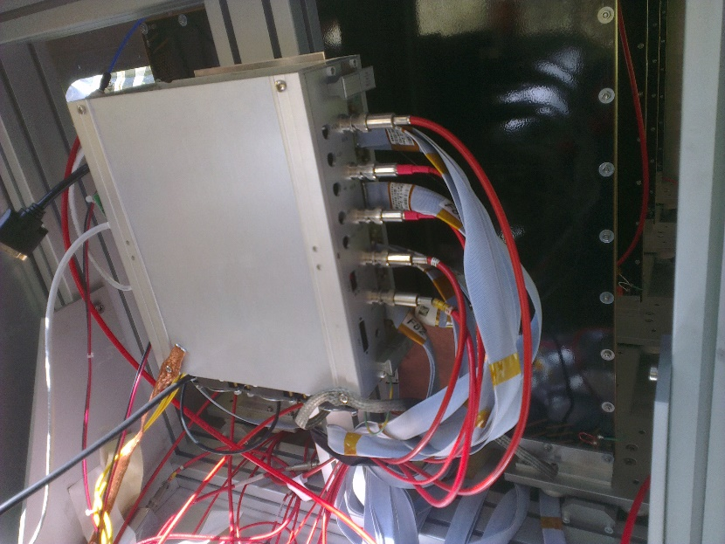
Data acquisition system
Readout electronic control
HV power supply control
Data storage
  SD card or USB disk
Nano-PC
  ARM based (smartphone)
Total consumption : 30W
  Less than light bulb
  Include HV, readout and DAQ
  Can be powered by battery

Slide 13
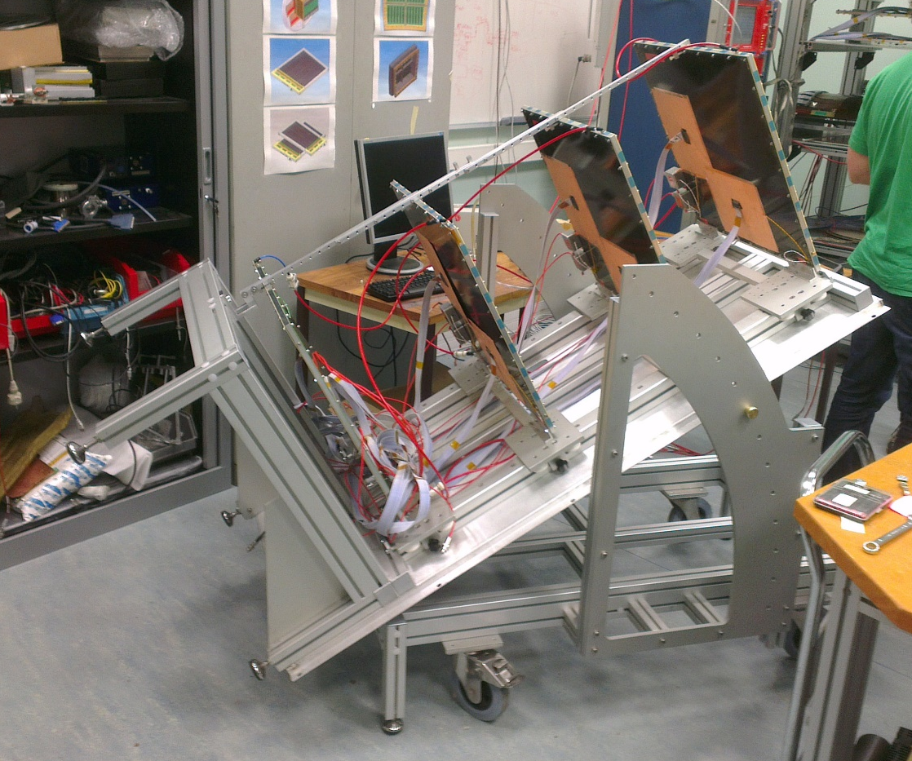
The WatTo experiment

Slide 14
Purpose
Proof that Micromegas can work outside of labs
Proof of concept validation
Test self-trigger
Test battery power operation
Check noise levels
Check outside environment influence
Make an experiment in a semi-controlled environment
  Inside Saclay center
    Easy operation but in real conditions
  Muography of the water tower

Slide 15
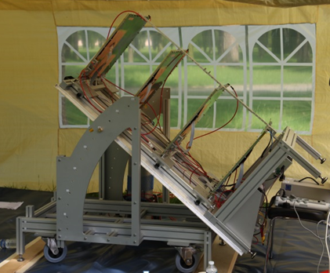
Experimental setup
4 2D readout prototypes
1 CLAS12 FEU
  4 detectors x 2 coordinates x 61 channels
Low power HV power supply
  1 positive channel for each detector (resistive strips)
  1 common negative channel for the 4 drifts
Worldwide first successful operation of Micromegas tracker outside
  3 month of data taking (June-August)

Slide 16
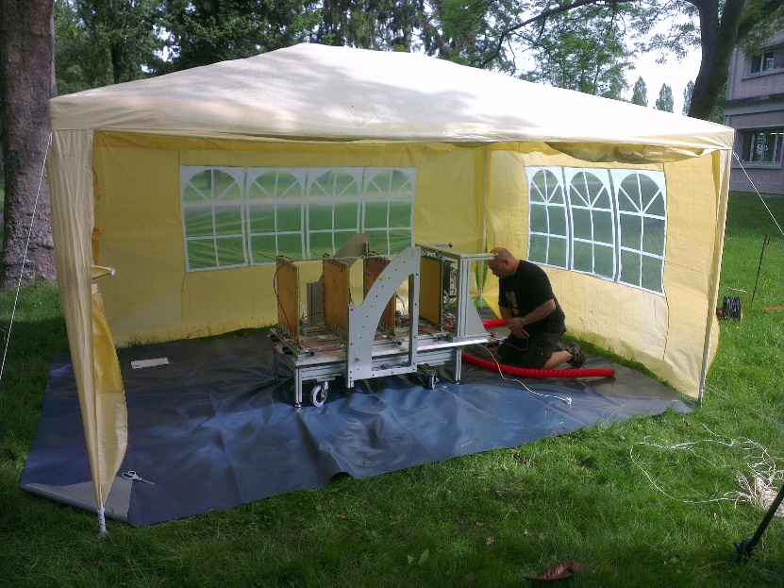
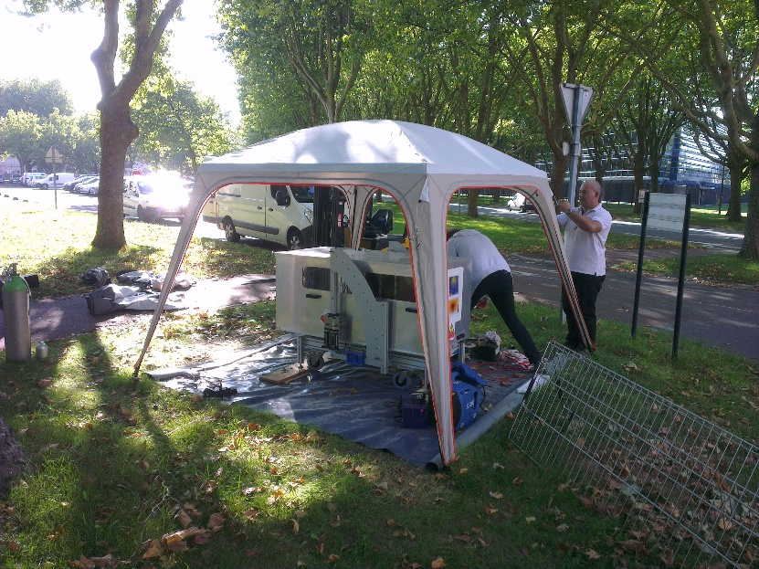
Experimental setup
Telescope protected by tent
First phase
  With power plug and network
  At 40m of the tower
  Telescope at 30° from the horizontal
Second phase
  Battery/solar panel operation without remote access
    12V truck battery
    ~1.5m² solar panel
  At 25m of the tower
  Telescope at 35° from the horizontal
    More flux

Slide 17
Self-trigger operation
First use of DREAM self-triggering mode
Huge noise dependence
  Common noise saturate triggering system
  Need to have a well defined electrical ground
  Difficulties during battery operation
Gain dependence
  Change whether the signal pass the threshold or not
  Environmental fluctuations

Slide 18
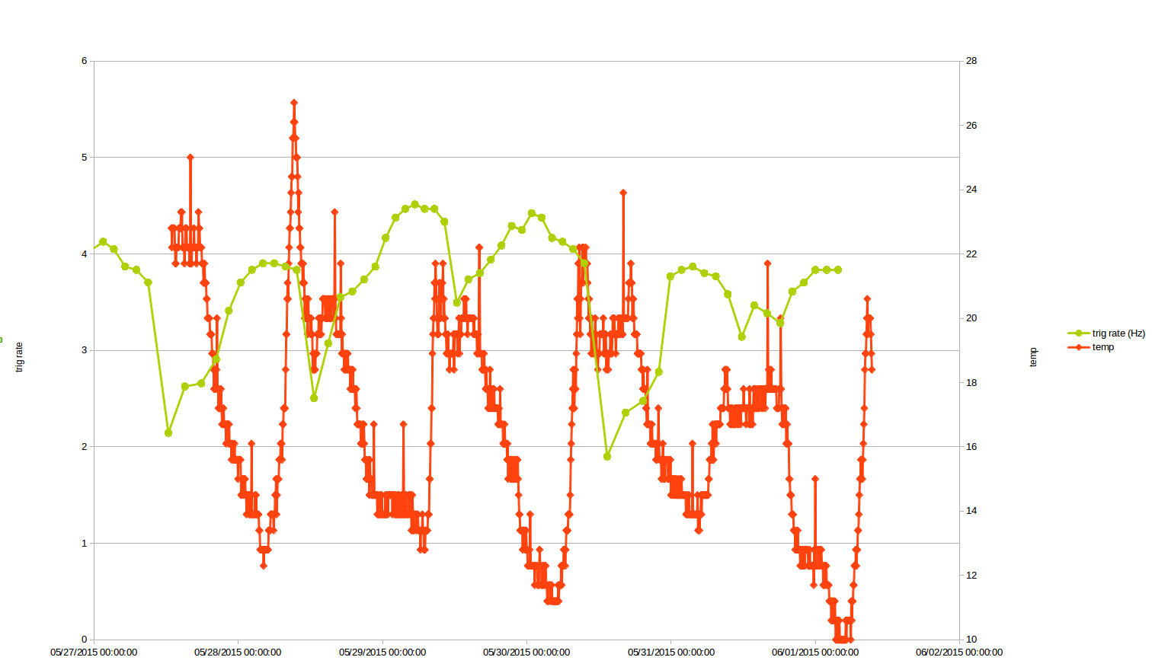
Environment influence
Day/night trigger rate cycle
  Influence of temperature
  Signal saturation at low temperature
  Feedback HV tension w.r.t temperature → keep constant gain
    ~1.4V/°C
Slower fluctuations
  Correlated with pressure
Further checks in controlled (T,P) chambers ongoing

Slide 19
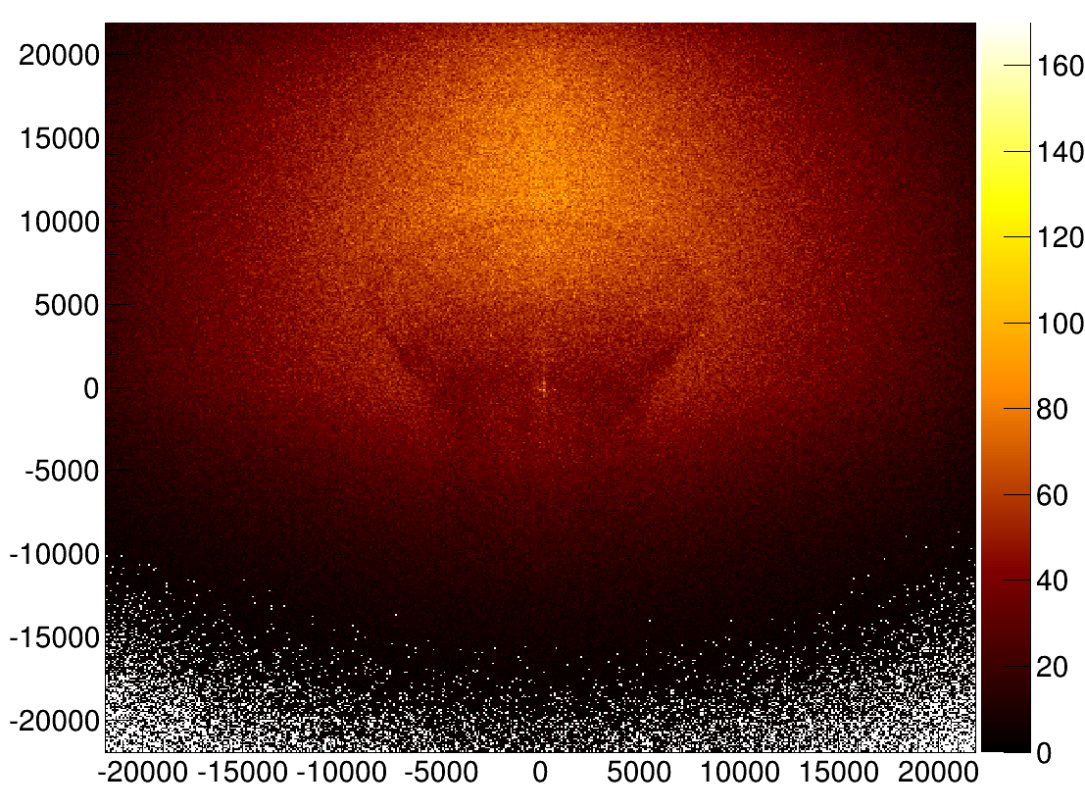
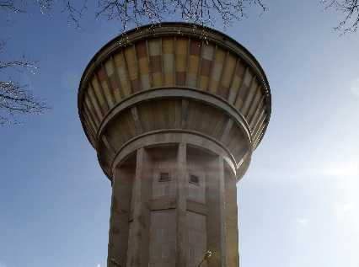
Results
Y [mm]
Muon flux extrapolated to tower plane (4 week of data taking)
X [mm]

Slide 20
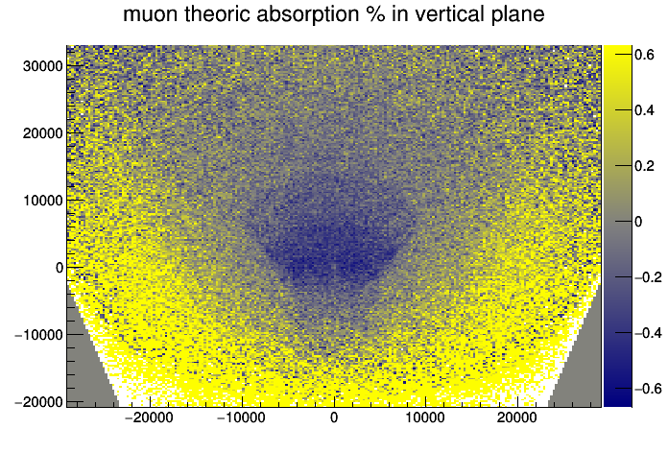
Results
Y [mm]
Accurate density maps of the tower
  Water tank
  Concrete structures
X [mm]
Muon absorption w.r.t theoretical flux (10 days of data taking)

Slide 21
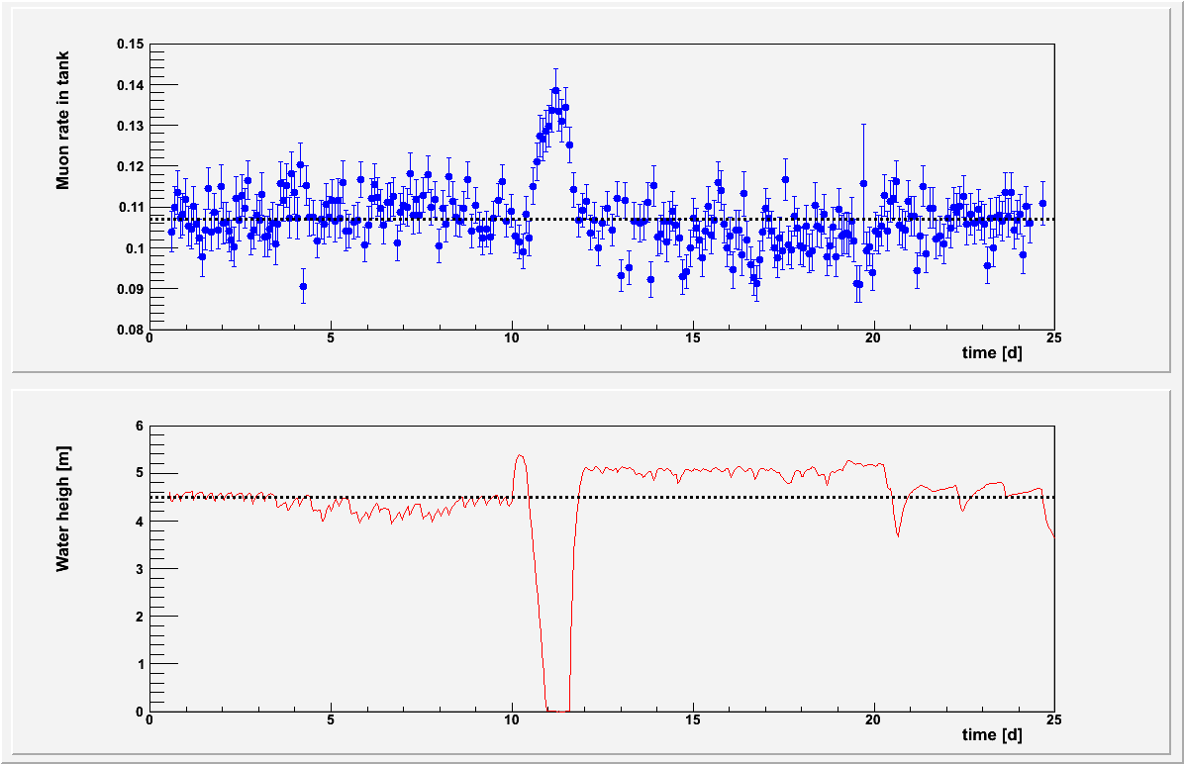
Results
Dynamic studies done even with cosmic muon low flux
  Tank water level monitoring
  Do not need pressure correction

Slide 22
Perspectives

Slide 23
Further developments
Autonomy improvements
  Gas recycling
    Further tests with recirculating pump and contaminant filter
  FEU power consumption
    >50% of total power consumption
    Power consuming magnetic field proof component should be replaced
    CLAS12 high rate adapted FPGA can be down clocked
Reconstruction improvements
  Software reconstruction shall be improved to improve resolution
  Multiplexing ambiguities must be solved

Slide 24
Further muography experiments
Archeological sites imaging
  Unknown gallery prospection
  Buried structures location
Mining prospection
  Radio-element deposit

Slide 25
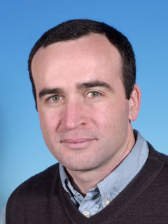
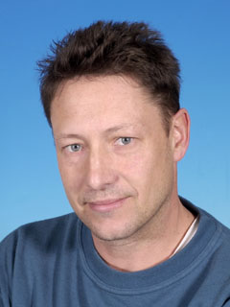
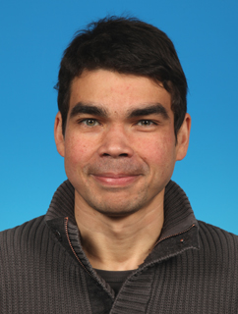
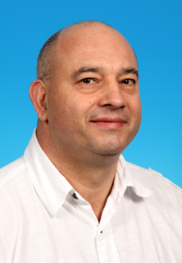
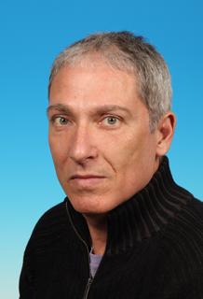
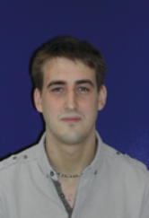
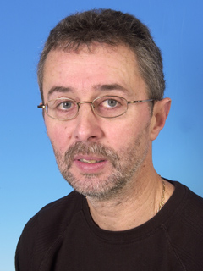
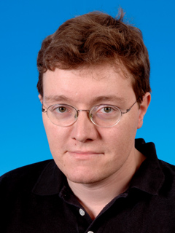
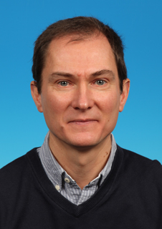
Thank you for your attention
And thanks to the WatTo team

