Slide 1

Erice, Italy, 19th - 20th of March, 2017
Recapitulation of Electromagnetism
Ursula van Rienen, Johann Heller, Thomas Flisgen

Slide 2
Overview
Maxwell’s equations
Electromagnetic fields in different materials - material equations
Electrostatic fields
Magnetostatic fields
Electromagnetic waves
Field attenuation in conductors

Slide 3
Please note:
All illustrations underlying a copyright were removed for the online version of this lecture.

Slide 4
Maxwell‘s Equations

Slide 5
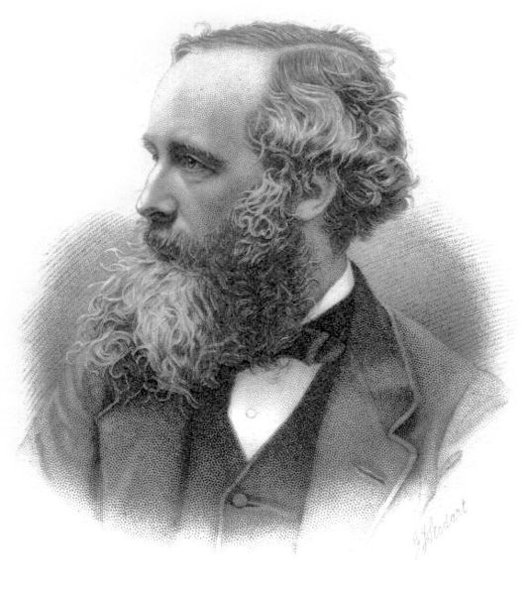
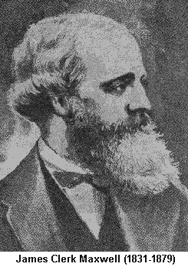
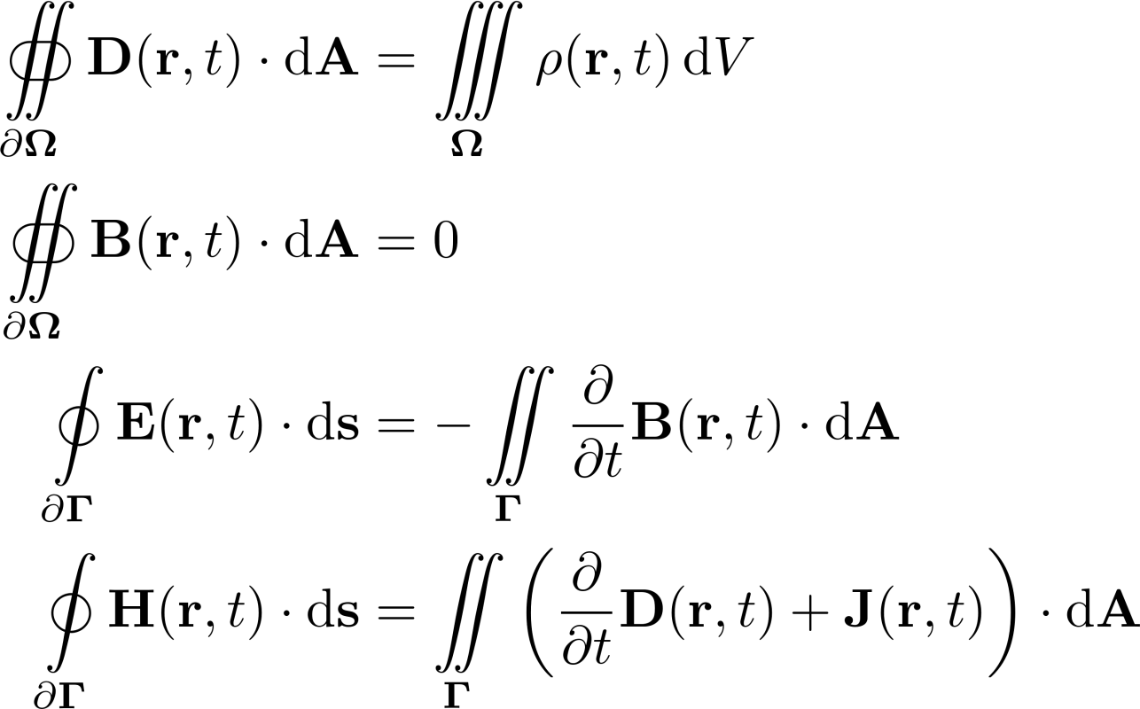
Maxwell‘s Equations in their Integral Representation
Figure: https://upload.wikimedia.org/wikipedia/commons/thumb/1/1e/James_Clerk_Maxwell_big.jpg/390px-James_Clerk_Maxwell_big.jpg

Slide 6



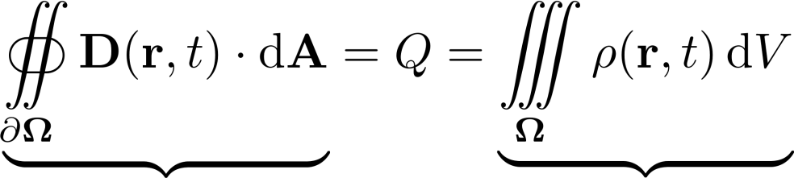
Gauss‘ Law (for Electricity) in Integral Form
Electric charges or electric charge densities generate electric flux densities .
total electric flux through Gaussian surface
total electric charge enclosed in Gaussian surface

Slide 7
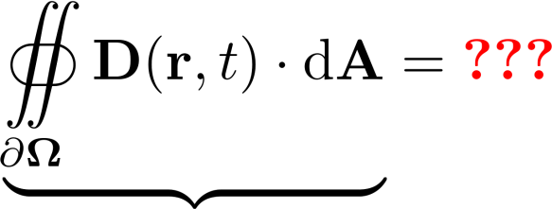
Quick Quiz (I/II) – Value of Net Flux through Surface?
total electric flux through Gaussian surface

Slide 8
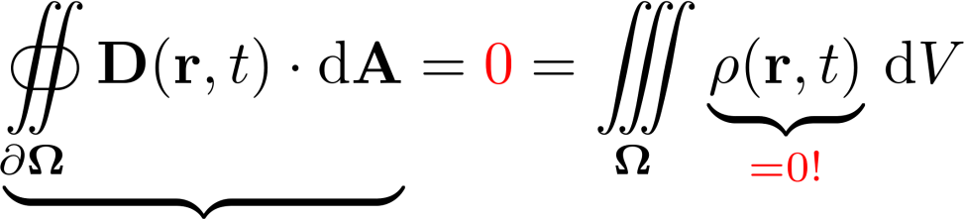
Quick Quiz (II/II) – Value of Net Flux through Surface?
total electric flux through Gaussian surface
Total electric flux through the Gaussian surface equals zero since no charges are contained in the volume!
Total amount of flux flowing into the Gaussian surface is equal to total amount of flux flowing out of the surface
Absence of charges in the volume does not mean that the electric displacement fields are zero in the volume

Slide 9
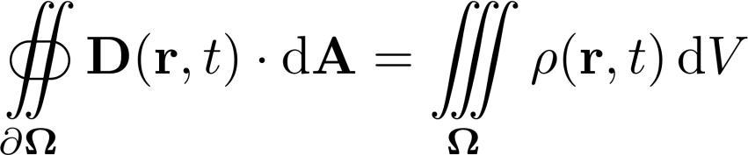


Gauss‘ Law (for Electricity) –
from Integral to Differential Form
for infinitely small volumes

Slide 10

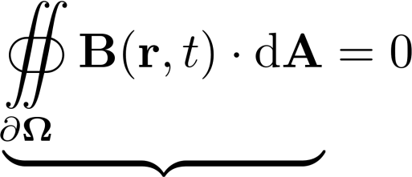
Gauss‘ Law for Magnetism in Integral Form
Magnetic flux densities do not have sources, i.e. they are solely curl fields.
total magnetic flux through Gaussian surface

Slide 11
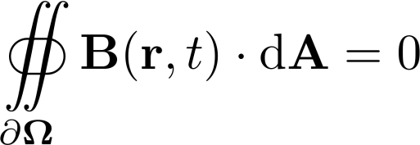

Gauss‘ Law for Magnetism –
from Integral to Differential Form
for infinitely small volumes

Slide 12

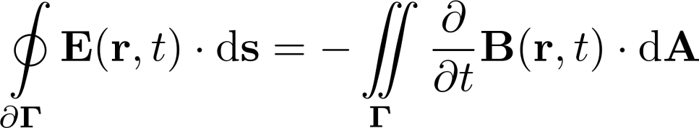
Faraday‘s Law of Induction
Time-dependent magnetic flux densities generate curled electric field strength .

Slide 13
Faraday‘s Law of Induction – The Minus Sign (I / II)
The polarity of the induced electric field strength is such that it tends to produce a current that creates a magnetic flux to oppose the change in magnetic flux through the area enclosed by the current loop. This is known as Lenz’s Law.

Slide 14
Faraday‘s Law of Induction – The Minus Sign (II / II)
The polarity of the induced electric field strength is such that it tends to produce a current that creates a magnetic flux to oppose the change in magnetic flux through the area enclosed by the current loop. This is known as Lenz’s Law.
The minus sign in the induction law is also required for Maxwell‘s equation to be energy conserving!

Slide 15

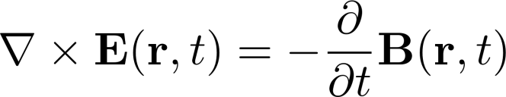
Faraday‘s Law of Induction –
from Integral to Differential Form
for infinitely small areas

Slide 16

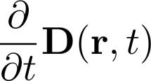

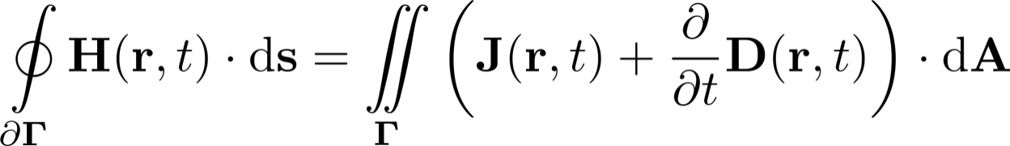
Ampère‘s Law with Maxwell‘s Extension
Electric currents and time-dependent electric displacement currents generate curled magnetic field strengths .

Slide 17
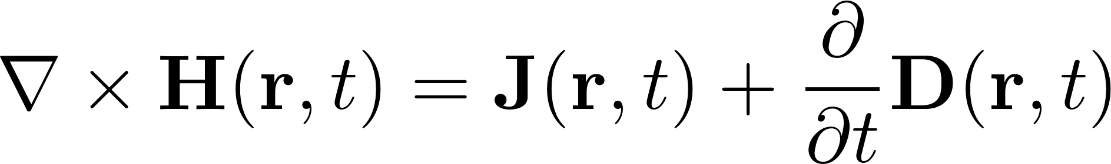
Ampère‘s Law with Maxwell‘s Extension –
from Integral to Differential Form
for infinitely small areas

Slide 18
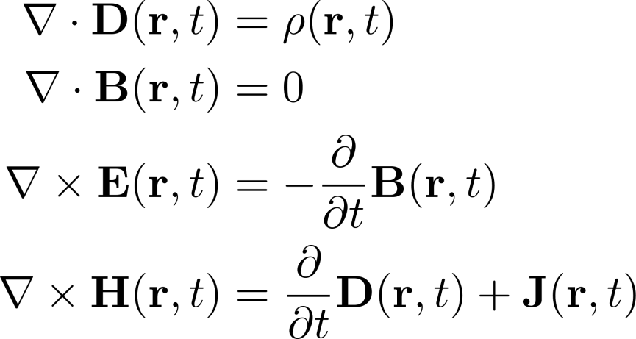
Maxwell‘s Equations in their Differential Representation
Figure: https://upload.wikimedia.org/wikipedia/commons/thumb/1/1e/James_Clerk_Maxwell_big.jpg/390px-James_Clerk_Maxwell_big.jpg

Slide 19



The Divergence Operator
The divergence operator measures the source strength of the vector field in that point
In some textbooks the divergence is denoted by
The divergence acts on a vector field and gives back a scalar field, i.e. the source strength!
In Cartesian coordinates, the divergence is defined in terms of:

Slide 20


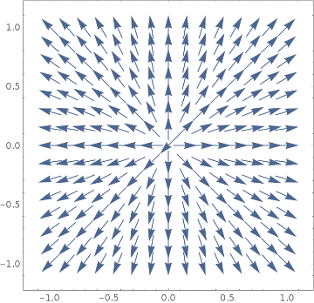
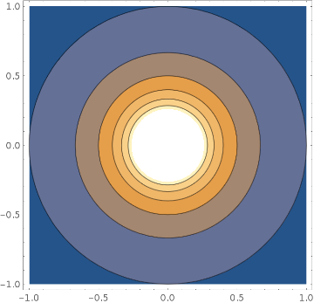
The Divergence Operator – A 2D Example
vector field
scalar field

Slide 21


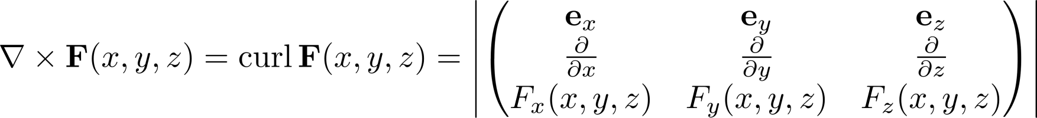
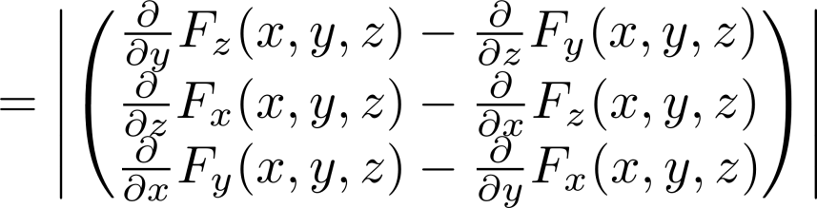
The Curl Operator
The curl operator measures the rotation of a vector field in that point
In some textbooks the curl (or rotation) is denoted by
The curl operator acts on a vector field and gives back a vector field, i.e. the curl strength!
In Cartesian coordinates, the curl is defined in terms of:

Slide 22
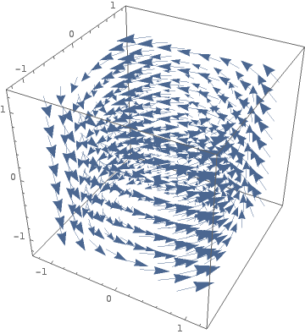
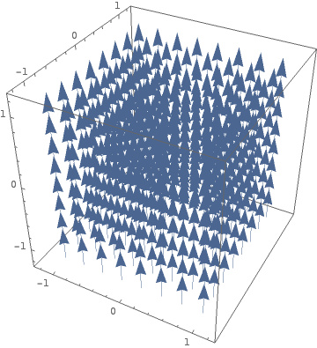
The Curl Operator – A 3D Example
vector field
vector field

Slide 23
Electromagnetic Fields in Materials

Slide 24





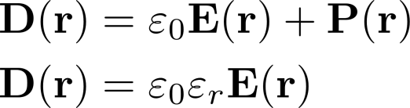
Electric Fields in Matter
Materials can be polarized by applied electric fields
The polarization is in fact a displacement of electric charges
Permittivity of free space:
Relative permittivity:

Slide 25




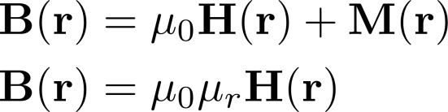
Magnetic Fields in Matter
Materials can be magnetized by applied magnetic fields
The magnetization is in fact a change of the orientation of magnetic dipoles
Permeability of free space:
Relative permeability:

Slide 26




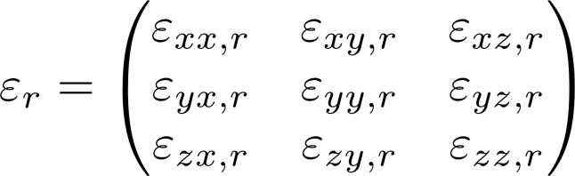
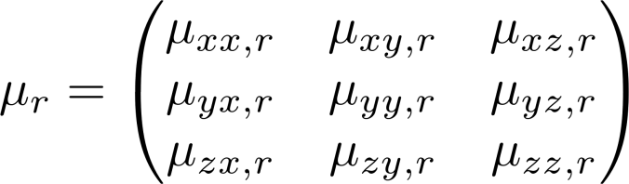

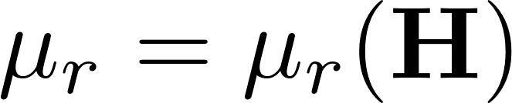
Some Remarks in Material Modelling
Often it is not sufficient to consider the material parameters as constants, because matter can be
  inhomogeneous
  dispersive, so that the material parameters are complex-valued and frequency-dependent:
  anisotropic (directional dependent), so that the material parameters become tensors
  non-linear (and can have a hysteresis in addition), so that the material parameters are functions on the field strength itself

Slide 27
Electrostatics

Slide 28
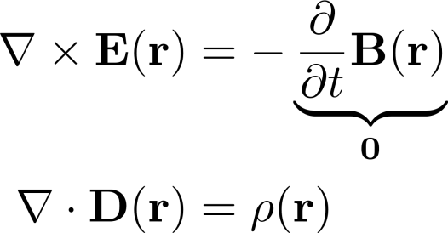

Electrostatics – Maxwell Simplifications
The electric field is curl-free
Gauss‘ law of electricity:
The divergence of the electric flux density is equal to the charge density
Due to the electric field being curl-free it can be expressed as negative gradient of an arbitrary scalar potential
With this approach, we can ensure that Faraday’s law of induction holds for the static electric field:

Slide 29


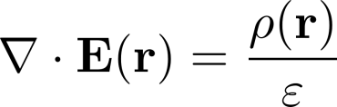
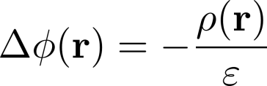
Electrostatics – Derivation of Poisson‘s equation
Starting with Gauss’ law of electricity
we employ the material equation for electric fields and assume that the permittivity is homogeneous:
Next, we express the electric field in terms of the gradient of an arbitrary scalar potential
Combining both equations delivers the so-called Poisson equation (or potential equation)

Slide 30
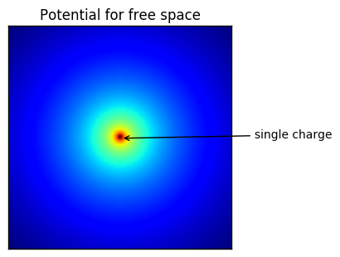
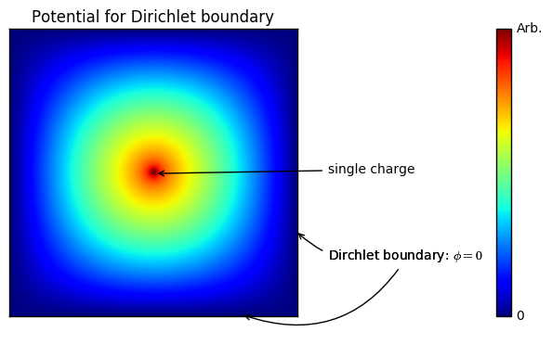
Electrostatics – Poisson‘s equation
In its simplest case, Poisson’s equation describes the electric potential of a point charge:

Slide 31

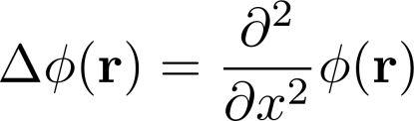
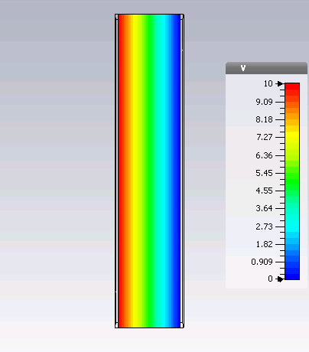
Electrostatics – A simple example: Capacitor
A capacitor is free of charges between its plates:
Assuming that the potential does only depend on one spatial direction, the Laplace-operator can be simplified to

Slide 32
Magnetostatics

Slide 33
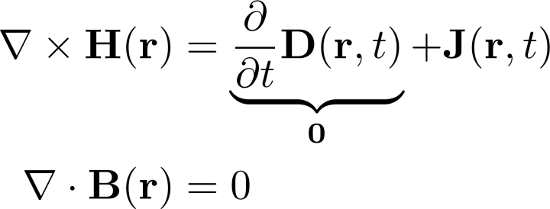

Magnetostatics – Maxwell Simplifications
Simplified Ampère‘s law: The curl of the magnetic field equals the current-density
Gauss' law of magnetism:
The magnetic flux density is divergence-free
The magnetic flux density is divergence-free so that it can be expressed as curl of an arbitrary vector-potential
With this approach, we can ensure that Gauss’ law for magnetism holds:

Slide 34



Magnetostatics – Derivation of Poisson‘s equation
Starting with Ampère‘s law
we employ the material equation for magnetic fields and assume that the permeability is homogeneous:
Next, we express the magnetic flux density in terms of the gradient of a vector potential
Combining both equations delivers Poisson’s equation for the magnetic vector potential

Slide 35
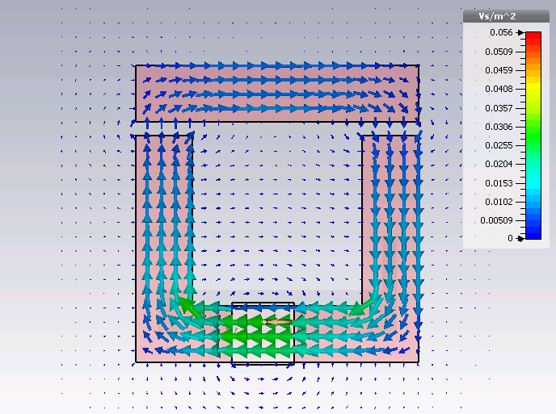
Magnetostatics – Electromagnet
A possible application is the computation of magnetic fields in an electromagnet

Slide 36
Electromagnetic Waves

Slide 37
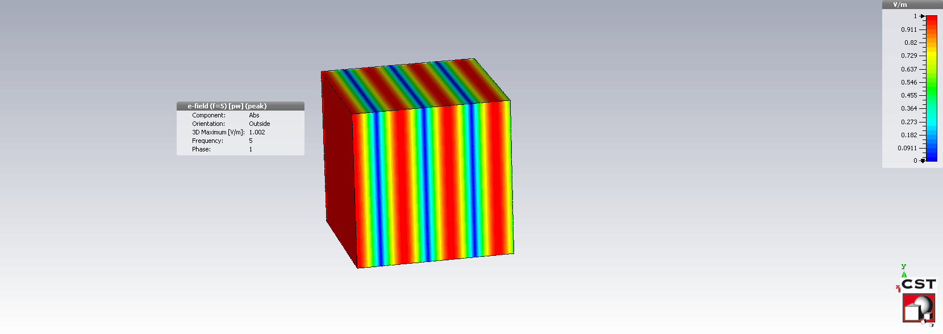
Electromagnetic Waves
Electromagnetic waves exist with different properties - such as waves in free space

Slide 38
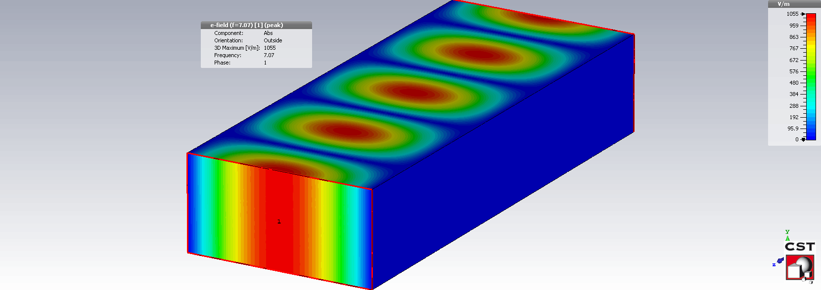
Electromagnetic Waves
Electromagnetic waves with different properties exist - such as guided waves

Slide 39
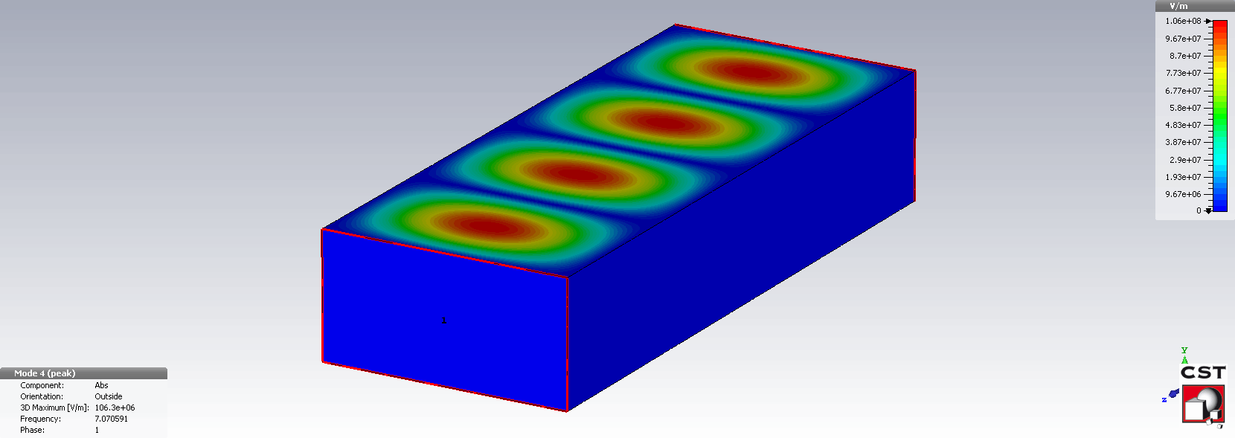
Electromagnetic Waves
Electromagnetic waves with different properties exist - such as standing waves

Slide 40
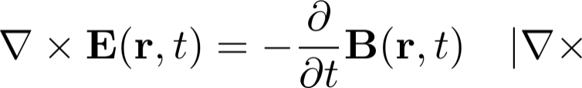
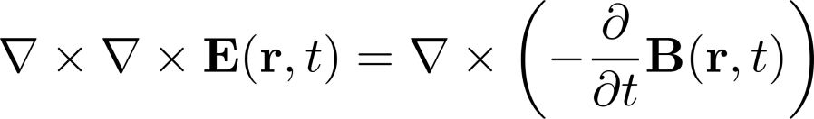
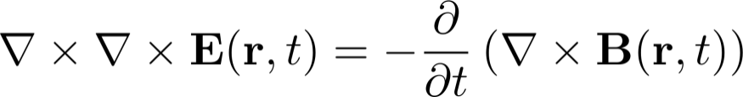
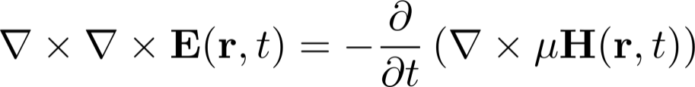
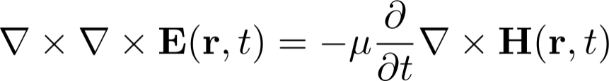
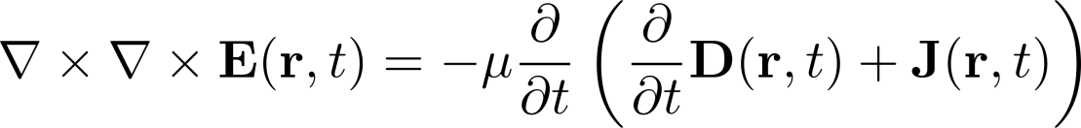
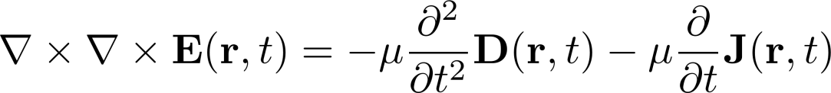
Wave Equation arising from Maxwell‘s Equations
All electromagnetic waves in homogeneous media satisfy Maxwell‘s equation, in particular, the wave equation that we will derive here:

Slide 41
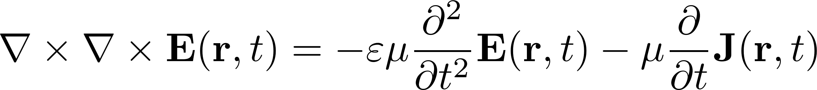
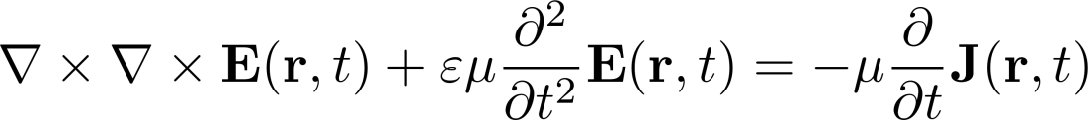
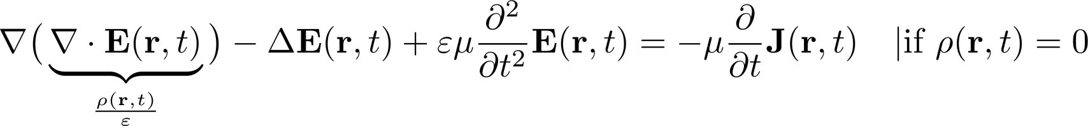
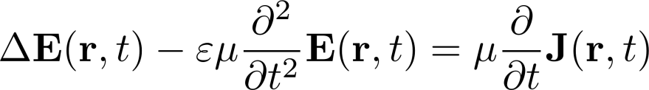
Wave Equation arising from Maxwell‘s Equations
All electromagnetic waves in homogeneous media satisfy Maxwell‘s equation, in particular, the wave equation – here we continue its derivation:
Curl-Curl Equation
Wave Equation (with excitation)

Slide 42
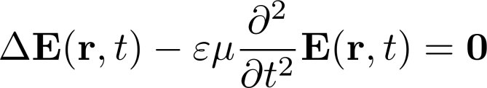



Eigenmodes – Solutions of the Homogeneous Wave Equations
Eigenmodes are solutions of the wave equation for the non-excited, loss free and charge-free case:
The partial differential equation comes with either of these boundary conditions:
Perfect Electric Conducting
Perfect Magnetic Conducting
boundary
boundary

Slide 43




Electric Field of some Eigenmodes in a Resonator

Slide 44
Field Attenuation in Conductors

Slide 45




Influence on Conducting Matter on Waves (I / II)
In conducting matter, Ohmic electric current densities will flow. They are proportional to the electric field strength with the conductivity as constant:
Replacing the electric current density in the wave equation with the upper relation gives
Transforming this equation into frequency domain delivers
Now, consider a plane wave propagation in +z – direction:
Plugging this into the frequency-domain representation of the wave equation gives

Slide 46




Influence on Conducting Matter on Waves (II / II)
The wave number is complex valued
with the following real and imaginary parts
The real part describes the propagation of the wave while the imaginary part describes the exponential decay of the field strengt in the conductor
The distance which is required for the fields to drop by a factor of is called penetration depth

Slide 47



Exponential Decay of Amplitudes in Conductors

Slide 48
What we have done
Maxwell’s equations
Electromagnetic fields in different materials - material equations
Electrostatic fields
Magnetostatic fields
Electromagnetic waves
Field attenuation in conductors

