Slide 1


Timing, Synchronization & Longitudinal Aspects I
H. Damerau
CERN
CAS Course on
Beam Injection, Extraction and Transfer
13 March 2017

Slide 2
Outline
Introduction
General concepts
  Signals with noise, transmission of RF signals
  Phase detectors and dividers
Beam transfer
  Fundamental periodicity
  Transfer between circular lepton accelerators
Transfer between hadron accelerators
  Beam phase loop, bucket numbering
  Transfer process: Synchronization, transfer triggers
  Longitudinal matching
Summary

Slide 3
Introduction

Slide 4

Introduction
Two or more people must be synchronized to meet
  Calendar item: date, time and location
  Typical uncertainty: some minutes
Slightly more precision required to have a meeting with a particle beam
  Typical uncertainty: some nanoseconds down to femtoseconds
To be at the right time in the right place
Set conditions and generate timings and RF signals with a given time relation with respect to the beam
Make beam feel comfortable in its new accelerator

Slide 5
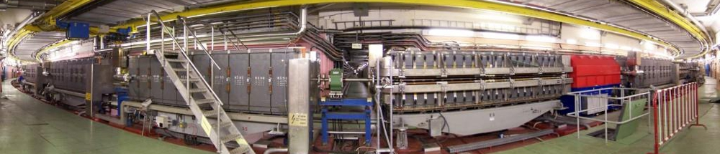
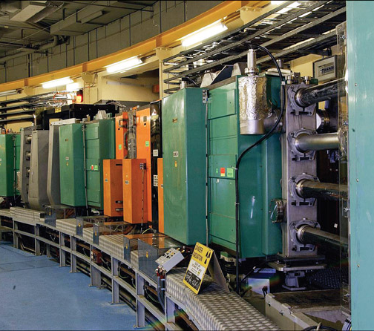
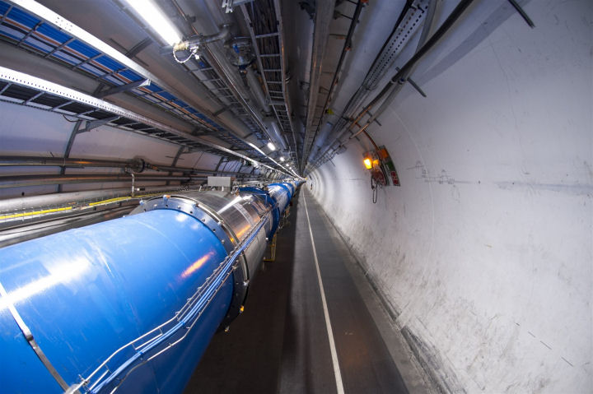
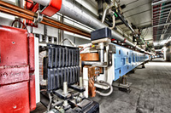
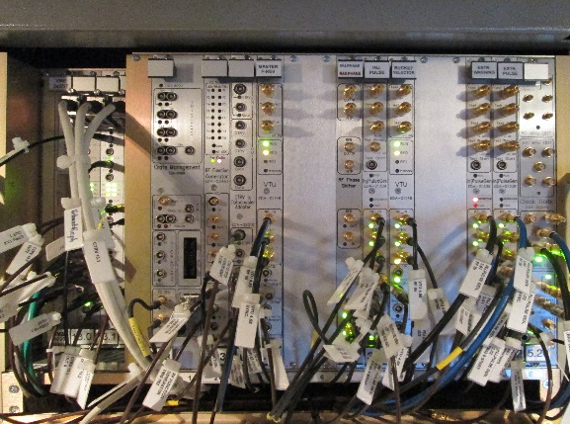
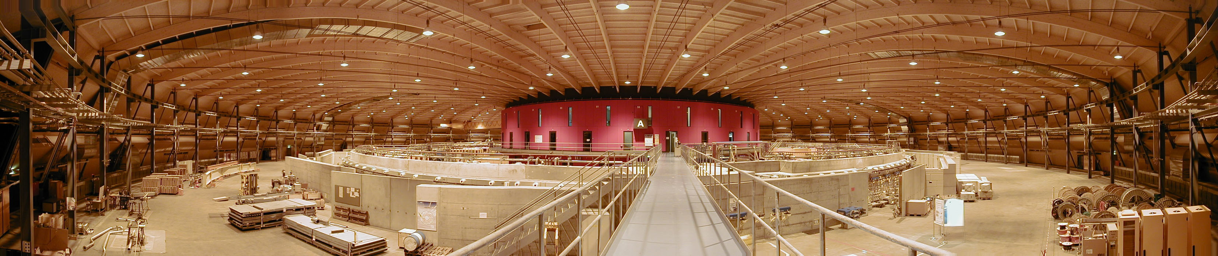
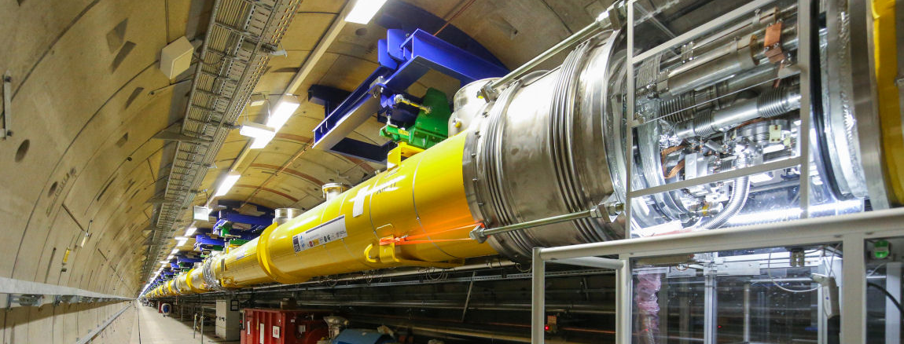
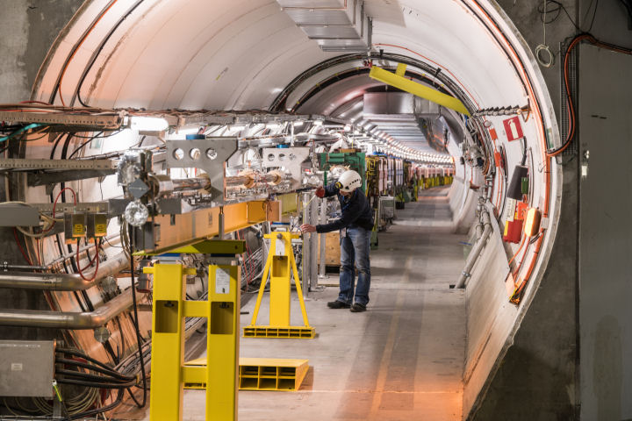
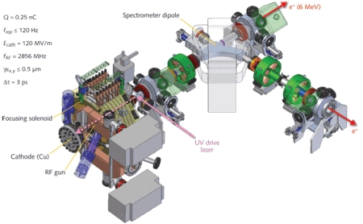
Timescales
Proton bunches in low energy synchrontrons
10 ns
Proton synchrotrons at medium energy
1 ns
100 ps
Hadron colliders
Electronics
Low-level RF systems
10 ps
Electron storage rings
1 ps
SASE FELs
Plasma wakefield experiments
100 fs
Pump-probe FELs
10 fs
Geometrical size: few meters to some km

Slide 6

Synchronization for beam transfer
How to get the beam trough the accelerator?
How to transfer beam from accelerator A to B?
Beam passes many elements on its way:
  RF structures → Must be in phase
  Septa, bumper and kicker magnet → Trigger
  Fast beam instrumentation → Trigger
  RF systems in source and target accelerator → Correct phase with respect to beam
Source
Exit
Accelerator A
Accelerator B

Slide 7
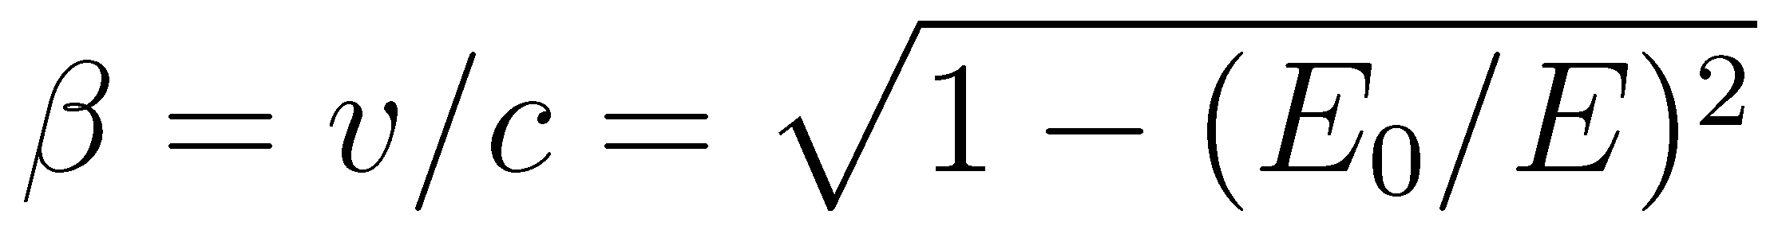
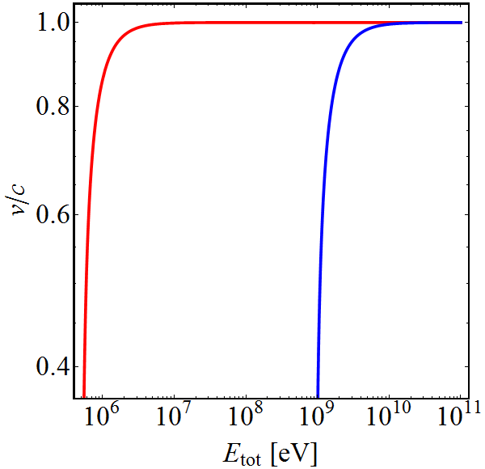
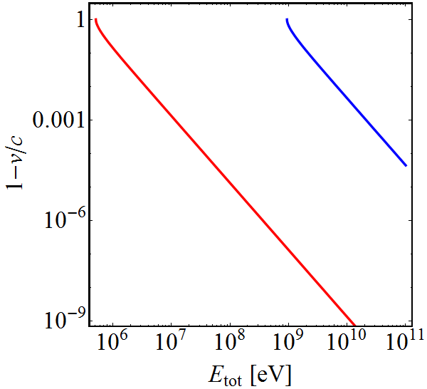

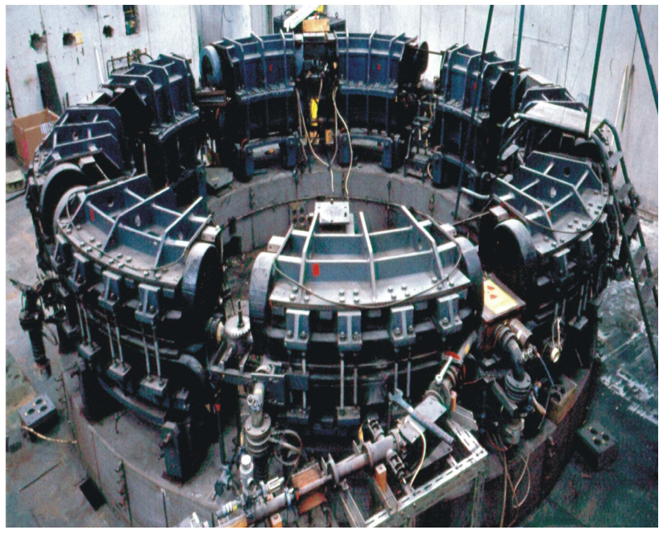
Particle velocity
Particle velocity depends on its type:
Old television set (30 kV): Electrons at 30% of c₀
            Protons just at 0.7%
Small synchrotron (500 MeV): Electrons at 99.99995%
              Protons at 75.8%
Many electron accelerators at ‘fixed’ frequency
e⁻
p⁺
e⁻
p⁺

Slide 8
Synchronization needs for particle types
Lepton accelerators | Hadron accelerators
Velocity v ≈ c in high energy accelerators Synchrotron radiation damping (mainly circular accelerators) Short bunches Storage rings: ~10…100 ps Linear free electron lasers: 50…200 fs | Slow, even velocity change relevant to the multi-GeV range Negligible or small damping from synchrotron radiation Long bunches Synchrotrons: 1...1000 ns (depends on RF frequency) Linear accelerators: typically few ns
Fixed frequencies High precision | Variable (sweeping) frequencies Moderate precision

Slide 9
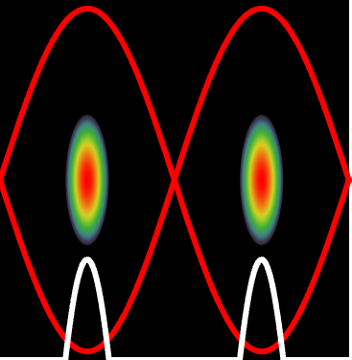
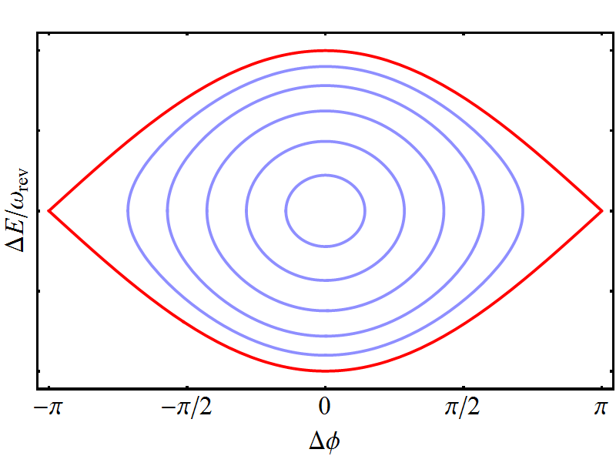
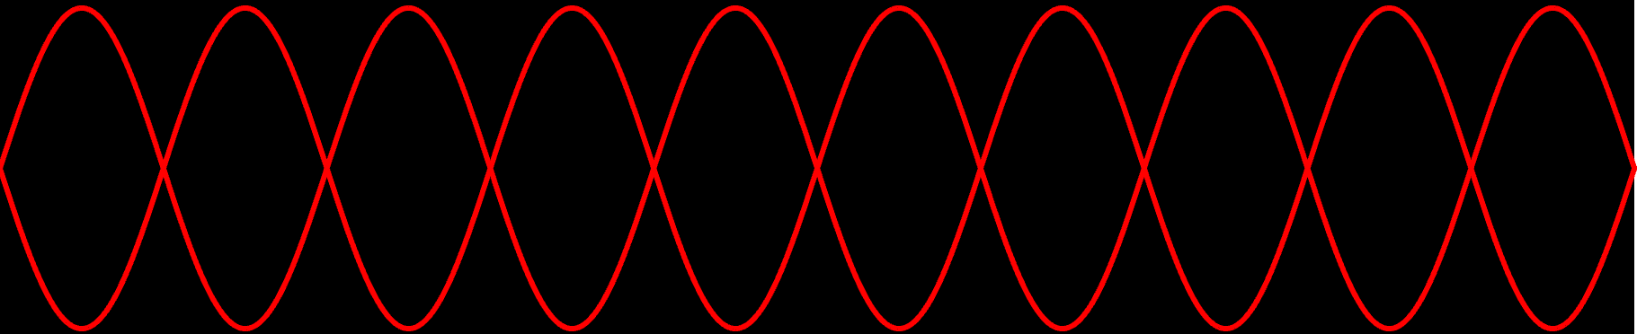
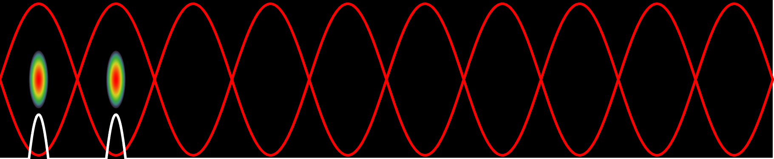
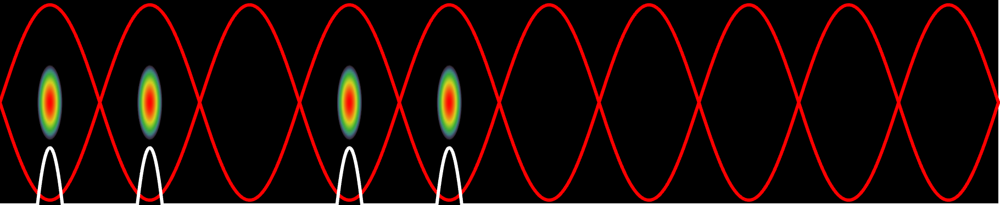
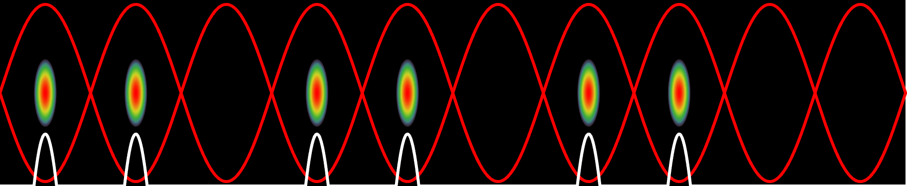
Bunch-to-bucket transfer
Bunch from sending accelerator into the bucket of receiving
Advantages:
Particles always subject to longitudinal focusing
No need for RF capture of de-bunched beam in receiving accelerator
No particles at unstable fixed point
Time structure of beam preserved during transfer to the next

Slide 10
Noise on signals

Slide 11
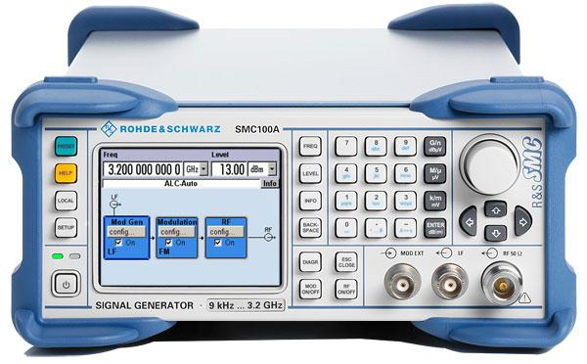
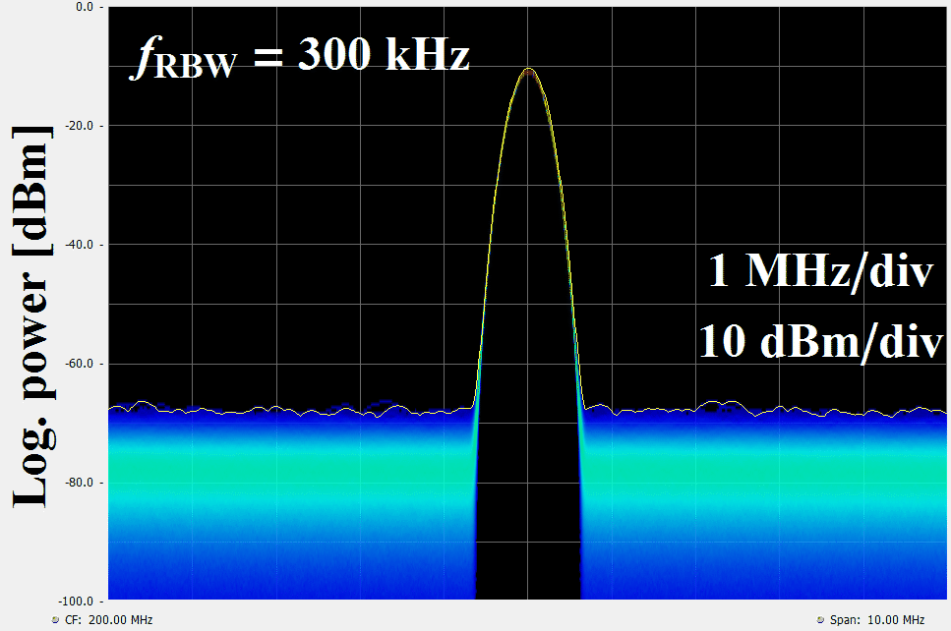
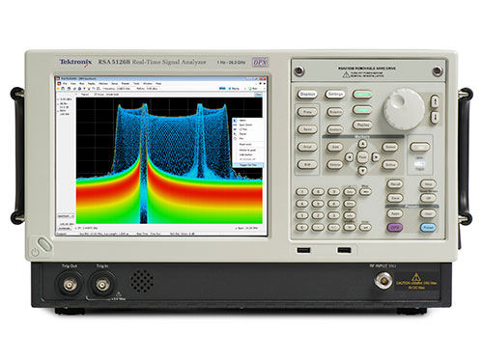
Noisy signals
Degradation of signal quality due to noise
  Amplitude and/or phase jitter
What is the difference between a coherent signal and noise?
Amplitude of coherent, quasi monochromatic signal (at 200 MHz) is independent of observation bandwidth
Incoherent noise power (dominated by spectrum analyzer front-end amplifier/mixer) is proportional to bandwidth
Thermal noise power
Noise
Noise

Slide 12
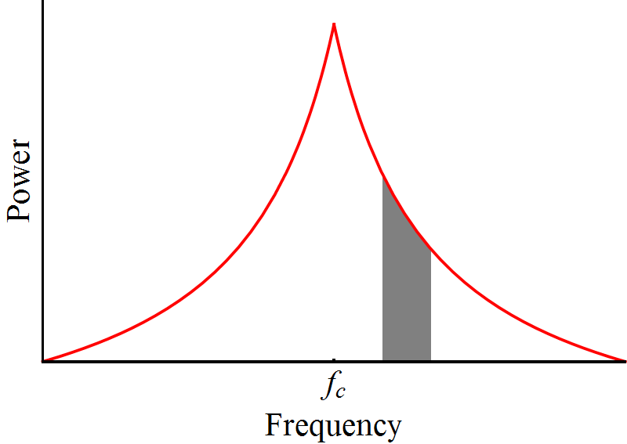
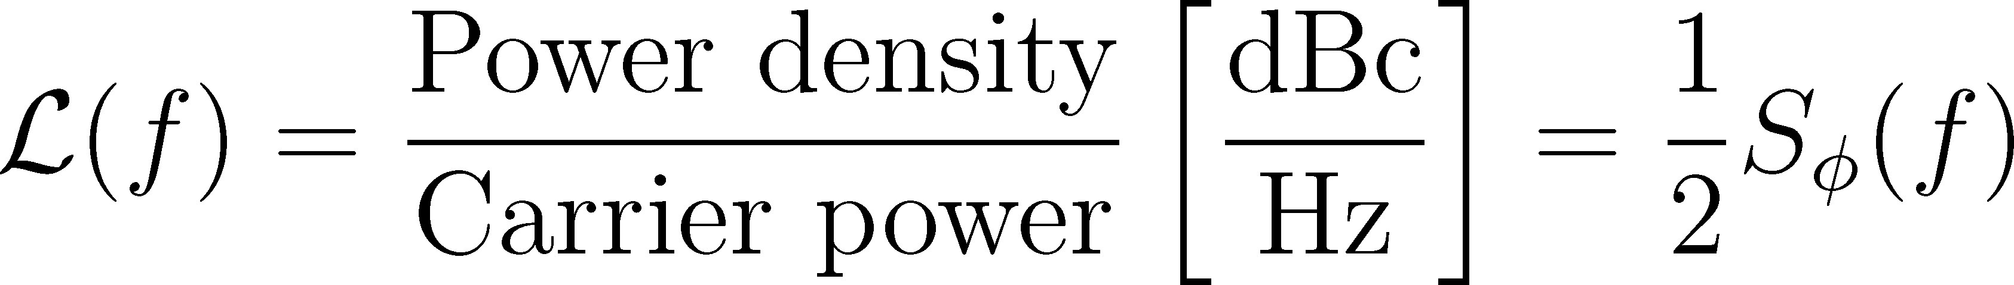
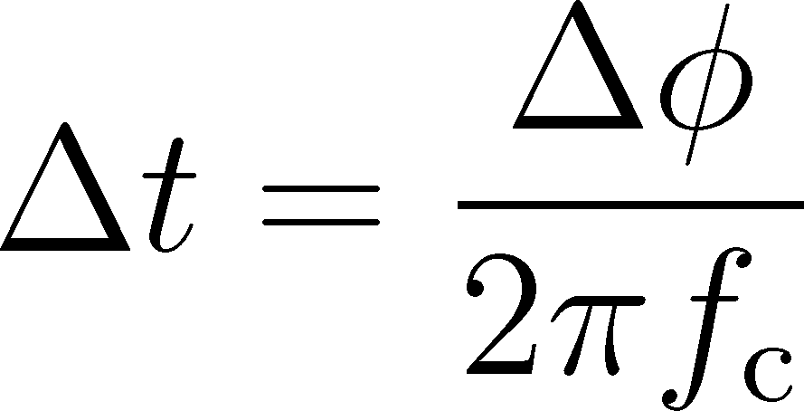
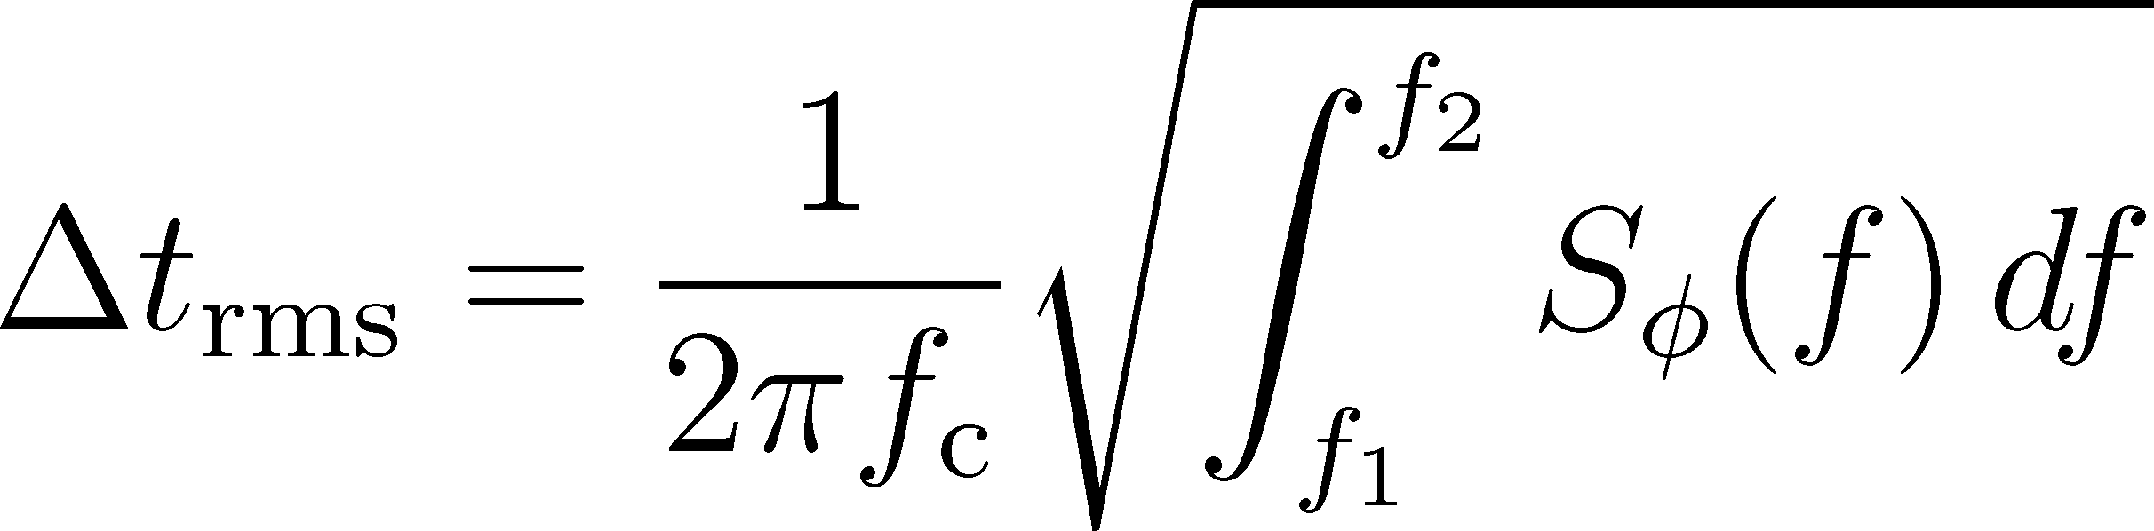
Analysis of phase noise
Compare noise power with carrier power as reference
Ratio of carrier to noise: dBc
Bandwidth Δf = 1 Hz for normalization
Δf
Noise power density
Its integral is the phase jitter and using
the jitter in time becomes

Slide 13
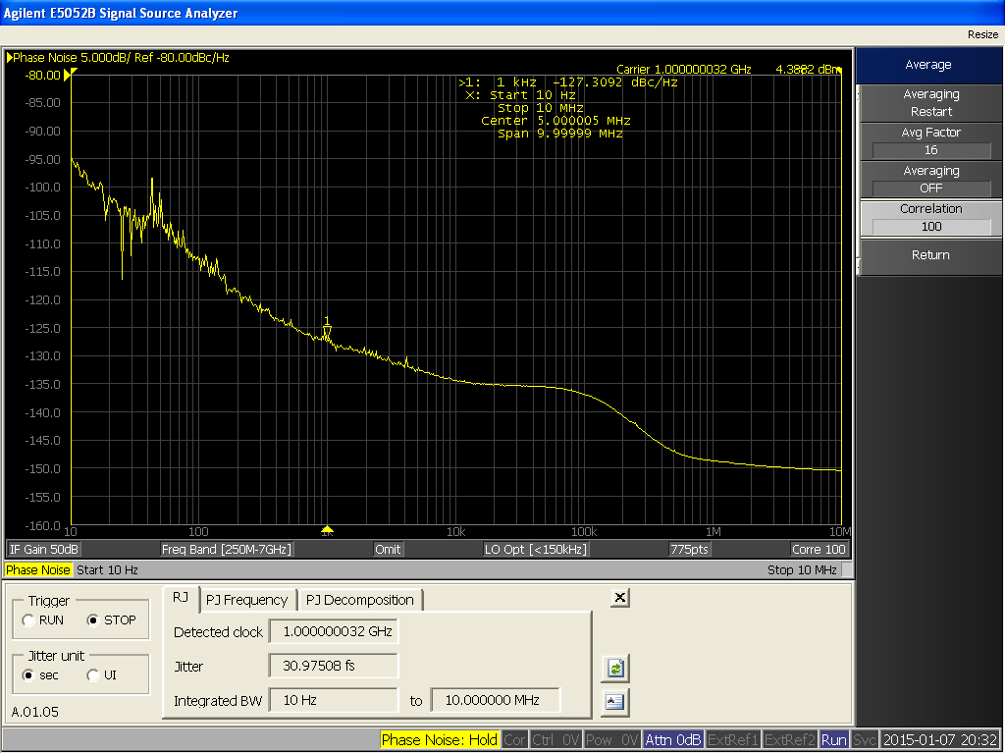
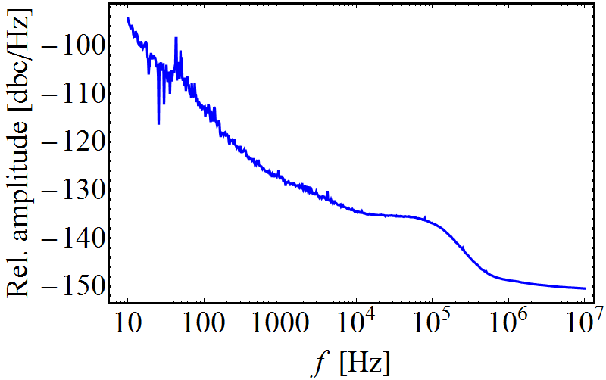
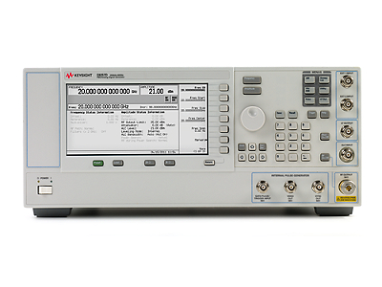
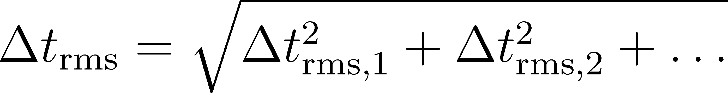
Typical phase noise plots
Measure phase noise of a synthesized lab generator
Frequency range | Δt_{rms} [fs]
10…100 Hz | 12.4
100 Hz …1 kHz | 5.4
1…10 kHz | 5.4
10…100 kHz | 11.1
100 kHz…1 MHz | 13.0
Total | 31.0
Note: jitter values can be added as square root of quadratic sum
Convenient split to relevant ranges

Slide 14
Signal transmission

Slide 15
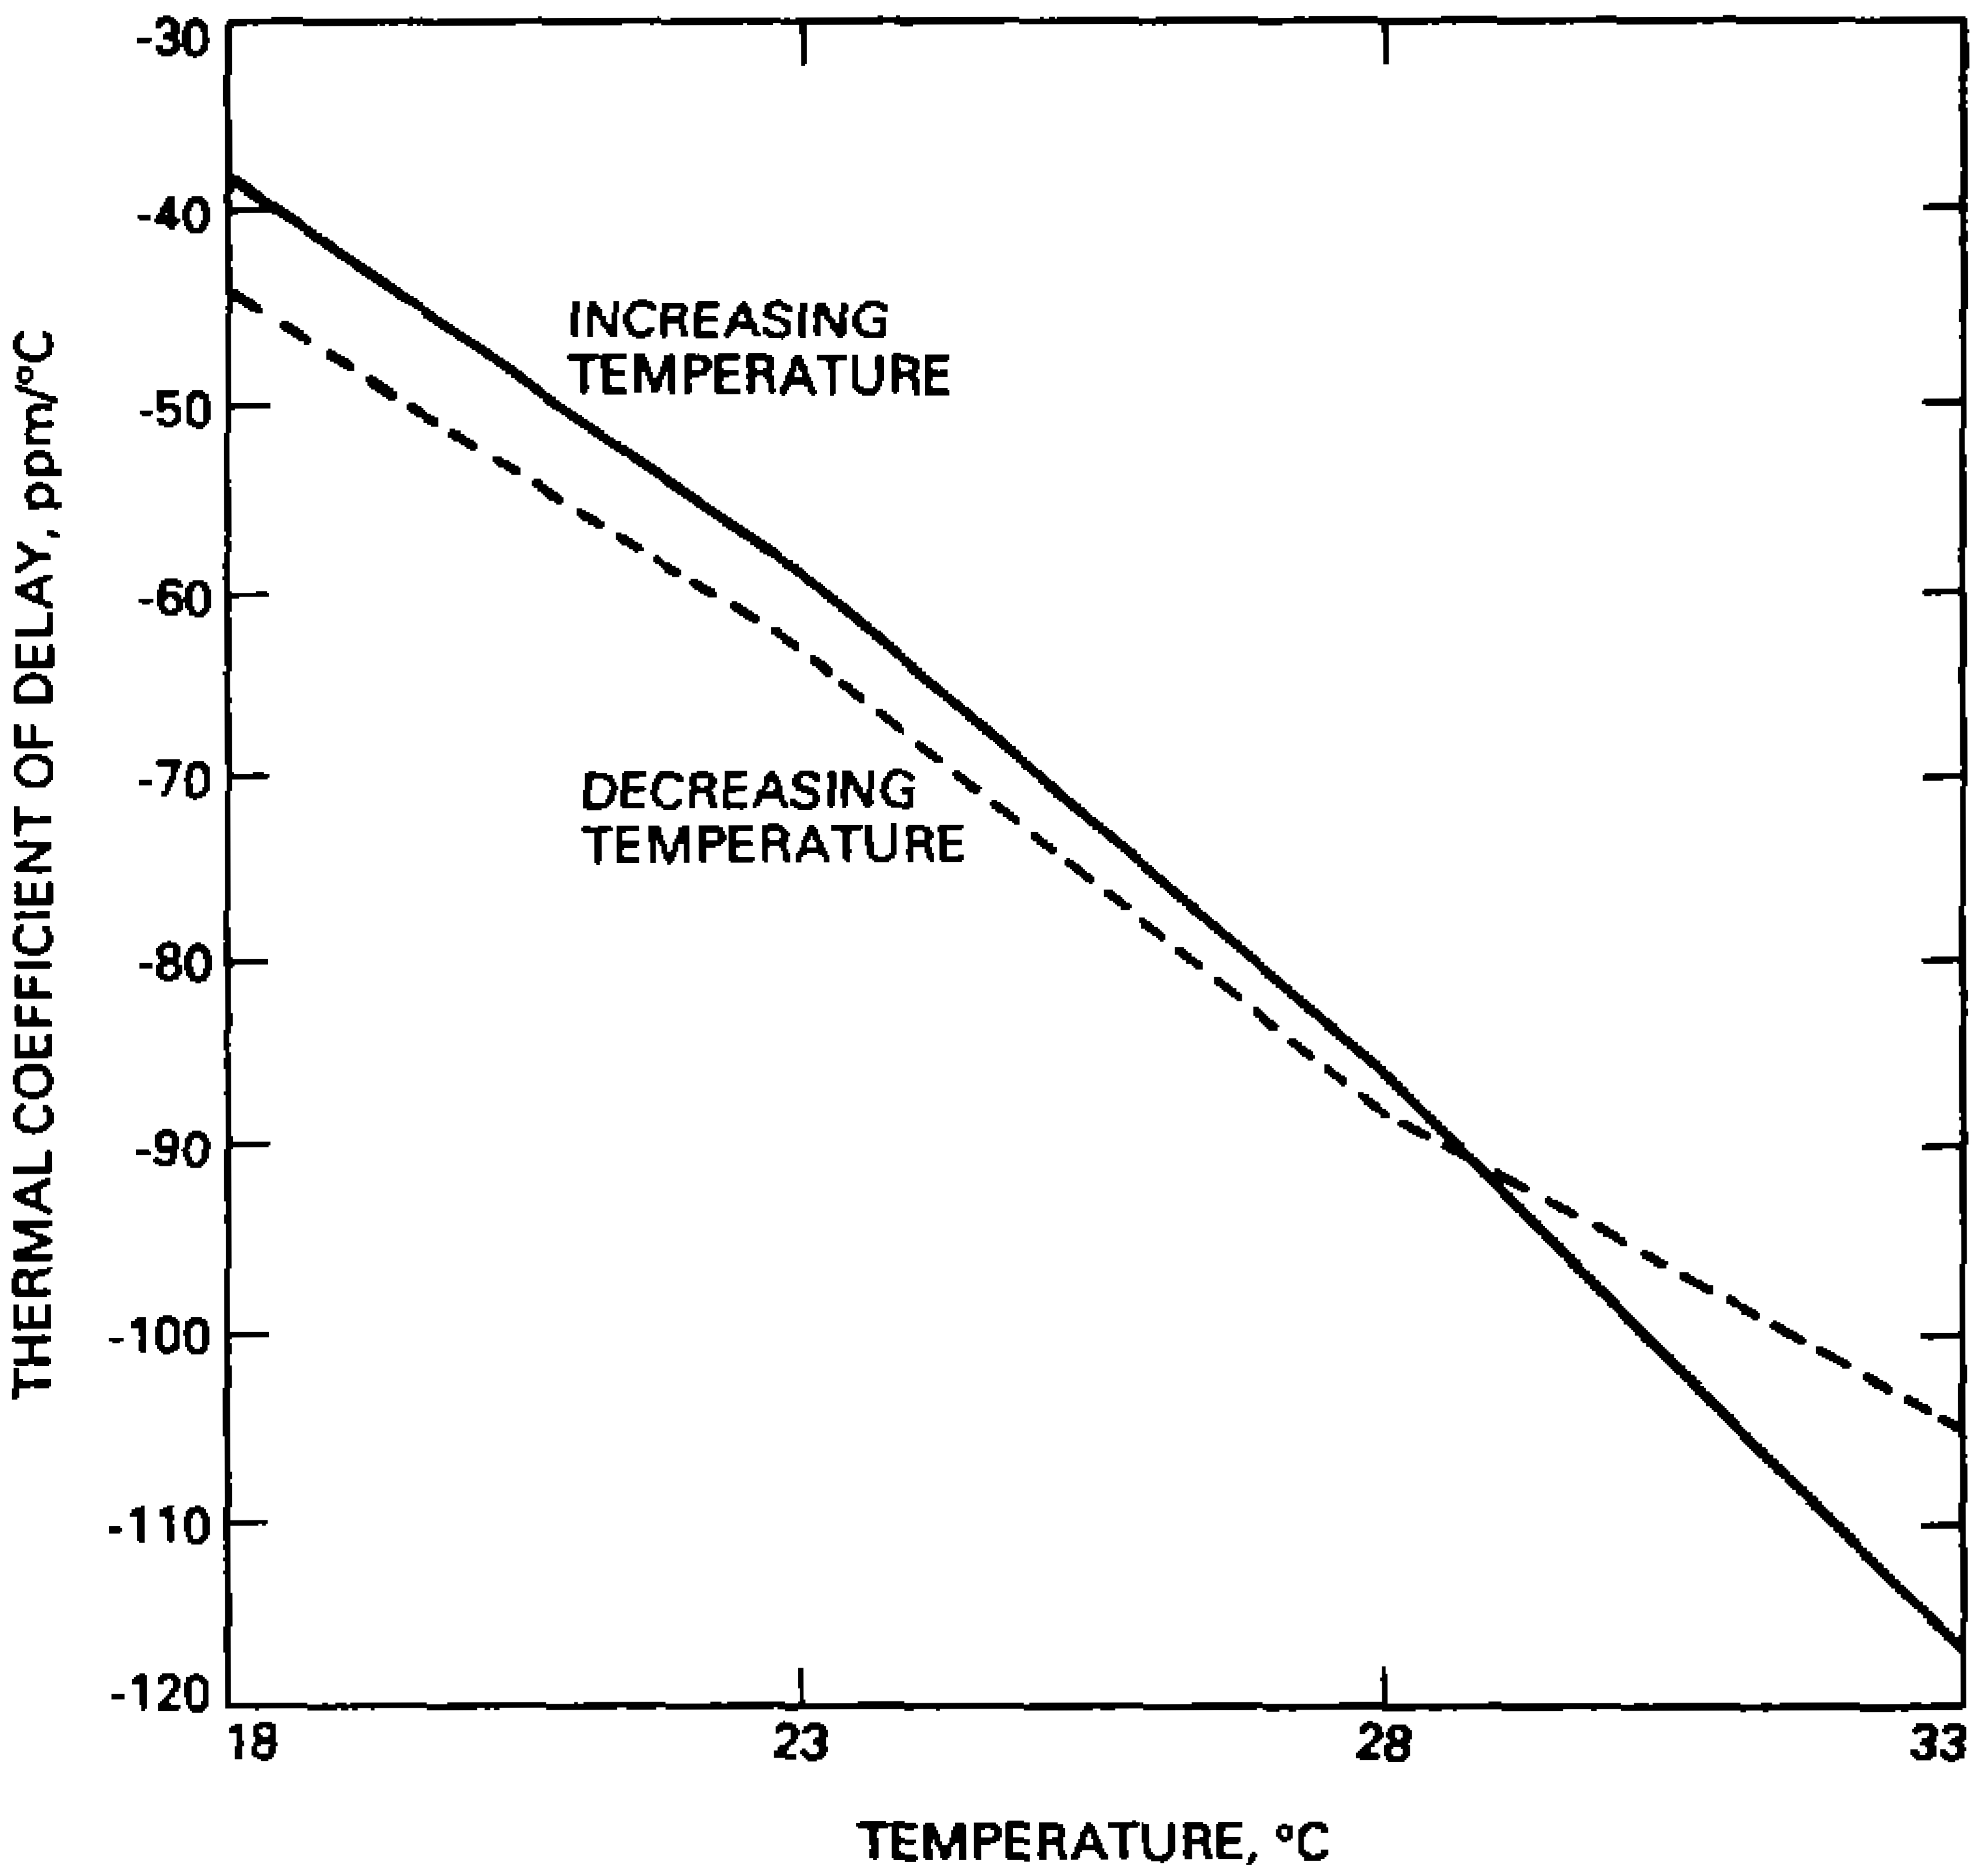
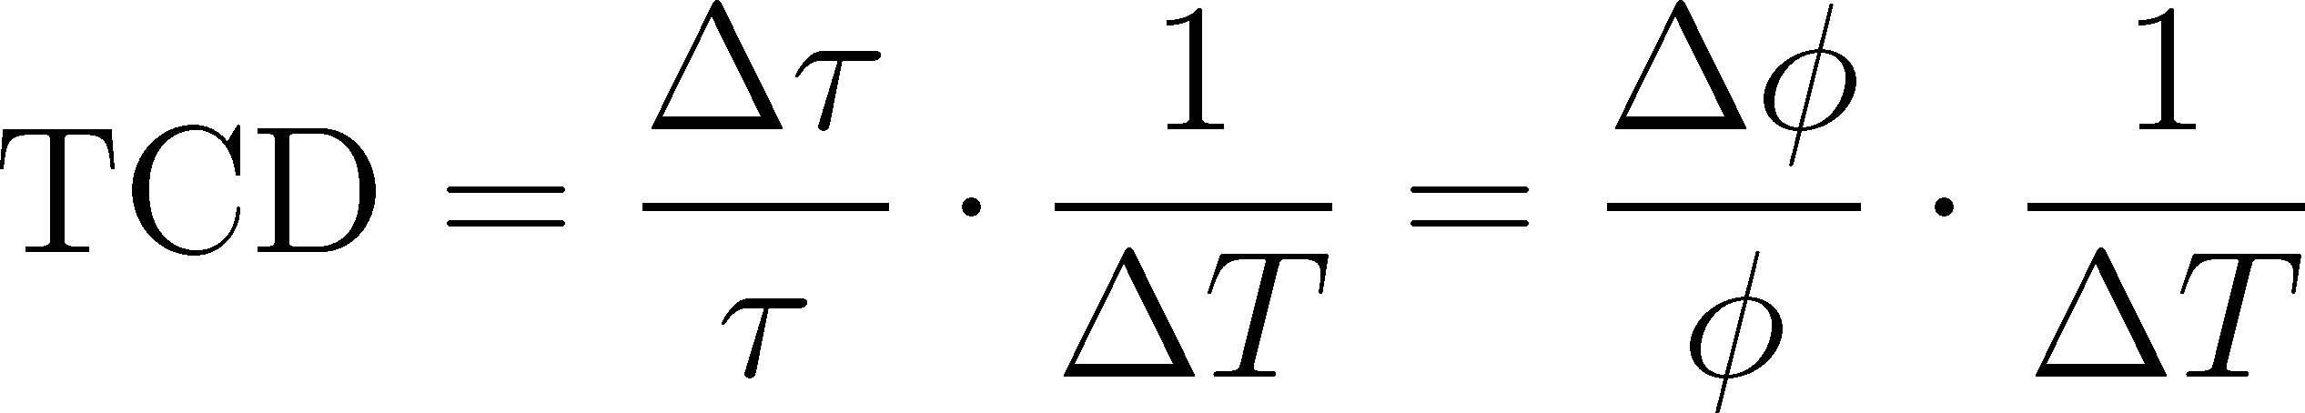
Transmission of reference signals
Thermal drift of long coaxial cables or optical fibres
Thermal coefficient of
delay:
RG223 coaxial cable
Lutes/Diener, NASA TDA Progress Report 42-99
Example: 2 km long RG223 cable with ~10 μs delay
ΔT of only 1° C (room temperature) changes delay by ~0.5 ns
1.8° at 10 MHz (CERN PS), but 73° at 400 MHz (LHC)
Optical fibres are typically 10…100 times more stable
What to do if this is still not sufficient?

Slide 16
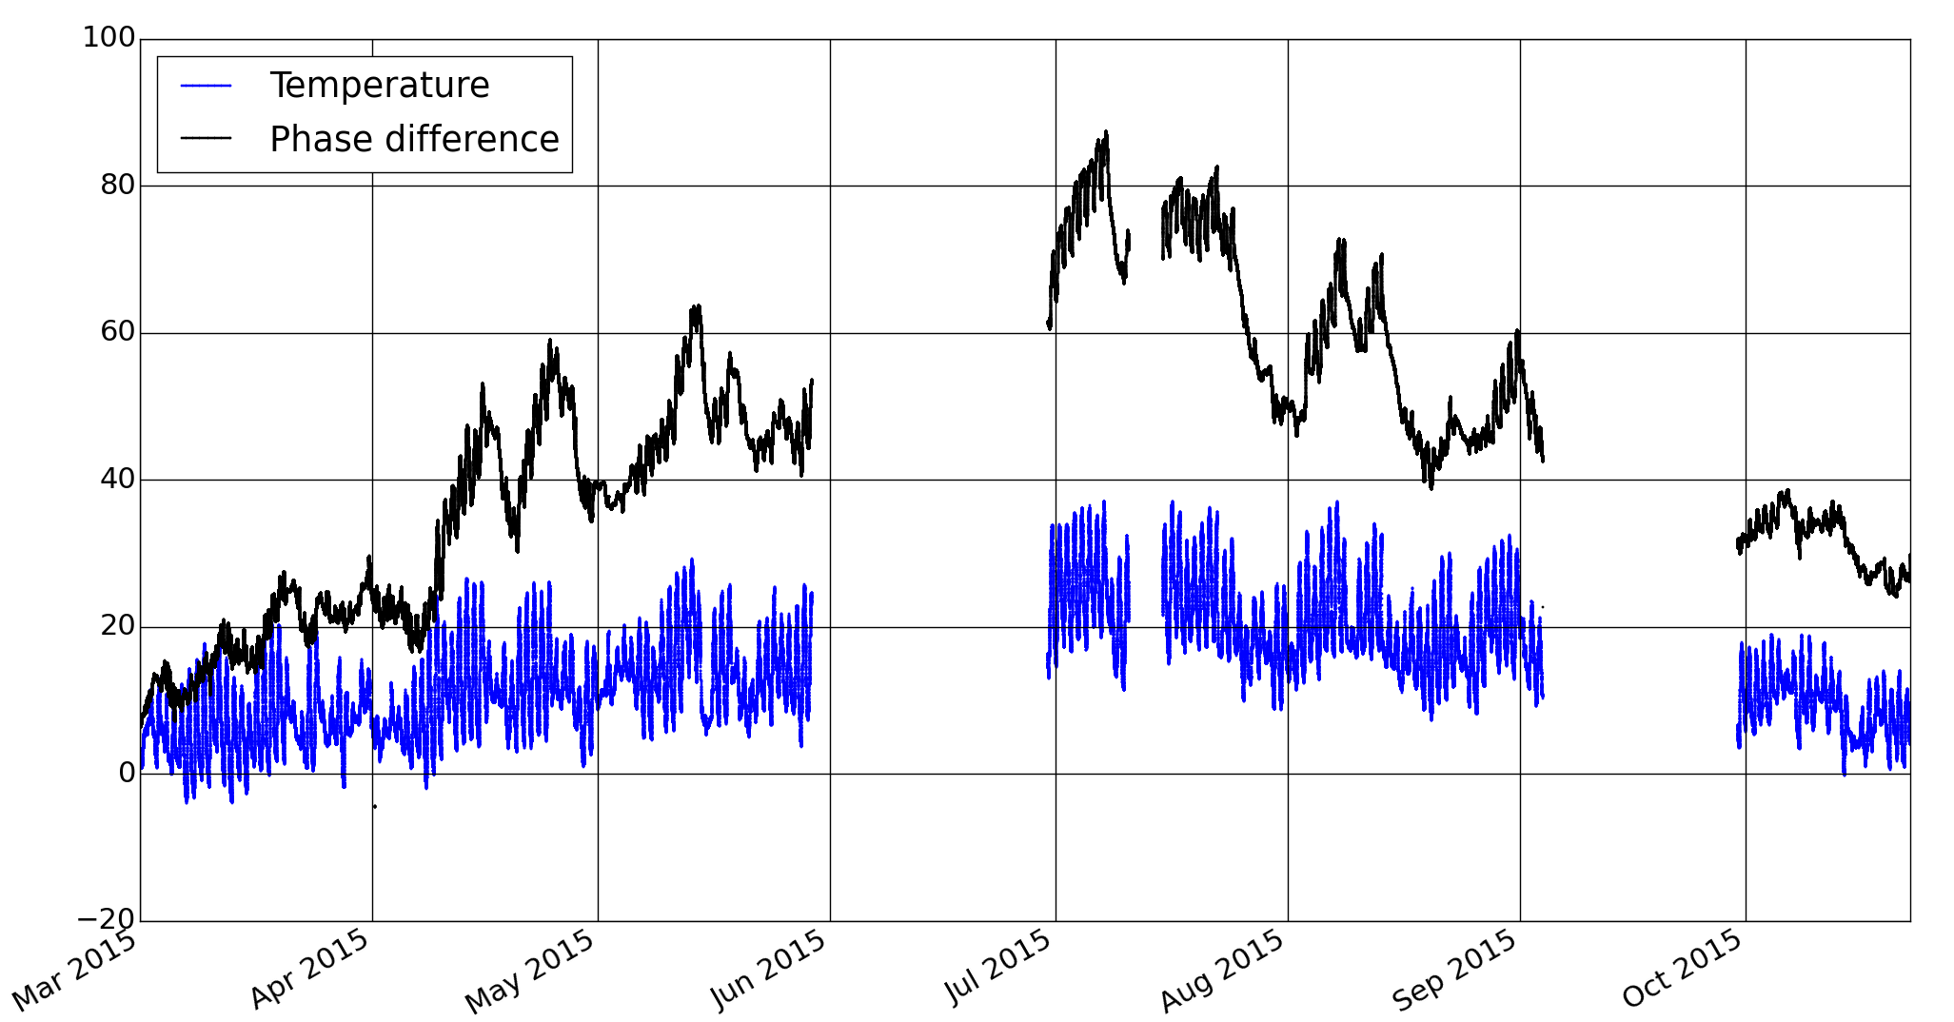
Transmission of reference signals
Measured drift of optical fibres over long distance standard optical fibre
Drift by about 1 ns insufficient for requirements of setup
Active compensation of delay
Measured temperature and delay drift of ~6.3 km fiber
Temperature [°C], Δφ at 200 MHz
1.67 ns
Time

Slide 17
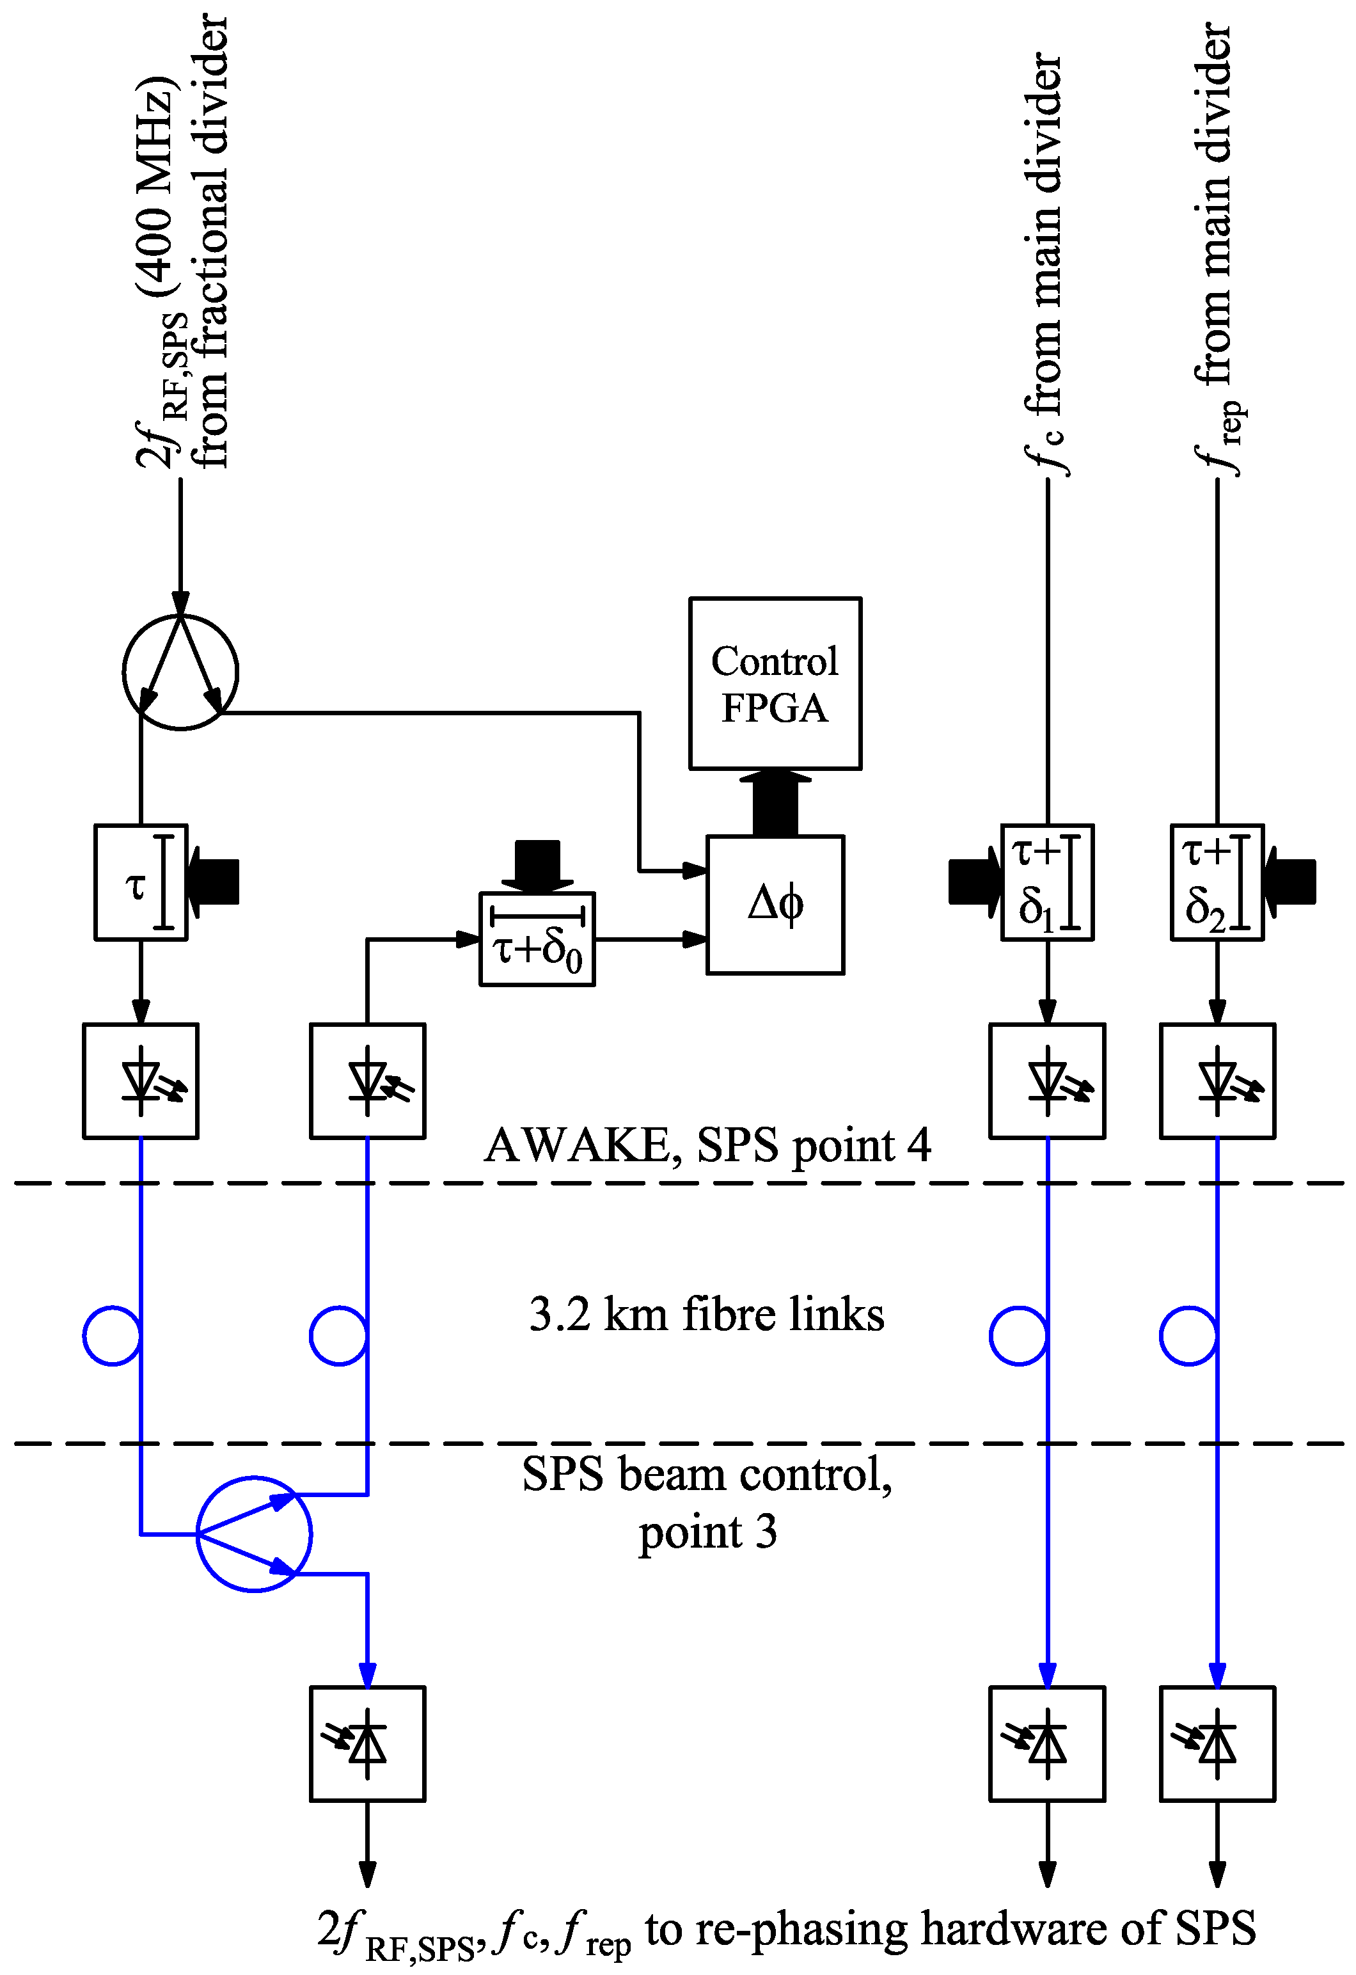
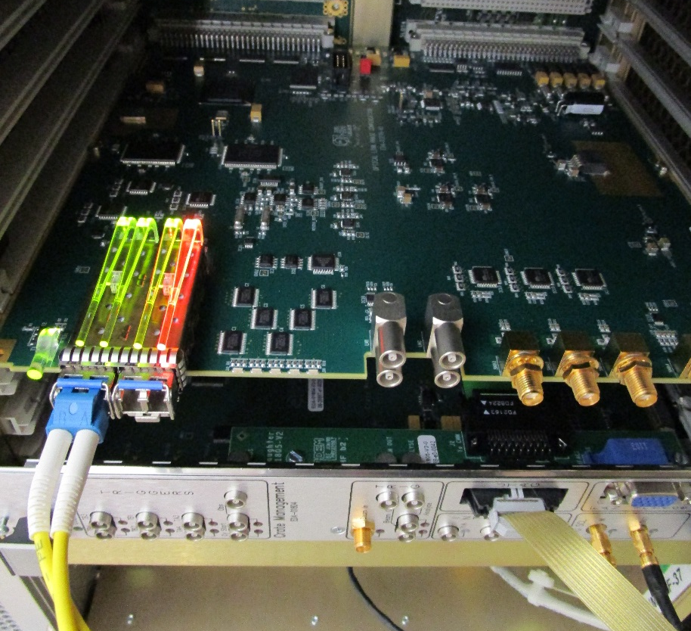
Example: Active drift compensation
Simplified diagram
Precise synchronization of proton beam from CERN SPS with plasma wake-field experiment AWAKE
Prototype hardware
Expect picosecond precision over several kilometres
D. Barrientos, J. Molendijk

Slide 18
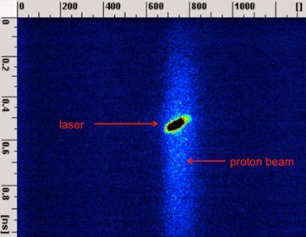
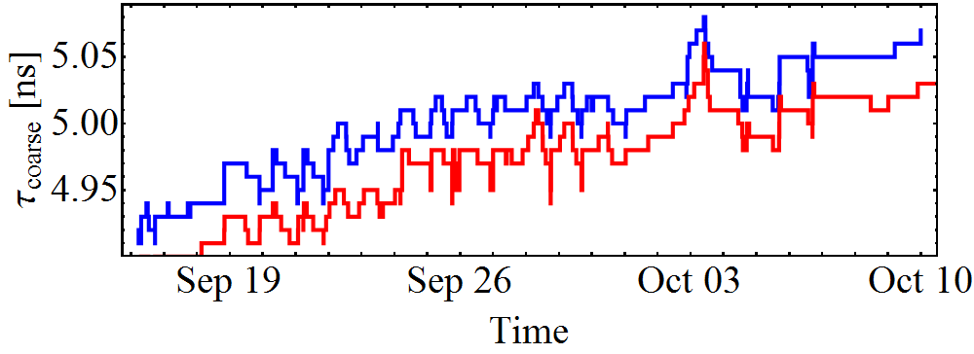
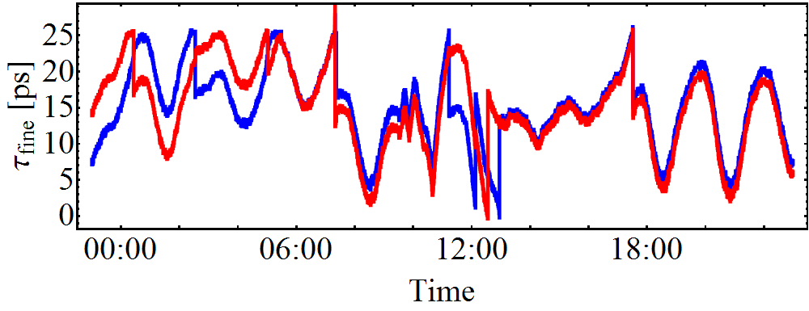
Transmission of reference signals
Total delay composed of coarse (steps of 10 ps) and fine ~30 ps range: τ = τ_{coarse} + τ_{fine}
1 ns
Precision difficult to evaluate without 2nd ‘reference’ link
Arrival of two beams in AWAKE experiment stable to better ~100 ps over months
D. Barrientos, J. Molendijk

Slide 19
Overview of transmission methods
Various approaches:
Δt
Δf
=
t f
1) RF distribution
standard
reflectometer
interferometer
SLAC
FLASH
E-XFEL
~
f ~ 100MHz …GHz
LO
~
MO
2) Carrier is optically
f ~ GHz
SwissFEL
MZT
~
3) Carrier is optically + detection
SLAC
FERMI
(LBNL)
SACLA
f ~ 200 THz
4) Pulsed optical source
FERMI
FLASH
E-XFEL
SwissFEL
Δf ~ 5 THz
Mode locked
Laser
OXC
H. Schlarb

Slide 20
Phase detection

Slide 21
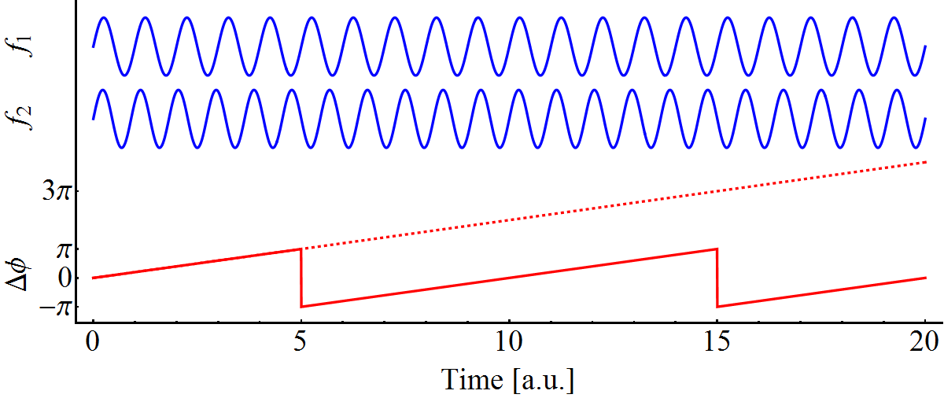
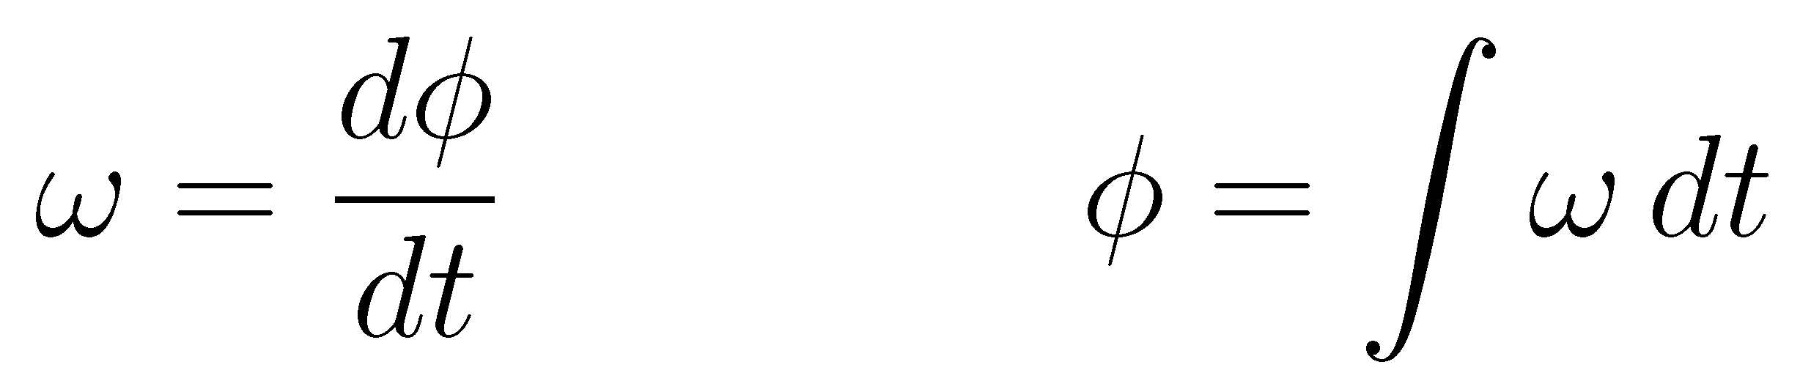
Frequency and phase
Two signals at different frequencies ω₁ and ω₂
Phase difference, Δφ, between both signals changes linearly
Ambiguity to distinguish between Δφ = -π, π, -3π, 3π,...
Saw-tooth in phase means constant frequency difference
Equivalence of frequency and phase
↔

Slide 22
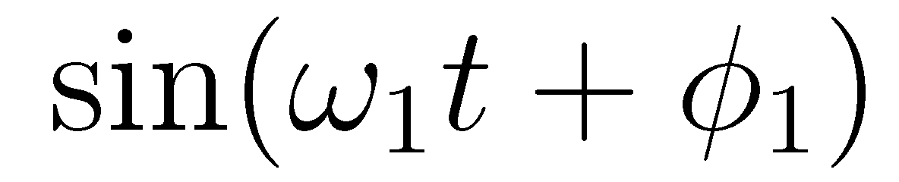
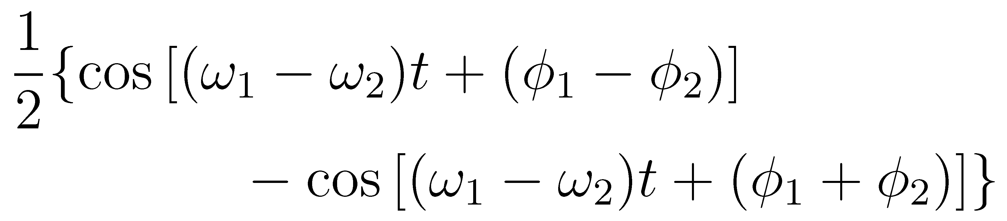
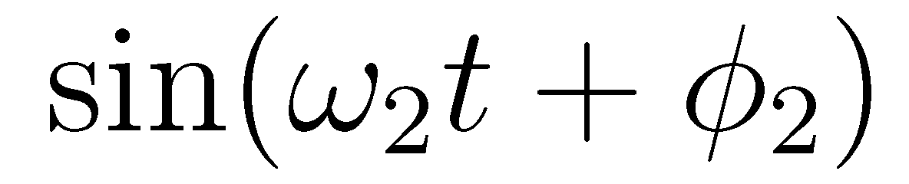
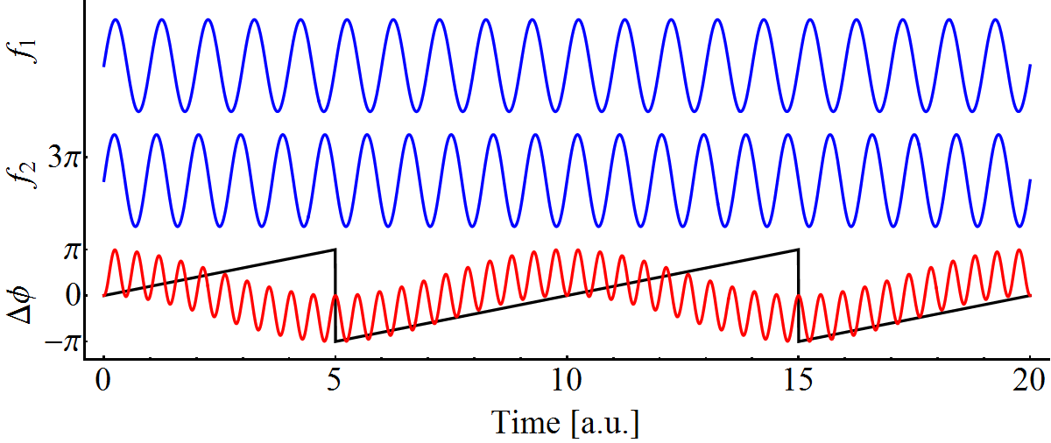
How to detect phase differences?
Example: analogue 4 quadrant multiplier and low pass filter
Signals:

Slide 23
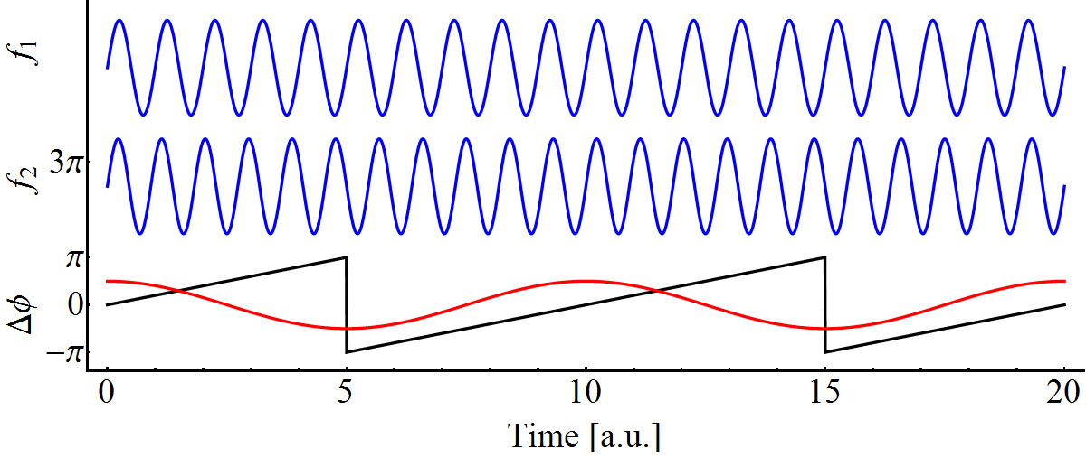
How to detect phase differences?
Example: analogue 4 quadrant multiplier and low pass filter
Signals:
Remove ripple → Low-pass filter

Slide 24
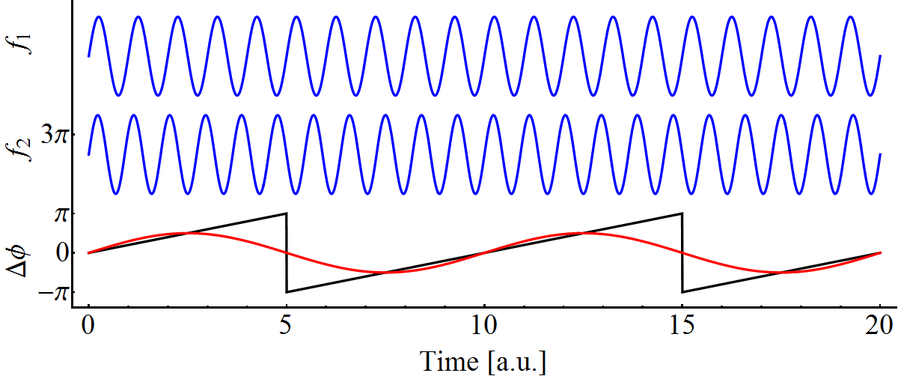
How to detect phase differences?
Example: analogue 4 quadrant multiplier and low pass filter
Signals:
Phase discriminator in approximately +/-90° range
Remove ripple → Low-pass filter
Relative: arbitrary shift by 90°

Slide 25
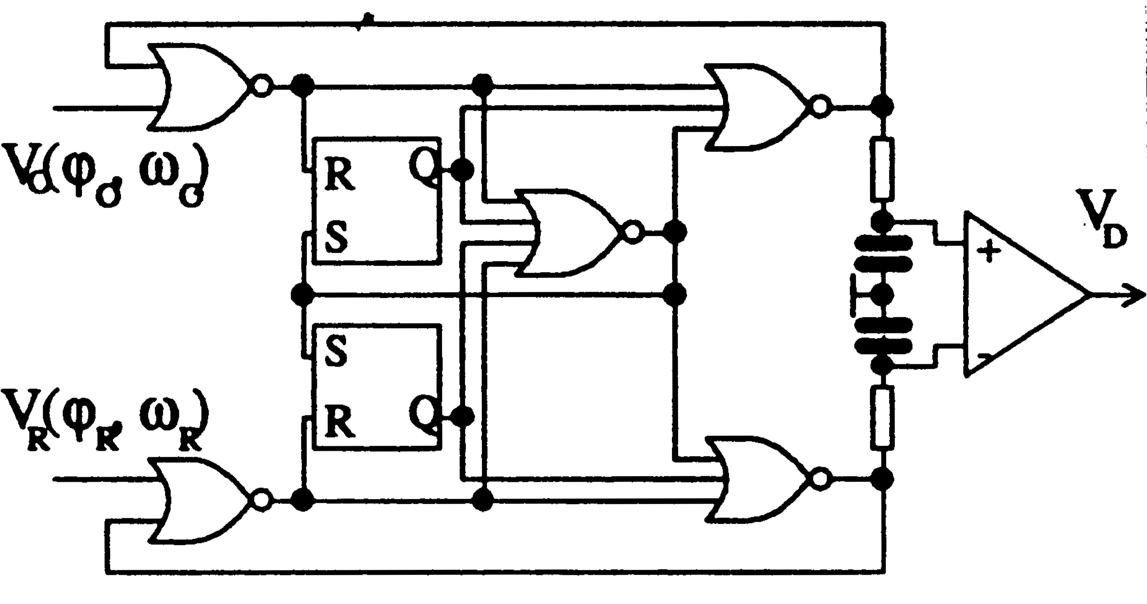
Further phase detection techniques
Multitude of different phase discriminators
Type | Range | Behavior
Analogue 4 quadrant multiplier | π | Sinusoidal: s_{out} ~ cos φ
Exclusive OR gate | π | Linear: s_{out} ~ φ - 3π/2, or s_{out} ~ -φ + π/2
Sample and hold | π | Sinusoidal: s_{out} ~ sin φ
Flip-flop phase detector | π | Linear: s_{out} ~ φ - π
Tri-state double flip-flop | 2π | Linear: s_{out} ~ φ
Balanced optical microwave phase detector (Sagnac loop) | <π | Sinusoidal: s_{out} ~ sin φ (clipped)
R. Garoby
Full phase coverage of 2π range excludes ambiguity of ±π
Avoids locking of phase loop with unwanted offset
Measure phase at high frequencies for precision

Slide 26
Dividers

Slide 27
Frequency dividers
Generate signals using frequency division from f_{RF}
Works (well, on paper), so what is the problem?
f_{RF}
f_{RF}
n
n
n
m
1
1
1
1
f_{RF}/n
f_{RF}/n
f_{RF}/n
f_{RF}/m
Dividers are nothing but counters! Initial value?

Slide 28
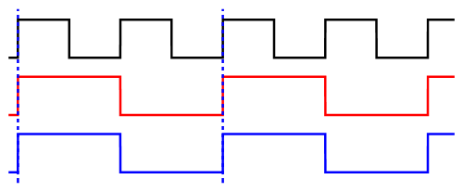
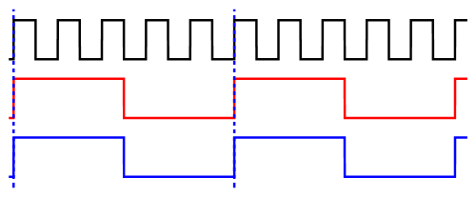
Synchronizing multiple dividers
Generate signals using frequency division from f_{RF}
How to fix?
n = 2:
f_{RF}
n
n
Re- set
n = 5:
1
1
f_{RF}/n
f_{RF}/n
Reset from master to slave divider(s) to force initial condition
Never more than one divider without reset!

Slide 29
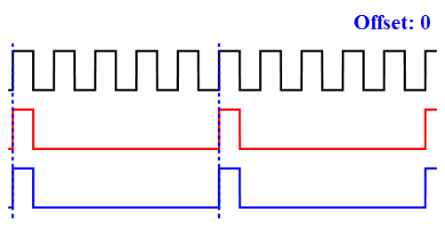
Multiple divider with counting offset
Counter with programmable offset value
Single counter/divider split in two output branches
Impossible to lose relative phase of outputs
More complicated set-up allows also f_{RF}/m and f_{RF}/n, etc.
f_{RF}
Offset
Counter to n
+
Adder with Mod(x,n)
x = 0?
x = 0?
f_{RF}/n
f_{RF}/n

Slide 30
Fundamental periodicity

Slide 31


Example: BESSY II booster and storage ring
Storage ring circumference 240 m, f_{RF} = 499.6 MHz
Circumference ratio of Booster and storage ring: 2/5
Sync. divider
16
1/10
3.125 MHz, f_{rev} booster
Master: f_{RF} = 500 MHz
1
1/25
1.25 MHz, f_{rev} storage ring
96 m
1/50
0.625 MHz, periodicity
240 m
Everything repeats with periodicity of
  5 turns in booster
  2 turns in storage ring
Each gray point represents 4 RF buckets

Slide 32

Example: SLS booster and storage ring
Storage ring circumference 288 m, f_{RF} = 499.6 MHz
Circumference ratio of Booster and storage ring: 15/16
K. Babak, C. Gough
Booster f_{rev}
500 MHz master
Booster super-period
Storage ring f_{rev}
Storage ring super-period
Fundamental periodicity (super-period)
  16 turns of booster corresponding to 15 turns in storage ring

Slide 33
Fundamental periodicity for transfer
Two accelerators with revolution periods T_{rev,1} and T_{rev,2}
Beam transfer may take place at every period mT_{rev,1} or nT_{rev,2}
This periodicity is, depending on the accelerator and laboratory, called super-period, common or fiducial period
In case of integer ratio of revolution frequencies, beam can be transferred once every turn of the larger accelerator
Sending | Receiving | Ratio | Remark
BESSY booster | BESSY SR | 2/5 | Fixed frequency
SLS booster | SLS SR | 15/16 | Fixed frequency
J-PARC RCS | J-PARC MR | 2/9 | Profit from ratio for bucket selection
PS booster | PS | 1/4
PS | SPS | 1/11
PS | AD | 3/1 | Particle type and energy change at transfer
SPS | LHC | 7/27 | f_{c} as low 1.6 kHz

Slide 34

Synchronous triggers
How to generate beam synchronous triggers?
Chains of counters to re-synchronize timings
Booster f_{rev} marker
f_{RF} clocks
Super-period marker
Value
Clock
Value
Out
Clock
#3
Value
Out
Start
Clock
#2
Out
#1
Start
Start
Each step re-synchronizes with respect counter clock
‘Start engine button’ synchronous to nothing
Complete system of two accelerators periodic with timing #1
Timing #2 marks, e.g., a delay in number of turns
Timing #3 counts f_{RF} clocks to fine adjust, e.g., bucket number

Slide 35
Synchronous trigger trees
Booster f_{rev} marker
Super-period marker
Value
Clock
#2
f_{RF} clock counter
Value
Out
Clock
#1
Out
Start
Start
Booster ejection
Storage ring f_{rev} marker
Value
Clock
#3
f_{RF} clock counter
Out
Start
Storage ring injection
Timing counters may use different clocks, as long as the clocks are derived from the same source
Reproducible delay between clock #2 and #3
Tree structures of timings

Slide 36

Circular electron/lepton accelerators
Simplification for most electron accelerators:
Leptons are practically at speed of light
Synchrotron radiation damping forces bunches into buckets
Beam synchronous timing triggers can be derived by counting RF master clock (or its sub-multiples)
Everything is predictable from the beginning
Each gray point represents 5 RF buckets
Diagnostics
Kicker
magnet
Kicker
magnet
Let’s get frequencies moving

Slide 37
Transfer between hadron accelerators

Slide 38
Synchronous triggers and bucket counting
Circular hadron accelerators: master clock sweeps
Need again synchronous timings with respect to beam
  Kicker magnets
  Beam instrumentation
RF manipulations require bunches in certain buckets
  Beating pattern due to multiple RF harmonics
    Splits behaviour for different buckets
  Bucket numbering
Need to know longitudinal beam position for transfer
Where (in phase/in time) is the beam?
Do not measure!
Know!

Slide 39

Phase-locked loop
Frequency re-generation and multiplication
Voltage controlled oscillator (VCO) locked in phase to input
Loop filter, H(ω)
f_{in}, φ_{in}
Δφ
VCO
f_{out}, φ_{out}
~φ_{in} - φ_{VCO}
φ_{VCO}
1
n
RF
Slow signal
Fixed phase relationship: φ_{out}/n – φ_{in} = const.
Optional divider: f_{out} = n · f_{in}

Slide 40

Beam phase loop
RF cavity
RF
Phase pick-up
Slow signal
h f_{rev}
Δφ
Power amplifier
Beam phase
Cavity phase
h
f_{RF}
1
DDS
Digital synthesizer
Beam synchro- nous f_{rev}
Synchronous phase, φ_{s}
+
φ_{err} ~Δf
Loop corr.
-
f_{out} = f_{in} ± Δf
Precision VFO
h · f_{rev}, from B
Phase-locked loop with beam phase as reference for RF system

Slide 41


Benefits of beam phase loop at transfer
Adapt RF phase to bunch phase before beam blows-up
Fast compared to timescale of synchrotron frequency, f_{s}
Rigid RF, no phase loop
With phase loop
Even large transients (injection, transition) can be controlled
Small longitudinal emittance blow-up

Slide 42
Start counting with injection
f_{RF}
Start of divider/counter?
Get it right from injection
Use output from divider as reference for incoming beam
h
1
Beam synchro- nous f_{rev}

Slide 43
Start counting with injection
f_{RF}
Start of divider/counter?
Get it right from injection
Use output from divider as reference for incoming beam
Before injection:
  Distribute delayed revolution frequency to sending accelerator
  Bunches are injected synchronously with f_{rev,delayed}
  Shifted with respect to f_{RF} and f_{rev}
h
1
Delay
Δτ
f_{rev,delayed}
f_{rev}
To sending accelerator

Slide 44
Start counting with injection
Offset
bucket #
f_{RF}
Start of divider/counter?
Get it right from injection
Use output from divider as reference for incoming beam
Before injection:
  Distribute delayed revolution frequency to sending accelerator
  Bunches are injected synchronously with f_{rev,delayed}
  Shifted with respect to f_{RF} and f_{rev}
Counter to h
+
x = 0?
x = 0?
f_{rev,delayed}
f_{rev}
To sending accelerator

Slide 45

Beam phase loop without beam?
Just replace beam by a simple RF generator!
RF cavity
RF
Phase pick-up
Slow signal
h f_{rev}
Δφ
Power amplifier
Beam phase emulator
Cavity phase
Beam phase
h
f_{RF}
1
φ_{err} ~Δf
DDS
VCO
f_{out} = f_{in} ± Δf
Beam synchro- nous f_{rev}
Precision VFO
h · f_{rev}, from B

Slide 46

Synchronization chain for bucket counting
Beam phase emulator
Offset
bucket #
φ const.
+
h
1
φ const.
Shifted f_{rev} to sending synchrotron
Synchro- nous f_{rev}
φ const.
φ const.
φ const.
Incoming beam
Incoming beam has reproducible phase with respect to RF bucket, synchronous f_{rev} and beam phase emulating generator
Straightforward switch to beam signals, already locked in phase

Slide 47
Synchronization chain for bucket counting
Phase pick-up
Offset
bucket #
φ const.
+
h
1
φ const.
Shifted f_{rev} to sending synchrotron
Synchro- nous f_{rev}
φ const.
φ const.
φ const.
Incoming beam
Incoming beam has reproducible phase with respect to RF bucket, synchronous f_{rev} and beam phase emulating generator
Straightforward switch to beam signals, already locked in phase
Beam phase with respect to f_{rev} always known

Slide 48
Bucket numbering

Slide 49



Bucket numbering for RF manipulations
 | Triple splitting | Batch compression
Injection harmonic
Periodicity of RF manipulation | Every bucket | Only one beating along circumference
Injection bucket selection | 4 buckets difference between both injections | Both injections into independently defined buckets
3
4
2
1
3
4
2
1
1st injection
2nd injection
Must inject into the correct bucket numbers

Slide 50









Example: PS injection bucket selection
Bunches must be placed into the correct buckets numbers
Harmonic number change only for even number of bunches
  Bucket number control during both transfers PSB → PS
  How to handle changing number of bunches?

Slide 51
Intermediate summary
Basic techniques of signal synchronizations
  Beware of dividers
Beam transfer between circular lepton accelerators
  Constant frequency
  Predictable, independently from beam
  Fundamental periodicity
Beam transfer between circular hadron accelerators
  Beam is reference, keep track

Slide 52
Timing, Synchronization & Longitudinal Aspects II
H. Damerau
CERN
CAS Course on
Beam Injection, Extraction and Transfer
13 March 2017

Slide 53
Outline
Introduction
General concepts
  Signals with noise, transmission of RF signals
  Phase detectors and dividers
Beam transfer
  Fundamental periodicity
  Transfer between circular lepton accelerators
Transfer between hadron accelerators
  Beam phase loop, bucket numbering
  Transfer process: Synchronization, transfer triggers
  Longitudinal matching
Summary

Slide 54
Synchronization and transfer

Slide 55
Steps of beam transfer synchronization
1.
Set bending fields in both accelerators the to same magnetic rigidity
2.
Synchronize sending or receiving accelerator
→ Ready for transfer
3.
Trigger bump and septum elements
4.
Start counting f_{rev} clock (sending/receiving accelerator)
5.
Start counting clock of fundamental periodicity
Start counting bucket clock
Fine delay
Ejection and injection kickers triggers
→ Transfer

Slide 56


Match bending field of both accelerator
Same magnetic rigidity ρB of sending (1) and receiving (2) accelerators
No rule without exception: Particle type change at transfer
  Proton to anti-proton conversion, e.g., 120 GeV/c ≠ 8 GeV/c (Fermilab), 26 GeV/c ≠ 3.6 GeV/c (CERN),
  Charge state change at transfer, e.g. LHC ion injector chain Pb54+ in LEIR/PS → Pb82+ (in SPS)

Slide 57






Match RF frequencies
RF frequencies of both accelerators must have appropriate ratio assuming that the beam velocity is unchanged
Common choice of most circular electron accelerators f_{RF,1} = f_{RF,2}
Harmonic number, h, proportional to circumference, 2πR
Again no rule without exception: Production of antiprotons in target in transfer line

Slide 58


Distance between bunches
Distance of bunches (bunch spacing, τ_{bunch}) from source accelerator must match distance of buckets
Example: τ_{bunch} = 2/f_{RF}
Example: τ_{bunch} = 5/f_{RF}
Common case: f_{RF,2} = n · f_{RF,1}
  f_{RF,LHC} = 2 · f_{RF,SPS} and f_{RF,SPS} = 5 · f_{RF,PS}
Several exceptional cases:
  No bunch distance with single bunch → more flexibility
  Adjust bunch spacing using multiple RF systems

Slide 59


Exception: double-harmonic RF at transfer
Was used at CERN PSB-to-PS to transfer 2 bunches at once
Circumference ratio C_{PS}/C_{PSB} = 4
Ratio virtually moved to 2/7: use h_{RF} = 2 + 1
1. Add h1 component such that bunches approach to 245 ns (small spacing) → big spacing becomes 327 ns
2. Synchronize on h1 to the PS
3. Trigger extraction kicker in-between the small spacing
4. Eject two bunches per ring at a distance of 327 ns
2.
1.
Next bunch ejected
Short gap for ejection kicker
1.
2.
Spacing larger than C_{PSB}/2 → h_{PS} = 7, C_{PS}/7
Christian Carli

Slide 60
Steps of beam transfer synchronization
1.
Set bending fields in both accelerators to the same magnetic rigidity
2.
Synchronize sending or receiving accelerator
→ Ready for transfer
3.
Trigger bump and septum elements
4.
Start counting f_{rev} clock (sending/receiving accelerator)
5.
Start counting clock of fundamental periodicity
Start counting bucket clock
Fine delay
Ejection and injection kickers triggers
→ Transfer

Slide 61


Before synchronization
Even with magnetic rigidity matched: revolution frequencies not at theoretical ratio due to imperfections
Bunches and buckets slip in phase
Slippage of bunches and bucket
Rotation in source accelerator subtracted
But: important question left unanswered!

Slide 62



Who is the boss?
• Transfer beam to a downstream machine: Bunch-to-bucket
Protons between synchrotrons → Synchronize accelerators
Move relative phase of RF together with beam between both machines to hit the empty buckets
Sending accelerator is, the boss?
?
Receiving accelerator is the boss?

Slide 63
Choice of master for transfer synchronization
Sending accelerator is master of transfer
  Receiving accelerator adapts to incoming beam
  Common choice when receiving accelerator has no beam before transfer
  Interesting for only single beam transfer, e.g., protons from PS → AD for antiproton production
Receiving accelerator is master of transfer
  Sending accelerator adapts to incoming beam
  Common choice when receiving accelerator has already beam before transfer (multiple injections)
  Most common at CERN, e.g., proton injector chain PSB → PS → SPS → LHC

Slide 64


Before synchronization
Simple test case of circumference ratio 2: C₂ = 2C₁
Source accelerator is master at transfer
Target accelerator is master at transfer

Slide 65


Before synchronization
Simple test case of circumference ratio 2: C₂ = 2C₁
Source accelerator is master at transfer
Target accelerator is master at transfer
Synchronize both accelerator to force: f_{rev,1} = 2f_{rev,2}

Slide 66



Simple synchronization process
Move beam to off-momentum (B const.):
  Well defined frequency difference between accelerators
Measure azimuth error, when beam at correct azimuth
  Close synchronization loop
  Moves beam to ref. momentum
f_{rev} (h = 1)
Δφ
Beam azimuth
(from phase loop)
Beam phase (from master)
Act on f_{RF} of slave
Bunch should be here
Δφ
Locked!
200 ms

Slide 67

Example: Synchronization of SPS to LHC
LHC is master for beam transfer from SPS
Measure Δτ of azimuth SPS-LHC
Arrival at flat-top +30 ms
Re-measure Δτ of azimuth
Close fine re-phasing loop at f_{RF, LHC}
Ready for transfer
RF phase [°]
SPS turns (10000 turns correspond to 231 ms
Set f_{rev,SPS} = 27/7 f_{rev,LHC}
Apply frequency bump
Apply frequency bump
Coarse and fine re-phasing to perfectly align bunches with respect to target buckets (400 MHz, 2.5 ns) in LHC
Complete synchronization process takes about 500 ms

Slide 68

Example: Fast cogging of booster at FNAL
Rapid cycling synchrotron from 400 MeV to 8 GeV
Total cycle length is only 25 ms → How to synchronize fast?
C. Drennan, R. Zwaska
Measure beam phase early in the cycle and predict azimuth at flat-top
Apply radial/frequency bumps already during acceleration

Slide 69

After synchronization
Simple test case of circumference ratio 2: C₂ = 2C₁
Source or target accelerator is master at transfer
Revolution frequencies coupled: f_{rev,1} = 2f_{rev,2}
Transfer can be triggered every turn of the target accelerator

Slide 70
Example: Ejection bucket numbering in PS
Azimuthal position of 1st bunch ambiguous after RF manipulations
Number of buckets and bunches changes during acceleration
But: Synchronous f_{rev,PS} signal with reproducible phase to beam
‘Re-numbering’ of buckets by shifting reference from SPS
Shift of external reference f_{rev,PS} adjustable in SPS bucket units
Synchronize external and beam synchronous f_{rev,PS}
f_{rev,SPS}
f_{RF,SPS}
Bucket number control
Ejection bucket selection
420
Synchronize
Reset
f_{rev,PS} (external)
f_{rev,PS} (internal)
f_{RF}/h from beam-control
1

Slide 71


Example: Ejection synchronization chain
Multiple ‘batches’ are transferred from PS to 11 times larger SPS
Outgoing
beam
φ const.
f_{rev,PS}
internal
φ const.
f_{rev,PS}
reference
φ const.
f_{rev,SPS}, f_{RF,SPS} for synchro.
Beam phase loop
Synchroni- zation loop
Ejection divider
Last turn before PS → SPS transfer
f_{rev,SPS} marker
φ const.
Outgoing beam
Beam phase with respect to f_{rev} always known

Slide 72
Steps of beam transfer synchronization
1.
Set bending fields in both accelerators to the same magnetic rigidity
2.
Synchronize sending or receiving accelerator
→ Ready for transfer
3.
Trigger bump and septum elements
4.
Start counting f_{rev} clock (sending/receiving accelerator)
5.
Start counting clock of fundamental periodicity
Start counting bucket clock
Fine delay
Ejection and injection kickers triggers
→ Transfer

Slide 73
Synchronous triggers
Cascade of trigger counters for fast transfer elements
Very similar to transfer with lepton synchrotrons
f_{RF,1} clock
Common frequency marker, f_{c}
f_{rev,1} marker
Value
Clock
Ejection elements
Value
Out
Clock
Value
Out
Start
Clock
Out
Start
Start
f_{RF,2} clock
Common frequency marker, f_{c}
f_{rev,2} marker
Value
Clock
Injection elements
Common
Value
Out
Clock
Value
Out
Start
Clock
Out
Start
Start

Slide 74
Steps of beam transfer synchronization
1.
Set bending fields in both accelerators to the same magnetic rigidity
2.
Synchronize sending or receiving accelerator
→ Ready for transfer
3.
Trigger bump and septum elements
4.
Start counting f_{rev} clock (sending/receiving accelerator)
5.
Start counting clock of fundamental periodicity
Start counting bucket clock
Fine delay
Ejection and injection kickers triggers
→ Transfer

Slide 75

Example: Turn count control at extraction
J-PARC rapid cycling synchrotron and main ring ratio: 4.5
Transfer possible once every two turns of main ring
Transfer of 4 times two bunches
Counter on f_{rev} of source (RCS) set normally
Counter on f_{rev} of source (RCS) delayed by one turn
Beam synchronous timing can also be used to control target azimuth (bucket number) of transferred beam

Slide 76
Energy matching

Slide 77

Energy matching of incoming beam
Ideal beam circulates with the expected revolution frequency (Δf = 0) on the central orbit (ΔR = 0) → Δp = 0
Real beam behaviour is calculated using

Slide 78
Energy matching of incoming beam
Ideal beam circulates with the expected revolution frequency (Δf = 0) on the central orbit (ΔR = 0) → Δp = 0
Real beam behaviour is calculated using
o
o
o
Choice of two parameters from B, p, R, f directly constrains all others
Example: at fixed magnetic field (ΔB = 0), revolution frequency and radial position are directly linked

Slide 79


Energy matching without RF
Observe de-bunching (no RF) with periodic trigger at n · f_{rev}
  Does the beam circulate with the expected f_{rev}?
  Does the beam circulate at the central orbit?
  Does the beam circulate
De-bunching with f_{rev} error
De-bunching expected f_{rev}
200 ns drift in 1.8 ms
Δf_{rev} ≈ 50 Hz
1.8 ms
1.8 ms
Badly matched,
ΔR ≈ 5.3 mm
Well matched,
ΔR ≈ 0 mm
Changing B alone insufficient, since f_{rev} and R linked (const. p)
Change two parameters to fix the others, e.g., B and p or B and f
All parameters are constrained

Slide 80
Longitudinal matching equations

Slide 81




Recap of longitudinal beam dynamics (1)
For a single harmonic RF system
with it becomes
using
The Hamiltonian simplifies to

Slide 82
Recap of longitudinal beam dynamics (2)
In the centre of the bucket, particles move on elliptical trajectories in Δφ-ΔE phase space
Hamiltonian is constant on these trajectories
Aspect ratio of the elliptical trajectories must be identical in sending and receiving accelerator
H = const.
ΔE
Δφ

Slide 83



Physical aspect ratio of bucket trajectories (1)
Compare two particles on the same trajectory
  No phase deviation 2. No energy deviation
Δφ depends on frequency → use physical duration Δτ instead
Also replacing
1.
2.

Slide 84


Physical aspect ratio of bucket trajectories (2)
Hamiltonian equal for both extreme particles, hence
which can be simplified to
This aspect ratio ΔE/Δτ must remain unchanged at transfer

Slide 85


Matched bunch-to-bucket transfer
Equating for sending (1) and receiving (2) accelerator gives a general matching condition
For most cases (fixed energy and no particle type change)
It simplifies to the voltage ratio between RF systems:

Slide 86



Simple matched transfer example
Transfer between to accelerators with f_{RF,2} = f_{RF,1}/2
Phase space aspect ratio:
Source (1) bucket
Target (2) bucket

Slide 87

Simple matched transfer example
Transfer between to accelerators with f_{RF,2} = f_{RF,1}/2
Phase space aspect ratio:
Source (1) and target (2) buckets
Obvious case of matched bunch-to-bucket transfer

Slide 88
Longitudinal matching

Slide 89


Longitudinal matching at injection
Long. emittance is only preserved for correct RF voltage
Matched case
Longitudinal mismatch
Bunch is fine, longitudinal emittance remains constant
Dilution of bunch results in increase of long. emittance

Slide 90


Longitudinal matching
Matched case
Longitudinal mismatch
Bunch is fine, longitudinal emittance remains constant
Dilution of bunch results in increase of long. emittance

Slide 91


Matching of phase and energy
What is the difference?
-45° phase error at injection
Can be easily corrected by bucket phase
Equivalent energy error
Phase does not help: requires beam energy change

Slide 92



Example: mismatch at injection to PS
Deliberate longitudinal mismatch at injection for blow-up
Mountain range
Bunch length evolution
7.4 ms
Controlled blow-up
Intentional mismatch contributes to controlled longitudinal blow-up
Mismatch
(Gaussian fit)

Slide 93


No problem with electron accelerators
Synchrotron radiation damping matches bunches by itself
Phase and energy oscillations decay
LEP synchrotron injection
Proposed FCC-ee injection
φ
1st injection
Circu- lating beam
R. Bailey, M. Aiba
φ
Δp/p [%]
Septum blade
φ
2nd injection
1st turn
2nd turn
φ [2π rad]
φ
Circulating beam
Mismatched injection can be a useful tool

Slide 94
Summary
Basic techniques of signal synchronizations
  Beware of dividers
Beam transfer between circular lepton accelerators
  Constant frequency
Beam transfer between circular hadron accelerators
  Variable frequency
  Moving target
Follow the beam
  No need to measure → keep track
  Matching between accelerators

Slide 95
A big Thank You
to all colleagues providing support, material and feedback
Masamitsu Aiba, Maria-Elena Angoletta, Kalantari Babak, Diego Barrientos, Philippe Baudrenghien, Chandra Bhat, Thomas Bohl, Craig Drennan, Roland Garoby, Christopher Gough, Steven Hancock, Stephan Hunziker, Andreas Jankowiak, Boris Keil, Karim Lihem, J. Molendijk, Holger Schlarb, Fumihiko Tamura, Frank Tecker, Daniel Valuch and many more…

Slide 96
Thank you very much for your attention!

Slide 97
References
R. Garoby, Timing Aspects of Bunch Transfer Between Circular Machines, State of the Art in the PS Complex, CERN PS/RF/Note 84-6, 1984, https://cds.cern.ch/record/2255149/files/Garoby_PS-RF-Note84-6.pdf
R. Garoby, Low level RF building blocks, CAS course, 1991, http://cds.cern.ch/record/225609
A. Gallo, Timing and Synchronization, CAS course, 2015, http://cas.web.cern.ch/cas/Poland2015/Lectures/Presentations/99Thursday08/Gallo.pdf
H. Schlarb, Timing and Synchronization, CAS course, 2013, https://cas.web.cern.ch/cas/Norway-2013/Lectures/Schlarb.pptx
F. Loehl, Timing and Synchronization, CAS course 2011, http://cas.web.cern.ch/cas/Greece-2011/Lectures/Loehl.pdf
C. Bovet et al., A selection of formulae and data useful for the design of A.G. synchrontrons, CERN-MPS-SI-INT-DL-70-4, 1970, http://cds.cern.ch/record/104153/files/cm-p00047617.pdf
S. Hancock et al., A Straightforward Procedure to achieve Energy Matching Between PSB and PS, CERN-AB-Note-2008-042, 2008, http://cds.cern.ch/record/1125475/files/AB-Note-2008-042%20MD.pdf
S.Hancock, Energy Matching Between LEIR and PS, CERN-ACC-NOTE-2015-0019, http://cds.cern.ch/record/2038693/files/CERN%20ACC%202015%20019.pdf

Slide 98





Normalized Hamiltonian representation
For a single harmonic RF system
with it becomes
using
this simplifies to

