Slide 1
Optics Measurement Techniques for Transfer Line
& Beam Instrumentation
CAS for Beam Injection, Extraction and Transfer Line
Erice, 16th and 17th of March 2017
Peter Forck
Gesellschaft für Schwerionenforschnung (GSI) and University Frankfurt
3rd part of this lecture covers:
Pick-ups so called Beam Position Monitors for position measurement
Application: trajectory & closed orbit determination
Longitudinal parameter (bunch length and momentum spread) measurement
Application: longitudinal matching

Slide 2
Pick-Ups for bunched Beams
Outline:
Signal generation → transfer impedance
Capacitive button BPM for high frequencies
Capacitive shoe-box BPM for low frequencies
Electronics for position evaluation
BPMs for measurement
Summary

Slide 3
Usage of BPMs
A Beam Position Monitor is an non-destructive device for bunched beams
It has a low cut-off frequency i.e. dc-beam behavior can not be monitored
The abbreviation BPM and pick-up PU are synonyms
1. It delivers information about the transverse center of the beam
Trajectory: Position of an individual bunch within a transfer line or synchrotron
Closed orbit: central orbit averaged over a period much longer than a betatron oscillation
Single bunch position → determination of parameters like tune, chromaticity, β-function
2. Information on longitudinal bunch behavior (→ see next chapter)

Slide 4
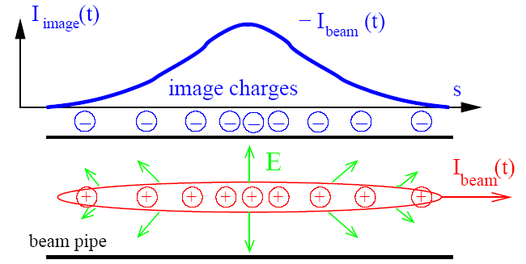
Pick-Ups for bunched Beams
The image current at the beam pipe is monitored on a high frequency basis
i.e. the ac-part given by the bunched beam.
Beam Position Monitor BPM is the most frequently used instrument!
For relativistic velocities,
the electric field is transversal:

Slide 5
Principle of Signal Generation of a BPMs, centered Beam
The image current at the wall is
monitored on a high frequency basis
i.e. ac-part given by the bunched beam.
V
-
+
-
+
-
-
+
-
+
-
+
-
-
+
-
+
-
+
-
+
-
-
+
-
+
-
+
-
+
-
+
-
+
-
-
-
+
+
-
-
+
+
-
-
-
-
+
-
+
-
+
-
-
+
-
+
-
+
-
-
+
-
-
-
-
-
+
-
+
+
-
+
-
-
+
-
+
-
+
-
+
-
+
+
+
+
-
+
-
-
+
-
+
+
+
+
+
+
+
+
+
+
+
+
+
+
+
+
+
+
+
+
+
+
+
+
+
+
+
+
+
+
+
+
+
+
+
+
+
+
+
+
+
+
+
+
+
+
+
+
+
+
+
+
+
+
+
+
+
+
+
+
+
+
+
+
+
+
+
+
+
+
+
+
+
+
+
+
+
+
Animation by Rhodri Jones (CERN)

Slide 6
Principle of Signal Generation of a BPMs, off-center Beam
The image current at the wall is
monitored on a high frequency basis
i.e. ac-part given by the bunched beam.
V
-
+
-
+
-
-
+
-
+
-
+
-
-
+
-
+
-
+
-
+
-
-
+
-
+
-
+
-
+
-
+
-
-
+
-
+
+
-
-
-
-
+
-
+
-
-
-
-
+
+
-
+
-
-
+
-
+
-
-
-
-
-
-
-
-
-
+
-
+
+
-
+
+
-
+
-
-
+
-
+
-
+
-
+
-
+
+
+
+
-
+
-
-
+
-
+
+
+
+
+
+
+
+
+
+
+
+
+
+
+
+
+
+
+
+
+
+
+
+
+
+
+
+
+
+
+
+
+
+
+
+
+
+
+
+
+
+
+
+
+
+
+
+
+
+
+
+
+
+
+
+
+
+
+
+
+
+
+
+
+
+
+
+
+
+
+
+
+
+
+
+
+
+
+
+
-
+
+
-
+
+
-
-
-
-
+
-
-
+
-
-
+
+
+
-
-
+
-
+
+
-
-
-
+
-
+
-
-
-
-
-
-
+
-
+
+
+
+
-
+
-
-
+
Animation by Rhodri Jones (CERN)

Slide 7
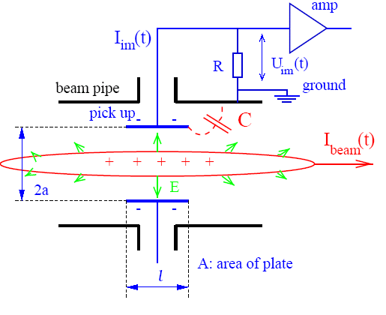
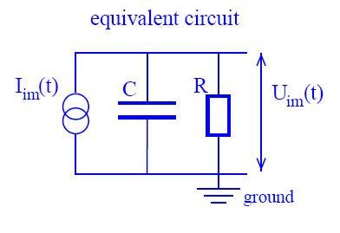
Model for Signal Treatment of capacitive BPMs
The wall current is monitored by a plate or ring inserted in the beam pipe:
The image current I_{im} at the plate is given by the beam current and geometry:
Using a relation for Fourier transformation: I_{beam} = I₀e^{-iωt} ⇒ dI_{beam}/dt = -iωI_{beam}.

Slide 8

Transfer Impedance for a capacitive BPM
At a resistor R the voltage U_{im} from the image current is measured.
The transfer impedance Z_{t} is the ratio between voltage U_{im} and beam current I_{beam}
in frequency domain: U_{im}(ω) = R · I_{im}(ω) = Z_{t}(ω, β) · I_{beam}(ω).
Capacitive BPM:
The pick-up capacitance C:
plate ↔ vacuum-pipe and cable.
The amplifier with input resistor R.
The beam is a high-impedance current source:
This is a high-pass characteristic with ω_{cut}= 1/RC:
Amplitude:
Phase:

Slide 9
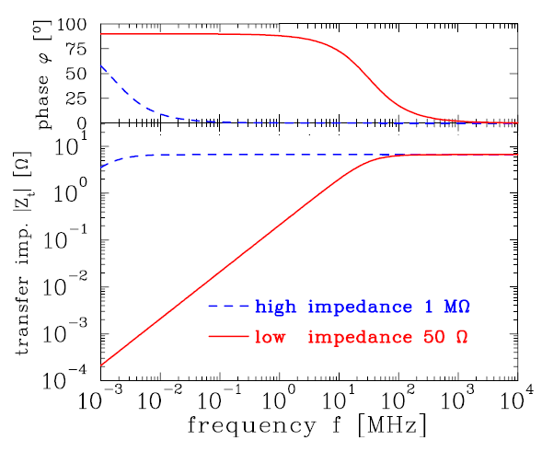
Example of Transfer Impedance for Proton Synchrotron
The high-pass characteristic for typical synchrotron BPM:
U_{im}(ω)=Z_{t}(ω)·I_{beam}(ω)
Parameter for shoe-box BPM:
C=100pF, l=10cm, β=50%
f_{cut}= ω/2π=(2πRC)⁻¹
for R=50 Ω ⇒ f_{cut}= 32 MHz
for R=1 MΩ ⇒ f_{cut}= 1.6 kHz
Large signal strength for long bunches → high impedance
Smooth signal transmission important for short bunches → 50 Ω
Remark: No signal is transferred from dc-beams e.g.
➢ de-bunched beam inside a synchrotron
➢ for slow extraction through a transfer line

Slide 10
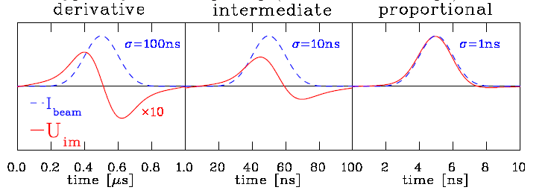
Signal Shape for capacitive BPMs: differentiated ↔ proportional
Depending on the frequency range and termination the signal looks different:
High frequency range ω >> ω_{cut}:
⇒ direct image of the bunch. Signal strength Z_{t} ∝ A/C i.e. nearly independent on length
Low frequency range ω << ω_{cut}:
⇒ derivative of bunch, single strength Z_{t} ∝ A, i.e. (nearly) independent on C
Intermediate frequency range ω ≈ ω_{cut}: Calculation using Fourier transformation
Example from synchrotron BPM with 50 Ω termination (reality at p-synchrotron : σ>>1 ns):
I_{beam}(t)
U_{im}(t)

Slide 11
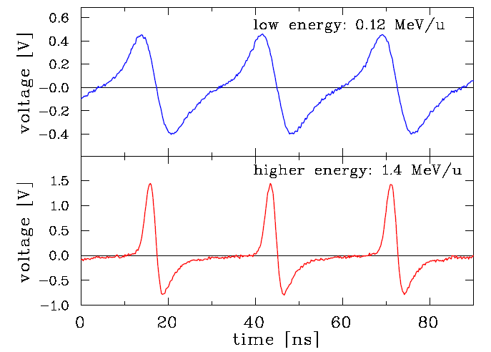
Examples for differentiated & proportional Shape
Proton LINAC, e⁻-LINAC&synchtrotron:
100 MHz < f_{rf} < 1 GHz typically
R=50 Ω processing to reach bandwidth
C≈5 pF ⇒ f_{cut} =1/(2πRC)≈ 700 MHz
Example: 36 MHz GSI ion LINAC
Proton synchtrotron:
1 MHz < f_{rf} < 30 MHz typically
R=1 MΩ for large signal i.e. large Z_{t}
C≈100 pF ⇒ f_{cut} =1/(2πRC) ≈10 kHz
Example: non-relativistic GSI synchrotron
f_{rf} : 0.8 MHz → 5 MHz
Remark: During acceleration the bunching-factor is decreased due to ‘adiabatic damping’.

Slide 12
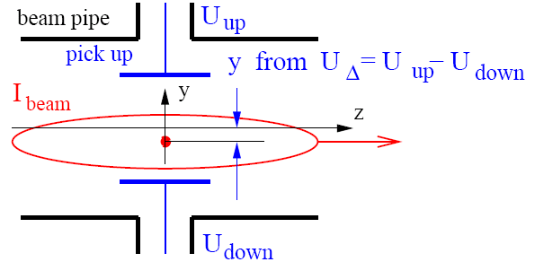
Principle of Position Determination by a BPM
The difference voltage between plates gives the beam’s center-of-mass
most frequent application
‘Proximity’ effect leads to different voltages at the plates:
y from ΔU = U_{up} - U_{down}
It is at least:
ΔU << ΣU /10
S(ω,x) is called position sensitivity, sometimes the inverse is used k(ω,x)=1/S(ω,x)
S is a geometry dependent, non-linear function, which have to be optimized
Units: S=[%/mm] and sometimes S=[dB/mm] or k=[mm].

Slide 13
Outline:
Signal generation → transfer impedance
Capacitive button BPM for high frequencies
used at most proton LINACs and electron accelerators
Capacitive shoe-box BPM for low frequencies
Electronics for position evaluation
BPMs for measurement of closed orbit, tune and further lattice functions
Summary

Slide 14
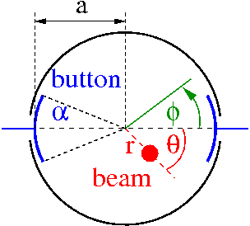
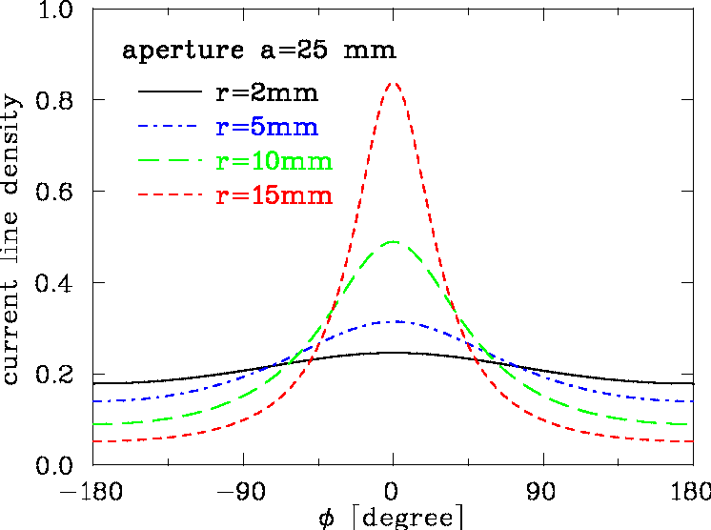
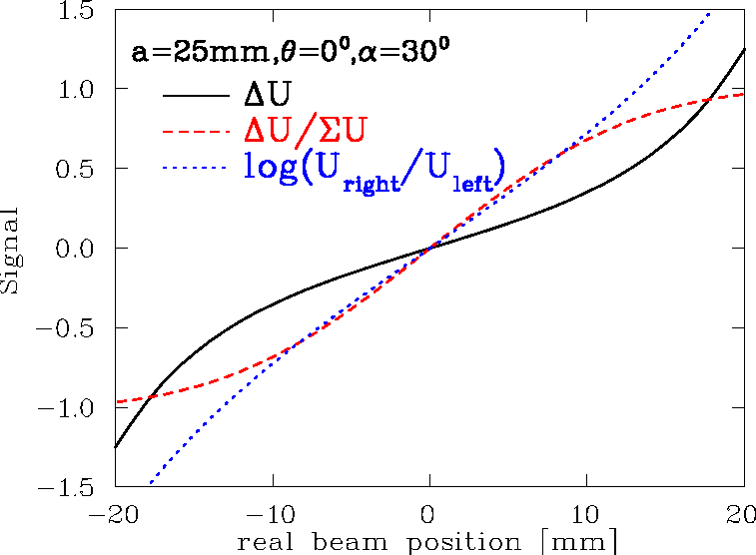
2-dim Model for a Button BPM
‘Proximity effect’: larger signal for closer plate
Ideal 2-dim model: Cylindrical pipe → image current density
via ‘image charge method’ for ‘pensile’ beam:
Image current: Integration of finite BPM size:
, θ = 0º

Slide 15
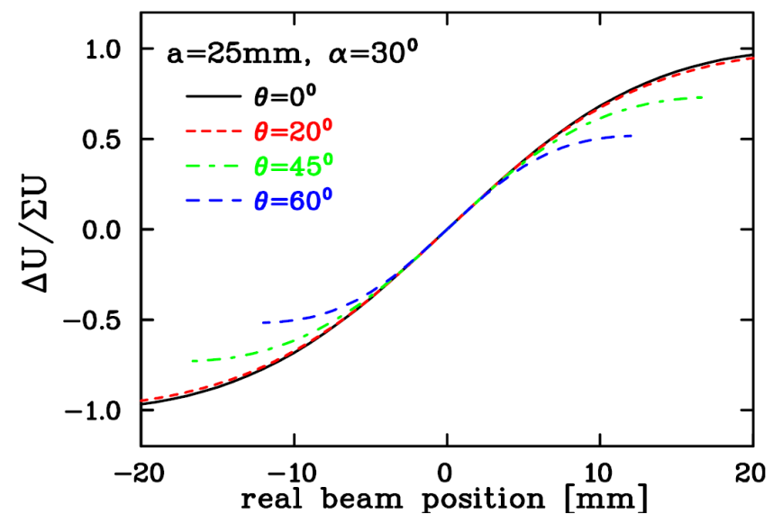
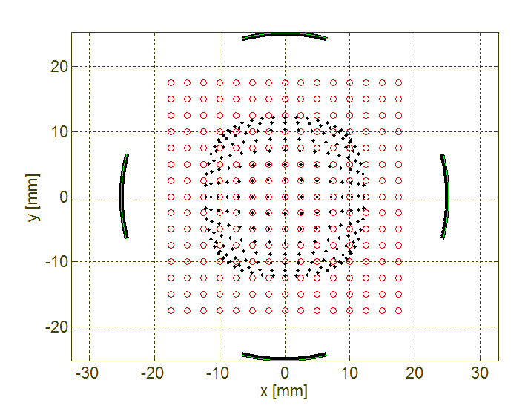
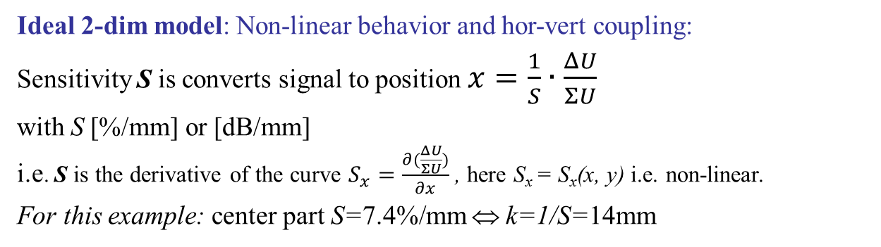
2-dim Model for a Button BPM
Ideal 2-dim model: Non-linear behavior and hor-vert coupling:
Sensitivity S is converts signal to position $x=\frac{1}{S}∙\frac{ΔU}{ΣU}$
with S [%/mm] or [dB/mm]
i.e. S is the derivative of the curve $S_{x}=\frac{∂(\frac{ΔU}{ΣU})}{∂x}$ , here S_{x} = S_{x}(x, y) i.e. non-linear.
For this example: center part S=7.4%/mm ⇔ k=1/S=14mm
Horizontal plane:
‘Position Map’:
button
○ real position
• measured posi.

Slide 16
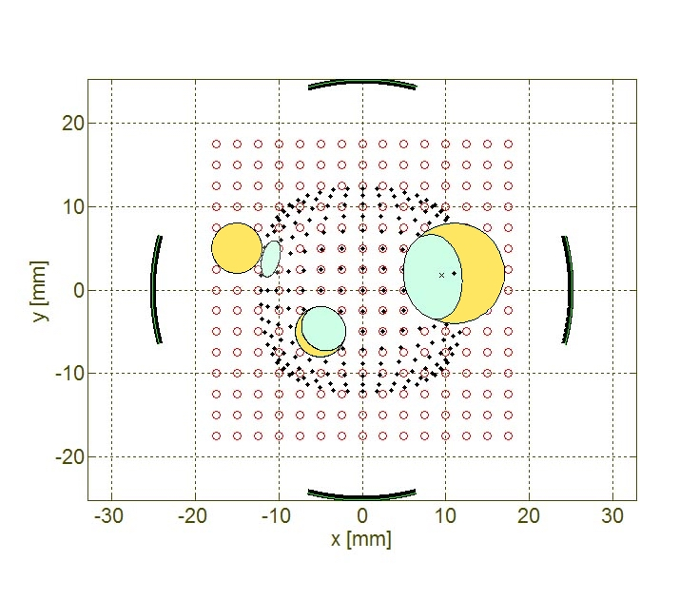
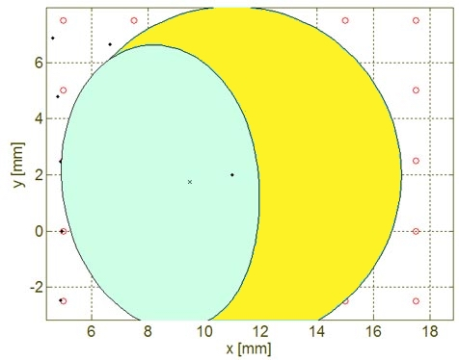
Estimation of finite Beam Size Effect for Button BPM
Ideal 2-dim model:
Due to the non-linearity, the beam size enters in the position reading.
Finite beam size:
Calculation of signal response
at different location
‘Averaging’ of image position
⇒ Cannot be corrected !
button
Beam envelope
Image envelope
Image center
beam center
Remark: For most LINACs: Linearity is less important, because beam has to be centered
Position correction as feed-forward for next macro-pulse.

Slide 17
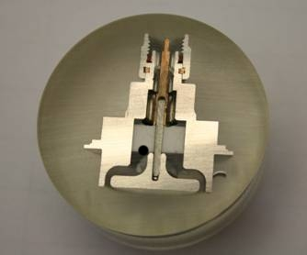
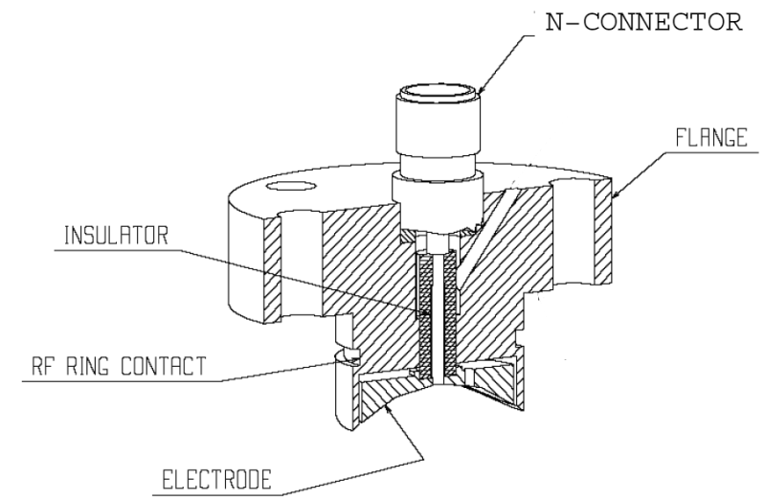
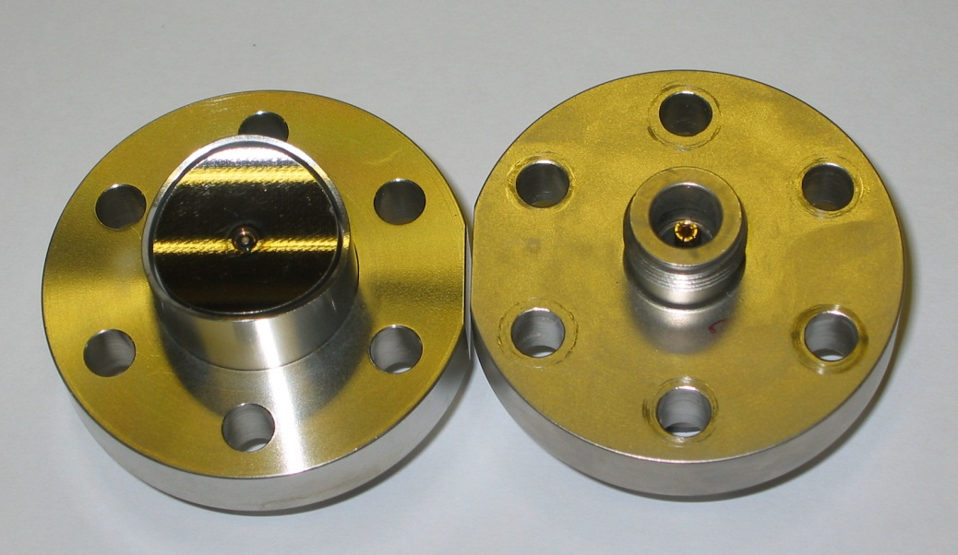
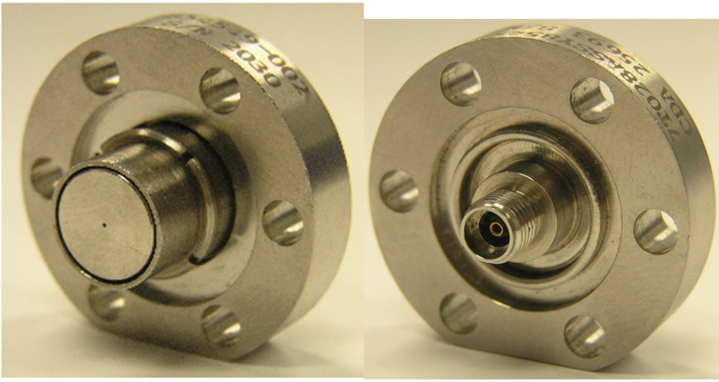
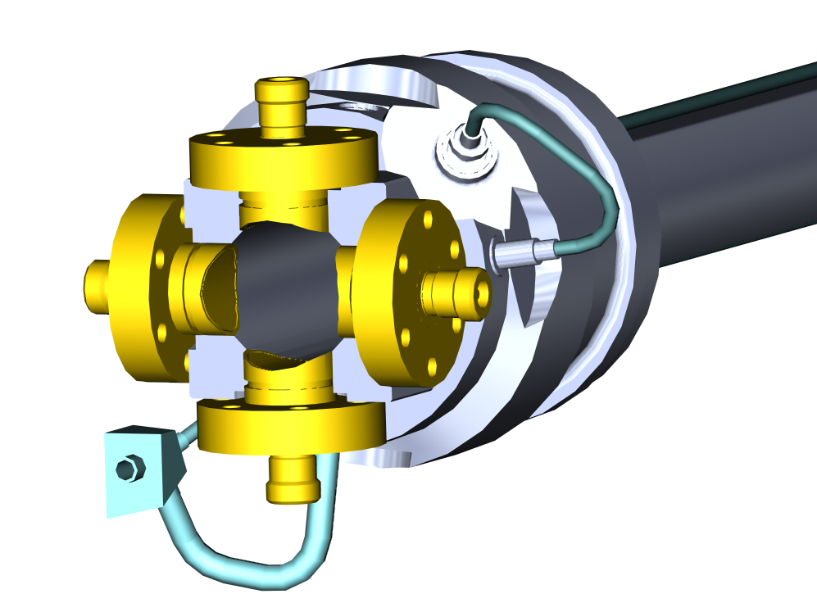
Button BPM Realization
LINACs, e⁻-synchrotrons: 100 MHz < f_{rf} < 3 GHz → bunch length ≈ BPM length
→ 50 Ω signal path to prevent reflections
Example: LHC-type inside cryostat:
24 mm, half aperture a=25 mm, C=8 pF
⇒ f_{cut}=400 MHz, Z_{t} = 1.3 Ω above f_{cut}
Ø24 mm
From C. Boccard (CERN)

Slide 18
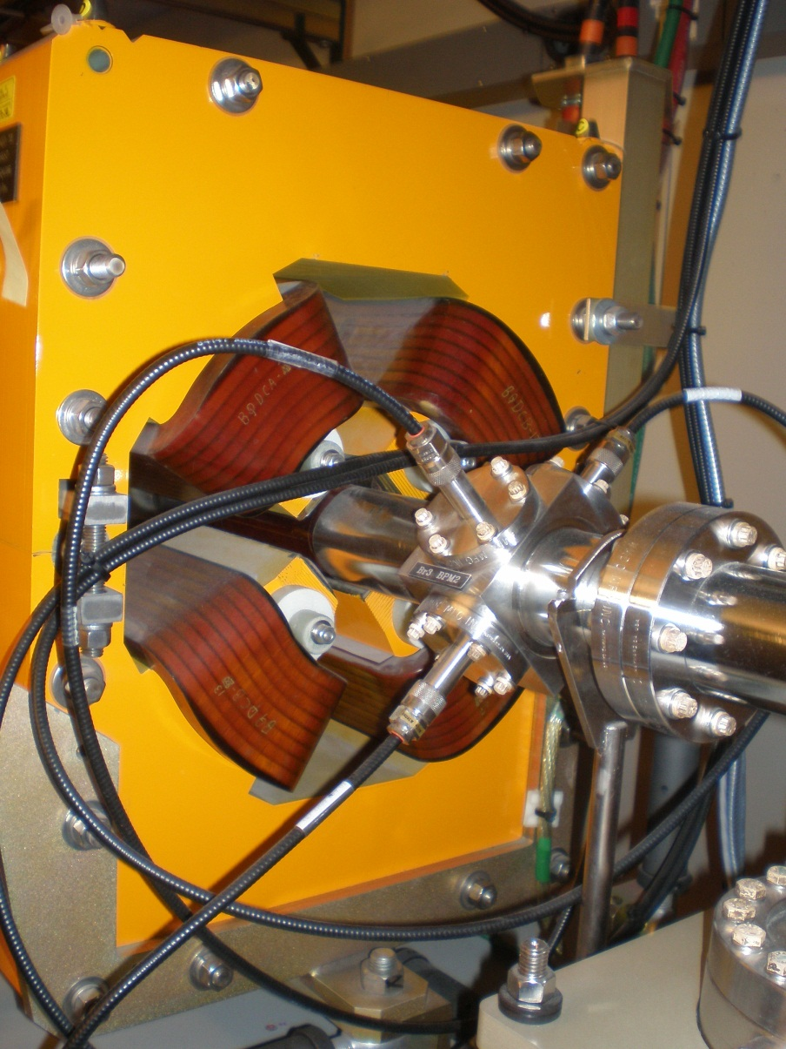
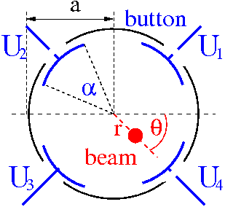
Button BPM at Synchrotron Light Sources
The button BPM can be rotated by 45⁰
to avoid exposure by synchrotron light:
Frequently used at boosters for light sources
Example: Booster of ALS, Berkeley

Slide 19
Outline:
Signal generation → transfer impedance
Capacitive button BPM for high frequencies
used at most proton LINACs and electron accelerators
Capacitive shoe-box BPM for low frequencies
used at most proton synchrotrons due to linear position reading
Electronics for position evaluation
BPMs for measurement of closed orbit, tune and further lattice functions
Summary

Slide 20
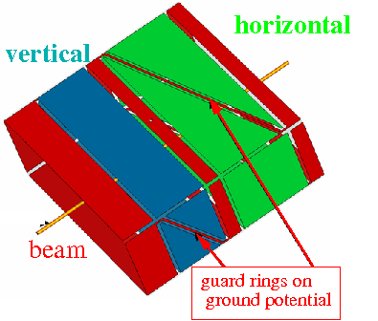
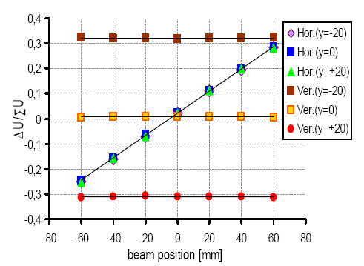
Shoe-box BPM for Proton Synchrotrons
Frequency range: 1 MHz < f_{rf} < 10 MHz ⇒ bunch-length >> BPM length.
Signal is proportional to actual plate length:
In ideal case: linear reading
Size: 200x70 mm²
Shoe-box BPM:
Advantage: Very linear, low frequency dependence
i.e. position sensitivity S is constant
Disadvantage: Large size, complex mechanics
high capacitance

Slide 21
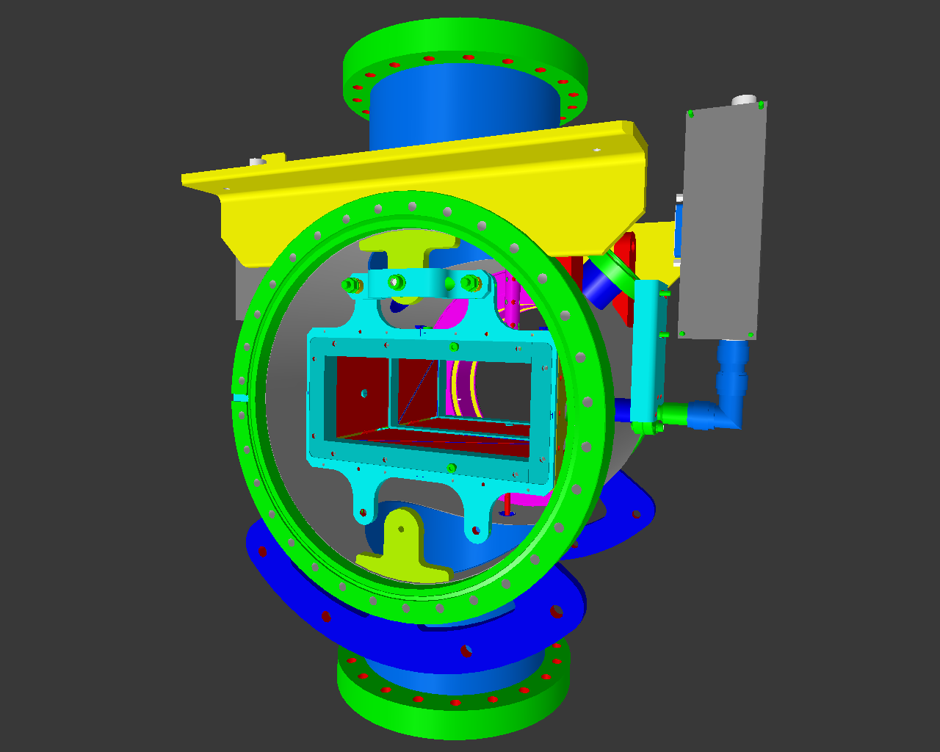
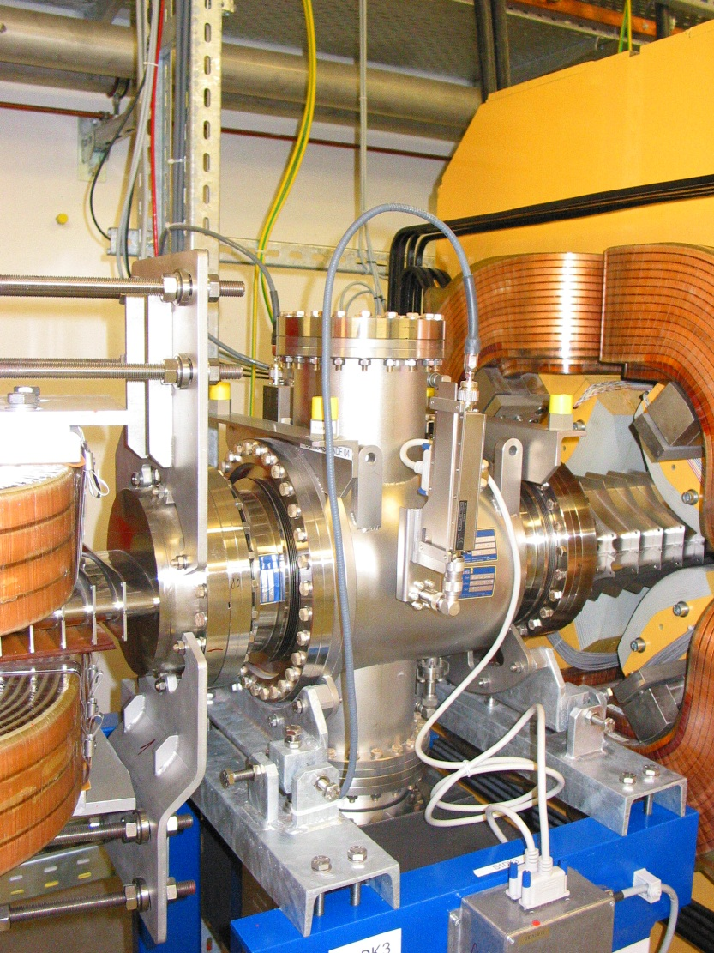
Technical Realization of a Shoe-Box BPM
Technical realization at HIT synchrotron of 46 m length for 7 MeV/u→ 440 MeV/u
BPM clearance: 180x70 mm², standard beam pipe diameter: 200 mm.
Quadrupole
Linear Ampl.
Linear Ampl.
70
Beam
Right
channel
180

Slide 22
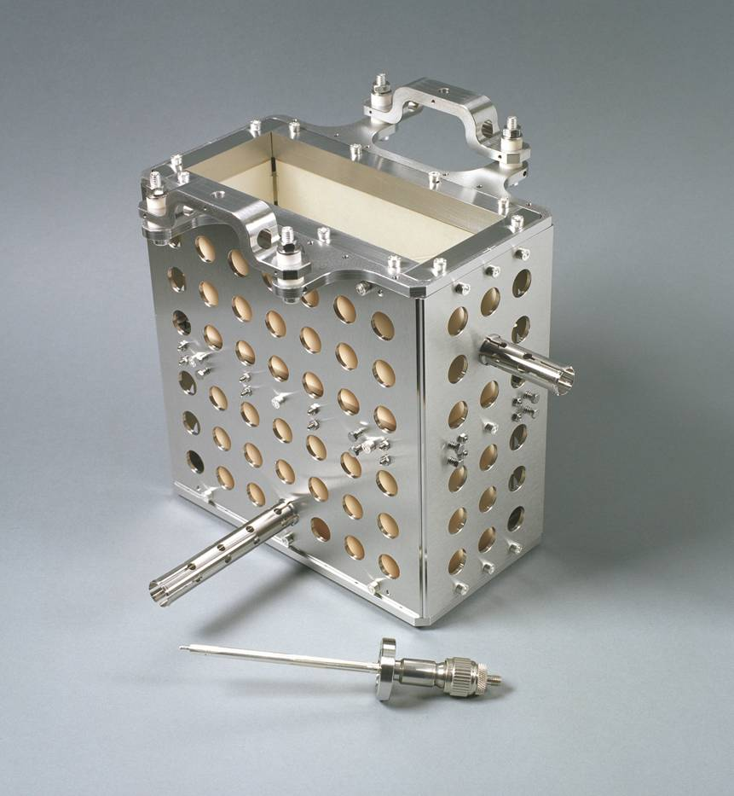

Technical Realization of a Shoe-Box BPM
Technical realization at HIT synchrotron of 46 m length for 7 MeV/u→ 440 MeV/u
BPM clearance: 180x70 mm², standard beam pipe diameter: 200 mm.
Linear Ampl.
70
Right
channel
180

Slide 23
Comparison Shoe-Box and Button BPM
 | Shoe-Box BPM | Button BPM
Precaution | Bunches longer than BPM | Bunch length comparable to BPM
BPM length (typical) | 10 to 20 cm length per plane | ∅1 to 5 cm per button
Shape | Rectangular or cut cylinder | Orthogonal or planar orientation
Bandwidth (typical) | 0.1 to 100 MHz | 100 MHz to 5 GHz
Coupling | 1 MΩ or ≈1 kΩ (transformer) | 50 Ω
Cutoff frequency (typical) | 0.01… 10 MHz (C=30…100pF) | 0.3… 1 GHz (C=2…10pF)
Linearity | Very good, no x-y coupling | Non-linear, x-y coupling
Sensitivity | Good, care: plate cross talk | Good, care: signal matching
Usage | At proton synchrotrons, f_{rf} < 10 MHz | All electron acc., proton Linacs, f_{rf} > 100 MHz
Remark: Other types are also some time used: e.g. wall current monitors, inductive antenna,
BPMs with external resonator, cavity BPM, slotted wave-guides for stochastic cooling etc.

Slide 24
Outline:
Signal generation → transfer impedance
Capacitive button BPM for high frequencies
used at most proton LINACs and electron accelerators
Capacitive shoe-box BPM for low frequencies
used at most proton synchrotrons due to linear position reading
Electronics for position evaluation
analog signal conditioning to achieve small signal processing
BPMs for measurement of closed orbit, tune and further lattice functions
Summary

Slide 25
Broadband Signal Processing
Hybrid or transformer close to beam pipe for analog ΔU & ΣU generation or U_{left} & U_{right}
Attenuator/amplifier
Filter to get the wanted harmonics and to suppress stray signals
ADC: digitalization → followed by calculation of of ΔU /ΣU
.
Advantage: Bunch-by-bunch possible, versatile post-processing possible
Disadvantage: Resolution down to ≈ 100 µm for shoe box type , i.e. ≈0.1% of aperture,
resolution is worse than narrowband processing, see below

Slide 26
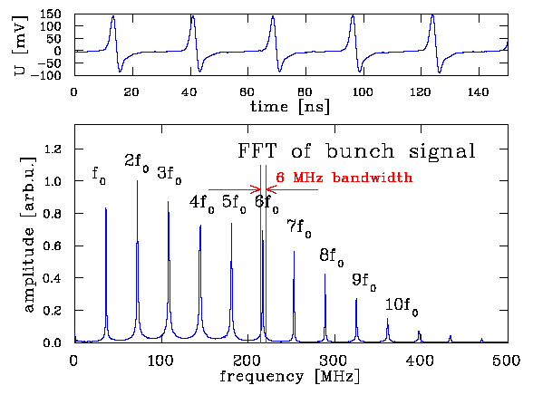
General: Noise Consideration
1. Signal voltage given by:
2. Position information from voltage difference:
3. Thermal noise voltage given by:
Signal-to-noise ΔU_{im}/U_{noise} is influenced by:
Input signal amplitude
Thermal noise at R=50 Ω for T=300 K
(for shoe box R = 1 kΩ …1 MΩ)
Bandwidth Δf
⇒ Restriction of frequency width
because the power is concentrated
on the harmonics of f_{rf}
Example: GSI-LINAC with f_{rf}=36 MHz
Remark:
Bandwidth restriction only meaningful for many bunches e.g. at LINAC or stored beam
Additional contribution by non-perfect electronics, typically a factor ≈ 3

Slide 27
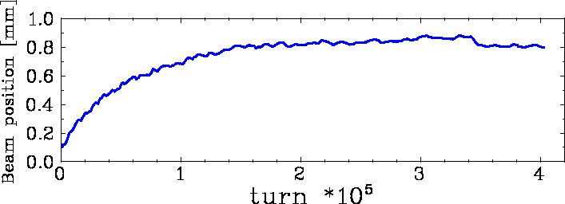
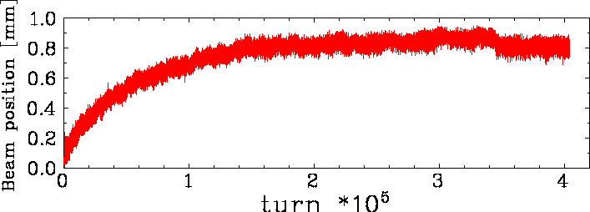
Comparison: Filtered Signal ↔ Single Turn
Example: GSI Synchr.: U⁷³⁺, E_{inj}=11.5 MeV/u→ 250 MeV/u within 0.5 s, 10⁹ ions
Position resolution < 30 μm (BPM half aperture a=90 mm)
average over 1000 turns corresponding to ≈1 ms
or ≈1 kHz bandwidth
1000 turn average for closed orbit
Variation < 10 μm (sufficient for application)
Turn-by-turn data have much larger variation
Single turn e.g. for tune
Variation ≈ 150 μm
However: not only noise contributes but additionally beam movement by betatron oscillation
⇒ broadband processing i.e. turn-by-turn readout for tune determination.

Slide 28
Narrowband Processing for improved Signal-to-Noise
Narrowband processing equals heterodyne receiver (e.g. AM-radio or spectrum analyzer)
Attenuator/amplifier
Mixing with accelerating frequency f_{rf} ⇒ signal with sum and difference frequency
Bandpass filter of the mixed signal (e.g at 10.7 MHz)
Rectifier: synchronous detector
ADC: digitalization → followed calculation of ΔU/ΣU
Advantage: spatial resolution about 100 time better than broadband processing
Disadvantage: No turn-by-turn diagnosis, due to mixing = ’long averaging time’
For non-relativistic p-synchrotron: → variable f_{rf} leads via mixing to constant intermediate freq.

Slide 29
Analog versus Digital Signal Processing
Modern instrumentation uses digital techniques with extended functionality.
Traditional analog processing
BPM analog
signal
Analog frequency
translator
Analog demodulator
and filter
ADC
digital
output
Analog
Digital
Digital processing (triggered by telecommunication development)
BPM analog
signal
Analog frequency
translator
ADC
Digital
filter
Digital
Signal Proc.
digital
output
Digital receiver as modern successor of super heterodyne receiver
Basic functionality is preserved but implementation is very different
Digital transition just after the amplifier & filter or mixing unit
Signal conditioning (filter, decimation, averaging) on FPGA
Advantage of DSP: Versatile operation, flexible adoption without hardware modification
Disadvantage of DSP: non, good engineering skill requires for development, expensive

Slide 30
Comparison of BPM Readout Electronics (simplified)
Type | Usage | Precaution | Advantage | Disadvantage
Broadband | p-sychr. | Long bunches | Bunch structure signal Post-processing possible Required for transfer lines with few bunches | Resolution limited by noise
Narrowband | all synchr. | Stable beams >100 rf-periods | High resolution | No turn-by-turn Complex electronics
Digital Signal Processing | all | Several bunches ADC 125 MS/s | Very flexible High resolution Trendsetting technology for future demands | Limited time resolution by ADC → undersampling complex and expensive

Slide 31
Outline:
Signal generation → transfer impedance
Capacitive button BPM for high frequencies
used at most proton LINACs and electron accelerators
Capacitive shoe-box BPM for low frequencies
used at most proton synchrotrons due to linear position reading
Electronics for position evaluation
analog signal conditioning to achieve small signal processing
BPMs for measurement of closed orbit, tune and further lattice functions
frequent application of BPMs
Summary

Slide 32
Trajectory Measurement with BPMs
Trajectory:
The position delivered by an individual bunch within a transfer line or a synchrotron.
Main task: Control of matching (center and angle), first-turn diagnostics
Example: LHC injection 10/09/08 i.e. first day of operation !
10
horizontal
0
x [mm]
-10
-10
10
vertical
0
y [mm]
-10
-10
Monitor number (530 BPMs on 27 km)
From R. Jones (CERN)
Tune values: Q_{h} = 64.3, Q_{v} = 59.3

Slide 33
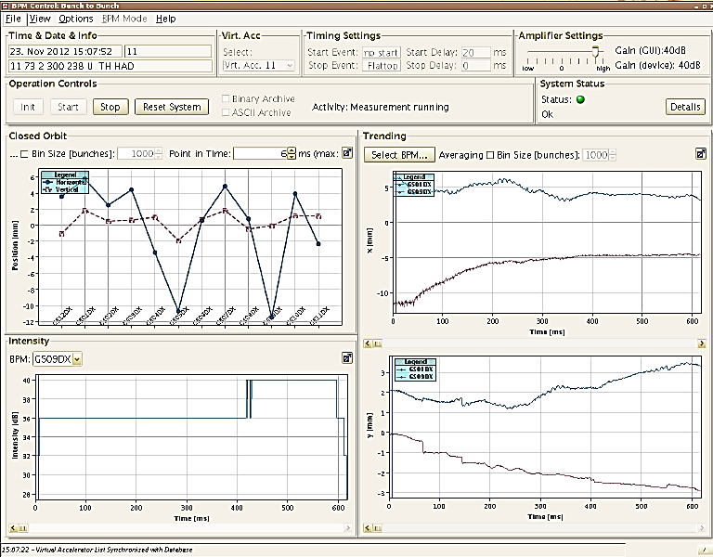
Close Orbit Measurement with BPMs
Single bunch position averaged over 1000 bunches → closed orbit with ms time steps.
It differs from ideal orbit by misalignments of the beam or components.
Example: GSI-synchrotron at two BPM locations, 1000 turn average during acceleration:
Closed orbit:
Beam position
averaged over many turns
(i.e. betatron oscillations).
The result is the basic tool
for alignment & stabilzation
6
horizontal
5
0
0
horizontal position at 2 BPMs
position [mm]
vertical
position [mm]
-5
-6
along synchrotron
-5
-10
time t = 0 ... 600 ms
Remark as a role of thumb:
Number of BPMs within
a synchrotron: N_{BPM} ≈ 4 ⋅ Q
Relation BPMs ↔ tune due to
close orbit stabilization feedback
(justification outside of the scope of this lecture)
-12
4
vertical position at 2 BPMs
signal strength
2
0
position [mm]
time t = 0 ... 600 ms
time t = 0 ... 600 ms
-2

Slide 34
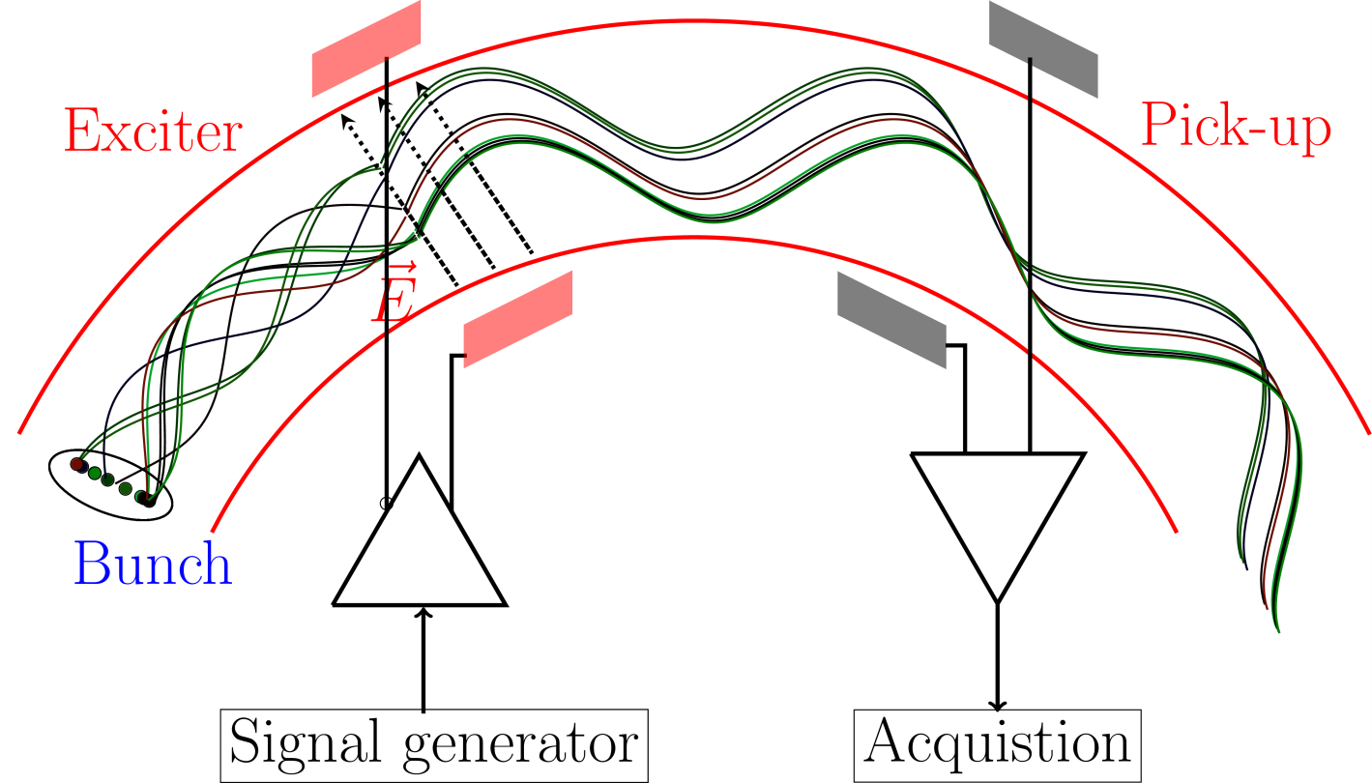
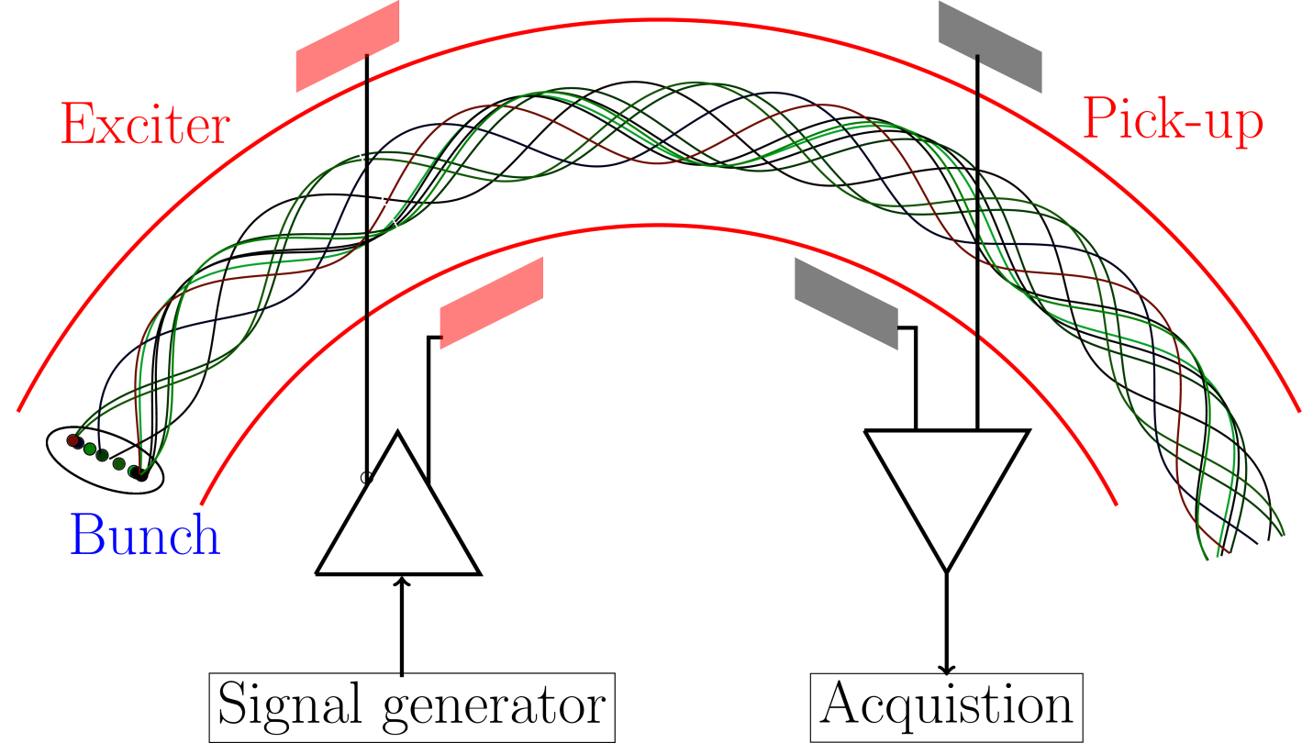
Tune Measurement: General Considerations
Coherent excitations are required for the detection by a BPM
Beam particle’s in-coherent motion ⇒ center-of-mass stays constant
Excitation of all particles by rf ⇒ coherent motion
⇒ center-of-mass variation turn-by-turn
Graphics by R. Singh, GSI
Notes:
Beam with several particles with randomly distributed phases and amplitude will give only very small fluctuations due to finite number of particles (schottky fluctuations) proportional to sqrt(N)
Beam excitation aligns the particle phases, and allows to measure center-of-mass before the beam decohores due to finite spread in frequency. Thus regular excitation needed. Types of excitation were studied as part of this work, Kick excitation (a wide band, or single time impulse excitation), requires high power, and significantly dilutes the phase space.
Chirp excitation, slow method, difficult to use in day to day operations, BTF excitation, to study the amplitude and phase response of the beam.
A compromise of the both the above methods, band limited (or pseudo random noise) for regular excitation without significant blow-up, usable along the ramp.

Slide 35
Tune Measurement: The Kick-Method in Time Domain
The beam is excited to
coherent betatron oscillation
→ the beam position measured
each revolution (’turn-by-turn’)
→ Fourier Trans. gives the non-integer tune q.
Short kick compared to revolution.
Decay is caused by de-phasing,
not be decreasing
single particle amplitude
The de-coherence time limits the resolution:
N non-zero samples
⇒ General limit of discrete FFT:
N = 200 turn ⇒ Δq > 0.003 as resolution
(tune spreads are typically Δq ≈ 0.001!)
Operational observation for b-to-b injection: Residual oscillations observable ⇒.no excitation required.

Slide 36
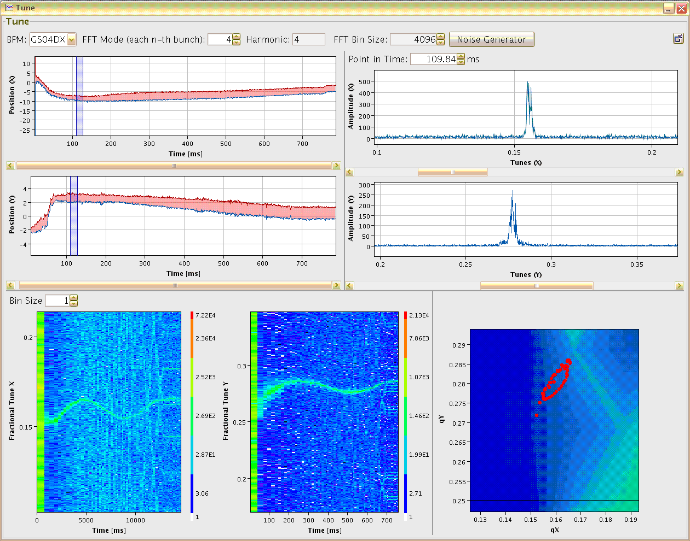
Tune Measurement: Gentle Excitation with Wideband Noise
Instead of a sine wave, noise with adequate bandwidth can be applied
→ beam picks out its resonance frequency:
Example: Vertical tune within 4096 turn
duration ≃ 15 ms
at GSI synchrotron 11 → 300 MeV/u in 0.7 s
broadband excitation with white noise
of ≈ 10 kHz bandwidth
turn-by-turn position measurement
Fourier transformation of the recorded data
⇒ Continues monitoring with low disturbance
vertical tune versus time
vertical tune at fixed time ≈ 15ms
0.3
δQ_{y} ≈ 0.02
vert. fractional tune q_{y}
excitation
noise band
δQ ≈ 0.05
amplitude [a.u.]
0.25
0.2
0.25
0.3
0.35
0.2
vertical fractional tune q_{y}
Advantage:
Fast scan with good time resolution
0
200
400
600
750
time [ms]

Slide 37
Transfer Line Diagnostics for bunched Beams
Goal of a transfer line: Acceptance at input → transport with low loss → matching to output
Instruments in transfer lines:
Current: transformer (bunched beam) or IC etc. (slow extraction)
Position: BPM (bunched beam)
Position and profile: SEM-Grid, scintillation screen, OTR screen (relativistic beam γ > 100)
Beam loss for transmission optimization: BLM
1. Entry section
steerer
dipole
2. Central section
3. Exit section
screen
screen
screen
BPM
BPM
BPM
BPM
steerer
BPM
BPM
beam
quad.
betatron phase μ_{β} ≈ 90⁰
quad.
synchrotron
synchrotron
1. Entry section: position and angle e.g. by two BPMs, beam size by e.g. screen
2. Central section (often FODO cell): BPM or screen, comparison to optics calculation,
best setting for orbit correction: steerer for active control → μ_{β} ≈ 90⁰ betatron phase advance to BPM
i.e. angle x’ @steerer is transformed to offset x @BPM
3. Exit section: Matching to next part via steerer and quadrupole duplet or triplet

Slide 38
Summary Pick-Ups for bunched Beams
The electric field is monitored for bunched beams using rf-technologies
(’frequency domain’). Beside transfromers they are the most often used instruments!
Differentiated or proportional signal: rf-bandwidth ↔ beam parameters
Proton synchrotron: 1 to 100 MHz, mostly 1 MΩ → proportional shape
LINAC, e−-synchrotron: 0.1 to 3 GHz, 50 Ω → differentiated shape
Important quantity: transfer impedance Z_{t}(ω, β).
Types of capacitive pick-ups:
Shoe-box (p-synch.), button (p-LINAC, e−-LINAC and synch.)
Position reading: difference signal of four pick-up plates (BPM):
Non-intercepting reading of center-of-mass → online measurement and control
Synchrotron: slow reading → closed orbit, fast bunch-by-bunch→ trajectory
➢ Synchrotron: Excitation of coherent betatron oscillations delivers tune q etc. .
Transfer line: Position reading and matching conditions
Remark: BPMs have high pass characteristic ⇒ no signal for dc-beam e.g. slow extraction.

Slide 39
Measurement of longitudinal Parameters
Measurement of longitudinal parameter:
Proton LINAC: Determination of mean energy & longitudinal emittance
Longitudinal injection matching and Schottky noise analysis
Bunch length measurement for relativistic beams
Summary
Longitudinal ↔ transverse correspondences:
position relative to rf ↔ transverse center-of-mass
bunch structure in time ↔ transverse profile in horizontal and vertical direction
momentum or energy spread ↔ transverse divergence
longitudinal emittance ↔ transverse emittance.

Slide 40
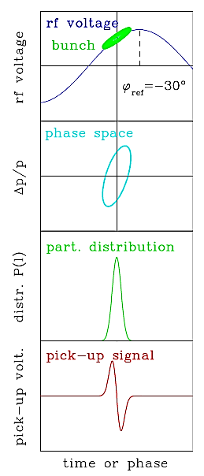
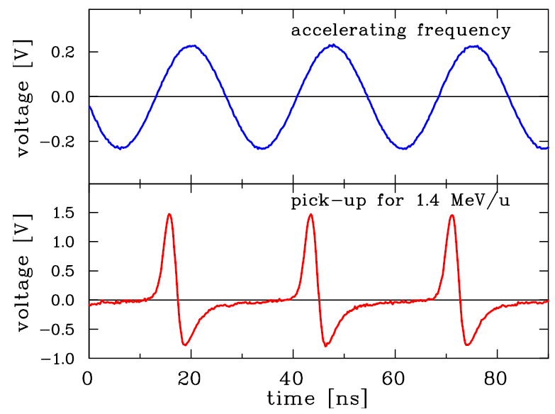
The Bunch Position measured by a Pick-Up
The bunch position is given relative to the accelerating rf.
e.g. φ_{ref}=-30º inside a rf cavity
must be well aligned for optimal acceleration
Transverse correspondence: Beam position
Example: Pick-up signal and 36 MHz rf at GSI-LINAC:
source
ADC
acc. f_{rf}
RFQ
LINAC
BPM
pick-up

Slide 41
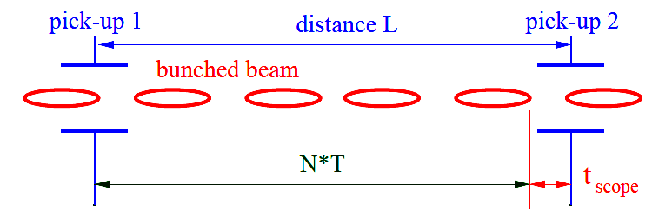
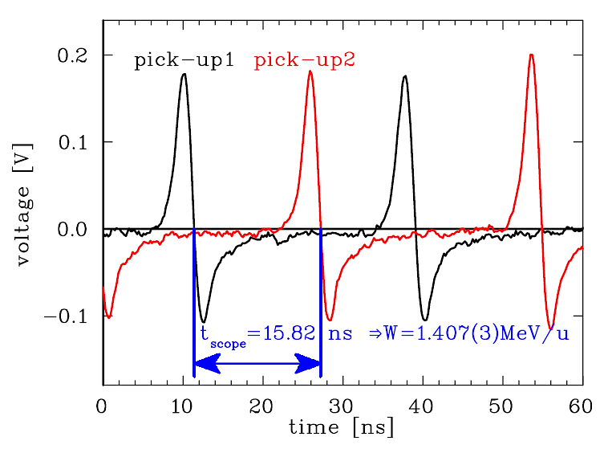
Determination of non-relativistic mean Energy using Pick-Ups
The energy delivered by a LINAC is sensitive to the mechanics, rf-phase and amplitude.
For non-relativistic energies
at proton LINACs time-of-flight
(TOF) with two pick-ups is used:
→ the velocity β is measured.
Example: Time-of-flight signal from
two pick-ups at 1.4 MeV/u:
The reading is t_{scope}= 15.82(5) ns with
f_{rf} = 36.136MHz ⇔ T = 27.673ns
L = 1.629(1) m and N = 3
β = 0.05497(7)
⇔ W=1.407(3) MeV/u
The accuracy is typically 0.1 %
i.e. comparable to ΔW/W
source
ADC
L
RFQ
LINAC
BPM
BPM
pick-up 1
pick-up 2

Slide 42
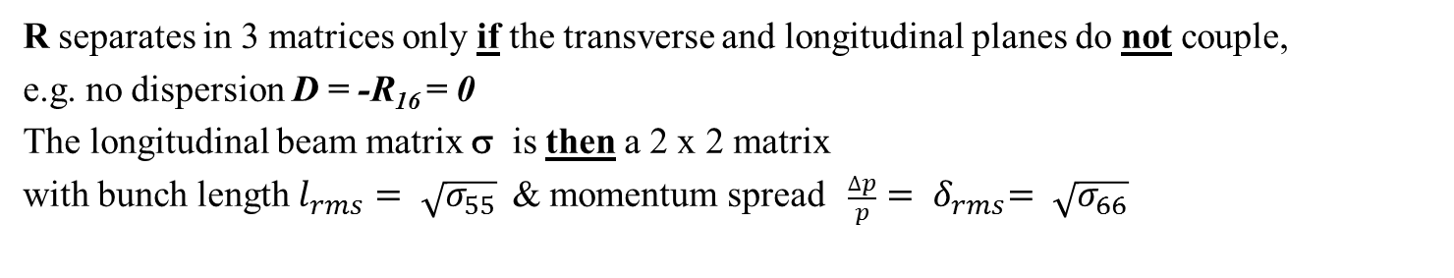
6-dim Phase Space for Accelerators
The particle trajectory is described with the 6-dim vector
For linear beam behavior the 6x6 transport matrix R is used:
Transformation from location s₀ to s₁ is:
Single particle:
Envelope i.e. emittance
defined by beam matrix:
= 0
σ( s₁ ) = R · σ( s₀ ) · R^{T}
=0
= 0
=0
R separates in 3 matrices only if the transverse and longitudinal planes do not couple,
e.g. no dispersion D = -R₁₆ = 0
The longitudinal beam matrix σ is then a 2 x 2 matrix
with bunch length $l_{rms}= \sqrt{σ_{55}}$ & momentum spread ${ \frac{∆p}{p}= δ}_{rms}= \sqrt{σ_{66}}$

Slide 43
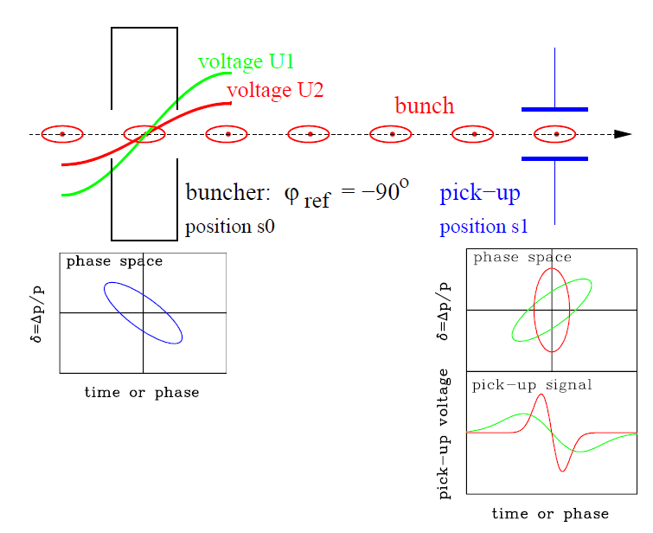
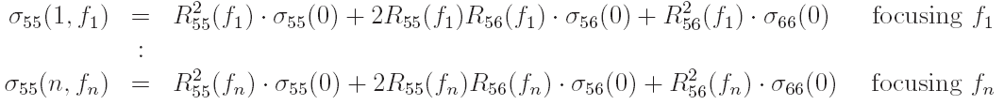
Longitudinal Emittance by linear Transformation using a Buncher
Longitudinal focusing:
Variation of the bunch shape by a rf-buncher
→ components 5 and 6 from 6-dim phase-space
Transversal corres.: Quadrupole variation
➢ Transfer matrix of buncher & drift:
with focal length:
➢ Variation of buncher amplitude U
⇒ different bunch width at s₁:
beam matrix Δt²_{rms}= σ₅₅(1, f)
➢ System of redundant linear equations for σ_{ij}(1) using σ(1)=R⋅σ(0)⋅R^{T}:
1

Slide 44
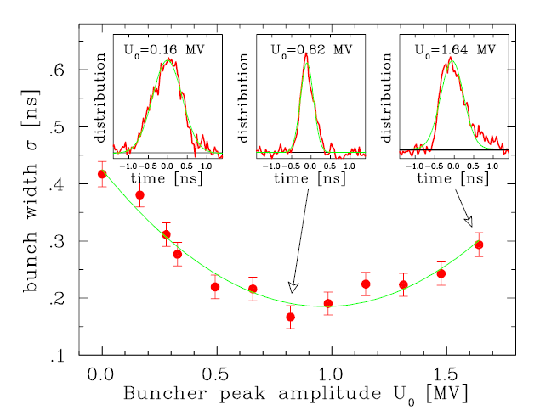

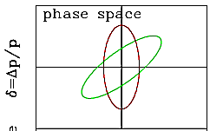
Result of a longitudinal Emittance Measurement
Example GSI LINAC: Voltage variation at buncher for 11.4 MeV/u Ni¹⁴⁺ beam, 31 m drift:
The structure of short bunches can
be determined with special monitor
This example: The resolution is better
than 50 ps or 2º for 108 MHz
Typical bunch length at proton LINACs:
σ_{bunch} ≈ 10 to 300 ps
Determination of longitudinal emittance possible
Application for synchrotron injection:
Shaping of longitudinal phase space by buncher
i.e. long bunches ⇔ low momentum spread
to match to the synchrotron long acceptance
p-synchrotron
source
Bunch Shape Monitor
Buncher
RFQ
LINAC
B.
BSM
injection
extraction

Slide 45
Measurement of Energy Spread by magnetic Spectrometer
Transfer line: The mom. spread δ = Δp/p can be determined by a magnetic spectrometer:
via dispersion, the momentum is shifted to a spatial distance.
An appropriate optic must b e chosen
to separate the transverse and
longitudinal parameters
However, a synchrotron is a very high resolution spectrometer
Goal: Measurement of central momentum p₀
and momentum spread Δp / p₀
un-bunched beam → Schottky noise analysis
bunched beam: broadband FCT or BPM recording
coherent synchrotron oscillations, bunch shape
Schottky
multi-turn
injection
p synchrotron
de-bunched
source
SEM-Grid
dipole
injection
extraction
RFQ
LINAC

Slide 46
Outline:
Proton LINAC: Determination of mean energy & longitudinal emittance
used for alignment of cavities phase and amplitude
Longitudinal injection matching and Schottky noise analysis
Signal generation by repetitive particle passage
Used at Hadron synchrotrons for momentum spread analysis for Multi-turn inj.
Bunch length measurement for relativistic beams
Summary

Slide 47
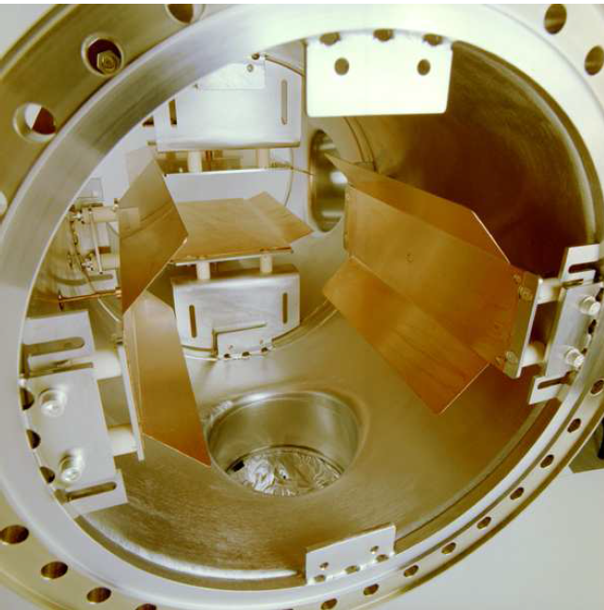
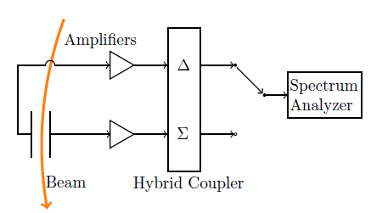
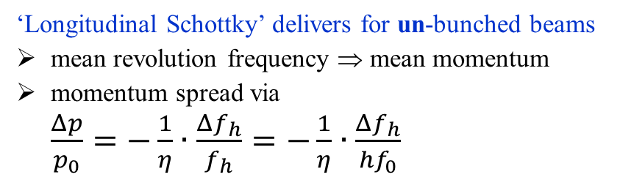
Schottky Noise Analysis
Schottky noise analysis is based on the power spectrum
for consecutive passage of the same finite number of ions
Schottky pick-up at GSI synchrotron
Analog signal processing chain:
Sensitive broadband amplifier
Hybrid for sum or difference
Evaluation by spectrum analyzer
horizontal
pick-ups
∅ 250mm
‘Longitudinal Schottky’ delivers for un-bunched beams
mean revolution frequency ⇒ mean momentum
momentum spread via
$\frac{Δp}{p_{0}}=−\frac{1}{η}∙\frac{Δf_{h}}{f_{h}}=−\frac{1}{η}∙\frac{Δf_{h}}{{hf}_{0}}$

Slide 48
Schottky Noise Analysis: Basics for longitudinal Signal Generation
Schottky noise analysis is based on the power spectrum
for consecutive passage of the same finite number of ions
1st particle with t₀ =1/f₀
1st particle with f = h⋅f₀
I(t)
2nd with t =1/(f₀ + Δf)
I²(f)
2nd with f = h⋅ ( f₀ + Δf )
Fourier trans. or
spectrum analyzer
0
1
2
3
4
0
1
2
3
4
time t / t ₀
harmonic number h = f / f ₀
I(t)
many particle of width σ_{t}
I²(f)
bands of width h⋅Δf
0
1
2
3
4
0
1
2
3
4
time t/t ₀
harmonic number h = f / f₀
‘Longitudinal Schottky’ delivers for un-bunched beams
mean revolution frequency ⇒ mean momentum
momentum spread via
$\frac{Δp}{p_{0}}=−\frac{1}{η}∙\frac{Δf_{h}}{f_{h}}=−\frac{1}{η}∙\frac{Δf_{h}}{{hf}_{0}}$
Schottky bands feature:
constant power within each band
width scales with harmonics h

Slide 49
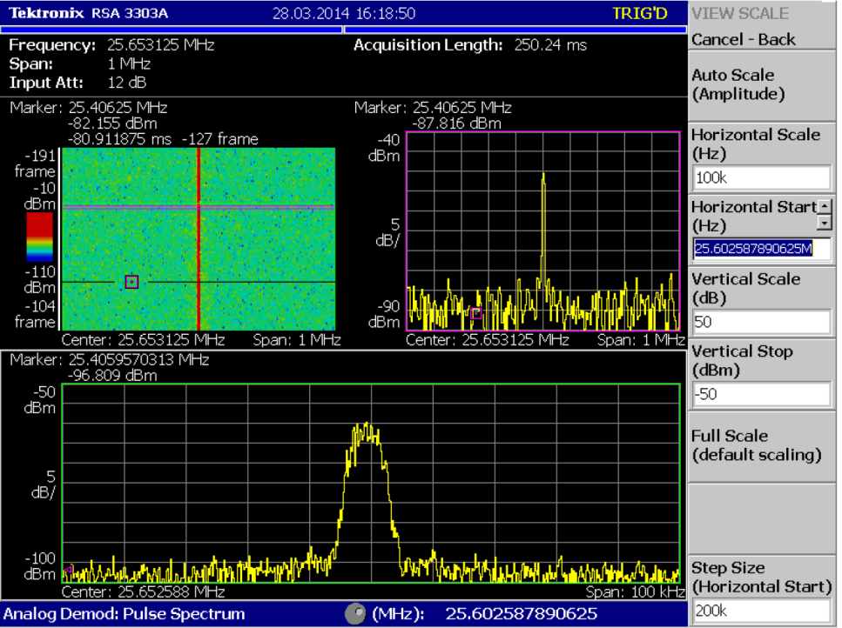
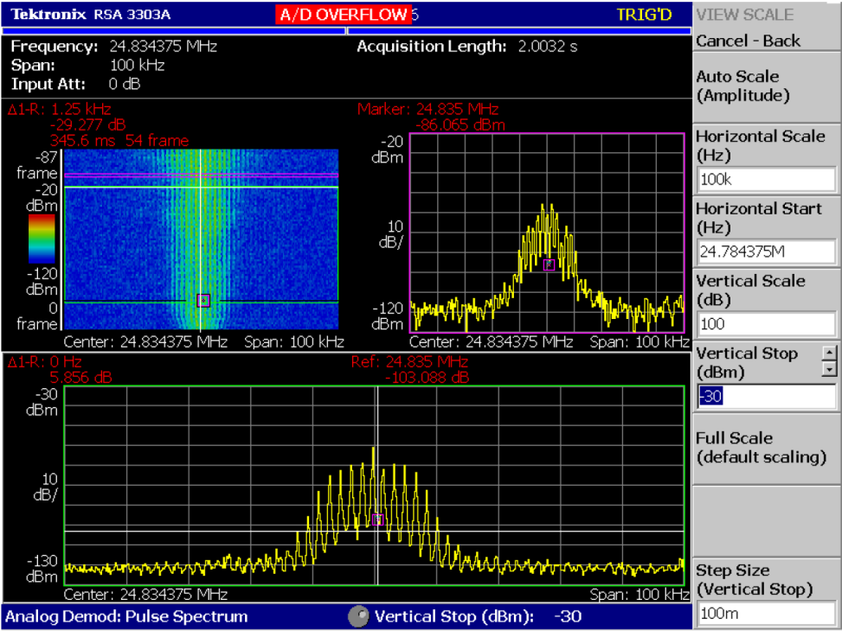
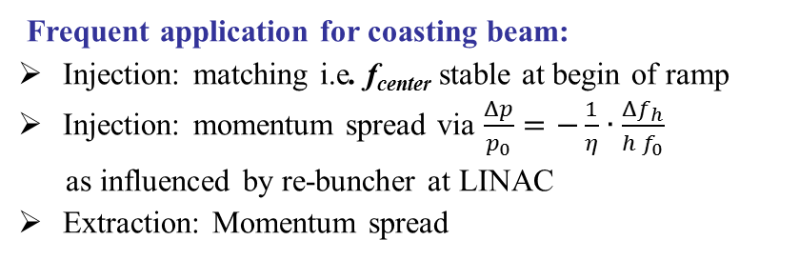
Longitudinal Schottky Noise Analysis
Example: Coasting beam at GSI synchr.
Example: Bunched beam at GSI synchr.
fast span: 1 MHz
spectrogram
spectrogram
fast span: 0.1 MHz
t =0.2s
5 dB
0.1 MHz
10 dB
10 kHz
t =0.3s
f =1MHz
f =0.1MHz
high resolution: 0.1 MHz span, 0.1 s
high resolution: 0.1 MHz span, 0.15 s
Δf_{h} ∝ h⋅Δp
synchr. f_{s}
5 dB
⇒ Δp/p ≈ 10 ⁻³
10 dB
10 kHz
10 kHz
Frequent application for coasting beam:
Injection: matching i.e. f_{center} stable at begin of ramp
Injection: momentum spread via $\frac{Δp}{p_{0}}=−\frac{1}{η}∙\frac{Δf_{h}}{{h f}_{0}}$
as influenced by re-buncher at LINAC
Extraction: Momentum spread
Application for bunched beam:
Measurement of synchrotron frequency
Coarse spectra: Observation during acceleration
Longitudinal mismatch diagnostics
Remark: Less useful as for coasting beam

Slide 50
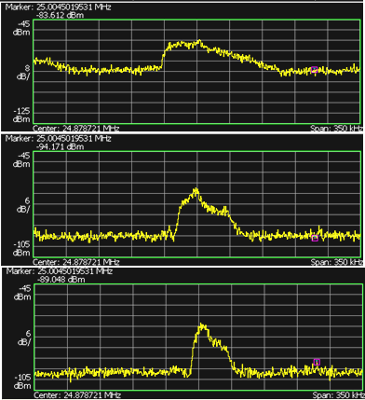
Longitudinal Schottky for Momentum Spread Δp/p₀ Analysis
Momentum spread Δ p/p₀ measurement after
multi-turn injection & de-bunching of t < 1ms duration
to stay within momentum acceptance during acceleration
Method: Variation of buncher voltage
i.e. sheering in phase space
minimizing of momentum spread Δ p/p₀
Δ p/p₀ preserves after de-bunching
Example: 10¹⁰ U²⁸⁺ at 11.4 MeV/u
injection plateau 150 ms, η = 0.94
Longitudinal Schottky at harmonics h = 117
Momentum spread variation:
Δp/p ≈ (1.5... 6.0) ⋅10⁻³
bunched
Δp/p ≈ 6.0 ⋅10⁻³
At injection:
De-bunching after some ms:
from LINAC
phase space
phase space
6 dB
35 kHz
de-bunching
δ = Δp/ p
δ = Δp/ p
only drift
Δp/p ≈ 3.0 ⋅10⁻³
time or phase
time or phase
Schematic phase space during acceleration:
stable region
longitudinal
Schottky
de-bunched
Δp/p ≈ 1.5 ⋅10⁻³
p synchrotron
buncher
unstable region
injection
extraction

Slide 51

Injection Mismatch: Longitudinal Schottky Noise Analysis
Example for longitudinal Schottky spectrum to check proper acceleration frequency:
Injection energy given by LINAC settings, here 11.4 MeV/u, β = 15..5 %
multi-turn injection & de-bunching within ≈ ms
adiabatic bunch formation & acceleration
Measurement of revolution frequency f_{rev}
Alignment of acc. f_{rf} to have f_{rev} = h ⋅ f_{rf}
i.e. no frequency jump !
frequency span [kHz]
0
250
500
0
injection
f_{rev} injection
un-bunched
beam
25
adiabatic
bunch formation
f_{rev} = h ⋅ f _{rf}
h=120
h=122
time [ms]
bunched
beam
50
h=121
start
acceleration
75
100
Zoom

Slide 52




Momentum Variation during Quadrupole-driven Extraction
Example for longitudinal Schottky spectrum to visualize slow extraction:
Momentum spread before extraction here $\frac{Δp}{p_{0}}=−\frac{1}{η}∙\frac{Δf_{h}}{{h f}_{0}} =0.3∙{10}^{−3}$ (1σ)
Chromaticity (here ξ =-1.5) i.e. coupling tune ↔ momentum spread : $\frac{∆Q}{Q}= ξ∙ \frac{∆p}{p}$
Slow extraction by quadrupole variation i.e. momentum dependent extraction
Lower momentum ions extracted first & variation of extraction angle at dispersive section in transfer
Beam parameter: GSI-synch. C⁶⁺ at 300 MeV/u ⇔ f_{rev} = 0.95 MHz, Schottky for h =26, Δf = 1.6 kHz (1σ)
Steinbach diagram:
begin
begin:
Δp/p ≈0.3⋅10⁻³
x
moving Q
un-stable
f = 50 kHz
end
stable
beam
stable
x
Δp/p
Extracted beam by scintillator:
extr.
beam
moving Q
t_{ex}= 1.2s
stable
beam
Δp/p

Slide 53




Momentum Variation during Knock-out Extraction
Example for longitudinal Schottky spectrum to visualize slow extraction:
Momentum spread before extraction here $\frac{Δp}{p_{0}}=−\frac{1}{η}∙\frac{Δf_{h}}{{h f}_{0}} =0.2∙{10}^{−3}$ (1σ)
Chromaticity (here ξ =-1.5) i.e. coupling tune ↔ momentum spread : $\frac{∆Q}{Q}= ξ∙ \frac{∆p}{p}$
Slow extraction by knock-out extraction i.e. only trans. amplitude growth ⇒ no momentum dependent
Lower momentum ions extracted first & variation of extraction angle at dispersive section in transfer
Beam parameter: GSI-synch. C⁶⁺ at 300 MeV/u ⇔ f_{rev} = 0.95 MHz, Schottky for h =26, Δf = 1.0 kHz (1σ)
Steinbach diagram:
begin
begin:
Δp/p ≈0.2⋅10⁻³
x
un-stable
excite
β-ampl.
f = 50 kHz
end
stable
beam
stable
x
Δp/p
Extracted beam by scintillator:
extr.
beam
excite
β-ampl.
stable
beam
t_{ex}= 1.9 s
Δp/p

Slide 54



Broadband longitudinal Bunch Shape Observation by FCT
Example: After multi-turn injection, the bunch formation is critical to avoid
coherent synchrotron oscillations → emittance enlargement
Observation by a FCT or BPM sum signal in broad-band mode and adaption of f_{rf}
f_{rf} shift by 0.2% of nominal value
⇒ Coherent oscillation
Matched f_{rf} ⇒ no oscillation
30
broad-band
FCT
25
synchrotron
20
rf-cacity
Time [ms]
15
injection
extraction
10
Same type of
aligmnent required
for transfer between
synchrotrons
5
0
0.5
1.0
1.5
2.0
Time [μs]
Required accuracy here: Δf_{rf} = 1 kHz or Δf_{rf} / f_{rf} = 0.1%
Courtesy H. Damerau, CERN

Slide 55




Longitudinal Bunch Diagnostics inside Synchrotron using FCT
Acceleration and bunch ’gymnastics’ are performed inside synchrotrons
different beam parameter for fast, single turn extraction
Measurement within synchrotron because bunch shape is constant during transport in most cases
Example: Transfer line L=100m, β=1, $\frac{∆p}{p}=2∙{10}^{−3}$ → $∆t= \frac{∆p}{p}∙t_{drift}= \frac{∆p}{p} ∙ \frac{L}{βc} = 0.7 ns ≪{ σ}_{bunch}$
Example: Bunch merging at upper flattop
using 2 cavities at GSI synchrotron
Beam: 10⁹ U⁷³⁺ at 600 MeV/u, FCT
Example: Bunch shape for ‘bunch compression’ prior to extr.
Beam: U⁷³⁺ at 300 MeV/u at GSI synchrotron
After acceleration
before & after
bunch compression
0.5
cycle time [s]
0.4
beam current
0.3
-0.4
-0.2
0.2
0
0.4
8
time [µs]
Tomographic
reconstruction of
longitudinal
phase space
depicted for
min. bunch width
0.2
4
0.1
time [µs] (one turn)
Δp/p₀ x 10⁻³
1 turn
0
0
-4
0
1
separatrix
-8
-0.4
-0.2
0.2
Courtesy H. Klingbeil, U. Hartel, et al. GSI
0
0.4
Courtesy O. Chroniy, GSI
time [µs]
→ conclusion

Slide 56
Outline:
Proton LINAC: Determination of mean energy & longitudinal emittance
used for alignment of cavities phase and amplitude
Longitudinal injection matching and Schottky noise analysis
Signal generation by repetitive particle passage
Used at Hadron synchrotrons for momentum spread analysis for Multi-turn inj.
Bunch length measurement for relativistic beams
Synchrotron light monitor used together with streak camera for long. matching
Summary

Slide 57

Bunch Length Measurement for relativistic e⁻
Electron bunches are too short (σ_{t} < 300 ps) to be covered by the bandwidth of
pick-ups (f < 1 GHz ⇔ t_{rise} >300 ps) for structure determination.
→ Time resolved observation of synchr. light with a streak camera: Resolution ≈ 1 ps.
Streak camera
e⁻ synchrotron
acc.
freq. f_{rf}
rf cavity
injection
extraction

Slide 58


Technical Realization of Streak Camera
acceleration
focusing
deflection
Hardware of a streak camera
Time resolution down to 0.5 ps:
≈ 30 cm
Streak tube
CCD
camera
Input optics
≈ 60 cm

Slide 59
Technical Realization of Streak Camera
acceleration
focusing
deflection
Hardware of a streak camera
Time resolution down to 0.5 ps:
≈ 30 cm
Streak tube
CCD
camera
Input optics
≈ 60 cm
The Streak Camera setup at ELETTRA, Trieste, Italy

Slide 60

Results of Bunch Length Measurement by a Streak Camera
The streak camera delivers a fast scan in vertical direction (here 360 ps full scale)
and a slower scan in horizontal direction (24 μs).
Example: Bunch length at the synchrotron light source SOLEIL for U_{rf} = 2 MV
for slow direction 24 μs and scaling for fast scan 360 ps: measure σ_{t} = 35 ps.
Slow Scan:
bunch length
2σ_{t} = 70 ps
Fast Scan:
Short bunches are desired by
the users
Example: Bunch length σ_{t}
as a function of stored current
(i.e. space charge de-focusing)
at SOLEIL
Streak camera
e⁻ synchrotron
acc.
freq. f_{rf}
rf cavity
injection
extraction
Courtesy of M. Labat et al., DIPAC’07
→ conclusion

Slide 61
Injection Mismatch at ALS Electron Ring
Injection mismatch in phase:
Injection mismatch in phase & energy:
Mismatch in bunch length:
Δp / p
Δp / p
Δp / p
Injected beam
with phase error
after ¼ ⋅ t_{sych} synchr. period
after ¼ ⋅ t_{sych} synchr. period
Injected beam
with bunch error
after ¼ ⋅ t_{sych} synchr. period
ϕ or t
ϕ or t
ϕ or t
Injected beam
with energy error
separatrix
separatrix
separatrix
Caused by:
Phase error between
booster cavity ↔ storage ring cavity
Cure:
Adjustment of
cavity phase synchronization
& timing for kicking
Caused by:
Phase & frequency error between
booster cavity ↔ storage ring cavity
Cure:
Adjustment of
cavity phase and amplitude
Caused by:
combined errors
Streak camera
e⁻ synchrotron
stoarge ring
acc.
freq. f_{rf}
ALS (Berkeley): E_{in} = 1.5 GeV
f_{rf} = 499.7 MHz
f_{synch} = 11.4 kHz
rf cavity
Courtesy of J.M. Bryd et al., PAC’99
& http://escholarship.org/uc/item/8k6677nw
e⁻ booster
injection
rf cavity
synchronization

Slide 62



Injection Mismatch at ALS Electron Ring observed by Streak Camera
Injection mismatch in phase:
Injection mismatch in energy:
Mismatch in bunch length:
Δp / p
Δp / p
Δp / p
Injected beam
with phase error
after ¼ ⋅ t_{sych} synchr. period
after ¼ ⋅ t_{sych} synchr. period
Injected beam
with bunch error
after ¼ ⋅ t_{sych} synchr. period
ϕ or t
ϕ or t
ϕ or t
Injected beam
with energy error
separatrix
separatrix
separatrix
150
t_{synch} = 1/ f_{synch}
t_{synch} = 1/ f_{synch}
100
0.3 ms after injection
100
Longi. position [mm]
Longi. position [mm]
0
50
t = 1/2 f_{synch}
0
-100
-50
Time [ps]
2.7 ms after injection
-100
40
40
100
40
centroid
centroid
0
20
30
30
-100
20
0
50
100
150
200
0
20
rms bunch length [mm]
Centroid position [mm]
rms bunch length [mm]
Centroid position [mm]
Time after trigger [µs]
-20
10
10
-40
rms length
rms length
0
0
0
100
200
300
0
100
200
300
Time after injection [µs]
Time after injection [µs]
Courtesy of J.M. Bryd et al., PAC’99 and http://escholarship.org/uc/item/8k6677nw

Slide 63
Summary of longitudinal Measurements
Devices for bunch length and momentum spread measurements:
Broadband pick-ups: ➢ position relative to rf, mean energy
➢ emittance at synchrotron via tomography
requirement: bunches longer than pick-up or β ≈ c
Injection matching: ➢ for de-bunched beam: momentum spread via long. Schottky Spectra
➢ for bunched beam: broadband observation of synch. oscillations
Streak cameras: ➢ time resolved monitoring of synchrotron radiation
→ for relativistic e⁻-beams, t_{bunch} < 1 ns, injection matching
reason: too short bunches for rf electronics.
Thank you very much for your attention!

Slide 64
General Reading on Beam Instrumentation
D. Brandt (Ed.), Beam Diagnostics for Accelerators, Proc. CERN Accelerator School CAS, Dourdan,
CERN-2009-005, 2009.
Proceedings of several CERN Acc. Schools (introduction & advanced level, special topics).
V. Smaluk, Particle Beam Diagnostics for Accelerators: Instruments and Methods,
VDM Verlag Dr. Müller, Saarbrücken 2009.
P. Strehl, Beam Instrumentation and Diagnostics, Springer-Verlag, Berlin 2006.
M.G. Minty and F. Zimmermann, Measurement and Control of Charged Particle Beams,
Springer-Verlag, Berlin 2003.
S-I. Kurokawa, S.Y. Lee, E. Perevedentev, S. Turner (Eds.), Proceeding of the School on Beam
Measurement, Proceedings Montreux, World Scientific Singapore (1999).
P. Forck, Lecture Notes on Beam Instrumentation and Diagnostics, JUAS School, JUAS Indico web-site.
Contributions to conferences, in particular to International Beam Instrumentation Conference IBIC.

