Slide 1

Big data for health
Third pillars of CERN: “Storage and treatment of large amount of data and detailed simulation”
Prof. Philippe Lambin
U.H. Maastricht

Slide 2

Why? Reusing data
Modified from
Deasy et al.
Courtesy of Jo Deasy

Slide 3
Why? Limitations of Evidence-based medicine
Conventional Clinical Research
High data quality
Less then 3% of the patients
Highly biased population
Randomized trials rarely done for new technologies
Low data quantity
Controlled
  Assigned patients
  “EORTC-RTOG grade” QA/Protocol
  Biobanking, translational research

Slide 4
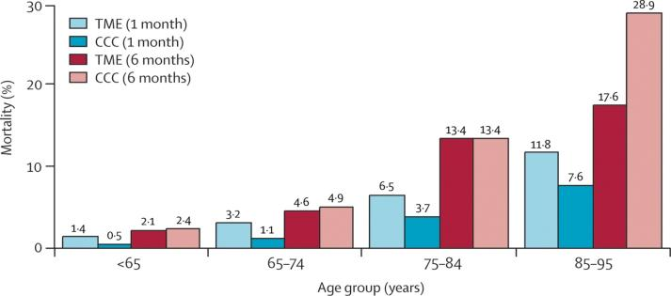
Example: having no evidence can have dramatic consequences
Rutten et al. Lancet Oncology 2008; 9: 494

Slide 5
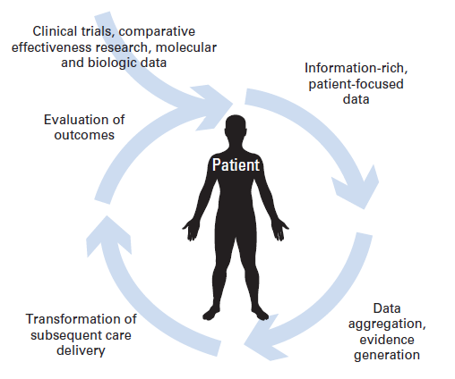
The solution? Use the 97%: Rapid Learning Health Care or “Big data in health care”
In [..] rapid-learning [..] data routinely generated through patient care and clinical research feed into an ever-growing [..] set of coordinated databases.
J Clin Oncol 2010;28:4268
[..] rapid learning [..] where we can learn from each patient to guide practice, is [..] crucial to guide rational health policy and to contain costs [..].
Lancet Oncol 2011;12:933
  Examples:
  Radiotherapy CAT (www.eurocat.info)
  ASCO’s CancerLinQ
Lambin et al. Aug 28, Radiother Oncol 2013, Adv. Drug Dev 2016
Notes:
5

Slide 6
Conventional Clinical Research
Rapid Learning Health Care (“Big Data”)
High data quality
Low data quality
Low data quantity
High data quantity
Controlled
  Assigned patients
  “EORTC-RTOG grade” QA/Protocol
  Biobanking, translational research
Reality
  Unassigned patients
  “Clinical grade” QA/Protocol
  Ad hoc biobanking/translational research
Relton C et al. BMJ. 2010; Burbach et al. Trials 2015; Lambin et al. Acta Oncol 2015

Slide 7
Example of clinically relevant questions
Treatment of
80 years old rectal cancer?
70 years old Stage IIIB NSCLC?
60 years old prostate cancer with oligometastasis?
Local relapse of a stage 3 oropharynx?
Cervix cancer stage 3, HIV+
…
Big Data to save lives

Slide 8
Watch the animation: http://youtu.be/ZDJFOxpwqEA

Slide 9
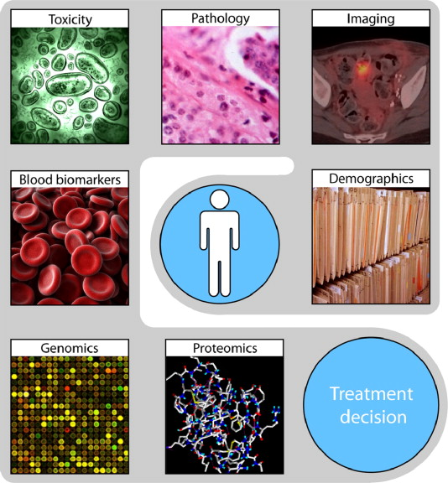
”Pan-omics approach”:
Multifactorial Decision Support System
But we need
Data,
preferably all
of them
How?
Lambin et al. Nature Rev. Clin. Oncol.

Slide 10
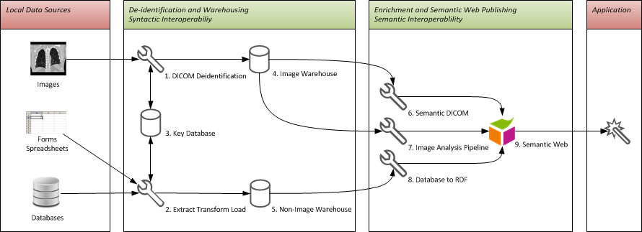
In-hospital infra & de-identification
Firewalls
SPARQL
Query (distrubuable)
Std ROO= Ontology
SPARQL = “Simple Protocol And RDF Query Language”
a query language for databases
Deidentification:
Removal of obvious patient identifiers (name, MRN, social security number, email etc.)
Assign a persistent token pseudonym
Change (data banding) of obvious but required patient identifiers (everyone born and died on the 15th of the month, part of the postal code)
No individual patient data leaves the hospital

Slide 11
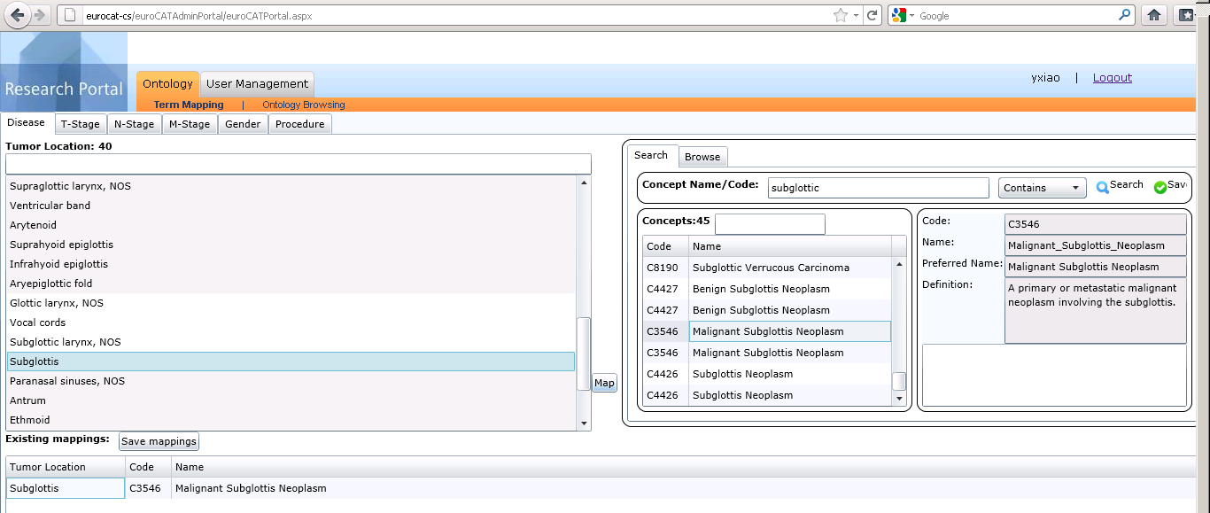
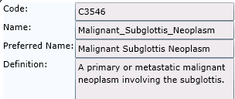



Ontology – International Coding System
2. Search the ontology for the matching concept
1. Select the local term
声门下区
3. Map the local term to the ontology
4. See the result of your mapping

Slide 12
The Semantic Web
The Semantic Web is an extension of the Web through standards by the World Wide Web Consortium (W3C). The standards promote common data formats and exchange protocols on the Web.
According to the W3C, "The Semantic Web provides a common framework* that allows data to be shared and reused across application, enterprise, and community boundaries". The term was coined by Tim Berners-Lee for a web of data that can be processed by machines.
*SPARQL is a semantic query language for databases

Slide 13
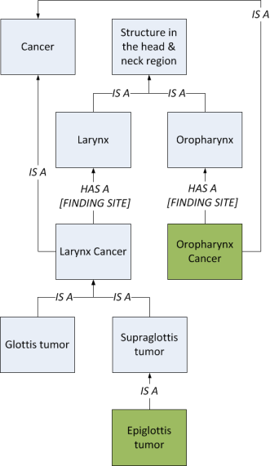
An ontology is more than a dictionary
Ontology is a set terms & their relationships.
Then we have “machine readable data” accessible to Artificial Intelligence

Slide 14
SPARQL
SPARQL (pronounced "sparkle", an acronym for SPARQL Protocol and RDF Query Language) is an RDF query language, that is, a semantic query language for databases, able to retrieve and manipulate data stored in Resource Description Framework (RDF) format.^{[3][4]} It was made a standard by the World Wide Web Consortium, and is recognized as one of the key technologies of the semantic web. In 2013, SPARQL 1.1 became an official W3C Recommendation.

Slide 15
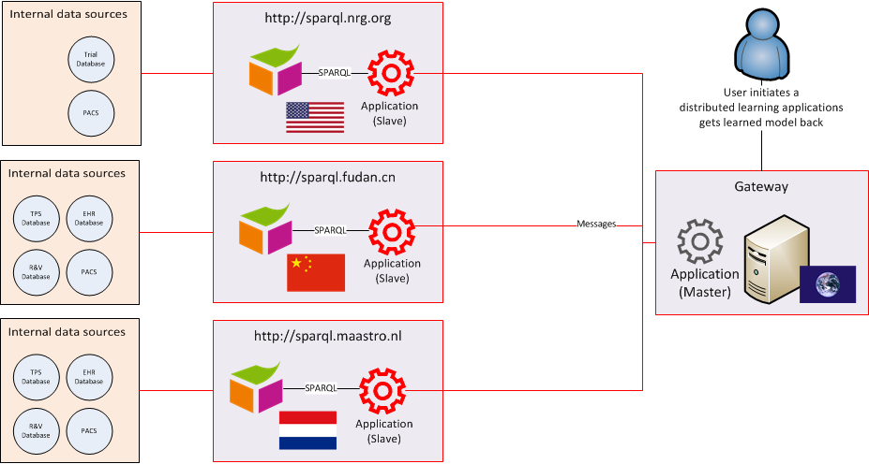
Semantic box (the secondary research database
Hospitals
SPARQL : Query language for application
Notes:
SPARQL language for application, ROO radiation oncology ontology

Slide 16

Funded: euroCAT, duCAT, chinaCAT, VATE, ozCAT
New: ukCAT, indiaCAT
4
2
7
Active or funded CAT partners (17)
Map from cgadvertising.com
Prospective centers

Slide 17

What next?:
The patient managing its own data
Data = Gold
Our vision in 2 min:
“from hospital to patient”

Slide 18
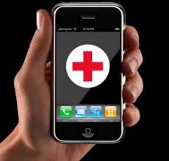

From data to models to
Virtual patient?

Slide 19
The 5 P’s of modern medicine
(modified from Leroy Hood)
« P » for Personalized
« P » for Preventive
« P » for Predictive
« P » for Participatory
« P » for Parcimonious

Slide 20
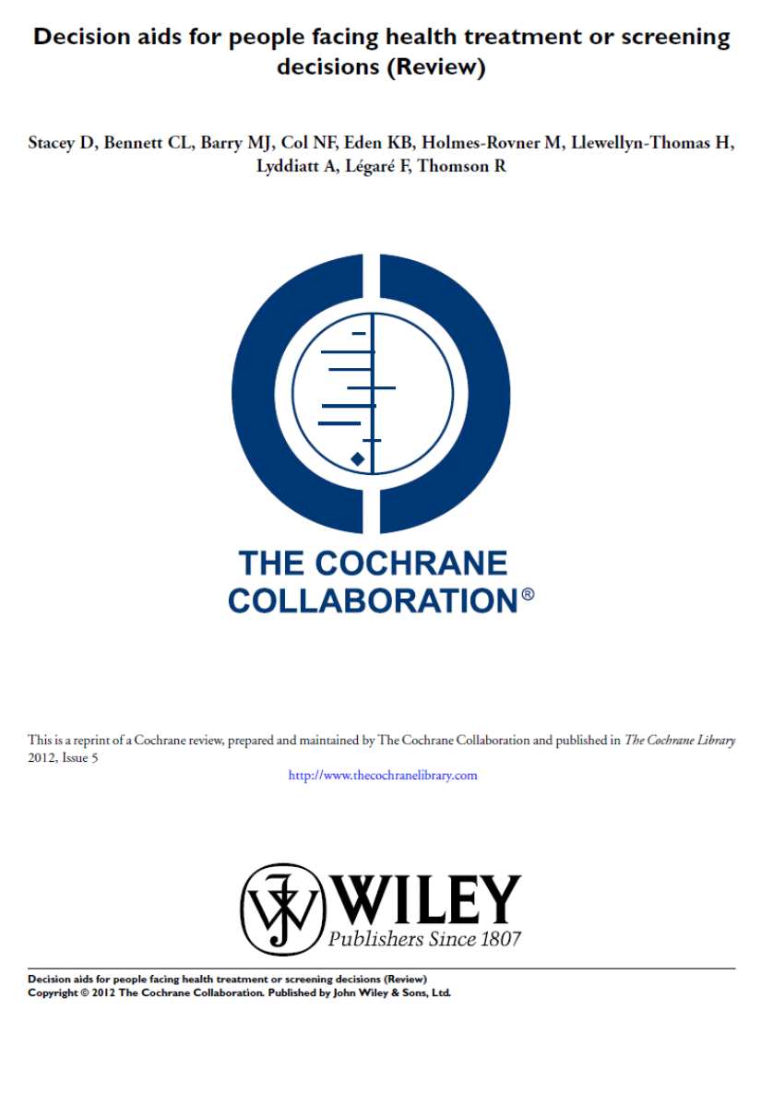
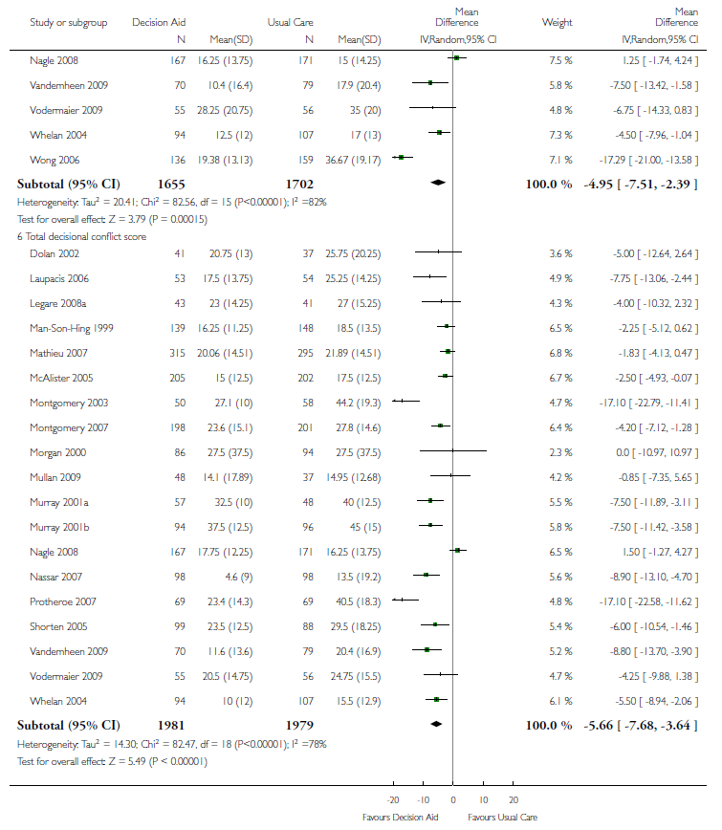
Shared Decision Making 1.0 with Decision aids

Slide 21
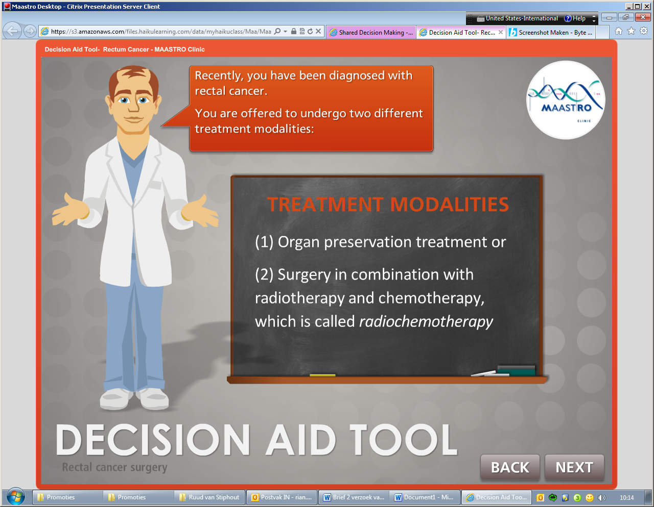

Shared Decision Making 2.0: model-based virtual patient or
Avatar-based Shared Decision making
www.treatmentchoice.info

Slide 22
Data
Patient avatar (or similar patients)
Simulation/DSS:
Virtual treatments
Virtual clinical trials
Virtual scenarios with preventive personalized interventions
…
Game changer!

Slide 23
Take home message: we need
Privacy-preserving Big data to build
Multifactorial decision support systems
And Shared decision making
Patient avatars (= model-based virtual patients or similar patients)
Used for simulations of virtual treatment in virtual hospitals and virtual clinical trials.
Big Data to save lives

Slide 24
What next?
Backcasting*
*= a planning method that starts with defining a desirable future and then works backwards to identify policies and programs that will connect the future to the present)

Slide 25
Thank you for your attention
Privacy-preserving Big data to build
Multifactorial decision support systems
And Shared decision making
Patient avatars (= model-based virtual patients or similar patients)
Used for simulations of virtual treatment in virtual hospitals and virtual clinical trials.

Slide 26

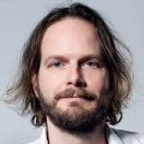


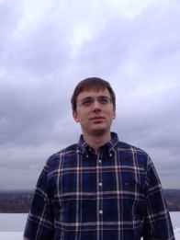
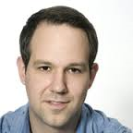

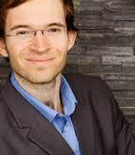

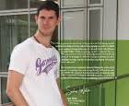

Acknowledgements
Policlinico Gemelli, Roma, Italy
UH Ghent, Belgium
UH Leuven, Belgium
UH Nijmegen, Netherlands
…
CHU Liege, Belgium
Uniklinikum Aachen, Germany
LOC Genk/Hasselt, Belgium
Catherina Zkh Eindhoven, Netherlands
Main MAASTRO collaborators
Andre Dekker
Cary Oberije
Timo Deist
Erik Roelofs
Arthur Jochems
Sean Walsh
Ralph Leijenaar
Janita van Timmeren

Slide 27
Reserve slides

Slide 28
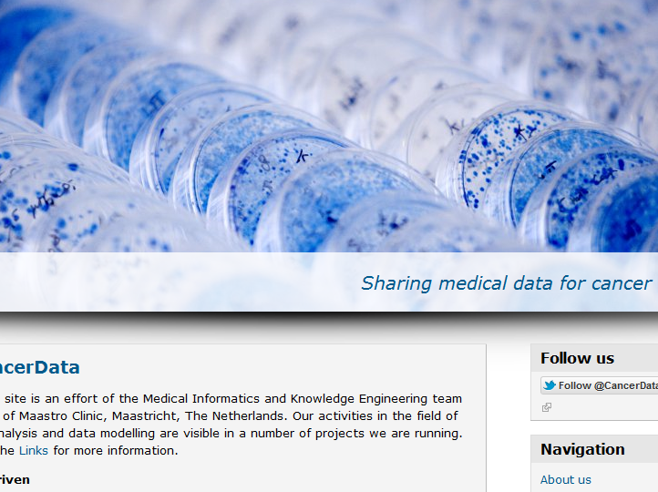
Open source data of publications: www.cancerdata.org

Slide 29
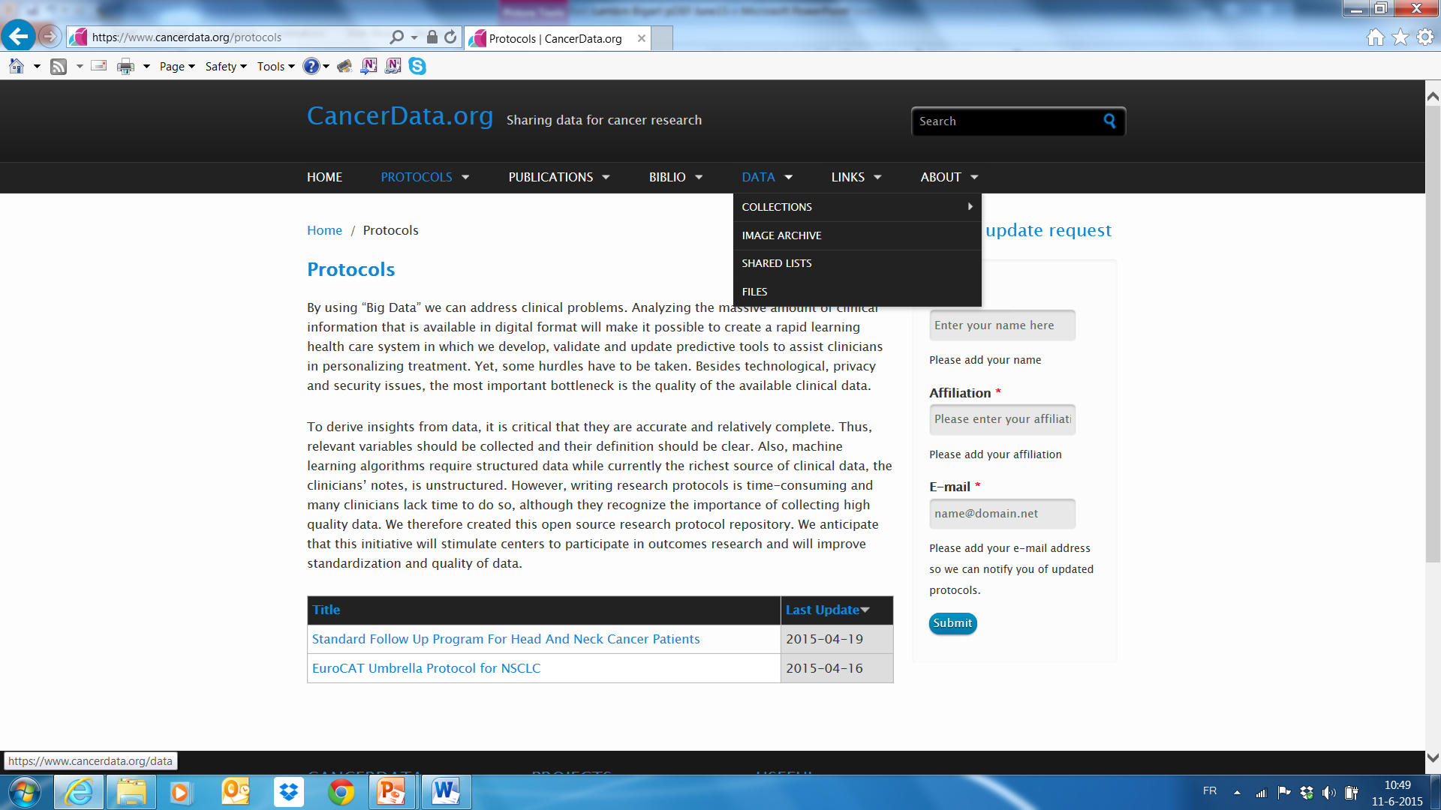

Slide 30
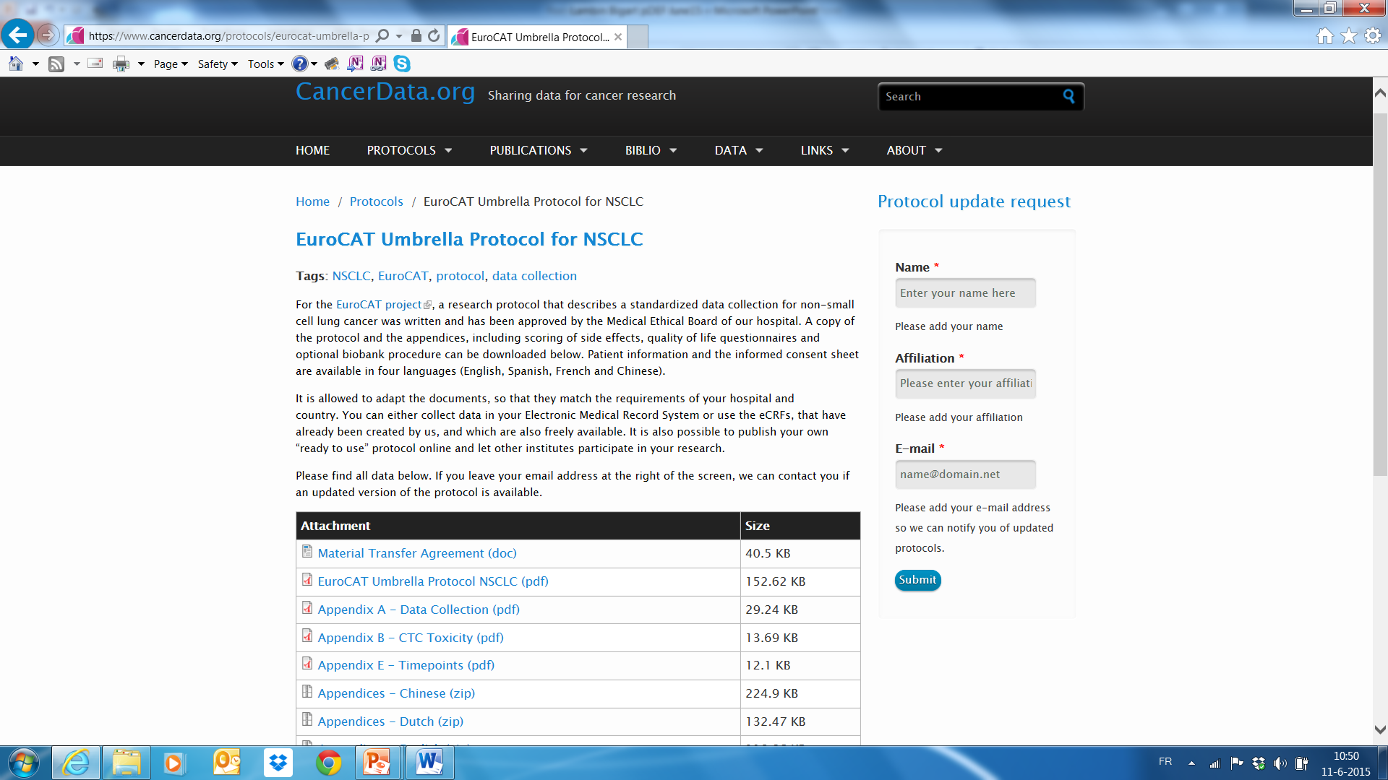

Slide 31
Can you give me
examples
of new knowledge coming from Big Data approaches

Slide 32
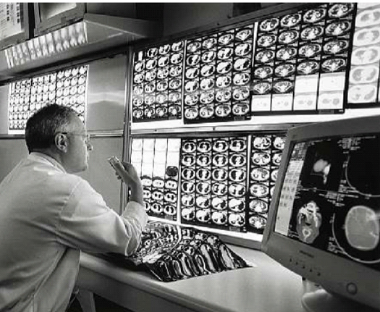
_{The Radiomic hypothesis}
One can extract more quantitative information from standard imaging
_{Radiology:}
_{Implicit knowledge}
_{Interpretability}
_{QUANTIFICATION}
_{RADIOMICS}
Extract quantitative features from images
Lambin et al. EJC, 2012; Aerts, Lambin et al. Nature Commun 2014

Slide 33
Predict survival in Lung and Head & neck cancer better then TNM
  Aerts…Lambin, Nature Commun 2014; Leijenaar et al. Acta Oncol 2015

Slide 34
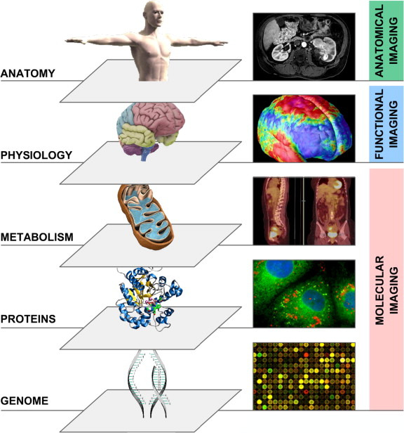
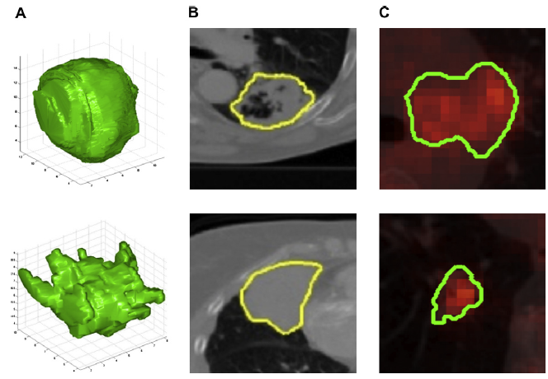
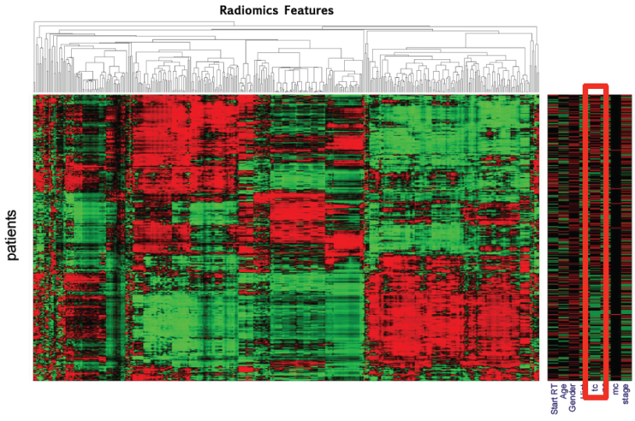
Entering the OMICS era… Radiomics
Lambin et al. EJC, 2012; Aerts, Lambin et al. Nature Commun 2014

Slide 35
Watch the animation: http://youtu.be/Tq980GEVP0Y
Or the website: www.radiomics.org

Slide 36
Take home message
We need Decision Support Systems (DSS = a “meta TPS”) to manage the large quantity of data and implement Personalized medicine in radiotherapy in particular for protontherapy due to its costs.
Two complementary approaches: conventional clinical trials (+ data reuse) + “Big Data approach” (Rapid Learning Health Care).
Building cancer informatics tools to enable analysis, exploration, and rapid evaluation of novel therapies or stratification e.g. Distributed learning based on semantic web technology.
DSS facilitate Share Decision Making, participative precision medicine and cost effective Health care (the 4th & 5th “P”). One key example could be protontherapy.
Lambin et al. Aug 28, Radiother Oncol 2013, Adv. Drug Dev 2016

