Slide 1
Welcome and Introduction
Fabiola Gianotti, Divonne, 20 February 2016

Slide 2
Medical Applications in the context of CERN’s mission
CERN main mission is fundamental research in particle physics.
Three instruments are the pillars of our research:
accelerators → e.g. superconducting magnets and RF cavities
detectors → e.g. fast, high-resolution, rad-hard sensors
computers → e.g. storage and treatment of large amount of data, detailed simulations
In these three areas, cutting-edge technologies need to be developed to satisfy the
discipline’s stringent requirements → these developments are made available to society
→ knowledge transfer is also part of CERN’s mission.
Medical Applications (MA) have been, are and will be a primary component of CERN’s
knowledge transfer activities. The (new) Directorate is firmly committed to this goal.
As of January 2016, MA activities have been reorganised, to give them larger
visibility and strategic weight:
A high-level steering committee (chaired by one of Directors) in charge of the strategy
A dedicated operational unit in the KT group
Input from external and internal experts: developers of CERN’s technologies,
medical doctors, CERN Member State countries interested in MA, etc.

Slide 3
(New) Organization of medical applications activities at CERN
Blue: internal bodies
Pink: external bodies
CERN Medical Applications
Steering Committee (CMASC)
Strategy and decision making body;
high-level follow-up of projects
Chair: Director for Accelerator
and Technology
Deputy Chair: Director for Research
and Computing
International Strategy
Committee (ISC)
External experts
Chair: M. Baumann
Deputy Chair: M. Dosanjh
Medical Application Section
of CERN Knowledge Transfer
Group (KT-MA)
Operational support to
CERN MA activities
Knowledge Transfer
Forum (KTF)
CERN + Member States consultation forum for KT activities (includes MA)
Chair: KT Group Leader
Medical Applications
Projects Forum (MAPF)
CERN experts of
MA-related technologies
Chair: KT-MA Section Leader

Slide 4
(New) Organization of medical applications activities at CERN
Blue: internal bodies
Pink: external bodies
CERN Medical Applications
Steering Committee (CMASC)
Strategy and decision making body;
high-level follow-up of projects
Chair: Director for Accelerator
and Technology
Deputy Chair: Director for Research
and Computing
International Strategy
Committee (ISC)
External experts
Chair: M. Baumann
Deputy Chair: M. Dosanjh
CERN Medical Applications Steering Committee (CMASC):
Chair: Director for Accelerators and Technology. Scientific Secretary: Manjit Dosanjh
Composition: Directorate, Heads of relevant Departments, ISC Chair, KT GL, KT-MA SL
Define strategy for MA activities at CERN, with inputs from all relevant bodies.
Decide which projects should be financed. Ensure projects follow-up.
Meeting frequency: every 1-2 (3-4) months at the beginning (later)
Medical Application Section
of CERN Knowledge Transfer
Group (KT-MA)
Operational support to
CERN MA activities
Knowledge Transfer
Forum (KTF)
CERN + Member States consultation forum for KT activities (includes MA)
Chair: KT Group Leader
Medical Applications
Projects Forum (MAPF)
CERN experts of
MA-related technologies
Chair: KT-MA Section Leader

Slide 5
(New) Organization of medical applications activities at CERN
Blue: internal bodies
Pink: external bodies
CERN Medical Applications
Steering Committee (CMASC)
Strategy and decision making body;
high-level follow-up of projects
Chair: Director for Accelerator
and Technology
Deputy Chair: Director for Research
and Computing
International Strategy
Committee (ISC)
External experts
Chair: M. Baumann
Deputy Chair: M. Dosanjh
International Strategy Committee (ISC):
Chair: M. Baumann, Deputy Chair: Manjit Dosanjh
Composition: Medical doctors and other MA experts from sectors that can potentially benefit
from CERN technologies, KT-MA SL (ex-officio).
Give input to CMASC on CERN’s technologies and activities potentially relevant for the medical
field. Follow up projects, in particular possible developments into clinical end-products.
Meeting frequency: every 4 months
Medical Application Section
of CERN Knowledge Transfer
Group (KT-MA)
Operational support to
CERN MA activities
Knowledge Transfer
Forum (KTF)
CERN + Member States consultation forum for KT activities (includes MA)
Chair: KT Group Leader
Medical Applications
Projects Forum (MAPF)
CERN experts of
MA-related technologies
Chair: KT-MA Section Leader

Slide 6
(New) Organization of medical applications activities at CERN
Blue: internal bodies
Pink: external bodies
CERN Medical Applications
Steering Committee (CMASC)
Strategy and decision making body;
high-level follow-up of projects
Chair: Director for Accelerator
and Technology
Deputy Chair: Director for Research
and Computing
International Strategy
Committee (ISC)
External experts
Chair: M. Baumann
Deputy Chair: M. Dosanjh
MA section of KT group (KT-MA):
Section Leader: Manuela Cirilli
Help CMASC identify CERN technologies relevant for MA. Provide operational support to
CERN MA activities and projects, implementing the strategy formulated by the CMASC.
Foster synergies and collaboration among MA-related activities at CERN.
Assist projects in the preparation of applications for external funding (EC, donors, etc.).
Support approved projects by liaising with relevant services (outreach, legal service, etc)
Medical Application Section
of CERN Knowledge Transfer
Group (KT-MA)
Operational support to
CERN MA activities
Knowledge Transfer
Forum (KTF)
CERN + Member States consultation forum for KT activities (includes MA)
Chair: KT Group Leader
Medical Applications
Projects Forum (MAPF)
CERN experts of
MA-related technologies
Chair: KT-MA Section Leader

Slide 7
(New) Organization of medical applications activities at CERN
Blue: internal bodies
Pink: external bodies
CERN Medical Applications
Steering Committee (CMASC)
Strategy and decision making body;
high-level follow-up of projects
Chair: Director for Accelerator
and Technology
Deputy Chair: Director for Research
and Computing
International Strategy
Committee (ISC)
External experts
Chair: M. Baumann
Deputy Chair: M. Dosanjh
MA projects forum (MAPF):
Chair: KT-MA Section Leader
Composition: CMASC Scientific Secretary (ex-officio), KT GL, CERN people involved in MA
projects or experts in MA-relevant technologies (proposed by relevant Department Heads)
Provide a forum for technical discussions of CERN activities and technologies of potential
interest for MA, and propose (new) projects to CMASC. Facilitate communication across
activities and with people from external Institutes.
Meeting frequency: every 3-4 weeks
Medical Application Section
of CERN Knowledge Transfer
Group (KT-MA)
Operational support to
CERN MA activities
Knowledge Transfer
Forum (KTF)
CERN + Member States consultation forum for KT activities (includes MA)
Chair: KT Group Leader
Medical Applications
Projects Forum (MAPF)
CERN experts of
MA-related technologies
Chair: KT-MA Section Leader

Slide 8
(New) Organization of medical applications activities at CERN
Blue: internal bodies
Pink: external bodies
CERN Medical Applications
Steering Committee (CMASC)
Strategy and decision making body;
high-level follow-up of projects
Chair: Director for Accelerator
and Technology
Deputy Chair: Director for Research
and Computing
International Strategy
Committee (ISC)
External experts
Chair: M. Baumann
Deputy Chair: M. Dosanjh
Knowledge Transfer Forum (KTF):
Chair: KT Group Leader
Composition: representatives from CERN Member State countries
Forum to exchange information and develop common strategies on KT (including MA)
between CERN and MS countries. Help CERN liaise with stakeholders in the MS.
Give input to the CMASC based on MS needs and goals.
Meetings frequency: every 2-3 months
Medical Application Section
of CERN Knowledge Transfer
Group (KT-MA)
Operational support to
CERN MA activities
Knowledge Transfer
Forum (KTF)
CERN + Member States consultation forum for KT activities (includes MA)
Chair: KT Group Leader
Medical Applications
Projects Forum (MAPF)
CERN experts of
MA-related technologies
Chair: KT-MA Section Leader

Slide 9
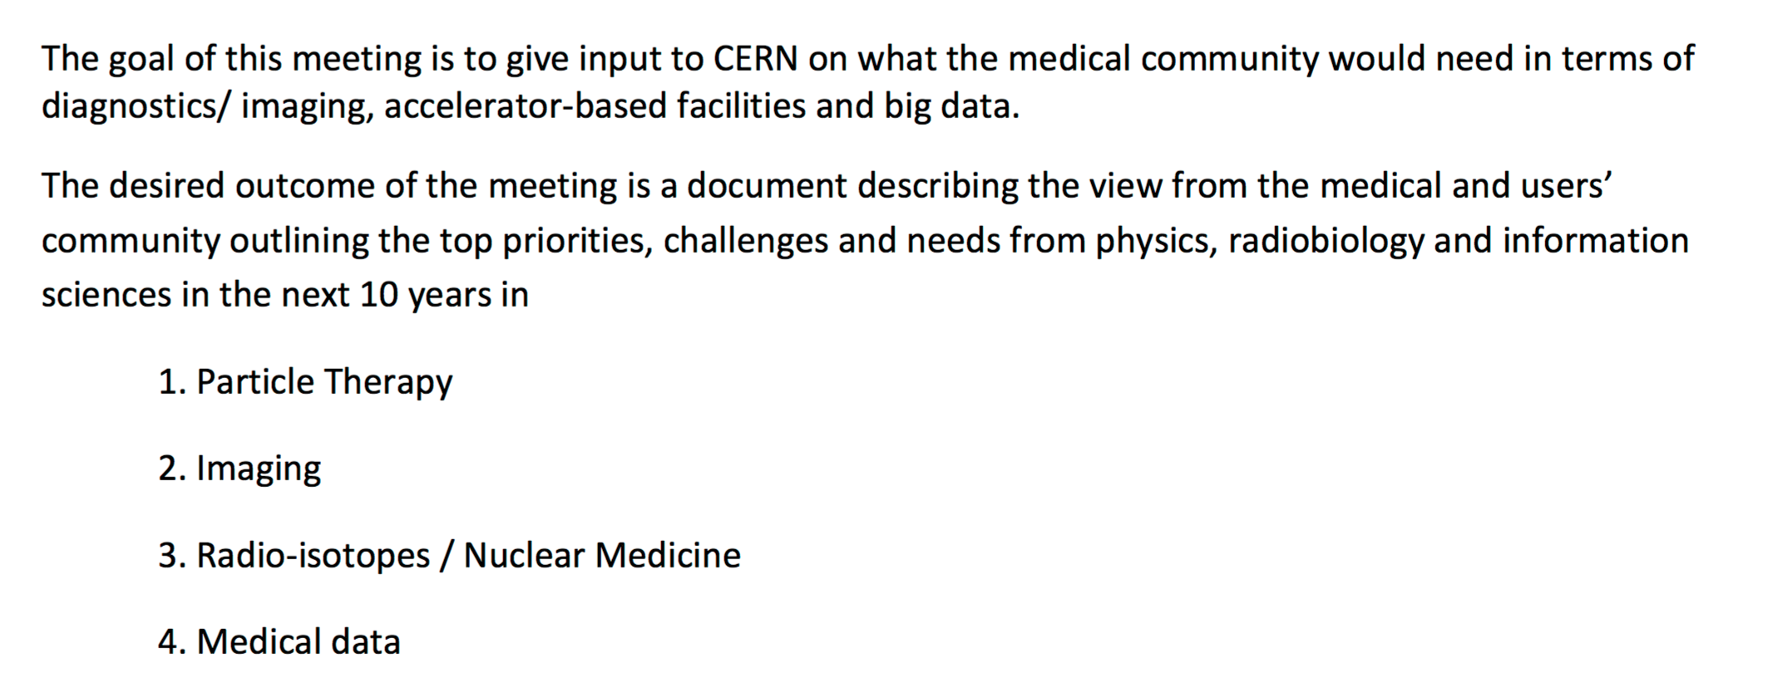
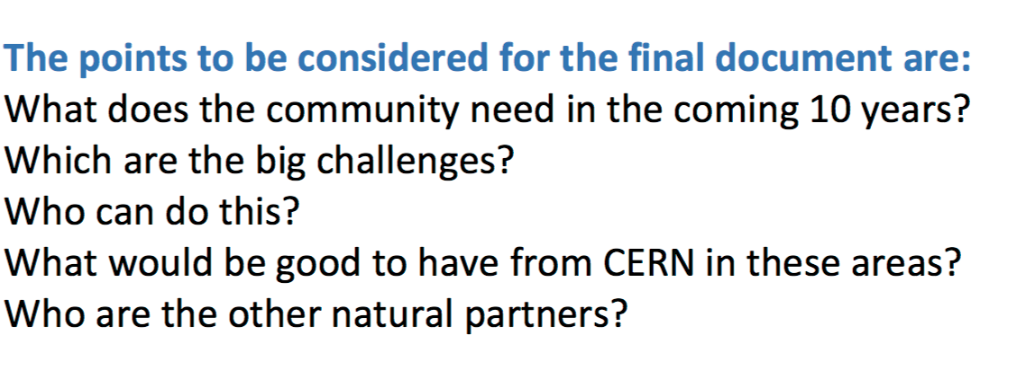
A primary goal for 2016
Produce a “strategy paper” with priorities and goals for CERN MA activities and
projects addressing all domains (accelerators, detectors, software/computing)
(→ submit for approval by CERN Council in the fall)
Input from the community (e.g. through this Brainstorming meeting) is CRUCIAL
Notes:
Three examples of medical applications, one for each main technology domain:
Detectors for medical imaging (top left picture)
Computer simulations for treatment planning (top right picture)
Accelerators for hadrontherapy (bottom picture). This picture is a treatment room in CNAO, presenting it you can mention both CNAO and MedAustron

Slide 10
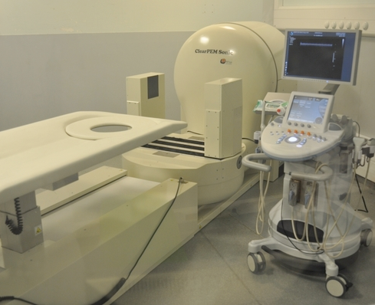
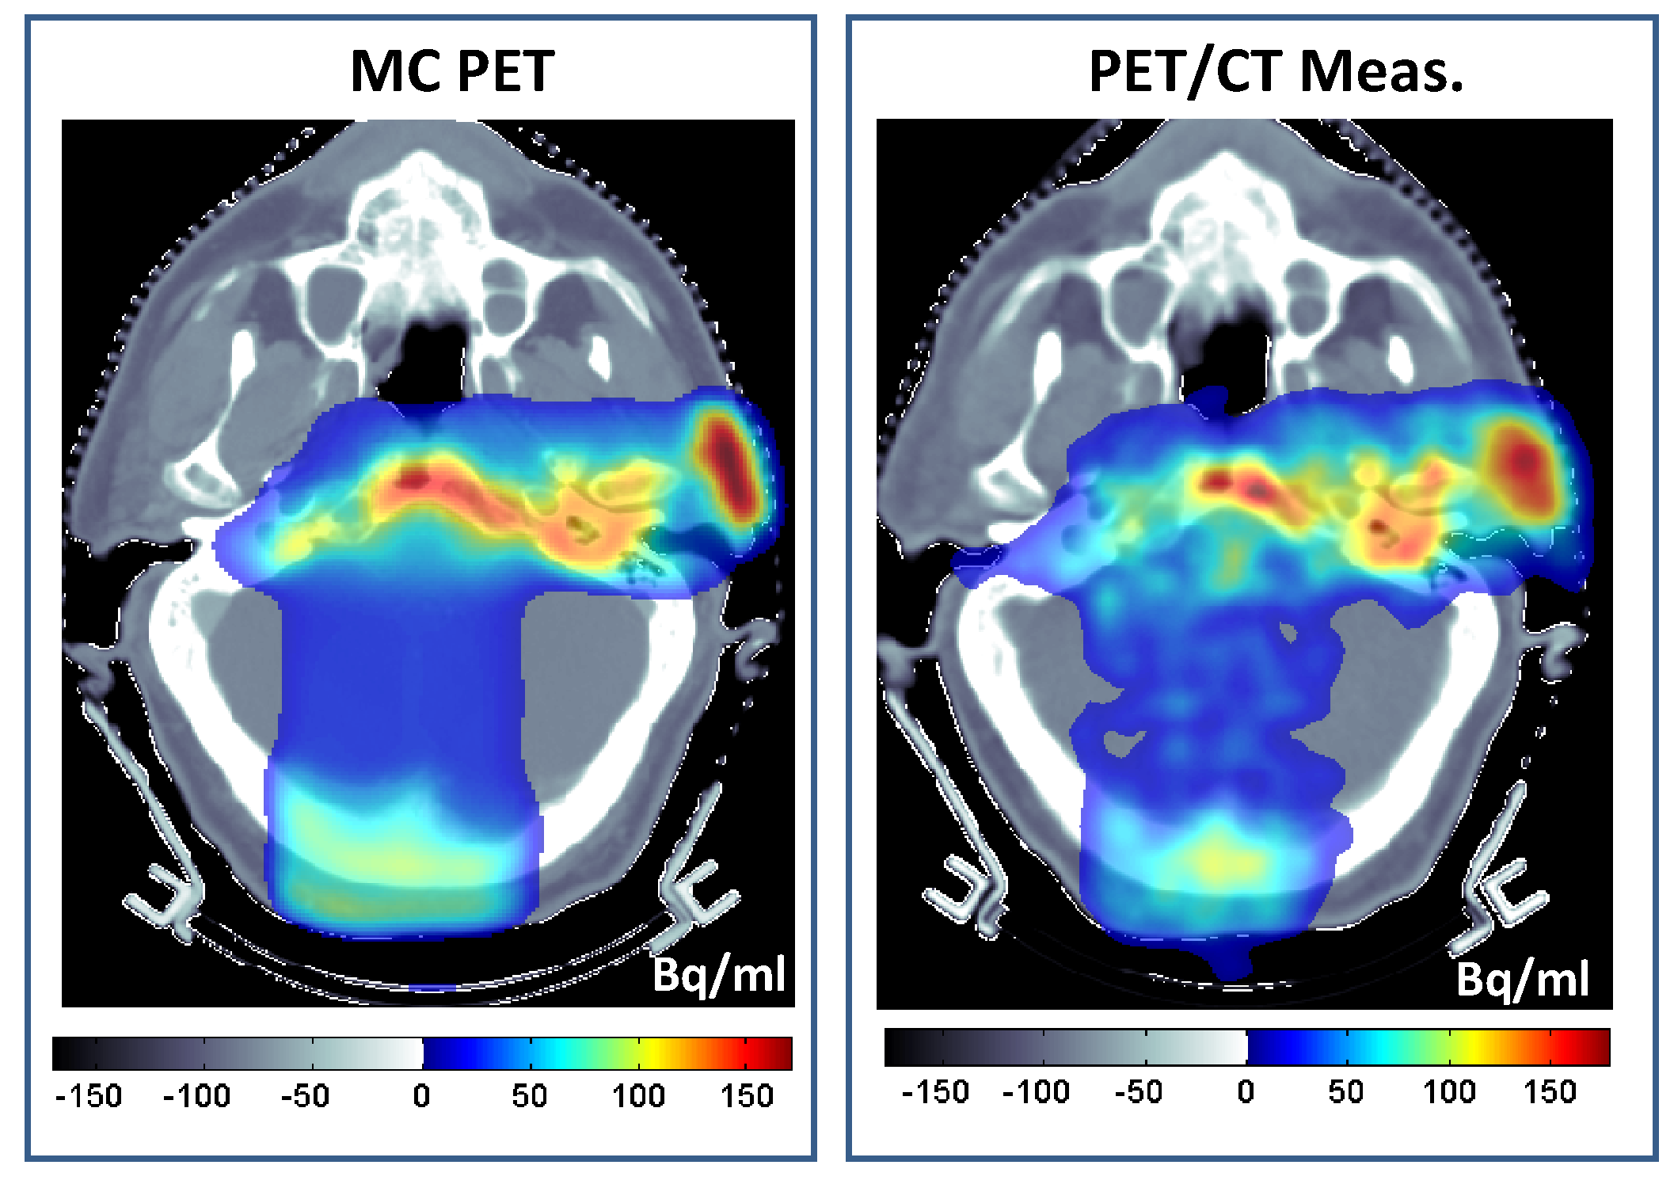
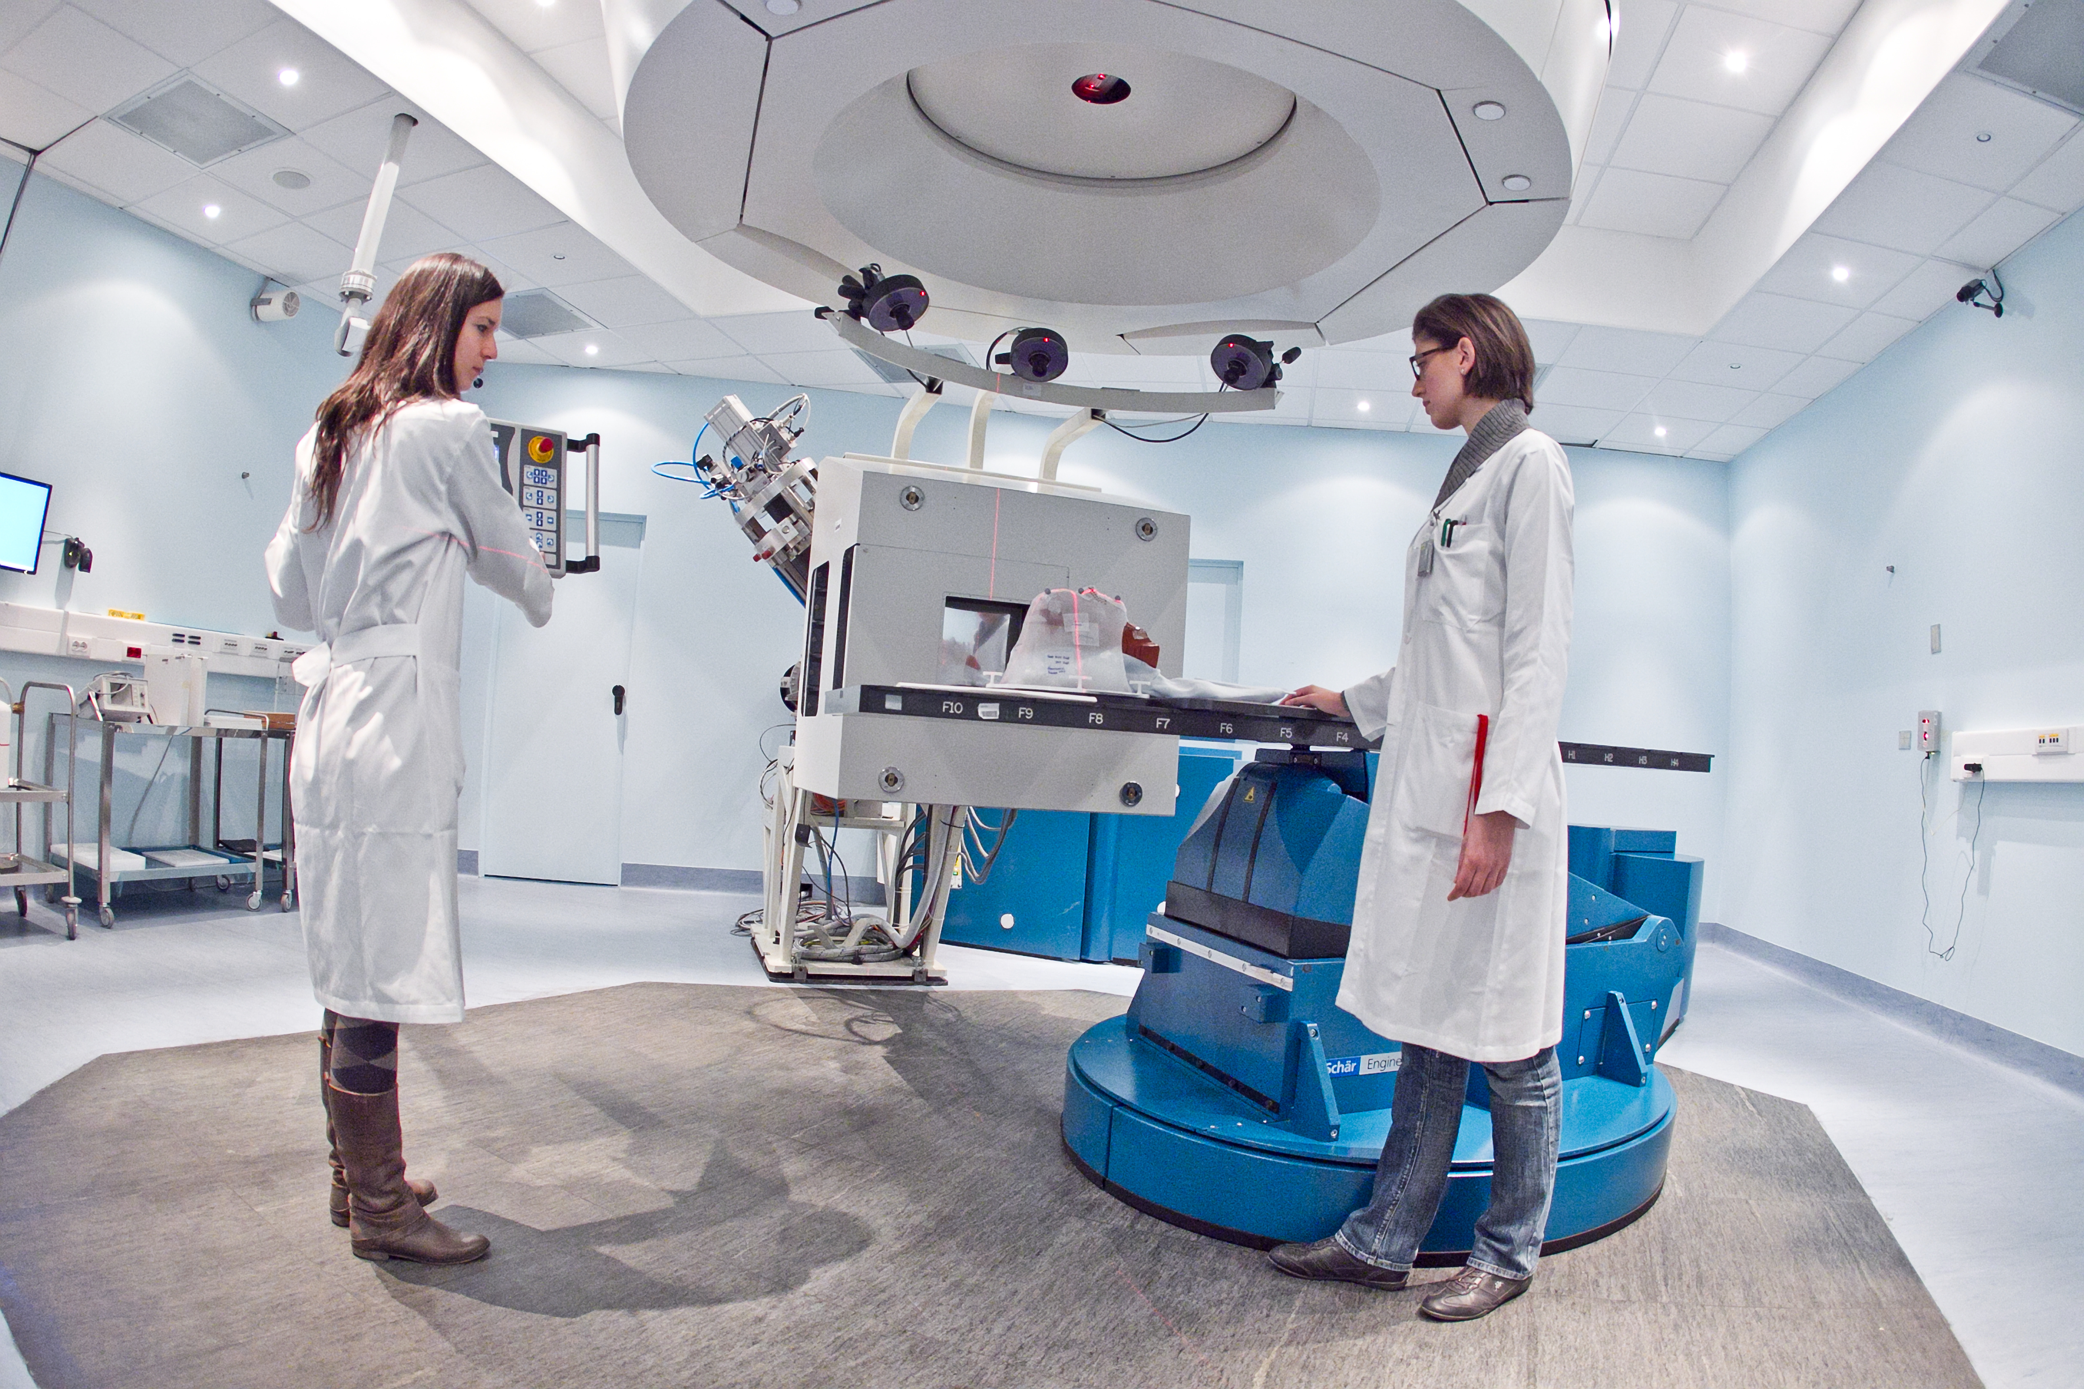
Have a fruitful
meeting !
Notes:
Three examples of medical applications, one for each main technology domain:
Detectors for medical imaging (top left picture)
Computer simulations for treatment planning (top right picture)
Accelerators for hadrontherapy (bottom picture). This picture is a treatment room in CNAO, presenting it you can mention both CNAO and MedAustron

Slide 11
SPARES
11

Slide 12
CERN DIRECTORATE
CERN Medical Applications Office
Head: Steve Myers
International Strategy
Committee (ISC)
External experts
Chair: M. Baumann
Co-Chair: S. Myers
CERN Medical Applications
Steering Group (CMASG)
Chair: CMA Head
Life Sciences section
of CERN Knowledge Transfer
Group (KT-LS)
Section Leader:
M.Dosanjh
(also deputy CMA and KT)
Knowledge Transfer Group
(KT)
Section Leader: Giovanni Anelli

Slide 13
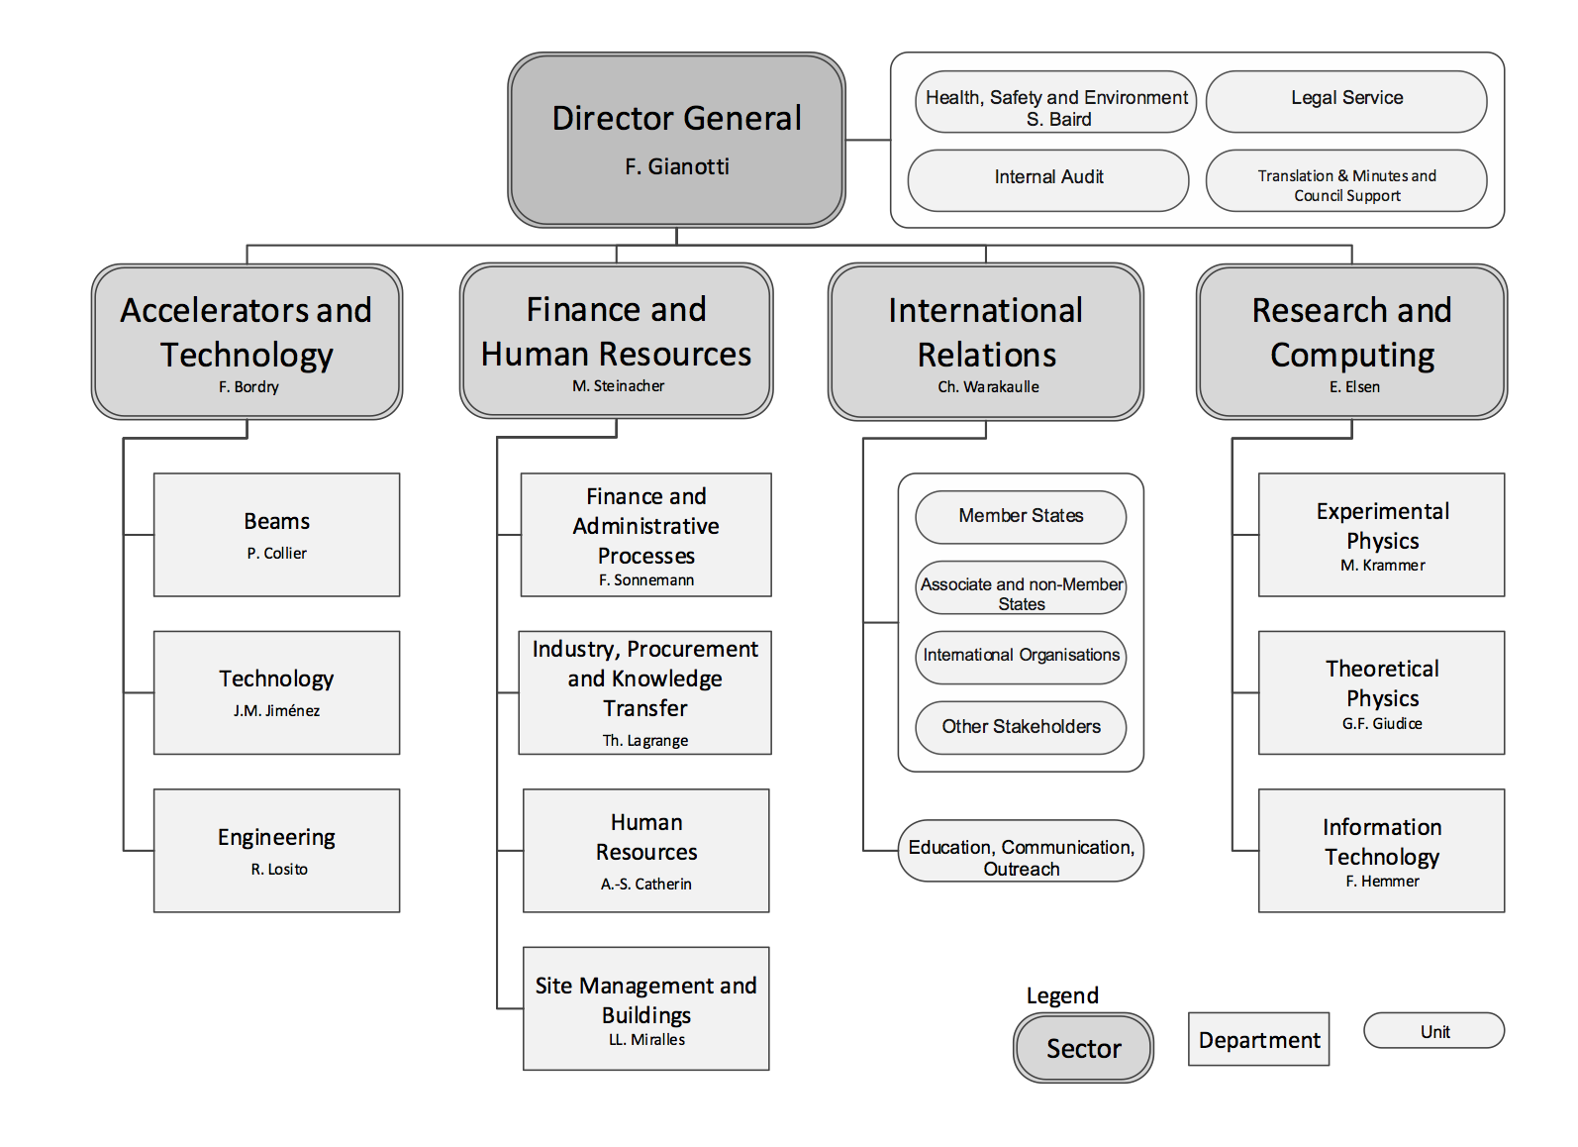
The new organisational and management structure
CMASC
KT-MA

