Slide 1
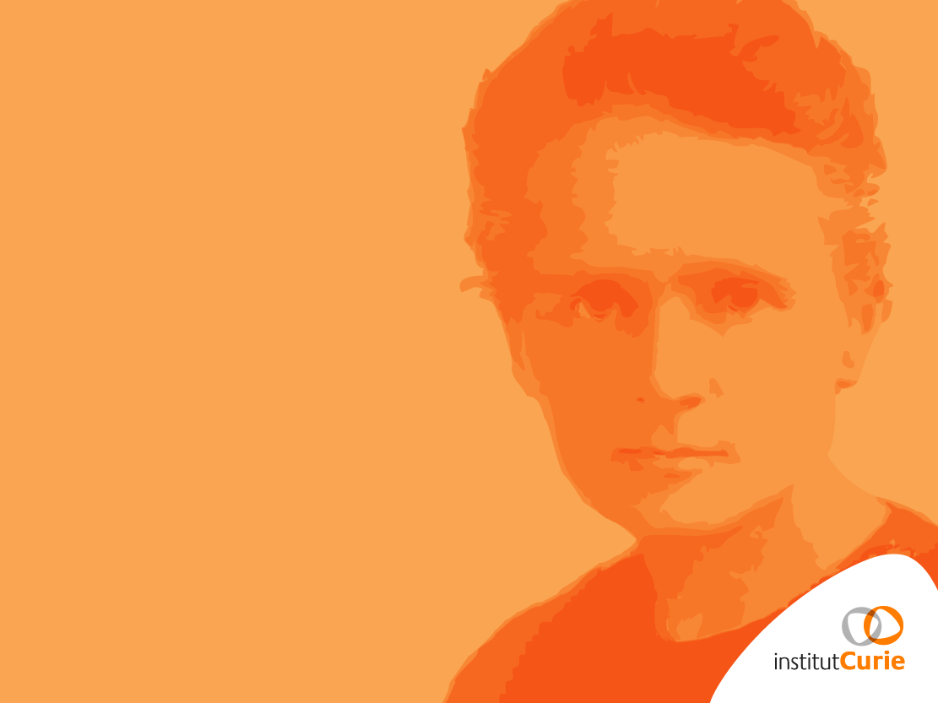

A.Mazal, F.Goudjil, S.Meyroneinc,
L.DeMarzi, A.Patriarca,
P.Verelle, V.Favaudon, F. Pouzoulet, M.Dutreix, R. Dendale, A. Fourquet
& staff
Centre de Protontherapie d’Orsay
Institut Curie, Paris, France
Physics in hadrontherapy:
From photons to Pan-omics,
through biology for clinics,
and $pecific challenge$
2nd CERN brainstorming meeting
Divonne, 20th February 2016

Slide 2
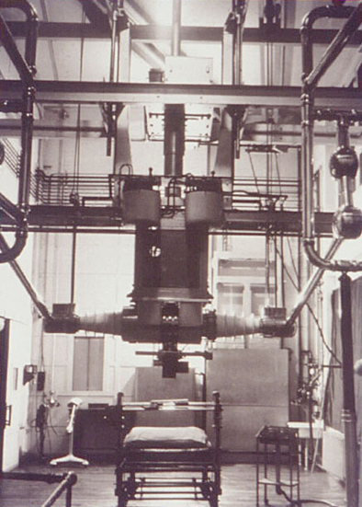
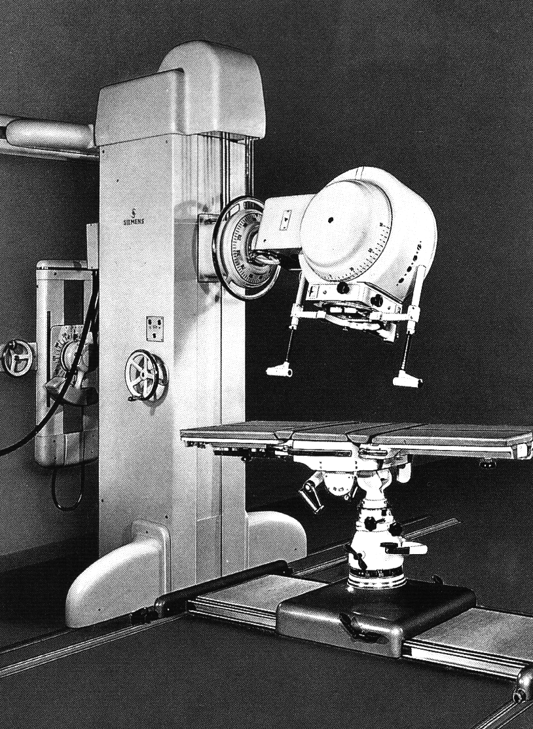
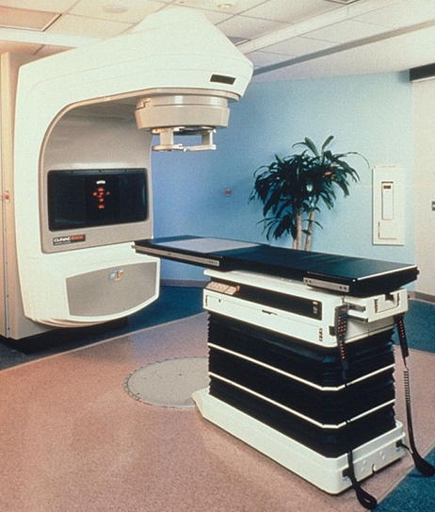
From the history of technology for radiation therapy with photons and electrons…
600 kV- Years’ 30
Gammatron
Siemens 1956
Cs-137 et Co-60
(1 MeV)
Linear Accelerators (ex.Varian)
(4-25 MV)

Slide 3
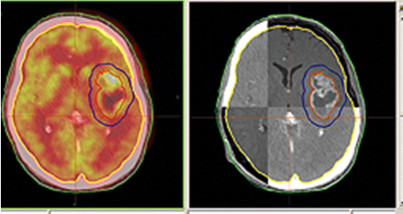
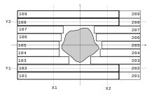
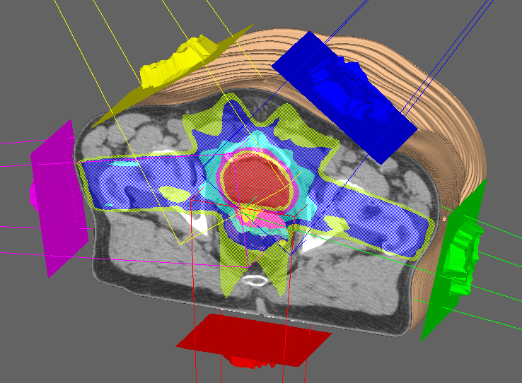
Evolution of software
and hardware tools
Multimodality imaging
including functional:
registration,
fast automatic segmentation,…
Multileaf_collimator
https://en.wikipedia.org/wiki/
Inverse Planning & IMRT
radiation-therapy-imrt.html
http://www.noyodecia.com/

Slide 4
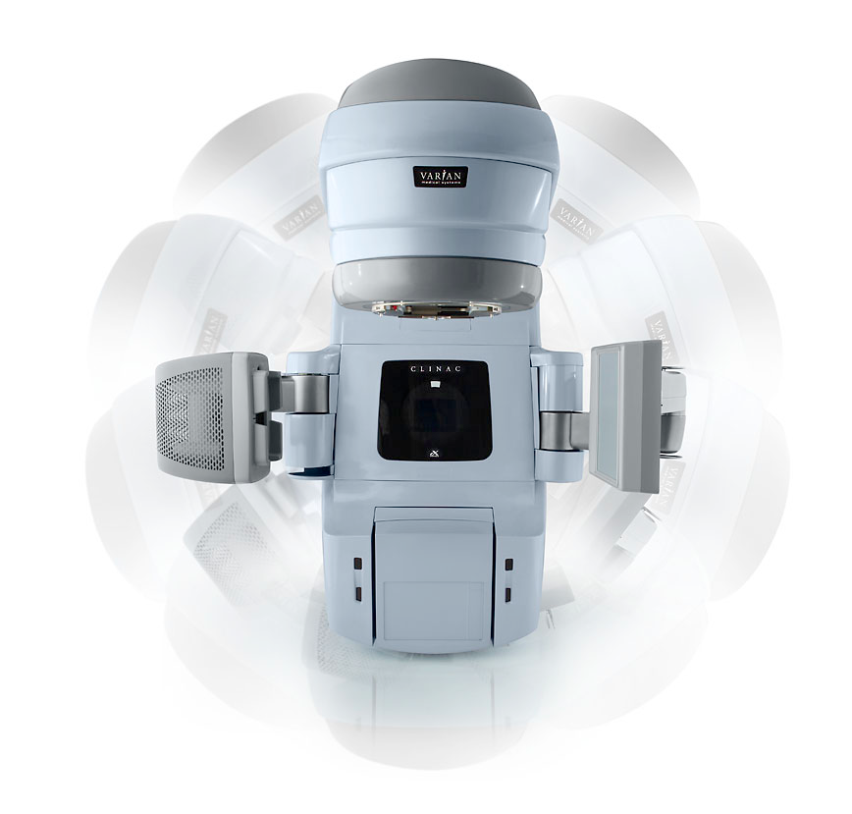
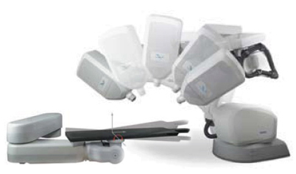
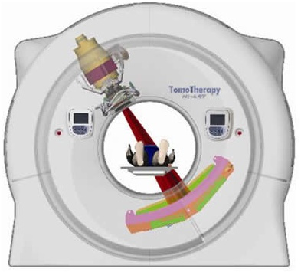
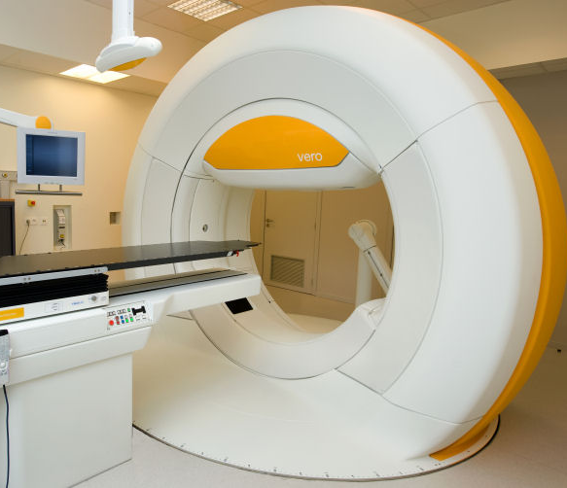
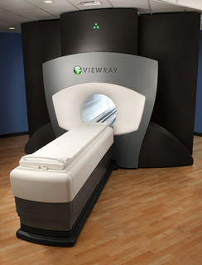
Physics and technology: Present delivery systems in external radiation therapy
Varian : 4 Pi
Elekta : on line MRI
Cyber: MLC
RapidArc or equivalents (wphospitals.org;
www.varian.com; www. Elekta.com)
Cyberknife
www.cyberknife.com
“state of the art” in photons ?
Tomo : soon
Tomotherapy
[www.tomotherapy.com]
Vero
[www.brainlab.com]
ViewRay (MRI+3Co-60)
[www.viewray.com]

Slide 5
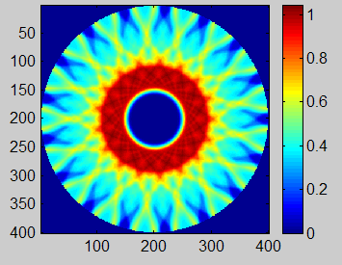
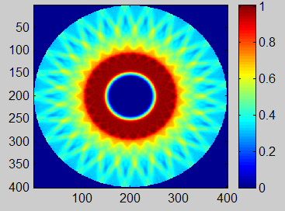
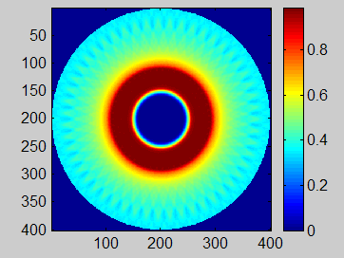
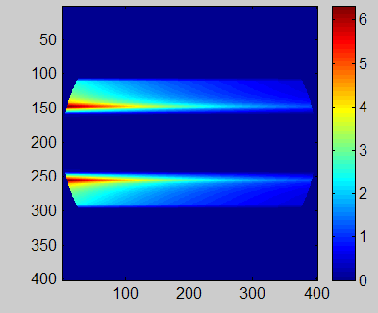
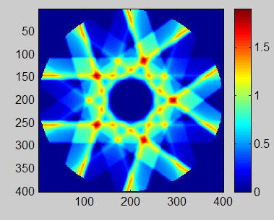
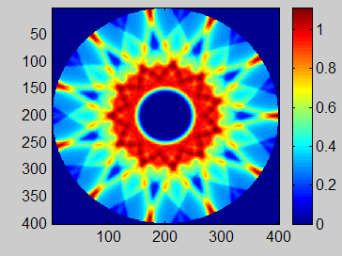
Multiplicity of incidences// changing the role of the energy
(from Tomotherapy)
mm
mm
mm
1 Beam
5 Beams
11 Beams
17 Beams
25 Beams
51 Beams
mm
mm
mm

Slide 6
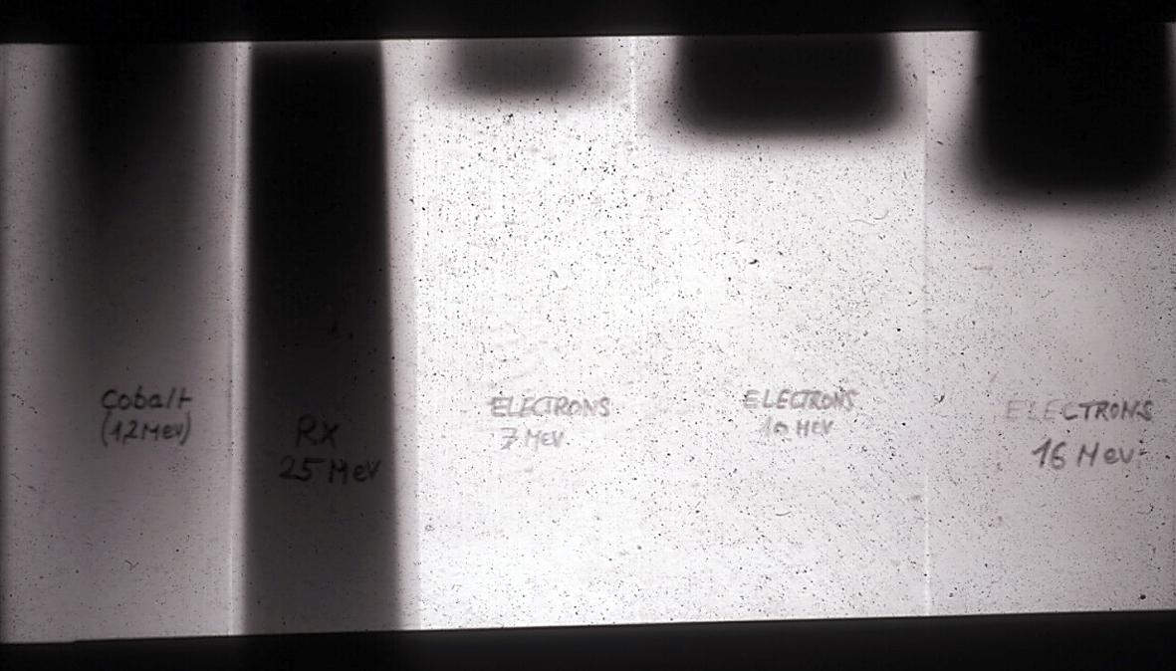
Electrons
Protons/Ions
Photons
20 cm
Much more than just “filling the gap”… ! :
Court J-C.Rosenwald. I. Curie

Slide 7
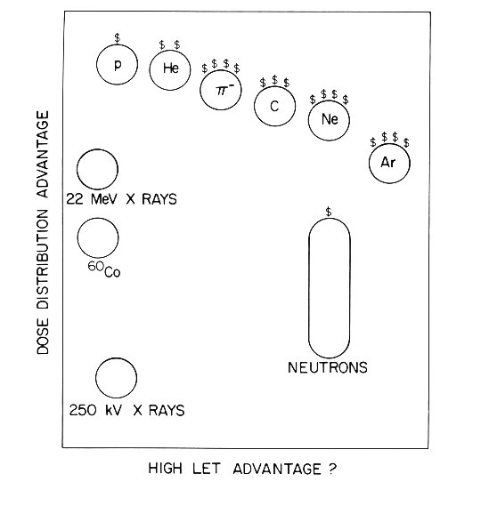
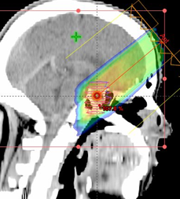


Hadrontherapy : Physical selectivity and/or Radiobiological effects
* pions
* fast
& slow neutrons
* protons
* light and heavy ions
IMXT
(Past)
(Present)
Linear Energy Transfer
(Future ?)
A. Koehler in [Raju. 1980]

Slide 8
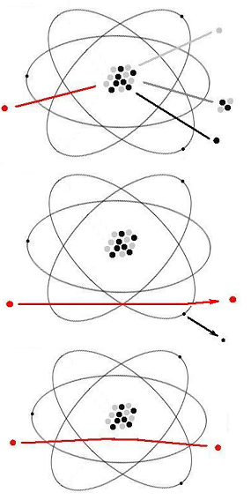
Hadrontherapy: some very basic physics
Many interactions of particles with matter … but keep 3 :
Inelastic collision w/nuclei :
neutrons, activation, fragments…
Inelastic collision with electrons: Dose
Elastic collision w/nuclei:
« multiple Coulomb scattering » :
+ Scattering foils,
- penumbra, distal edge,…

Slide 9
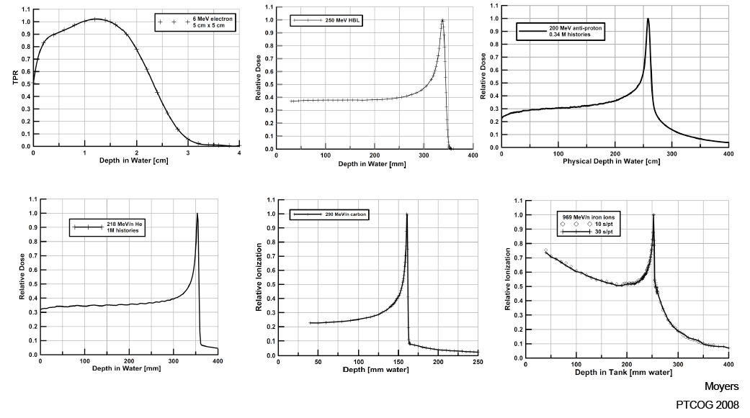
Finite Range = all charged particles
Electrons
Protons
Anti-Protons
Iron
Helium
Carbon

Slide 10
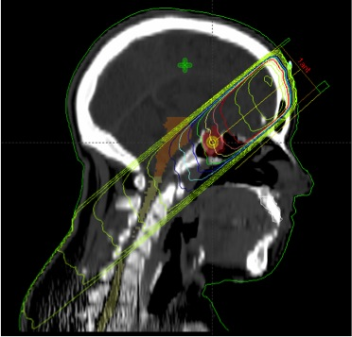
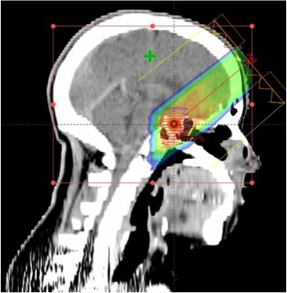
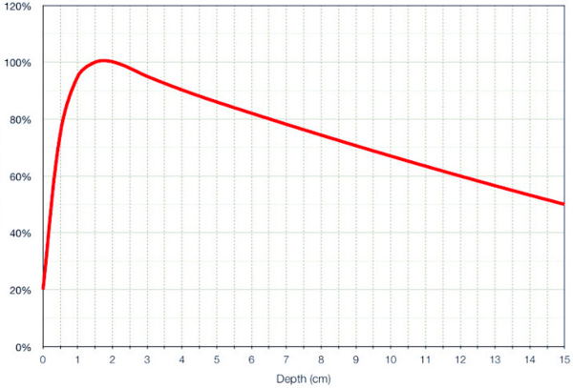
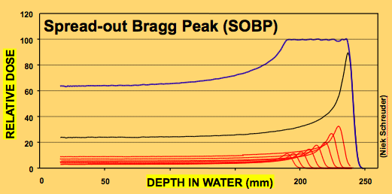
Clinics : ex Photons vs protons (1 beam) physics advantages
neutrons
Skin dose
Lateral penumbra
Range uncertainty
… and limits
(just the
physical ones)
10
Software: Varian´s Eclipse // Beam Data : IBA // Calcs : I.Curie
0
100

Slide 11

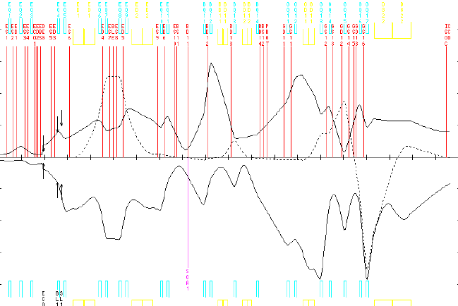
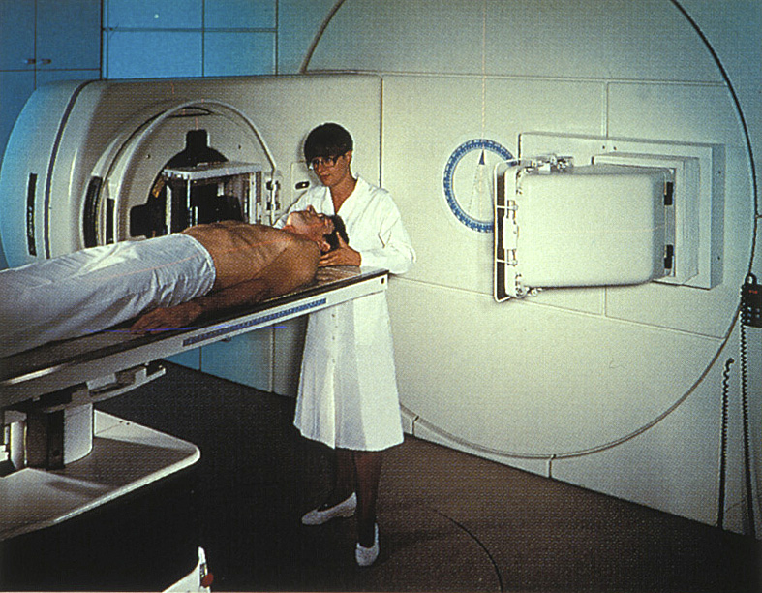
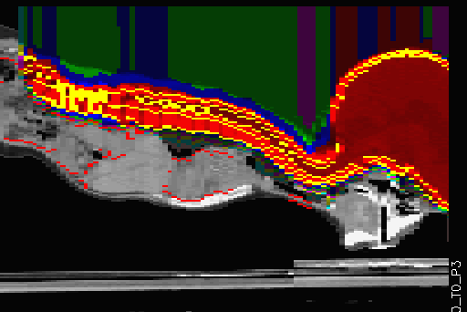
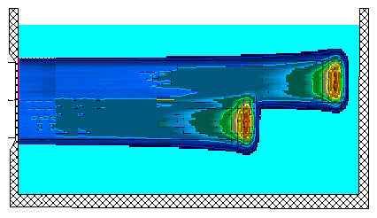
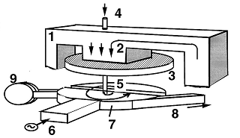
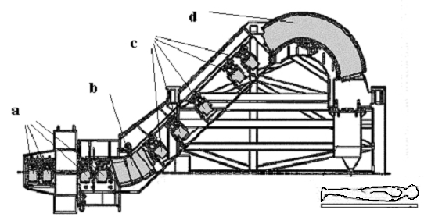
(Hadrontherapy for the physicist) :
Physical “frame” to optimize the physics of hadrontherapy (some examples) :
Accelerators
Beam transport
and delivery
q.v.B = mv²/r
Shieding
& traitement
Measurements/detectors
Models/calcs & simulations
(dE/dx)= 4 π z_{eff}² e⁴ N_{A}Z/A m_{e}v² { ln (2mv²/ Ι (1-β²)) - β ² - Σ(Ci/Z) } Stopping Power
θ ₀ = 14.1 z / p v { sqrt ( L / L_{R}) ( 1+ log(L /L_{R} ) / 9 ) } Scattering angle

Slide 12
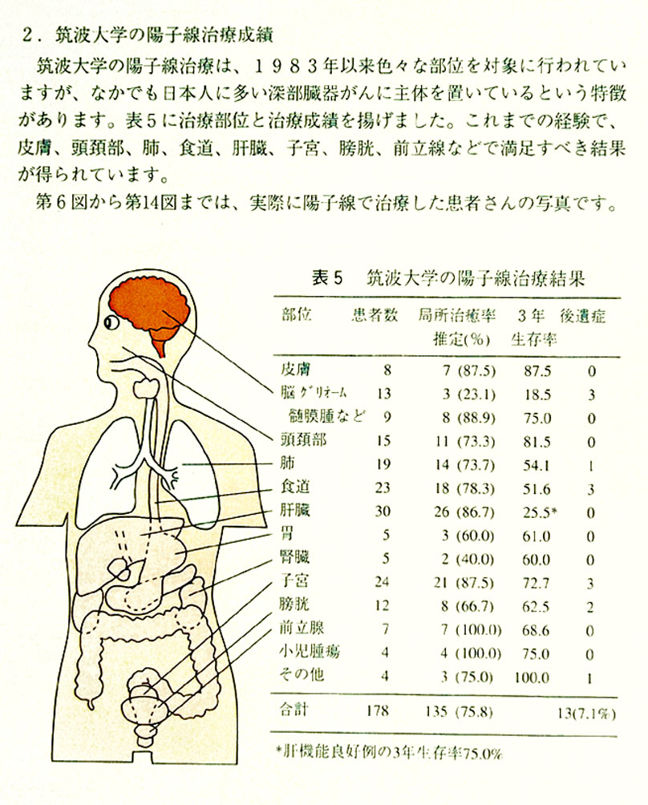
« Hadrontherapy » for the physician
(WHAT?)

Slide 13
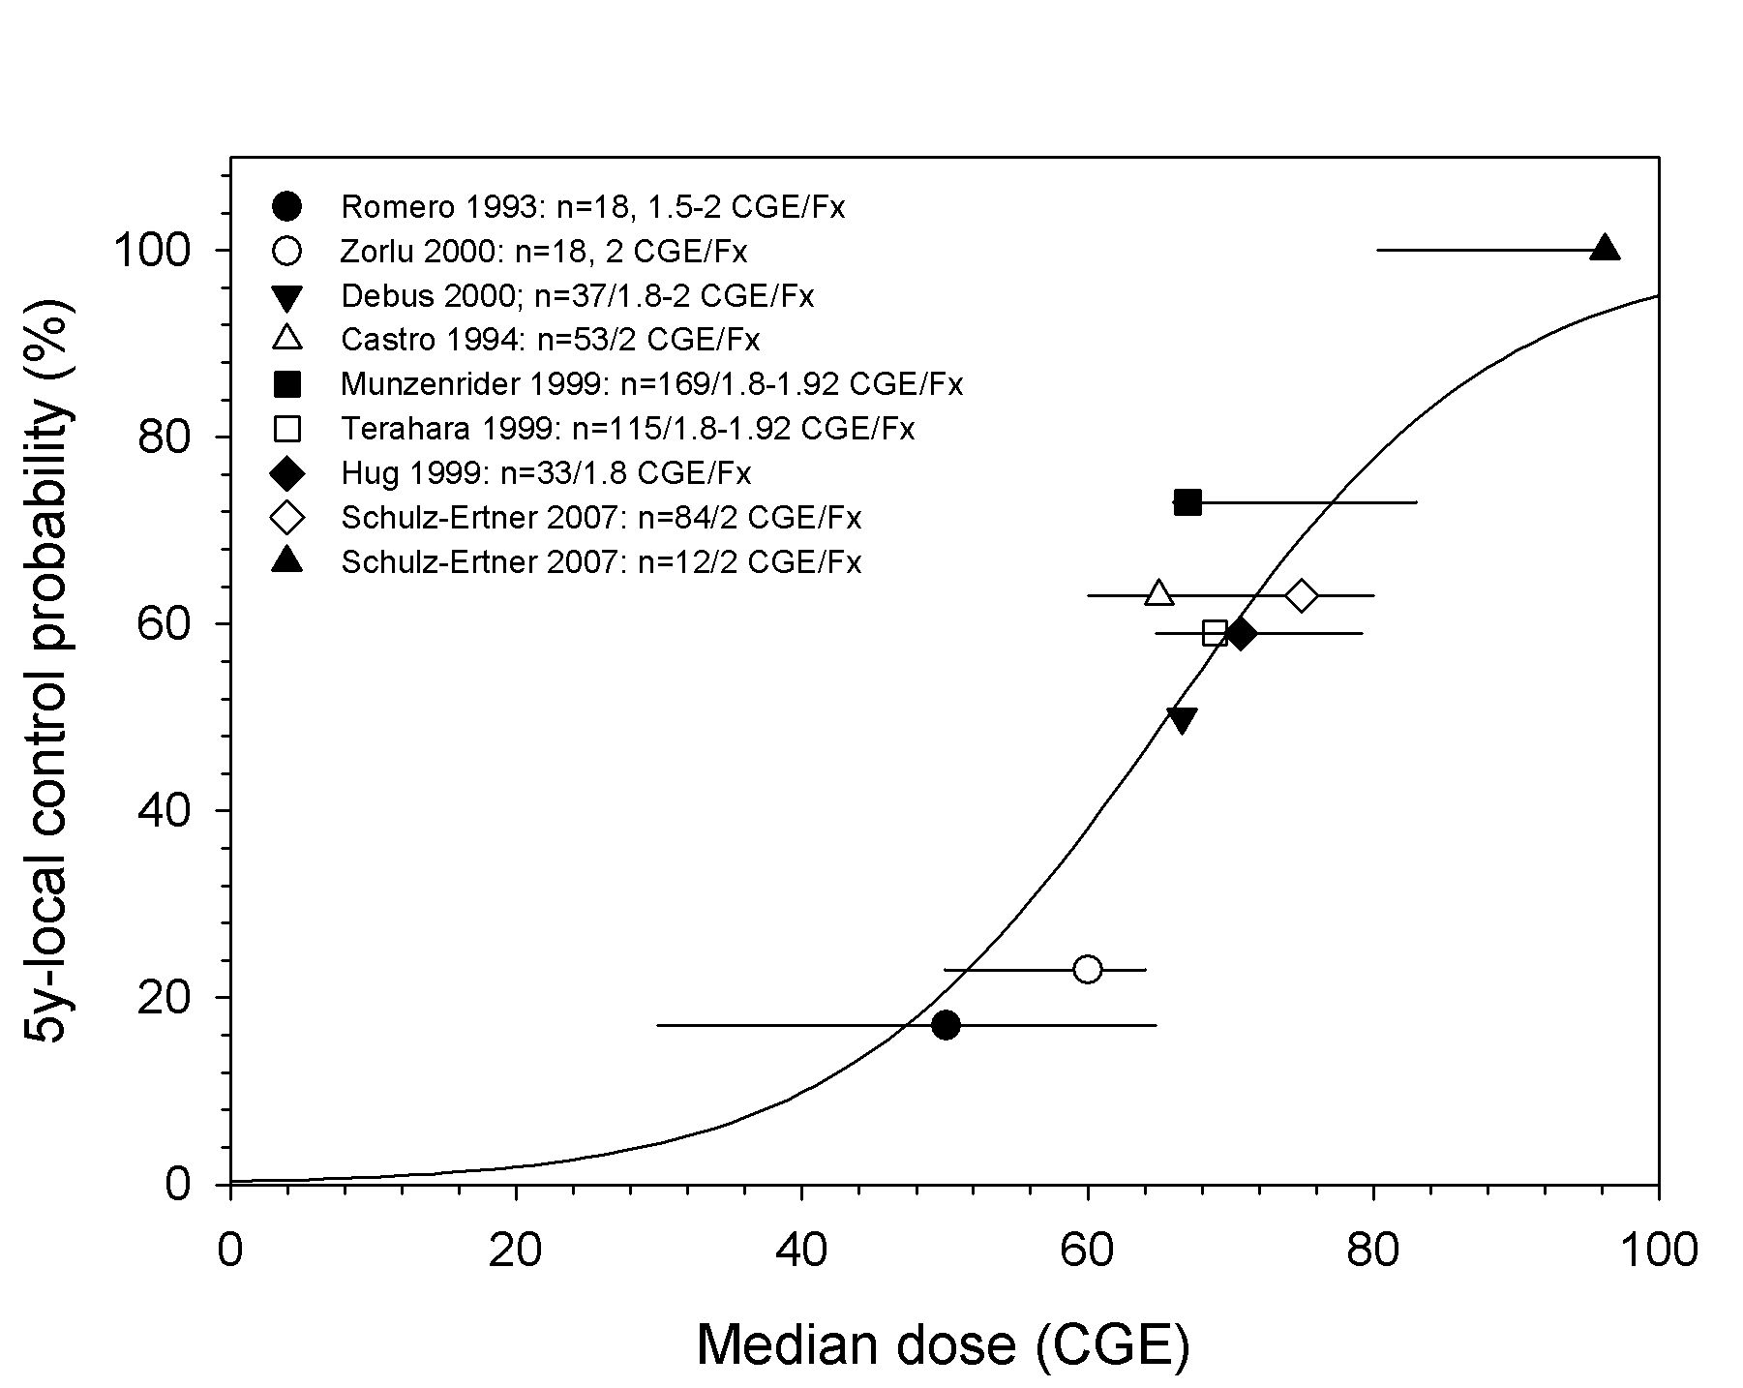
Dose-effect-relationship
Shulz-Ertner, IJROBP, 2007
A common goal :
C-Ions
Protons
Conventional RT
Schulz-Ertner, IJROBP 2007
Notes:
Fig. 21 : Curva sigmoidea de control local de sarcomas de la base del cráneo, con resultados experimentales en función del tiempo (1993-2007), de la dosis y del tipo de partículas (Shulz-Ertner, IJRBP, 2007).

Slide 14
Always asking for more ?
Higher Z (all ions inc radioactive)
Higher energy (radiography)
Higher intensity (dose rate)
…..
Welll… also to reduce !:
Reduce cost (size, iron, shielding,…)
Reduce uncertainties
…..

Slide 15
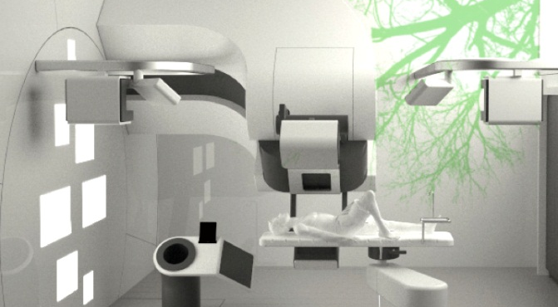
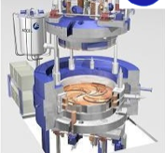
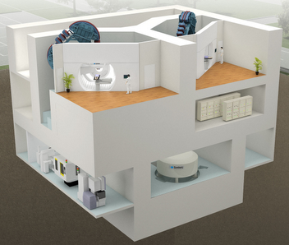
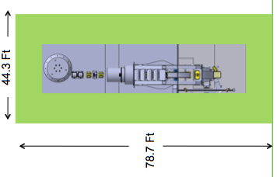
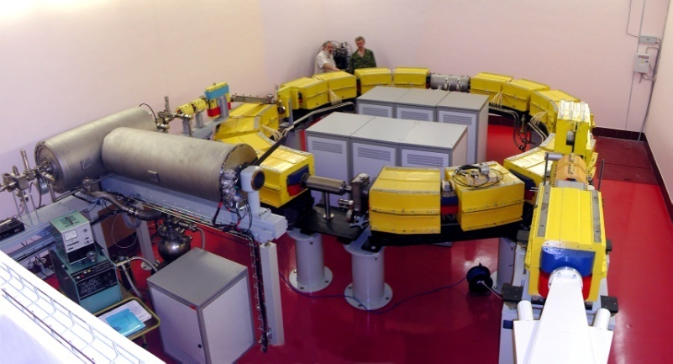
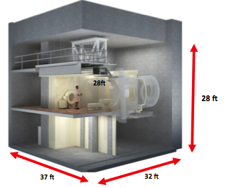
Some alternatives to make it compact and cheaper
Cyclotrons
IBA
“State of the art” in protons ?
(and HIT, NIRS, Pavia, MedAustron.. In Carbon)
Cryogenic
(Varian, Pronova,..)
2 levels (Sumitomo,…)
SynchroCyclotrons
Mevion
Synchrotrons
Compact synchrotron (Protom)
+ Hitachi, Mitsubishi, Toshiba,…

Slide 16
Number of treatment rooms in the world :
scatter and scanned
Clinical experience
with follow-up
M. Jermann, M. Schippers & A. Mazal PTCOG, 2015

Slide 17
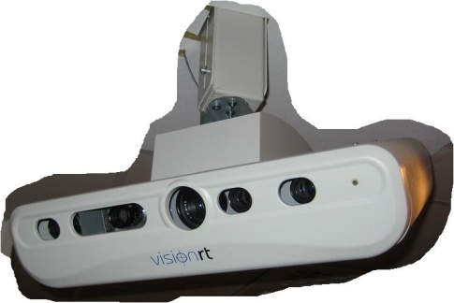
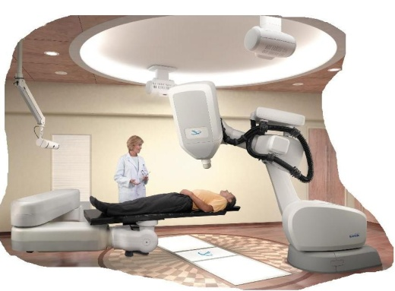
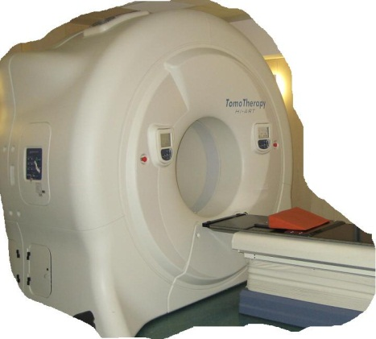
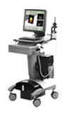
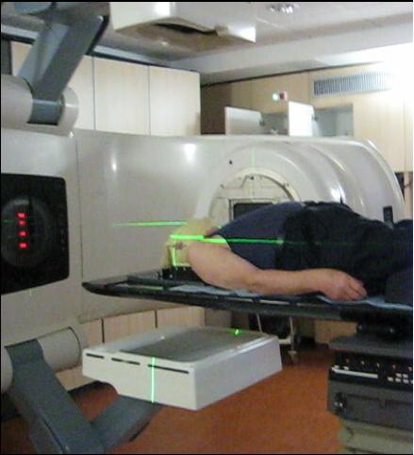
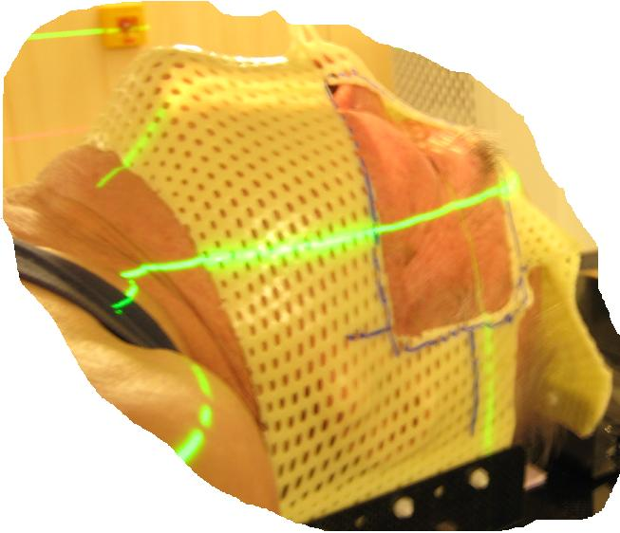
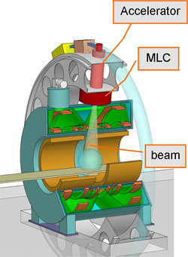
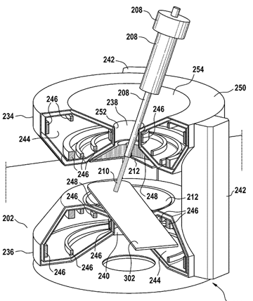
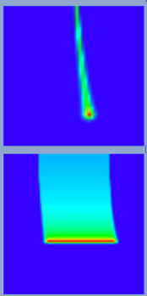
IGRT
kV&Fluo/gantry
Video
Surface
Vision/
Laser
Echo
kV&fluo fixed
MVPortal
& CBCT
MVCT
Linac+ IRM : www.umcutrecht.nl
Protons + IRM
Patent Overweg Philips
Raaymakers et al,
AAPM, 2014

Slide 18








Knife-edge slit camera
Positron Emission Tomography from patient activation with the beam
W. Enghardt et al
Prompt Gamma
D.Prieels, F.Roellinghoff,…..
Notes:
Fig.13 : Sistemas de verificación del rango de partículas cargadas pesadas usando PET y gamma promts generados por interacciones nucleares del haz con los tejidos

Slide 19


« Instead of using positron emission, could we use prompt γ ? » Y. Jongen (2001)
Time frame : 15 years !
(even more for scanning…)
Courtesy John Wong Kim (AAPM 2009)
D. Prieels, F. Stichelbaut, F. Roellinghoff et al, IBA et ENVISION

Slide 20
 | Classes of uncertainties | Class max Uncert | Eliminate / Mitigate / Take in charge | Square
 | PATIENT PREPARATION AND IMAGING | [mm] |  | [mm2]
1 | Patient immobilisation & contention devices | 10 | Minimise & Homogeneous material in beam path | 100
2 | CT calibration, QA, use and constancy | 5 | Methods, frequency, evaluation,… | 25
3 | CT conversion Hounsfield to Stopping power | 10 | Stoichiometric, analytical, data base, double Energy CT,… | 100
4 | CT grid size | 5 | Tests, compromises | 25
5 | CT artifacts (eg metals) | 10 | Acquisition parameters, MVCT, Double Energy CT, others… | 100
6 | Protocols for image acquisition | 5 | Conceive, Compromises, Verify use, human error, evolut | 25
7 | Movement management, breath holding, gating,… | 30 | 4D CT, breath holding, gating, (tracking), repainting,… | 900
8 | Patient imaging and correlations for tumor volume delineation | 10 | Image & correlation QA | 100
9 | Target & critical organs delineation | 30 | MD experience & goals, protocols, procedures, tools | 900
 | TECHNOLOGY: DEVICES & MEASUREMENTS
10 | Facility Commissioning (eg beam data) | 5 | Detectors, redundancies, small tolerances, interlocks | 25
11 | Beam on line range monitoring and feedback | 5 | Detectors, fast feedback and/or interlocks | 25
12 | Measuring errors : devices, procedures, human errors | 5 | Detectors, check lists, automatic tools and filters | 25
 | CALCULATIONS IN THE PREPARATION PHASE
13 | Range calculation algorithms | 5 | Improve & validate algorithm; comparisons and tests; | 25
14 | Compensator calculation, optimisation, fabrication, validation | 5 | Improve algorithm; Quality Control, smearing, drill size, | 25
15 | Dose calculation models (including multiple scattering and biological effects) | 10 | Improve algorithm; Quality Control, compensate, reoptimise,… | 100
16 | Management of Inhomogeneities (lung, metals, …) | 10 | Improve algorithms; tests, avoid incidences, reject cases,... | 100
17 | Accessories in beam path (eg table, masks, …) | 10 | Avoid or Verify, measure, model, test,… | 100
 | TRANSFER AND TREATMENT
18 | Patient specific QA on range | 5 | Detectors, redundancies,tolerances, stats, models | 25
19 | Accessories in beam path (eg table, masks, …) | 10 | Avoid or verify | 100
20 | Patient setup | 5 | Immobilise, margins, IGRT (CBCT, orthogonal X, vision, …) | 25
21 | Management of movements | 30 | Immobilise, margins, gate, track, repaint, monitor range | 900
22 | Changes in anatomy | 30 | in room - off room imaging, monitor range | 900
23 | Beam modifiers choice (compensator and others) | 30 | Check lists, test, interlocks, imaging, monitor range | 900
24 | Beam modifiers setup (compensator and others) | 10 | Fixations, verification, monitor range | 100
25 | Beam delivery (pattern, position, interruptions,…) | 10 | Monitoring, testing | 100
26 | Delivered Range (abs value, reproducibility,…) | 5 | QA, monitor range | 25
 | Sum[mm] | 305 | SqrtS[mm] | 76

Slide 21
MDA,LL,UPen
MGH
U Florida
Dotted lines: typically applied range uncertainty margins in proton therapy treatment planning as currently typically applied at the MGH (3.5% + 1 mm), the MD Anderson Proton Therapy Center in Houston, the Loma Linda University Medical Center and the Roberts Proton Therapy Center at the University of Pennsylvania (3.5% + 3 mm) and the University of Florida Proton Therapy Institute (2.5% + 1.5 mm). Note that these centers may apply bigger margins in specific treatment scenarios.
Dashed line: estimated uncertainty without the use of Monte Carlo dose calculation. Solid line: estimated uncertainty for complex geometries without the use of Monte Carlo dose calculation. Dashed-dotted line: estimated uncertainty with the use of Monte Carlo dose calculation.
H.Paganetti , PMB 57 (2012) R99-R117 & personal comm

Slide 22
Robust IMPT
IMPT
ROBUST
OPTIMISATION
Liu, Zhang and Mohan, 2012

Slide 23










IMRT and proton pencil beams in adaptive workflow
Planning Imaging
Treatment Planning
Patient QA
Electronic Prescription
?
In-off room /
iso or off iso
Imaging
Image Registration
and patient setup
Treatment
Assessment
Treatment
Delivery
Fast on line QA/
Range verification
On line
QA
Next day(s)
When needed
Adapt Treatment
G.Olivera/ D.Galmarini / A.Mazal

Slide 24



Proton MiniBeam Radiation Therapy (pMBRT)
Theoretical concept :
Y. Prezado et al., Med. Phys. 2013
Experimental beam :
CPO Mai-Juin 2014
Spatial distribution
PBS : without collimators,
High peak-valley ratio, no neutrons
Possibility to modulate intensity…
From synchrotron irradiation
(France Hadron)

Slide 25







Painting target volumes injected with nanoparticles ?
Phase I : NBTXR3 + 50 Gy Rx
More efficient with C⁶⁺
Sandrine LACOMBE
18%
33%
Erika PORCEL
ASCO, 2014
http://www.nanobiotix.com/news/release/
Porcel et al, 2010, 2014
Jong-Ki Kim et al // for protons 2012
From irradiations with photons

Slide 26







“FLASH –Effect” Ultrahigh dose-rate FLASH irradiation
Favaudon et al, Sci Transl Med 16 July 2014
Same T control
C
Less fibrosis
Vincent
Favaudon
F
no
days
“W-Effect”: Early cell response to split-dose irradiation
Ponette et al. (2000) Int J Radiat Biol 76: 1233-43 - Fernet et al. Int J Radiat Biol 76: 1621-29
From irradiations
with electrons

Slide 27
Which research with light ions for therapy ?
(and what to do in a research line?)
WORK IN PROGRESS
Thanks to :
G.SantaCruz, K.Parodi, D.Auvergne, F.Pouzoulet (building a table…)
D.Verellen, T.Lomax, T.Bortfeld (personal exchanges future of Medical Physics)
…..

Slide 28
>60 lines not exhaustive and still not “filtered”
Some presented in the previous slides…

Slide 29
CERN : “Accelerators, Detectors, Computers”
Medpix Chips
Fluka Monte Carlo
Medical molecular Imaging & Nuclear Medecine
Radioisotopes
OpenMed BioLeir
But today when users talk about
“Clinical, Biology, Medical Physics, Industry…”
Animals
Cells
State of the art of Industrial solutions
State of the art of other research institutions
Clinical data, trials and research
Health Economy and world status

Slide 30

2012
11250 Linacs
2271 Cobalt -60

Slide 31

11250 Linacs
2271 Cobalt -60
120+80 rooms
From Bill Chu, PTCOG 50, USA

Slide 32
Physics in hadrontherapy:
From photons to Pan-omics,
through biology for clinics,
and $pecific challenge$
THANK YOU !
2nd CERN brainstorming meeting
Divonne, 20th February 2016

Slide 33

Desarrollo de brazos isocéntricos más compactos
(y baratos)

Slide 34

TULIP at 3 GHz with E₀ = 30 MV/m
present technology : 30 MV/m
SM1
4.2 m
11 m
SM1
24 MeV
axis
scanned area:
25x25 cm²
Courtoisie : Amaldi et al

Slide 35


Beam Delivery : 3D Pencil Beam Scanning
Target
Narrow pencil beam
Magnets
Range shifted by changing beam energy (or absorbers)

