Slide 1

Development of a DC/DC converter for low voltage power distribution in LHC upgrades.
Stefano Michelis
Supervisor: Federico Faccio

Slide 2
Who I am
2004, September I obtained the Bachelor in Telecommunications Engineering at Polytechnic of Turin
2006, March, I started a stage contract at CERN
2006, September, I obtained the Master in Electronic Engineering at EPFL in Lausanne, Polytechnic of Turin and INPG Grenoble.
2006, November, I started the Marie Curie Early Stage Training fellow at CERN
2007, March, I started my PhD studies at EPFL in Lausanne

Slide 3
Outline
Power distribution in the trackers
  In LHC trackers
  Projection to SLHC
Use of DC-DC converters
  Advantages
  Main challenges
Attended courses and conferences

Slide 4
Distributing power
No on-detector conversion. Low-voltage (2.5-5V) required by electronics provided directly from off-detector. Sense wire necessary for PS to provide correct voltage to electronics.
Patch Panels (passive connectors ensuring current path between different cables. Regulation is very seldom used)
PS
Current path from PS to module (or more seldom star of modules) and return. Cables get thinner approaching the collision point to be compatible with material budget.

Slide 5
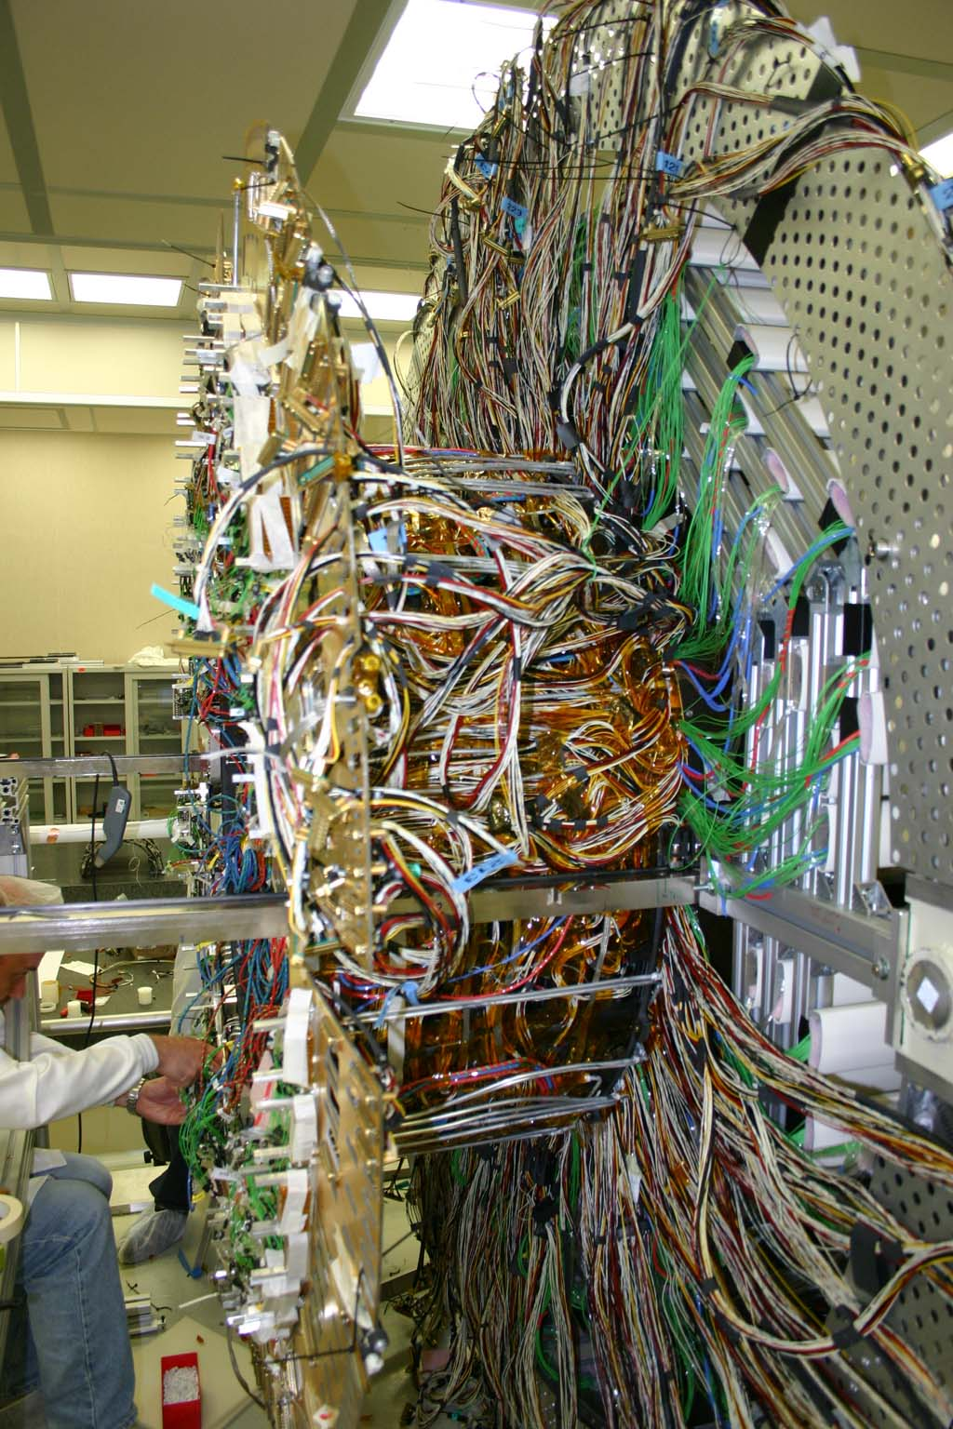
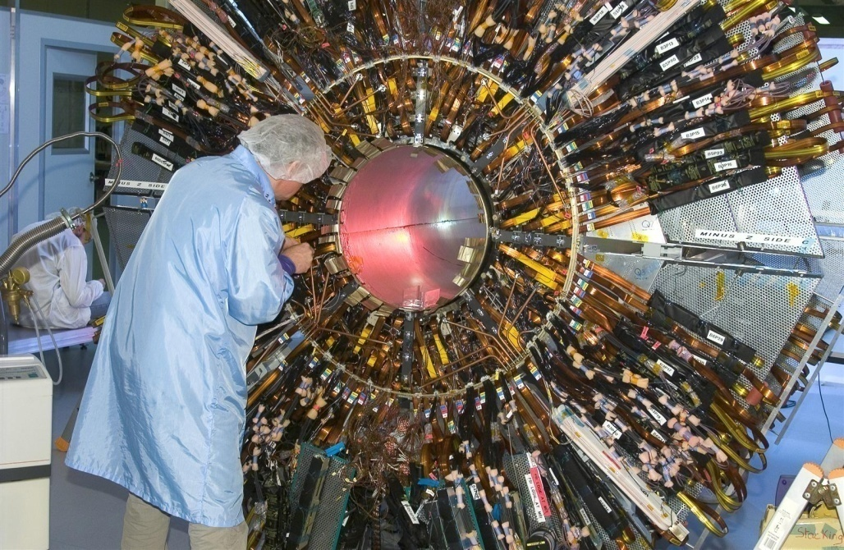
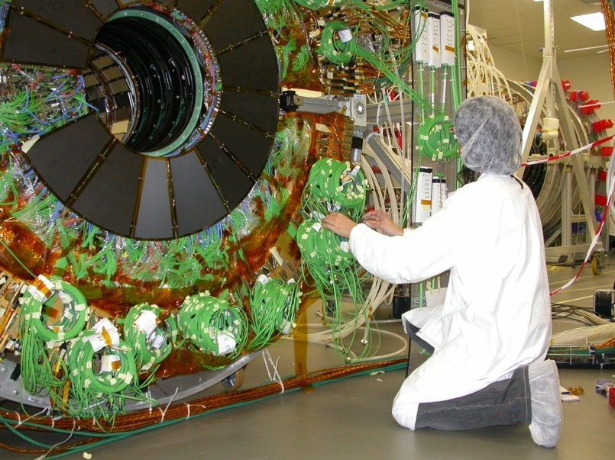
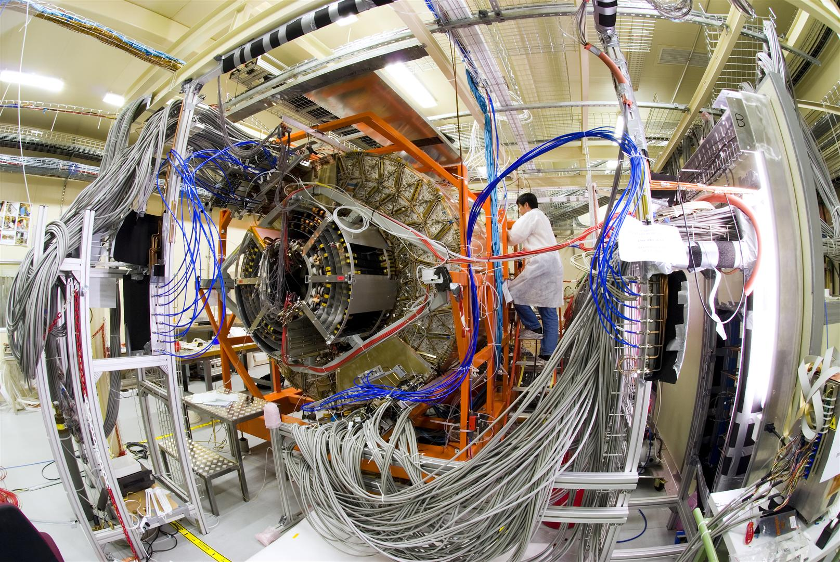
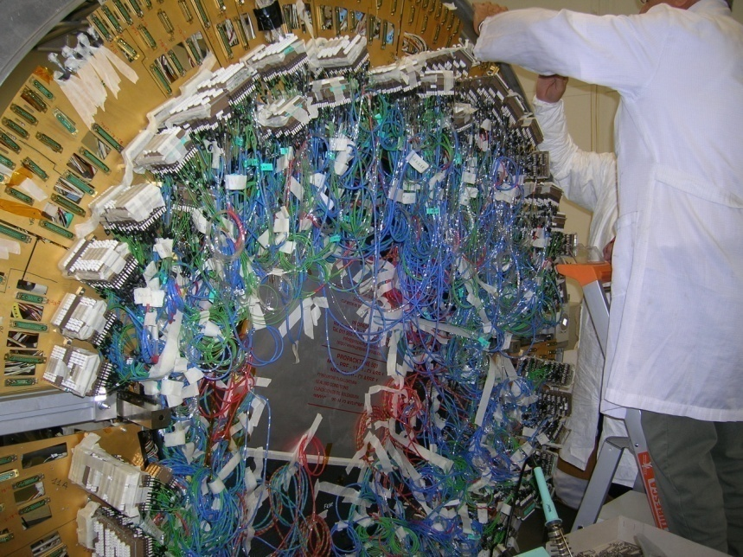
Distributing power

Slide 6
SLHC scenario
SLHC trackers: 10x more channels
  Impossible to linearly extrapolate the present scheme, this would result in much more material (cooling and/or cables)
Need to work on two aspects:
  Minimize power required by electronics
  Decrease the current to be brought to the tracker in order to limit the power lost on cables (RI²)

Slide 7
Outline
Power distribution in the trackers
  In LHC trackers
  Projection to SLHC
Use of DC-DC converters
  Advantages
  Main challenges
Attended courses and conferences

Slide 8
Advantages in using DC-DC converters in SLHC
10xV, I
DC-DC
V, 10xI
Advantages:
Decrease of the current
Minimize the power used by the electronics
Local voltage regulation
Modularity

Slide 9
Challenges
Converters to be placed inside the tracker volume
Magnetic field (up to 4T)
Radiation field (>10Mrd)
Environment sensitive to noise (EMI)
That’s why we need an R&D

Slide 10
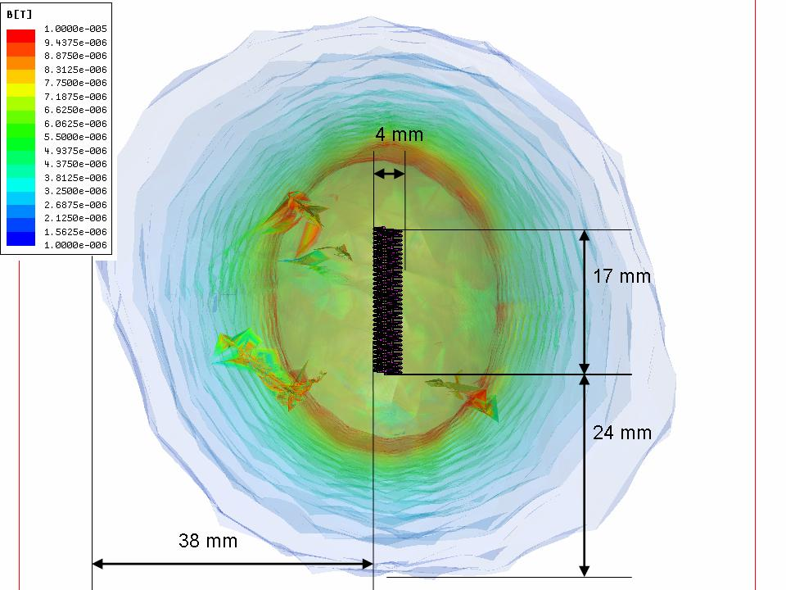
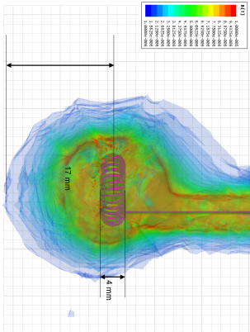
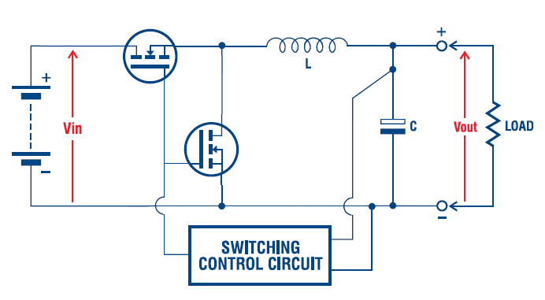
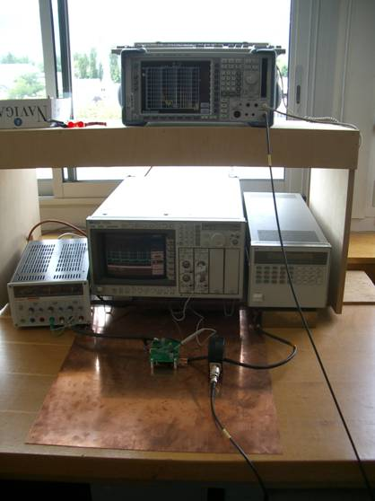
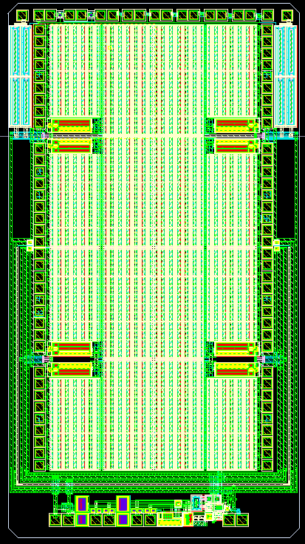
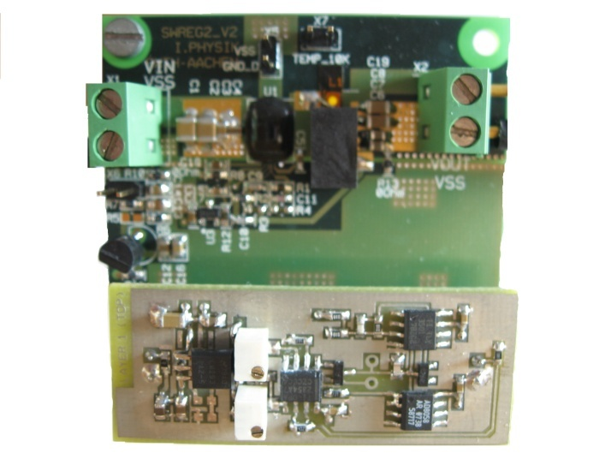
DC-DC converter: issues
Power dissipation
Inductor
Vin=25 V
Vout=2.5V
Iout=2A
Scale 1-10uT
GND_D
GND_D
D2
IND
Switching noise
Rad-hard technology
4.5mm
S2
Controller architecture
2.5mm
Vdd
Vss
V_{REF}
V_{RAMP}
VI
VF
BTSTR
SUB

Slide 11
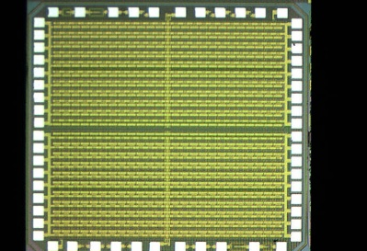
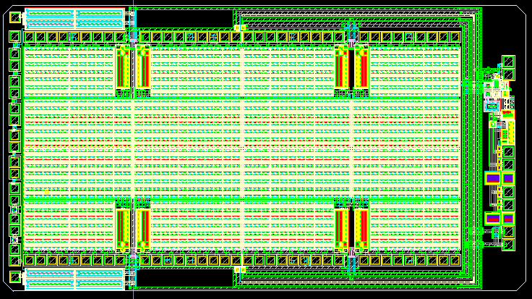
Design for radiation tolerance
The converter requires the use of a technology able to work up to at least 15-20V
High-voltage technologies are typically tailored for automotive applications
Integration of the two switches in 2007
First functional prototype designed and tested in 2008
New design will be submitted on December 1st

Slide 12
Outline
Power distribution in the trackers
  In LHC trackers
  Projection to SLHC
Use of DC-DC converters
  Advantages
  Main challenges
Attended courses and conferences

Slide 13
Conferences
Conferences with presentation / poster / papers
  TWEPP (Topical Workshop on Electronics for Particle Physics) 2007, Prague
  S. Michelis et al. “Inductor based switching DC-DC converter for low voltage power distribution in SLHC,” TWEPP conference, Prague, 2007
  IEEE NEWCAS-TAISA, Montreal
  S. Michelis et al. “Air core inductors study for DC/DC power supply in harsh radiation environment” IEEE NEWCAS-TAISA conference, Montreal, 2008
  S. Michelis et al. “Feedback loop conception methodology for step-down continuous switching DC/DC converter” IEEE NEWCAS-TAISA conference, Montreal, 2008
  TWEPP 2008, Naxos
  S. Michelis et al. “Custom DC-DC converters for distributing power in SLHC trackers”, TWEPP 2008 conference, September 2008
  S. Michelis et al. “Noise Susceptibility Measurements of Front-End Electronics Systems”, TWEPP 2008 conference, September 2008
  S. Michelis et al. “Characterization of the noise properties of DC to DC converters for the sLHC”, TWEPP 2008 conference, September 2008
  S. Michelis et al. “A prototype ASIC buck converter for LHC upgrades ”, TWEPP 2008 conference, September 2008
Other attended conferences
PESC (Power Electronics Specialists Conference) 07, Orlando
PESC (Power Electronics Specialists Conference) 08, Rhodos

Slide 14
Courses and tutorials
I am actually enrolled as PhD student at EPFL in Lausanne, Switzerland under the supervision of Prof. Maher Kayal
Attended courses in Lausanne
LOW-POWER, LOW-VOLTAGE ANALOG IC DESIGN, June 2007 MEAD-EPFL, Lausanne, Switzerland
TRANSISTOR-LEVEL ANALOG IC DESIGN, June 2007 MEAD-EPFL, Lausanne, Switzerland
ADVANCED ANALOG IC DESIGN, August 2007 MEAD- EPFL, Lausanne, Switzerland
POWER MANAGEMENT, September 2007 MEAD-EPFL, Lausanne, Switzerland
DESIGN FOR HOSTILE ENVIRONMENT AUTOMOTIVE AND INDUSTRIAL September 2007 MEAD-EPFL, Lausanne, Switzerland
CMOS PRACTICAL ASPECTS IN MIXED-SIGNAL Ics, August 2007 MEAD- EPFL, Lausanne, Switzerland
Other attended courses and tutorials
POWER DESIGN TECHNICAL COURSE 2007, National semiconductor, Zurich.
POWER ELECTRONIC CONVERTERS FOR DISTRIBUTED GENERATION, Tutorial PESC 07
GLOBAL STABILITY METHODOLOGY FOR SWITCHING POWER CONVERTERS, Tutorial PESC 07
ROBUST ASIC DESIGNS FOR HOSTILE ENVIRONMENTS, Tutorial TWEPP 07
DESIGNING CIRCUIT BOARDS NOT TO FAIL, Tutorial TWEPP 08
PREDICTIVE CONTROL IN POWER ELECTRONICS AND DRIVES, Tutorial PESC 08
CONTROLLING CONDUCTED AND RADIATED EMI ISSUES IN POWER ELECTRONICS DESIGN, Tutorial PESC 08
EMI OF CONVERTERS, AEMC Course, Paris 2008

