Slide 1
DATA ACCESS and DATA MANAGEMENT
CHALLENGES in CMS

Slide 2
Challenges
CMS produces ~20PB of raw and derived data per year
  An average replication factor of ~3
70 Computing sites that are globally distributed
How to deliver samples to 150k processor cores as directed by the experiment centrally and thousands of scientists

Slide 3
Network
The network capacity itself is keeping pace (just barely) due to the availability of 100Gb/s links
  However we have a factor of 100 between are best and worst connected sites
  Our ability to drive the network efficiently is still an issue, we use a lot of hardware to fill the pipes

Slide 4
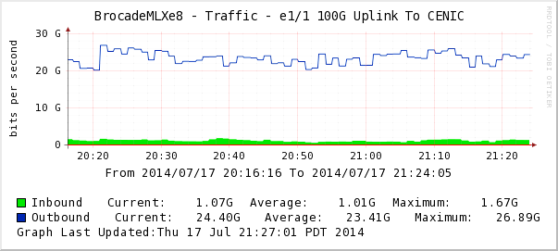
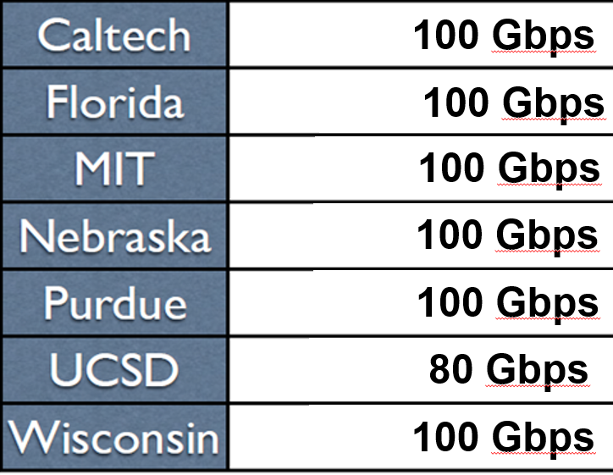
Transfer Rates: Caltech Tier2 to Europe July 2014
One Day after commissioning the 1st 100G TA research link
Upload rate: 27 Gbps; 20Gbps to CNAF (Italy) Alone
By Spring 2015: 12 – 40 Gbps Downloads were Routine
to US CMS Tier2 Sites with 100G Links
Downloading Terabyte Datasets to Tier3s desktop/laptops is being explored
US CMS university based Tier2s have moved to ~100G now routine
Harvey Newman
The move to 100G is timely and matches current needs, also at Tier2s.
Backbones should continue to advance to meet the needs during Run2.
30

Slide 5

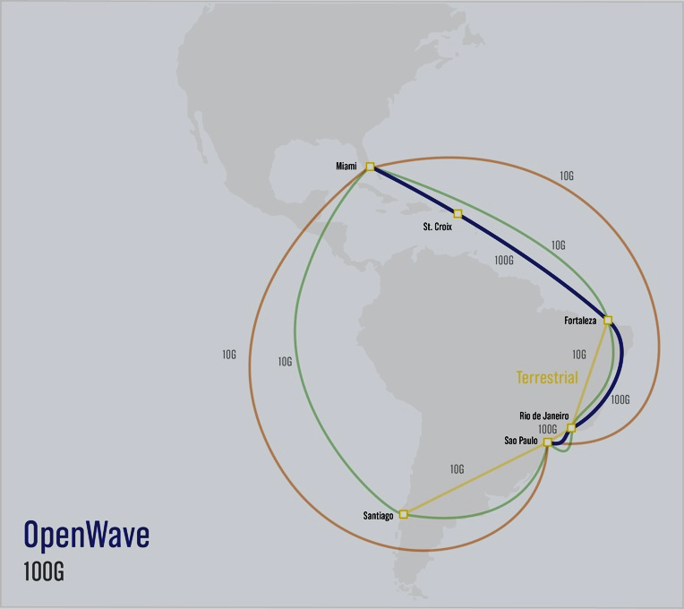
OpenWave: First 100G Link to Latin America in 2015. Connecting LSST
AmLight (US NSF) with RNP, ANSP
An “Alien Wave” at 100G
on the Undersea Cable
Precedent-setting access
to the frequency spectrum
by the academic community
Sao Paulo-Rio-Fortaleza
-St. Croix-Miami backbone
Scheduled to start soon
100G extensions by RNP in Rio and ANSP in Sao Paulo
Will be extended to Chile
at 100G then N X 100G
Will be heavily used
by LSST into the 2030s
Total Capacity for Next Two Years: 140G
10G
10G
100G
10G
10G
10G
Harvey Newman
February 2015
Using Padtec (BR) 100G equipment. Demonstrations
with the HEP team (Caltech et al) at SC2013 and 2014
J. Ibarra, AmLight

Slide 6
Coupling and Decoupling Services
We have spent the last several years trying to allow the processing and storage services to be more independent
  Disk is expensive and normally has move IO capability than the amount of local processing services
  Before this there was a lot of worry about the balance of CPU and storage
    CPU can be scheduled more dynamically
    CPU can be used opportunistically

Slide 7
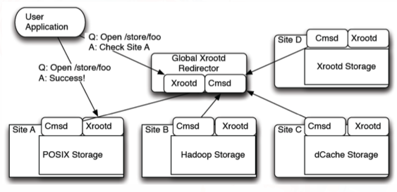
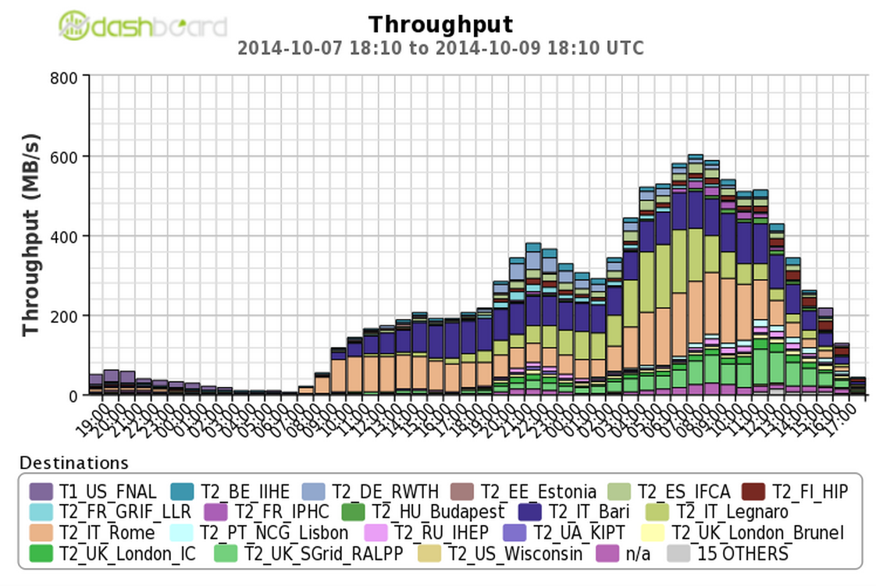
Data Federation in Run II
Any Data Anytime Anywhere has been a primary focus area
  We validated small scale use of non-local data access in the summer
    Fall-back when analysis jobs do not find data
    Very good feedback by users
  After summer scale tests were performed in Europe and the US
    20% of jobs were able to access data over the wide area (60k files/day, O(100TB)/day)
  Production system for Run2 enabling
    Interactive access
    Fail over protection
    The ability to share production workflows

Slide 8
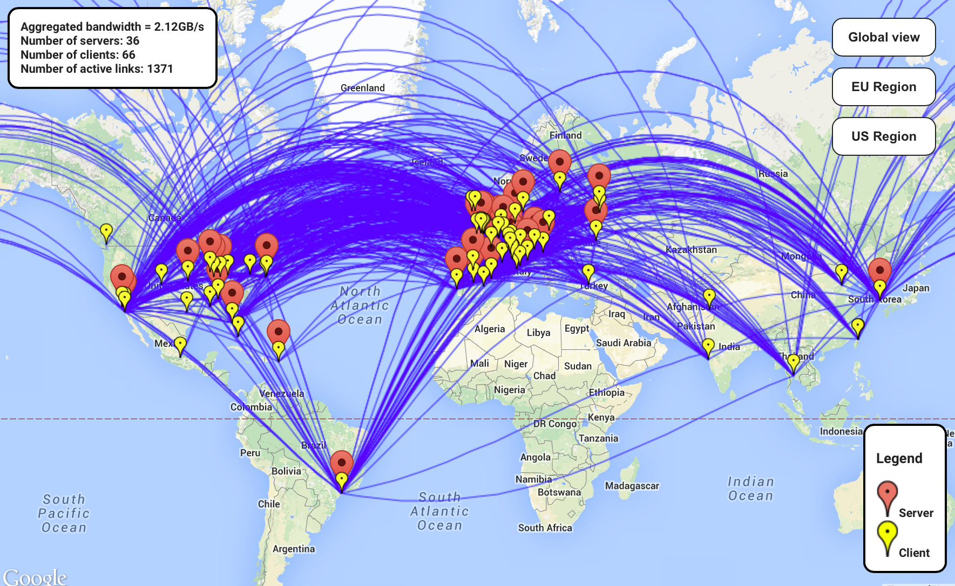
Successes in Connectivity
xxx
Aggregate bandwidth > 2GB/s
CMS
Each site has delivered PBs over the last year

Slide 9
Integration of network and storage
Data Federation is not a content delivery network (CDN)
  It has only basic network awareness
  Integration of more intelligent caching and intermediate storage
We see interesting opportunities in development of advanced data management that begins to close the gap between data federation and CDN
  End goal would be to care a lot less about the actual location of the data
Looking forward we would like to investigate Named Data Networks where more of the data management is integrated with the network itself

