Slide 1
Java
Luis Rodríguez Fernández
Notes:
<number>

Slide 2
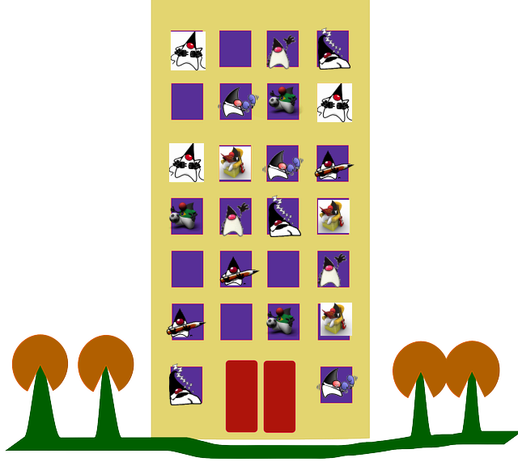
Oracle Weblogic 12.2.1 Beta Program
12.2.1 version is focus on multitenancy.
  Tenant (Merriam-Webster): one who rents or leases (as a house) from a landlord.
  Multitenancy: mode of operation of software where multiple independent instances of one or multiple applications operate in a shared environment. The instances (tenants) are logically isolated, but physically integrated.
<number>

Slide 3
Oracle Weblogic 12.2.1 Beta Program
Current setup
New setup
JVM
JVM
JVM
2-3x density
gain
PART
PART
APP1
APP2
APP1
APP2
PART
PART
APP3
APP4
JVM
JVM
PART
PART
APP3
APP4
APP5
APP6
PART
PART
APP7
APP8
<number>

Slide 4

Oracle Weblogic 12.2.1 Beta Program
Improve operational efficiency?
  Yes – Resource group cluster migration
Improve resource efficiency?
  Yes – Partitions. Resource limitations
Enable cloud architectures?
  Yes – RESTful management APIs
Improve responsiveness?
  Yes – Fast provisioning/Better fault detection
<number>

Slide 5


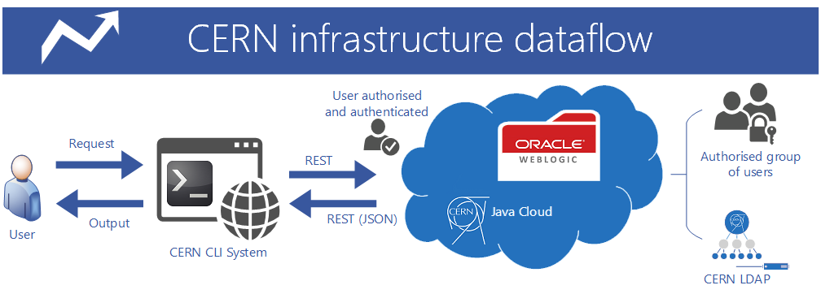
Outreach
Oracle Open World:
  Presentation: Oracle Weblogic Server 12.2.1 Multitenancy: Efficiency, Agility, and Lower Cost [CON8630] Artur Wiecek (CERN) & David Cabelus (Oracle)
  Interview: Artur Wiecek
Oracle Scene Magazine:
  Oracle APEX in the CERN Java Cloud (Spring 15 | Issue 56)
  CERN develops a new WebLogic Command Line Interface tool for CERN Java Middleware Services (first edition of 2016)
<number>

Slide 6

Next steps
Help the developer community to make their applications “cloud-ready”
Explore the Oracle Public Cloud
Multi-tenancy improvements:
  Export/Import applications (partitions)
  RESTful for 12.2.1
Investigate Maximum Availability Architectures
  Load Balancing (Oracle Traffic Director)
Oracle Enterprise Manager PaaS capabilities
12.2.1 is JAVA EE 7 fully compatible
<number>

Slide 7
Virtualization
Antonio Nappi(September 2015)
Notes:
<number>

Slide 8
Integration tests
Oracle Openstack Deployment
  Openstack Icehouse Release.
  Controller Node with CentOS 7.
  Compute Nodes with Oracle VM.
  KVM and XEN as Hypervisors:
    Un-solved network problems with XEN.
  Compatibility issues: current Oracle Openstack is linked to Openstack Icehouse release (April 2014), CERN Openstack is based on Kilo release (April 2015).
<number>

Slide 9
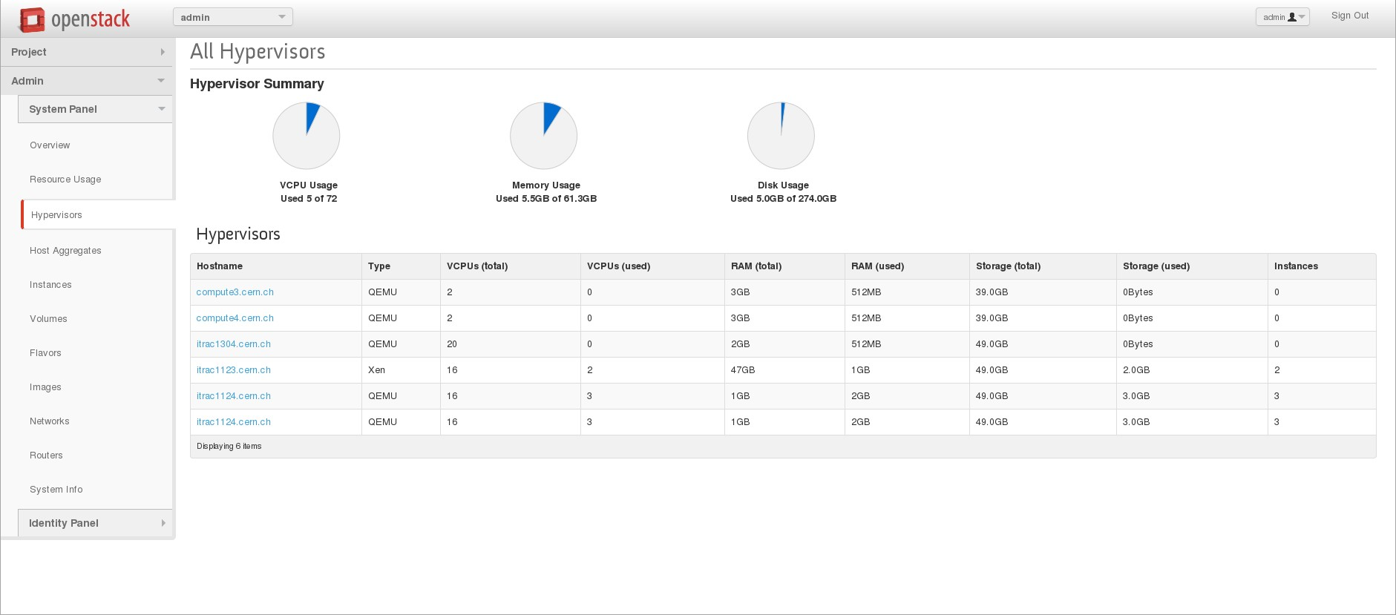
<number>
Notes:
<number>
<number>

Slide 10
Next steps
Goals:
  Test new Oracle VM beta version (new UEK based on Linux 4).
  Test new Oracle OpenStack release (based on OpenStack Kilo release.
  Integration of Compute Nodes(Oracle VM) with new Oracle OpenStack Release in OpenStack CERN deployment.
<number>

Slide 11
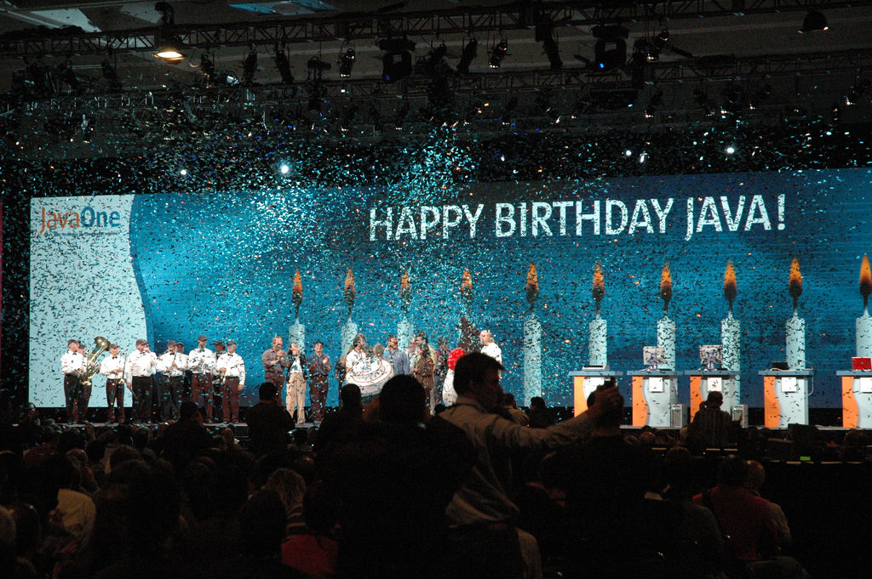
Questions?
<number>

Slide 12

Resources
Weblogic 12.2.1 download: Oracle Technology Network
What's new in Oracle Weblogic Server 12.2.1
Domain Partitions for Multi-tenancy in WebLogic Server 12.2.1
Oracle Weblogic Server 12.2.1 Multitenancy: Efficiency, Agility, and Lower Cost [CON8630]
Artur Wiecek OOW interview, coming soon!
Oracle APEX in the CERN Java Cloud (Oracle Scene magazine)
Weblogic Client project on github.com
Trouble-Maker (performace issues samples) on github.com
Oracle Cloud (Java)
Databases at CERN blog
<number>

Slide 13

Images
Building: pixabay.com
All Duke images: Duke images project
JVM consolidation diagram taken from Oracle Weblogic Server 12.2.1 Multitenancy: Efficiency, Agility, and Lower Cost [CON8630]
“You rock, you rule”: James Sanden web site
Oracle Open World logo: Oracle Open World web site
Oracle Scene logo: UK Oracle User Group site
CERN Weblogic Command Line diagram courtesy of Konrad Aleksander Kaczkowski (IT/DB)
Happy Birthday Java!!!: Scott Schram flicker
<number>

