Slide 1
HIE-ISOLDE Project Status Report:
Planning of Phase II
74th ISOLDE Collaboration Committee meeting
November 10th 2015
Y. Kadi

Slide 2
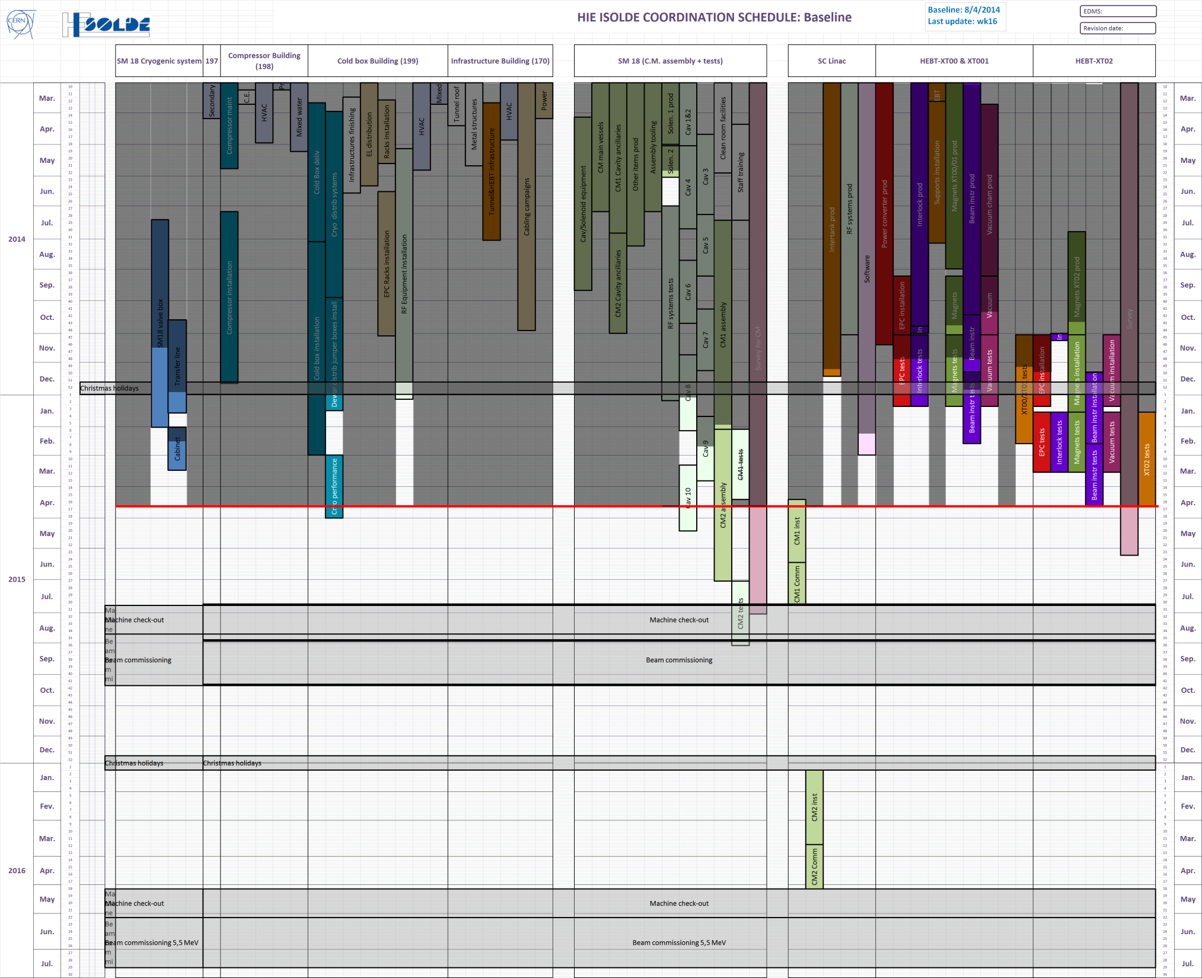
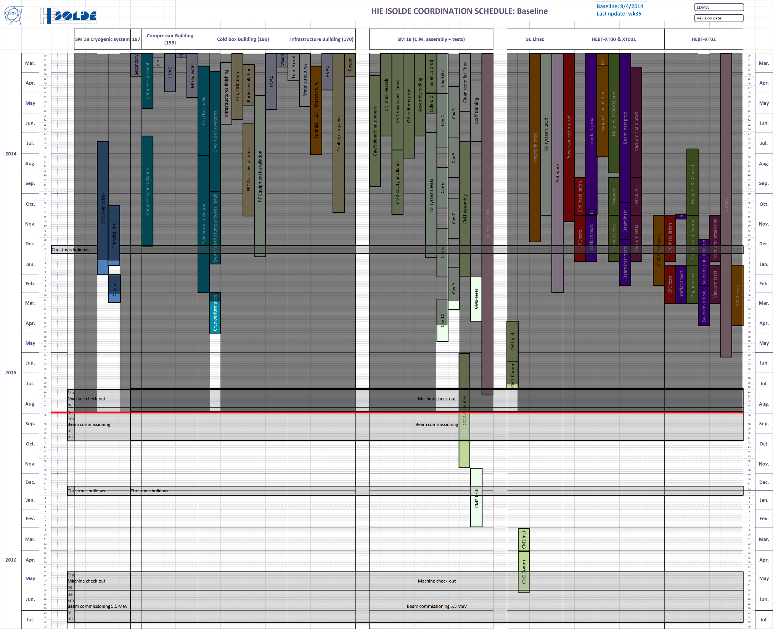
F. Formenti
Enormous progress since April 2015
Physics with RI as planned
Re-engineering of the RF coupler => Need to work out coherent planning for CM1, CM2 and CM3
WK16/2015
WK35/2015
HIE-ISOLDE physics 2015
On Oct. 22nd

Slide 3
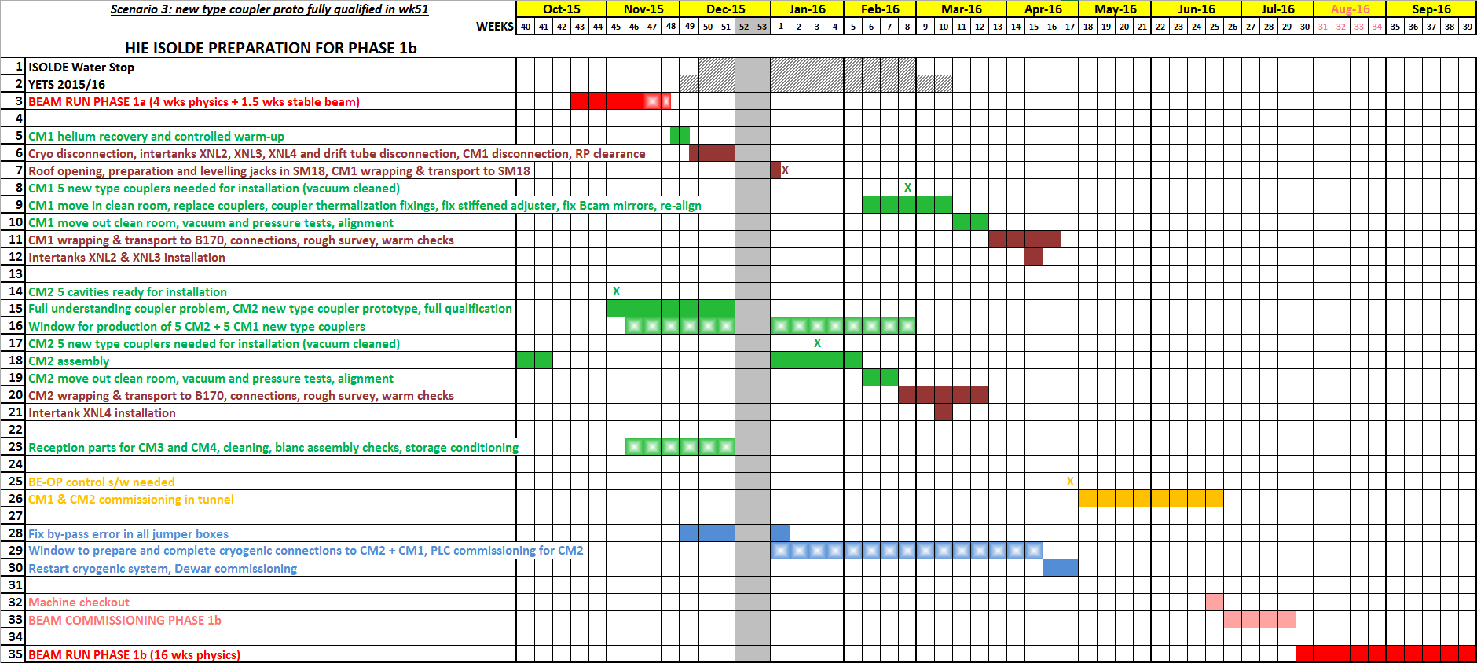
Preparation for running w/ CM1 + CM2
(get new couplers, complete CM2, fix CM1)
EDMS: 1470895
Move CM1 to SM18
CM1
Fix CM1 & re-install
Prepare 5 cavities & 10 new couplers
CM2
Stop assembly CM2
Resume CM2 & install
Prepare parts for CM3 + CM4
CM1 + CM2 h/w commissioning
Fix all jumper boxes
Cryogenic services of CM2 + CM1
CM1+CM2
Beam commissioning
16 wks physics w/ CM1 + CM2
Today

Slide 4
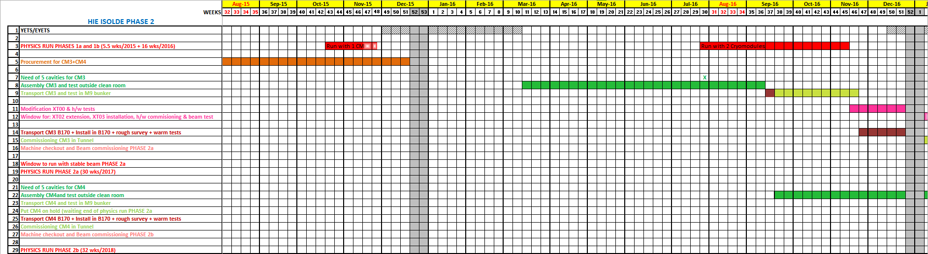
Forecast for HIE-ISOLDE Phase 2 (years 2015- 2016)
EDMS: 1470895
CM3 + CM4 part procurement
CM3 assembly
CM3 test in M9 bunker
Waiting for C.R. free
(CM2 being assembled)
XT00 modification
CM3 install
CM4 assembly
Today
C.R. free
(scenario 3)
General remarks:
Test in M9 bunker is now mandatory for CM3 and CM4 because the HIE-ISOLDE facility is running
XT00 modification for PHASE 2: push forward the quadruplet and move 1 doublet to XT03

Slide 5
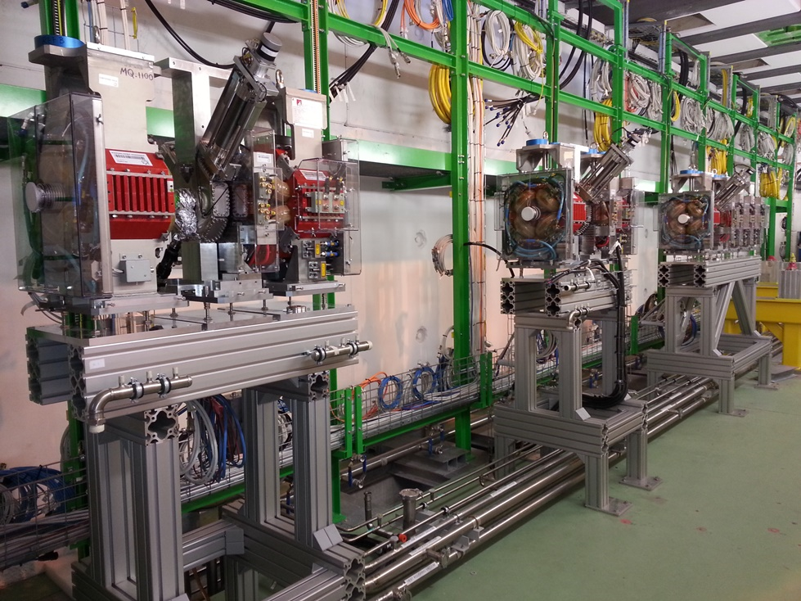
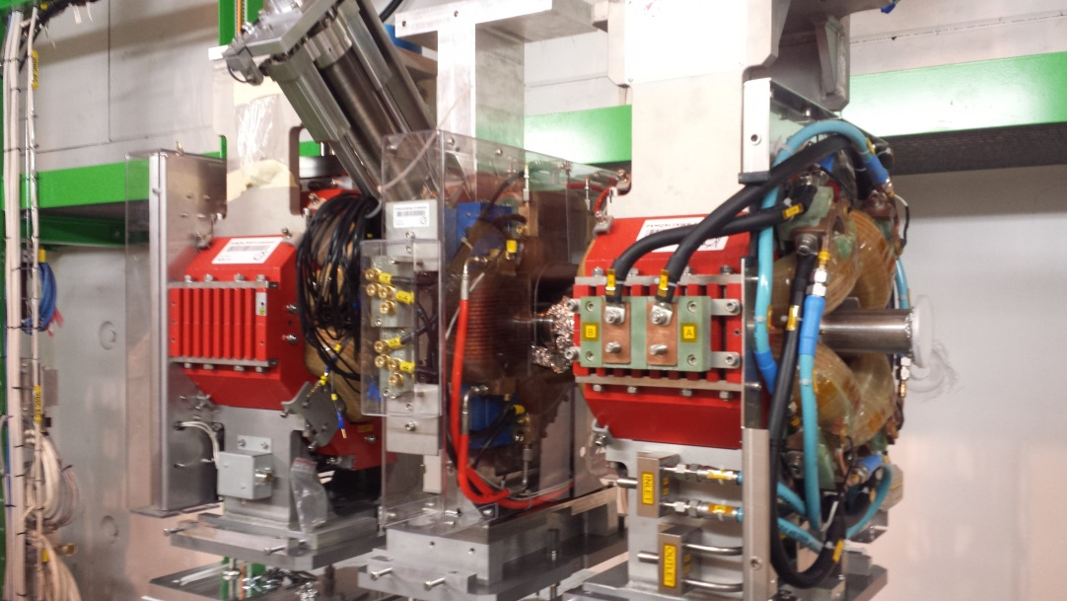
HEBT installation status (XT00 in Linac tunnel, B170)

Slide 6
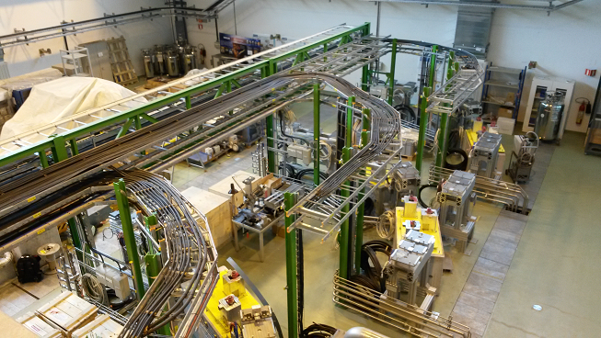
HEBT installation status (XT00 / XT01 / XT02, B170)

Slide 7
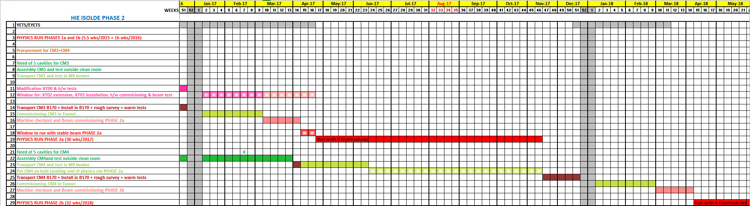
Forecast for HIE-ISOLDE Phase 2 (years 2017- 2018)
EDMS: 1470895
Window for XT02 extension,
XT03 installation & commissioning
CM3 commissioning & beam commissioning
Run PHASE 2a with CM1+CM2+CM3 & XT01+XT02+XT03
CM4 assembly
CM4 installation, commissioning
CM4 test in M9 bunker, then put on hold (adj. window)
Beam commissioning
Run PHASE 2b
General remarks:
NEW: PHASE 2 run is split into PHASE 2a (2017) and PHASE 2b (2018)
NEW: beam optics with 3 CMs: CM4 replaced by one doublet & replace first doublet XT03 with drift tube

Slide 8
Overall Summary
Radioactive beam delivered to Miniball experiment on Oct. 22nd 2015 as initially planned.
The results of the hardware tests highlighted that CM1 is not fully qualified for sustained operation (problem on RF couplers):
    De-install CM1 and re-work during winter shutdown;
    Re-engineer RF couplers;
    Improve thermalisations of the RF power line.
New coherent planning is proposed for CM1, CM2 and CM3
    Agree with Collaboration on a common scope for Physics run 2 & 3 (2016-2017)
Procurement for the 3rd beam line and extension of XT02 for HELIOS has been launched:
    HELIOS solenoid magnet => TE/MSC & Isolde Coll.

Slide 9
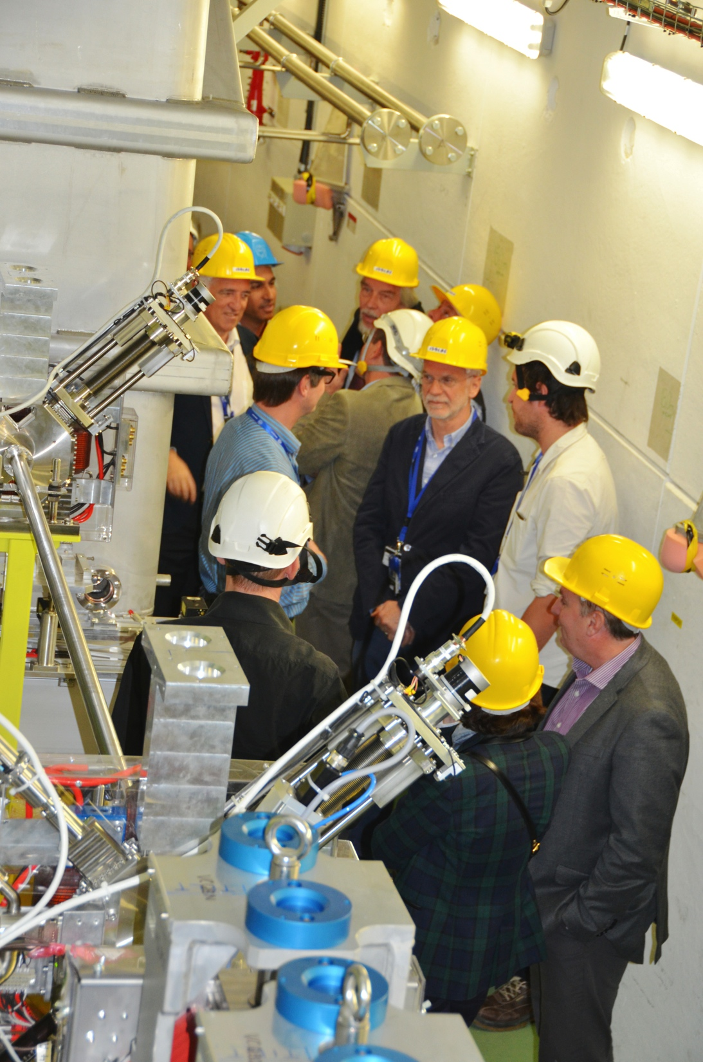
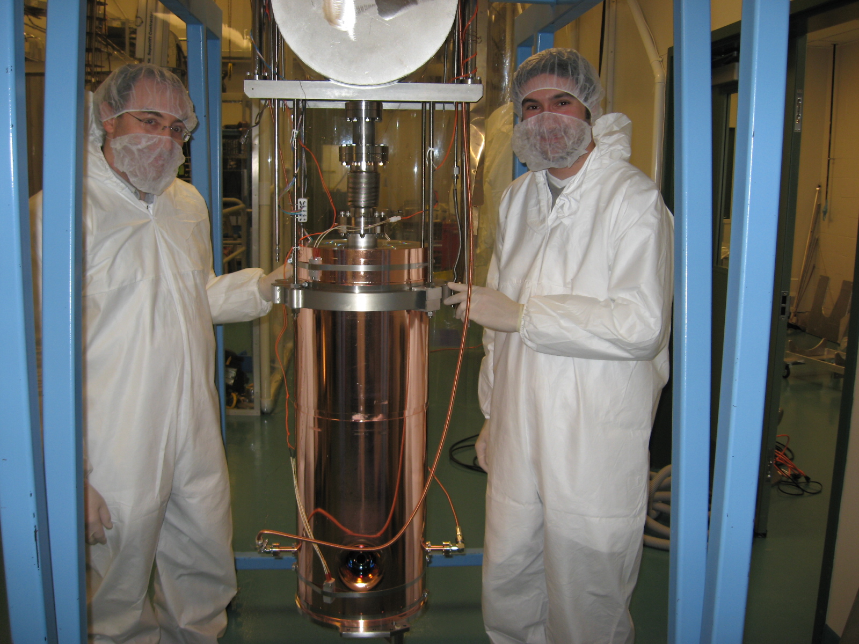
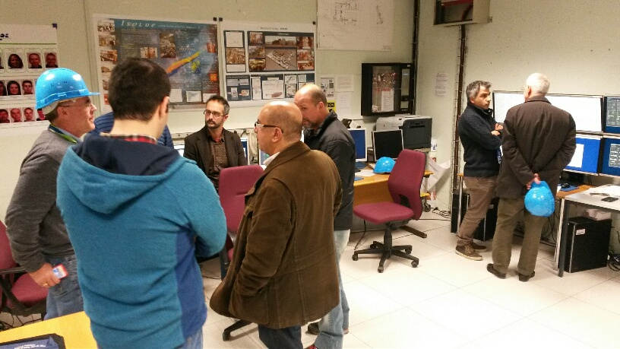
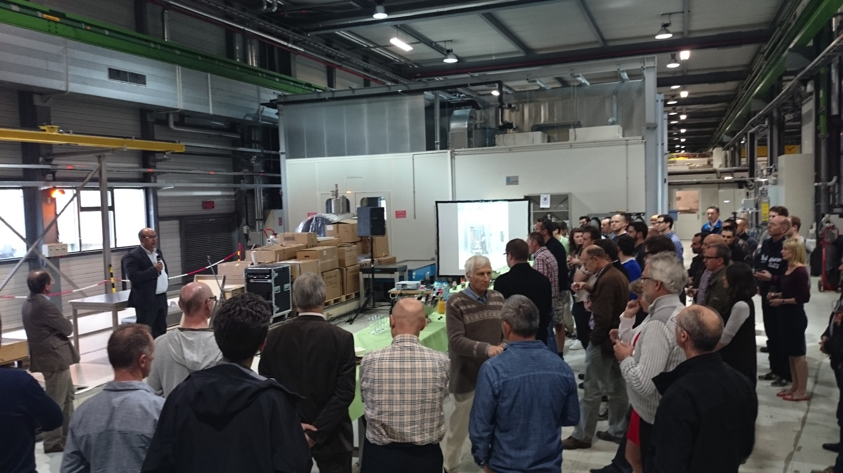
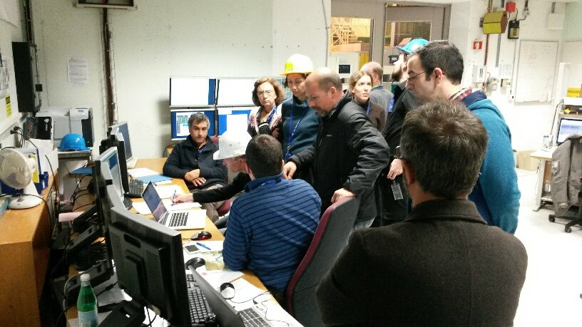
Acknowledgments

Slide 10
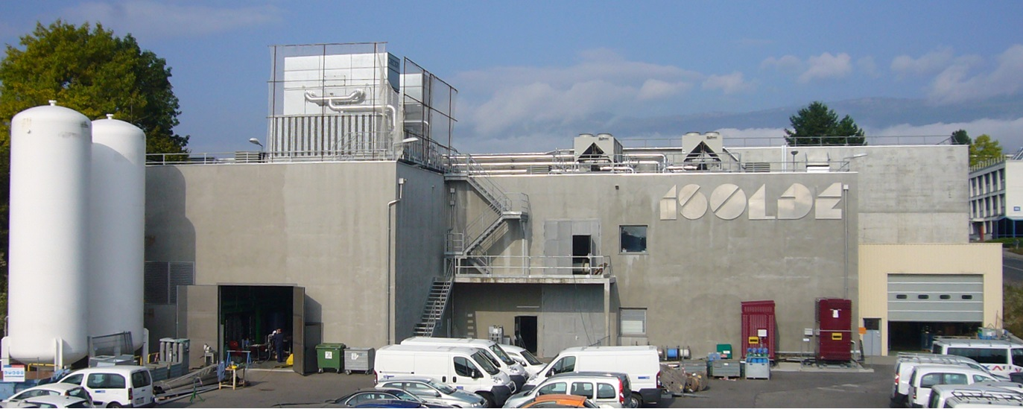
Thank you for your attention

