Slide 1

Technical news, shutdown and TISD
Thierry Stora on behalf of Richard Catherall

Slide 2
MENU
Issues in Summer:
HRS coupling table piston 14th July
BTY Line water leak 28th July
HRS valve shutter 5th August
GPS Extraction Electrode (and coupling piston) 11th August
Shutdown (not yet finalized):
Final modification of the target area/ventilation
Completion of target storage in class A building
Machine
TISD:
Negative ion source tests
LIEBE high power target
New uranium oxide batch/ 6mu/25mu Ta foil targets
NEWS Isolde and EN dept

Slide 3
HRS Coupling Issue
14th July 2015

Slide 4
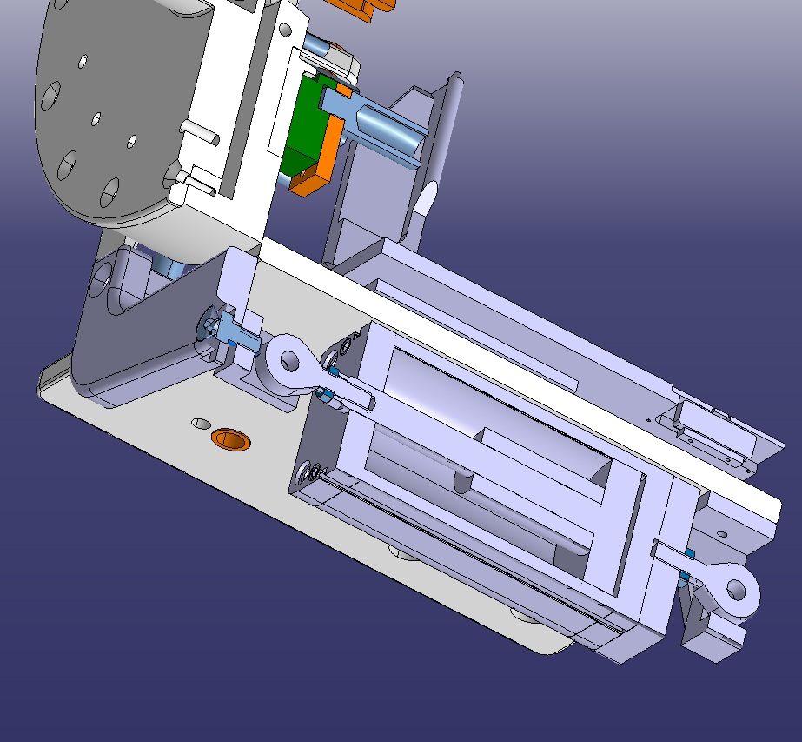
History
The HRS coupling piston was modified and replaced in Oct 2014 (IEFC).
All metal leaking piston replaced with standard piston with polyurethane seals. (Expected lifetime ~ 1-2 years) :GPS piston exchanged March 2015
Observations…Monday 13th July
Unable to pump target #541, then target #519.
Potentiometer value OK but large uncertainty.
Human intervention for observation:
  Target clearly not connected to Front end + A lack of coupling force
Compressed air electrovalves in HRS separator confirms that Frontend piston has internal leaking
Replacement and outlook
  Piston replaced with spare identical : ~ 1 min (Collective dose observ 66µSv & repair 51 µSv)
With piston lifetime ~ 6 months, exchange GPS piston in Sept 2015 after 2 weeks w/o protons.
  all metal replacement… if finished and tested, or with identical standard piston with PU seals.
All metal pistons should be available for replacement during the next shutdown

Slide 5
Water Leak Near BTY Line
28th July 2015

Slide 6
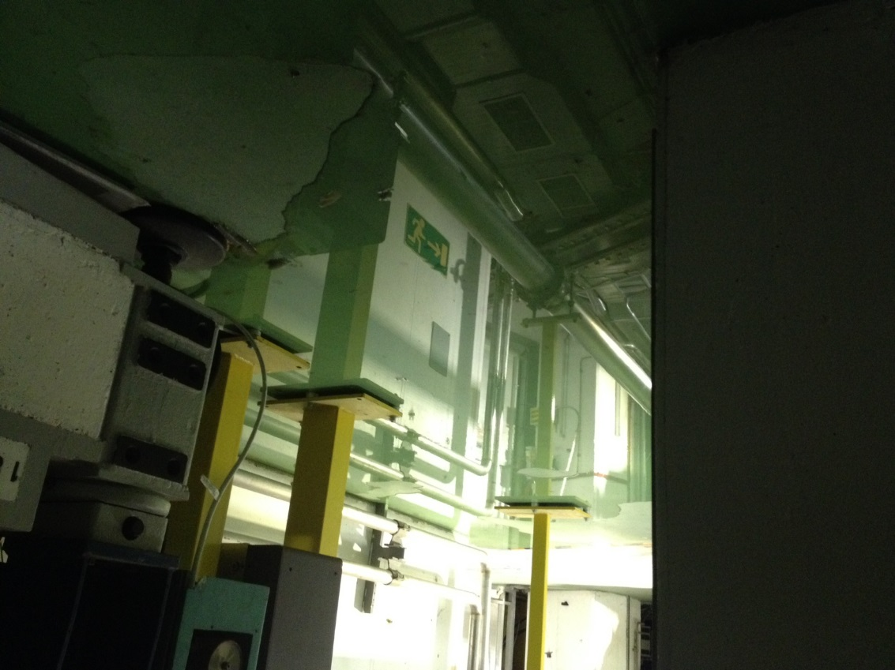
Water leak – Tuesday 28th July 2015
Alarm on water detectors in both GPS and HRS trenches
  Repeated filling of water reservoir not detected due to slow rate (6lh⁻¹). This will be modified this shutdown
  <1cm of water in GPS trench
  Water puddle underneath BTY line between GPS and HRS Frontends
A disconnected tube and faulty valve used for the purge of the magnet cooling system.
A permanent repair will be done during the YETS

Slide 7
HRS Target Valve/Shutter Issue
11th August 2015

Slide 8
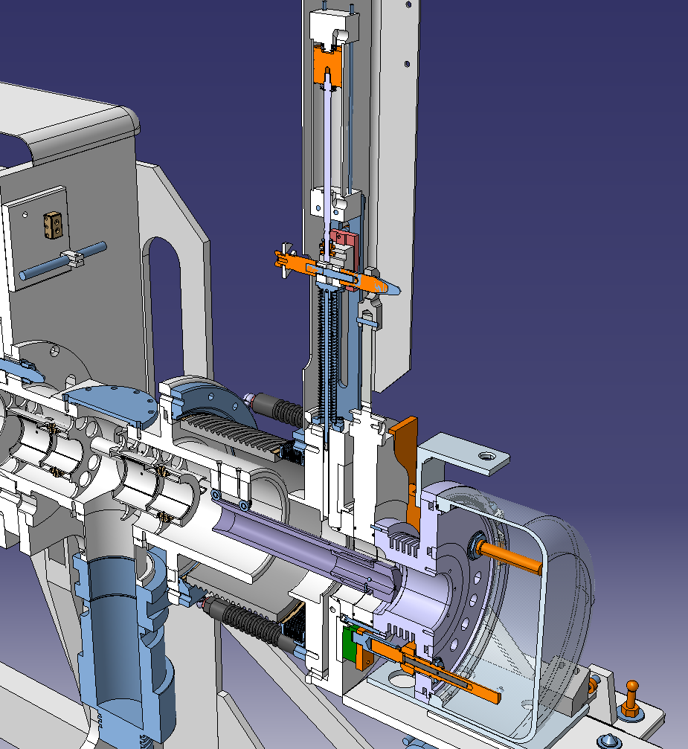
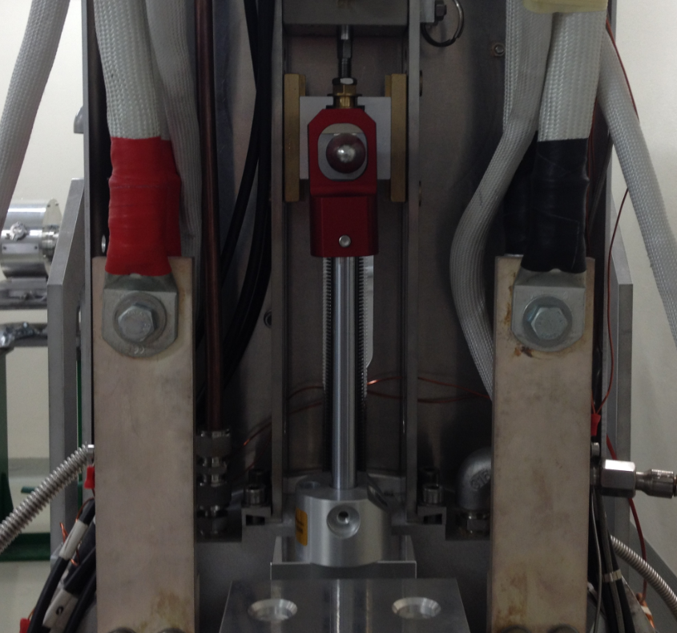
HRS Valve/Shutter
Checks
The valve on target #543 could not be moved to its fully closed (sealed) position
No sign of movement could be observed on the cameras (all interlocks ok)
A compressed air tube in the HRS separator zone was reconnected but still no movement
An electro-valve on the same compressed air line was found to have a fault.
These were (all replaced in January 2015 as a preventive measure) still no piston movement
The compressed air pressure was checked in the line No sign of any CA leaks in the accessible areas
Possible causes
A compressed air leak in the line situated in the less accessible areas
  This has happened 1x / only checked by measuring P at the entrance to the target valve piston
A compressed air leak at the CA connection with the piston
  Possible due to orings in connectors: Would be heard/seen upon intervention
The extraction electrode is still inserted : since interlocks are OK : only if mechanics are broken internally
The target valve is gripped
The piston is gripped

Slide 9
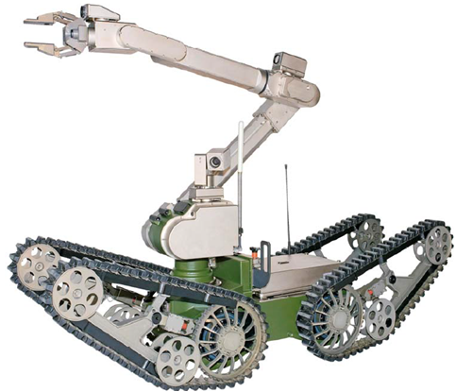
Control
All possible causes were checked and everything was working fine with the exception that the valve closed but did not seal: Acceptable for target removal; Was probably the case all the time but…
Poor visibility from existing cameras
A certain stress accumulates under these circumstances
  An accidental high dose received by one person
  CERN hierarchy (On one occasion Richard was asked to present the issue to the IEFC before the actual repair)
  CERN safety
  Physics program etc
Long term action
Improve on cameras : Telescopic camera design on-going. Ready for installation during the next shutdown
Improve on redundancy of feedback from Frontend movements
  During long shutdown period due to inaccessibility
Precede any human intervention with a Telemax intervention
  Better diagnostics through visualization
  Possible to do minor interventions if prepared beforehand

Slide 10
GPS Extraction Electrode Issue
11th August 2015

Slide 11
Situation
Tuesday 11th August
  The extraction electrode on the GPS Frontend could not be moved back to its home position
    Stopped at position 153 instead of 178.
  This is required to close the shutter and target valve prior to a target change.
  All external infrastructure checked
    Compressed air, controls etc

Slide 12
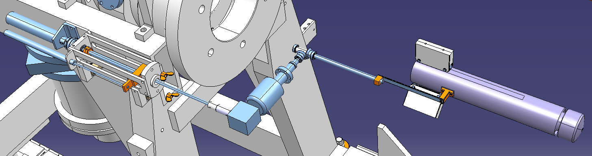
Remote Interventions
Wednesday 12th August
Sent in Telemax robot to visualise and to identify cause of problem
Pneumatic motor
clutch
Rotational feedthrough
Electrode tip
spindle
End stop
spindle
Potentiomètre
90° transmission

Slide 13
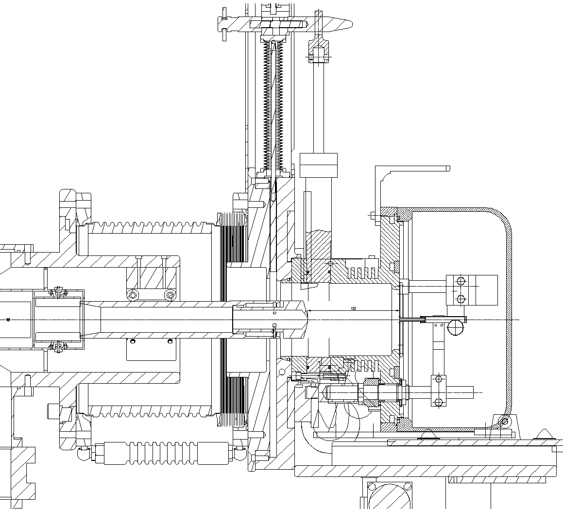
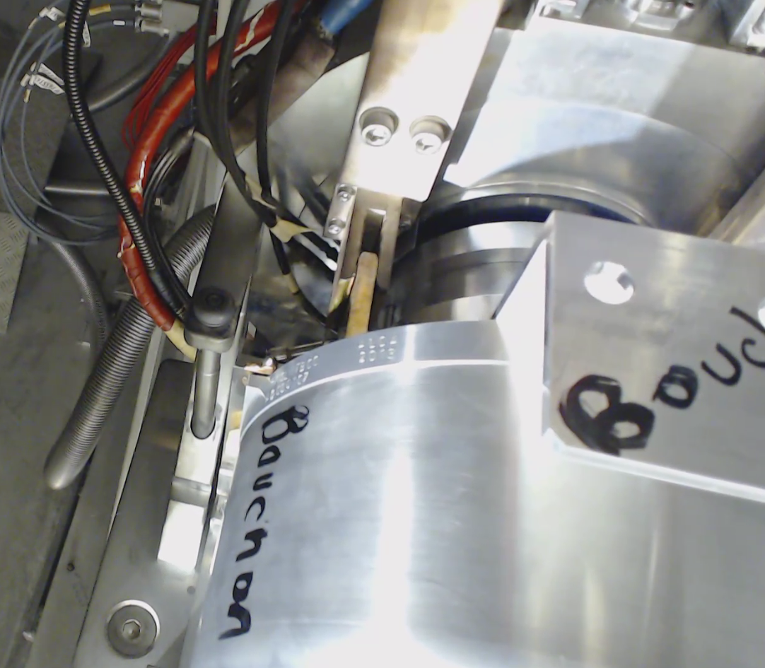
Remote Interventions
Removal of highly radioactive target with Kuka robot to facilitate possible future interventions.
  Repair or failure of Telemax
Delicate operation due to unknown position of EE
Used Telemax to place a support to maintain valve in open position
Target uncoupled and after inspection, support removed with Telemax and target removed by Kuka robot
  Valve closed (but not sealed) by gravity
But plug target didn’t couple correctly?
  Neither did the second plug target
After further observations, the problem was located at the connection between the clutch and the spindle.

Slide 14
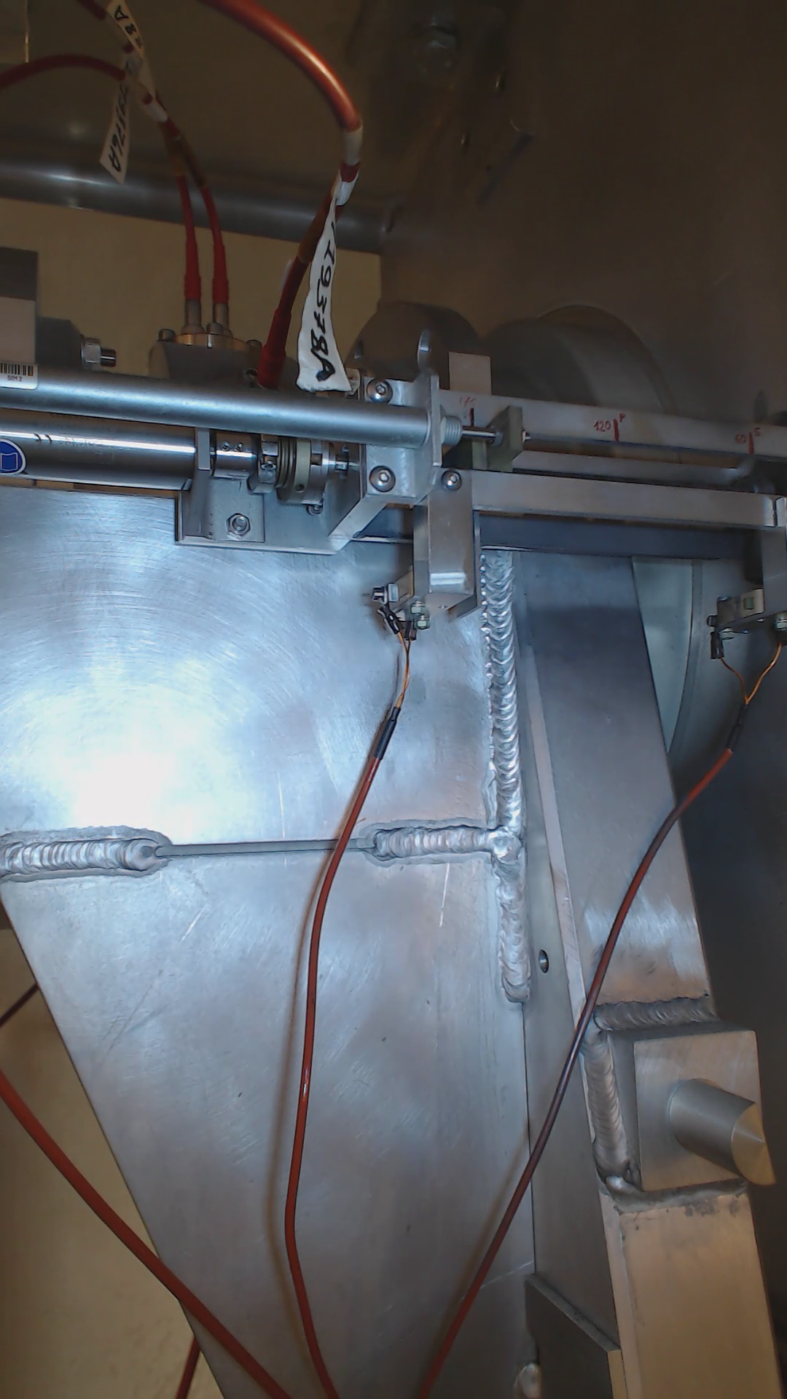
The Repair
25th August
Replace clutch screws with bigger and easily accessible pointed screws
But…
2 screws on the 90 deg. transmission were also loose!
Loss of synchronisation between real EE position and potentiometer measurements
  Slippage
  During tests, shutter hit the EE tip even though at home position
Replacement of target coupling piston
  Same as recent HRS coupling failure
  Planned to be done as a preventive measure

Slide 15
Finally…
Extraction electrode couldn’t be moved more than ~40mm (instead of up to 120mm)
  During tests, a mix up in the EE/shutter/clamping process ended in the finger not being engaged in the target valve.
  EE collided with valve and the tip had become dislodged in its support.
Plate for micro-switch triggering had to be re-adjusted
26th August..12:00
  Extraction electrode repaired and GPS FE deemed operational again.

Slide 16
Conclusions
Vibration seems to be the cause of the screw loosening and we will have to revise the EE mechanism during the next shutdown
  Very difficult for internal pieces
The Telemax robot has been instrumental in diagnosis and consequently reducing the collective dose
Hidden consequences of trying to improve on reliability
  New robots > new coupling table > new piston design/configuration
  Stepping motors with encoders > compressed air motors > new EE mechanism
  All tested but not tried…

Slide 17
Other Issues
A repeat of the coupling piston issue on HRS 30th October
  Replaced with all metal piston 4th November
Concerns with opening the GPS faraday cage door
  Decided not to intervene due to dose rate. Telemax will be used to assist door if necessary.

Slide 18
Some news on the shutdown
Temporay Magnetite shielding removed next week
Ventilation SAS creation
Used target storage with shielded doors for Isolde and Medicis
Final shielding in primary target area
Rail Conveyor System Installation for Isolde and Medicis
Start up Kuka Robot for storage/Medicis

Slide 19
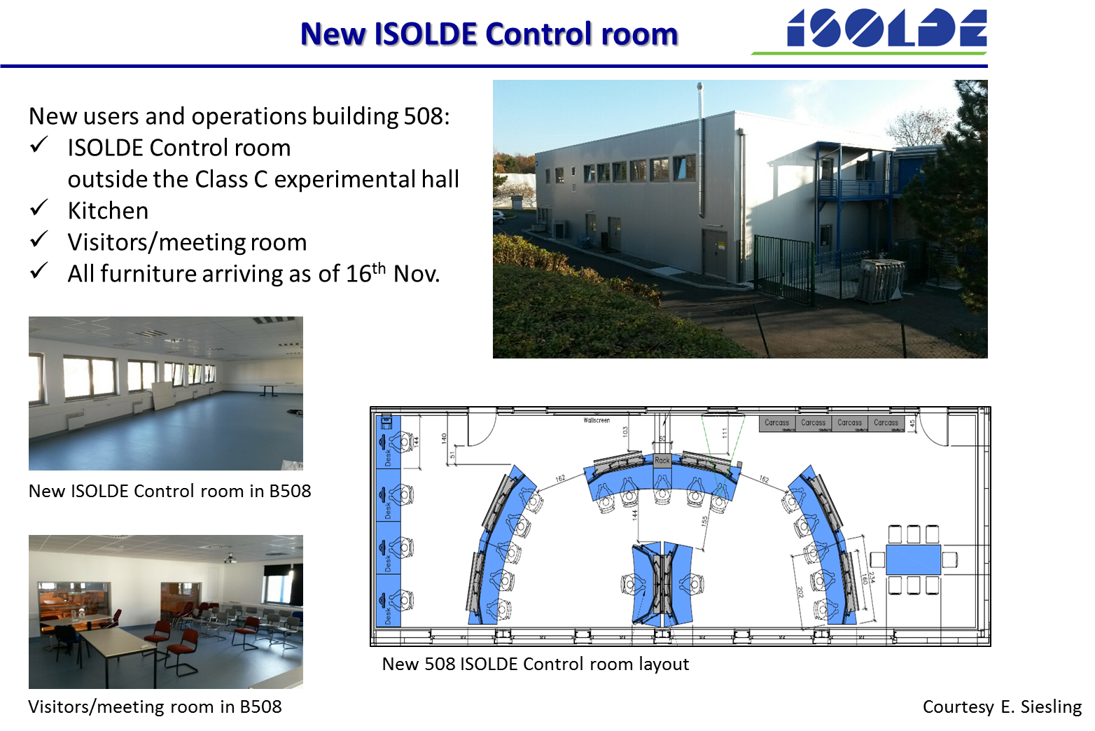

Slide 20
Target and Ion Source Development
Negative ion source tests
LIEBE high power target
New uranium oxide batch/ 6mu/25mu Ta foil targets

Slide 21
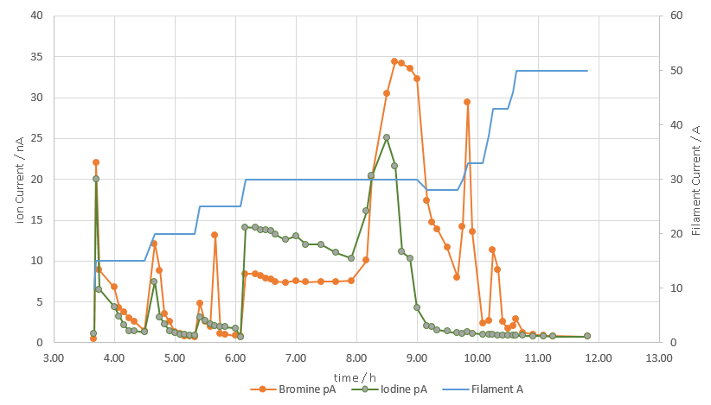
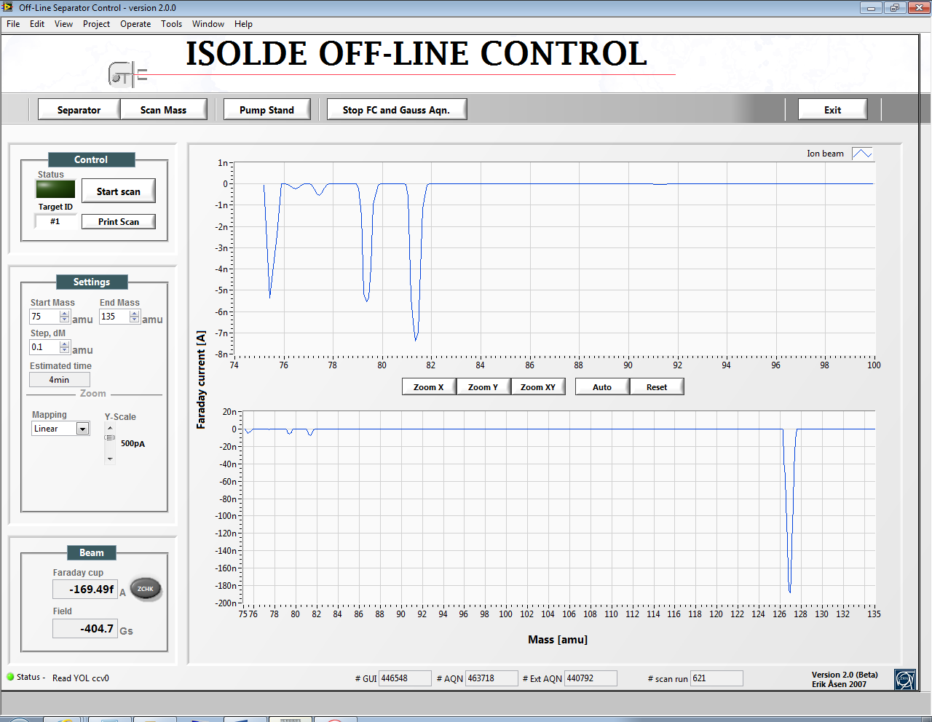
Niobium and Thorium - negative ion source
Nb535 & ThO540 units
Negative beams :
  Negative ion source prototype (GdB6 tub ion, Menna et al. NIMB, 266(2008) 4391)
Offline efficiencies 2015:
ε (Br-,I⁻ ) = 17% @1700C
with some questions remaining
Online TISD with Nb535
and ThO540 targets, starting this week
Y. Martinez, J. Ballof, T. Mendonca

Slide 22
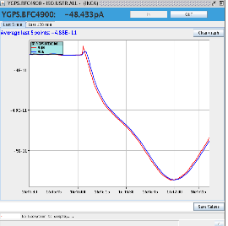
Nb535-GdB6 unit
Beam was not constant over time,
Change in the line temperature have low impact on yield (below 20% variation – positive and negative),
Not possible to recover the yields after a change in the Cs dispenser voltage,
Highest gain in yield comes from increase of Cs dispenser voltage (up to 1 order of magnitude)
Day1
Day 2
Oven 2 at 0 V
Variation of 127I beam over time
Courtesy T. Mendonca, Y. Martinez, J. Ballof, B. Gonsalves, JP Ramos
on behalf of « negative beams group(s) »

Slide 23
ThO540-GdB6 unit
Identical behavior than previous unit.
Day 3
Despite a lot of efforts to obtain these online data,
some more « offline work required »
Courtesy T. Mendonca, Y. Martinez, J. Ballof, B. Gonsalves, JP Ramos
on behalf of « negative beams group(s) »

Slide 24
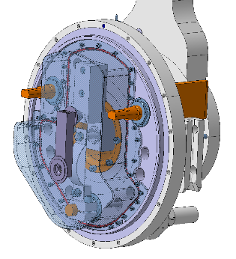
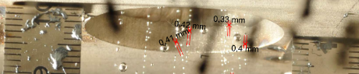
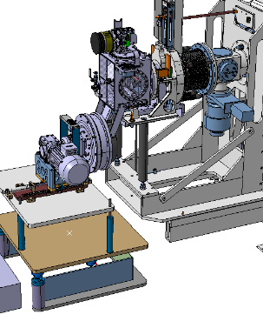
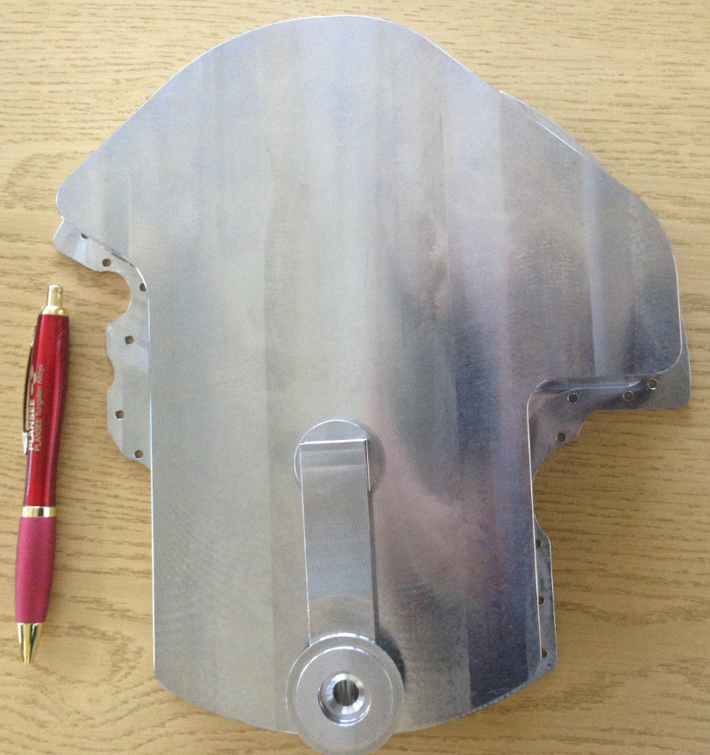
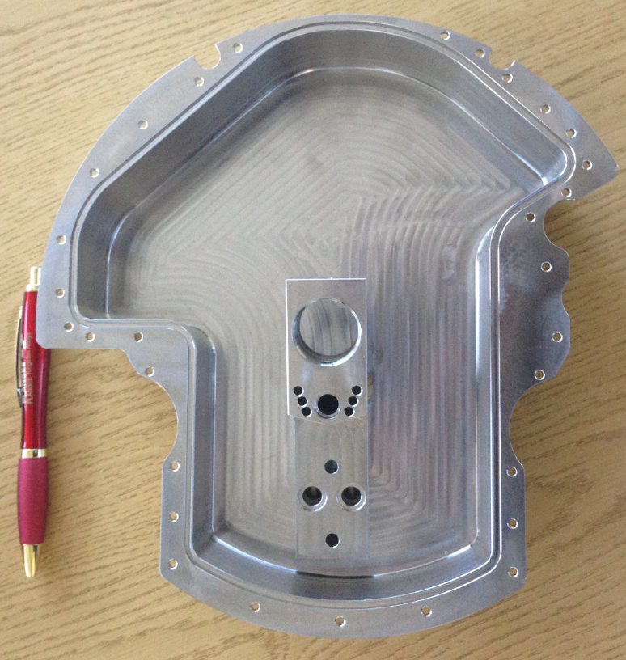
LIEBE project – follow up
Tests for shower feasibility done
  Minimum droplets size is 0,4 mm diameter
Design finalized,
Manufacturing started (see pictures),
Full target manufacturing and assembly planned for April 2016.
M. Delonca et al., for the LIEBE collaboration

Slide 25
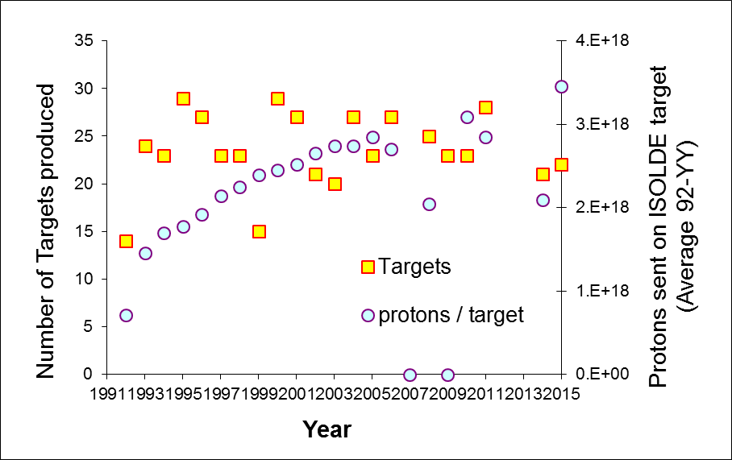
Target and Ion sources units in 2015
This year, UC-Ta n 539 unit
Received the ISOLDE PSB record
PoT (proton on target): 13.3 10¹⁸;
It’s good for operation opimization
But it’s much detrimental for waste
Management (max PoT of max
10 10¹⁸)
Isolde-PSB

Slide 26
A new UO2 batch
( total 6.1e19 81% of Isolde protons on UCx targets in 2015)

Slide 27
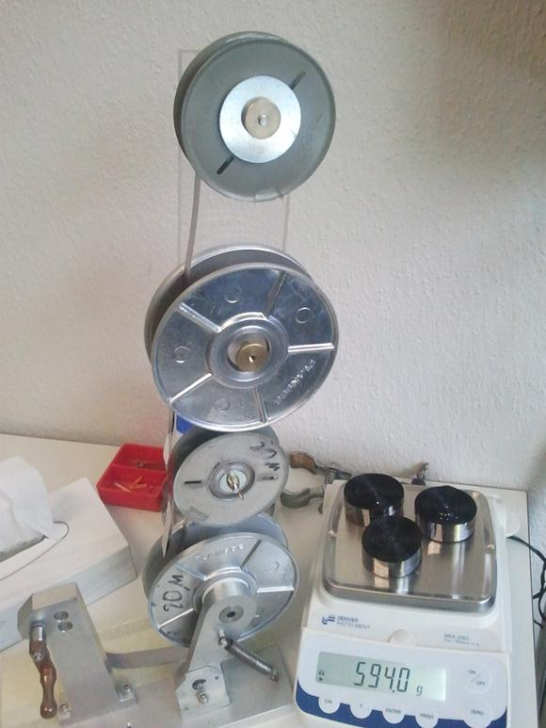
Ta544-W unit for medical Tb collections
Mixed 6/25 mu Ta foils
learning from EURISOL DS TARPIPE project: E, Noah et al. http://cds.cern.ch/record/1355076/files/document.pdf
S. Fernandes, et al Journal of Nuclear Materials 416.1 (2011): 99-110.
L4P-E14: 6 μm Ta foil in Mo frame
PIE in PSI hot cell
“Hi Thierry,
It was the first year that we came close to the shipping limits, between 150MBq and 170MBq or so of 149Tb…(max is 200MBq).
Not every day but was like this for the first few days anyway. “
Courtesy Karl Johnston
Next step : reduce oxyde « sidebands »

Slide 28
News related to ISOLDE
2GeV…From the minutes of the ATSMB meeting
Freddy concludes that this project will cost around 7 to 10 MCHF. Based on the positive reactions from Council in June, no changes will be done on the MTP that will be presented for approval in September, i.e. if this upgrade has to be done, it can only be during LS3.
A request has been made for consolidation money (~4MCHF) for the beam dumps
…but after discussions and a clear lack of finance, this has not been further pursued.
Consequently, ISOLDE will not benefit from more intensity due to Linac 4 commissioning
  But this also depends on air activation to be further analysed next year once the ventilation systems are stable.
660kCHF has been granted from the consolidation budget for the replacement of both Frontends during LS2
A work request to re-align the hall beam lines in LS2 (yes already!) has been submitted to the PLAN office.
But the green light should be given by the ISCC

Slide 29
News from EN dept
Roberto Losito will become the EN department head
He will be replaced by Simone Gilardoni
  Who knows ISOLDE quite well due to work done on convertor target simulations and liquid mercury targets.
Ana-Paula Bernardes will diversify her role by taking on PS complex shutdown safety coordination, especially LS2 but starting this year. She will be “replaced” by a Fellow paid for by TE department.

Slide 30
Thank you !

