Slide 1

UPDATE ON LAYOUT
CERN, 14th October 2015
FCC other magnets
E. Todesco
CERN, Geneva Switzerland
Acknowledgements: D. Schulte, R. Martin, R. Tomas Garcia

Slide 2
LATTICE: THE ARC
Main choice: cell lenght of 210 m
  Twice the LHC, allows to double the number of cells of the LHC instead of having 4 times more
  Tune is number of cells/4 (for a 90 degrees), so since the tune has to be controlled within 0.001, a larger tune means tighter reproducibility of quadrupoles
  Today we are at 0.001/60 = 16 ppm of reproducibility of quadrupole TF, with FCC we will go to 8 ppm
    Please not less than that
    Going to 60 degrees phase advance could be interesting
  The longer length also gives less requirement on quadrupole focusing

Slide 3
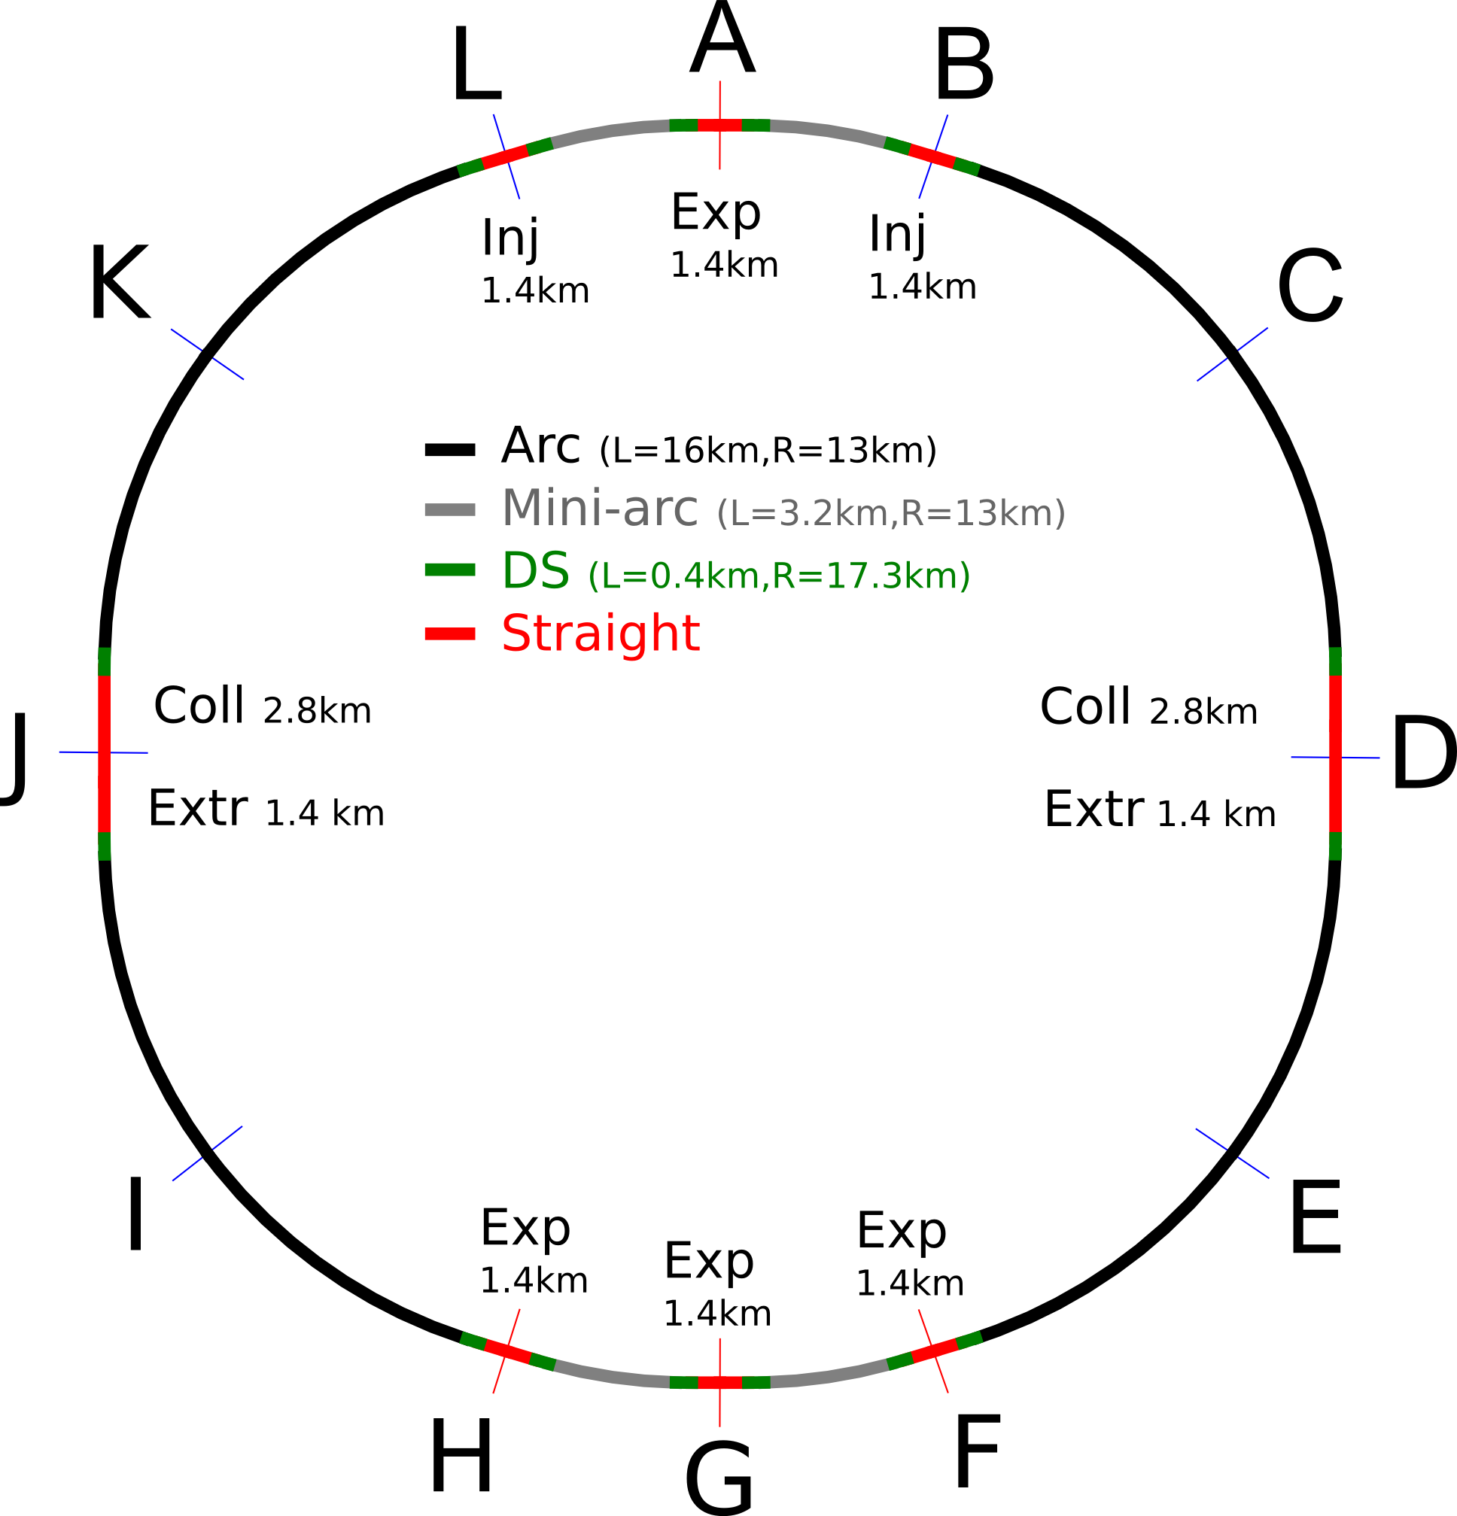
LATTICE: THE ARC
Overview [D. Schulte]

Slide 4
LATTICE: THE ARC
Cell and beta functions [D. Schulte]

Slide 5
LATTICE: THE ARC
The requirement of 50 mm for arc magnets aperture looks solid
  Space for shielding and beam screen needed,
  Design in progress
  Influence on field quality to be seen
This magnet will have low high orders
  Lot of coil, small multipoles
  One could wonder if removing totally the spool pieces and using only lattice sextupoles, making more room for the dipoles
First tracking (only random) give very large dynamic aperture
  Too good to be true, systematic should be included
  Work in progress, iteration on field quality tables
The beam screen design of [C. Garion]

Slide 6
LATTICE: THE INTERACTION REGION
I would guess that l* (today 23 m) has to be doubled
  7 times larger energy, experiment resolution given by BL², factor two from B and a factor two from L
Until now we had 50% more (35 m), I think we will have to go towards 46 m
  With 35 m, Rogelio and Roman
  think about a 100 m long triplet
  with 114 mm aperture and
  192 T/m operational
  Looks challenging but not impossible
    Peak field 12.6 T
    A big brother of HQ, with grading
  Longer triplet are not considered for the moment
  With longer l* we could go to larger apertures, in a range well explored by HL-LHC
The IR region [R. Martin]

