Slide 1
LINAC4 50 MeV phase BIS STATUS
- Linac4 50 MeV BIS architecture
- Current situation with the different users
- Commissioning plan

Slide 2
- Linac4 50 MeV BIS architecture
- Current situation with the different users
- Commissioning plan

Slide 3
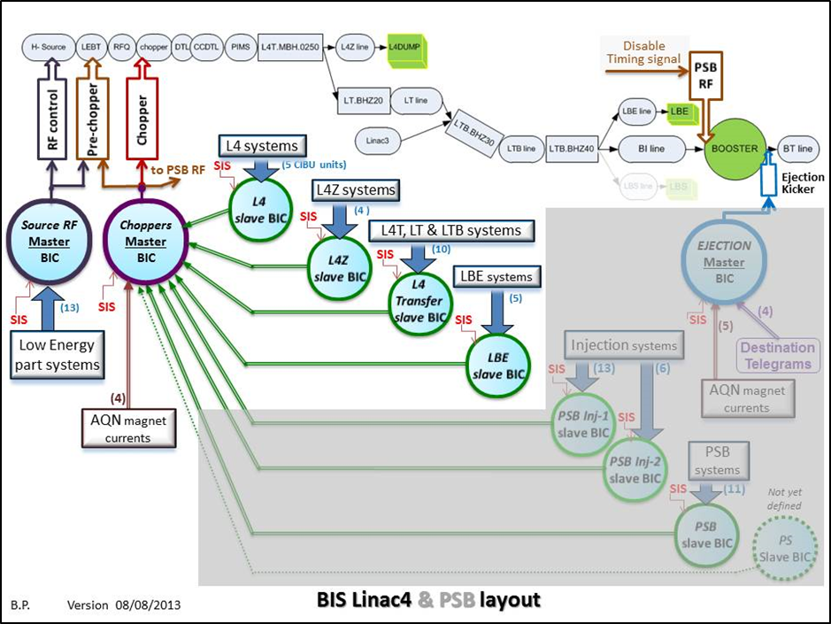
LINAC4 BIS Final implantation

Slide 4
LINAC4 BIS : 50 MeV

Slide 5
- Linac4 50 MeV BIS architecture
- Current situation with the different users
- Commissioning plan

Slide 6
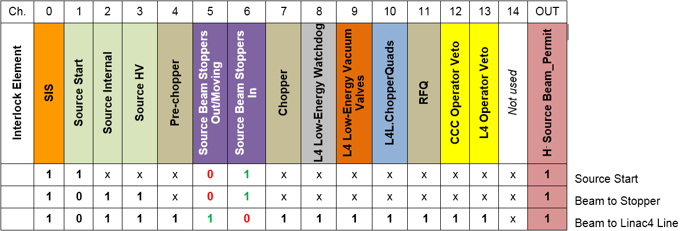
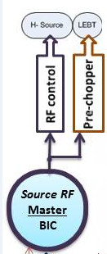
Master BIC RF : the new functionality
Following a request from the “RF Source team”, a new CIBU named « Source Start » has been added on a free input of the “Master BIC RF ”.
During the Source start-up the nominal conditions are very different from those during standard operation; the Beam Stopper is “IN” and the Beam Permit delivered to the source must stay “TRUE”.
Thanks to this new input, a third equation has been added to this “Master BIC RF”.
Final Master BIC RF implementation
Note: When the “Source Start” gives User Permit = “TRUE”, the protection of the source will then be under the responsibility of the source team

Slide 7
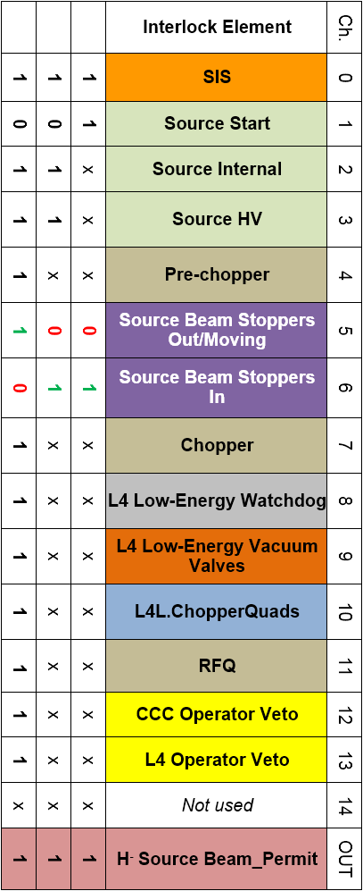
Master BIC RF for 50MeV : the real situation
Not Ready (mask inside the user’s PLC)
Not Ready before 2016
Commissioning Dump

Slide 8
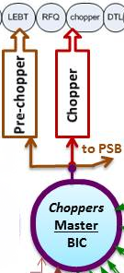
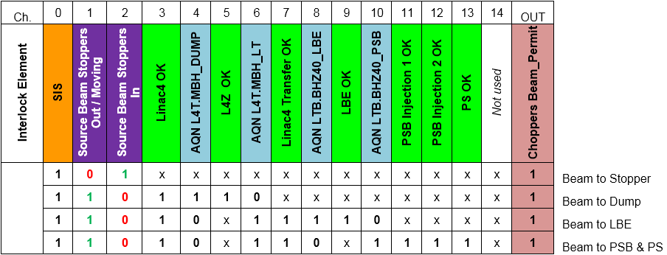
Master BIC Chopper : the new functionality
Following an issue with the measurement in the faraday cup during the 12 MeV phase, two new CIBUs have been added on 2 free inputs of the “Master BIC Chopper”. The new User permits are “Beam Stopper Out/Moving” and “Beam Stopper IN” (same interlock logic as signals connected to the “Master RF BIC”).
Adding the Beam Stopper inputs is required to force the Beam Permit delivered to the Pre-Chopper to be “TRUE” when the Beam Stopper is “IN” position.
A new equation has been added to this “Master RF BIC”.
Final Master BIC Chopper implementation

Slide 9
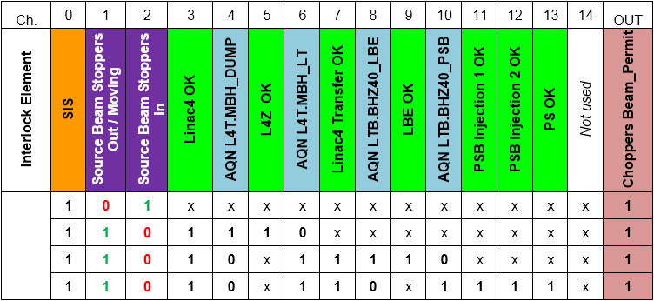
Master BIC Chopper : the real situation
Only the 2 first out of the 4 destinations are required for the 50MeV phase:
Beam to stopper
Beam to Dump
Forced to “TRUE”
Inputs not required for the 50 MeV phase; permits are forced to the required level in order to allow decoding the second destination “Beam to Dump”
Forced to “TRUE”
Forced to “FALSE”
not considered (destination LBE & PSB)

Slide 10

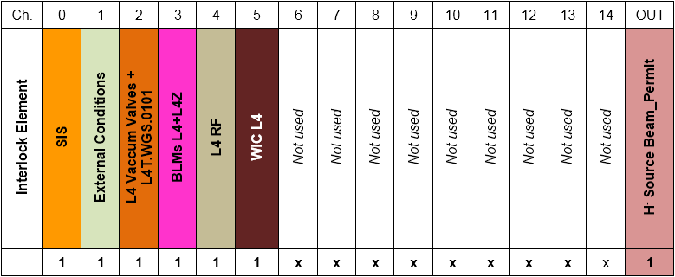

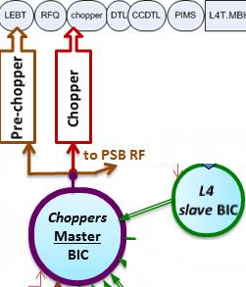
Slave BIC L4 : the real situation
Forced to “TRUE”, not required for the 50 MeV
Forced to “TRUE”, not required for the 50 MeV
L4 RF moved on “Maskable” input for 50 MeV commissioning phase ( as for 12 MeV)
Note: for this phase, the system “Diamond Detector” will no be anymore connected to the BIS

Slide 11
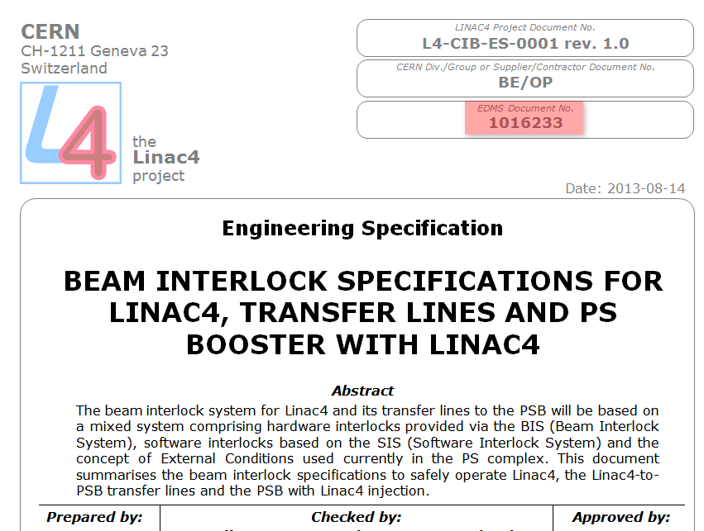
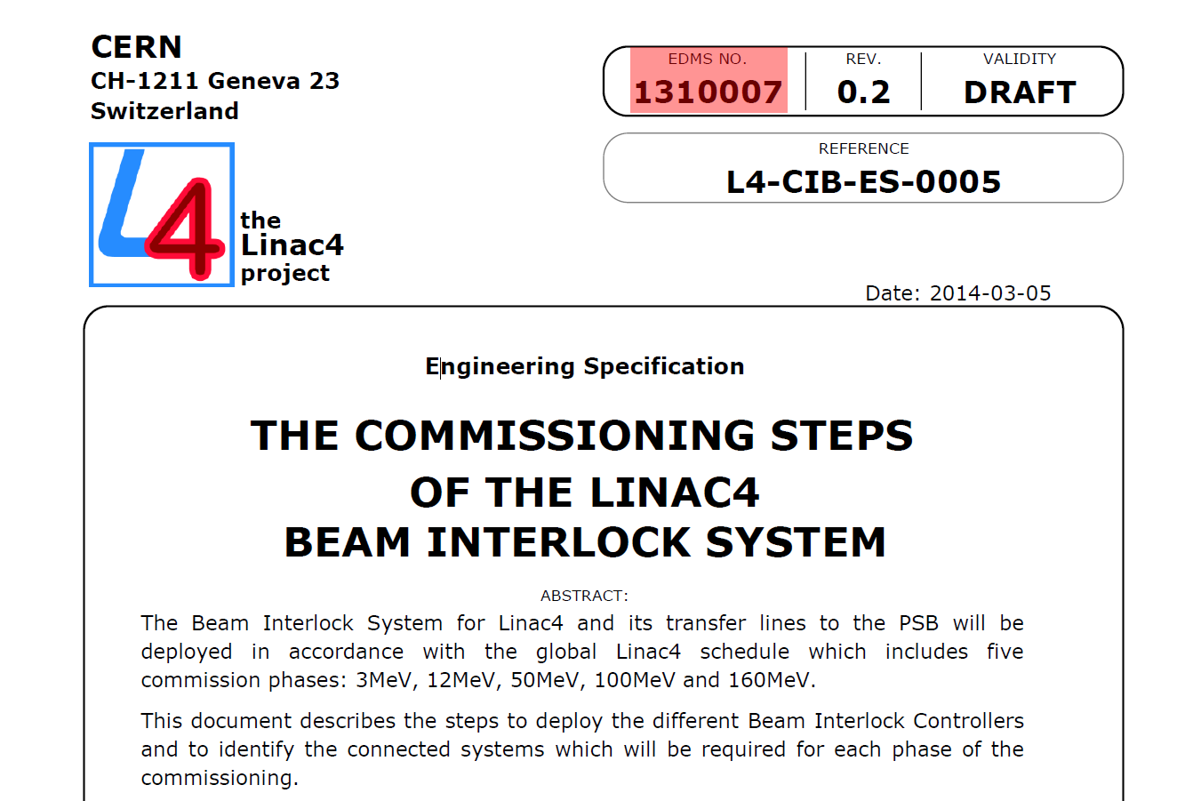
WORKING DOCUMENTS

Slide 12
- Linac4 50 MeV BIS architecture
- Current situation with the different users
- Commissioning plan

Slide 13
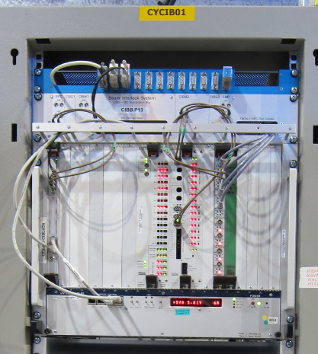
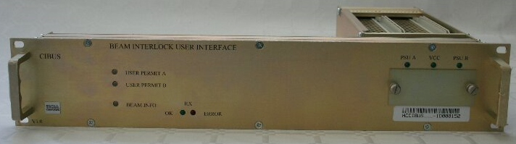
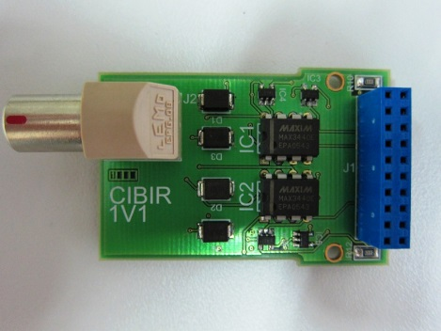
The 3 elements of the BIS architecture

Slide 14
L4 BIS IST (Individual System Tests)
The BIS IST are performed by the BIS experts; These tests include:
The connection between the CIBU and the BIC
The Beam Interlock Controller behavior
The reception of the Beam Permit at the CIBIR level
Note : these tests do not involve neither the User Systems nor the Target Systems; nevertheless the CIBIR module should be powered on.

Slide 15
L4 CIBU & CIBIR hardware commissioning tests
The BIS hardware commissioning tests (CIBU & CIBIR) are performed by the BIS experts and the involve person of either the User System or the Target System.
These tests check the electrical connections between the User electronics and the BIS interfaces and also the redundancy of the two User Permits & Beam Permits
The test procedure is explained in the document “CIBU COMMISSIONING STEPS”
EDMS 1400288
In each case, a test report is generated and archived by the Beam Interlock team
REMINDER : if the user system electronics has been modified, the interlock team should be always informed in order to take the relevant actions (with a partial or full recommissioning)

Slide 16
BIS commissioning of the full interlock chain
Some tests to validate the full interlock chain are outside the scope of the BIS responsibility:
The related interlock logic is under the responsibility of the User System and is not checked during the BIS commissioning.
The action resulting from the 2 redundant Beam Permits level is outside of TE/MPE responsibility. From the BIS side we only guarantee the availability of these signals.
Note: the past issue with the Diamond detector during the 12 MeV phase was due to 2 bypasses of the Beam Permit signals: 1 in the Pre-Chopper and 1 in the Chopper !

Slide 17
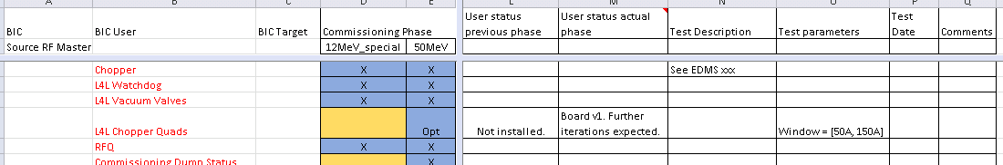
MPP Linkman
Mandate
  …The role of the machine protection linkman is to be a central point of contact for all interlocks (WIC, BIS, SIS) and the associated interfaces to client systems. The linkman will have at all times an understanding of the present and future interlock status of the machine…
MPP Linkman for LINAC4
  David Nisbet
Actions
  Ensure all required BIS client inputs are defined and documented.
  Define functional tests for each user input (if not already existing).
  Make the SIS operational for 50MeV.

Slide 18
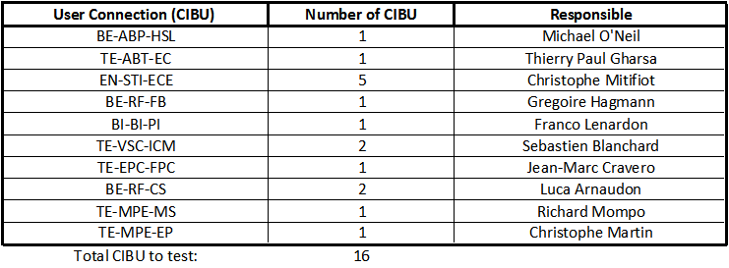
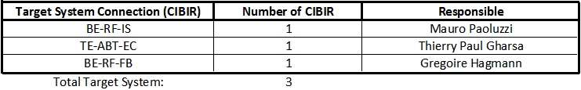
Schedule
Connection of the new “Source Start” CIBU to the BIS and programing the new equation in the Master BIC “Source RF” (done)
CIBU recommissioning (foreseen 12/10 to 16/10)
Target System recommissioning (foreseen 19/10 to 21/10)

Slide 19
Conclusion
There is no show stoppers to install the BIS for the 50 MeV phase
A schedule is proposed to both User Systems and Target Systems to performed the recommissioning before 22 October
A clear procedure for testing the whole interlock chain has to be defined

