Slide 1
More on Timing in Fe and W
K. Elsener, N. Nikiforou, CERN/PH-LCD

Slide 2
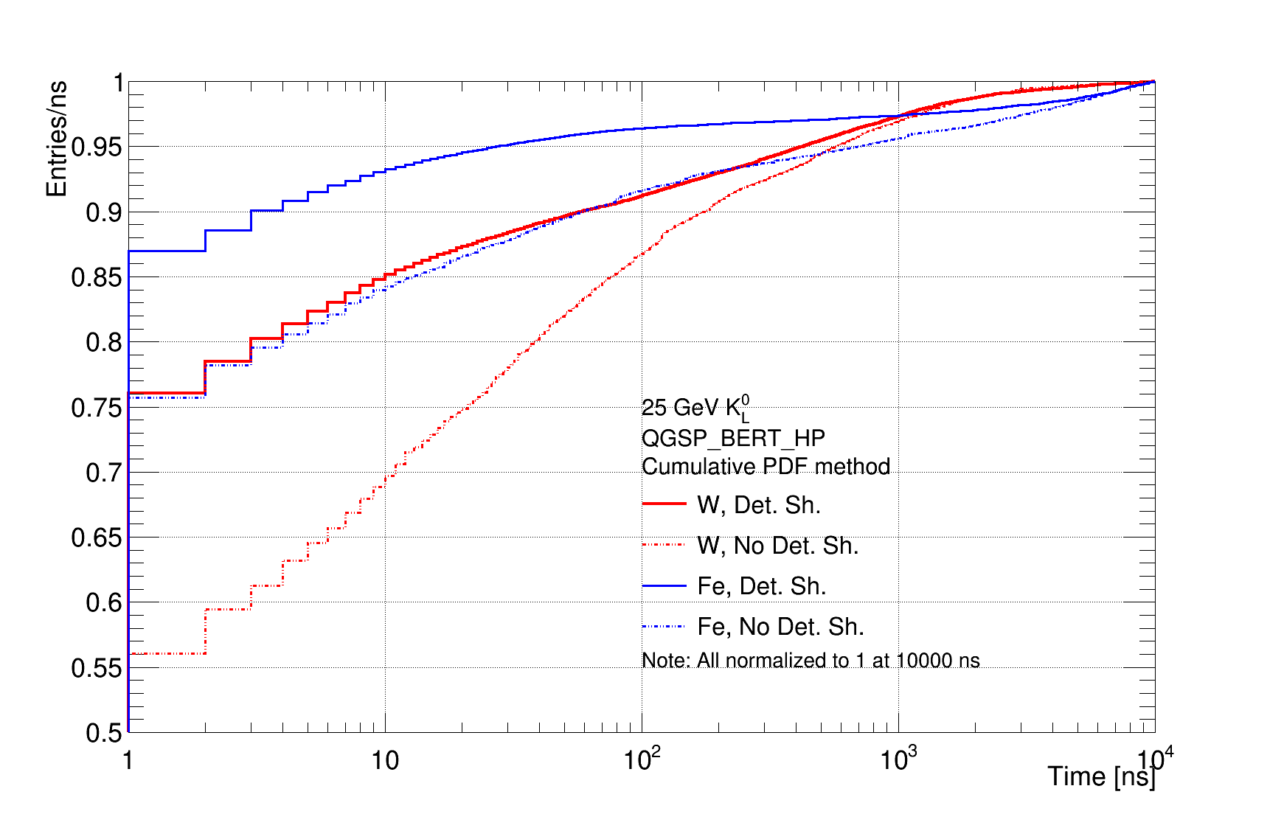
From last Time
Fraction of Energy in HCal/ns
Saw surprising long slow timing tail in Fe
  Fe energy fraction rises much faster in the beginning compared to W, but then takes much more delayed energy contributions
Studies performed with Geant4 9.05.p02 (not 9.6 as previously mentioned) with Mokka, using mod. Version of ILD_o1_v06
  60x19 mm Fe + cassette
  70x10 mm W + cassette, etc…
From Mokka 8.04
Geant4 9.05.p02
(erroneously mentioned G4 9.06 last time)
Method Reminder:
  Fill energy weighted time pdf for all MC contributions, all hits in HCal Barrel hit collection
  Make cumulative PDF to obtain plots above
Implicitly normalizes to one at end or range
  If you normalize to something below ~1000 ns, probably you miss the slow Fe tail

Slide 3
What could have gone wrong?
  Mokka/Geant4 versions? 
    Seeing similar results with new DD4hep/DDSim simulation chain based on Geant4 10.01
  Geometry model? 
    Used DD4hep implementation of new CLIC det. model
  Also used simple HCal stack in DD4hep rather than full detector model
Geant4 issues (late deposits not to be trusted)? ?
  Geant4 people not responded yet
Is it actually physical maybe?
  Today’s plots investigate whether late deposits can be attributed to a physical process like late neutrons

Slide 4
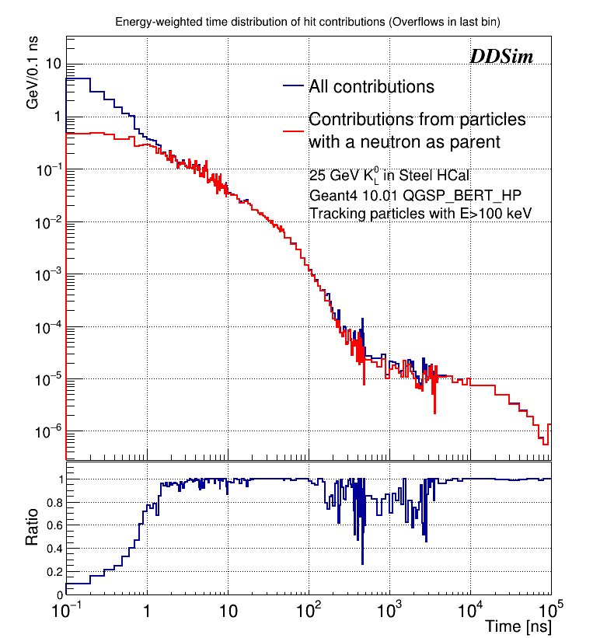
Investigating the Source of Late Energy Depositions in Steel
CLIC_o2_v03 implemented in DD4hep (60x19 mm Fe + cassette)
DDsim software with Geant4 10
  Much more flexibility in modifying geometry and simulation parameters
  Could have “super-detailed” shower information by lowering energy threshold for keeping MCParticle history and enlarging “tracking region” thereby keeping entire decay tree for Calorimeter hit contributions
Not enough to ask for “contributions from final state neutrons (pdg: 2112)”
  Need to include contributions from final state particles originating from neutrons
Apparently, this method yields something meaninful (left)
What’s the dip at ~ 1000 ns ?
Note: Overflows put in last bin

Slide 5
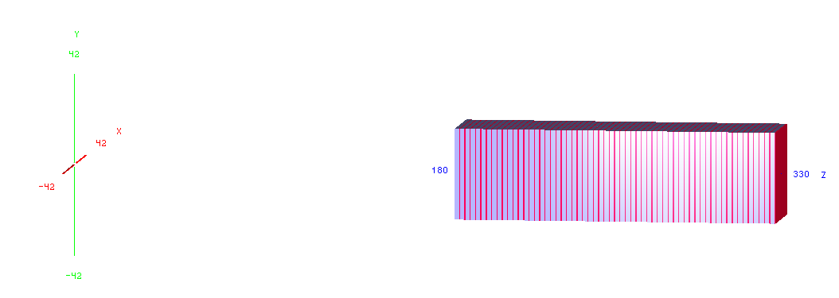
Calorimeter Stack in DD4hep
  To make sure there was no geometry influence in the results, a simple HCal stack was implemented in DD4hep
  Only interleaved layers of Absorber and scintillator along the z-axis
    60 x 20 mm Fe + 5 mm Polysterene [OR]
    70 x 10 mm W + 5 mm Polysterene
R~30 cm

Slide 6
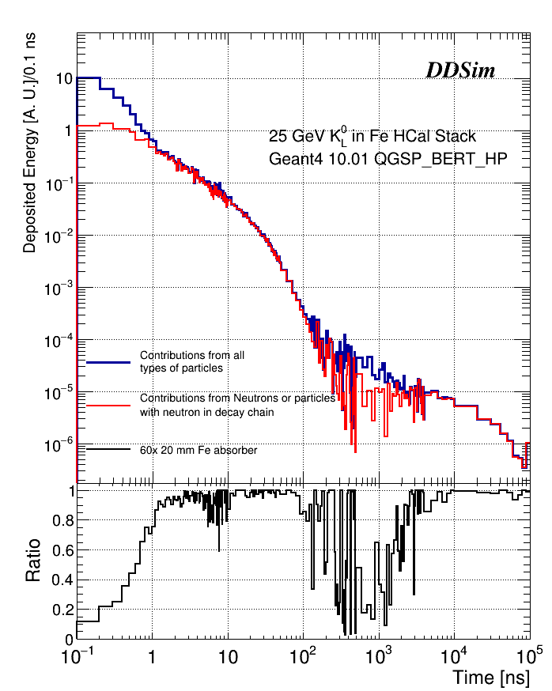
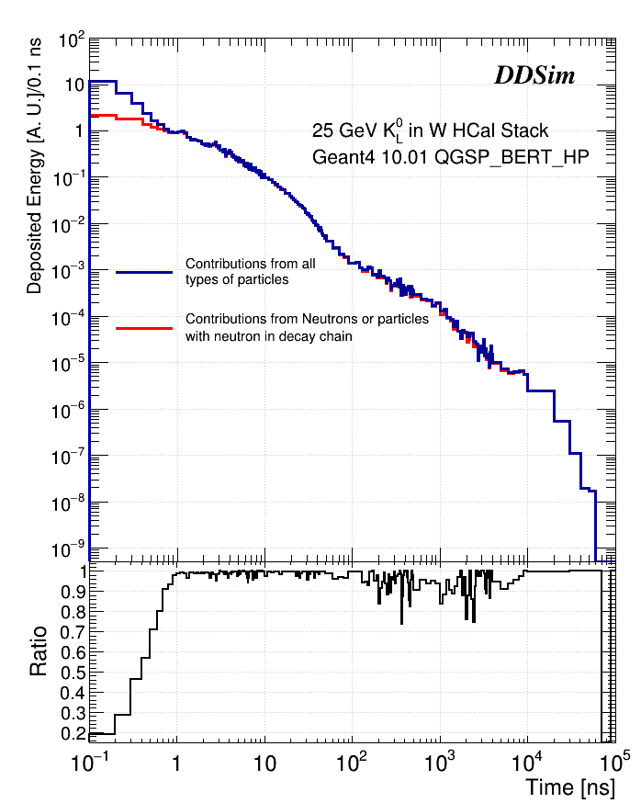
Results in Stack. Steel (left) vs Tungsten (right)
More pronounced dip wrt “realistic” HCal
Much less pronounced dip

Slide 7
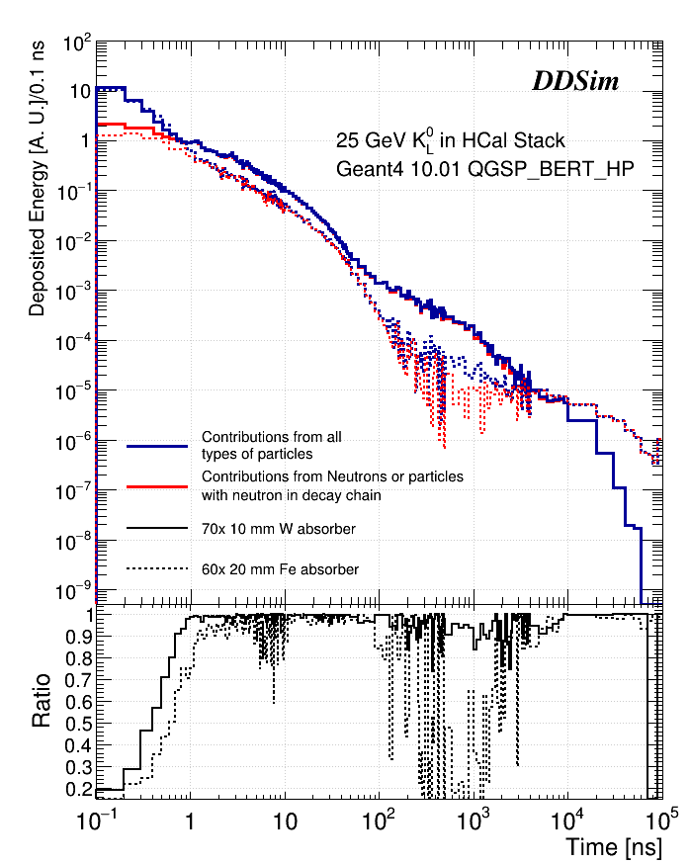
Same in Overlay
Notes on the plots (this and ones before):
Overflows (t>10⁵ ns) artificially put in last bin
X-axis has variable bin sizes but shape is corrected for bin width
Hit energy is uncalibrated but should be in the GeV-scale
No normalization so the absolute Fe and W plots are not directly comparable (ratio should be OK)
  The blue line integrals should add up to the sum of the energy of all hits of all 100 simulated events

Slide 8
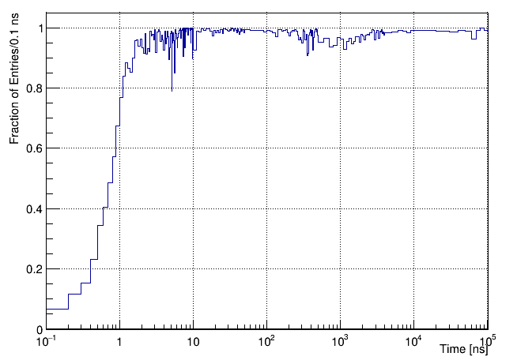
One more thing
If you divide the unweighted time distributions (neutron/all) the effect is not so prominent
  Correlation with energy?
Fe HCal Stack
Ratio of unweighted time distributions

Slide 9
Conclusions?
The late energy deposits appear to be associated with neutrons
Do not understand “dip” at ~1000 ns for Fe
  Does not appears to be anything that relates to geometry
    Otherwise why not present in W?
    Also tried changing size, thickness, #layers with no effect
  Lowering the MCParticle energy threshold does not change the dip
    Raising it lowers our efficiency to find neutron parents (we lose parts of the MC history)
  Is it due to some correlation with the energy?

Slide 10
Backup slides
Mainly from last presentation

Slide 11
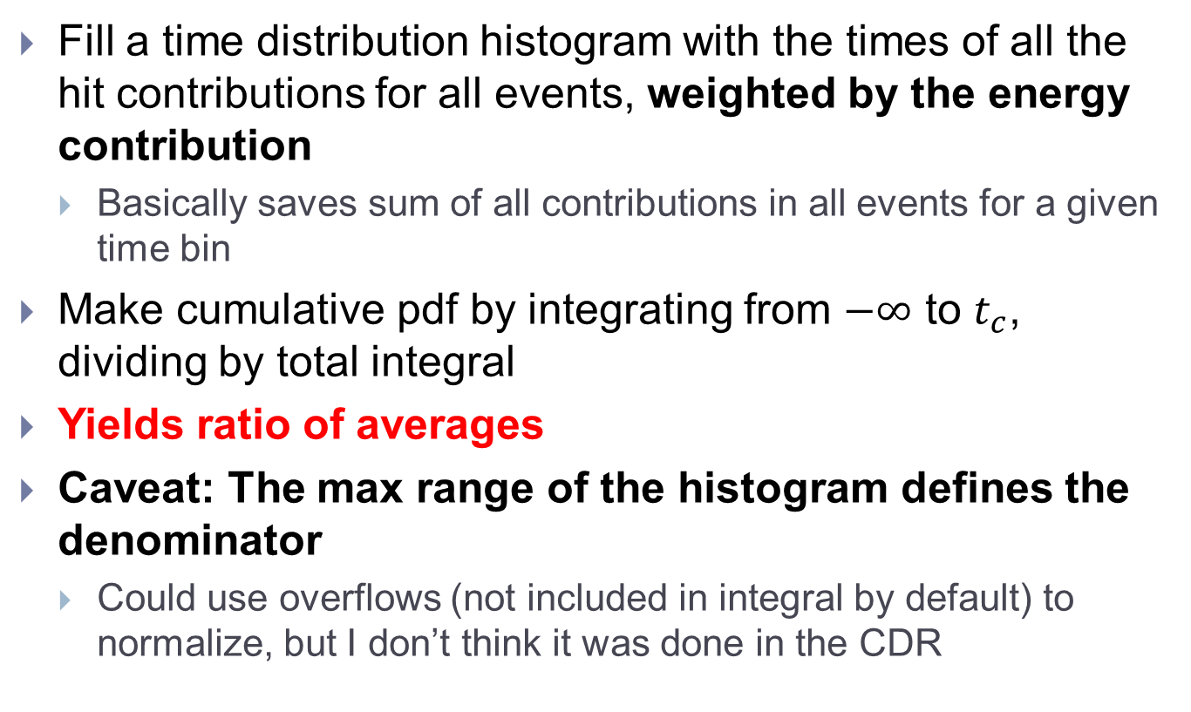
Cumulative PDF method
Fill a time distribution histogram with the times of all the hit contributions for all events, weighted by the energy contribution
  Basically saves sum of all contributions in all events for a given time bin
Make cumulative pdf by integrating from $−∞$ to $t_{c}$, dividing by total integral
Yields ratio of averages
Caveat: The max range of the histogram defines the denominator
  Could use overflows (not included in integral by default) to normalize, but I don’t think it was done in the CDR

Slide 12
Reminder: Single Reconstructed 50 GeV K0L response vs Readout window
μ(Ε)/Ε [%]
σ(Ε)/μ [%]
Readout Window Timing Cut [ns]
This is not what we want:
  Reconstructed quantities, includes digitization and Pandora
  We also don’t want to calibrate away the timing dependence

Slide 13
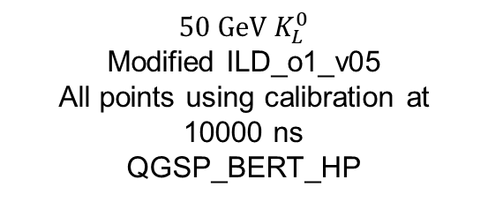
But …
(still talking about reconstructed 50 GeV K0L)
Even if we did want to study the reconstructed single particle response, we still need to make sure we use detailed shower mode
$$50 GeV K_{L}^{0}$$
Modified ILD_o1_v05
All points using calibration at 10000 ns
QGSP_BERT_HP
μ(Ε)/Ε [%]
Timing Cut [ns]

Slide 14
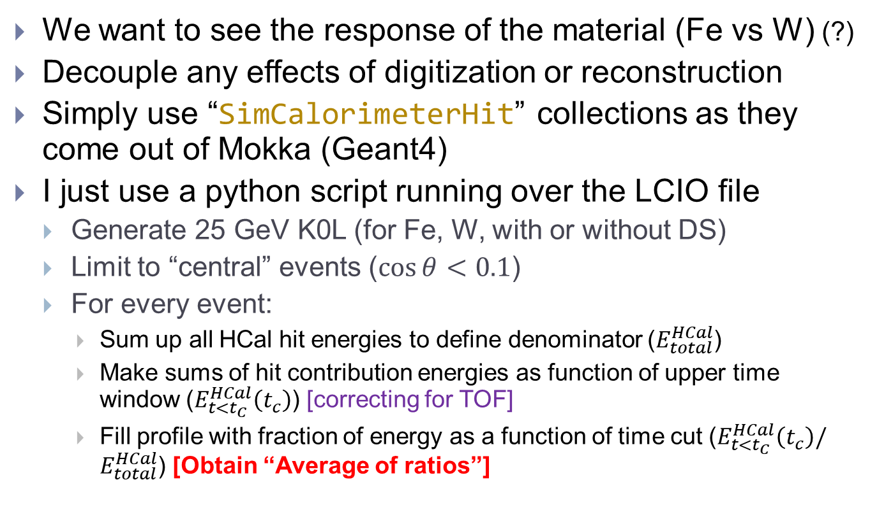
Do something simpler instead
We want to see the response of the material (Fe vs W) (?)
Decouple any effects of digitization or reconstruction
Simply use “SimCalorimeterHit” collections as they come out of Mokka (Geant4)
I just use a python script running over the LCIO file
  Generate 25 GeV K0L (for Fe, W, with or without DS)
  Limit to “central” events ($\cos{θ}<0.1$)
  For every event:
    Sum up all HCal hit energies to define denominator ($E_{total}^{HCal}$)
    Make sums of hit contribution energies as function of upper time window ($E_{t<t_{C}}^{HCal}\left(t_{c}\right)$) [correcting for TOF]
    Fill profile with fraction of energy as a function of time cut ($E_{t<t_{C}}^{HCal}\left(t_{c}\right)/E_{total}^{HCal}$) [Obtain “Average of ratios”]

Slide 15
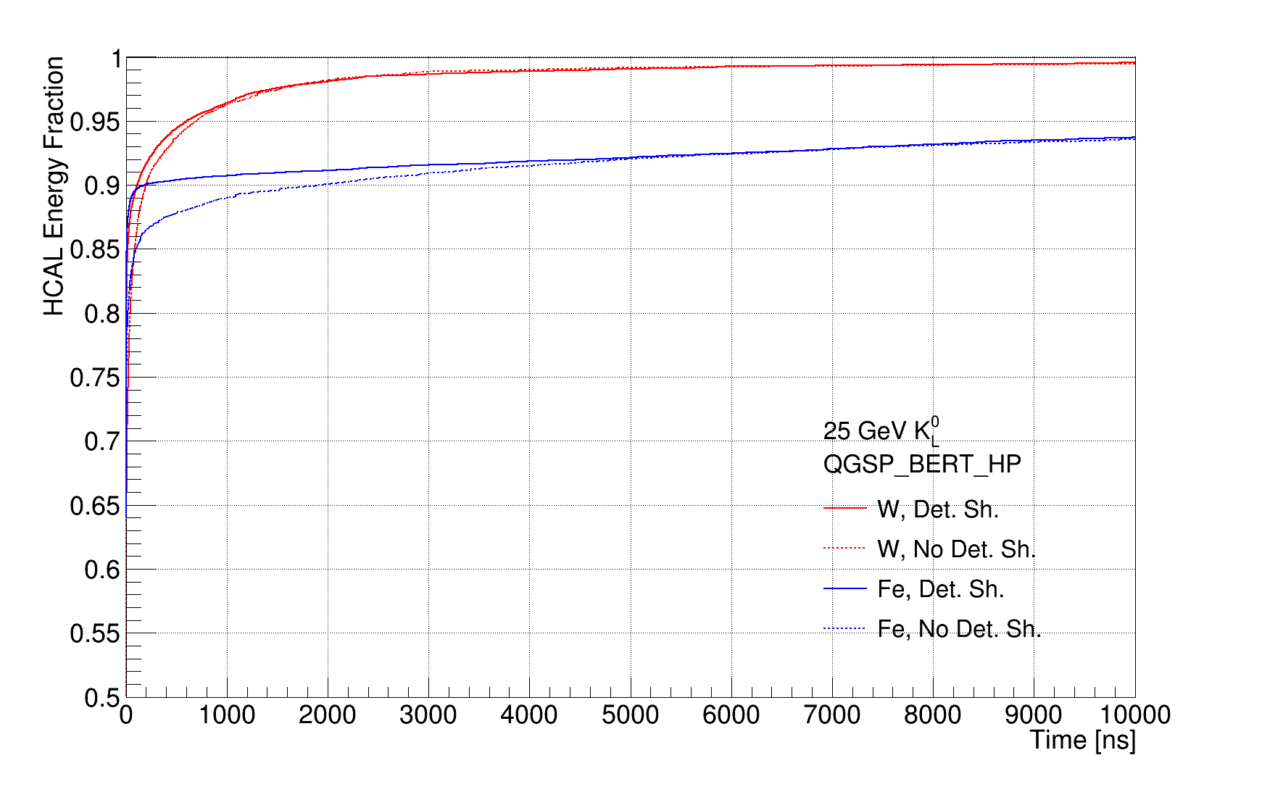
Profile method, W vs Fe, DS vs No DS

Slide 16
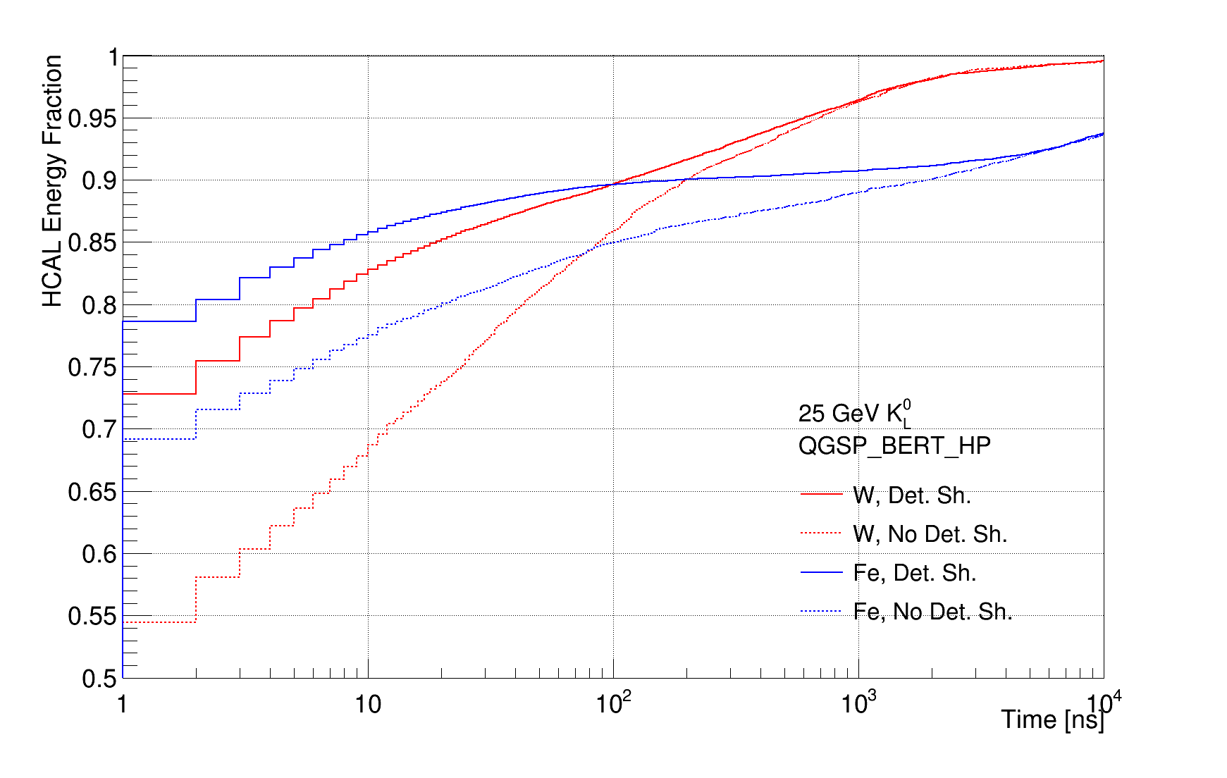
Profile method, W vs Fe, DS vs No DS
Once again, should definitely use Detailed Shower

Slide 17
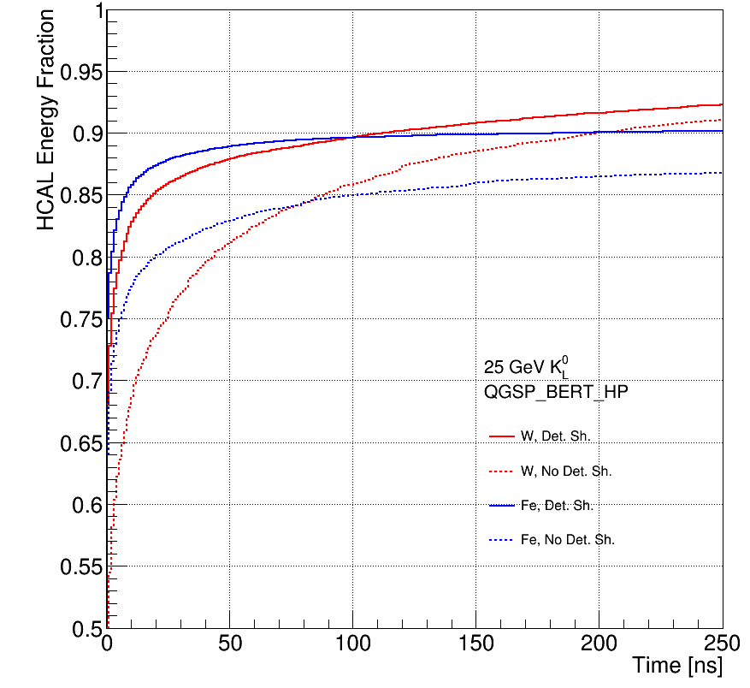
Profile method, Format like CDR
Clearly the normalization is “off” wrt CDR plot
  But it is almost clear that in the CDR, Detailed Shower was not used
What could be wrong?
  Low time cut? 
  Cell energy cut? 
  Different denominator? 
  Different method? 

Slide 18
Yet another method
Fill a time distribution histogram with the times of all the hit contributions for all events, weighted by the energy contribution
  Basically saves sum of all contributions in all events for a given time bin
Make cumulative pdf by integrating from $−∞$ to $t_{c}$, dividing by total integral
Yields ratio of averages
Caveat: The max range of the histogram defines the denominator
  Could use overflows (not included in integral by default) to normalize, but I don’t think it was done in the CDR

Slide 19
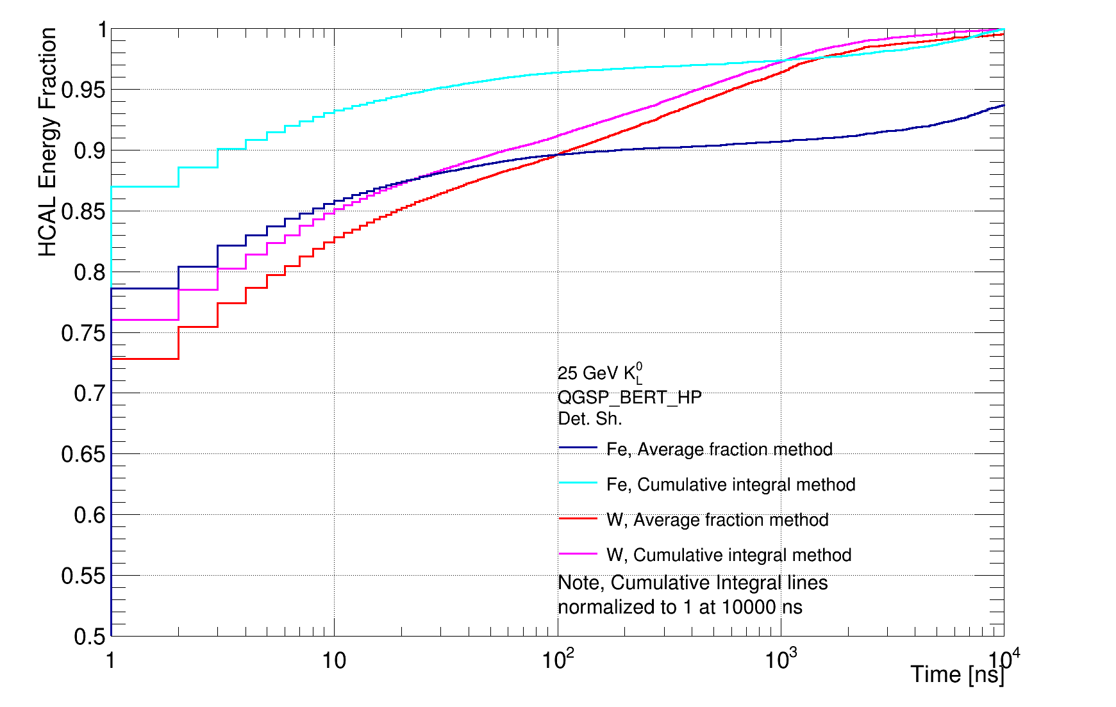
Cumulative Integral Vs Profile
Profile method (average of ratios) underestimates fraction. But wait: the normalization is not the same!

Slide 20
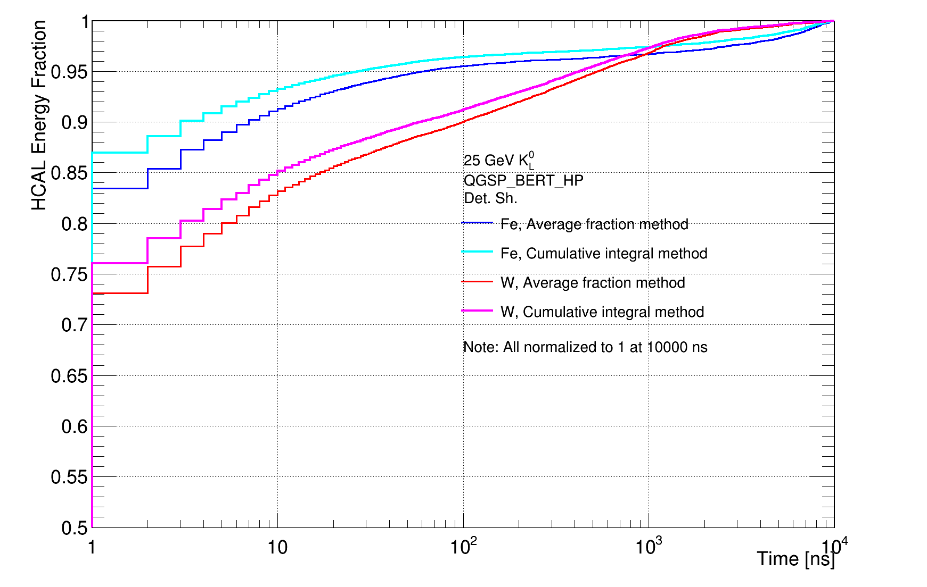
Cumulative Integral Vs Profile normalized to 10000 ns (set denominator to energy with t< 10000 ns)
Profile method (average of ratios) still underestimates energy fraction

Slide 21
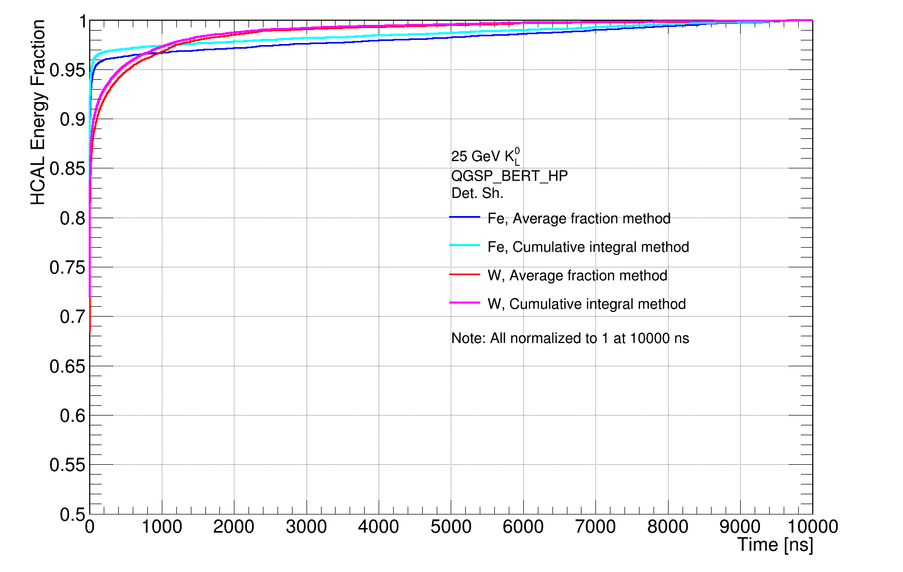
Same, linear X-axis

Slide 22
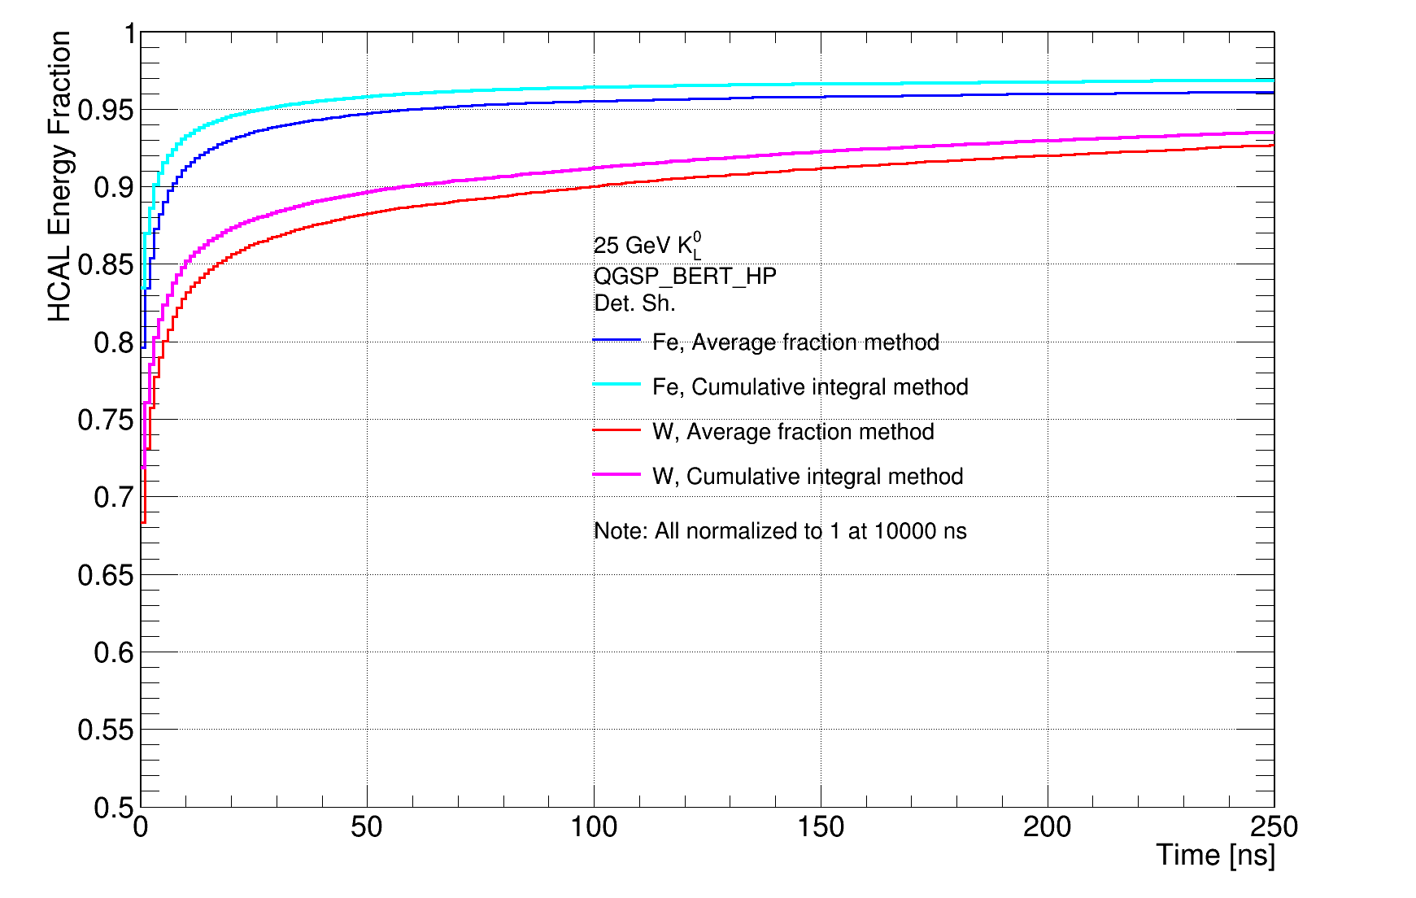
How does it look at 250 ns ?
Normalization similar to CDR, differences could be due to DS or an unknown cutoff (we used 10000 ns)

Slide 23
Cumulative Method With and Without DS

Slide 24
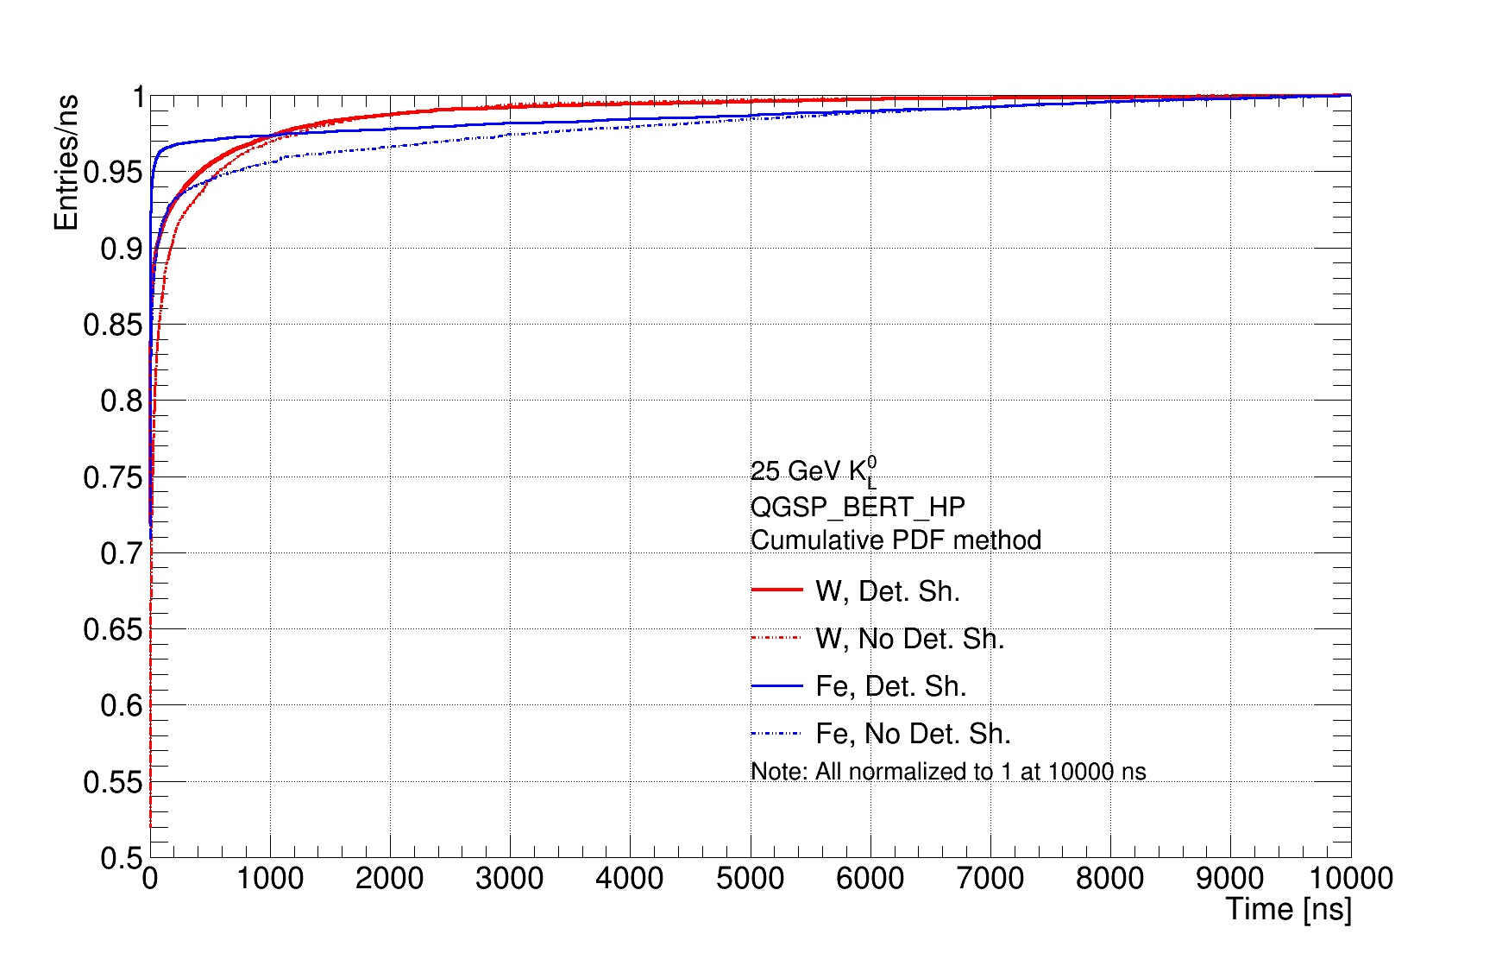
Cumulative Method With and Without DS
Linear scale

Slide 25
Conclusions
We definitely need to remake the CDR plot
  Don’t even show non-detailed shower lines
I believe we should stick to simple, undigitized hits (Geant4 output) to demonstrate the material properties (which the relevant section in the CDR addresses)
Which of the two quantities is more appropriate ?
  Profile: Puts the focus on individual events, i.e. “What is the most probable energy fraction I expect to get for a single event at a given time cut?”
  Cumulative PDF: Overall expected response of material, i.e. “What is the expected energy fraction for a given time cut?”
Also, is it meaningful to normalize to ~10000 ns?
  Could claim impractical to integrate more than that

Slide 26
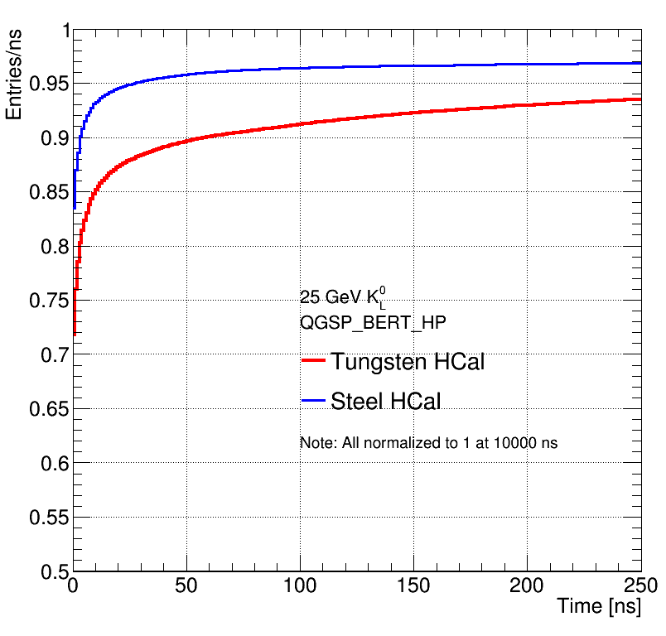
CDR Plot replacement?
(But misleading since normalized to 10000 ns)

