Slide 1
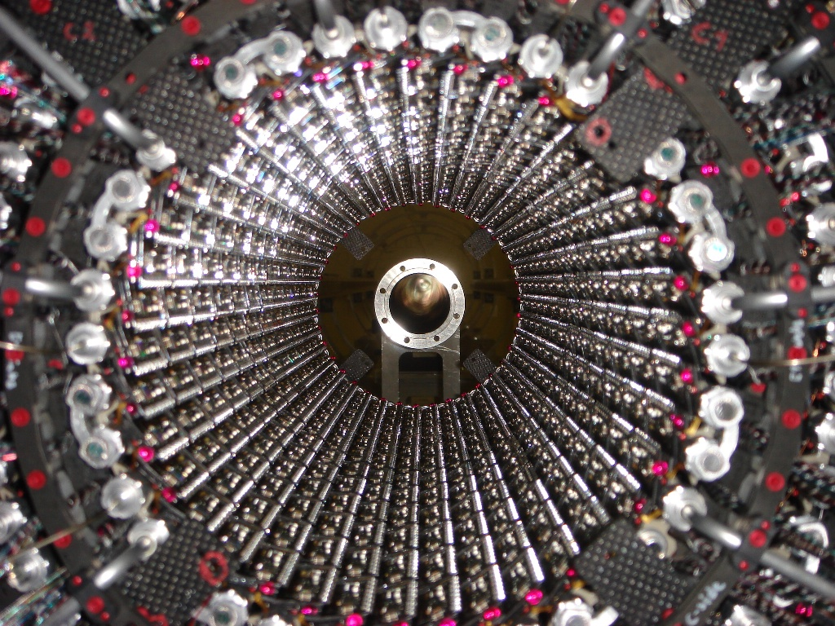
Upgrade Strategy for the Experimental Vacuum Systems
Ray Veness / CERN-AT-VAC
With thanks to R.Assmann, O.Bruning, R.Ostojic, E.Tsesmelis

Slide 2
Contents
Introduction
Organisation for the baseline vacuum system
Current work programme for consolidation and upgrades
Input required from experiments
Proposed strategy for upgrades
Conclusions and issues

Slide 3
Introduction
Background
  Baseline LHC experimental beampipe project started in 1993
  Last system commissioned in Sept. ‘08
Why do we need this talk?
  Designs ‘frozen’ 2000-2003, but with plans for consolidation
    Some requests for work from the experiments were not possible due to manpower limitations
    Some technology was shown to be unreliable without further development, and downgraded for later installation
  Machine and experimental upgrade plans advancing quickly
    Need a definition of the central beampipe radius for ATLAS and CMS PIXELS
    Impact of phase- I triplet upgrade on ATLAS and CMS needs to be analysed
  Missing some mandates to continue
    Baseline project is now complete and in ‘operation-shutdown’ mode
    Financial basis of upgrades needs renewing
    Technical scope, priorities and responsibility need updating

Slide 4
Organisation for the Baseline Systems
Structure
  ‘LHC Experimental Beampipes’ working group, active 1993-2004 reporting to LEMIC and then LHC Technical Committee reviewed from conceptual design to construction
  Design reviews and TDRs with experiments and machines closed the final designs
Scope
  Layouts and designs of chambers, supports and interfaces inside 4 LHC caverns, plus TOTEM Roman Pots
  Chamber geometries, machine and experimental physics requirements (aperture, impedance, RF, vacuum, background), follow-up of R&D
Resources
  All installed hardware funded by relevant experiment
  R&D, design, assembly, test, installation and management funded from a ‘work package’ given to AT-VAC in 2001
  Staff assigned to project by AT-VAC and other groups, design office and additional industrial support paid from AT work package

Slide 5
Current Work Programme for Beam Vacuum Consolidation and Upgrade
Consolidation
  ATLAS: Replace stainless VA (&VT) steel chambers and bellows with aluminium for background and ALARA reasons
  LHCb: Replace defective UX85/3 beryllium chamber, optimise UX85/2 supports, replace stainless steel bellows with aluminium
  CMS: Re-evaluate forward vacuum chamber supports and gas injection system operation for magnetic fields
Upgrades
  Machine insertion upgrade: New forward chambers in ATLAS and CMS, new TAS and/or TAS chambers, new VAX region (TAS-Q1)
  ATLAS: New (insertable) B-layer, tracker upgrade (beryllium) beampipe
  CMS Tracker upgrade (beryllium) beampipe,
  New materials and manufacturing methods for transparent chambers
  FP420-type forward physics moving beampipes
  Phase – II upgrade concepts

Slide 6
Apertures for Next Generation Beampipes
History
  ATLAS requested a smaller beampipe diameter in Z ±3.5m for B-layer and PIXEL upgrades
  Presentation to ATLAS tracker upgrade workshop in 2006 based on aperture requirement at injection (which was the limit for the current beampipe radius)
  A number of open questions remained to be answered, (eg, future optics and collimation) with final value expected some time after machine start-up
Information required from ATLAS and CMS
  Formal statement needed on range of β* in IR’s 1 and 5 required for physics
    TOTEM or other high β* optics required after phase – I triplet upgrade?
  Latest information on structural stability of experimental caverns
Next steps
  Calculate baseline aperture of beampipe in cavern, taking into account new information on triplet and collimation
  Make detailed simulations based on beam loss, background and machine protection before agreeing final value
Need a forum for advancing this in a structured way

Slide 7
Proposed Organisation for Upgrades
Re-activate ‘LHC Experimental Beampipes’ (LEB) Group
  Mandate for consolidation and upgrade (phase I and II) of vacuum sectors from Q1 to Q1, plus new forward physics experiments
  Vacuum chambers, support systems and interfaces with experiments and machine
  Constraints from experiments and machine, geometry, technology, project management
Membership
  1 member (TC or nominated) per experiment, representation from concerned machine groups, plus safety
  Reporting to ?
Urgent topics for discussion
  Definition of upgrade aperture in ATLAS and CMS
  Follow-up on consolidation projects, and scheduling

Slide 8
Conclusions and Issues
Baseline vacuum systems
  The design and follow-up of the currently installed systems was via a VAC-led working group called LEB. This worked well!
Current situation
  There are a large number of requests for consolidation and upgrade activities
  The financial basis, priorities and resourcing for these activities are not clearly defined
Proposed actions
  The LEB working group should be re-activated with an updated mandate and membership
  A budget for consolidation and upgrade of experimental vacuum should be agreed between the research and accelerator sectors, along with an associated resource plan

