Slide 1
Conductor for ERMC
Ballarino
18/11/2015

Slide 2
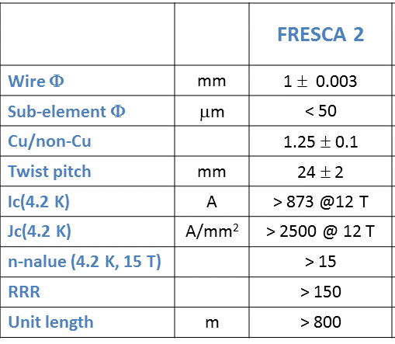
Conductor for ERMC
Fresca 2 wire
1 for ERMC
To be specified at 16 T
?
A. Ballarino

Slide 3
FRESCA 2 RRP Strand
RRP 132/169
Specified values
> 2500 A/mm²
> 150
Billet ID 1.0 mm 132/169 | Jc (4.2 K,15T) A/mm² OST | Jc (4.2 K,12T) A/mm² OST | Jc (4.2 K,12T) A/mm² CERN | RRR CERN
14310 | 1569/1627/1627 | 3020/3047/3026 | 2751/2810/2780 | 296/311/317
14311 | 1698/1624/1627 | 3119/3098/3071 | 2843/2781/2897 | 311/318/304
14312 | 1562/1557/1595 | 2967/2983/3040 | 2738/2739/2799 | 329/335
14108 | 1612/1599/1644 | 3102/3028/3090 | 2749 | 297
14393 | 1609/1641/1655 | 3006/3057/3102 | 2808/2940 | 281/267
14839 | 1540/1579/1599 | 2947/2943/3016 | 2746/2794/2793 | 201/241/218
14840 | 1646/1641/1604 | 3040/3051/3013 | 2743/2833/2800 | 222/250/288
14842 | 1617/1644/1594 | 3025/3058/3026 | 2656/2785/2664 | 222/263/230
Average value | 1613 A/mm² | 3036 A/mm² | 2783 A/mm² | 280
1240 A/mm²
@ 16 T
Cu/non Cu : 1.23 -1.32
50 hours at 650 °C
A. Ballarino

Slide 4
FRESCA 2 PIT Strand
PIT 192
Billet ID 1.0 mm | Jc (15T) A/mm² Bruker | Jc (12T) A/mm² CERN | RRR CERN
10503 | 1399 | 2508/2528 | 153/155
11201 | 1410 | 2451/2453/2616 | 160/172/175
10402 | 1353 | 2462/2477/2634 | 103/96/105/135
11302 | 1337 | 2519/2415 | 165
11403 | 1463/1507 | 2512/2507 | 154/173/179/201
23448 | 1403/1433 | 2442/2412 | 225/226/241/201
23258 | 1406/1382 | 2480/2447/24792391/2372/2446 | 159/161/201/209
23728 | 1518/1523 | 2548/2621 | 180/184/154/147
Average values | 1423 A/mm² | 2478 A/mm² | 176
1140 A/mm²
@ 16 T
Cu/non Cu ratio: 1.23 - 1.32
A. Ballarino

Slide 5
Hi-Luminosity Nb₃Sn Summary Table J_{c} & B_{c2} @ 4.22 K
 | Layout | Sub-Element size | RRR | J_{c} (12 T), RMS [A/mm²] | J_{c} (15 T), RMS [A/mm²] | J_{c} (16 T), RMS [A/mm²] | J_{c} (17 T), RMS [A/mm²] | B_{c2}, RMS [T] | Sub-Element Shape
0.7 mm RRP | 132/169 | 41 μm | 185, 64 | 2508, (2450) 125 | 1232, 81 | 924, 70 | 670, 60 | 23.2, 0.36 | Hex
 | 144/169 |  | 172, 30 | 2408, 146 | 1186, 104 | 888, 91 | 644, 80 | 23.2, 0.52
 | 150/169
0.85 mm RRP | 132/169 | 50 μm | 235, 52 | 2777, (2450) 81 | 1427, (1280) 55 | 1091, 48 | 814, 43 | 23.8, 0.3
0.7 mm PIT | 114 | 44 μm | 138, 34 | 2426, (2450) 66 | 1357, 50 | 1089, 45 | 845, 40 | 25.9, 0.32 | Circular
 | 120 |  | 103, 50 | 2302, 101 | 1284, 65 | 1027, 57 | 804, 49 | 25.8, 0.36
0.85 mm PIT | 192 | 41 μm | 175, 30 | 2340, (2450) 53 | 1306, (1280) 41 | 1047, 37 | 822, 34 | 25.8, 0.3

Slide 6
Procurement
50 km RRP + 50 km PIT
No Market Survey
IT + Spec Committee: Dec 2015 (very optimistic)
Offers by Febr 2015
No FC (two suppliers, below 700 kCHF)
6 months for raw material procurement +
6 months for production (in // with Hi-Lumi wire)
Delivery: Febr 2016 (we can try Dec 2016)
Spec and procurement by Bernardo

Slide 7
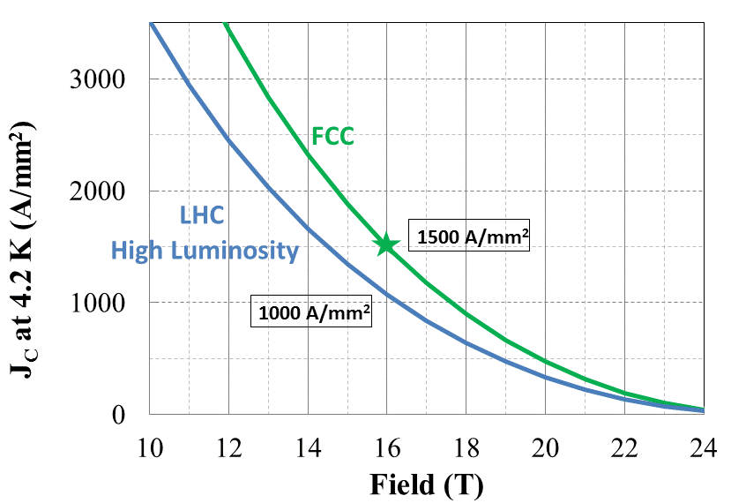
Nb₃Sn Targets for FCC
FCC Target
A. Ballarino

Slide 8
FCC: Nb₃Sn Development targets
Wire diameter | mm | ∼ 1
Non-Cu Jc (16 T, 4.2 K)* Cu/non-Cu | A/mm² | 1500 1
μοΔM(1 T, 4.2 K) | mT | ≤ 150
σ(μοΔM) (1 T, 4.2 K) | % | ≤ 4.5
Deff | μm | ≤ 60 (20)
RRR | - | ∼ 150
Unit length | km | ≥ 5
Cost | Euro/kA m** | ∼ 5

Slide 9
Development program-Nb₃Sn wire
Four years program
Industry: Korea, Russia, Japan, Europe
European laboratories for characterization studies
FC Dec 2015: Japan (KEK), Russia
FC March 2016: Europe (Bruker), Korea – discussions
started

