Slide 1

FuturE circular collider MAGNETS TECHNOLOGIES
Wound Conductor Test Facilities
(TASK 2)
Status of visits performed at labs
Friedrich Lackner, November 18th, 2015
Acknowledgements:
Bernhard Auchmann, Amalia Ballarino, Emanuala Barzi, Johannes Bernardi, Thomas Baumgartner, Luca Bottura, Bernardo Bordini, Pierluigi Bruzzone, Shlomo Caspi, Michael Eisterer, Jerome Fleiter, Carmine Senatore, Christian Scheuerlein, Davide Tomassini, Davide Uglietti, Arjan Verweij, Gerard Willering,

Slide 2
Task 2.1
Characterization of Cable Processing and Splicing
Description
Review of existing instrumentation and tools presently in use at CERN and at partner institutes to characterize the electromechanical performance of Nb₃Sn cables
September 2015: FNAL, UNIGE, TU-Wien – Atominstitut;
2015 - 2016: TWENTE, PSI, NHMFL;
Design and set-up of a tool to characterize the cable wind-ability;
Design and set-up a tool to test splices under different mechanical constraints.
Deliverables
D1: Critical review of existing tools including internal review, 6 months;
D3: Procurement/fabrication, instrumentation and splicing methods, 3 months;
D2: Proposal tools and test program n, commissioning, 6 months;
D4: Test campaigns, 36 months.

Slide 3
Task 2.2
Impregnated wound conductor insert
Description
Review of existing instrumentation and tools presently in use at CERN and at partner institutes to characterize the electromechanical performance of Nb₃Sn superconductors;
Enhancement of an existing tool or design and manufacture of a new tool capable of exploring the electromechanical behavior of impregnated wound conductors as a function of different parameters, in particular the superconductor itself, the insulation schemes, the heat treatment, the impregnation, the role and possible transformation of the binder. It is important that the tool allows to explore different configurations (different samples and different testing conditions, load, magnetic field, current) with a short lead time;
Organize an internal review of the selected proposal as well as of the relevant test program;
The work also includes, where needed, the setting up of tailored instrumentation tools in particular to provide an accurate characterization of the structural conditions of the sample;
Perform the tests and analyze the relevant results.
Deliverables
D1: Critical review of existing tools, 6 months;
D2: Proposal of tools and test program, including internal review, 6 months;
D3: Procurement/fabrication, commissioning, 18 months;
D4: Test campaigns, 24 months;

Slide 4
CERN contributors to task 2
Person/Section | Task
TE-MSC-LMF
F. Lackner | Coordination
S. Triquet | Tooling
E. Grospelier | Tooling & design (will leave LMF in 2016)
N. Dalexandro | Splicing
D. Pulikowski | PhD student, windability + instrumentation aspects
P. Ebermann | PhD student (November 1st), complementary test setup
Fellow 1 + 2 | To be hired, testing + instrumentation + splicing
TE-MSC-SCD
EN-MME | Contributions to test campaigns

Slide 5
Overview on visits:
Visits | Date | Persons
163 | Aug. 2015 | J. Fleiter
UNIGE | Sept.2015 | C. Senatore
FNAL | Sept.2015 | 11T collaboration
MT24 | Oct.2015
PSI | Oct.2015 | P. Bruzzone
AIT | Oct.2015 | M. Eisterer
USTEM | Oct.2015 | J. Bernardi
AuM | Oct.2015 | N. Durakbasa
TWENTE | Contacted | M. Dhalle
NHMFL | ?

Slide 6
Wire tests and facilities

Slide 7
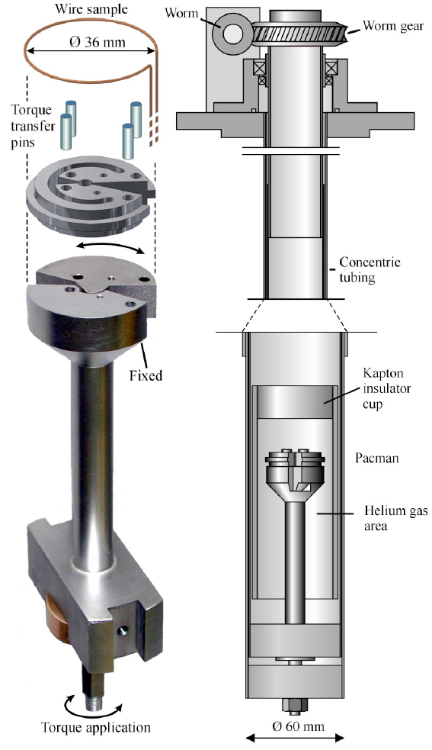
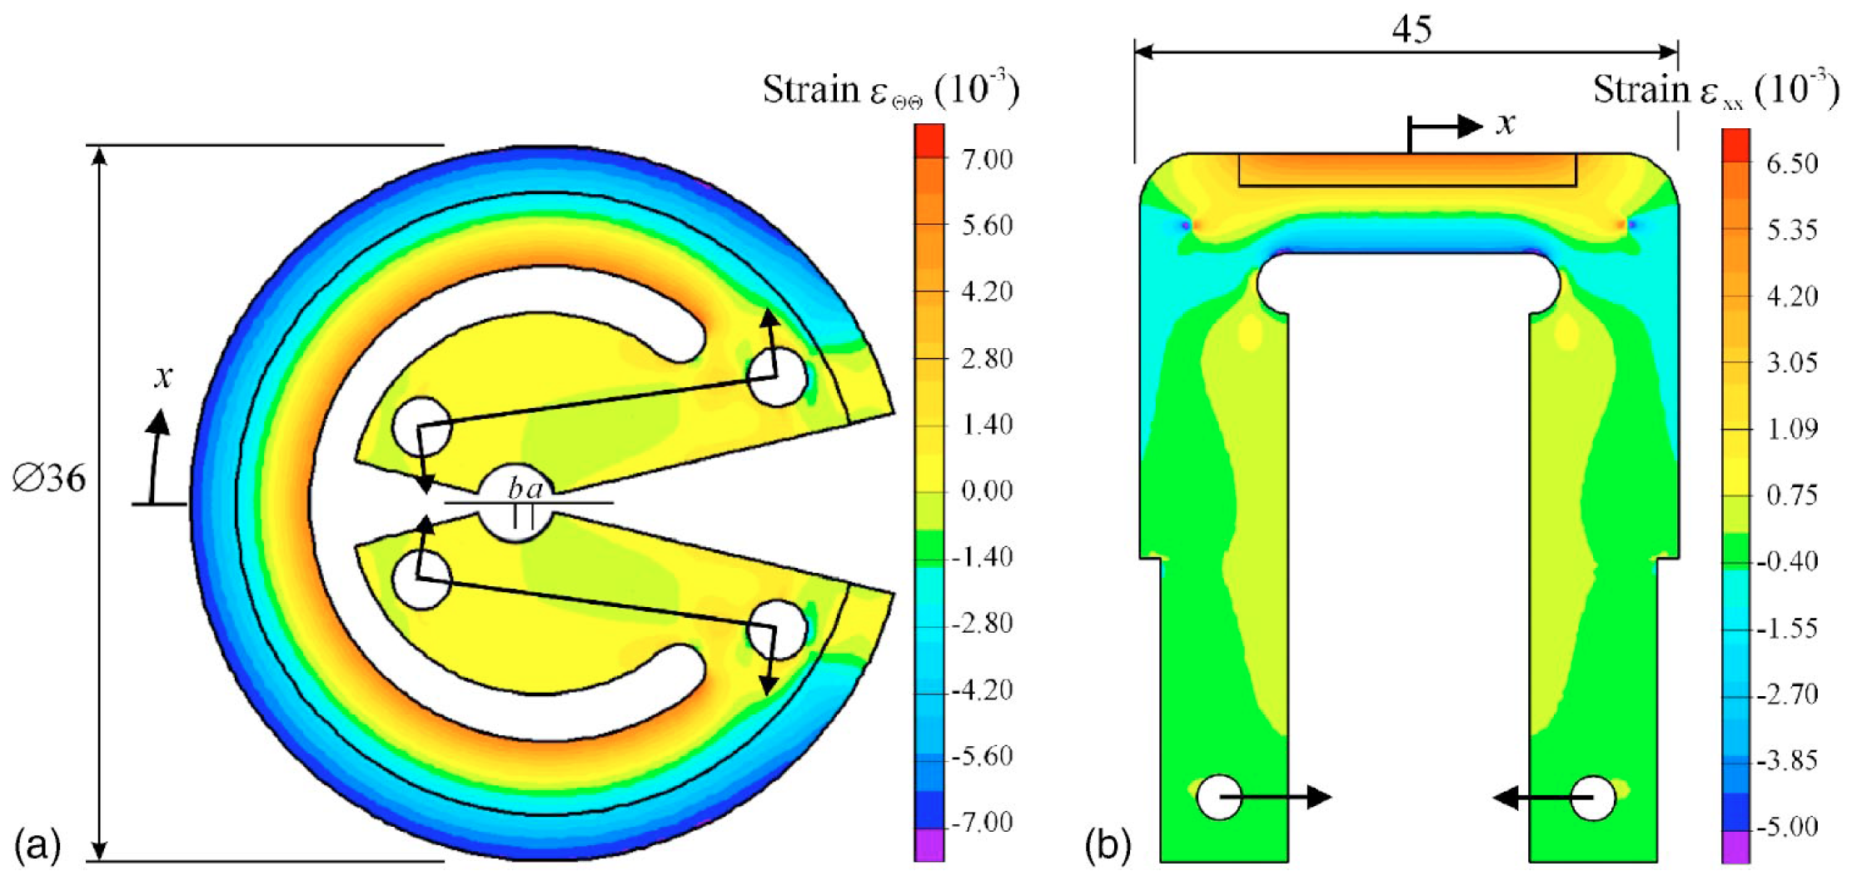
Uniaxial tensile and compression
1) Samples are soldered onto a sample holder:
So-called Walters spring, e.g. used at
NIST, University of Geneva.
Bending spring (so-called Pacman), e.g. used at University of Twente.
Finite element simulations on the practical planar shape of the Pacman (a) and on a U spring (b)
A device to investigate the axial strain dependence of the critical current density in superconductors
A. Godeke,a) M. Dhalle, A. Morelli, L. Stobbelaar, H. van Weeren, H. J. N. van Eck,
W. Abbas, A. Nijhuis, A. den Ouden, and B. ten Haken
Low Temperature Division, Faculty of Science and Technology, University of Twente, P.O. Box 217,
7500 AE, Enschede, The Netherlands

Slide 8
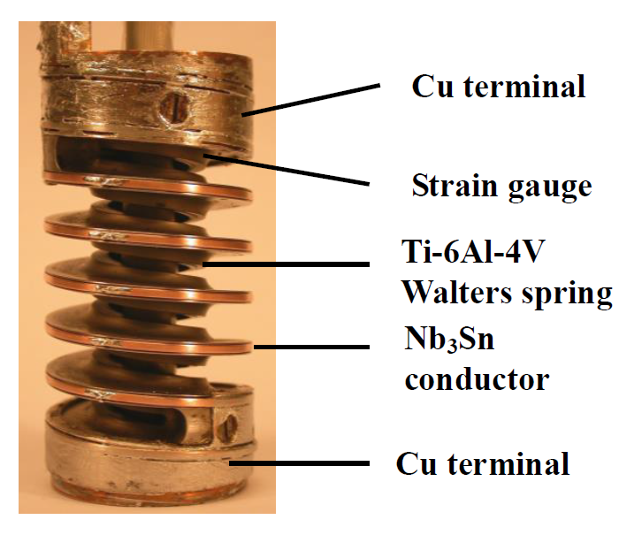
Uniaxial tensile and compression
Spring materials:
Ti–6Al–4V with an upper elastic strain limit at 4.2 K of 1.3%.
Cu–2Be (UNS C17200) with 1.0% upper elastic strain limit at 4.2 K.
The magnetic field is applied in parallel to the spring axis.
Rotation angle and elastic strain is computed by FEA and compared with the
readings of the strain measurement.
Walters Spring Probe. Courtesy of the Applied Superconductivity Group of the University of Geneva.
Long sample high sensitivity critical current measurements under strain,
C. R. Walters, I. M. Davidson, and G. E. Tuck
Cryogenics, vol. 26, pp. 406–412, Jul. 1986.
Toward a standard for critical current
versus axial strain measurements of
Nb₃Sn
B. Seeber, G. Mondonico and C. Senatore
Supercond. Sci. Technol. 25 (2012)

Slide 9
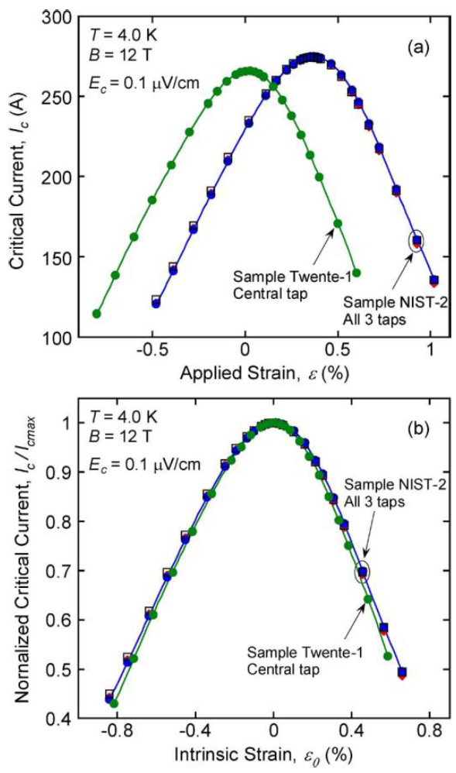
Uniaxial tensile and compression
Comparison of the εmax values measured with Walters spring and Pacman:
Thermal contraction from 456 to 4.2 K is ΔL/L=-0.30 and
ΔL/L=-0.61 for Ti-6Al-4V and Cu-2wt.%Be, respectively.
Strain and Magnetic-Field Characterization of a Bronze-Route ITER Wire: Benchmarking of Strain Measurement Facilities at NIST and University of Twente”, IEEE Trans. Appl. Supercond. 22(3), (2012)
N. Cheggour, A. Nijhuis, H. J. G. Krooshoop, X. F. Lu, J. Splett, T. C. Stauffer, L. F. Goodrich, M. C. Jewell, A. Devred, Y. Nabara,
Strain Dependence of Critical Current in Bi2212
W & R Wires Under Magnetic Field Up to 30 T
M. Sugano, K. Itoh, and T. Kiyoshi, IEEE Trans. Appl. Supercond. 16(2), (2006)

Slide 10
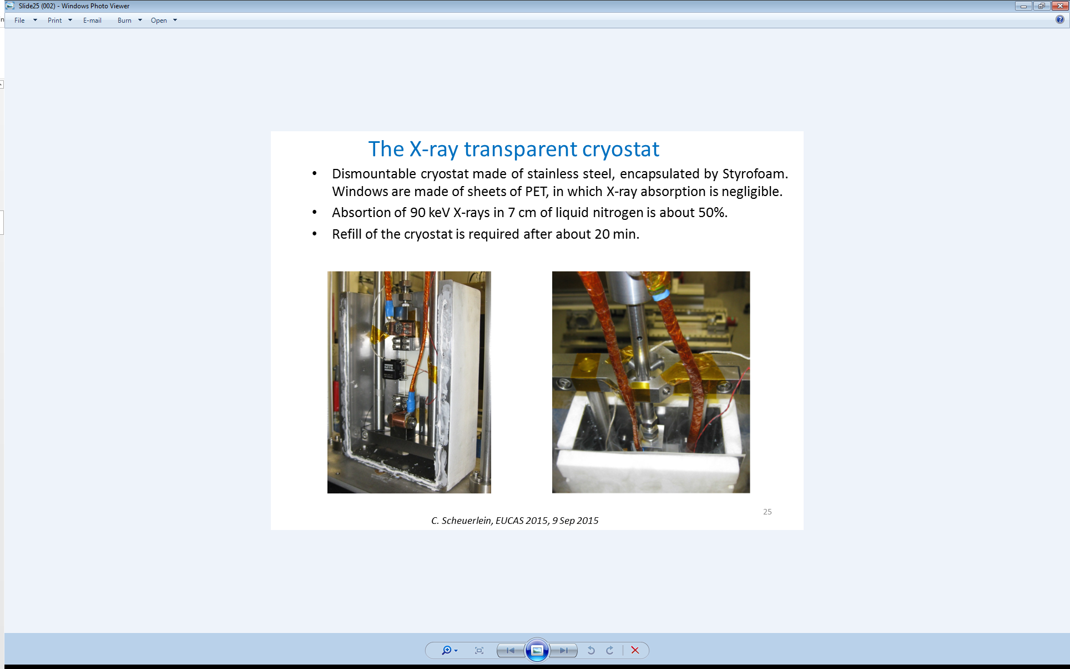
Irreversible damage characterization
2) Samples can freely contract during cool down for irreversible damage characterisation. Developed for strand measurements but potential to be used for cables.
Measurement in self field at 77 K. Adding cryocooler would allow to measure below T_{crit} of Nb₃Sn.
Reversible degradation of Nb₃Sn must be studied under operating temperature and field;
Irreversible degradation of conductor could be performed without applied field and below T_{crit} (but above 4.2 K).
Potential for measurments under transversal pressure would need development.
Simultaneous measurement of critical current, stress, strain and lattice distortions in high temperature superconductors
C. Scheuerlein et al. EUCAS 2015, invited talk

Slide 11
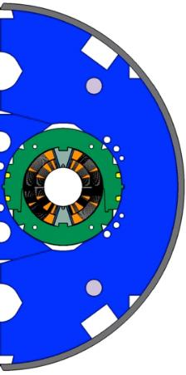
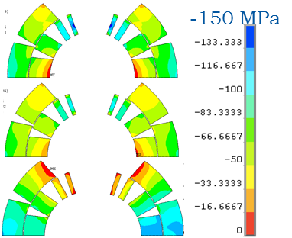
Load case in accelerator magnet coils
Dominant load case: transversal stress
Typical stresses up to 200 MPa
2-in-1 structure, 11T dipole

Slide 12
Transversal compression wire
Developed by University Geneva with the aim to o compare wire degradation under transversal compressive stress.
Constrained in a U-shaped groove and is pressed by an upper anvil that fits the groove. Confinement within four walls, measuring effects of compressive stress on impregnated wires.
Electro-mechanical properties of PIT Nb₃Sn
wires under transverse stress: experimental
results and FEM analysis
C. Calzolaio, G. Mondonico, A. Ballarino, B. Bordini, L. Bottura,
L. Oberli and C. Senatore.

Slide 13
Cable tests and facilities

Slide 14
Preliminary status, to be updated…
 |  | CERN FRESCA | EPFL-CRPP SULTAN | EPFL-CRPP EDIPO | TWENTE
Current supply |  | RT-PS or cold transformer | SC transformer | SC transformer | SC transformer
Max. field | (T) | 10 (dipole) | 11 (solenoid) | 12.35 (dipole) | 15 (solenoid)
Max. DC current (kA) | kA | ~40, being upgraded | 100 | 100 | 45
Operating Temperature (K) | K | 1.8 or 4.3 | 4.5 – 10 | 4.5 - 50 | 4.3
Insert | mm | Ø 70 | 94 x 142 | 89 x 138 | U & helical
Max. field region length | mm | 800 (600 – 1% homogeneity, 10T) |  | 900 (680 - 0.5% homogeneity, 12.3T)
Mechanical constraints (MPa) | MPa | YES at RT | YES at RT | YES at RT
Current distr. measurement |  | YES | YES | YES | NO
Specific functions |  |  | AC field 0.43T ≤10 Hz, 80 channels DAQ | AC field 0.312 T f ≤ 0.8 Hz,
Sample mounting |  | Vertical insert | Vertical insert | Vertical insert
Preparation |  | Careful preparation, demanding

Slide 15
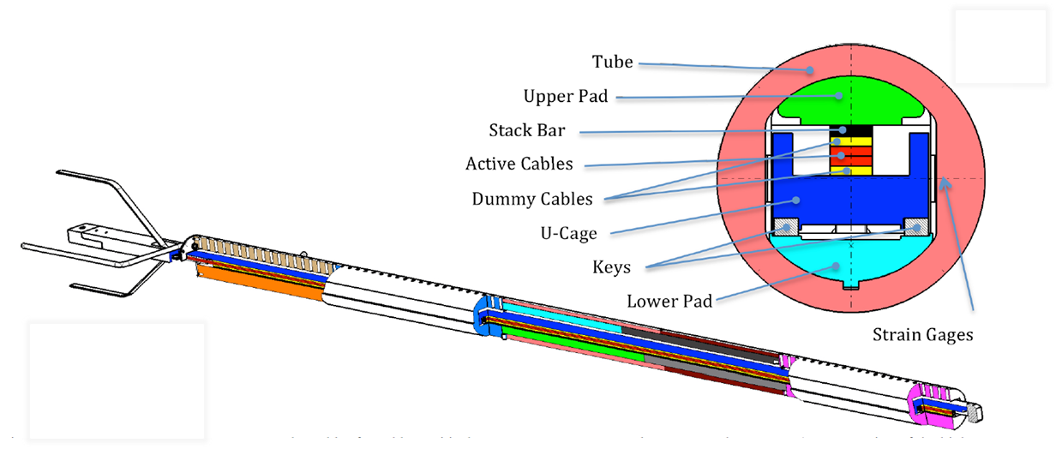
CERN - FRESCA
Transversal force: 2 MN/m
Cable length: 1.8 m
Transversal load ε_{th}: 90 MPa to 155 MPa
10 mm wide Rutherford cable
Fits into the Ø70 mm bore of FRESCA
Critical Current Measurements of High-Jc Nb3Sn
Rutherford Cables under Transverse Compression
B. Bordini, P. Alknes, A. Ballarino, L. Bottura, L. Oberli, MT23, 2013.

Slide 16
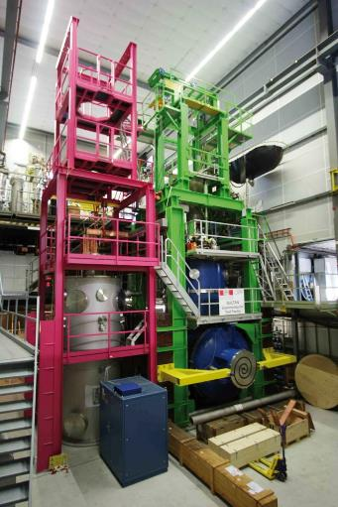
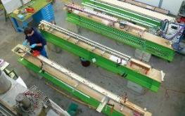
EPFL - PSI
Electromagnetic cycling
Thermal cycling of large CICC conductors
100% in use for testing of ITER CICC foreseen reduction in 2016 to 70%
Up to 10000 cycles to investigate cable degradation at the nominal operating conditions
Demanding sample preparation
ITER Conductors from Design, through Specification, Qualification, Production and Test
Pierluigi Bruzzone EPFL-CRPP, Villigen, Switzerland

Slide 17
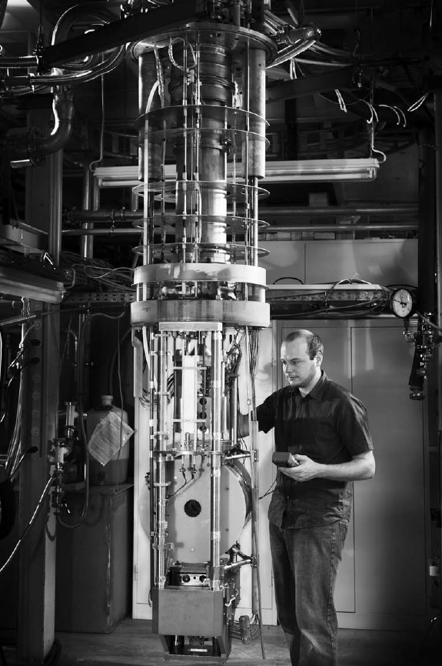
KIT - FBI
FBI (F force, B magnetic field, I current)
Measurement Facility for High Temperature
Superconducting Cable Designs
Critical current of a cable up to 10 kA
With an LTS split coil magnet of 12 T and a sample gap of 80 × 40 mm²
Different HTS cable types can be measured
Mechanical forces can be applied up to 100 kN in axial direction of a cable based on a electromechanical tensile machine
FBI Measurement Facility for High Temperature
Superconducting Cable Designs
C. Bayer, C. Barth, P. V. Gade, K.-P. Weiss, and R. Heller
IEEE TRANSACTIONS ON APPLIED SUPERCONDUCTIVITY, VOL. 24, NO. 3, JUNE 2014
Imax =10 kA
Bmax =12 T
Fmax =100 kN.

Slide 18
FNAL
The cable sample (1)
Inconel plates (2)
Inconel rod assembly (3)
Top plate welded to Inconel tube (4)
Inconel tube (5) welded to the top flange
Copper leads (6) including a pair of Nb₃Sn strand splices.
Test setup
Transverse pressure: Hydraulic cylinder 20 t
Current up to 2000 A
Operating temperature 4.2 K
Transverse magnetic field up to 12 T
Tests were carried out at pressures up to 200 MPa
14 mm wide Rutherford-type cables, 28 Nb₃Sn strands 1 mm in diameter
Sample after impregnation
Sensitivity of Nb₃Sn Rutherford-type cables to transverse pressure
E. Barzi , T. Wokas, and A. V. Zlobin
Fermi National Accelerator Laboratory
Batavia, Illinois 60510, USA

Slide 19
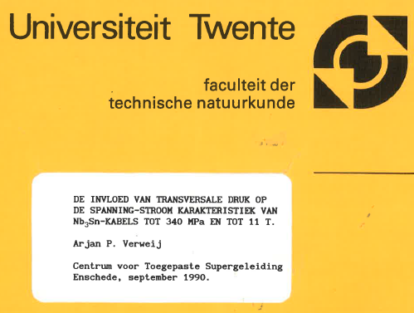
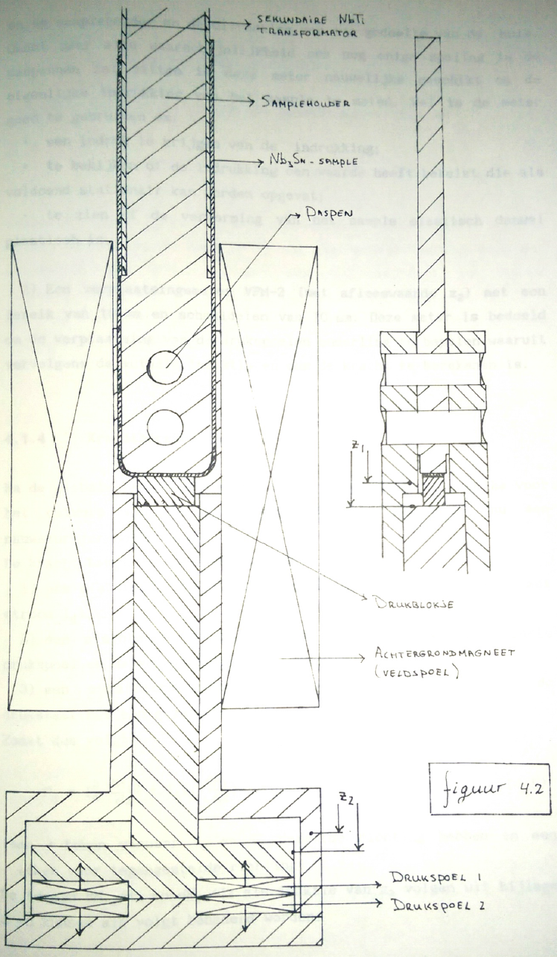
TWENTE
Master Thesis A. Verweij
Alternative concept for electromechanical cable characterization:
Magnetic press for cable testing, still operational…

Slide 20
Cable windability

Slide 21
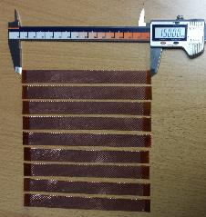
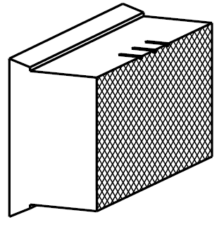
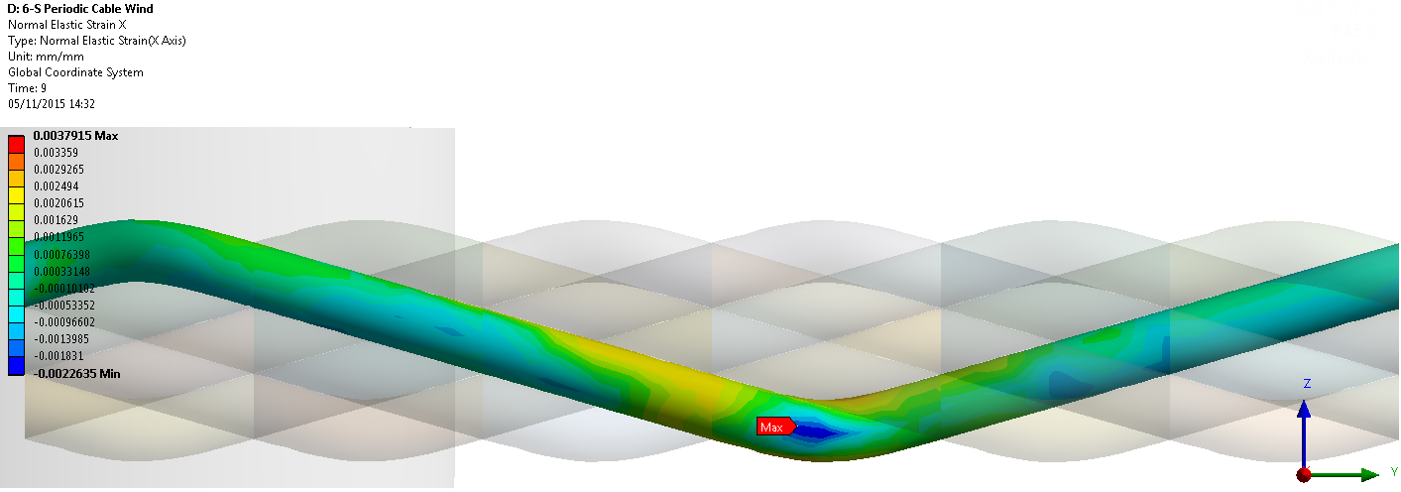
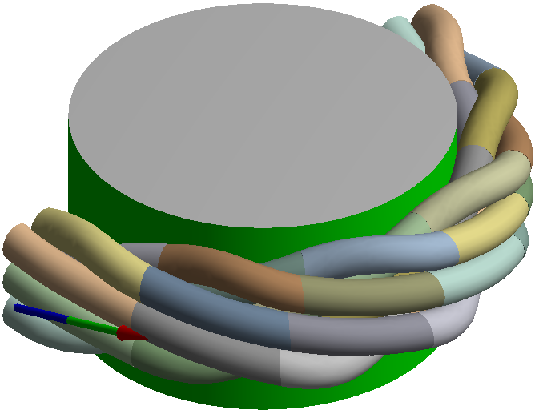
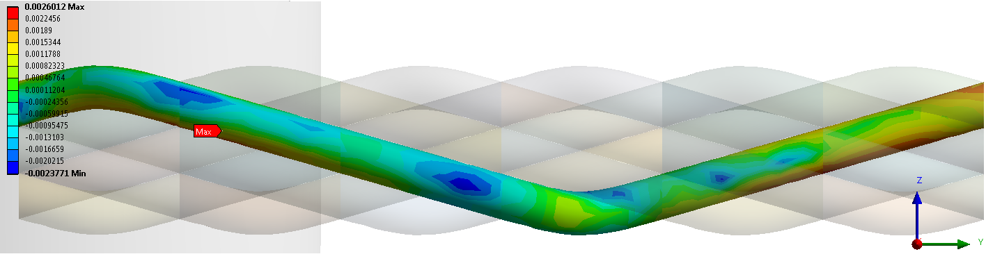
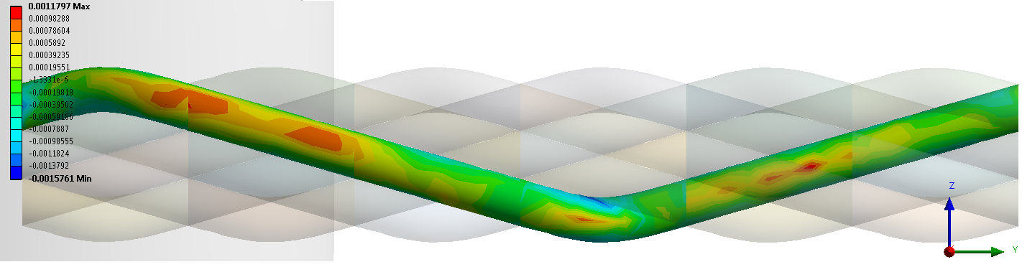
Task 2.1
Mechanical characterization for winding process “wind-ability”:
Tensile test conducted with EN-MME
Preparation of test samples
New clamping tool, specific for 11T cable geometry
X-axis
Y-axis
Work ongoing by Dariusz Pulikowski (PhD student Poland - CERN)
Presentation on status on Friday, Nov. 20th, meeting room bldg. 180.
Z-axis

