Slide 1
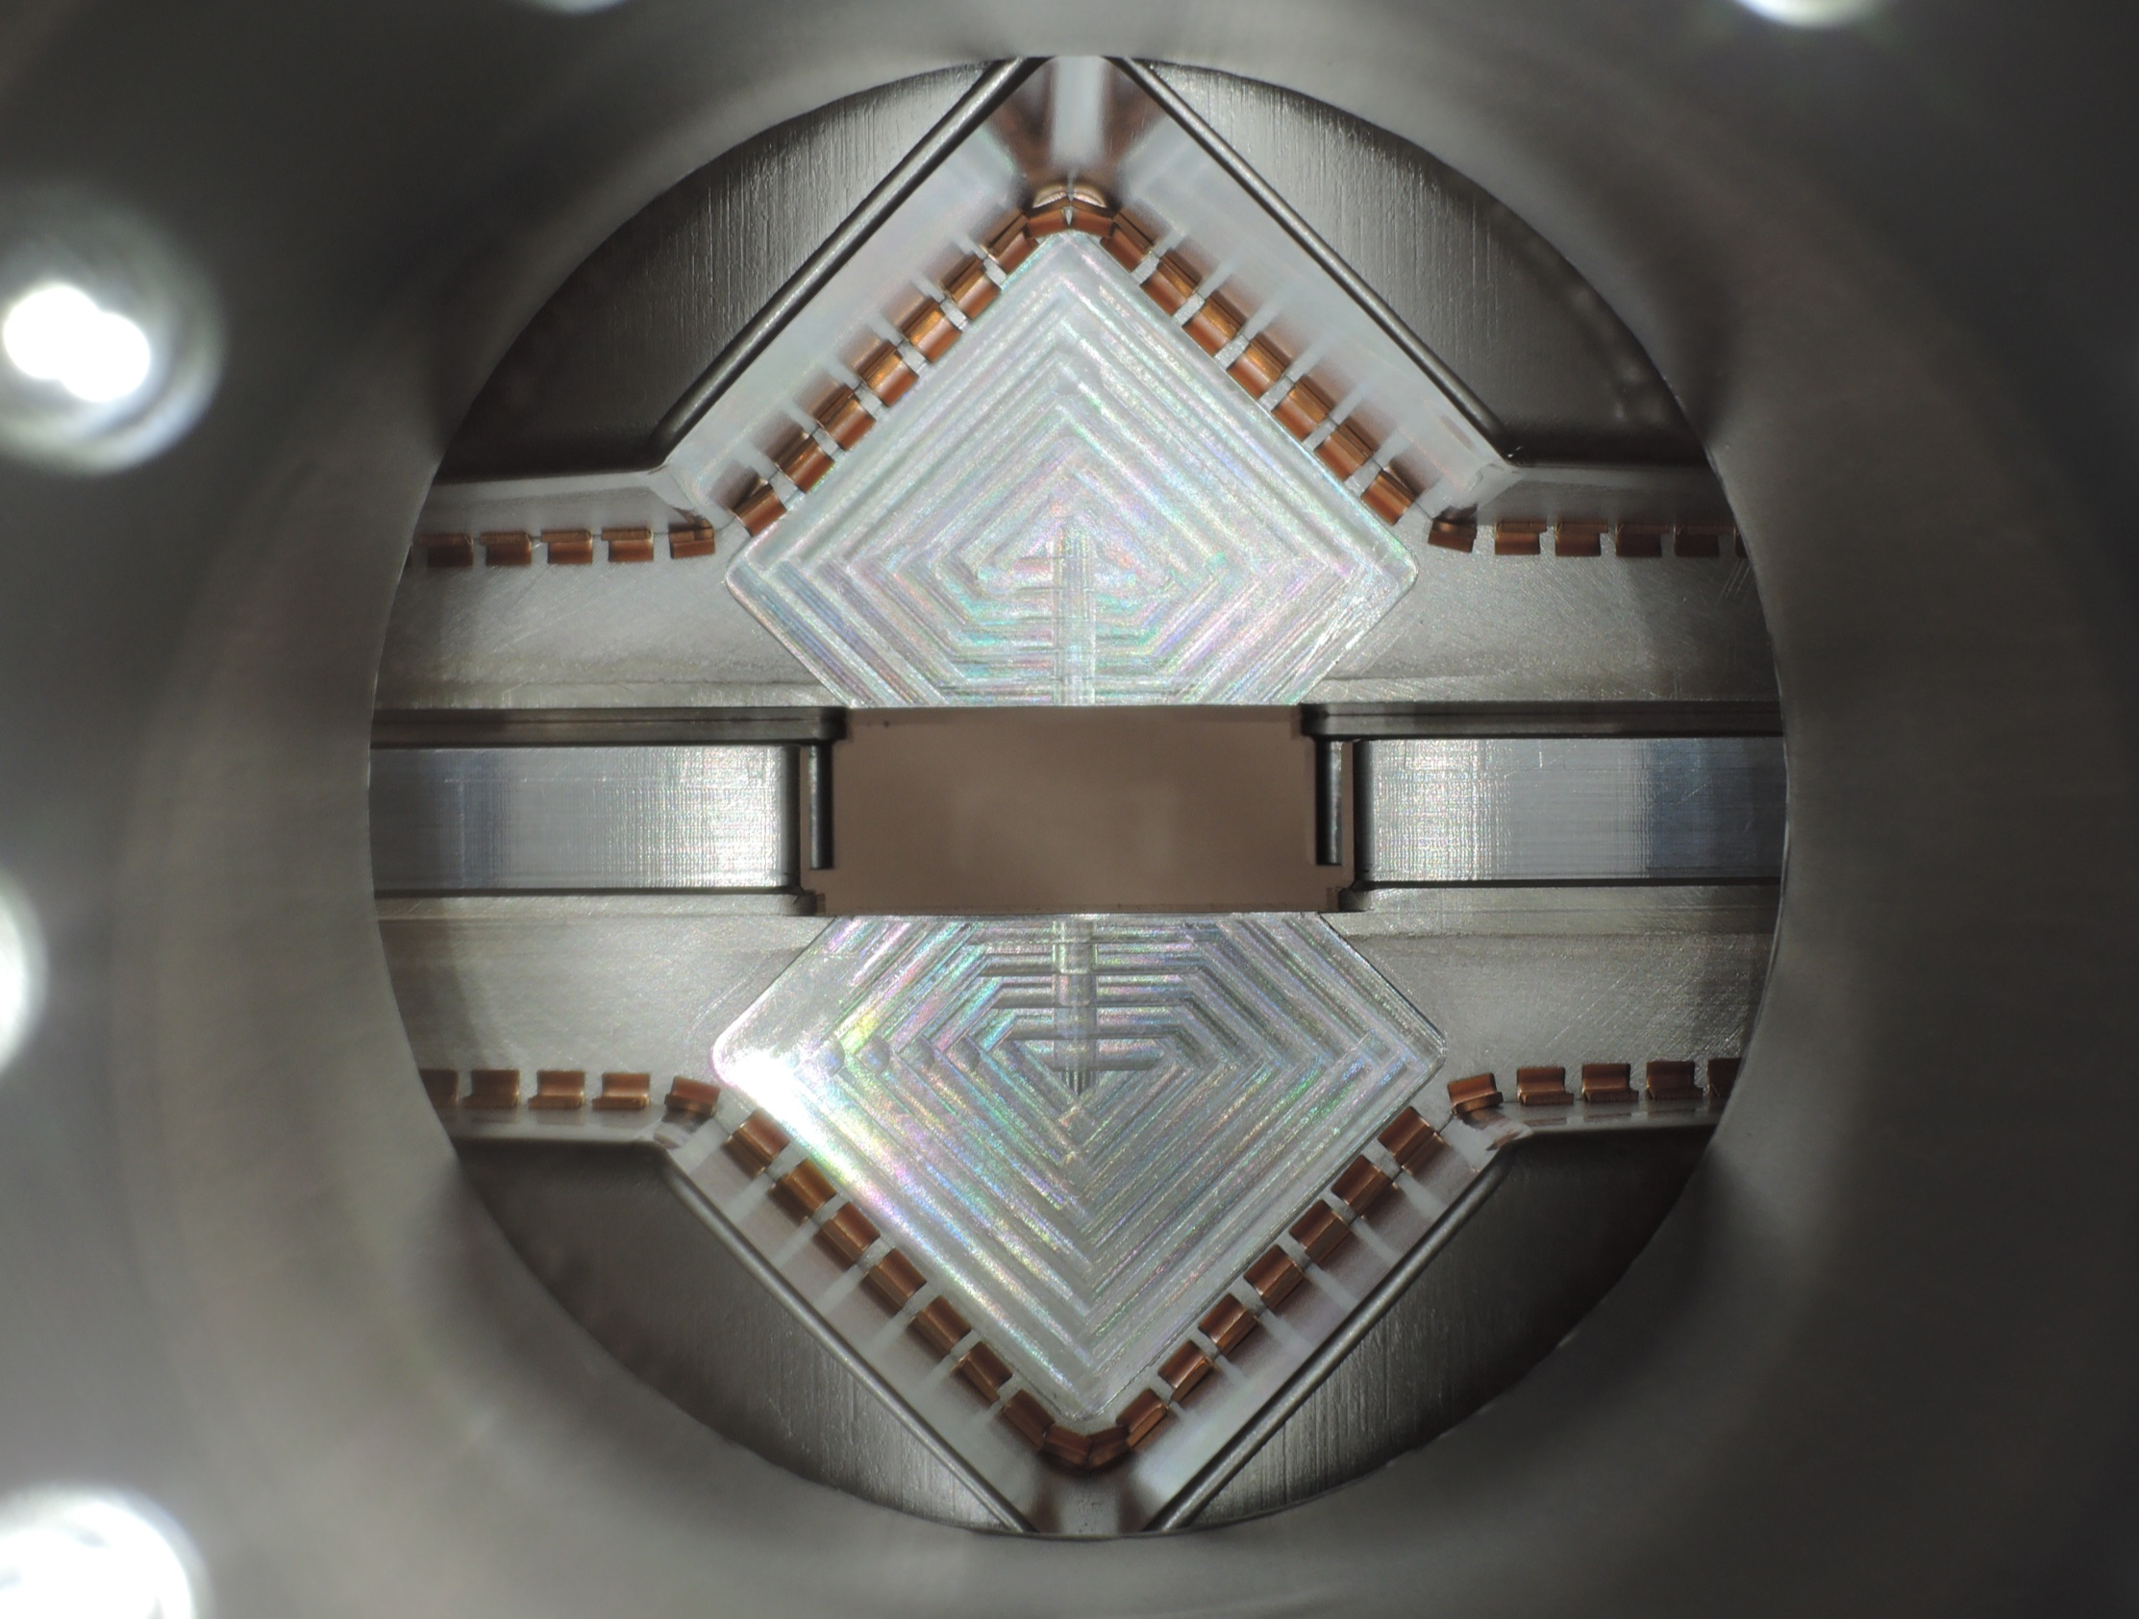
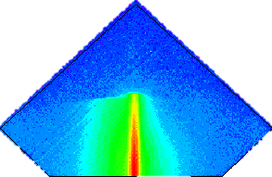
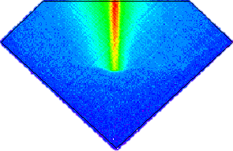
ATLAS/ALFA operation at β*=90m
K. Hiller on behalf of ATLAS
Photos S. Jakobsen

Slide 2
Outline of the talk:
Reminder about detector & physics
6 days of β* = 90m running
Physics prospects

Slide 3
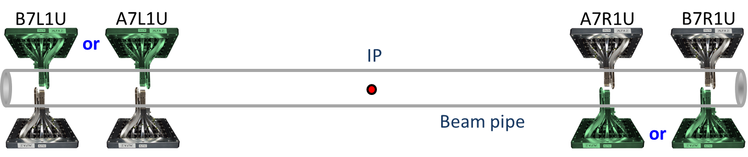
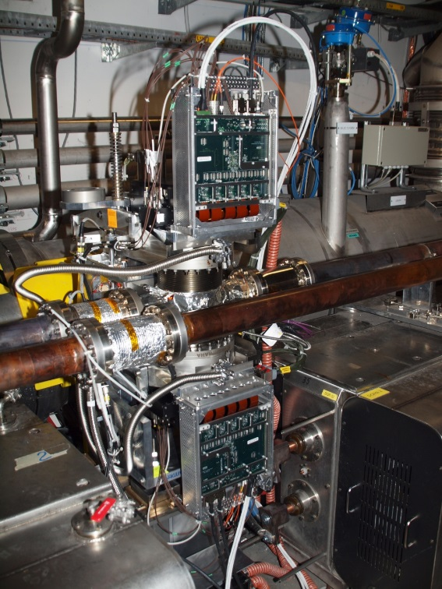
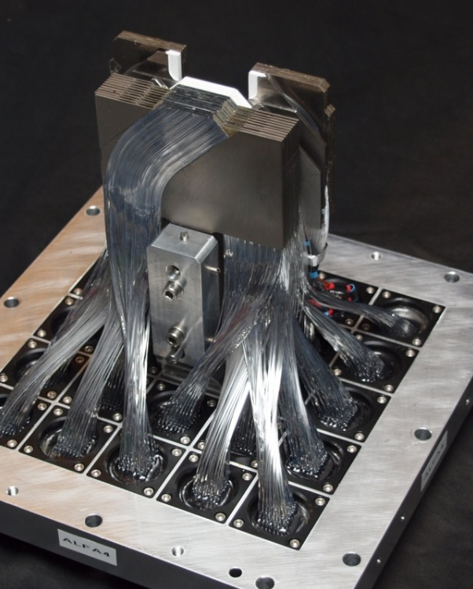
The ALFA detector
ATLAS
2 x 2 stations
~ 240 m from ATLAS IP
8 fiber detectors with
2 x 10 layers of 0.5 mm
quadratic fibers
Movable in vertical
direction
Resolution ~ 35 μm

Slide 4
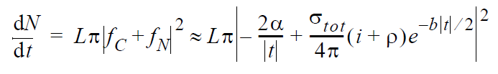
ALFA physics – elastics program
Measurement of luminosity and total cross section by elastic scattering at very low t
In dependence on t-range two
options:
1. Only nuclear scattering and
luminosity from ATLAS → σ_{tot}
2. Coulomb + nuclear scattering:
→ Luminosity and σ_{tot}
Key parameter: small t_{min} requires
small emittance ε_{N} , close distance N_{σ}
and large β*
To access this region:
β* > 2km, ε < 2 μrad, N_{σ} < 5
Steep Coulomb part

Slide 5
ALFA physics – diffraction
Different beam optics allows access to different kinematic regions
Many diffractive triggers ALFA + MBTS / LUCID / ID / calorimeters in the menu
Contrary to standard β* = 0.55 m collision optics, β* = 90 m covers the full ξ-range
Potential analysis topics:
Inclusive single diffraction: cross section, ξ / t – spectra
Inclusive central production: ….
Central exclusive production: double Pomeron / photon-Pomeron processes
Hard diffraction with jets

Slide 6
6 days of β*=90m running

Slide 7
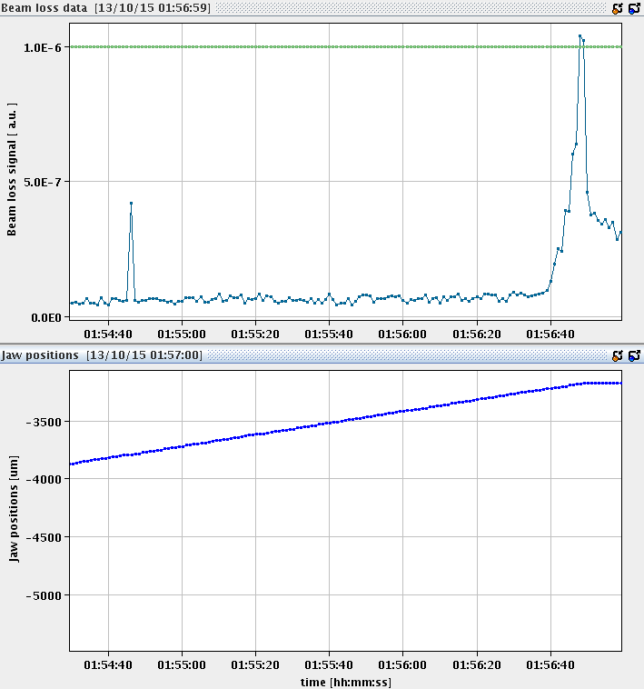
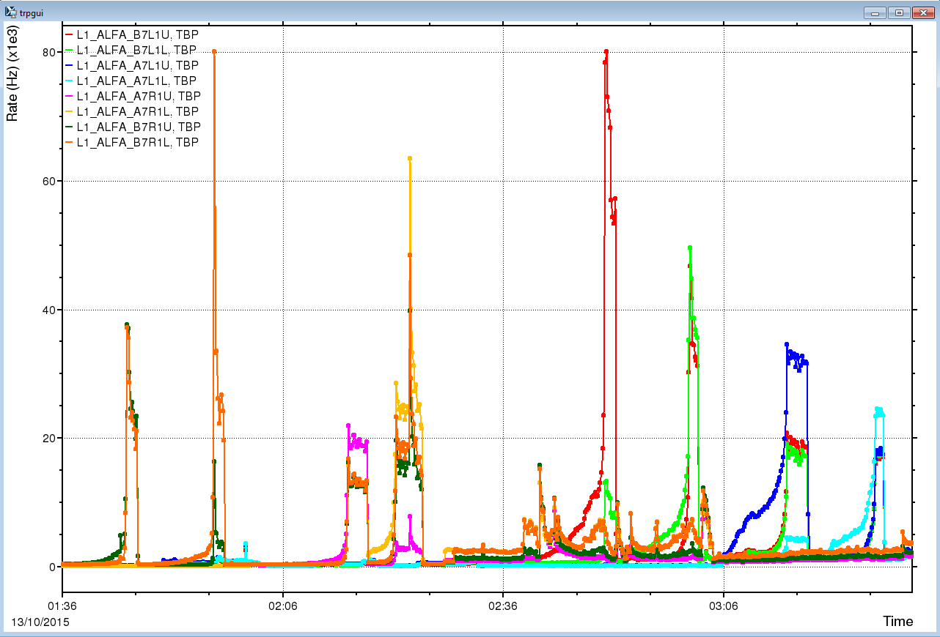
Day#1: beam based alignment
Touch the beam edge with the Roman Pots to measure the center of the beam
Necessary for machine protection, if detectors for physics are closest to the beam
These positions violate the collimator hierarchy and are only allowed for low intensities
ALFA position and BLM signal
ALFA detector trigger rates during alignment
S.Jakobsen
B7R1U.B1
B7R1L.B1
A7R1U.B1
A7R1L.B1
B7L1L.B2
A7L1U.B2
A7L1L.B2
B7L1U.B2
P.Fassnacht
All done after ~ 2.5 hours

Slide 8
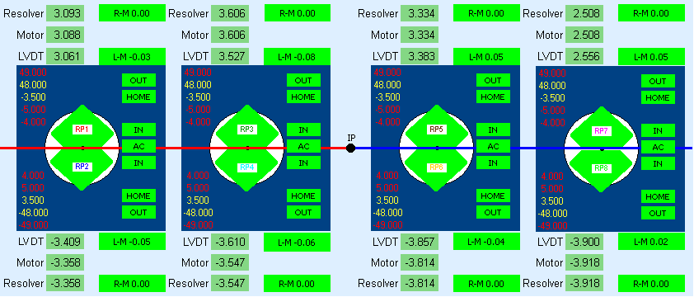
Day#2: elastics part#1
After the alignment the Roman Pots where moved to 4.5 σ_{nominal}
But the background was too high, so the Roman Pots were moved out to 5.5 σ_{nominal}
Detectors at 3 – 4 mm distance to the beam center, ~ 600 μm to the beam edge
For luminosity cross check by vertex counting IBL was included in readout
L.Seabra
After about 2 hours beam was dumped by machine
Collected: 17 million physics, 6.5 million elastic, 45 million calibration triggers
Caveat: crossing angle 50 μrad not removed, alternative sample …

Slide 9
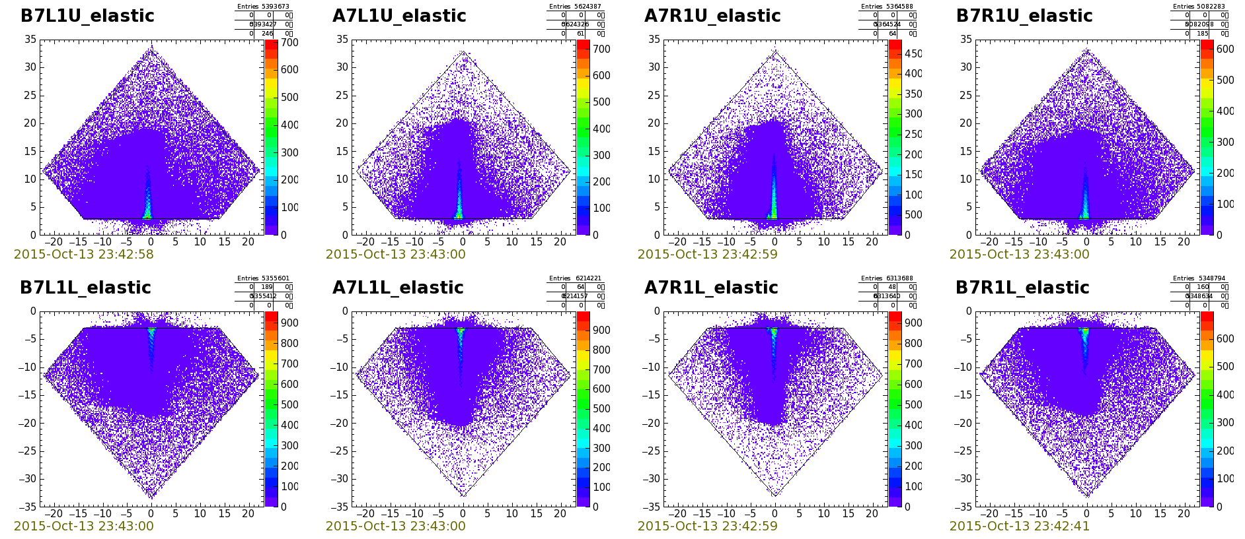
Day#2: elastics part#2
Refill LHC with 3 bunches ~ 8E10 plus up to 10 pilot bunches ~ 1E10
Move the Roman Pots again to 5.5 σ_{nominal}
Follow data recording by farm processing for various groups of trigger items
Now w/o IBL in readout to allow higher trigger and storage rates
K.Korcyl
After about 4.5 hours beam was dumped by operator !!!
Collected: 40 million physics, 11 million elastic, 450 million calibration triggers
Data w/o crossing angle for standard elastics analysis
Qualification by loss map tests for Roman Pots at 10 σ successful, originally 12 σ

Slide 10
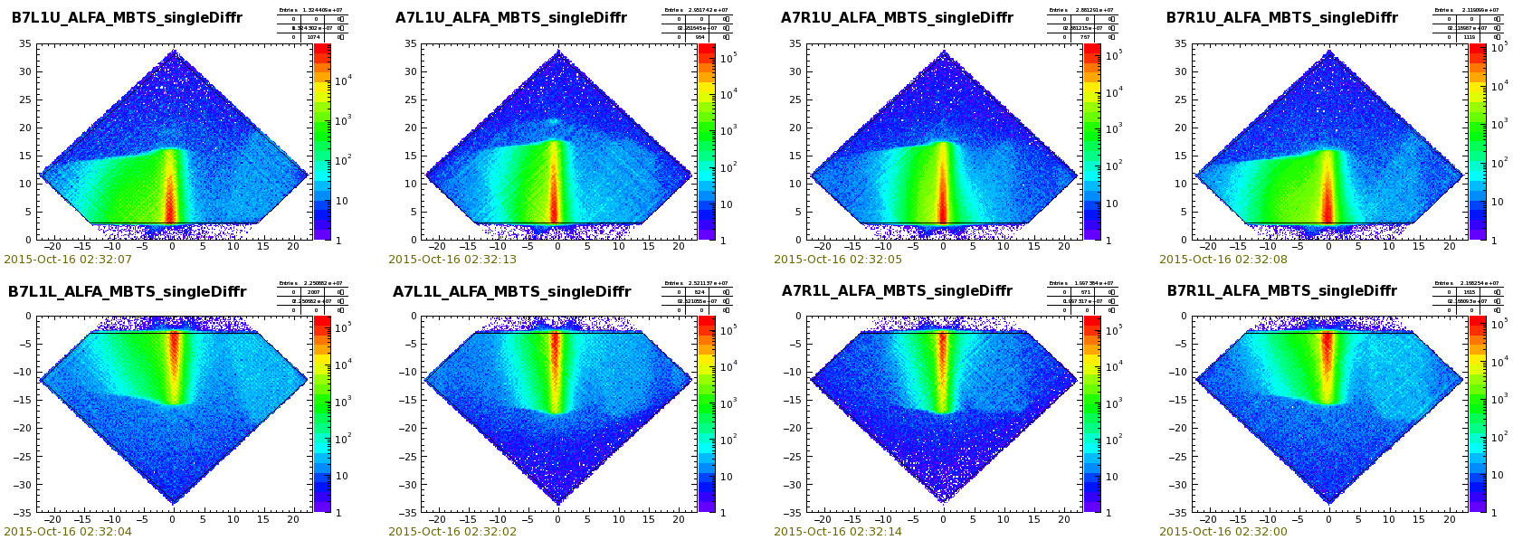
Day#3-6: diffraction
Due to ALFA dead time min bunch spacing 100 nsec, allows max 700 bunches
Unusual filling scheme, never before tested …
Strategy for intensity ramp: 50 → 250 → 700 bunches
Move all Roman Pots to 10 σ_{nominal} (5-7 mm)
Example: Online plots for single diffractive events combining ALFA & MBTS
Integrating over all 7 fills:
LHC delivered: 735 nb-1
ATLAS+ALFA in position recorded: 652 nb-1
ATLAS+ALFA optimal: ~600 nb-1 (~82 % efficiency)
K.Korcyl

Slide 11
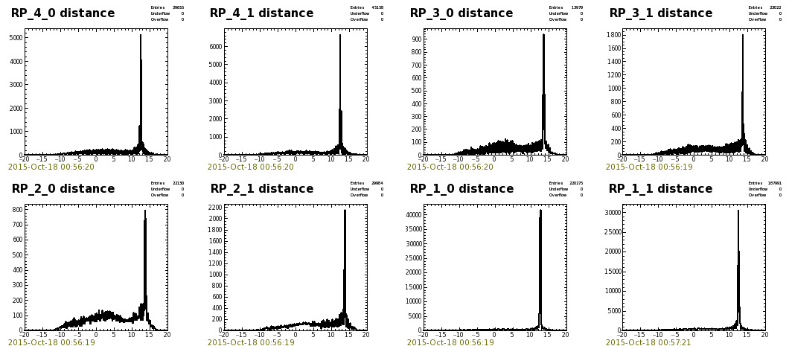
Online distance plots
The precise distance of upper and lower detectors is a key ingredient for the alignment
Online plots could be used for a first estimates, during data taking it is a quality check
Shown is the distance for the diffractive fill 4510, with Roman Pots at 10 σ_{nominal}
Outer stations
Inner stations
Left B7R1 Right
Left A7R1 Right
Left A7L1 Right
Left B7L1 Right
S.Mortensen

Slide 12
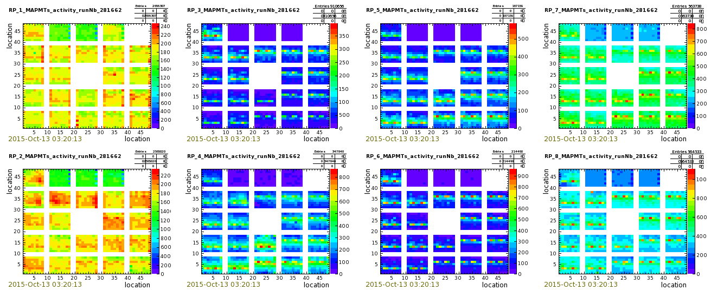
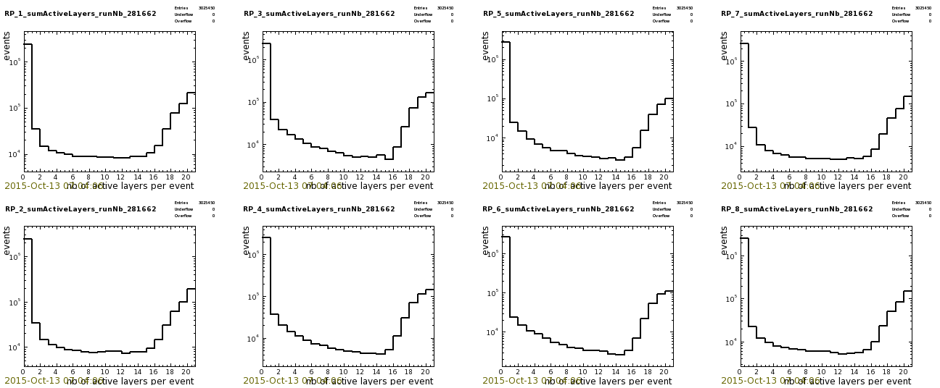
Data quality
In short: very good
All MAPMTs alive
(2holes hardware)
Good tracking
quality indicated
by peak at 20 layers
(peak at 0: other
detector triggers)
Failures: 5 single
event upsets due to
radiation
(FE not rad-hard)
- 2 PMF/layer lost
- 2 trigger PMF lost
- 1 motherboard lost
K.Korcyl

Slide 13
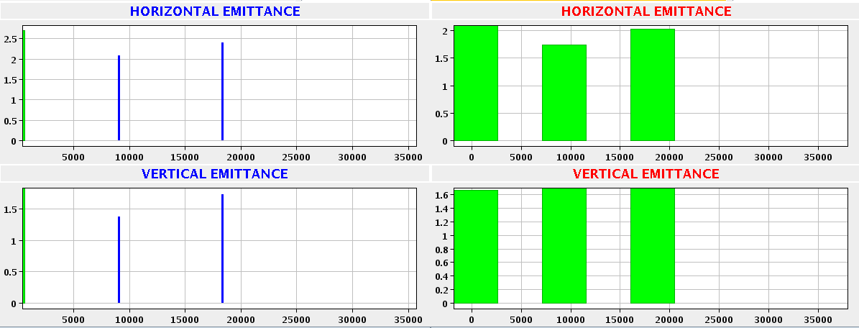
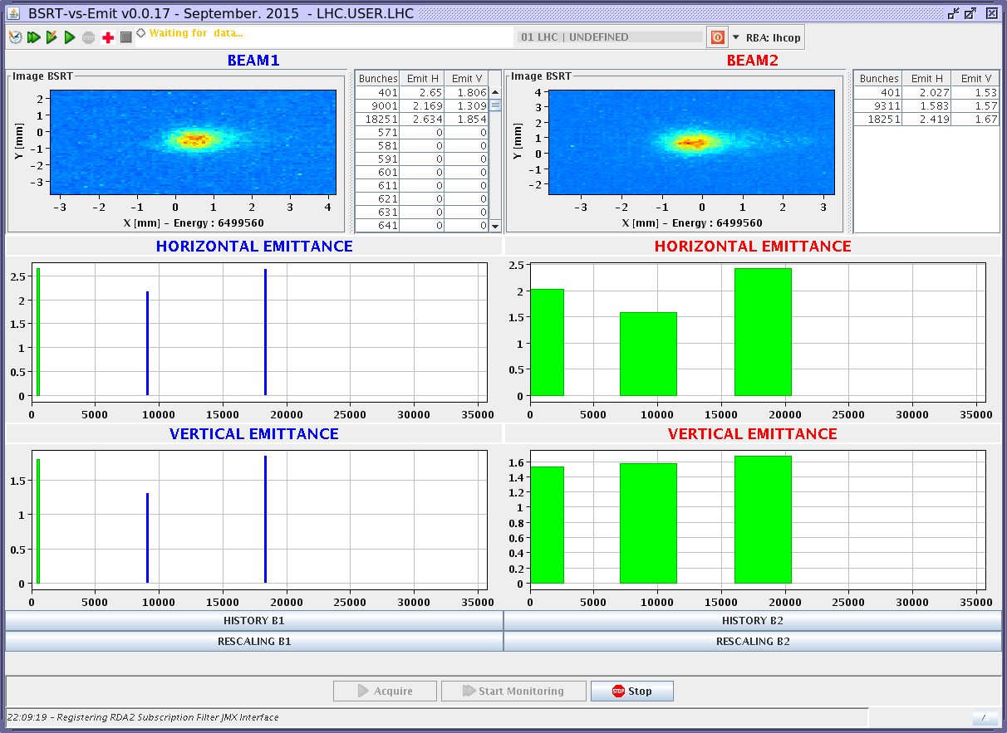
Emittance in elastic part#2
before data taking
Emittance sets the overall
scale of the t-resolution
Two types of feedback:
wire scans
synchrotron radiation
= BSRT
Many measurements done
in all stages of the run
Typical values ~ 2 μrad,
growth a few 0.1 μrad
~ 2.2
~ 1.8
~ 1.6
~ 1.6
end of data taking
~ 2.5
~ 2.0
~ 1.5
~ 1.6

Slide 14
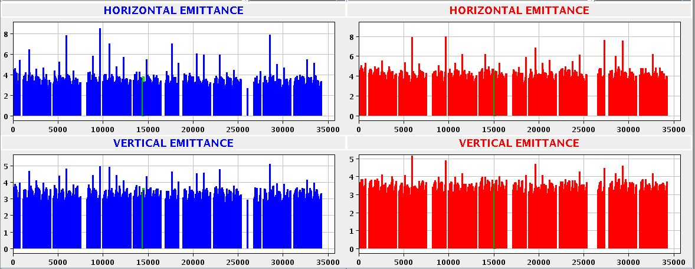
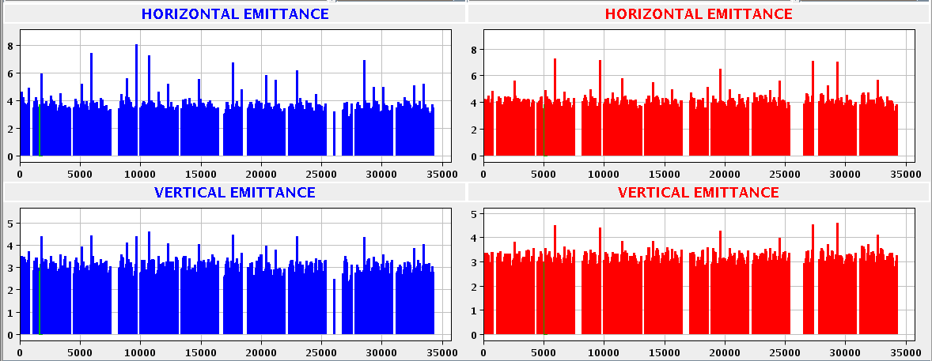
Emittance in diffractive fill#5
before data taking
end of data taking
Typical values
3-4 μrad,
growth is small

Slide 15
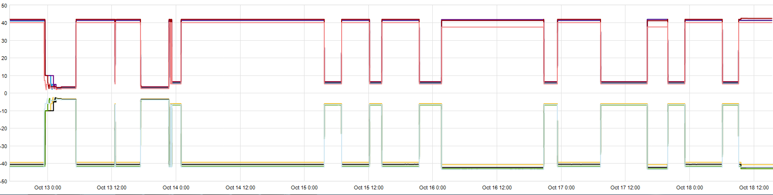
Time line all 90m fills
Optics
Fill#2
Scraping &
Elastics#1
Elastics#2
Xing = 0
Diffractive
Fill 54b
Diffractive
Fill 252b
5 diffractive with Fills 685b
Loss maps
10 sigma
Magnet access
& recovery
RF trips
Cryo fault
Monday 8:00 Sunday 12:00

Slide 16
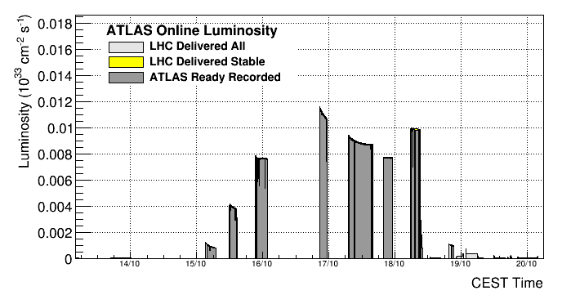
Luminosity profile diffractive fills
# Colliding bunches
671
671
671
671
671
240
Magnet access
& recovery
42
Typical duration 2-4 hours per fill, longest fill ~ 9 hours
In total about 34 hours of data taking in a period of 6 days + 6 hours

Slide 17
Summary of good fills
Fill # | Bunches colliding | Stable*) beam | Peak lumi | Int. lumi [nb-1] | Physics goal | Dump
4489 | 2 | 1h55 | 3.0e28 | 202 μb-1 | elastics | PC fault
4491 | 2 | 4h17 | 4.0e28 | 545 μb-1 | elastics | OP dump
4495 | 42 | 3h32 | 1.1e30 | 11 | diffraction | OP dump
4496 | 240 | 2h39 | 4.2e30 | 36 | diffraction | OP dump
4499 | 671 | 4h12 | 7.7e30 | 115 | diffraction | Cryo PLC
4505 | 671 | 2h40 | 1.2e31 | 103 | diffraction | QPS
4509 | 671 | 8h47 | 9.4e30 | 280 | diffraction | QPS
4510 | 671 | 3h15 | 7.8e30 | 88 | diffraction | EE spurious
4511 | 671 | 3h33 | 1.0e31 | 122 | diffraction | OP dump
*) for elastics “quiet beams”, RPs close
Integrated luminosity with ATLAS ready:
Elastic fills 747 μb-1
Diffractive fills: 735 nb-1, ALFA IN 652 nb-1 (efficiency ~ 89%)

Slide 18
Physics prospects

Slide 19
Standard analysis 13 TeV
Elastic & total cross section via optical
theorem:
Conditions evolution Run1 → Run2:
Distance 6.5/9.5 → 5.5 σ_{nominal}
Emittance H/V 2-4/2 → 2-2.5/1.5 μrad
At 5.5σ t_{min} ~ 0.01 GeV2 for acceptance
> 10%, similar as for 7/8 TeV data
Precision:
At 7TeV luminosity dominant contribution:
ΔL/L = 2.4% → Δσ_{el}/σ_{el} = 2.5%, σ_{tot} = 1.4%
Luminosity for 13 TeV data pending, but
probably again the dominant value …
t_min
Acceptance > 10%
Distance / σ_{nominal}
H.Stenzel

Slide 20
Alternatives for σ_{tot}
Adding elastic and inelastic cross sections (ρ-independent method):
Can be done with two independent measurements
MBTS 13 TeV: σ_{inel} = 73.1 ± 0.9 (exp) ± 6.6 (lum) ± 3.8 (extr) mb
(→ MBTS talk tomorrow B.D. Axen)
An error estimate based on ALFA elastic result σ_{el}(7TeV) = 24.0 ± 0.6 mb
and MBTS inelastic gives: Δσ_{tot}/σ_{tot} ~ 8%
In case of 2% luminosity error it will be reduced to: Δσ_{tot}/σ_{tot} ~ 5%
Dominant contribution is the uncertainty for extrapolation beyond ξ < 10E-6
2. Combining elastic and inelastic rates (luminosity-independent method):
All MBTS-triggers enabled to measure elastic and inelastic rate at the same time
For 7 TeV the contributions from the optical point and the elastic rate are < 1%
Neglecting these errors the dominant uncertainty is due to the inelastic rate ξ < 10E-6
Using above quoted MBTS results one obtains: Δσ_{tot}/σ_{tot} = ~ 4%
Bottom line: the luminosity-dependent method gives by far the most precise result, 1.4%
for 7 TeV, but alternative approaches are useful as long as precise luminosity is unknown

Slide 21
Summary
Data taking:
ALFA/ATLAS had a very good 90m campaign w/o major hardware failures
More luminosity collected compared to Run1:
  elastics runs 7/8 TeV: 80/500 μb-1 → 13 TeV: 650μb-1
  diffractive runs 7/8 TeV: 0.1/37nb-1 → 650 nb-1
Also other parameters, distance and emittance, slightly better
All the time shifter in CCC to react quickly on changing conditions
Physics prospects:
Good chance to get t_{min} for fits of nuclear term around 0.01 GeV2, as for 7 TeV
Start with analysis of 13 TeV data as soon as 8 TeV analysis finished
In parallel a young investigator group take care for 8 TeV / β* = 1km data
Diffractive analyses: we expect soon to finish exclusive pion production at 7/8 TeV
For 13 TeV diffractive data the spectrum of analysis topics is much wider
In YETS the magnet cables for Q4 will be installed to allow more phase space
for optics to achieve β* > 2 km
The plan for 2016 is commissioning and data taking with β* > 2 km

Slide 22
Backup slides

Slide 23
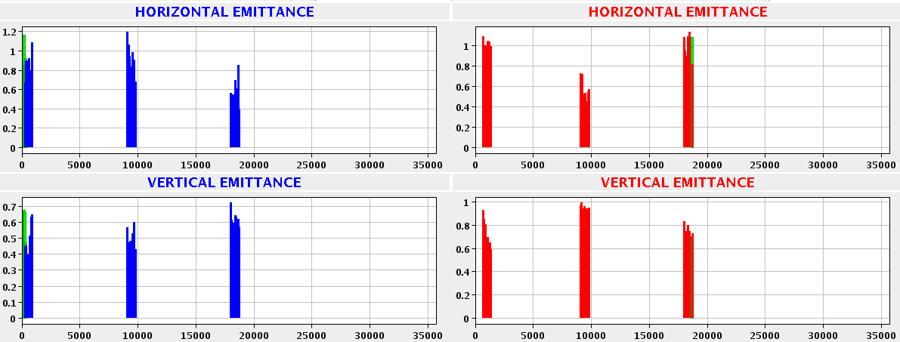
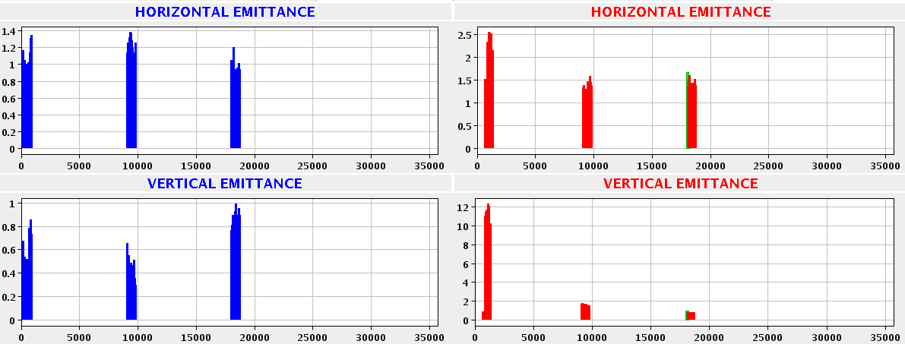
Emittance in diffractive fill#1/54b
Before
Data
taking
LHC can deliver emittance ~ 1 μrad !!!
After
Data
taking

Slide 24
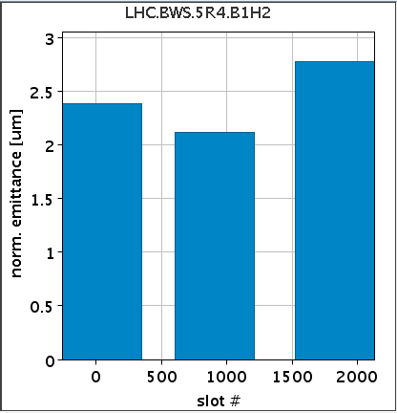

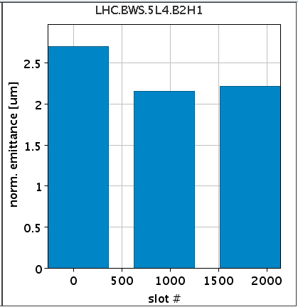
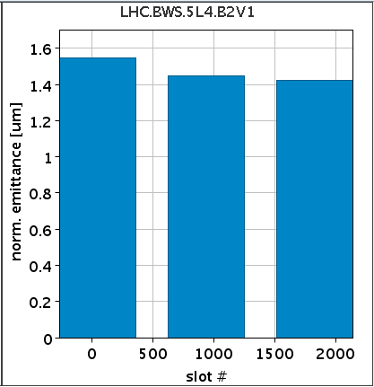




Emittance in elastics part#1
Wire scans just before physics data taking – beam1 , beam2
~ 2.4
~ 1.7
~ 2.2
~ 1.4
Wire scans just before end of physics data taking – beam1 , beam2
~ 2.8
~ 1.8
~ 2.4
~ 1.5
➔ Typical emittance ~ 2 μrad, growth after 2 hours ~ a few 0.1 μrad

