Slide 1
AFP Trigger DAQ and DCS
Krzysztof Korcyl
Institute of Nuclear Physics - Cracow
on behalf of TDAQ and DCS subsystems

Slide 2
agenda
LVL1 trigger
full system project
AFP2+0 installation
current status and development
DAQ
full system project
AFP2+0 installation
current status and development
DCS
full system project
current status and development

Slide 3
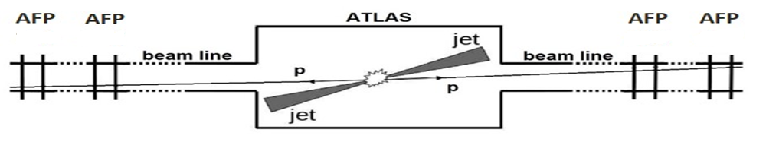
AFP LVL1 trigger
217 m
205 m
205 m
217 m
ARM 8-1
ARM 1-2
Current ATLAS L1 latency: 84 BCXs
Protons from P1 to 217 m: 29 BCXs
Fast air-core cable (300m): 43 BCXs
ATLAS CTP work: 6 BCXs
Trigger logic: 6 BCXs
NIM signals with encoded information from timing detectors
AFP_CTPIN
ATLAS
Central Trigger Processor

Slide 4
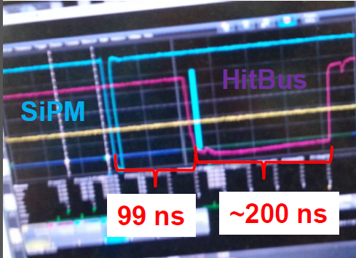
AFP2+0 LVL1 trigger
205 m
217 m
ARM 1-2
We plan to use signals from tracking detectors (FE-I4 HitOR output) and HitBus chip from DBM to make logic function (AND) from 3 out of 4 FE-I4 HitOR outputs
25 ns NIM signals from tracking detectors
ATLAS
Central Trigger Processor

Slide 5
AFP0+2 LVL1 trigger setup
USA 15
LHC tunnel
4* FE-I4
Local
Trigger Board
300 m
HitBus
217 m
LVDS/NIM
ATLAS CTP
4* FE-I4
Local
Trigger Board
300 m
HitBus
205 m
LVDS/NIM

Slide 6
AFP LVL1 trigger status and development
during the beam tests we performed standalone runs with prototype of the Local Trigger Board (LTB) and parts of the ATLAS TDAQ system
  VME crate with LTP and TTCvi
  NIM output from the LTB was used by the LTP to produce L1A and start readout
    falling edge of the trigger was used to generate L1A
  HitOR trigger signal spans over 10 BCXs
new version of the LTB is being designed
before installation of the air-core cables in the LHC tunnel we plan to send 25 ns pulses and verify signal quality at the other end of the cable

Slide 7
AFP DAQ
217 m
205 m
205 m
217 m
ARM 8-1
ARM 1-2
L1A initiates readout
Local Trigger Board
Local Trigger Board
R
C
D
L
T
P
T T C
VME crate
Local Trigger Board
Local Trigger Board
ATCA + COB
RCE
TTC
optoboard
optoboard
Slink
ROS

Slide 8
AFP0+2 DAQ
USA 15
R
C
D
L
T
P
T T C
tunnel
VME crate
300 m
4* FE-I4
HPTDC
217 m
RCD
8 TTC
16 data
Local
Trigger Board
HSIO
5
HitBus
TTC
adapter board
RCE (ROD)
data
Optoboard
Slink
4* FE-I4
TTC
205 m
Local
Trigger Board
ROS
4
fiber
LVDS
HitBus

Slide 9
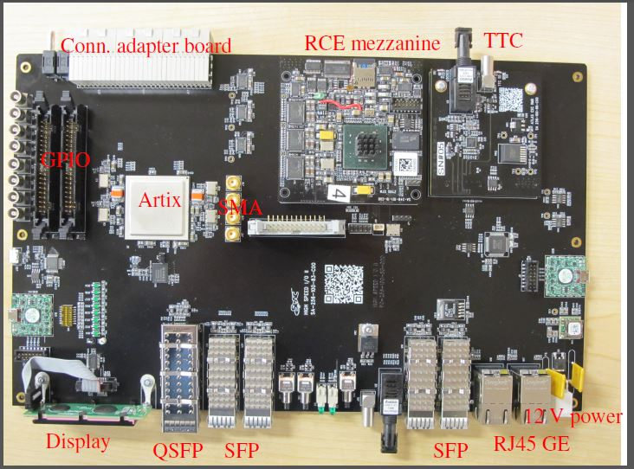
AFP DAQ status and development
readout via HSIO:
  integration with ATLAS TDAQ demonstrated during the beam tests
  uses HSIO firmware (Artix) to serialize and format data before entering RCE
  Event Building currently in software – likely will be put in FPGA
  firmware for S-link (ROS) exists in CSC – needs to be ported to AFP
  dedicated PC to run RCD controlling and monitoring RCE
plan to build trigger/DAQ test setup in SR1
HSIO board

Slide 10
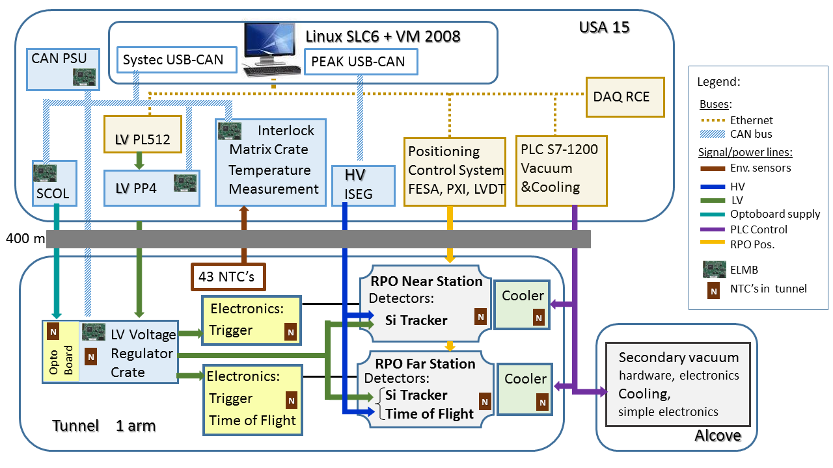
DCS: overview of AFP Final Hardware Structure
Hardware for both arms:
HV - ISEG crate with 2 modules
LV – 2 Wiener PL512 + 2 LVPP4
SC-OL – 1 block
IMC – 1 crate
in total 15 ELMB’s
Vacuum and Cooling – PLC Controlled
Positioning – similar to TOTEM and ALFA
DAQ: final – ATCA RCE
AF0+2 – HSIO RCE
Hardware for 1 arm
1 optobard
1 Vreg Crate – 1 ELMB
2 Cooler Stations

Slide 11
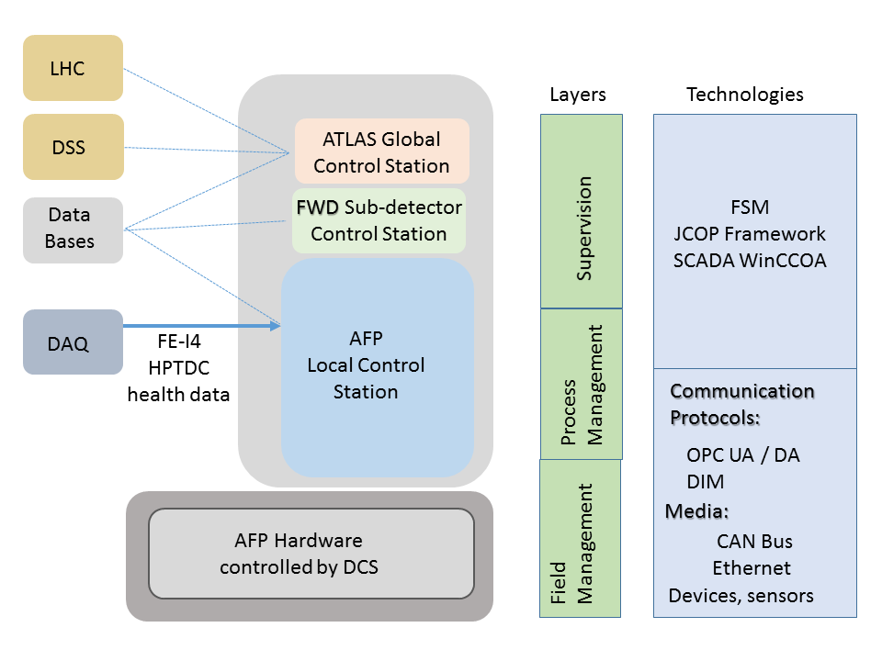
DCS software structure and integration in Central DCS
DCS Software
WinCCOA 3.11 SCADA
JCOP Framework Components
Central ATLAS DCS Framework Components, rules and guidelines
OPC servers as a middleware communication layer
FSM for detector hierarchical representation, supervision and visualisation
AFP sub-detector is already defined in the ATLAS Central DCS structure

Slide 12
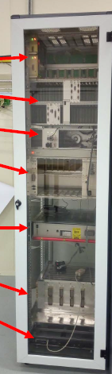
Present activity: DCS in SR1 AFP LAB
Goal: design, develop and test DCS software
DCS Rack
DCS Machine Dell 1950:
SLC6 (WinCCOA + OPC UA servers + all DCS software) + VM2008 (WinCCOA + OPC DA servers)
Will be kept in SR1 AFP LAB as Test Machine
CAN PSU
IMC - Interlock Matrix Crate
SC-OL optoboard supply
Hardware in SR1 (as a pool of spare components):
CAN PSU – power supply for Can bus, crate + 2 modules
Interlock Matrix Crate – will be completed soon with modules
VREG Voltage Regulator Crate – cards to be provided
ISEG HV crate + modules
Wiener LV PL 512 – will be delivered soon
ISEG Crate 1 HV module
Wiener PL512
(no LVPP4 yet)
RCE in SR1 Rack area:
Used for development of FE Health Parameters embedded OPC UA server
VREG crate
DCS Machine
SLC6, VM 2008
P. Sicho info & photo

Slide 13
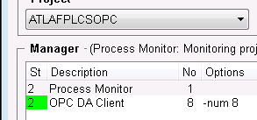
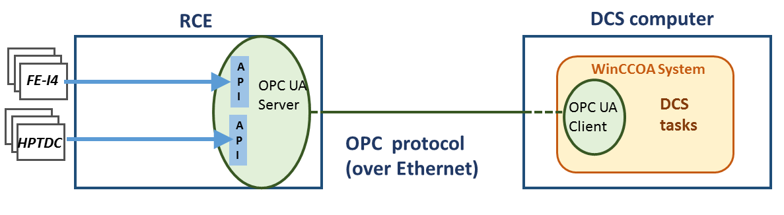



Status of software development in SR1
Software development ongoing:
High Voltage
ISEG OPC DA Server (VM2008) and ISEG Framework component installed and tested, ready for final hardware (from Cracow) and further development
FE Chips health parameters
OPC UA server embedded in RCE will acquire health parameters via dedicated API’s -> OPC UA server framework installed on RCE, ready for development
Secondary Vacuum
Preliminary datapoint structure and panels defined
ELMB-Controlled Equipment Ilock MC, SCOL, LVPP4, VREG
framework-like software development (based on IBL/Pixel) on-going

Slide 14
DCS current status and plans
Status of final hardware:
HV ISEG crate and modules – tested OK in Cracow, ready to be sent to CERN
Wiener PL512 power supplies - still waiting for delivery
DCS production machine Dell R620 – ready in USA15
ELMB controlled equipment: partially ready in SR1
ELMB’s – all needed (17) and some spares (3) available
Status of software:
AFP DCS added to Atlas Central DCS environment
DCS Project in SR1 exists and allows for concurrent developments
Status of individual software parts is progressing
Plans:
Continue software development in SR1: availability of detector parts will be necessary
Install final production OS + necessary software packages in DCS P1 machine after TS3
Start moving some parts of hardware and DCS software from SR1 to P1
First tests in P1

