Slide 1
UFSD update
Test beam results
Sensor design
Board design
Timeline
INFN and Università di Torino, Università Piemonte Orientale

Slide 2
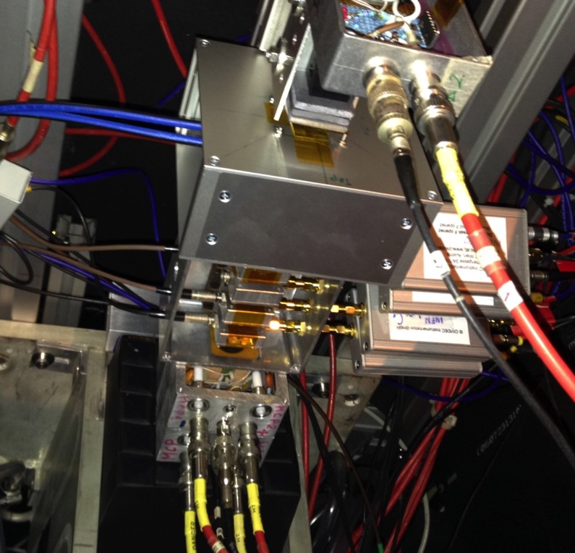
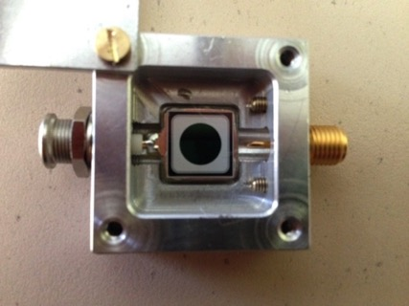
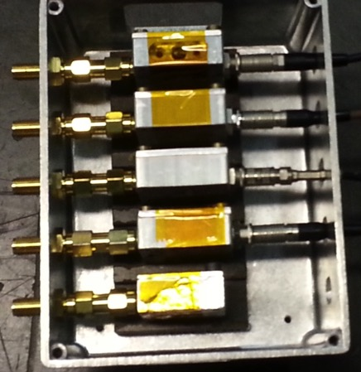
Testbeam Set-up
Testbeam part of the July CMS HGC
UFSD
pions

Slide 3
Testbeam: signal and noise
- Testbeam, very clean shape:
- 120 GeV muons
- Two UFSD, gain 10 and gain 20.
- Read-out with a CSA amplifier with a 4 ns integration time.
Noise ~ 1 mV,
Signal ~ 150-200 mV
Rise time 20-80% ~ 5 ns
online
pions
offline
500 MHz FFT
cleaning

Slide 4
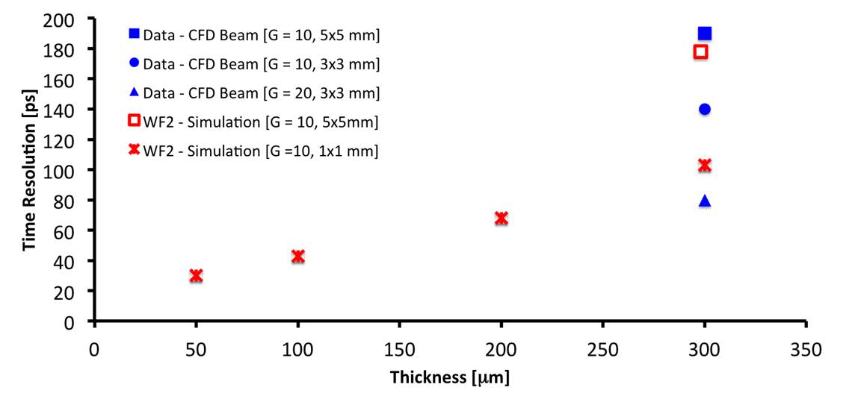
Testbeam Results
Previous testbeam
New testbeam
300 micron thick, ~ 4 pF sensor
Gain 10 ➔ resolution ~ 145 ps
Gain 20 ➔ resolution ~ 85 ps

Slide 5
New productions: winter 2015
FBK: 300 micron, UFSD new production.
Gain foreseen ~ 10-20
CNM: 50 and 100 micron thick silicon,
with final PPS geometry ➔ next pages

Slide 6
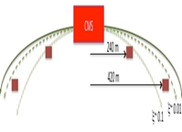
Possible Coverage
Detector occupancy per mm² at pile-up = 50
Use as reference the Quartic coverage
Beam
How large each pad can be?
1 mm² = 2 pF for 50 micron thick sensors
1 mm² = 1 pF for 100 micron thick sensors
Need to evaluate
dV/dt vs area.
How long each bond wire can be
Electronic noise
Set as goal 1 mV noise ➔ dV/dt ~ 50 mV/ns to obtain 20 ps resolution

Slide 7
dV/dt vs Signal fraction for C = 4, 6 pF and gain = 8, 10, 12, 14, 16
4 pF, G = 8
4 pF, G = 10
4 pF, G = 12
4 pF, G = 14
4 pF, G = 16
60
50
40
30
20
10
4 pF, G = 10
0.2 0.4 0.6 0.8 1
Fraction of the rising edge
dV/dt> 50 mV/ns
Gain = 14-16
C = 4-6 pF
dV/dt = 50 mV/ns
BB amplifier, 40 db,
R input = 50 Ohm,
Gain = 8 - 16
6 pF, G = 8
6 pF, G = 10
6 pF, G = 12
6 pF, G = 14
6 pF, G = 16
4 pF, G = 10

Slide 8
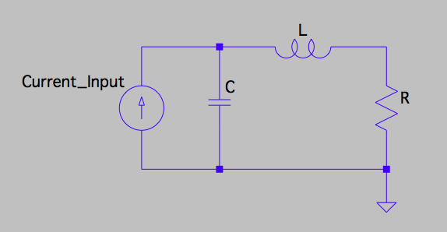
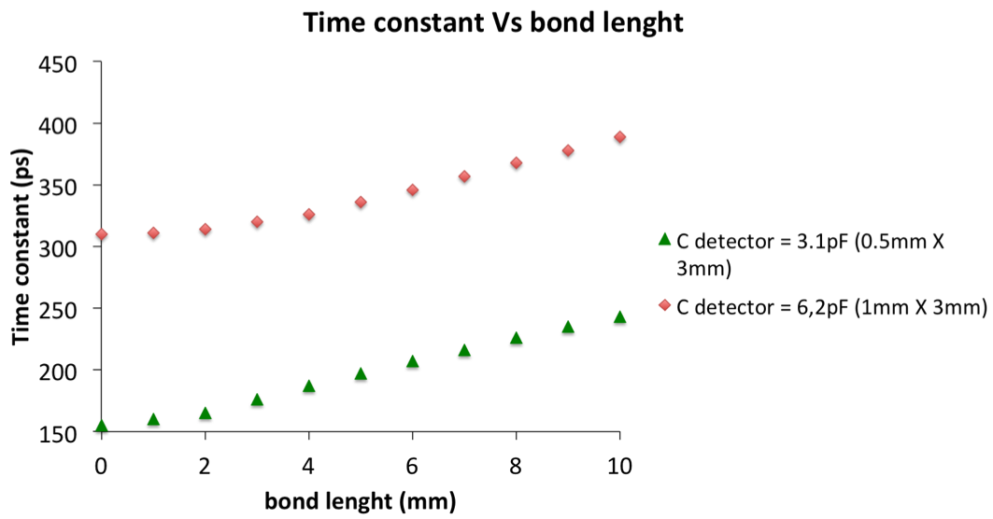
Bond wire
The geometry of the sensor has to take into account the bond-wire length
A bond wire act as an inductor of 0.8 nH/mm placed in between the detector capacitance C and the amplifier input resistance R
Good
Simulation by
Marco Ferrero

Slide 9
CT-PPS proposed sensor geometry
50 micron inactive gap
1.0 mm
0.5 mm
0.45 mm
3.1 mm
6 mm
Beam
spot
2.9 mm
8 mm
4 mm
0.95 mm
16 Pixel ~ 3 mm²
Cap. Pixel ~ 6 pF
16 Pixel ~ 2 mm²
Cap. Pixel ~ 4 pF
Asymmetric designed
Area = 12mmX6mm;
Thickness = 50 um;
# of pixels = 32
Beam
180º turn
No cracks aligned: 2 (3) planes facing the beam, and 2 (3) turned by 180º

Slide 10
CT-PPS proposed sensor geometry
50 micron inactive gap
1.0 mm
0.5 mm
0.45 mm
3.1 mm
6 mm
Beam
spot
2.9 mm
8 mm
4 mm
0.95 mm
16 Pixel ~ 3 mm²
Cap. Pixel ~ 6 pF
16 Pixel ~ 2 mm²
Cap. Pixel ~ 4 pF
Asymmetric designed
Area = 12mmX6mm;
Thickness = 50 um;
# of pixels = 32
Beam
180º turn
No cracks aligned: 2 (3) planes facing the beam, and 2 (3) turned by 180º

Slide 11
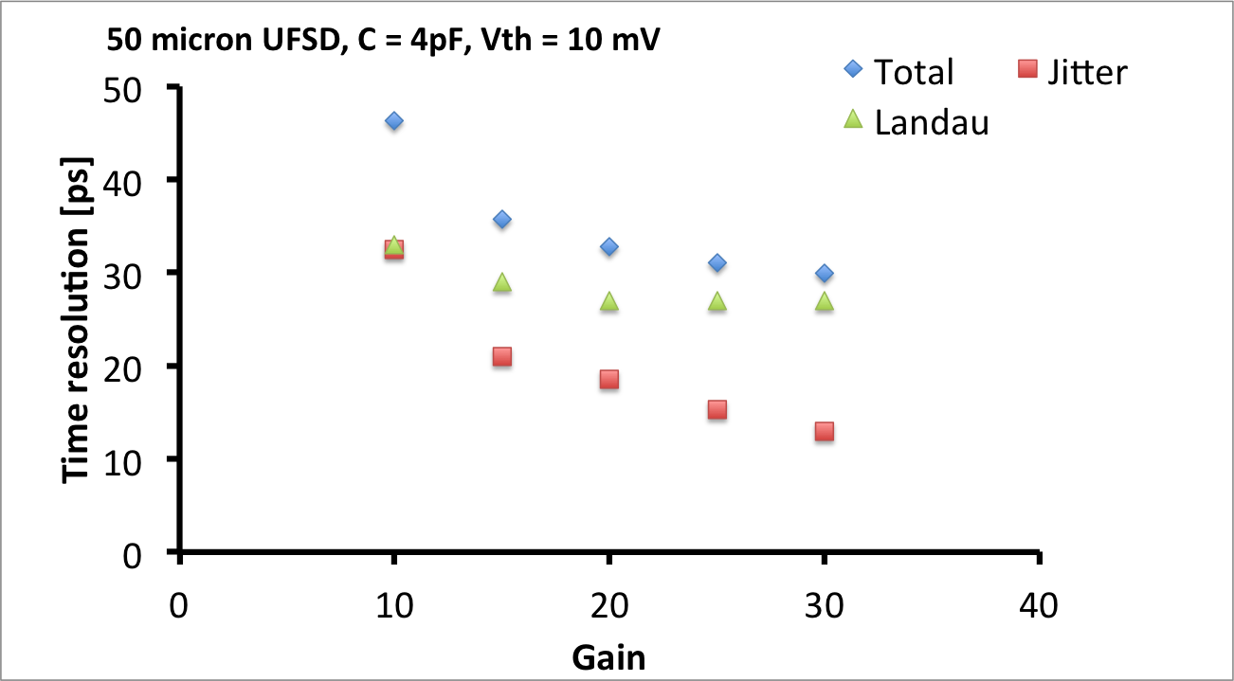
UFSD expected time resolution
What resolution per plane can we expect?
There are 2 known main contributions:
Noise ➔ jitter (from current electronics and testbeam)
Landau fluctuations ➔ additional time spread (from simulation)
For gain >~15 ➔ σ < 40 ps
Note we remain below 40 ps even assuming an un-accounted for additional time spread of 20 ps.

Slide 12
Comparison with Quartic
Detector occupancy per mm² at pile-up = 50
6 x 12 mm coverage,
to have 32 ch per plane
Beam

Slide 13
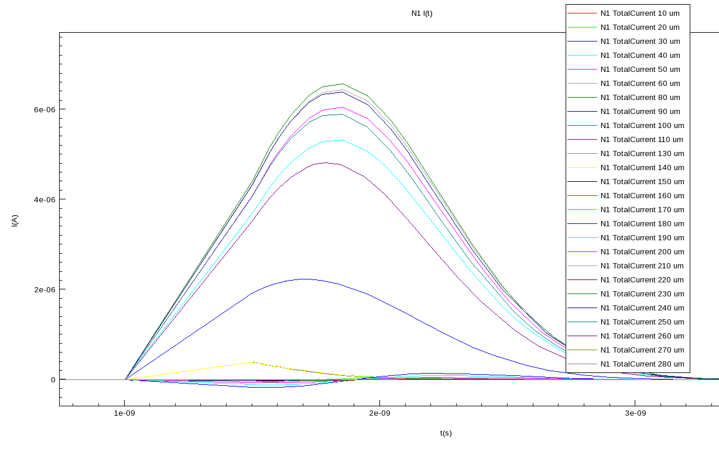
Lateral collector ring and sensor fill factor
No multiplication for particles hitting in between pads
current
~ 50 micron
p-stop
TCAD simulation
F. Cenna
Gain region
Gain region
n-deep
Very important: need n-deep well at the end of each pad to prevent particles hitting in between pads from reaching the gain region.
Dead region: ~ 50 micron along each internal pad border = 5 mm²
Active area: 67/72 = 93% per sensor.

Slide 14
Sensor thickness and slim edge
Rule: when the depletion volume reaches the edge, you have electrical breakdown.
It’s customary to assume that the field extends on the side by ~ 1/3 of the thickness.
edge = k* thickness
k = 1 very safe
k = 0.5 quite safe
K = 0.3 limit
~ 0.3 d
non depleted
depleted
By construction, thin detectors (~ 50 micron) have therefore slim edge

Slide 15
PPS proposed read-out card
Bond wire: 0.8 nH/mm.
Rule: <~ 2 nH
Max. length: 2-3 mm
Low noise BB amplifier to match NINO inputs
Extra
Low Voltage
16 channels
NINO 32
Signal from
50 um thick UFSD,
Q = 5fC
Differential NINO
Input, ~ 100 fC
~ 1.5 ns
16 channels
High Voltage
Extra sensor for alignment

Slide 16
Next steps
Done:
Testbeam in July with 300 micron thick UFSD sensors. Preliminary analysis indicates a time resolution of ~85 ps for a gain~20, and ~145 ps for a gain~10.
We finalized the 50 and 100 micron thick sensor design, and submit the production at CNM. Turn around time ~ 3-4 months.
➔ Foreseen time resolution ~ 40 ps
To be done:
Develop the pre-amplifier chain, to be compatible with the NINO inputs. Need to be rad-hard. ➔Torino, Pilsen, Santa Cruz…?? ~ 6 month
Evaluate the heating requirements
Study the NINO behavior for very short pulses (Jose might help in this topic). Hopefully it works….
Define the services needed in the tunnel: Low voltage, High voltage, cooling

Slide 17
Conclusions
Simulation shows a time resolution of ~ 40 ps for 4-6 pF sensors with gain ~ 15.
We have developed a sensor design with minima dead area, short bond-wires and the possibility of 100% coverage. Ready by ~ winter 2015.
We are working towards a pre-amplifier design compatible with the NINO+HPTDC read-out chain.
➔ Need to evaluate the NINO chip with UFSD sensors. Does it work?

