Slide 1


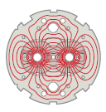


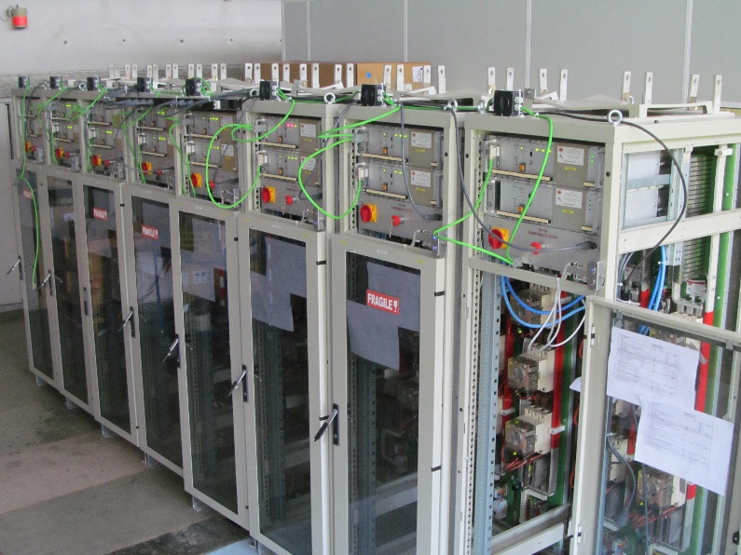
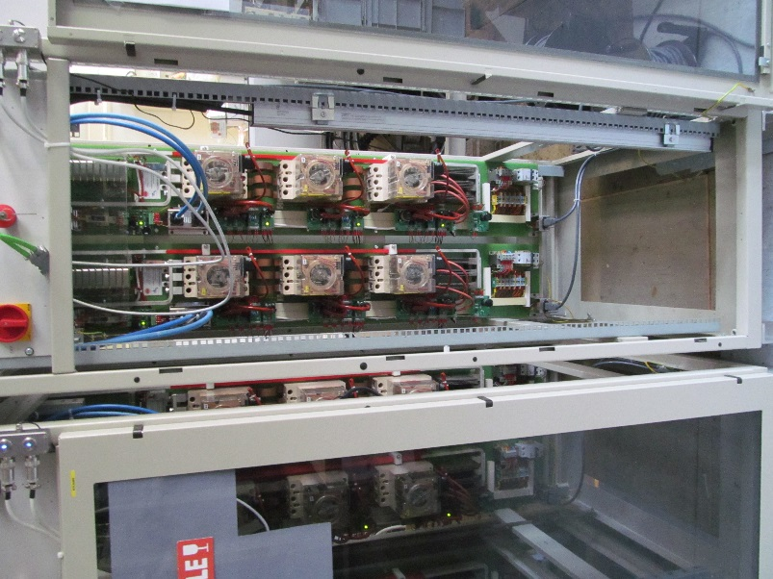
FAIR Test Benches - update by 14 October 2015
TE/MPE/ee
LHC Machine
Update and status for the Work Unit ‘Energy Extraction’
equipping the three test benches for series testing of Super-FRS Dipoles D2, D3, D4 and Quadrupoles Q3, Q4, Q5, Q6
in B180
The inventory of 600 A Extraction Switch Systems comprises today 22 complete units - intended as spares for LHC (16 systems) and reserved units for the three S-FRS test benches (6 systems)
Every system has been upgraded for conformity with the LHC/LS1 standards and corrected for some closing problems
The systems are presently subjected to an endurance test (‘on’ state for one month with acquisition activated)
K. Dahlerup-Petersen TE/MPE/ee – 14 October 2015
Six units will then be selected for FAIR for further routine tests at rated current and precision measurement of the commutation process – prior to delivery and insertion into the test benches
The appointed test engineer (Szymon Michniuk/AGH) arrived to CERN on 1 September. Together with members of the MPE on-call team he shall perform the final program of routine testing
The 6 systems will be ready for installation in B180 on 1 Dec. 2015. To be completed by 30.04.16 as planned.

Slide 2
FAIR Test Benches – update by 14 October 2015
TE/MPE/ee
LHC Machine
DQR – extraction resistors:
3 x 2 units of 1.4 Ω, 2 MJ are foreseen. They are based on the use of carbon discs as the energy absorbing body. With natural air cooling by convection
2 prototypes arrived in August from Industry. After power testing (November 2015) the rest will be ordered (lead time: 6- 8 weeks)
The aluminium terminals will require bi-metallic cable lugs
Testing shall include verification at full energy deposit
K. Dahlerup-Petersen TE/MPE/ee – 14 October 2015
The tested systems shall be ready for installation and connection in B180 by early January 2016

Slide 3
