Slide 1
The Building 180 Cryogenic infrastructure water cooling system
Status Update
Stefano Moccia, EN-CV
Coordination meeting 14/10/15

Slide 2
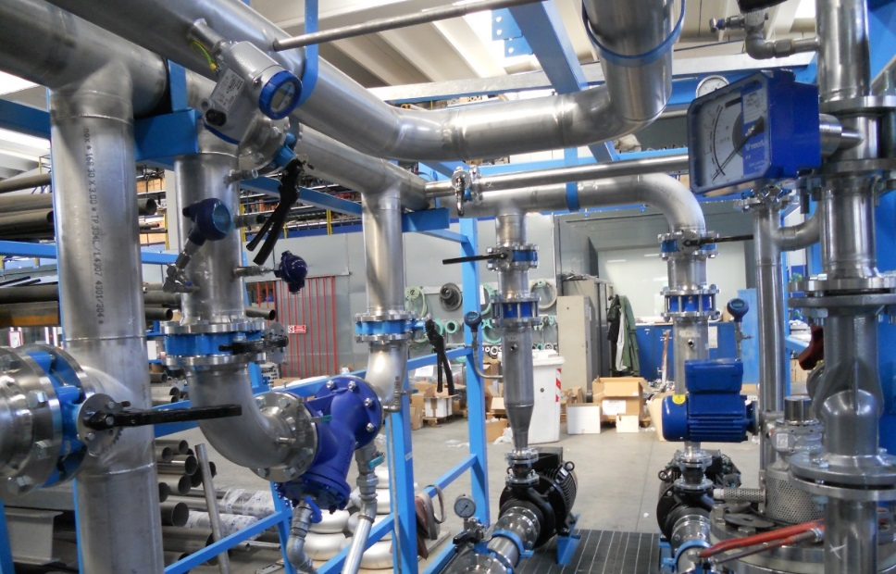
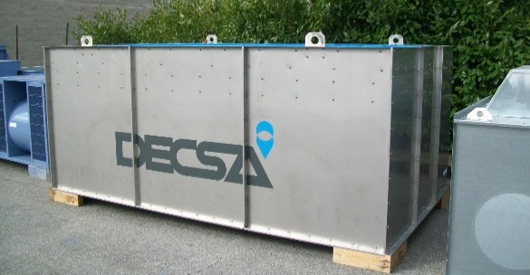
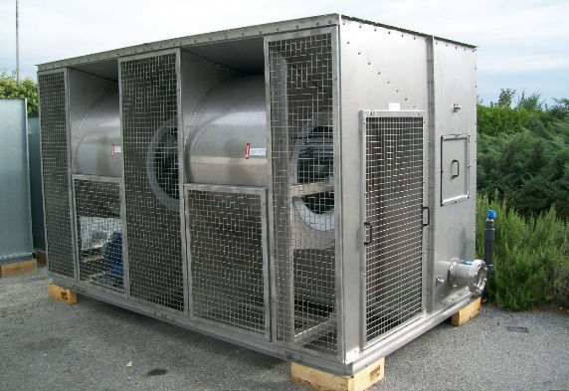
Fabrication Status Summary
The skids construction is well underway.
The cooling tower has been manufactured
Schedule
Delivery of the two skids and the cooling tower: Mid November 2015
Interconnecting piping and electrical installation: before Xmas 2015
Commissioning: January-February 2016
Overall Heat load test: July 2016

Slide 3
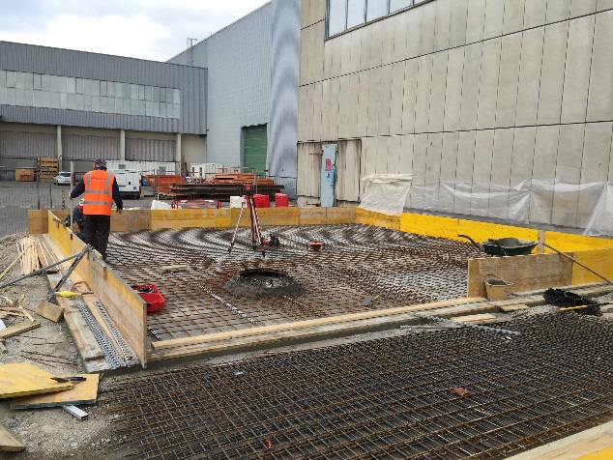
Interfaces Status
EN-EL: Next week meet about power connection cabling to skids’ power cubicles (temporary and/or final)
EN-ICE: Functional analysis delivered to ICE for coding. Control software ready by mid November.
GS-SE-CEB:
  Concrete slab outside Build. 279 almost ready.
  Concrete slab and “carottage” outside Build. 180 ready at the end of
  November.
TE-CRG-ML/ME:
  Compressors layout in Build. 279 seems well advanced. Meet within the
  next two weeks to define piping integration.
TE-EPC-MPC: reduced cooling requirements.
  Cooling power from 160 kW to 34 kW Demi water flow from 15 m³/h to 5 m³/h.
  Demi water skid bigger than needed. Too late to modify/optimize for the present needs.
  Integration in Build. 180 still ongoing.

