Slide 1
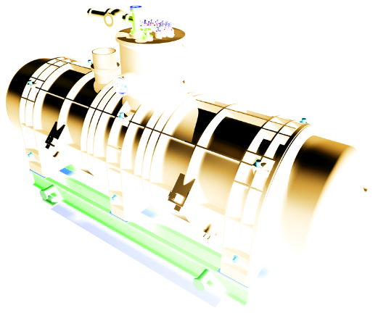
FAIR
Building 180
Integration_Current Status
20151014
Edms# 1416390_A.Kosmicki

Slide 2
FAIR
Building 180
History
Latest configuration to be approved
General views
Different configurations
Conflicts and left to be done
Conclusion
Edms# 1416390_A.Kosmicki

Slide 3
History

Slide 4
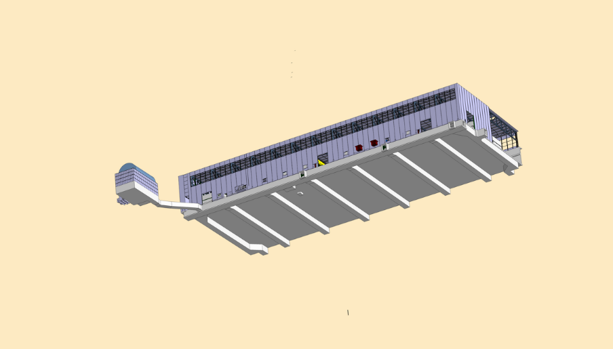
Building 180
HISTORY…
Building 279
Bottom view_Galleries

Slide 5
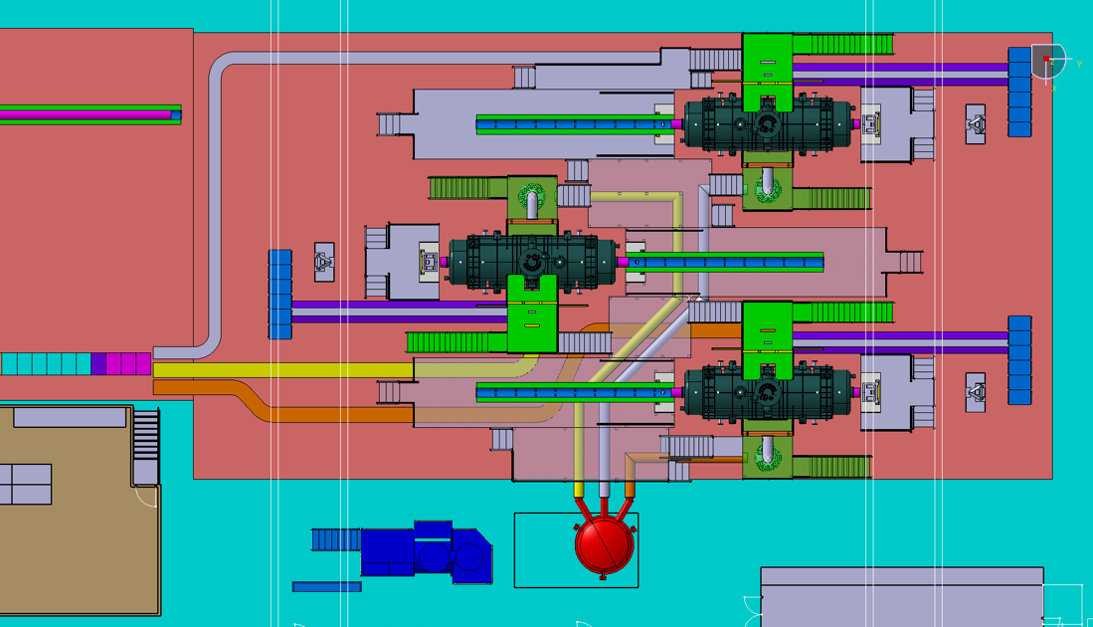
Racks
Position of benches
Racks
HISTORY…
Power converters
Cryo pipes
Racks
Control room

Slide 6
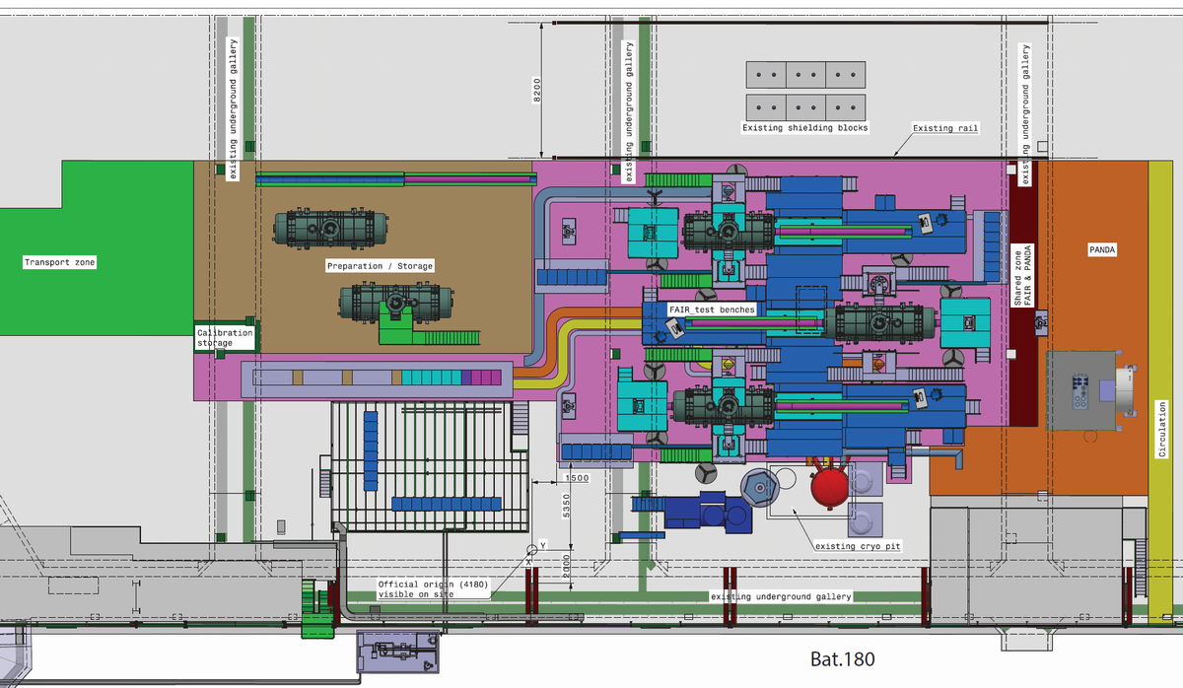
Racks
Racks
HISTORY…
Power converters
Control room
Racks

Slide 7
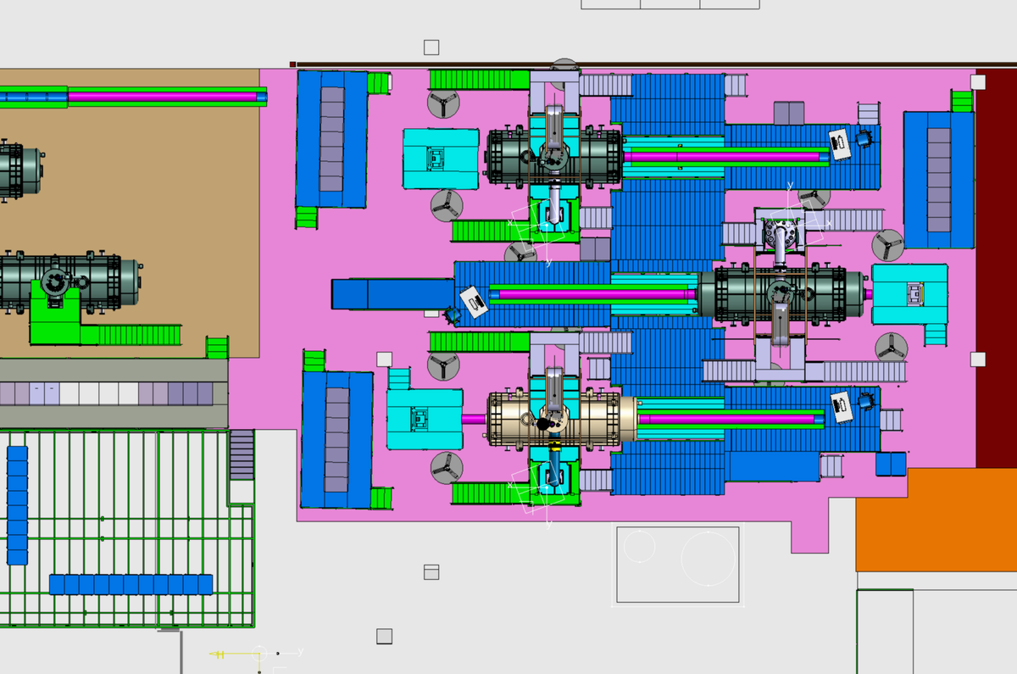
Position of racks
HISTORY…

Slide 8
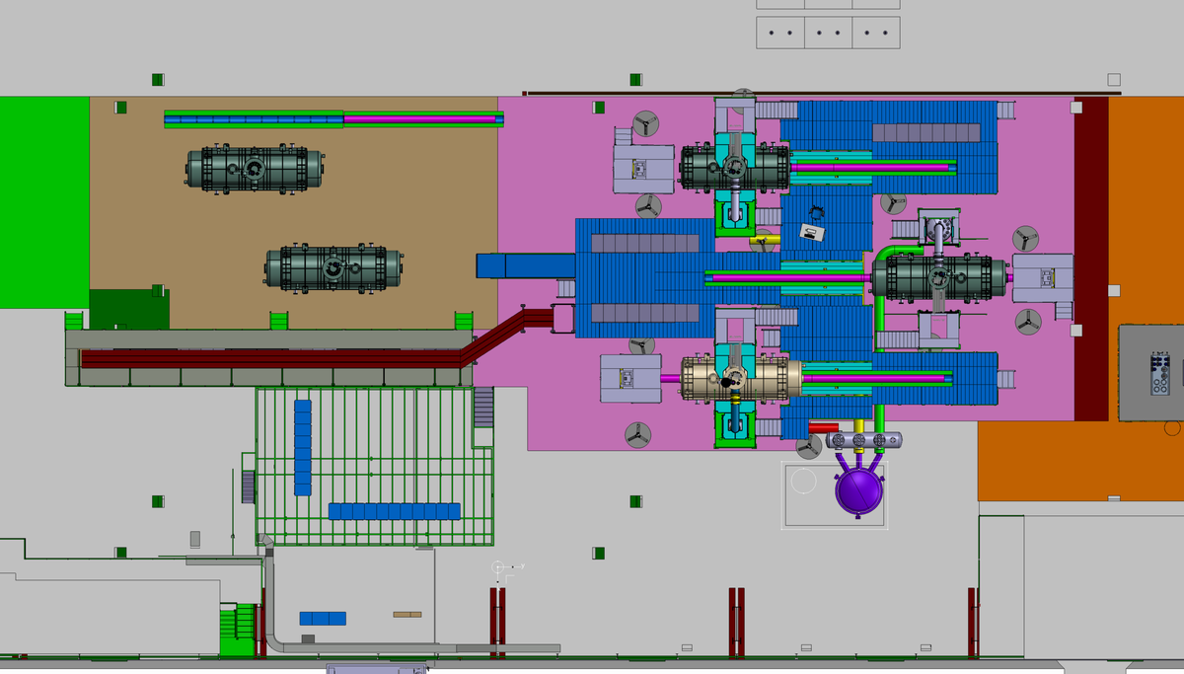
Position of racks
HISTORY…

Slide 9
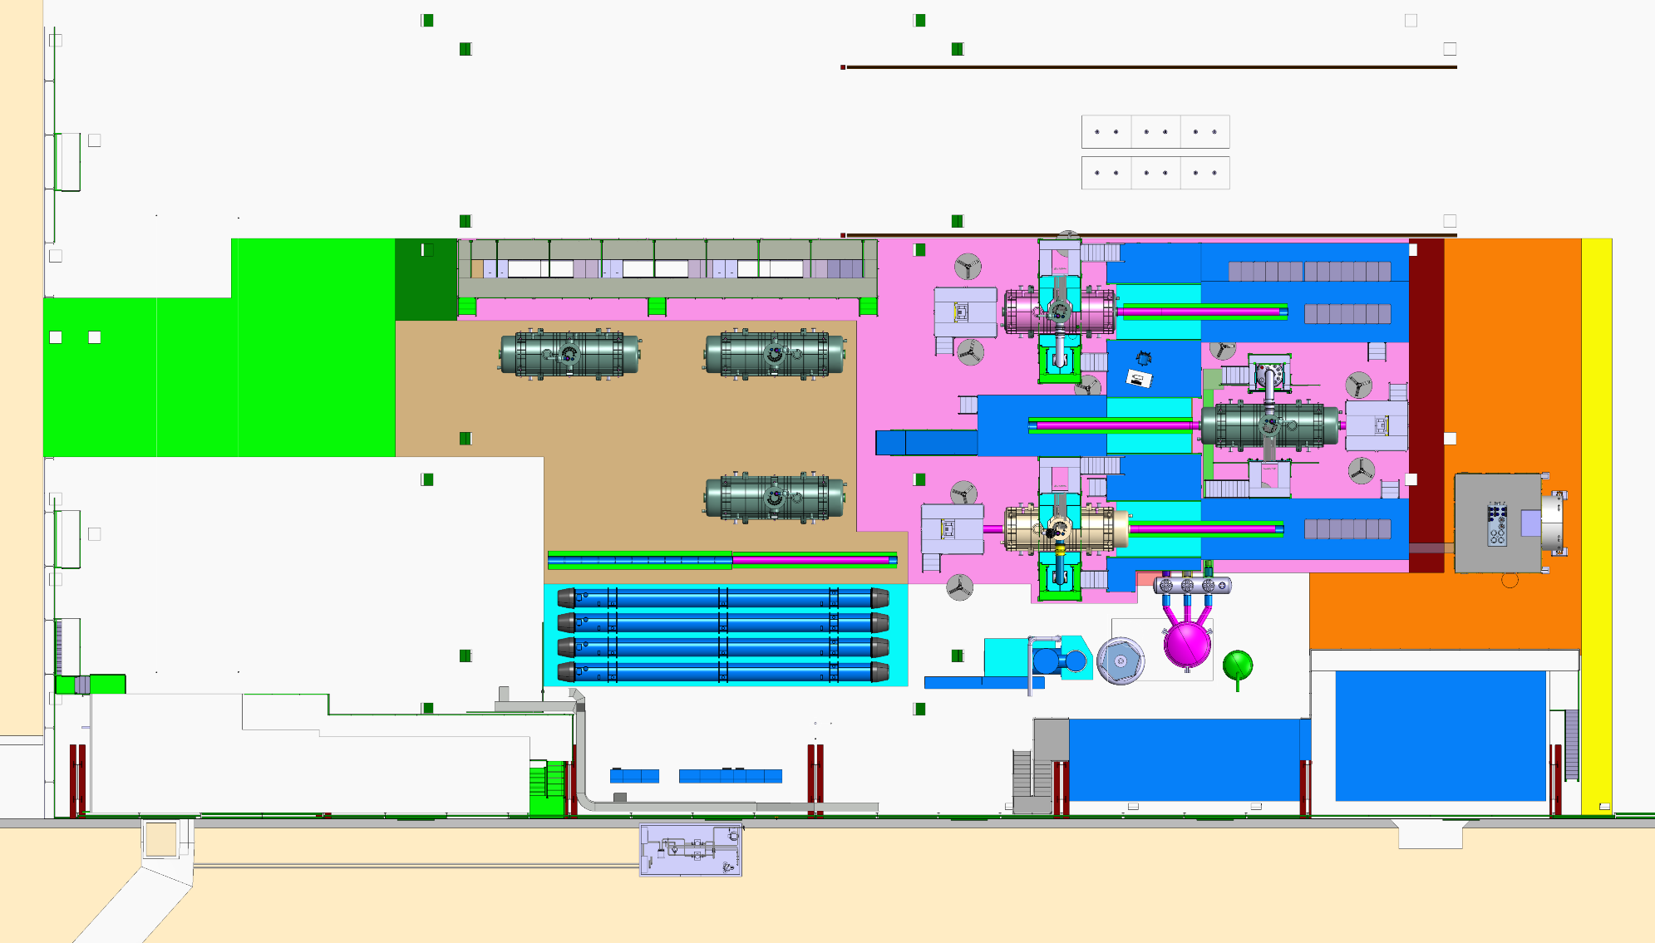
Transport
Preparation area
Test area
PANDA
Main door
HISTORY…
LHC dipoles
Personnal access
Stockage & Offices
Atelier & Control room

Slide 10
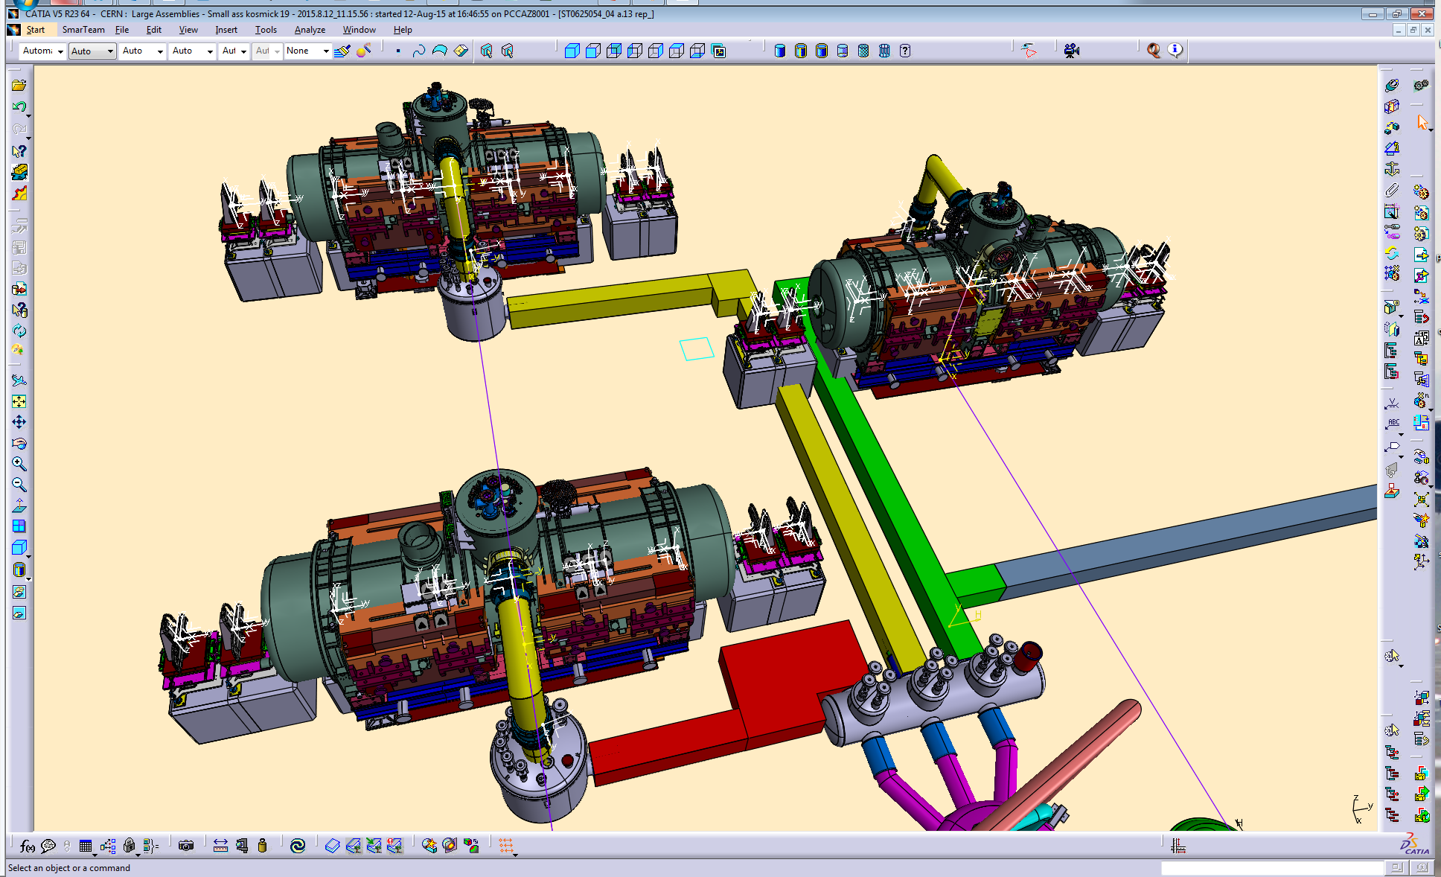
Vue comportant tous les types d’aimants sur chaque banc de test, ainsi que toutes les positions des blocs béton pour les systèmes de fil tendu.
ST0625054_04

Slide 11
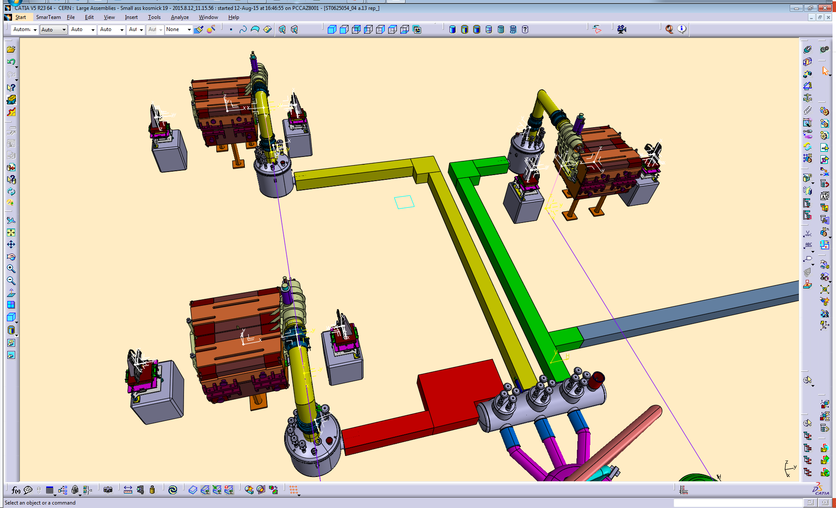
Dipole 1/2 → OK

Slide 12
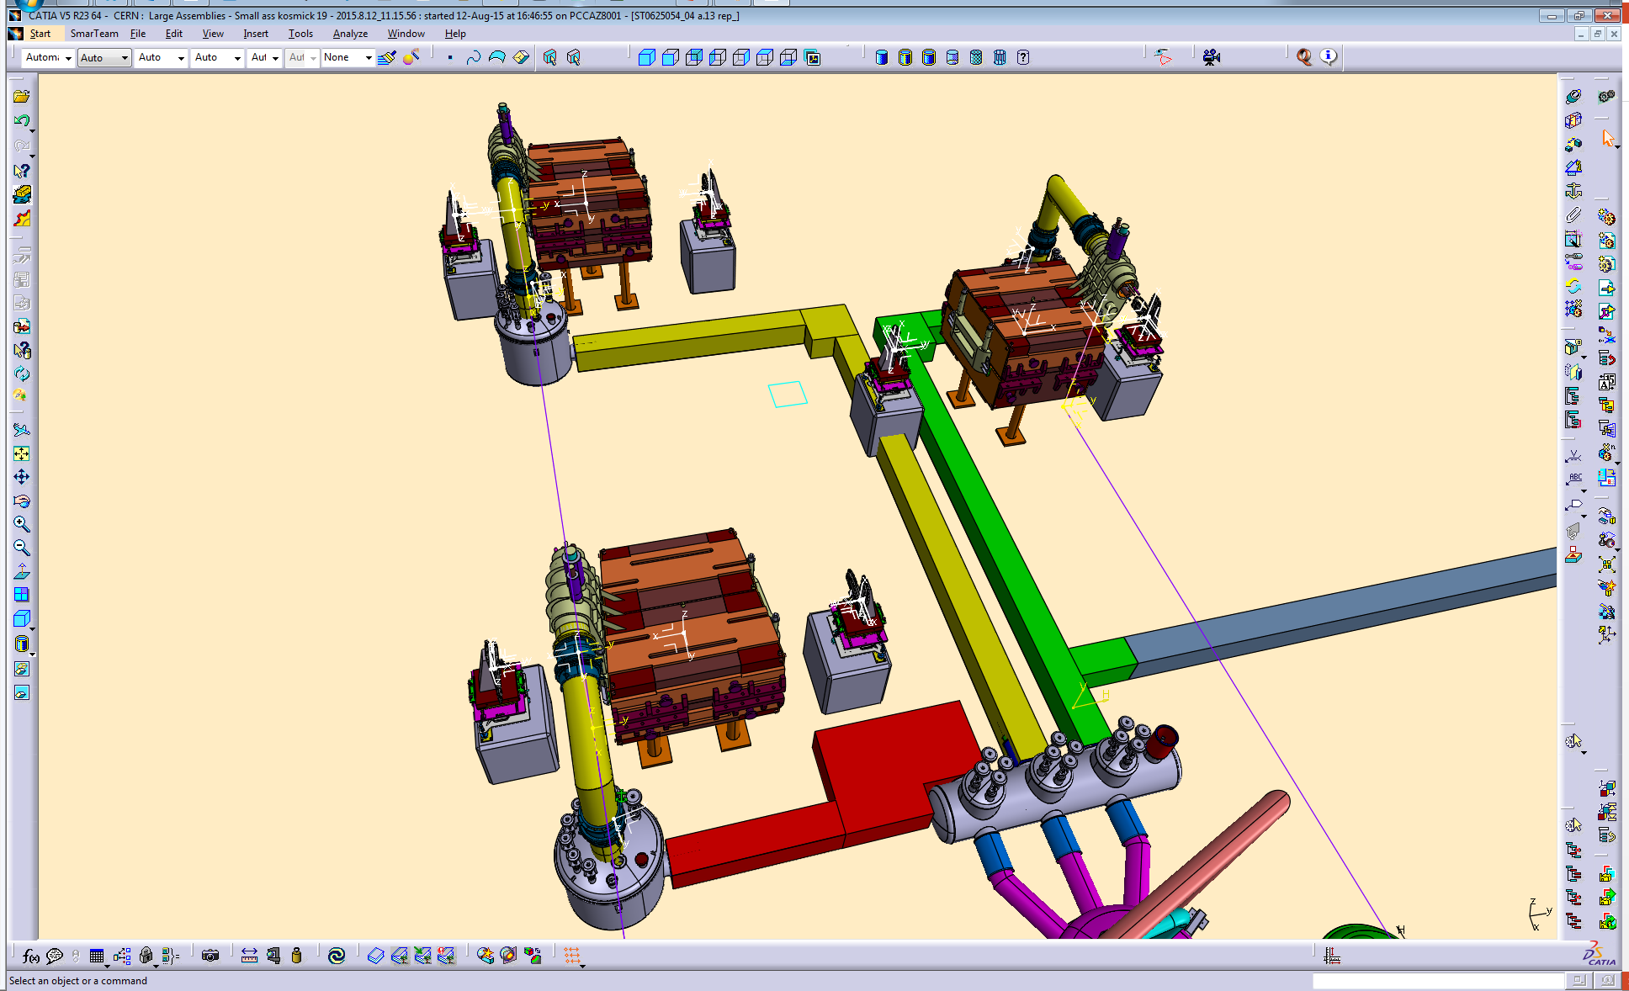
Dipole 2/2 → CLASH

Slide 13
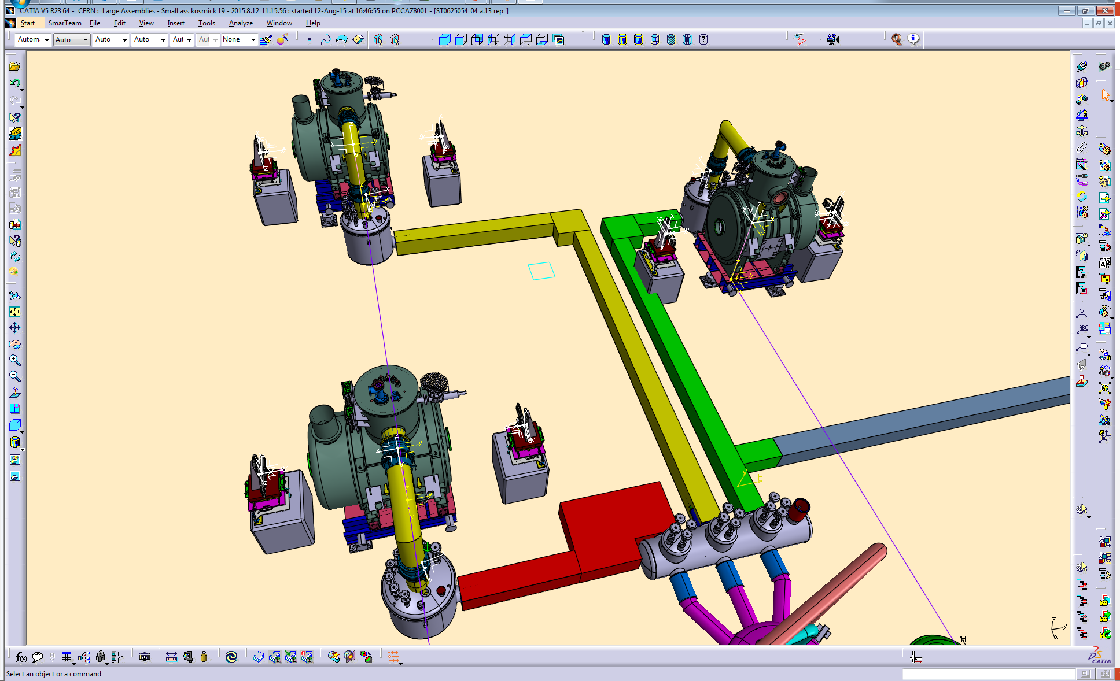
Multiplet 2675mm → CLASH

Slide 14
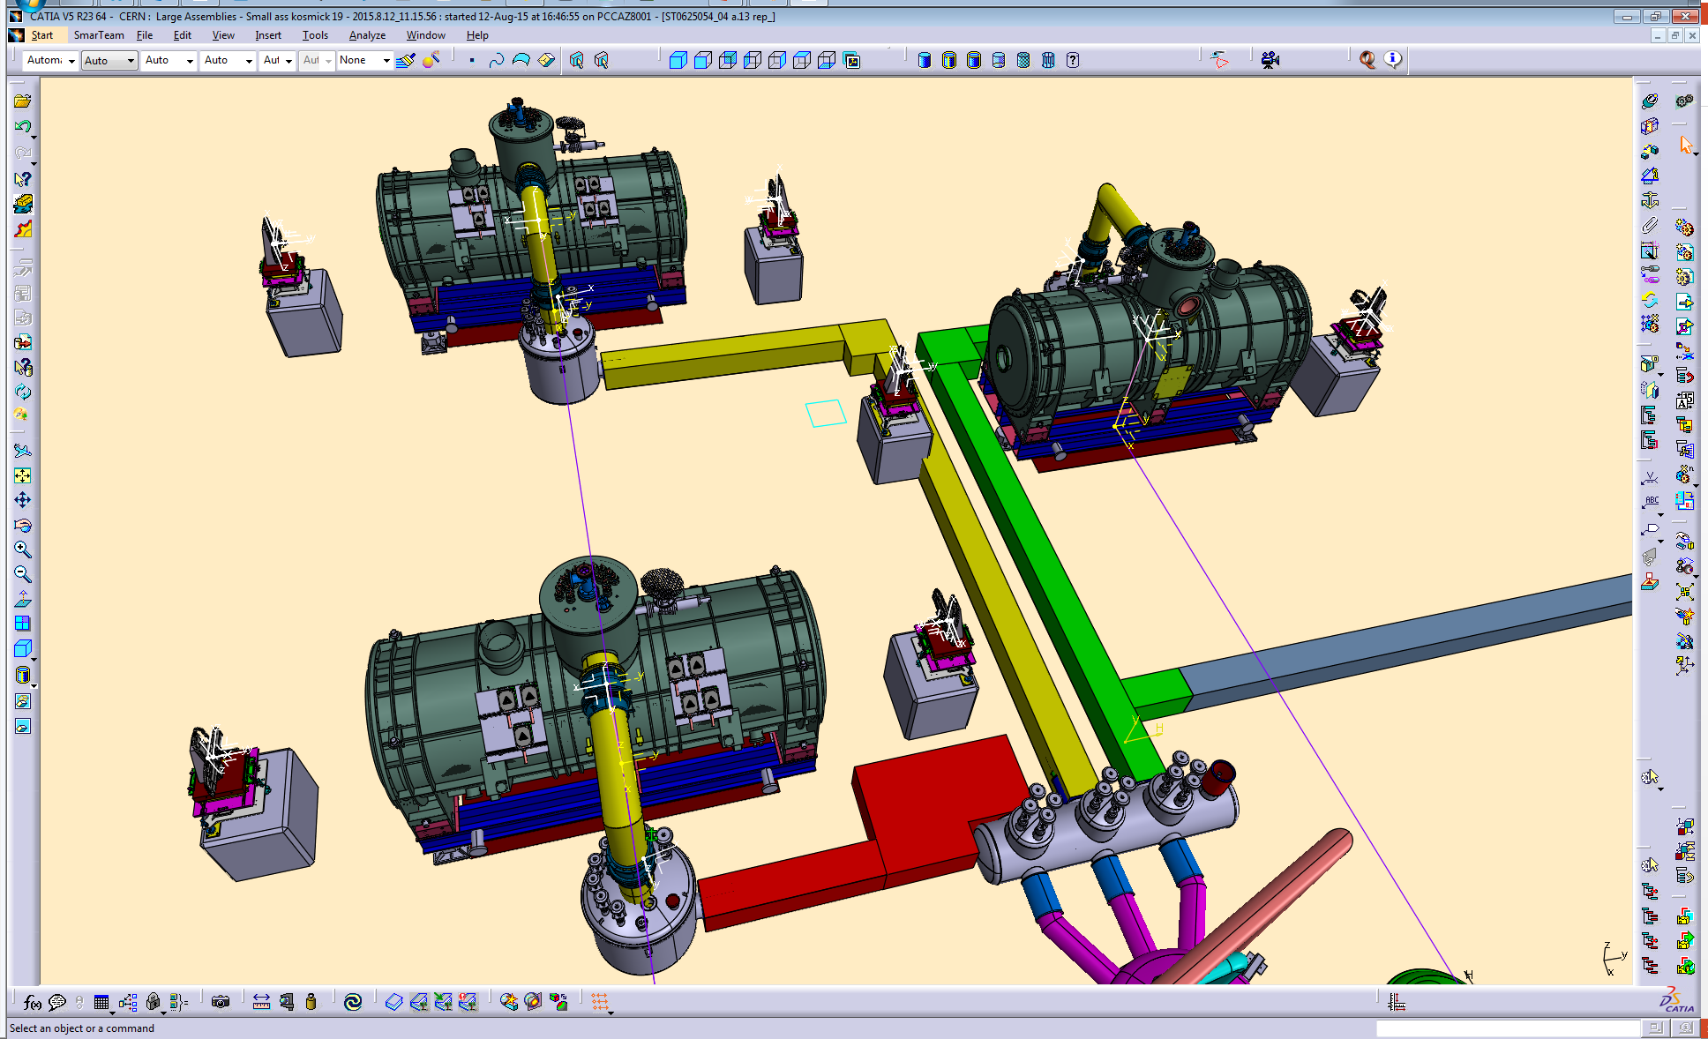
Multiplet 5628mm → CLASH

Slide 15

Multiplet 6266mm → CLASH

Slide 16
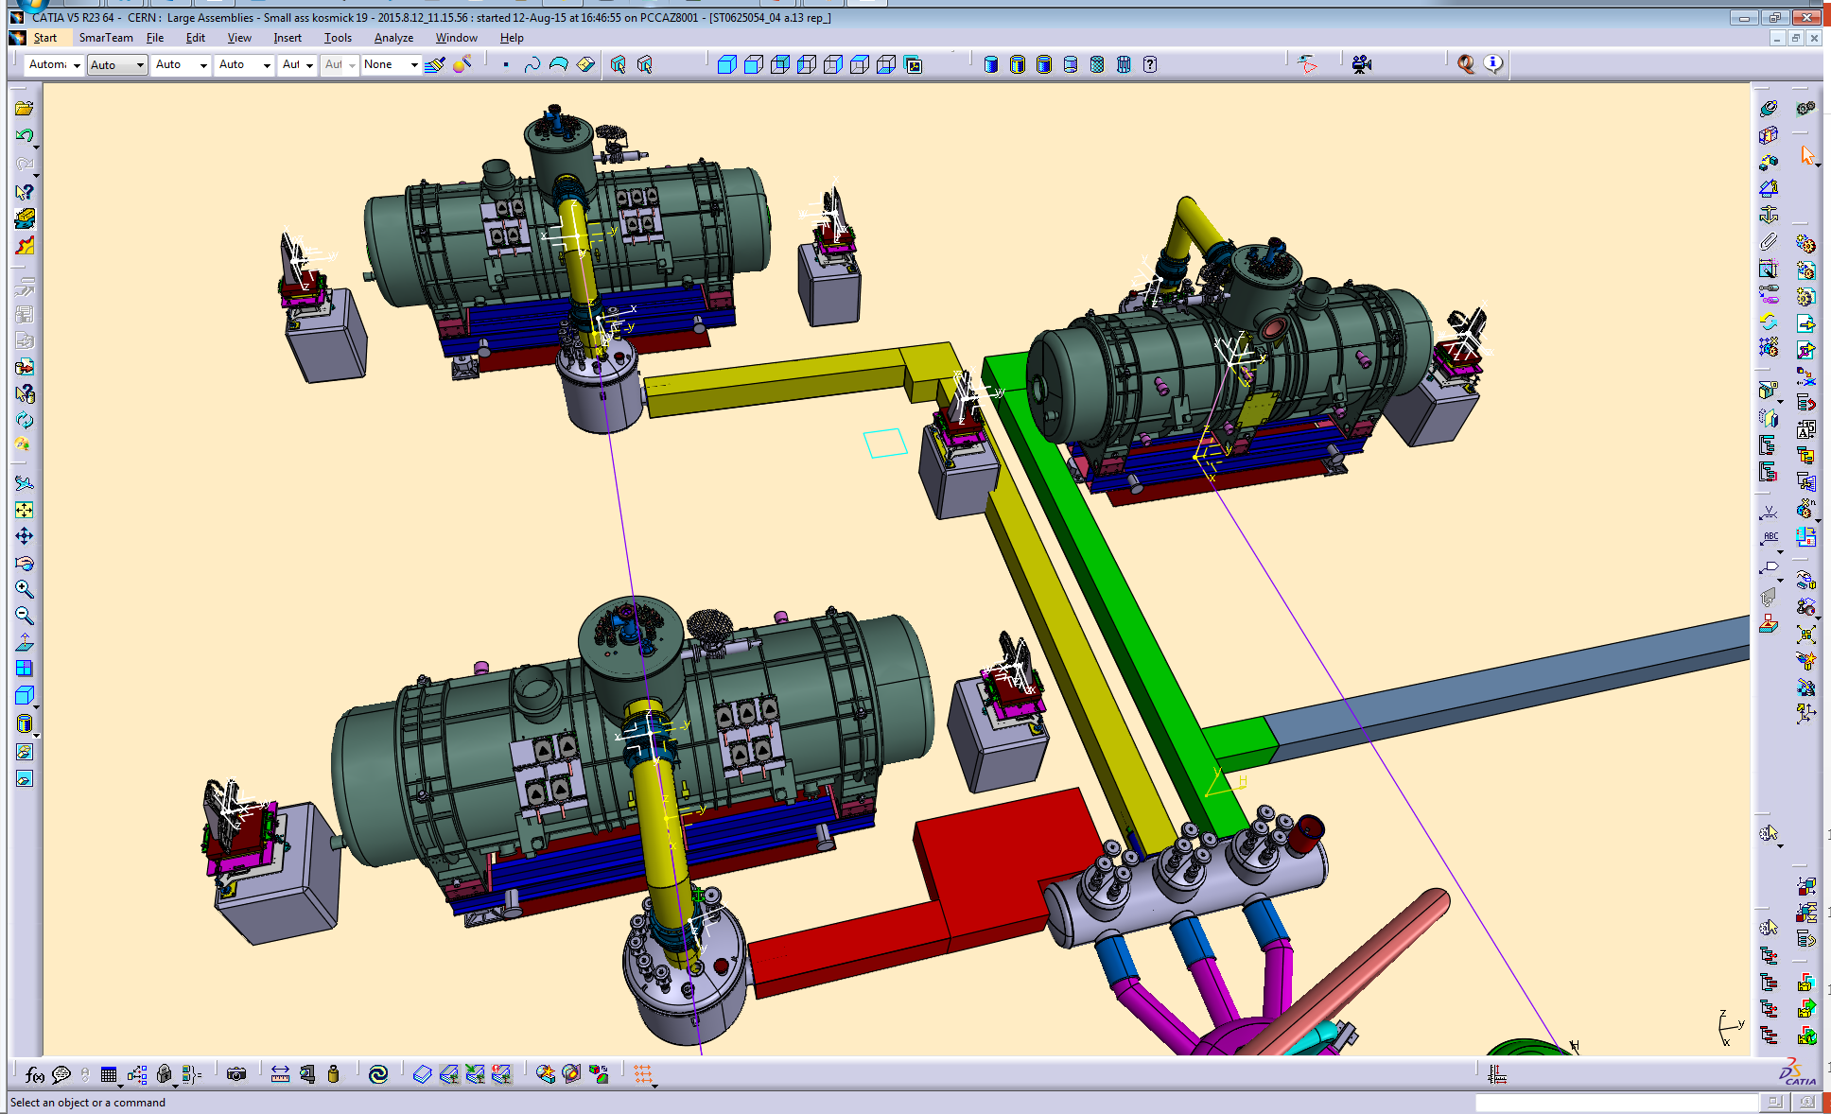
Multiplet 6904mm → CLASH

Slide 17
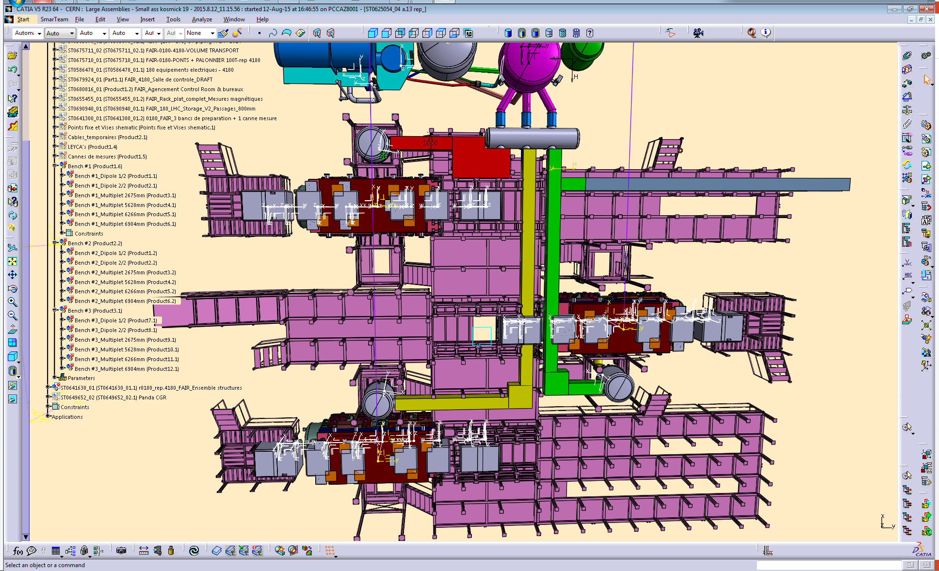
Possible to re-rout the cryo lines?
→ No

Slide 18
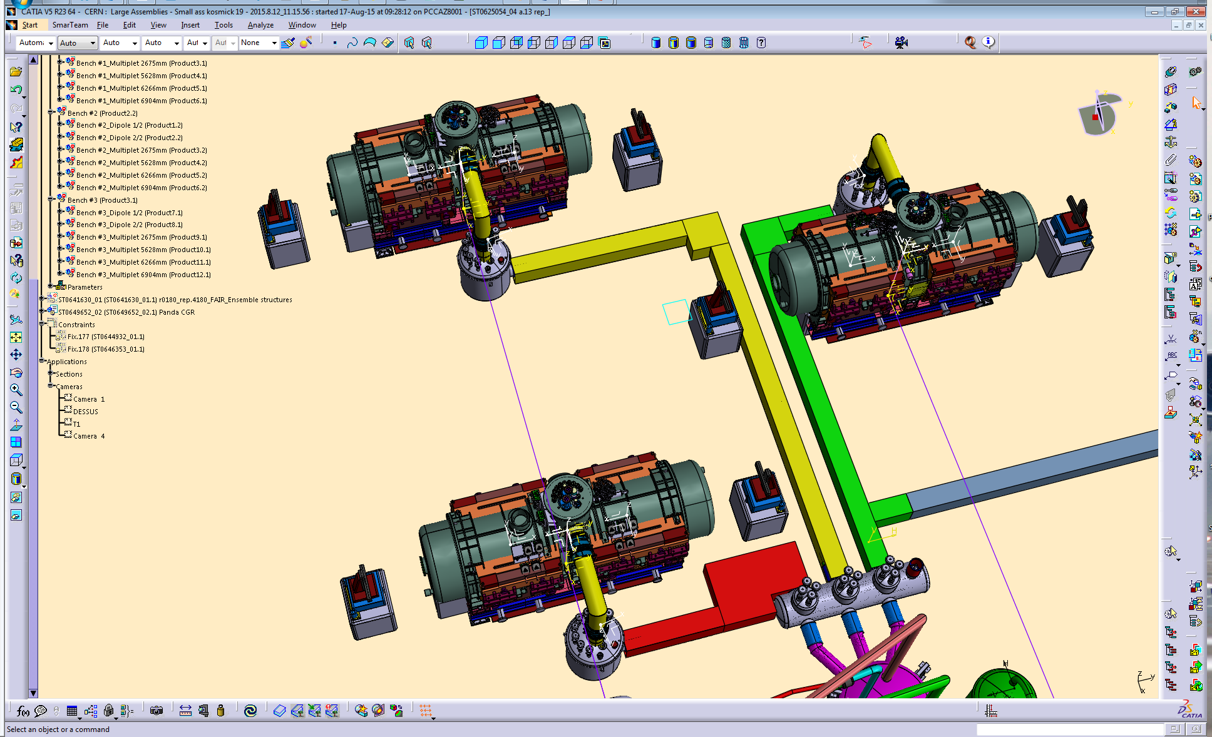
The wire tracking equipments
Have been adapted

Slide 19
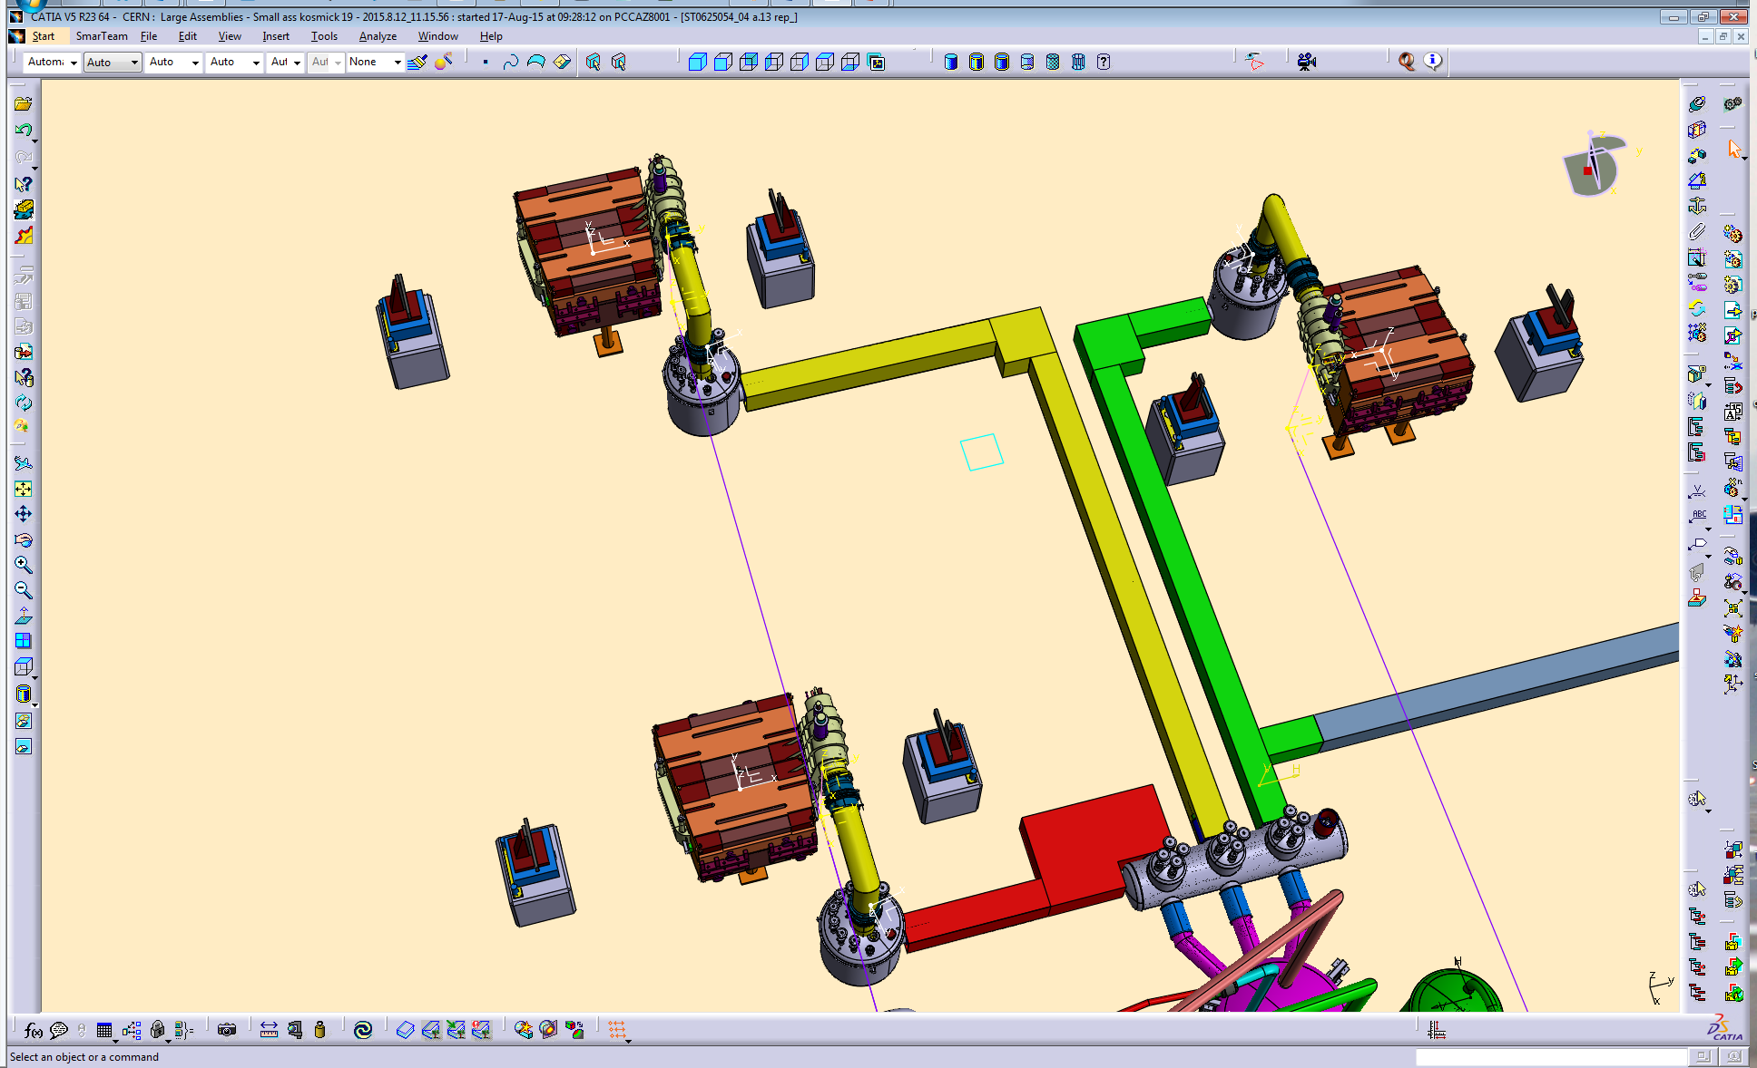
Dipole 1/2 → OK

Slide 20
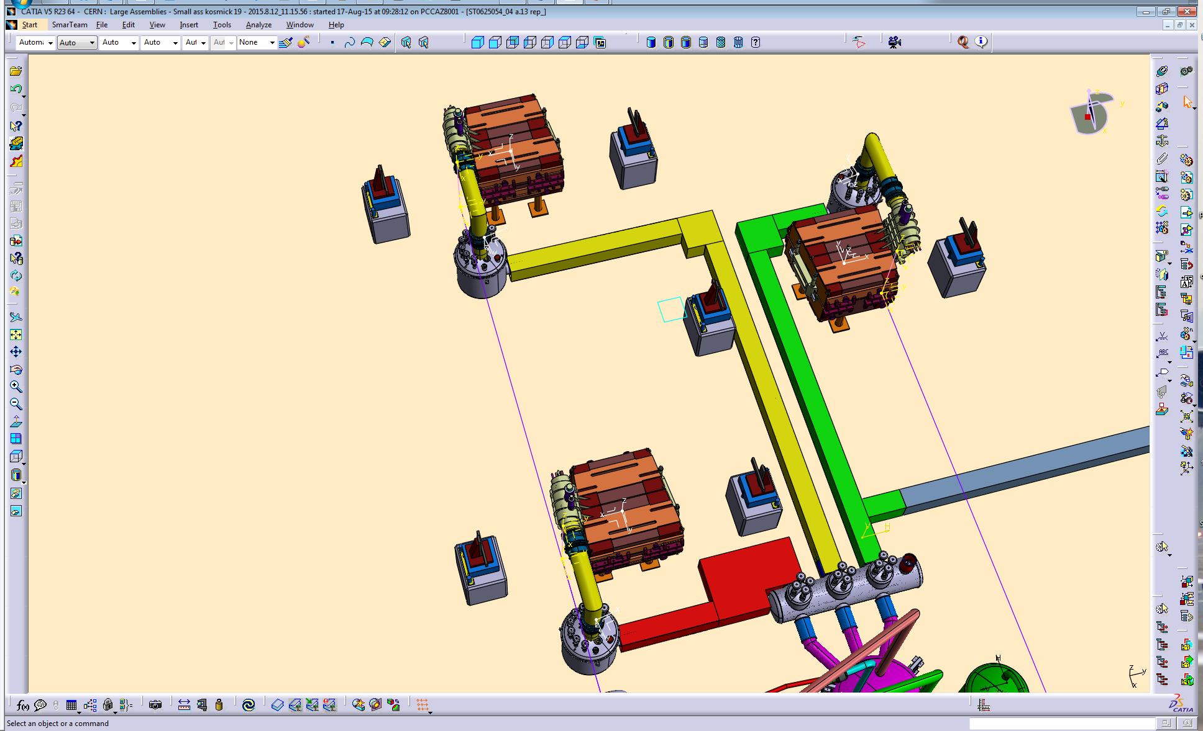
Dipole 2/2 → OK

Slide 21
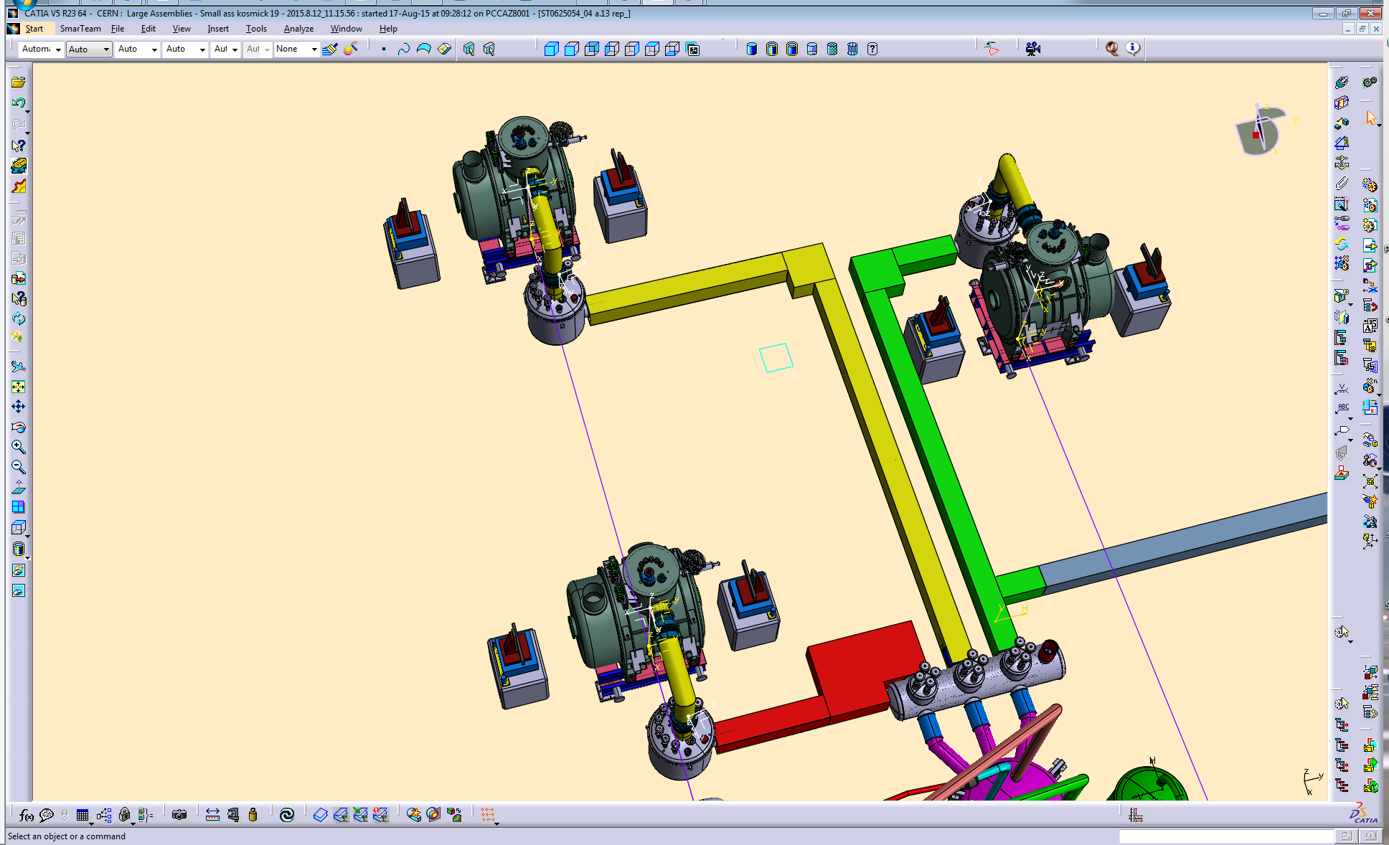
Multiplet 2675mm → OK

Slide 22
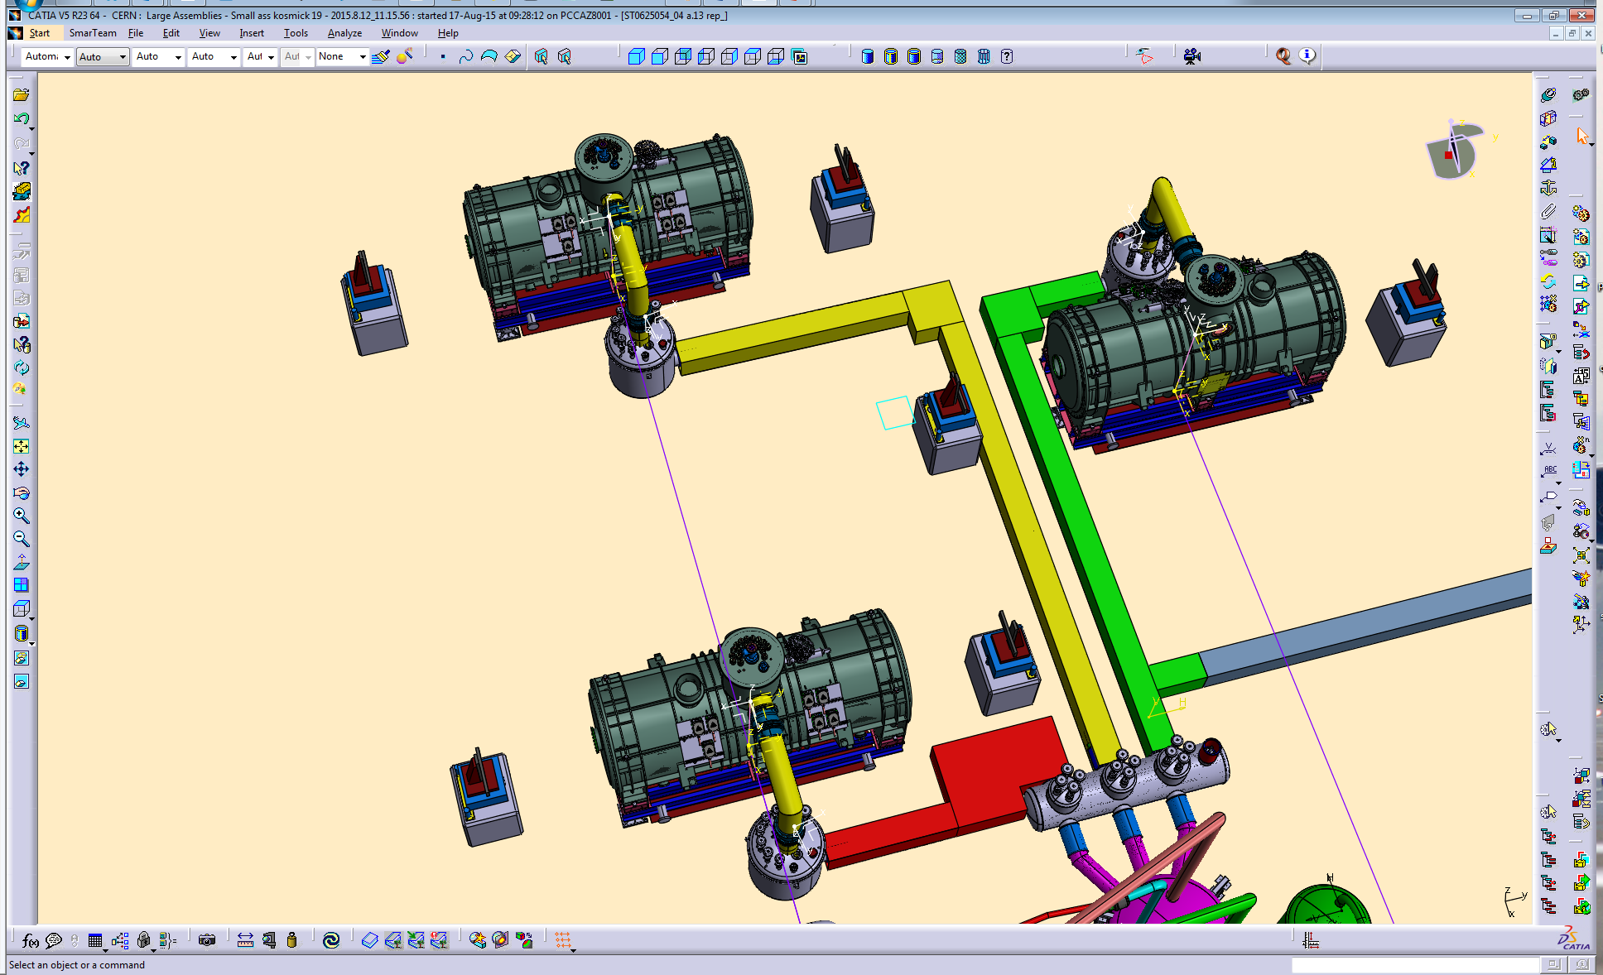
Multiplet 5628mm → OK

Slide 23
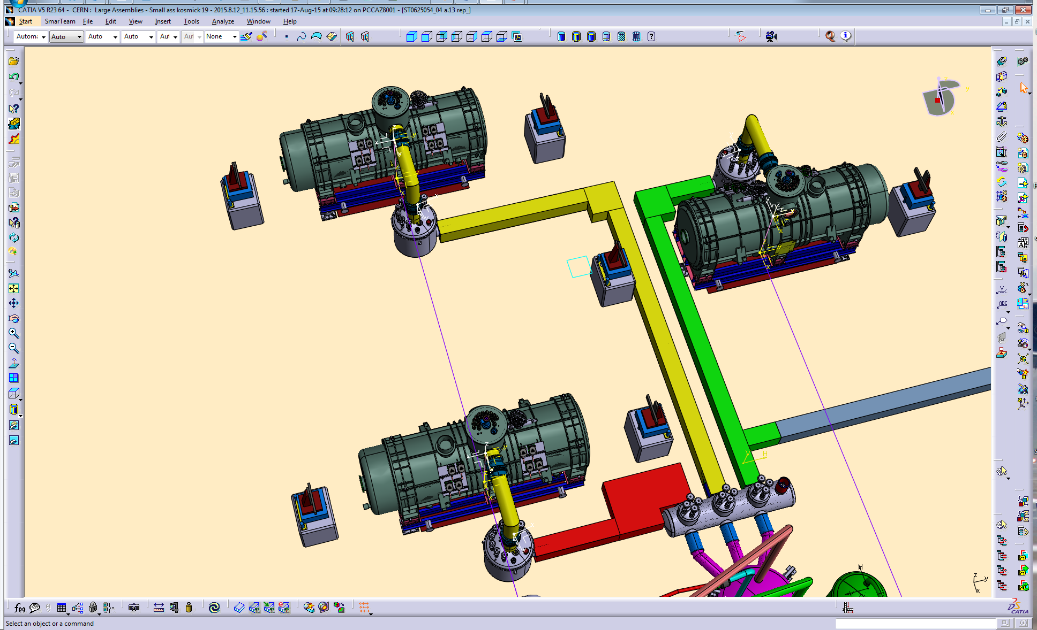
Multiplet 6266mm → OK

Slide 24
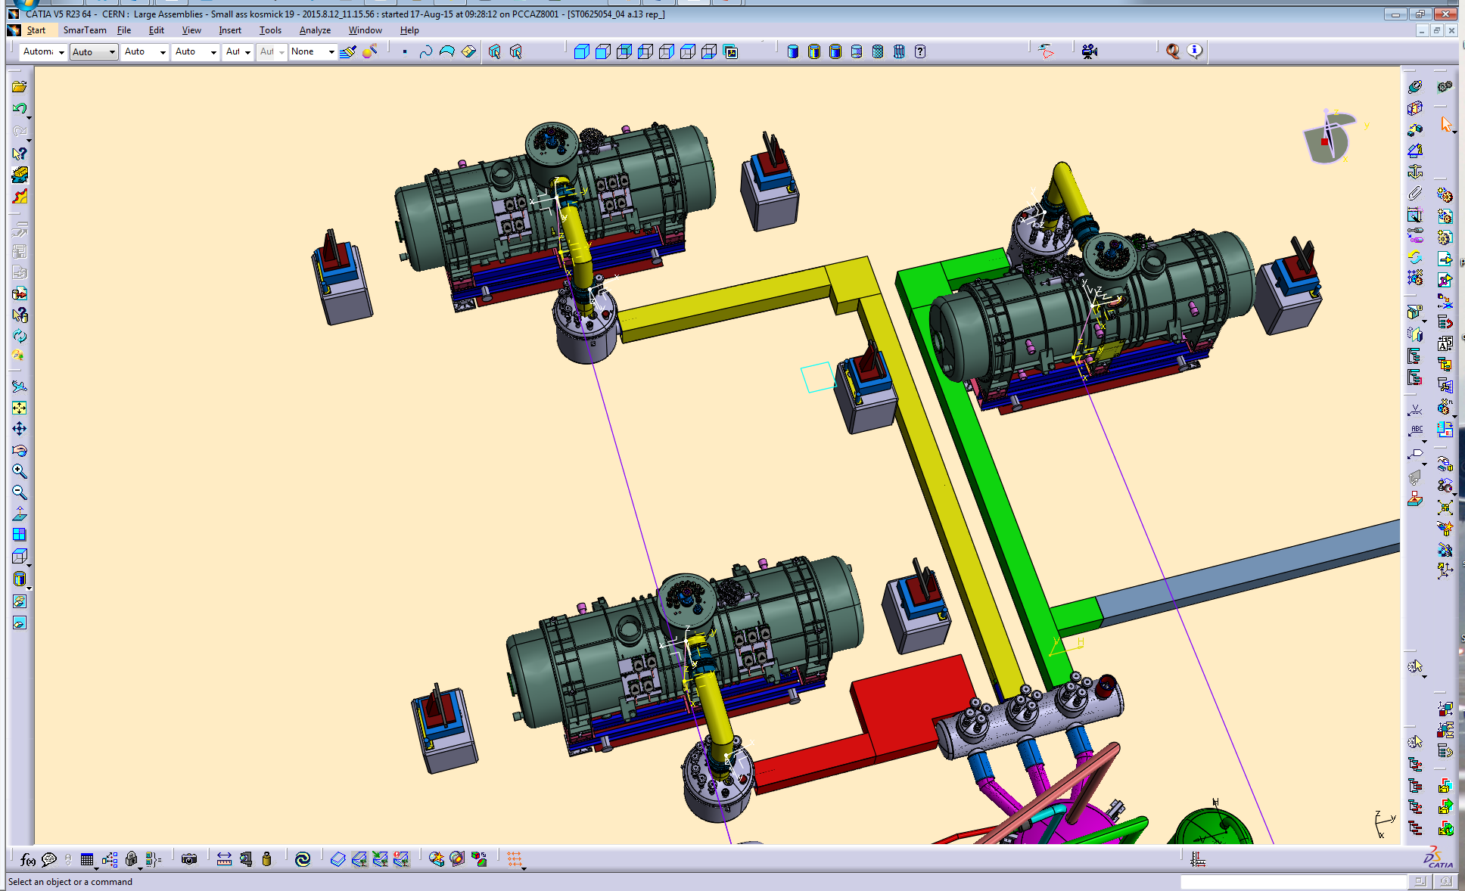
Multiplet 6904mm → OK

Slide 25
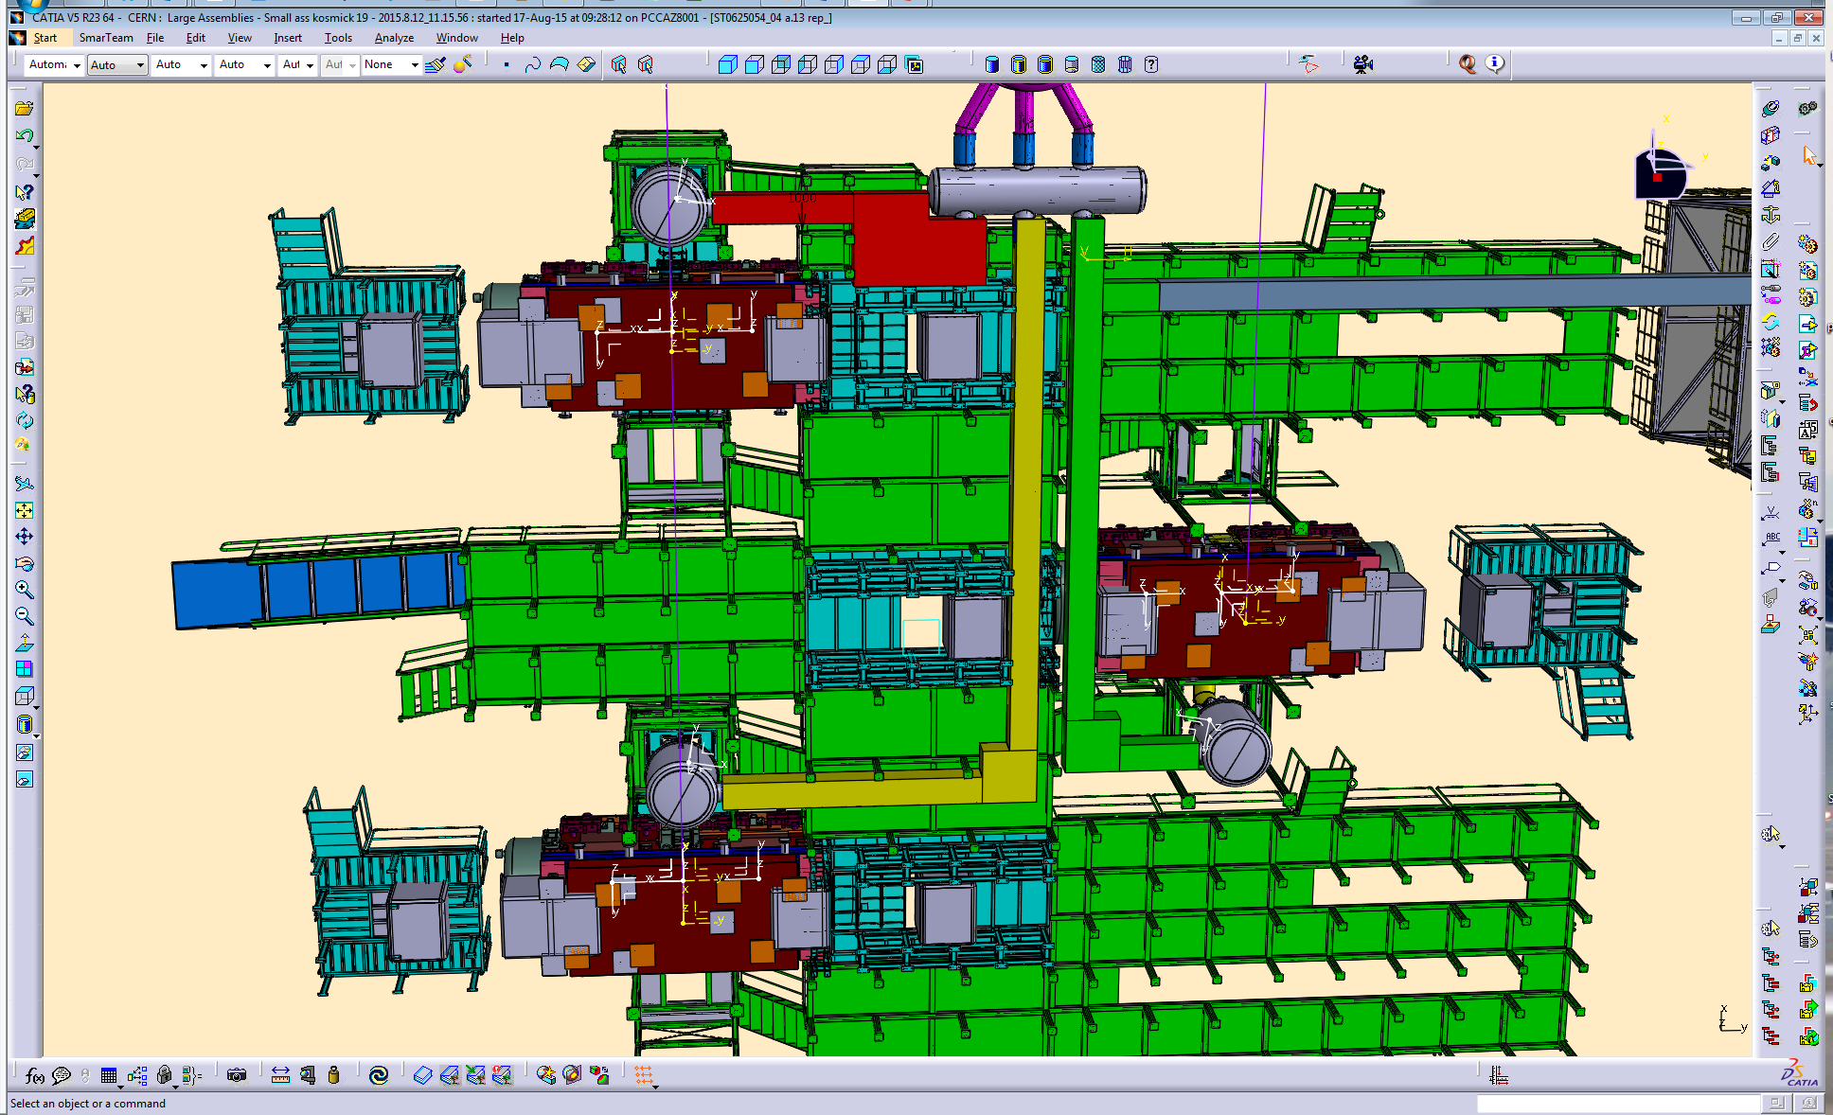
Vue de dessous

Slide 26
Latest configuration
to be approved

Slide 27
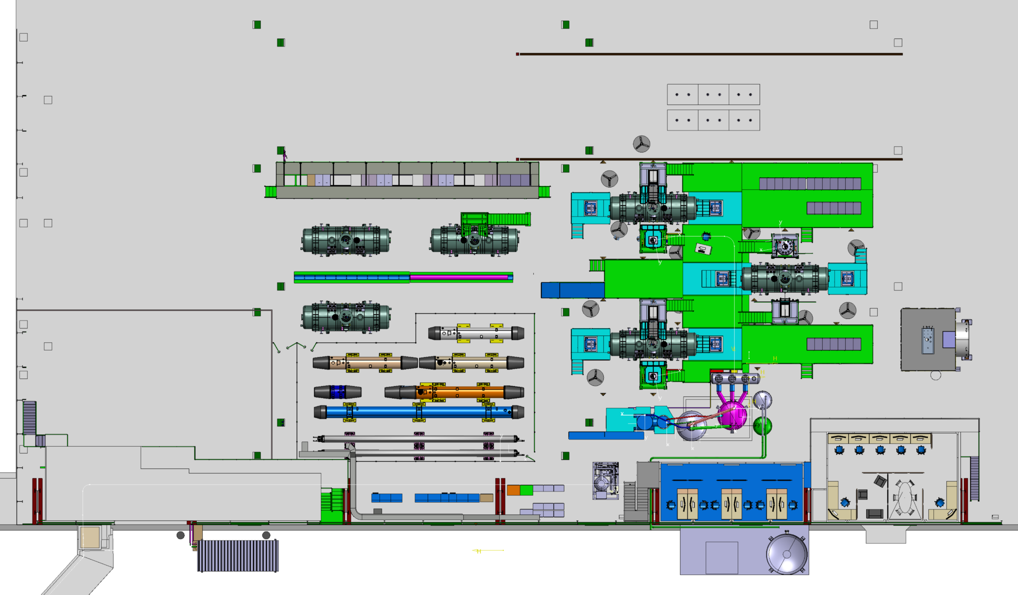
Preparation area
Test area
Transport
Main door
PANDA
General view_ Latest configuration to be approved
LHC magnets
Atelier & Control room
Stockage & Offices
Personnal access

Slide 28
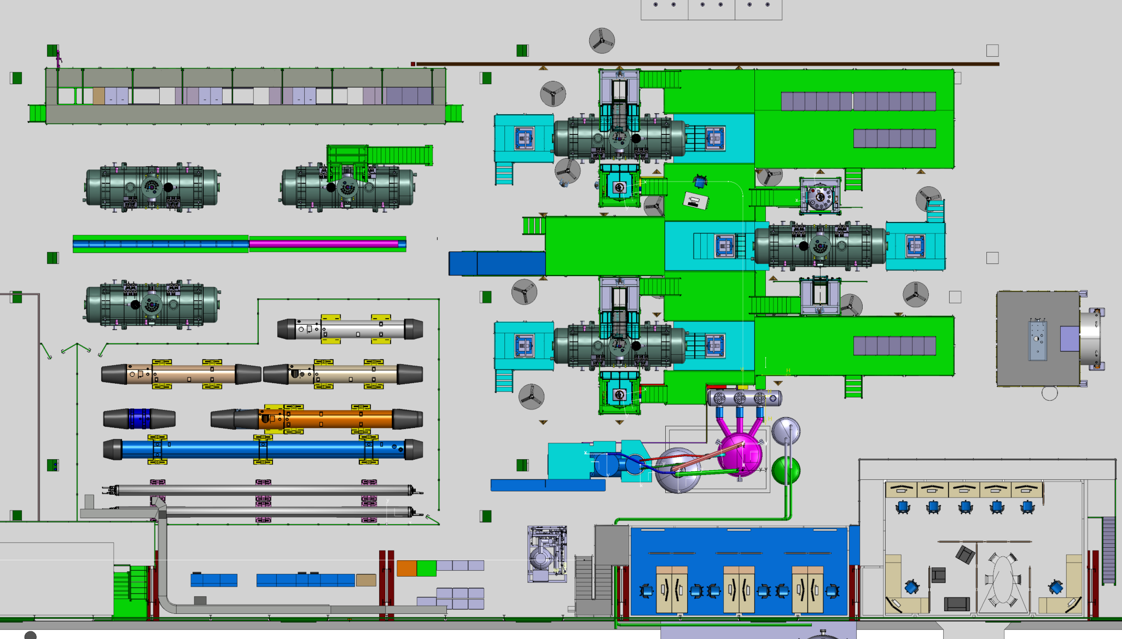
General view_ Latest configuration to be approved

Slide 29
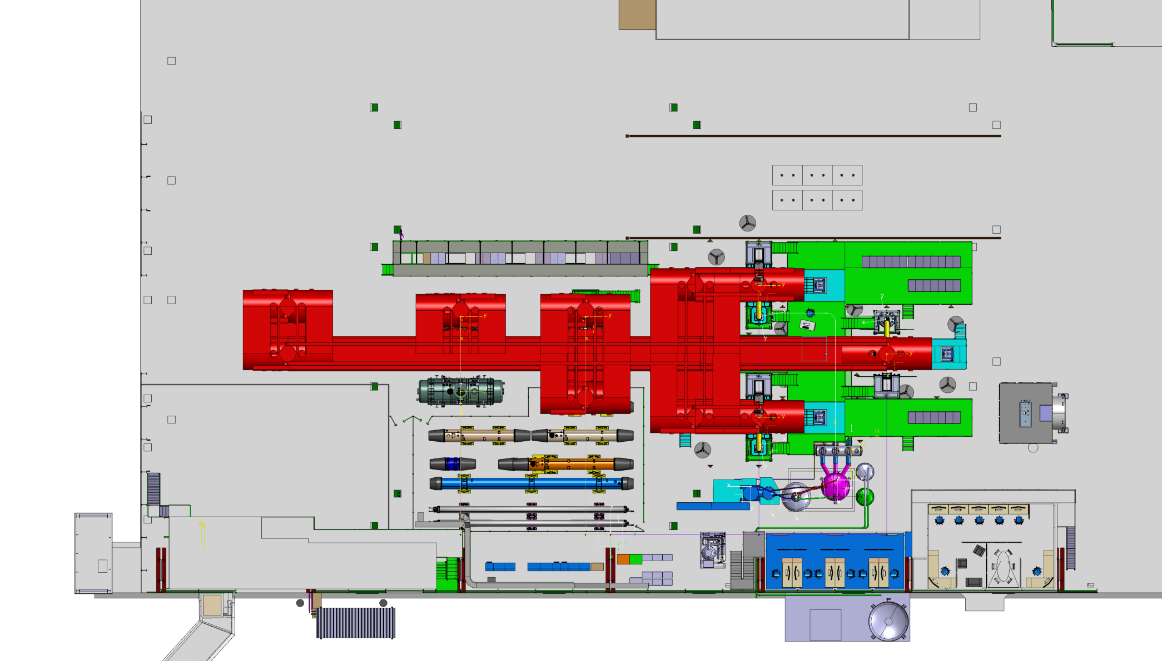
Transport zone to be re-studied

Slide 30
General views

Slide 31
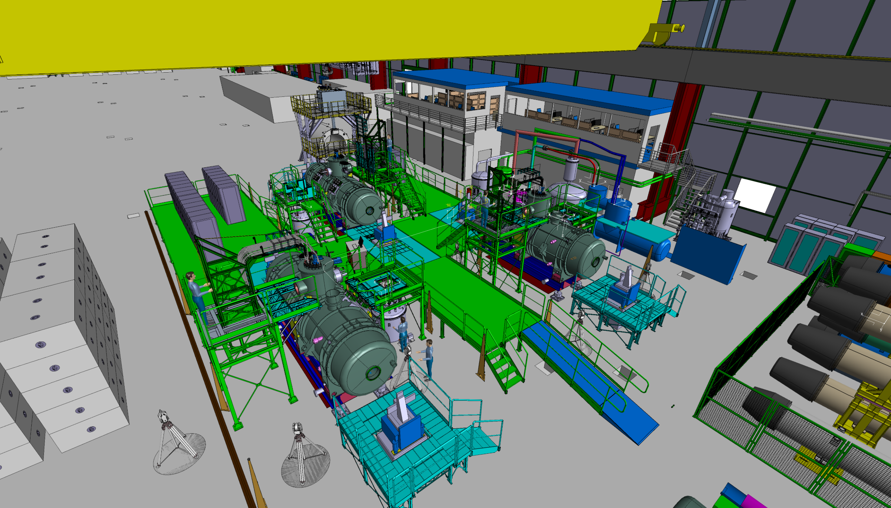
General views

Slide 32
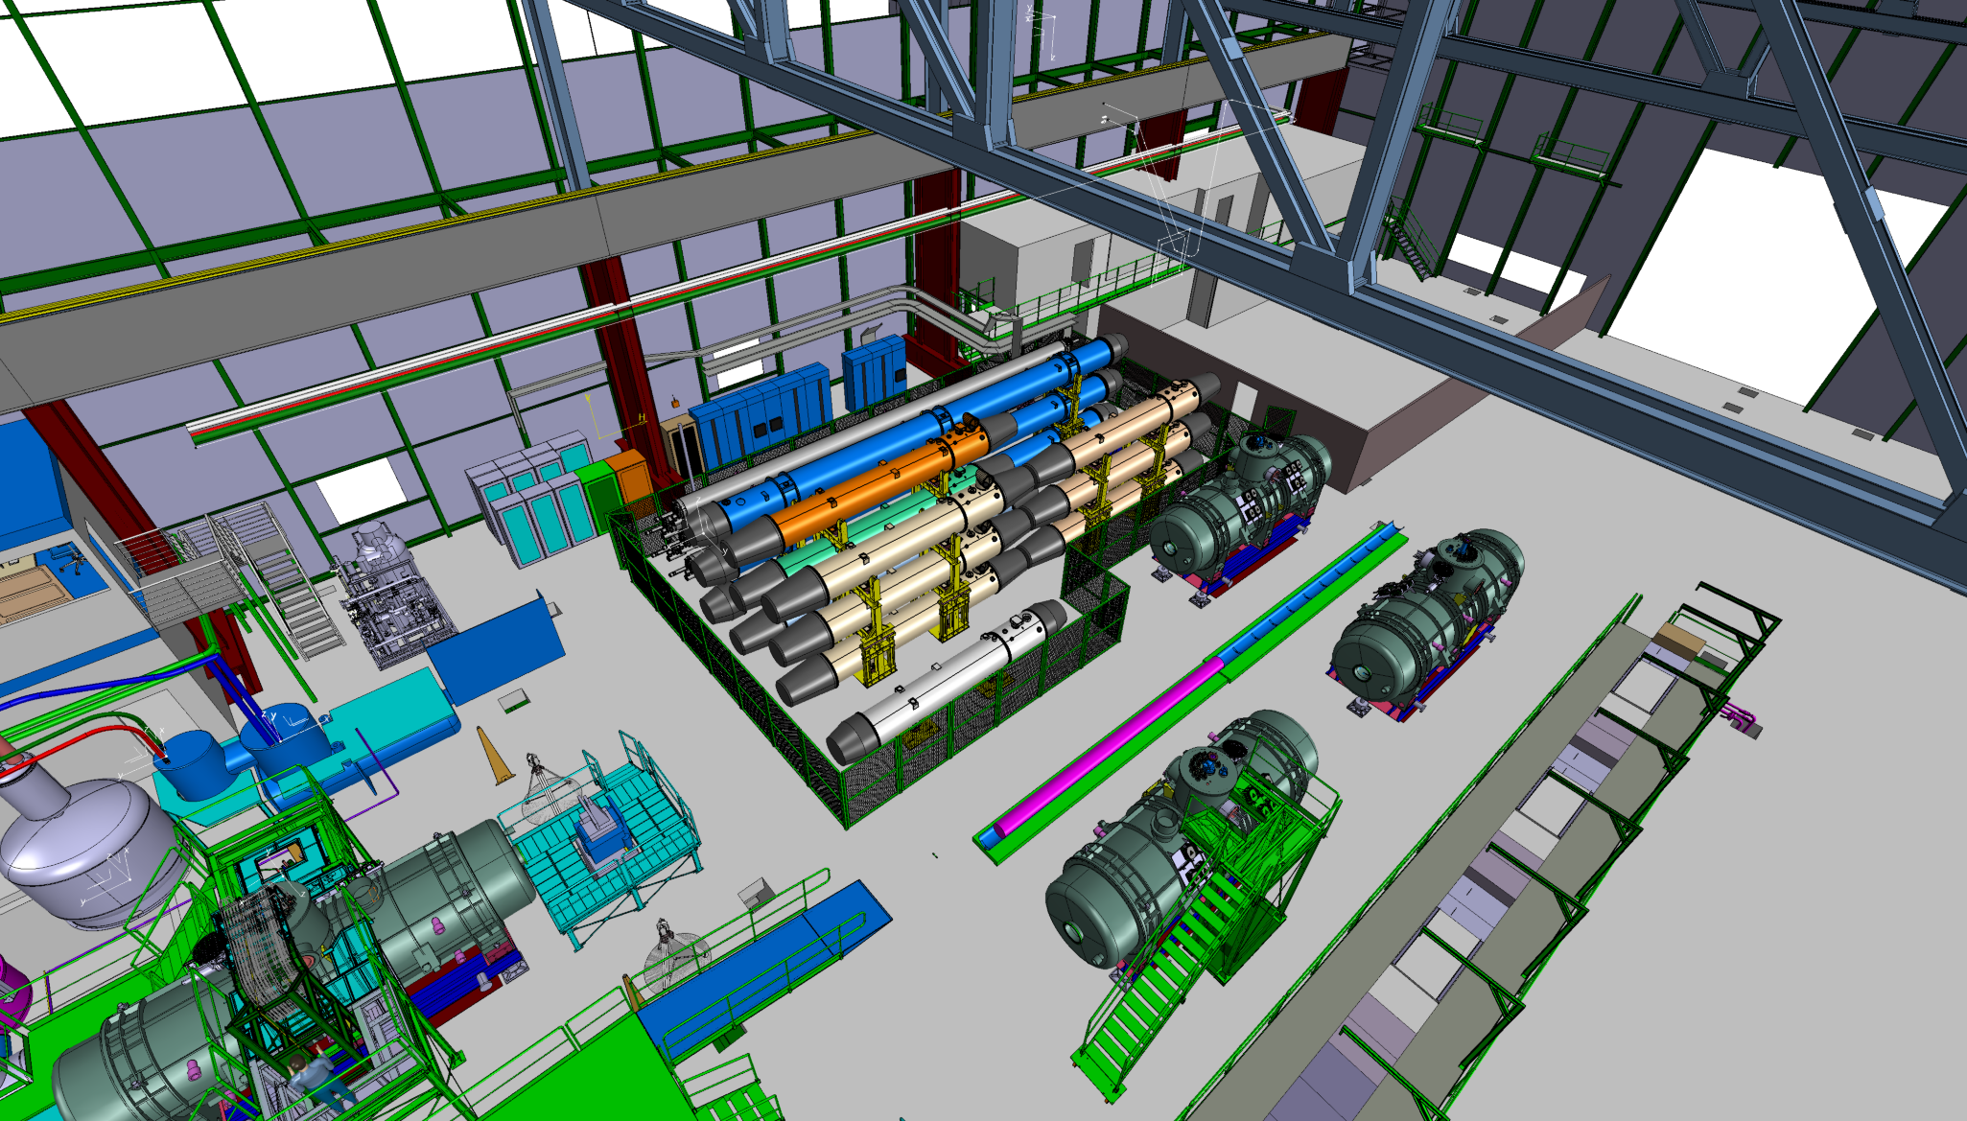
General views

Slide 33
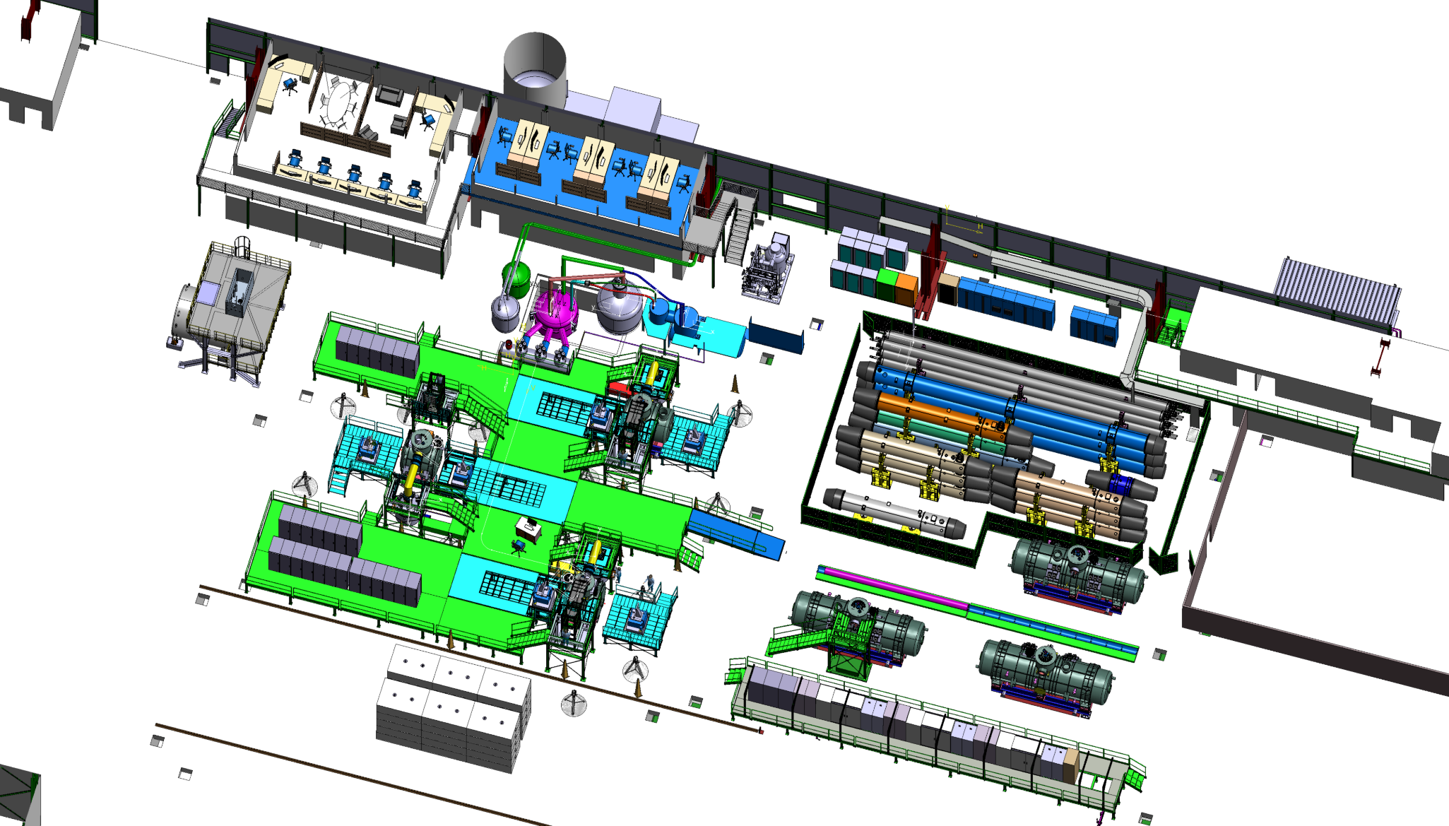
General views

Slide 34
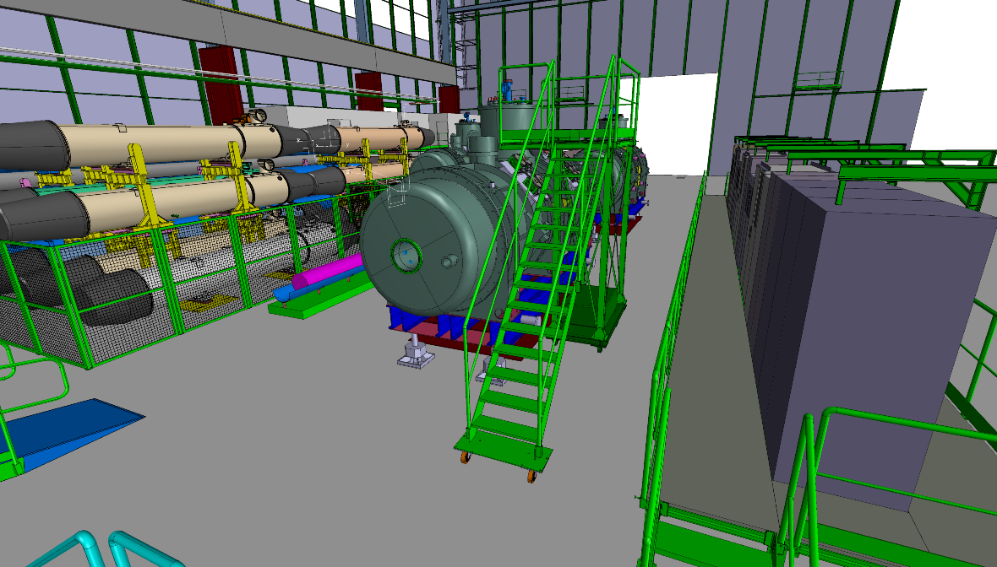
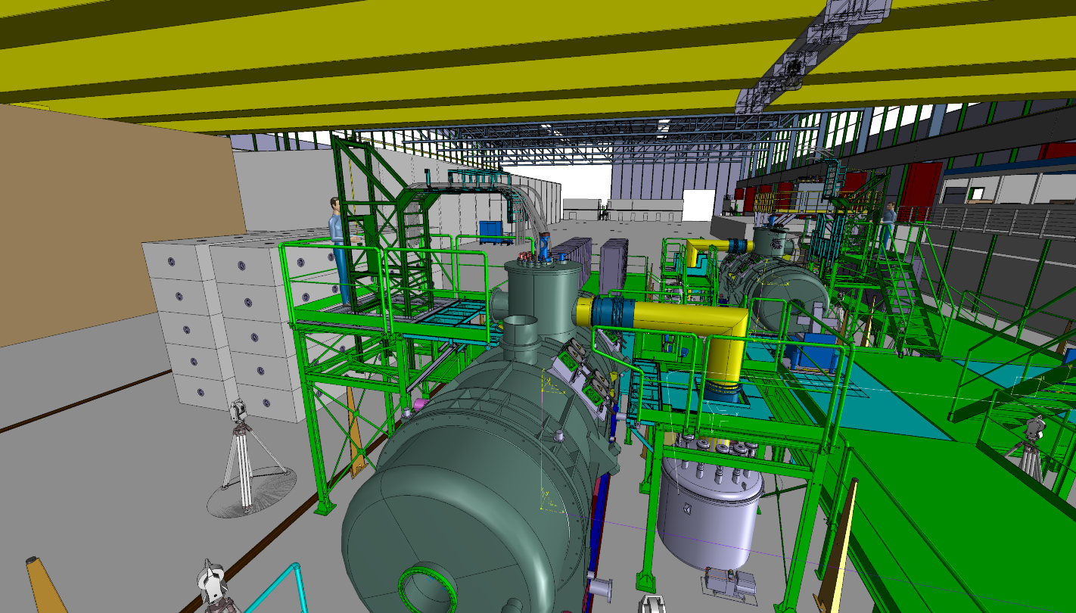
Movable cable trays
General views
Movable stairs for preparation zone

Slide 35
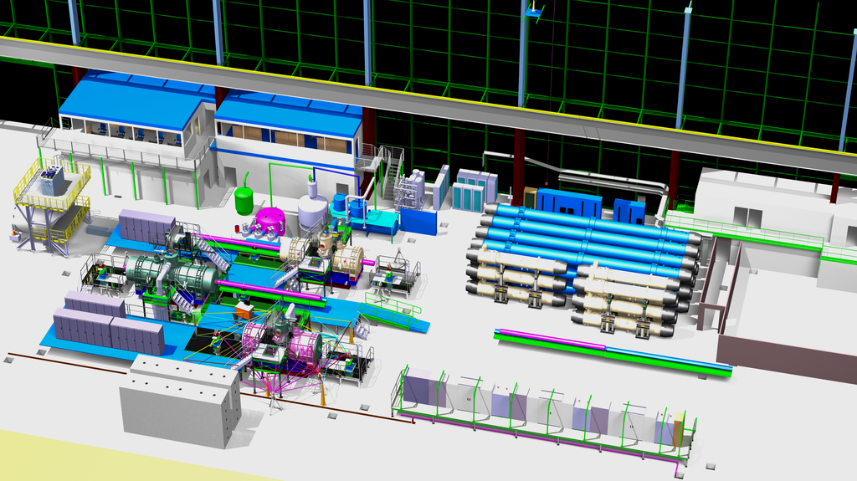
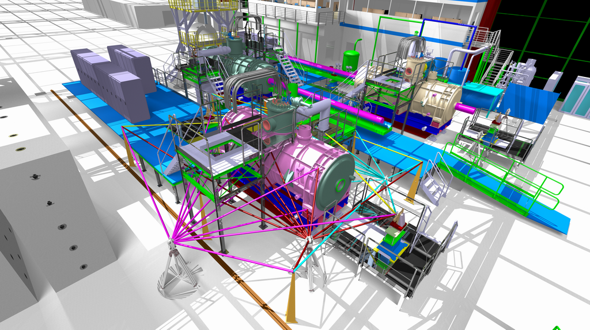
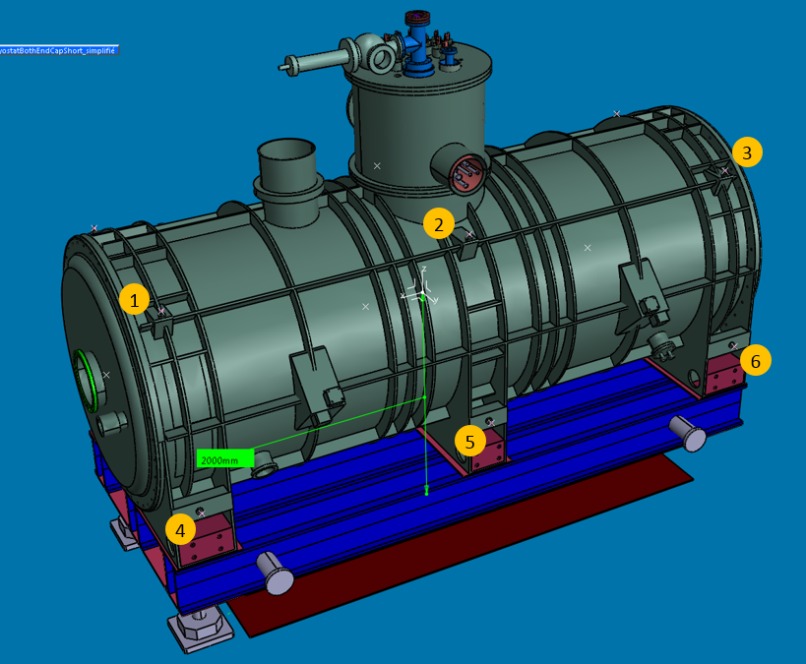
Points | X (mm) | Y (mm) | Z (mm)
1 | 2393 | 760 | 828.915
2 | 0 | 760 | 828.915
3 | -2393 | 760 | 828.915
4 | 2379 | 1103.415 | -644.5
5 | 0 | 1103.415 | -644.5
6 | 2379 | 1103.415 | -644.5
7 | 2393 | -760 | 828.915
8 | 0 | -760 | 828.915
9 | -2393 | -760 | 828.915
10 | 2379 | -1103.415 | -644.5
11 | 0 | -1103.415 | -644.5
12 | -2379 | -1103.415 | -644.5
Survey measuring

Slide 36
Different configurations

Slide 37
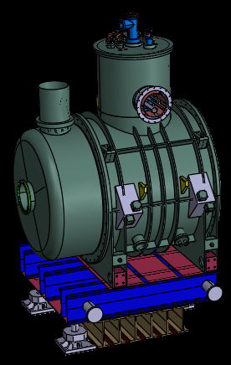
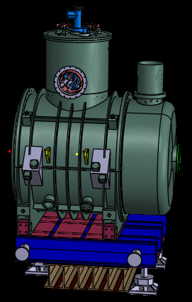
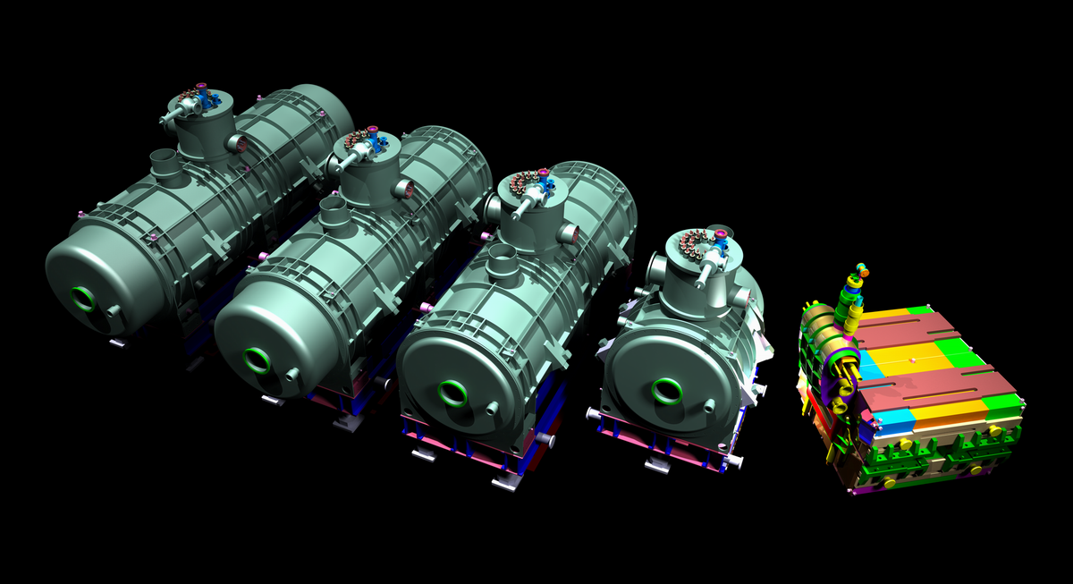
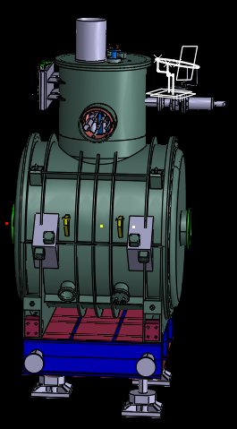
2675mm var_1
2675mm var_2
2000mm
3D magnets from GSI
Another 300mm longer dipole?

Slide 38
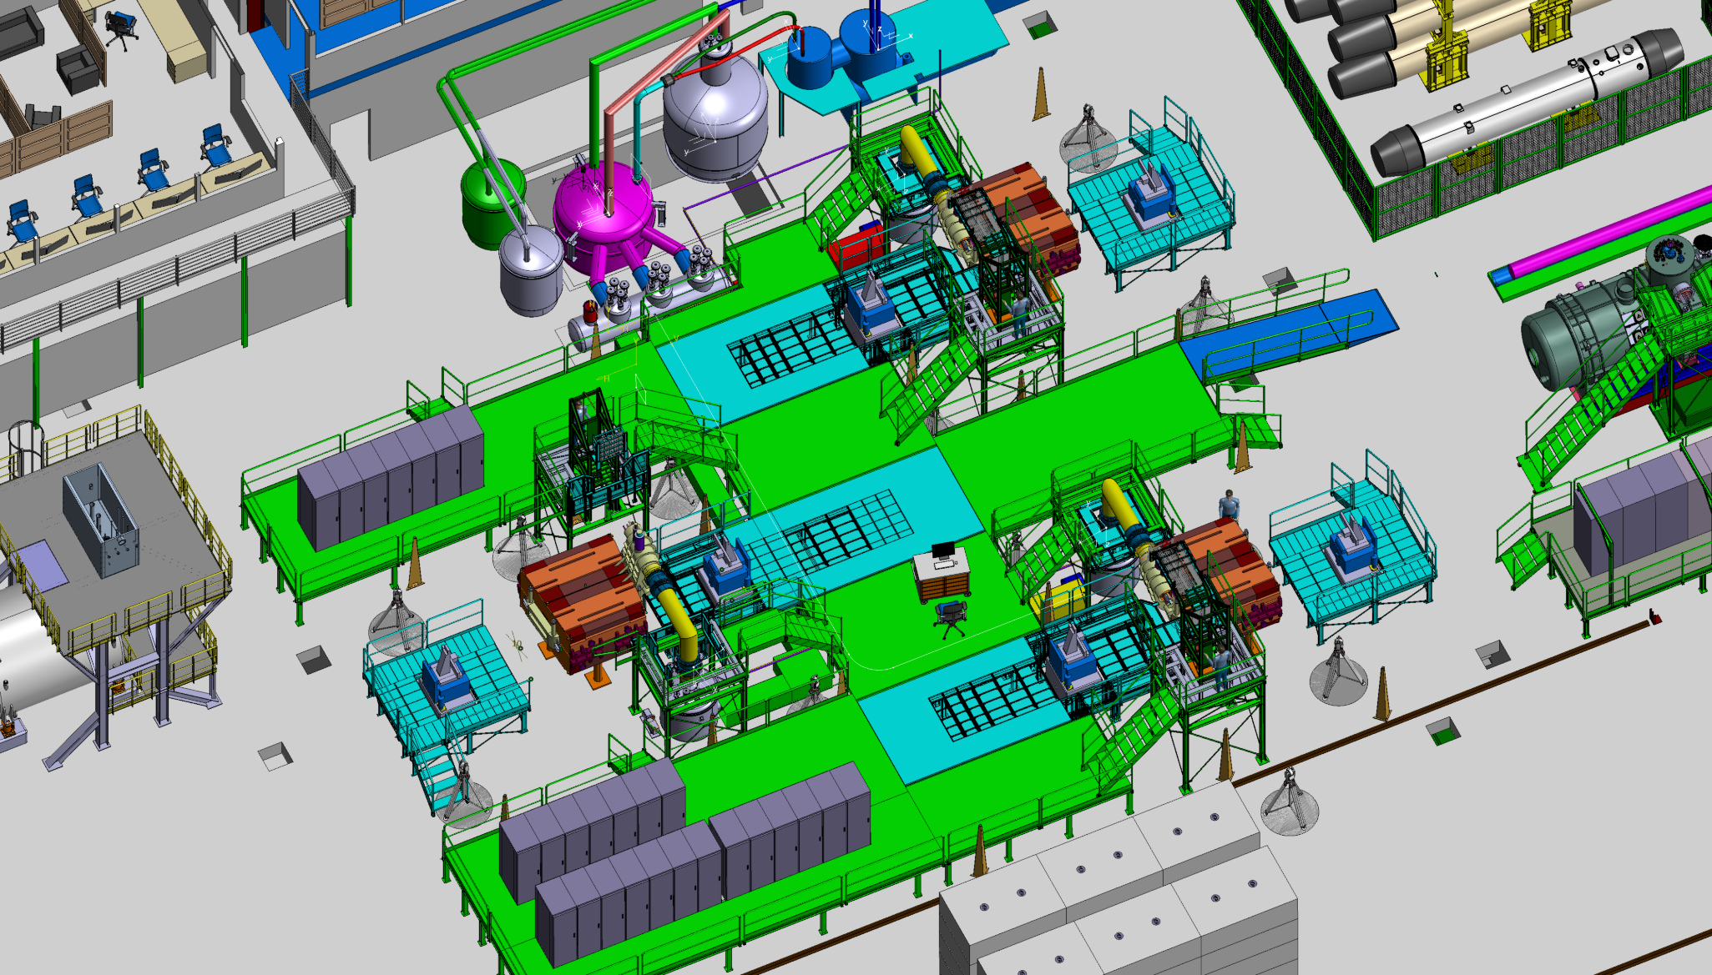
Dipole var_1
Different configurations

Slide 39
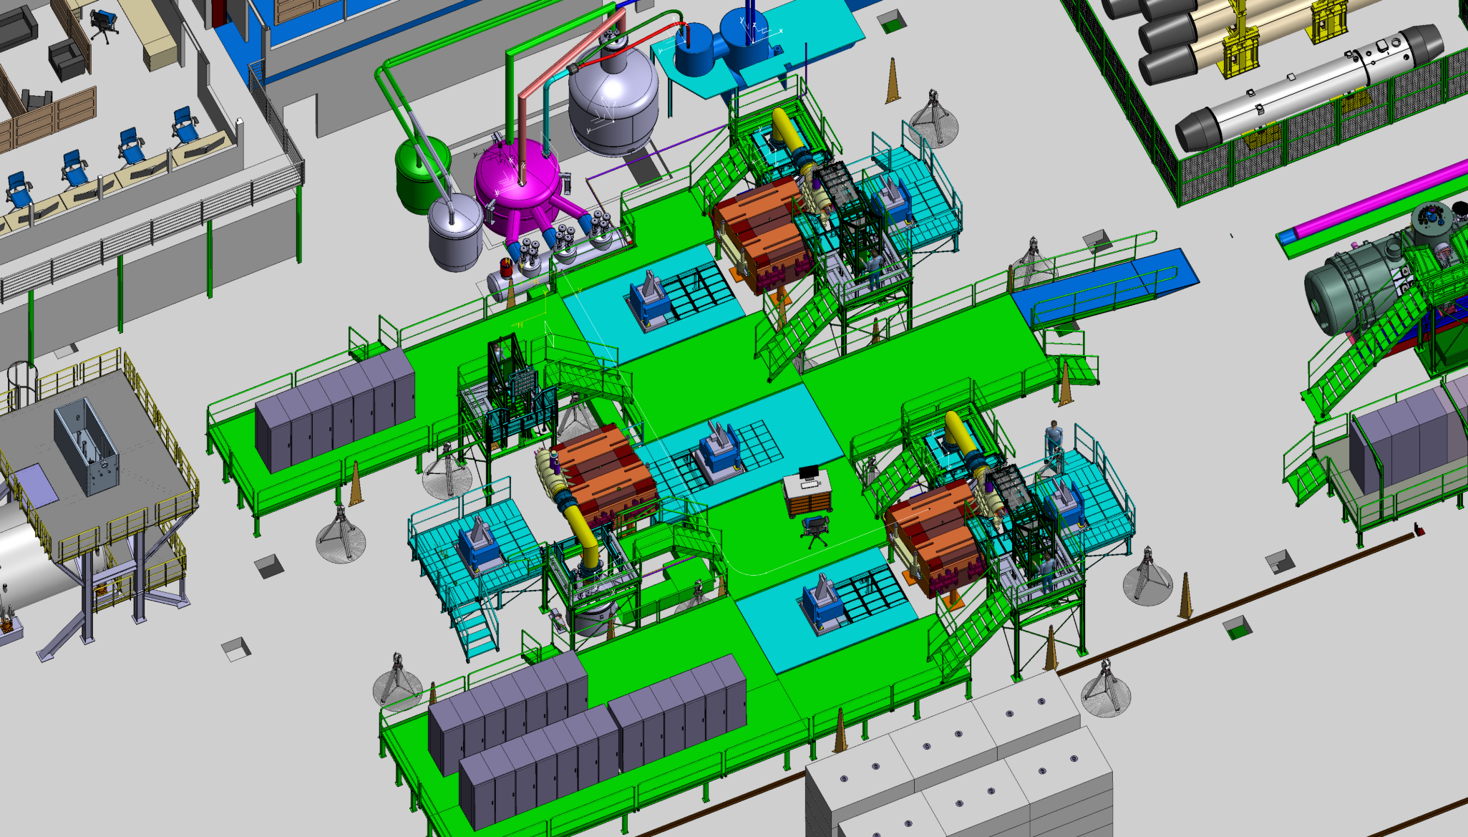
Dipole var_2
Different configurations

Slide 40
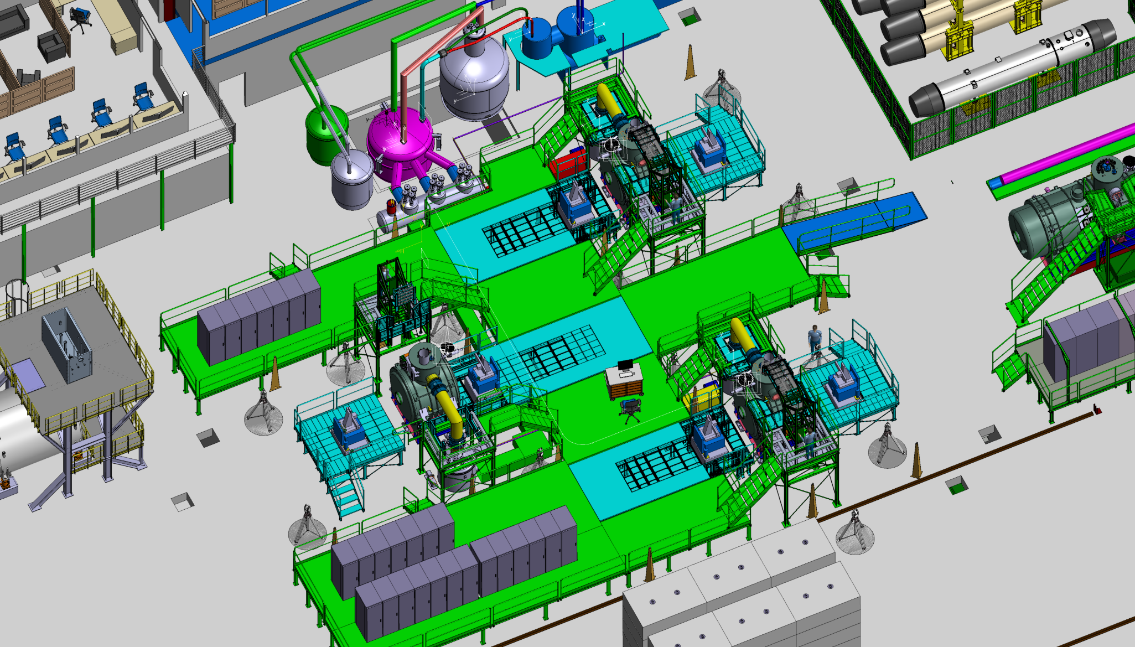
Multiplet 2000mm
Different configurations

Slide 41

Multiplet 2675mm var_1
Different configurations

Slide 42

Multiplet 2675mm var_2
Different configurations

Slide 43
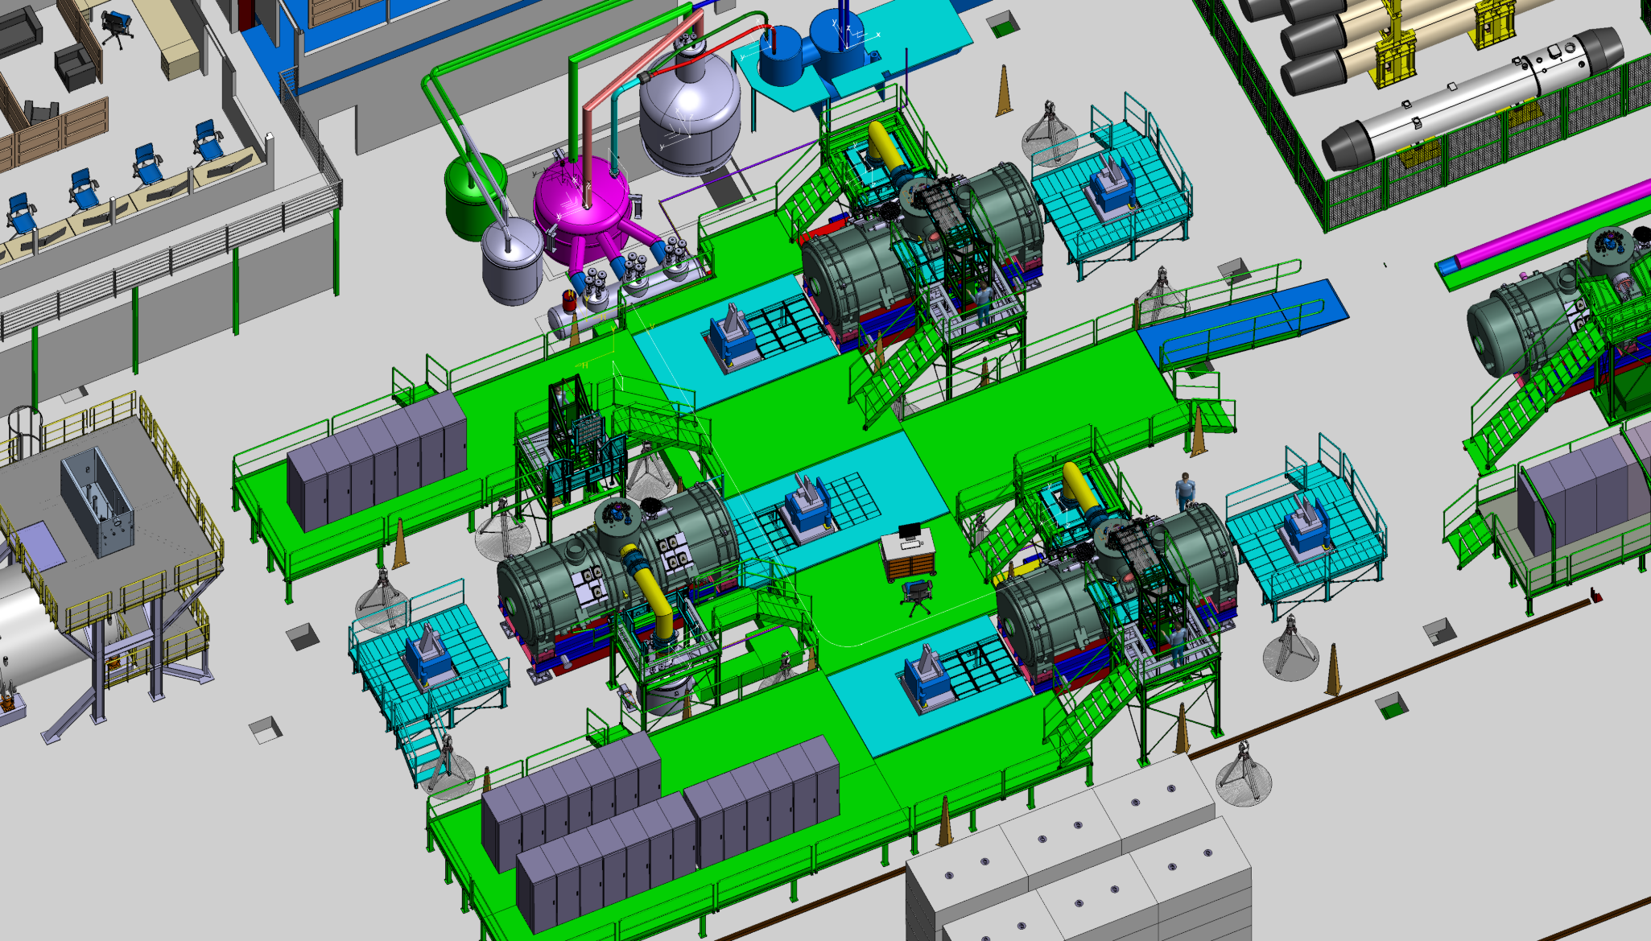
Multiplet 5628mm
Different configurations

Slide 44

Multiplet 6266mm
Different configurations

Slide 45

Multiplet 6904mm
Different configurations

Slide 46
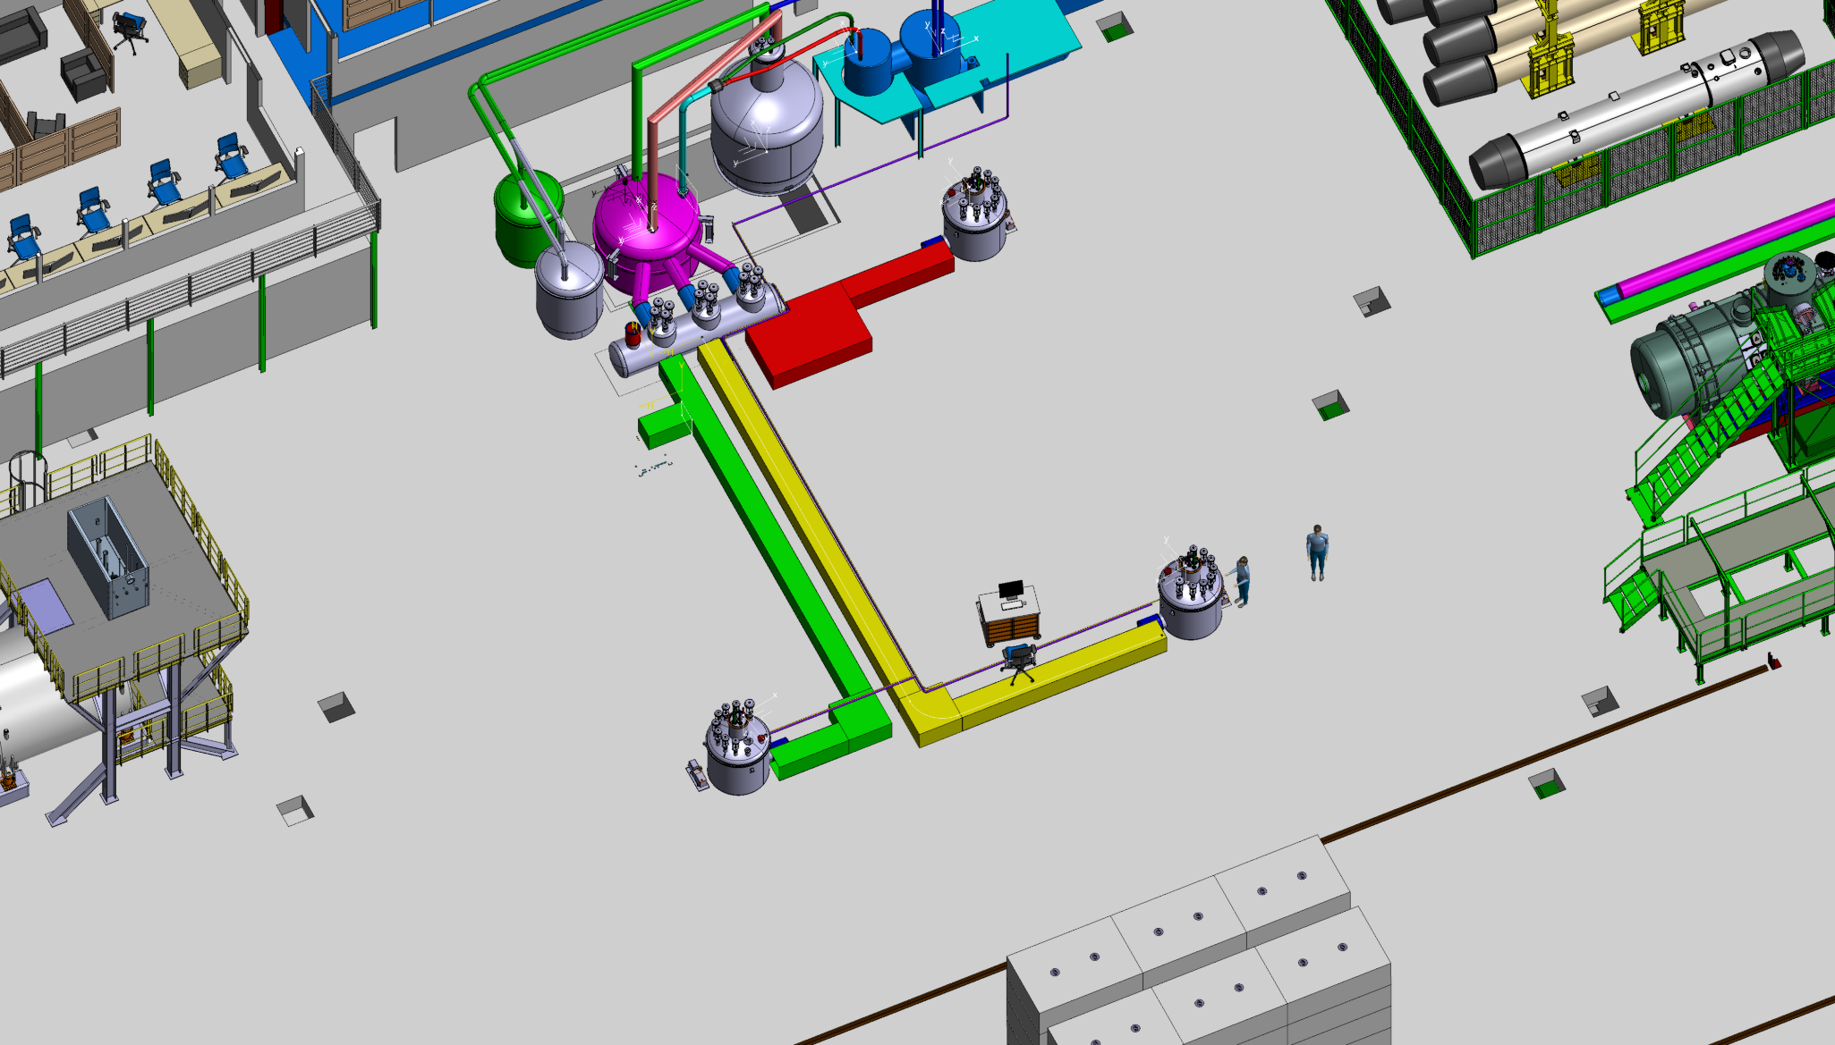
Different configurations

Slide 47
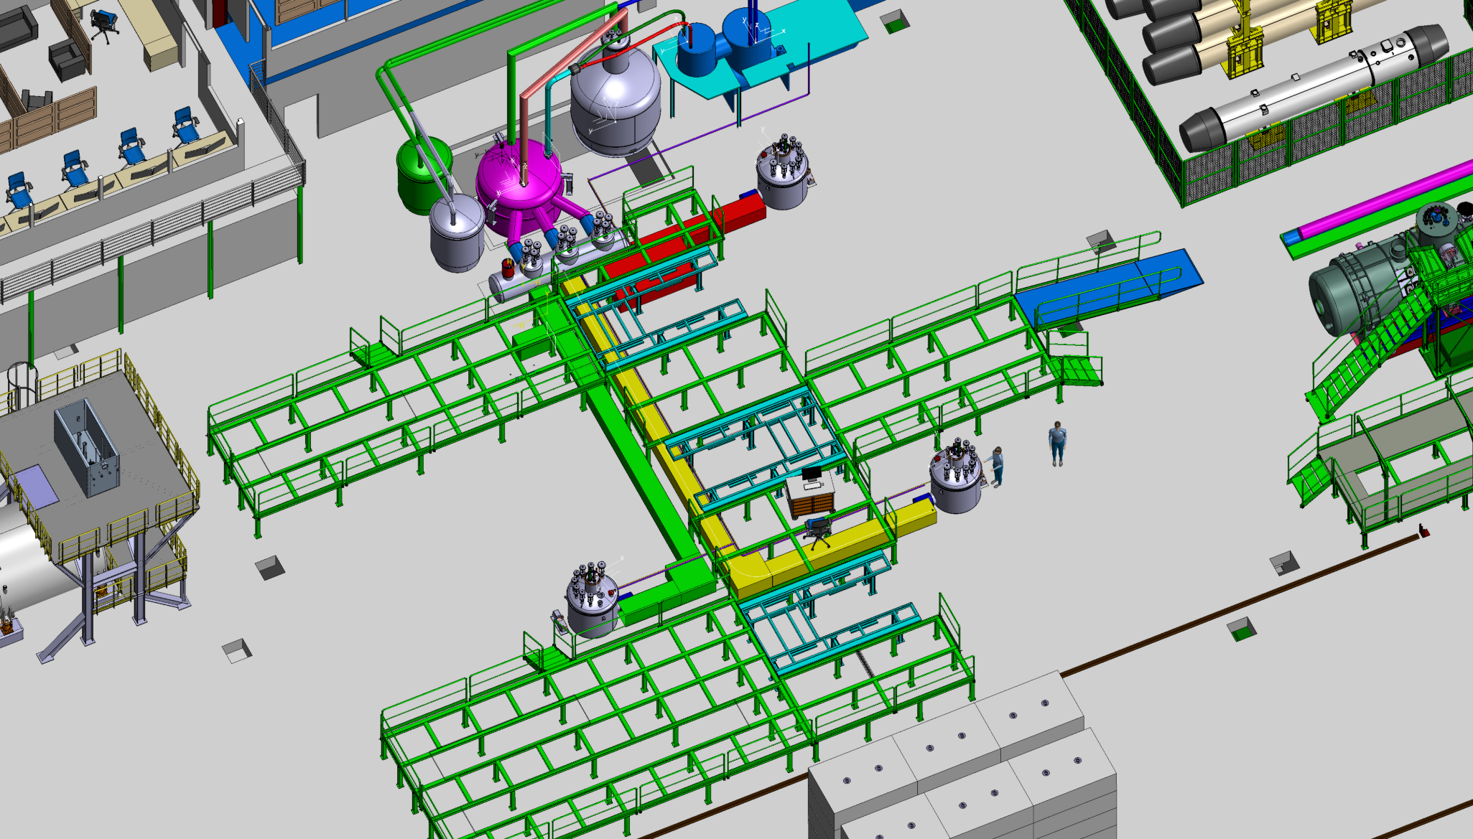
Different configurations

Slide 48
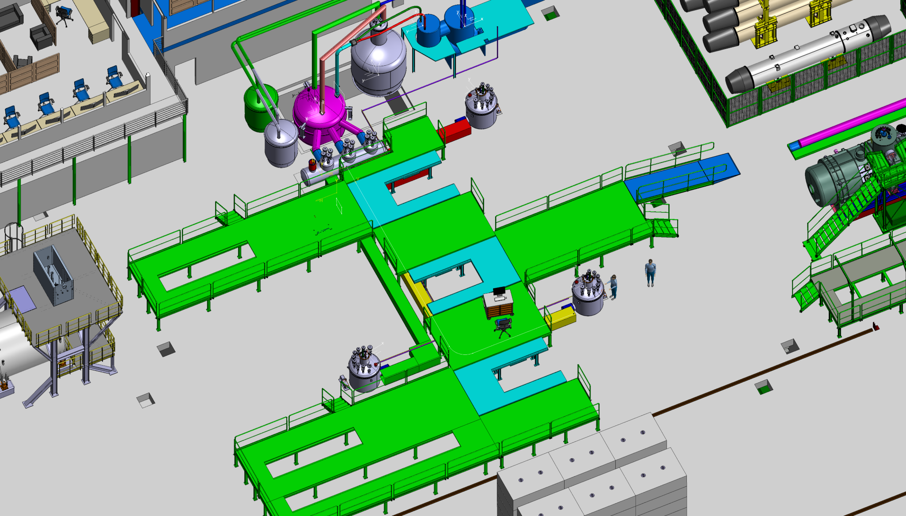
Different configurations

Slide 49
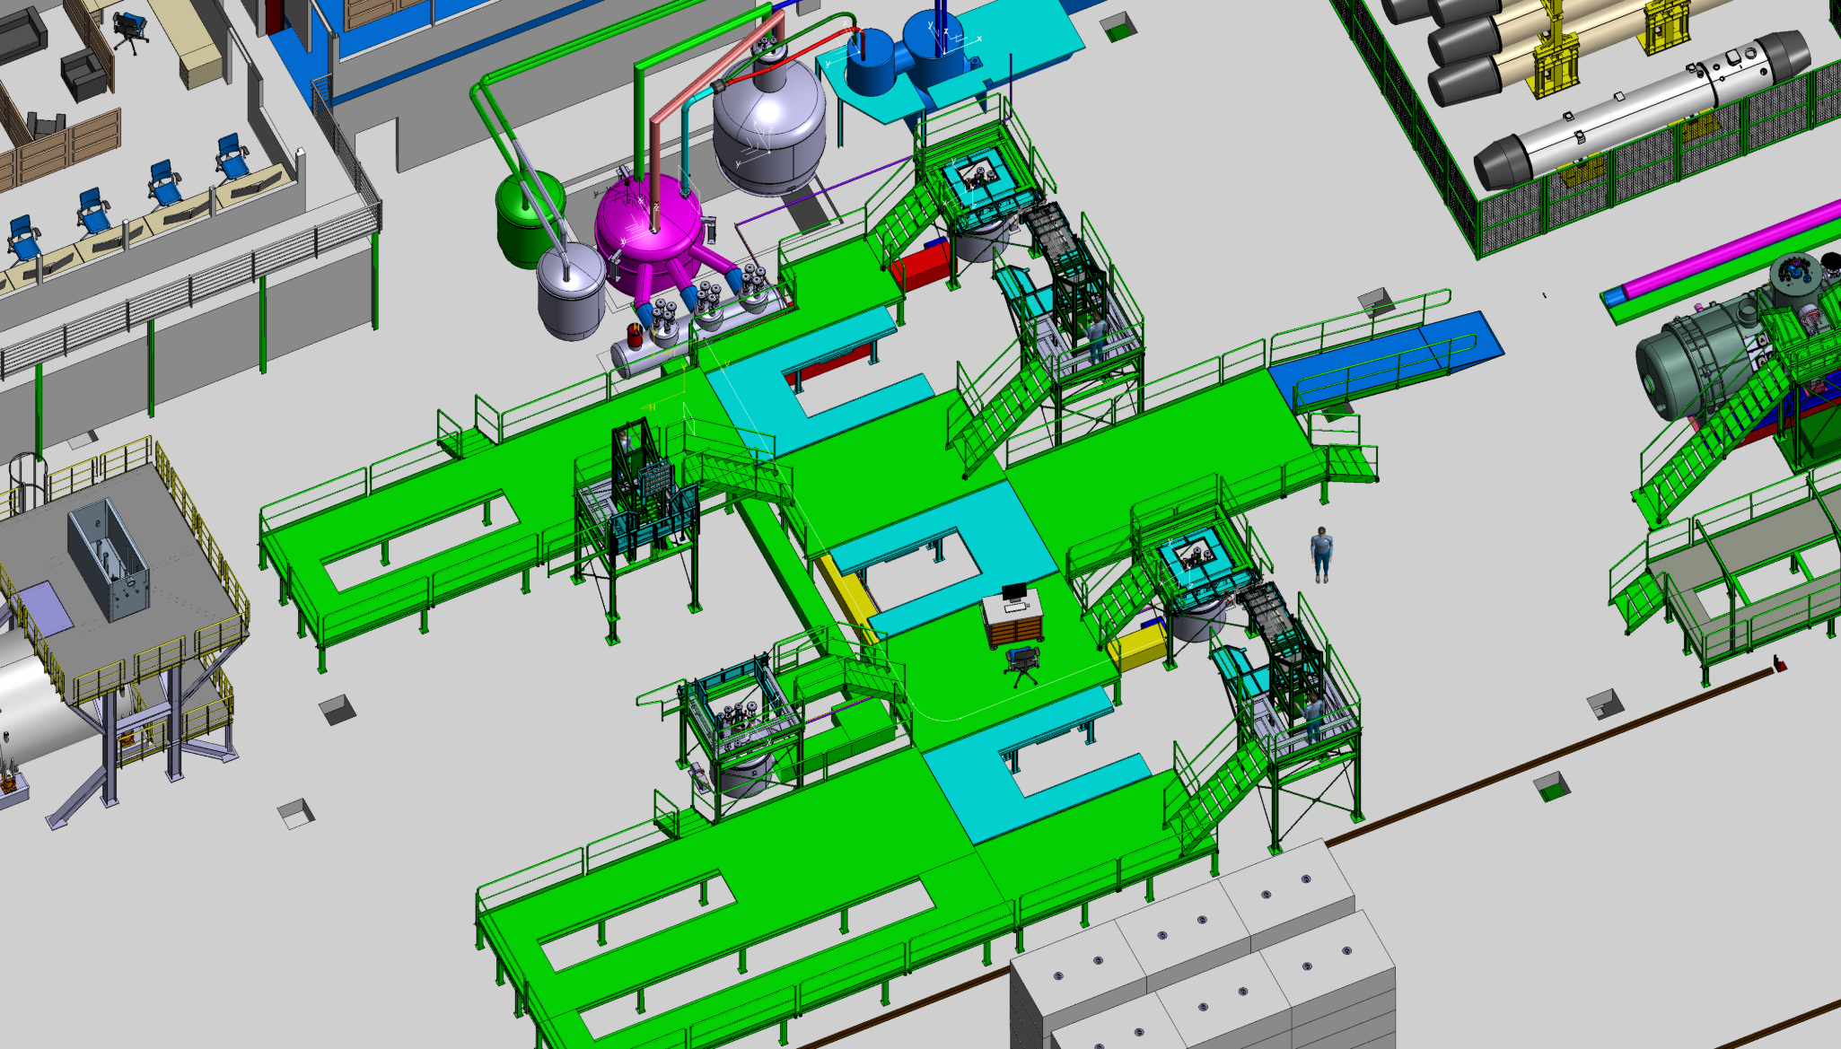
Different configurations

Slide 50
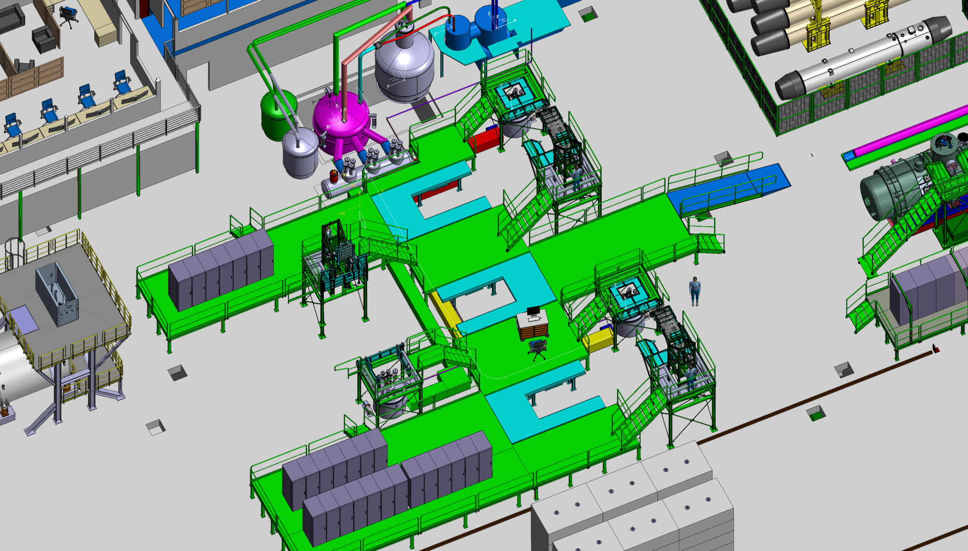
Different configurations

Slide 51

Different configurations

Slide 52
Conflicts and
Left to be done

Slide 53
Conflict between structures and 2675mm multiplet Variant 1
Conflict between structures and 2675mm multiplet Variant 2
Adapt platforms and wire device with 2675mm Variant 1
Adapt platforms and wire device with 2675mm Variant 2
Adapt platforms and wire device with 2000mm
Update the transport study
Update the survey laser tracker’s positions
Conflicts

Slide 54
To approve the metallic structure and start the construction drawings we need to freeze the:
  Position and size of the magnets
  Position of the racks
  Height of the plateforms
  Position of the power converters
  Position of the cryo equipments
  Path of the cable trays
Layouts of the metallic structure
Construction
October 2015
Conclusion
Decembre 2015
Starts April 2016
Ends June 2016
Thank you

