Slide 1
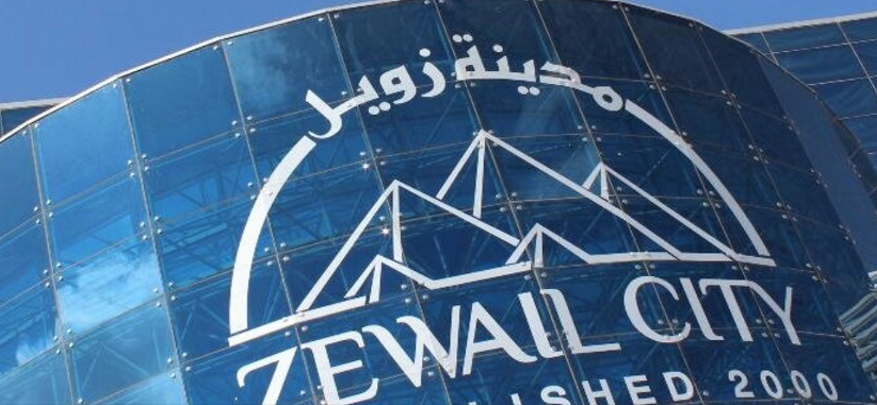
Hands on with MINERVA
Lecture 3
Kate Shaw
International Centre for Theoretical Physics
INFN Udine/ICTP ATLAS Group
5th Egyptian School of High Energy Physics, Zewail City, Cairo
14th – 19th November 2015

Slide 2
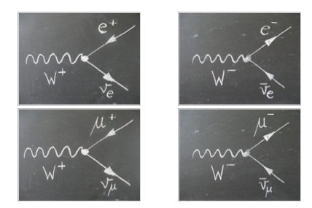
Analysis
Search for W+ and W- bosons using the ATLAS Detector
What is the final state?
How does ATLAS detect these event?
Website: http://kjende.web.cern.ch/kjende/en/index.htm

Slide 3
Analysis
Search for W+ and W- bosons using the ATLAS Detector
Whats your signal?
What are the backgrounds?
What cuts do we need to isolate the signal?
Website: http://kjende.web.cern.ch/kjende/en/index.htm

Slide 4
Physics Analysis
TODAY: We will look at events using the event display teaching program: MINERVA
  Each event we apply cuts to see if the event is signal or background, and count them
In analysis: We use C++ and ROOT to loop over thousands/millions of events
  The code loops over the events and applies the cuts
  Ones that pass as signal are then put into histograms
  Do for the Monte Carlo simulation (SIGNAL, backgrounds)
  Do for the data – does it fit?
Website: http://kjende.web.cern.ch/kjende/en/index.htm

Slide 5
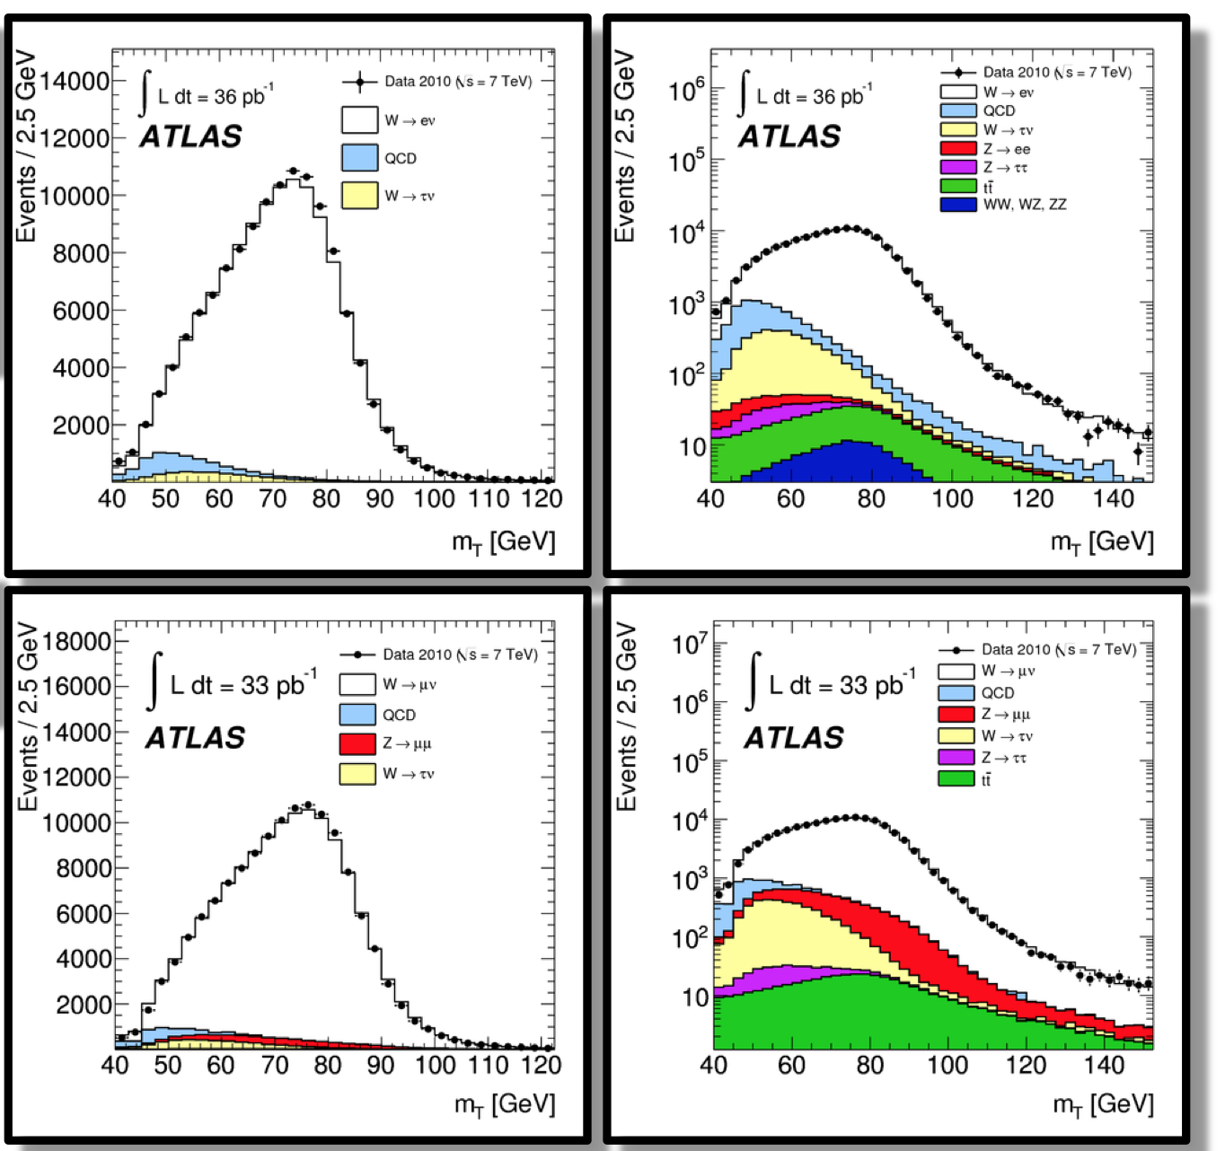
Physics Analysis

Slide 6
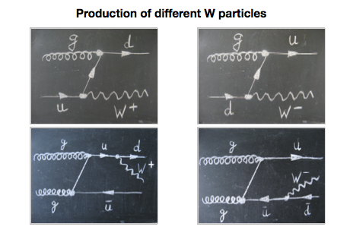
W Production

Slide 7
W decay

Slide 8
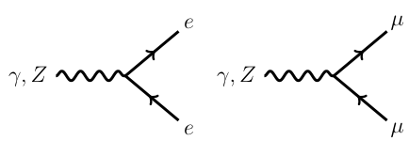
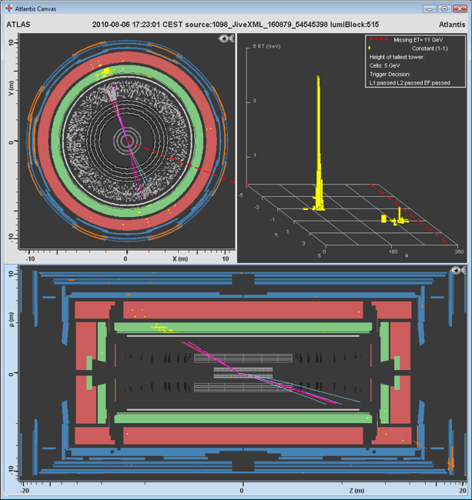
Background
  Z→μ⁻+μ⁺ (or Z→e⁻+e⁺)
  there is TWO OPPOSITELY CHARGED Leptons (either an electron or a positron or a muon or an anti-muon),
  Multiple Jets
  there are multiple jets (collections of hadrons particles)

Slide 9
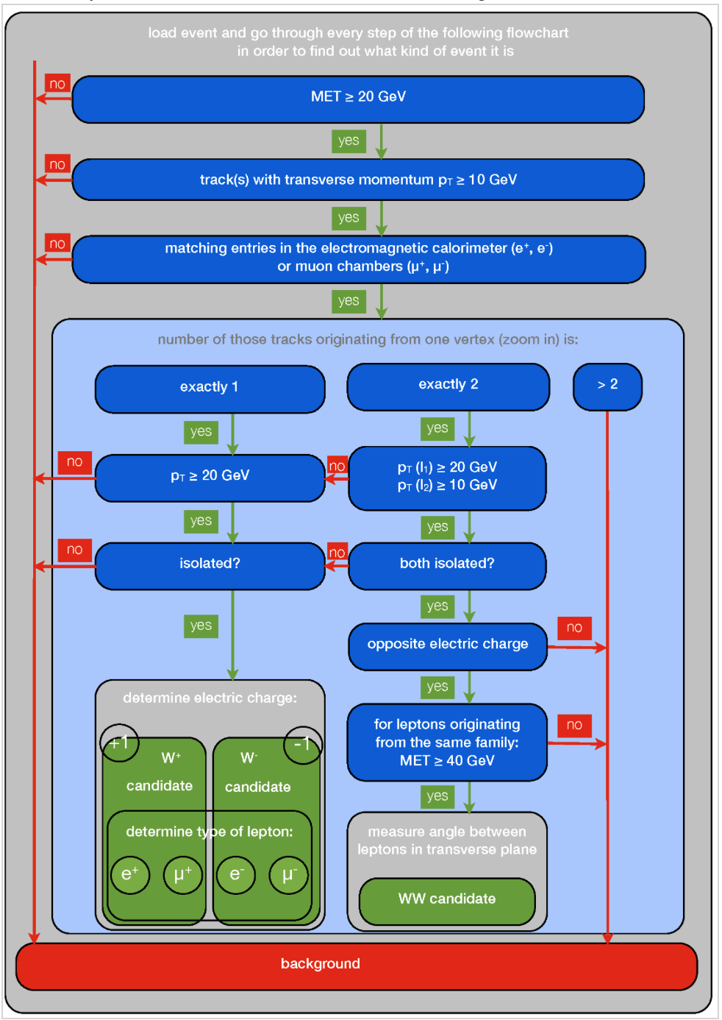
CUTFLOW
Isolates
W -> lepton + neutrino events
What do WW events look like?

Slide 10
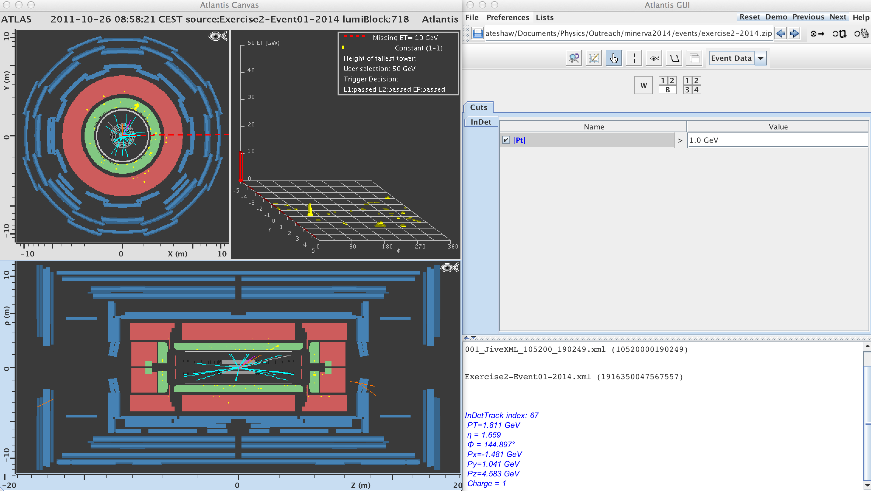
Learning MINERVA
  In DIR: minerva2014/events/exercise2-2014.zip

Slide 11
Exercise
Use the link online:
http://kjende.web.cern.ch/kjende/en/wpath_exercise2.htm
There are 10 events to look at – each of a different type
  W⁺→e⁺+ν_{e}
  W⁻→e⁻+ν_{e}
  W⁺→μ⁺+ν_{μ}
  W⁻→μ⁻+ν_{μ}
  WW⁻→l⁻+ν_{l}+l⁺+ν_{l}
  Background from jets, Z→e⁺e⁻, Z→μ⁺+μ⁻
Load up events from “exercise2.zip” in ATLANTIS (OPEN)
  In DIR: minerva2014/events/exercise2-2014.zip
Distinguish between background and signal events!
Aim to correctly identify all of them

Slide 12
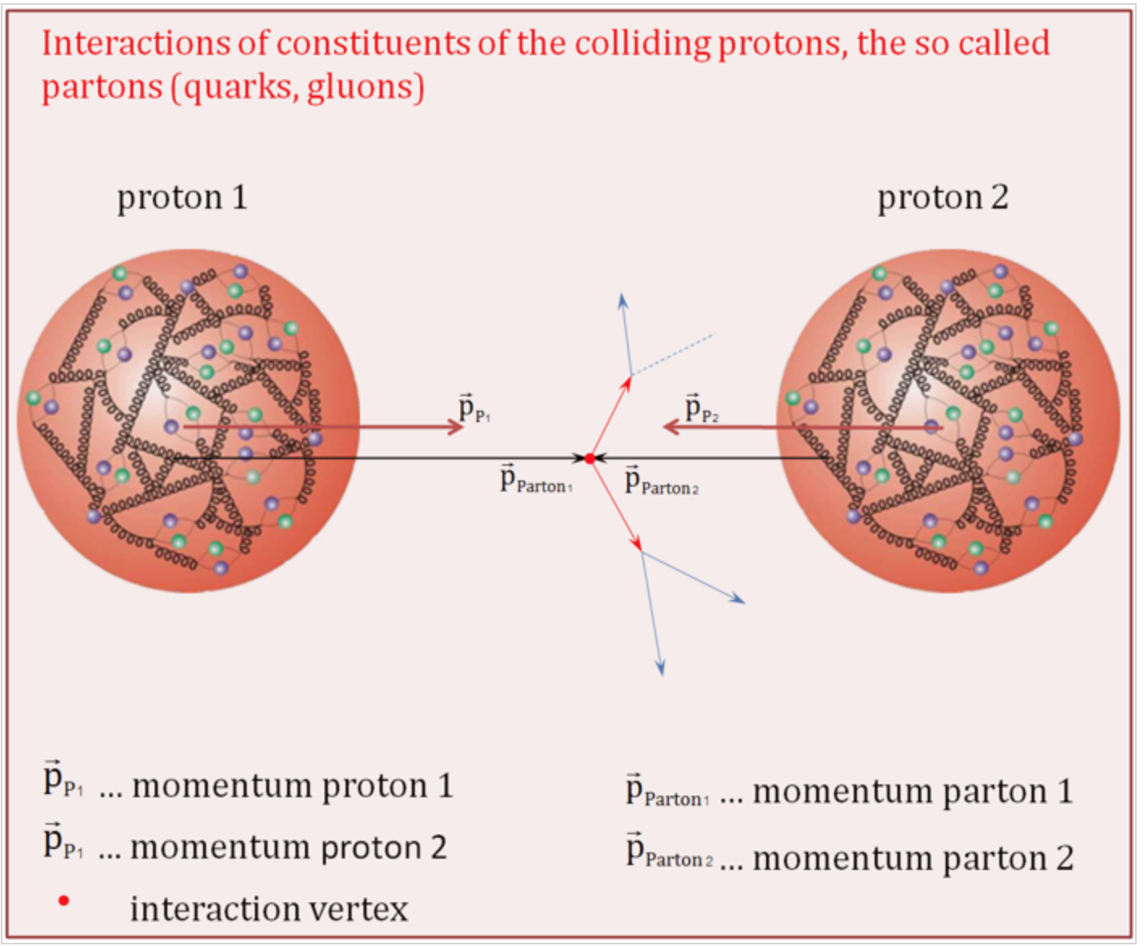
Proton Structure

Slide 13
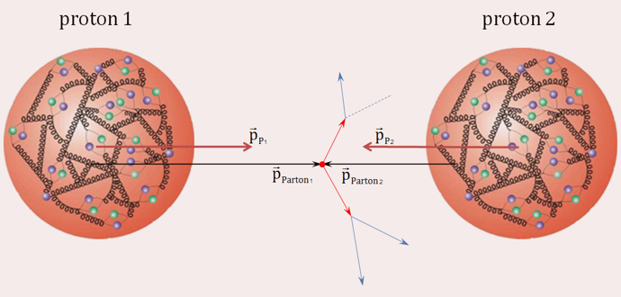
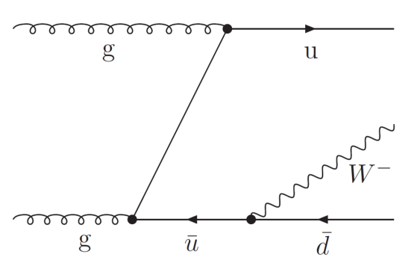
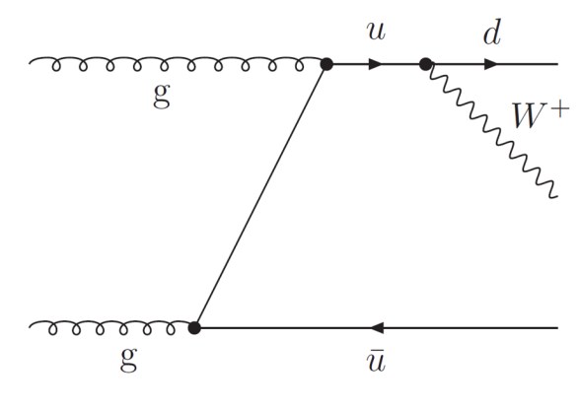
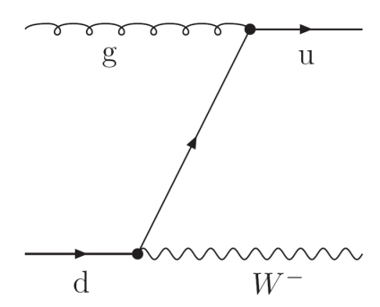

Proton Structure
Proton does not react as a
whole
Different methods of
production of
Decays – 1/3 of the time W decays into a lepton and neutrino (electron, muon or tau)
Protons are complicated at high energies!

Slide 14
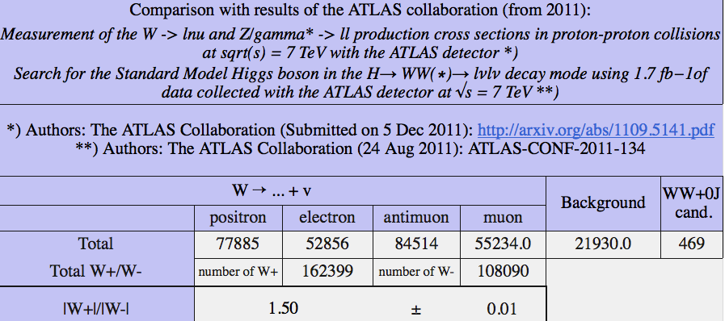
Proton Structure

