Slide 2
Superconducting Radio Frequency (SRF) Thin Film & Surface Treatment 2015 status
Leonel Ferreira, Guillaume Rosaz, Alban Sublet
VSC Seminar - 27.11.2015

Slide 3
Outline
Introduction and HIE-ISOLDE production results
A. Sublet
Surface treatment activities
L. Ferreira
LHC cavities and alternative materials/coating
G. Rosaz
Nb film R&D, simulations and collaborations
A. Sublet

Slide 4
Outline
Introduction and HIE-ISOLDE production results
Surface treatment activities
LHC cavities and alternative materials/coating
Nb film R&D, simulations and collaborations

Slide 5
Technology Department objectives (from SRF mini workshop, 14.11.2014, CERN)
Fulfill LHC and HIE-ISOLDE cavities production specification
Increase Thin Film & Surface Treatment R&D activities
Be at the forefront of Thin Film SRF technology
Short term goal → 4 cavities/month:
1 LHC → 2 cavities prototypes under production, moke-up tube coated
1 HIE-ISOLDE → 1 coating/month
1 SPL/Crab → 2 SPL + 1 Crab in 2015, 2 SPL + 1 Crab + 1.3 GHz for 2016
1 R&D (1.3GHz/QPR…) → completely refurbished HiPIMS setup
→ THIN FILM technology must be mature for 2018 (ESU)

Slide 6
TE - Thin Film & Surface Treatment SRF plan 2015

Slide 7
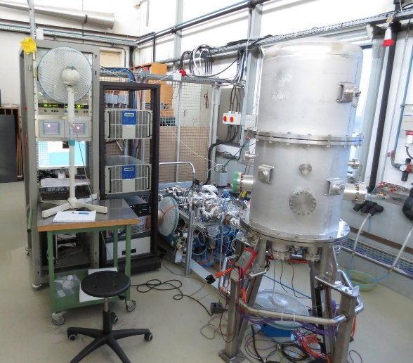
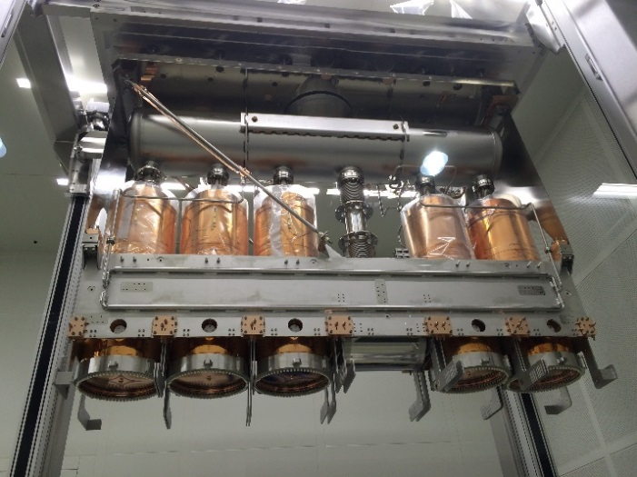
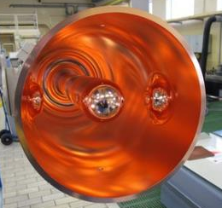
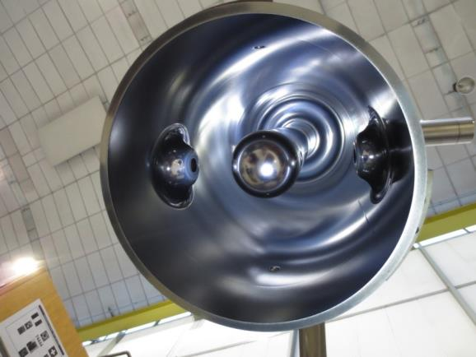
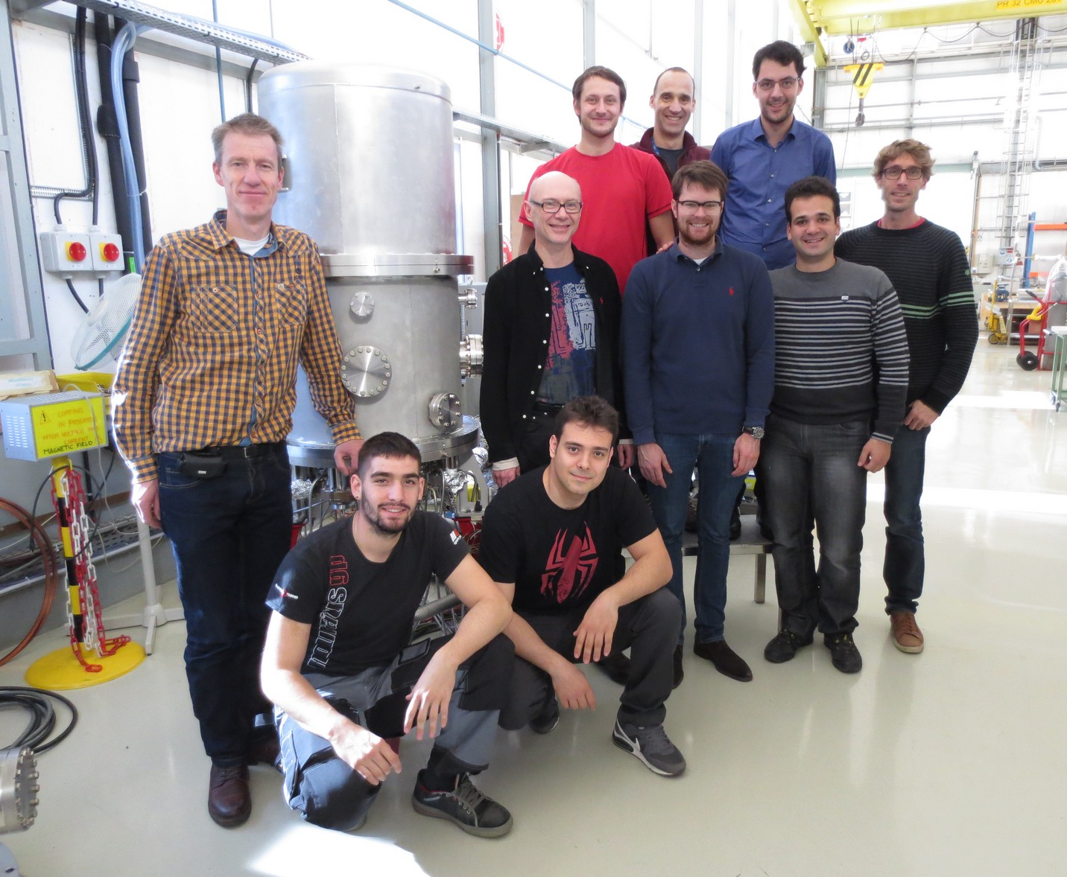
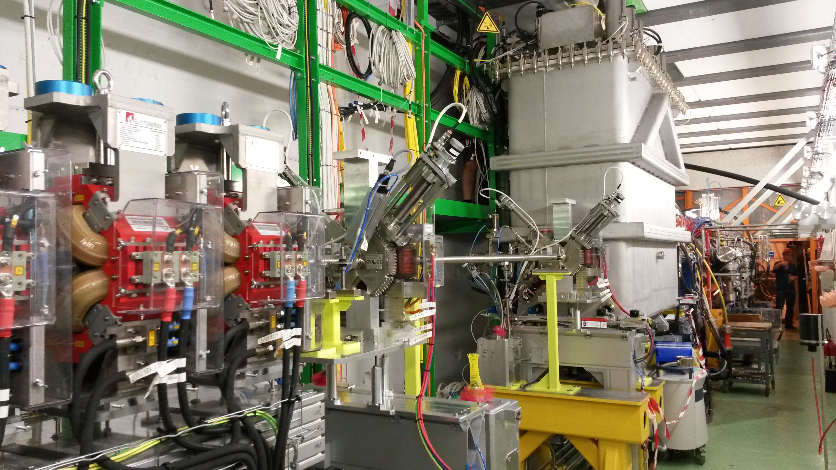

HIE-ISOLDE production 2015 (I)
First cryomodule installed and commissioned, physics started
…but coupler issue → switch with second cryomodule by spring 2016

Slide 8
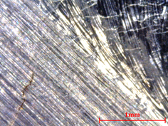
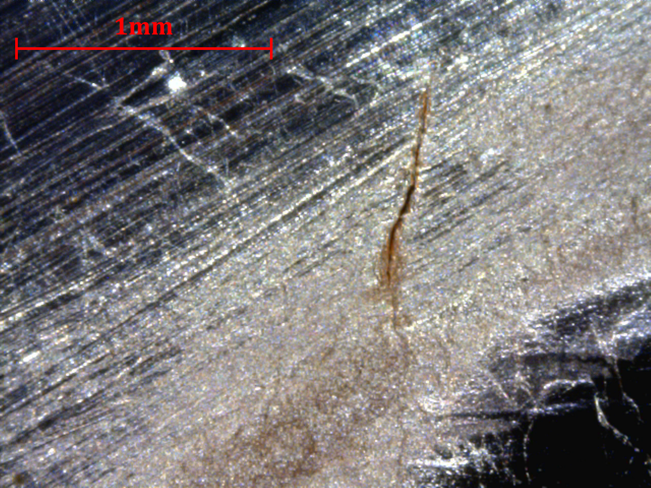
HIE-ISOLDE production 2015 (II)
QS9
courtesy of A. Miyazaki
QS10
Before subu
QS11
5 cavities + 1 spare ready for second cryomodule
15 cavities to be coated till mid 2017: 2x 5 cavities for Phase 2 + 5 spares
…but issue with substrates (cracks), 4 rejected, 2 used for investigation (QS6 at RI + QS9 at CERN)
Production stopped at RI, lack of substrates, “recycling” of rejected substrate (ex. QS10)
Large troubleshooting campaign (MME/RF/VSC) on going
However difficult to correlate with cavities low performances

Slide 9
Outline
Introduction and HIE-ISOLDE production results
Surface treatment activities
LHC cavities and alternative materials/coating
Nb film R&D, simulations and collaborations

Slide 10
OUTLINE
Present installations
Latest developments
Foreseen activities and developments

Slide 11
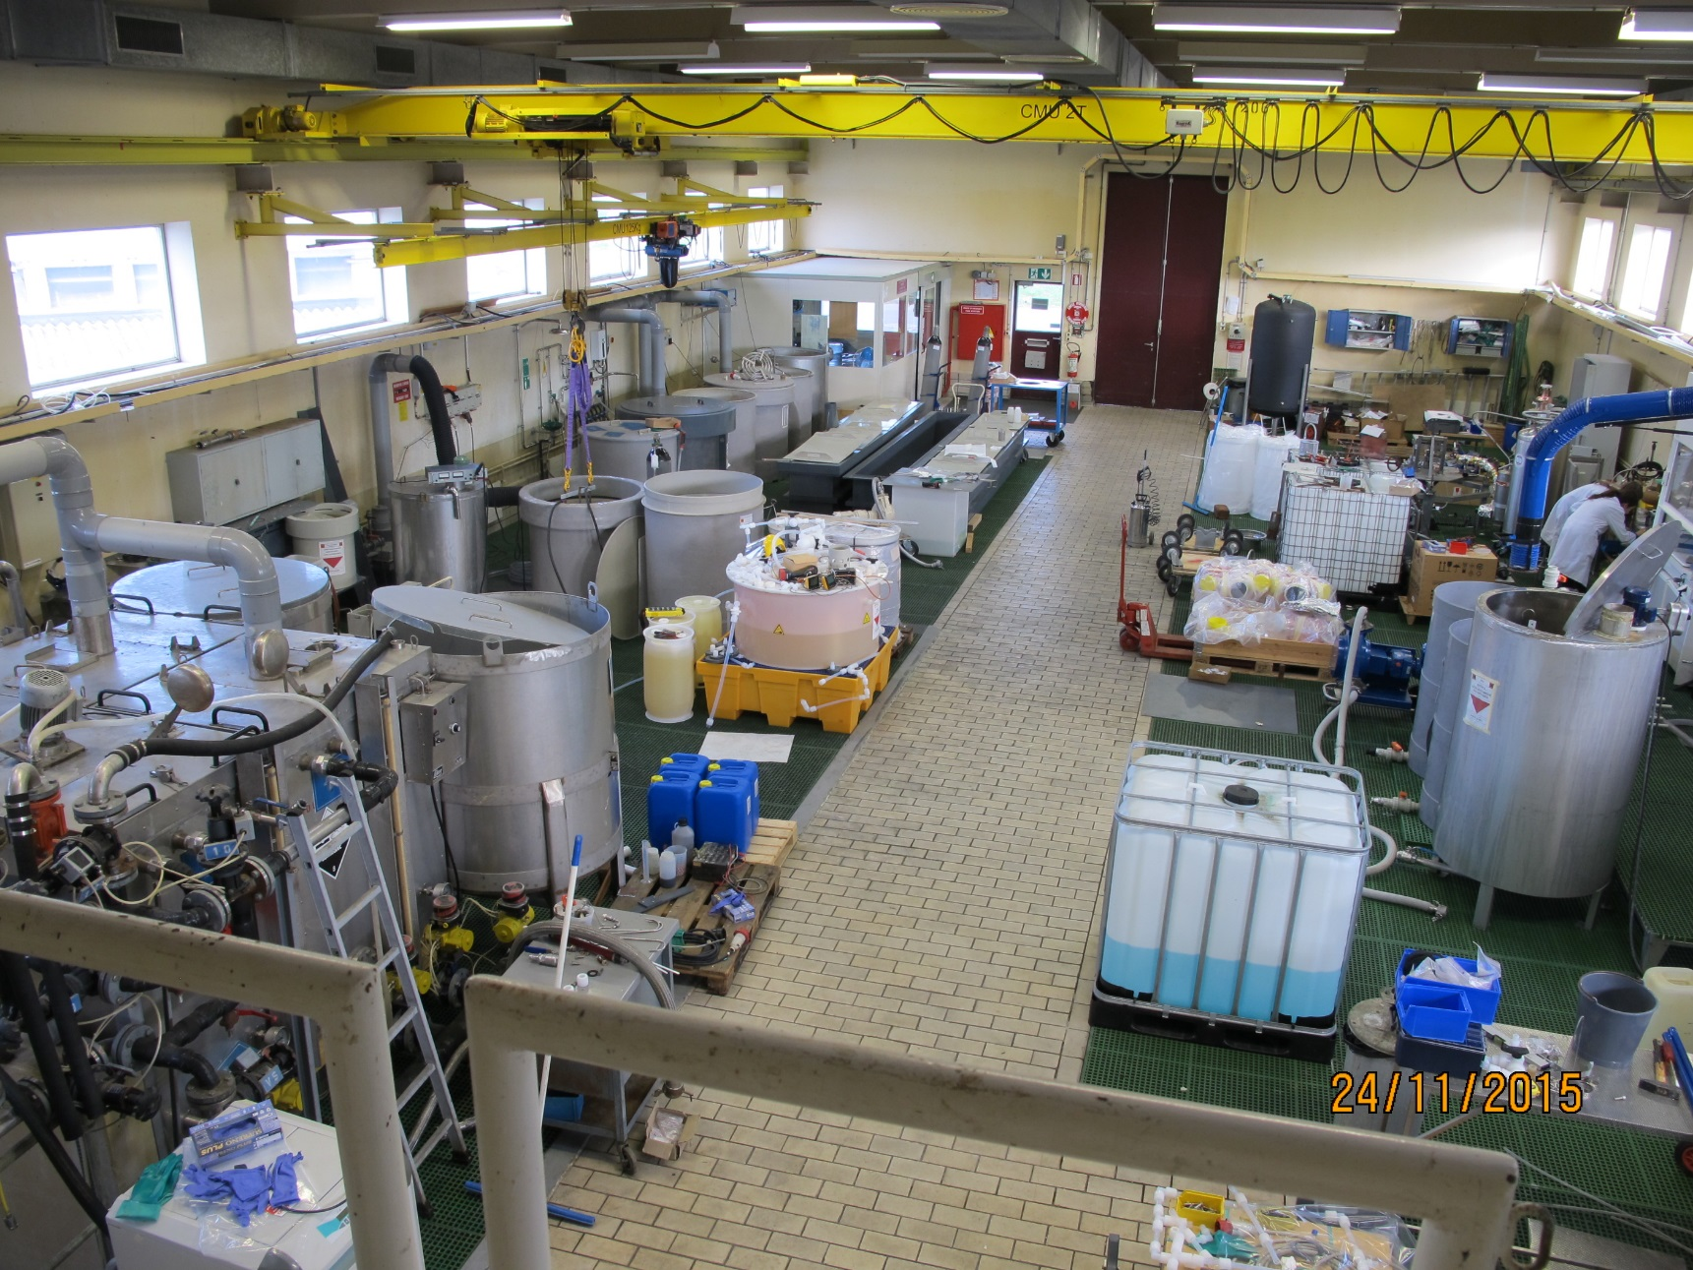
Present installations in b.118
Copper chemical polishing (SUBU)
1.3 GHz
HIE-ISOLDE
LHC

Slide 12
Present installations in b.118
Copper electrochemical polishing
LHC
1.3 GHz

Slide 13
Present installations in b.118
Niobium chemical polishing
BCP
SCRF subcomponents
CRAB

Slide 14
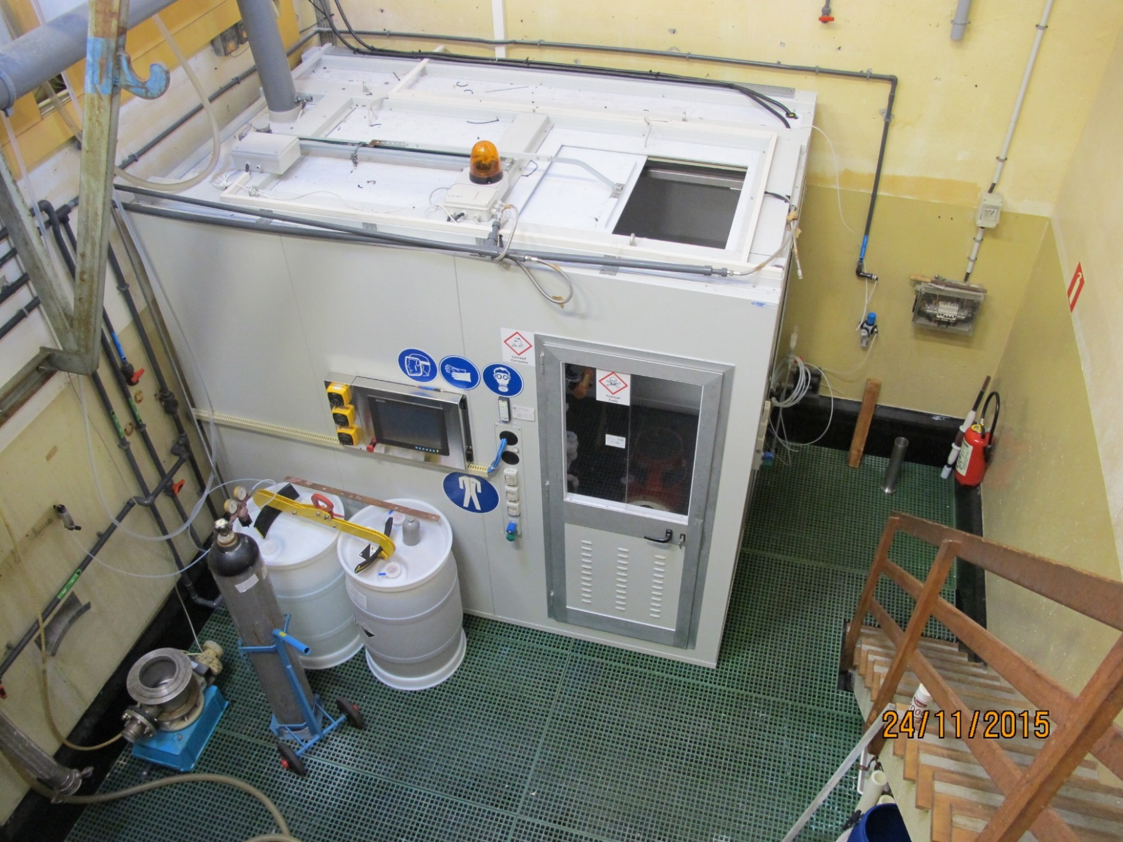
Present installations in b.118
Niobium electrochemical polishing

Slide 15
Present installations in b.118
HPWR

Slide 16
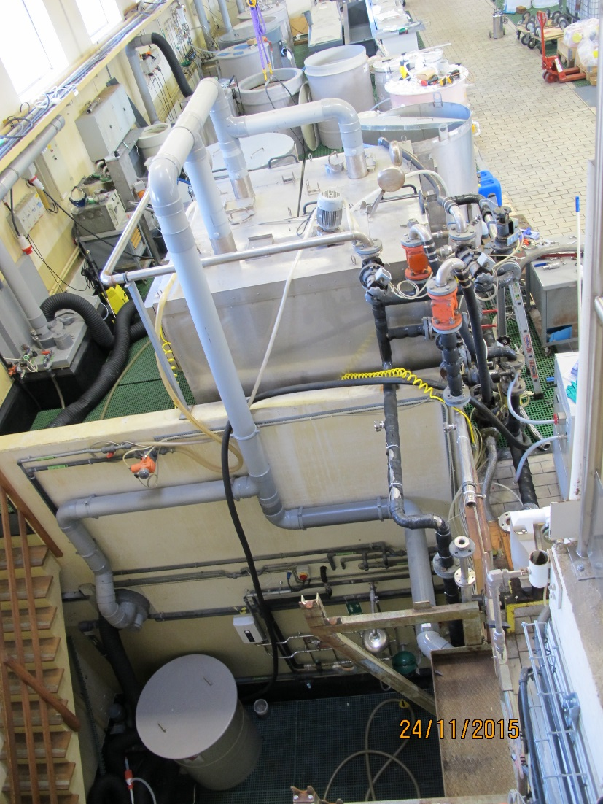
Present installations in b.118
Niobium stripping
Niobium stripping

Slide 17
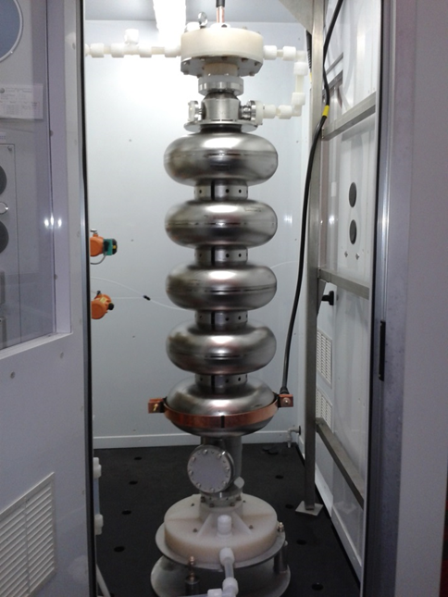
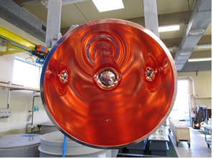
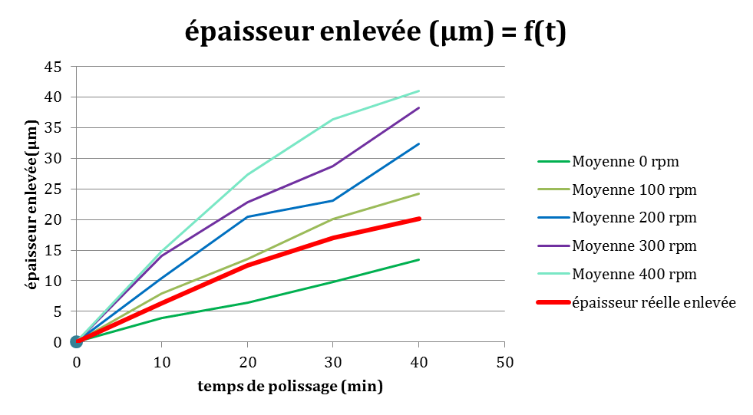
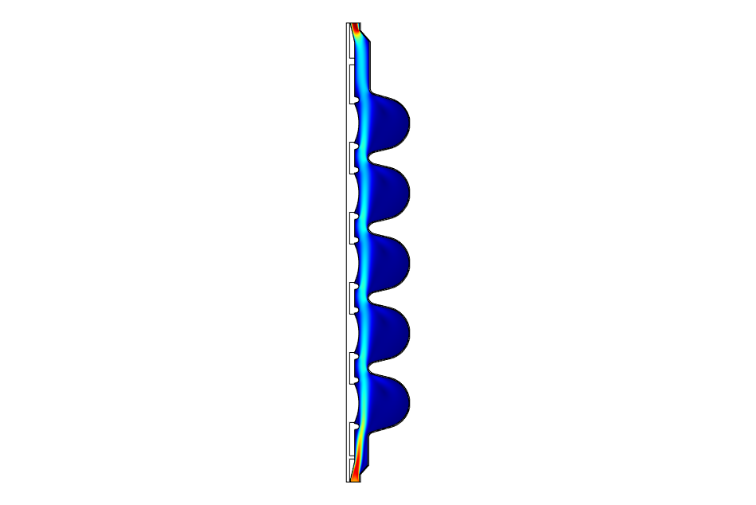
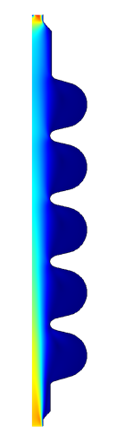
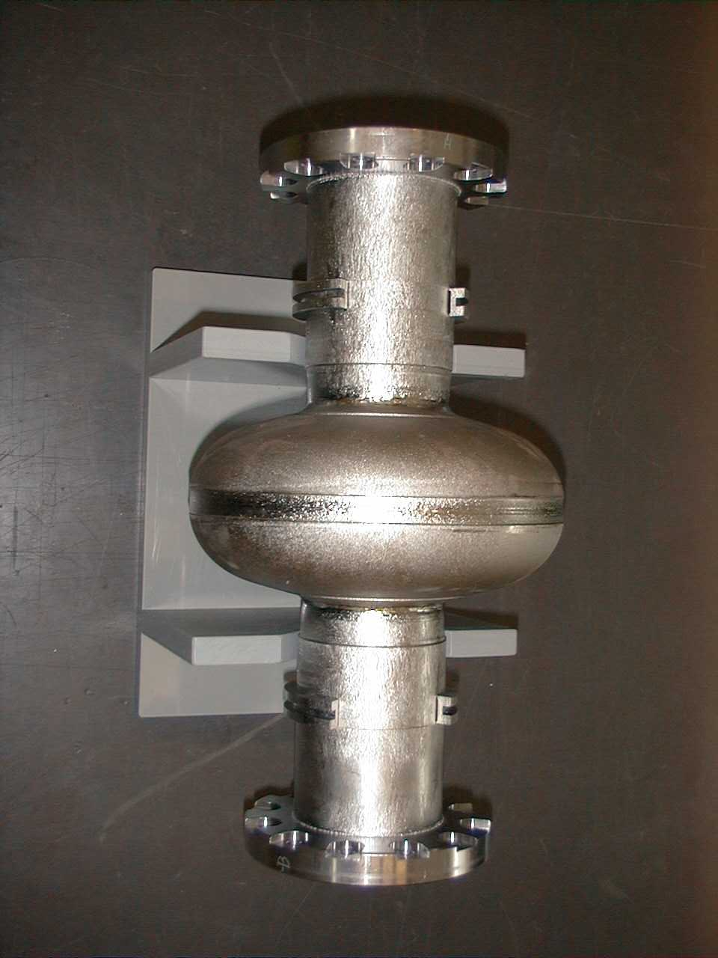
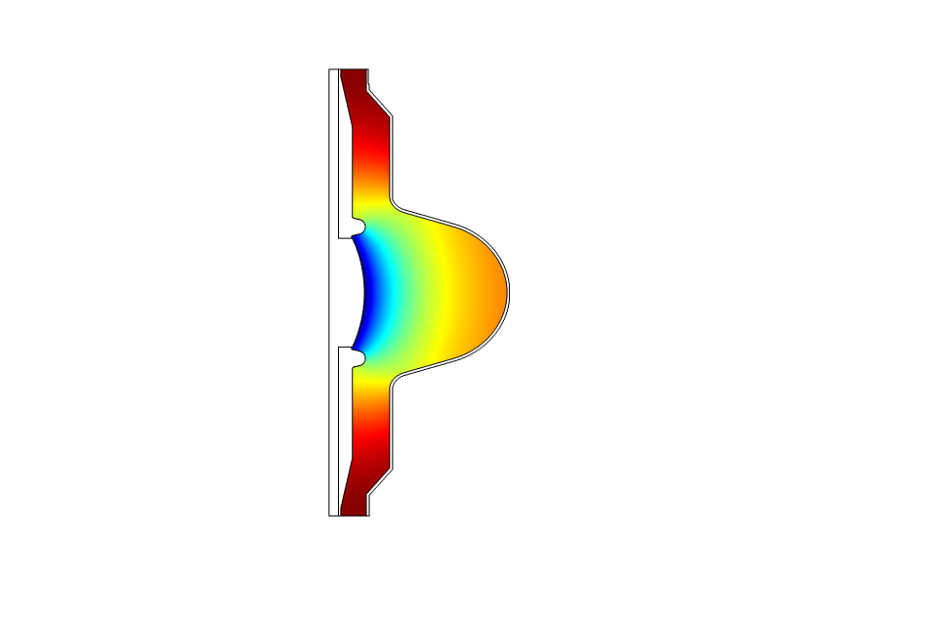
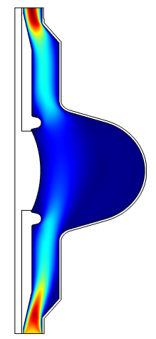
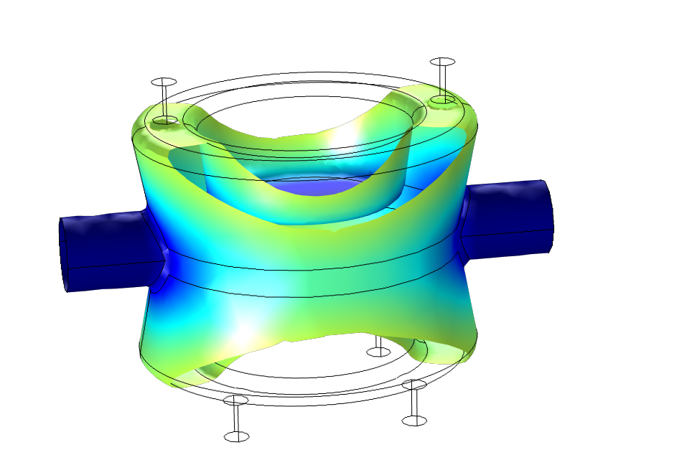
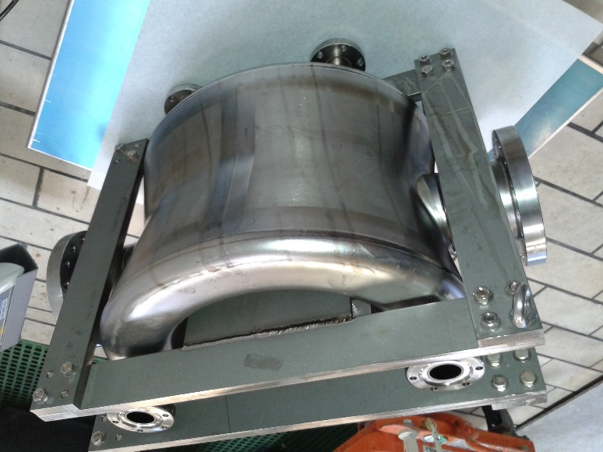
Latest developments
HIE-ISOLDE
1.3 GHz
SPL >>> High gradient
CRAB - DQW

Slide 18
Foreseen activities and developments
1x Eng + 2xTech
LHC spare cavities (Nb/Cu):
- Define and build tool to improve bath agitation (SUBU):
- Homogeneous etching;
- Avoid pinholes.
- Evaluate electropolishing feasibility:
Simulation work;
Define facilities needs.
Possible impact on available space and services
CRAB cavities (Nb):
- define and build setup for heavy BCP (200 microns);
- evaluate bath speed impact on polishing rate:
Experimental + simulation work;

Slide 19
Foreseen activities and developments
1x Eng + 2xTech
FCC 800 MHz cavities (Nb/Cu):
- define and build tools for improved bath agitation SUBU;
- define v+h setup for electropolishing;
Possible impact on available space and services
High gradient (5 cell and 1.3 GHz monocell: Nb/Nb):
- define v+h setup for electropolishing
Possible impact on available space and services

Slide 20
Foreseen activities and developments
1x Eng + 2xTech
Thin film CRAB (Nb/Cu):
- define and produce tools for improved bath agitation SUBU;
- define tools for electropolishing;
Possible impact on available space and services
HIE-ISOLDE (Nb/Cu):
- define and produce tools for improved bath agitation (SUBU);

Slide 21
General R&D
1x Eng + 1x Fellx + 1x PhD
New chemistries for niobium and copper:
- Different formulations;
- Ionic liquids (plating/polishing);
- pulse polishing;
External collaboration
New power supply
Alternative cavity assembly process:
- Inverse Nb / electroforming

Slide 22
Possible bottlenecks
HPWR availability for large (LHC) and small cavities (1.3 GHz)
Space and/or services
Manpower & coactivity in B118

Slide 23
Outline
Introduction and HIE-ISOLDE production results
Surface treatment activities
LHC cavities and alternative materials/coating
Nb film R&D, simulations and collaborations

Slide 24
Outline
LHC spares program
New materials for SRF cavities
New coating techniques for SRF cavities

Slide 25
LHC SPARES PROGRAM

Slide 26
Production
Short term : 2 prototypes to be built by end 2015
Half cells to be welded in the next two weeks
Dedicated to coatings/RF tests only
Long Term
4 + 1 cavities for spare cryomodule
Tuning bench to be manufactured/refurbished

Slide 27
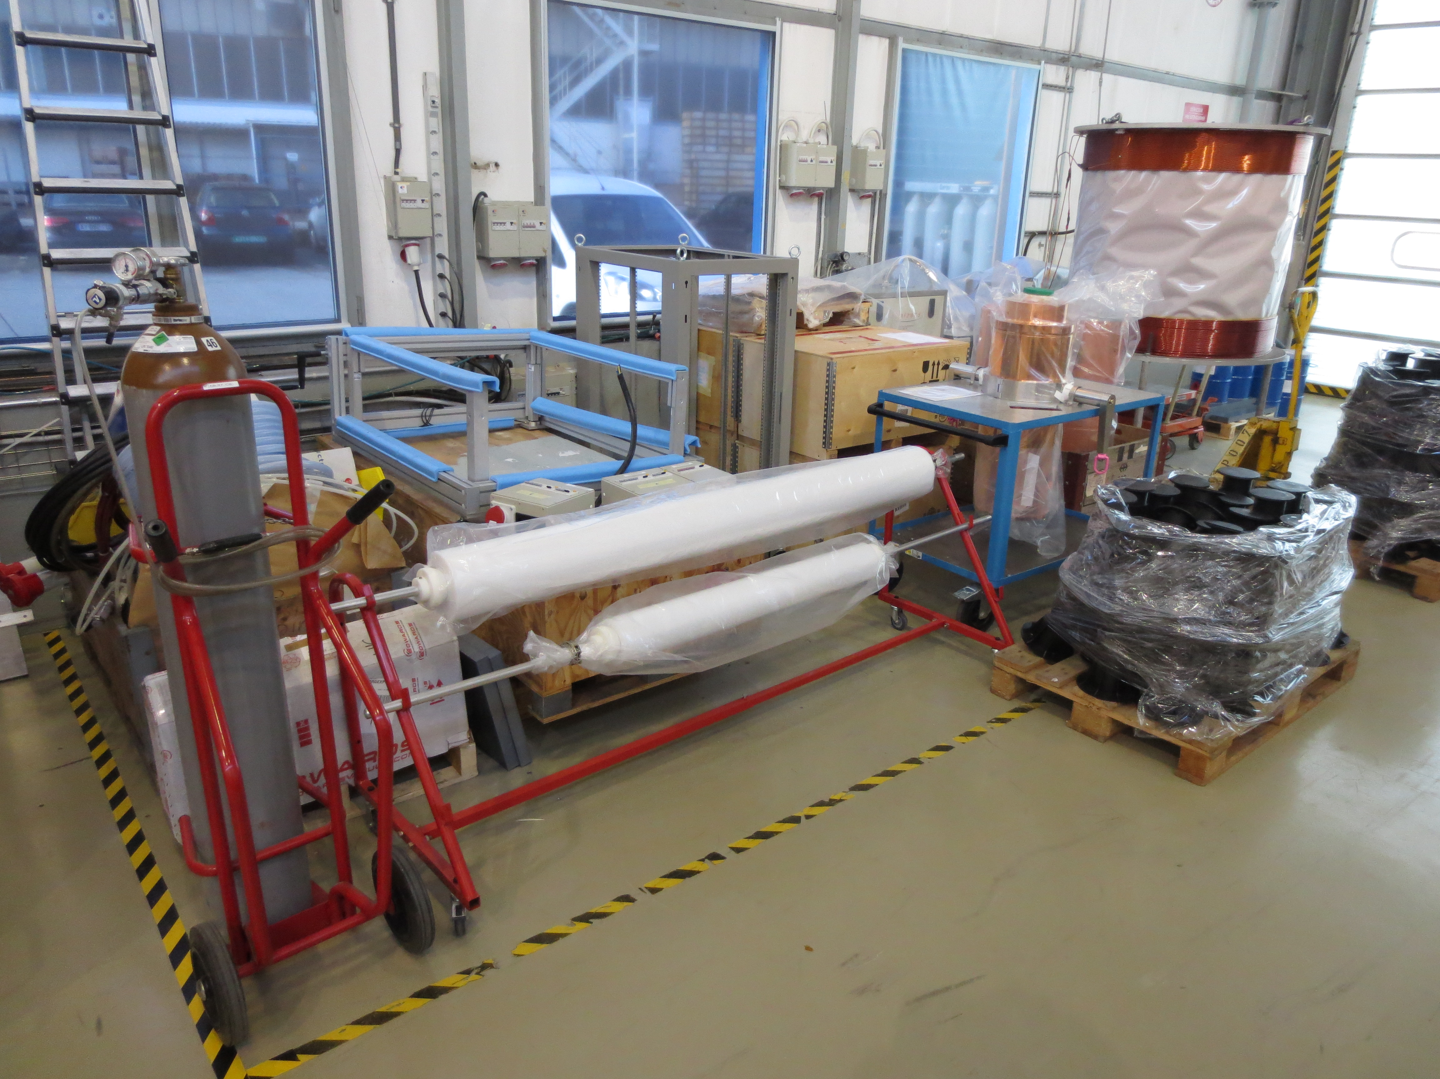
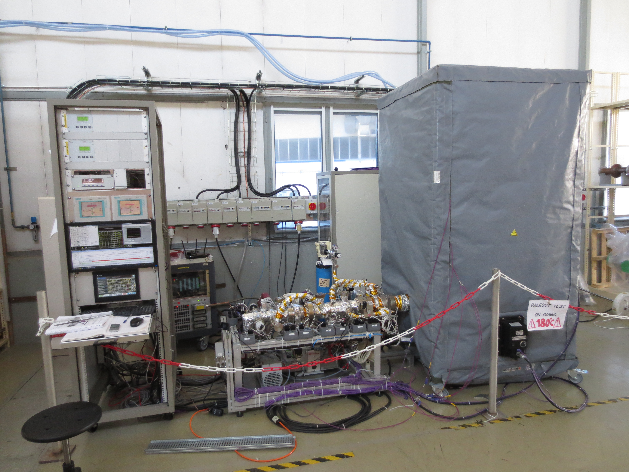
Coating of LHC spares
Setup installation @ 252
Electrical installation
Water supply
New BO system
Similar pumping group as HIE-ISOLDE benches

Slide 28
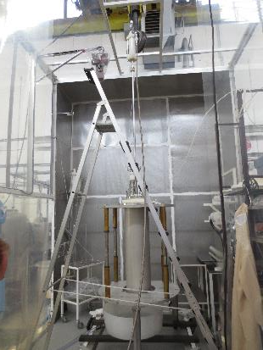
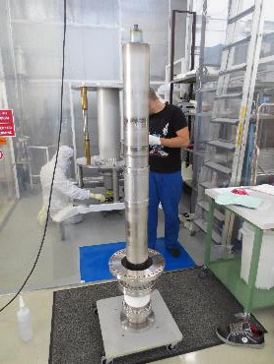
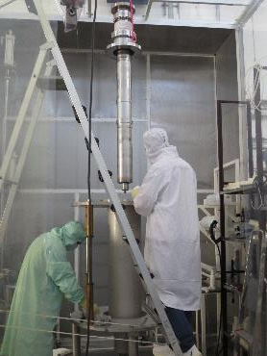
Pre-coating rinsing /Cathode assembly
MOCK-UP
Rinsing
Vertical assembly vs horizontal OK to GO
Safety
Efficiency
Cleanliness
OK TO GO

Slide 29
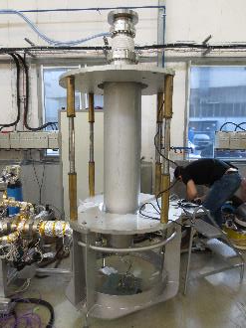
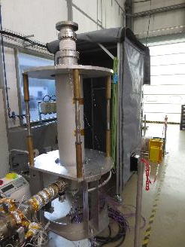
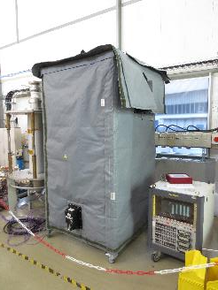
Vacuum / Bake out test
Cathode assembly (no clean room, no Nb sleeves)
Good behaviour of the tent
200C easily reached
OK TO GO

Slide 30
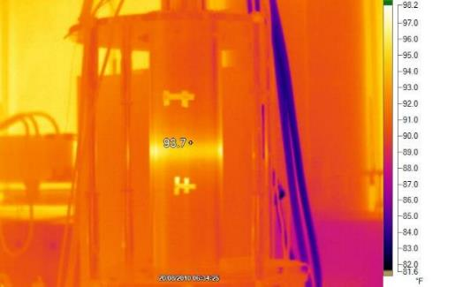
1st coating tests
Process point perfectly matches previous coatings i.e. I(V)
Infrared imaging showing the plasma discharge location through cavity temperature raise.
coil

Slide 31
Next steps
High pressure water rinsing validation b118.
Post coating step
In case of Field Emission in the cavity
All parts available
Mock-up on its way to b118 for test.
Mock-up modifications
Plasma diagnostics
Sample holders

Slide 32
New Materials for SRF cavities

Slide 33
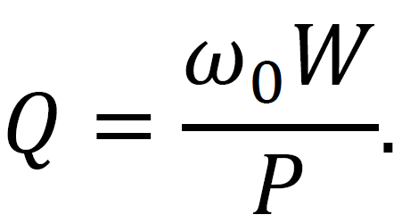
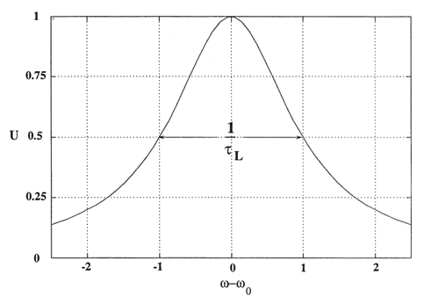
SRF cavities
Accelerating component for particle accelerators
Use high power RF waves to provide accelerating gradient
S = superconducting
Lower power losses through surface resistance reduction
Increase quality factor
Quality Factor
Needs:
High Tc
High Q0
Less cryo power required
Low R_{S}
Low resistivity in NC state
Nb₃Sn and V₃Si are very promising candidates

Slide 34
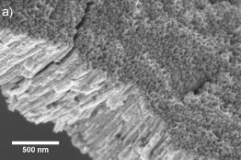
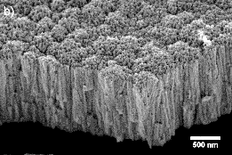
Current status
AS-DEPOSITED FILMS @ RT
As deposited films composition can be easily tuned by acting on coating pressure
Films are highly disordered with very small crystallites sizes (<10nm)
No superconductivity observed

Slide 35
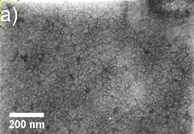
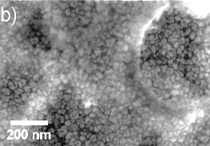
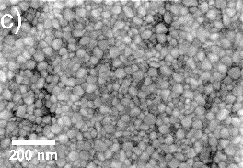
Current Status
ANNEALED FILMS
Annealing temperatures: 700 / 750 / 800 °C
Atmosphere: Vacuum (~1.10⁻⁶ mbar)
Duration: 24H
Goal: Obtain A15 superconducting cubic phase
Up to now: 1 film elaborated at 1.10⁻³ mbar annealed.
A15 phase obtained (XRD)
Superconducting properties to be characterized
700°C
750°C
800°C

Slide 36
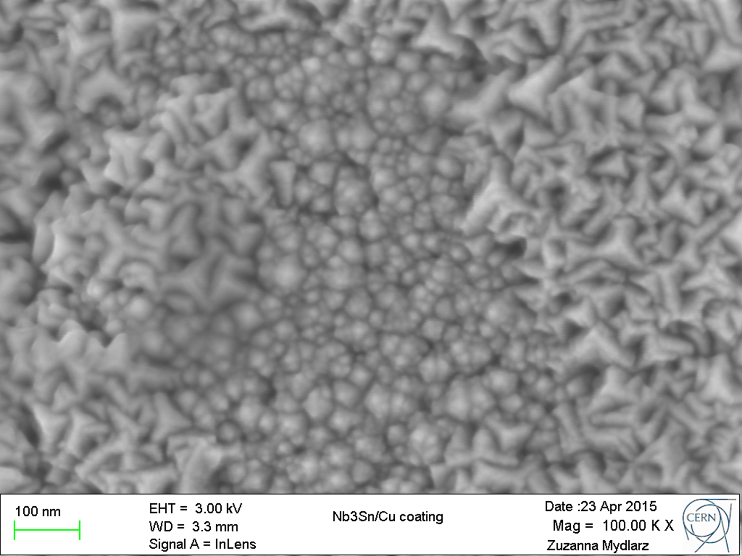
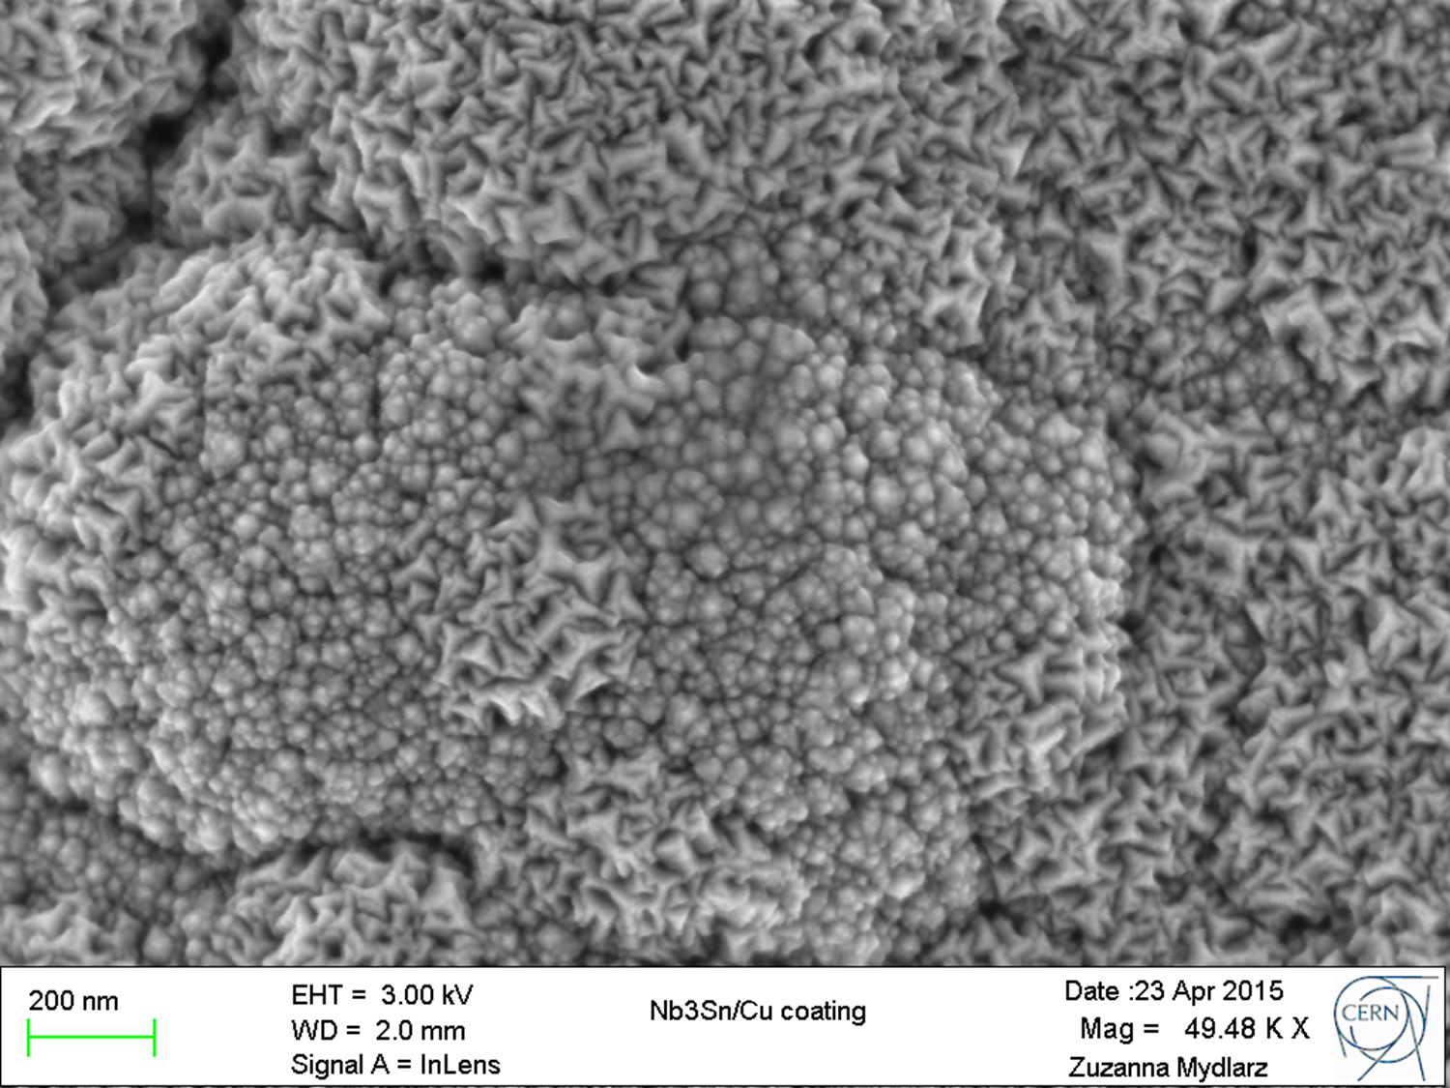
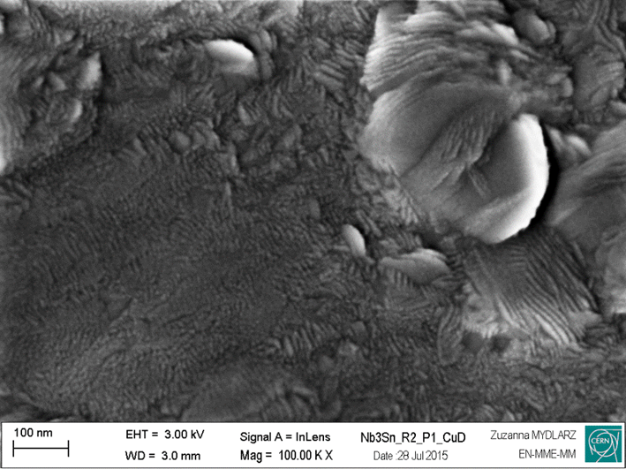
Current status
Effect of surface preparation for Cu
P_{Ar} = 1.10⁻³ mbar
P_{Ar} = 5.10⁻² mbar
Degreasing only
Chemical Polishing:
Bigger crystallites ONLY at low pressure
Chemical polishing (SUBU)

Slide 37
Next steps
Task | 2015 |  | 2016
 | Q3 | Q4 | Q1 | Q2 | Q3 | Q4
Nb₃Sn – RT + annealing characterization
Nb₃Sn high temperature coatings
V₃Si coatings
Fellow contract
Scale-up cathode design
Eucard2 milestone
RF properties
EUCARD 2 milestone: March 2016 = RF characterization of Nb₃Sn coating
Nov 2015 : V₃Si ramp up
New fellow: K. Ilyina

Slide 38
New Coating techniques for SRF cavities

Slide 39
How to improve current Nb films?
Improve
Density
Grain size
Roughness
Conformity
Control of ion production in the plasma
Energetic condensation (HiPIMS)
Control ion flux at the substrate
Ionize species to be deposited – sensitive to bias

Slide 40
Setup
Fully refurbished
New holding frame
Data acquisition
Remotely controlled BO
New Nb cathodes
New ceramic spacers

Slide 41
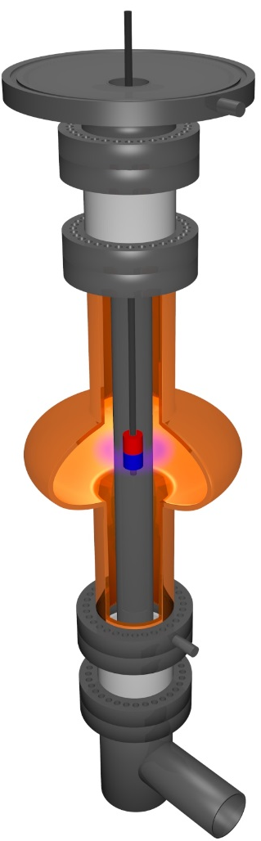
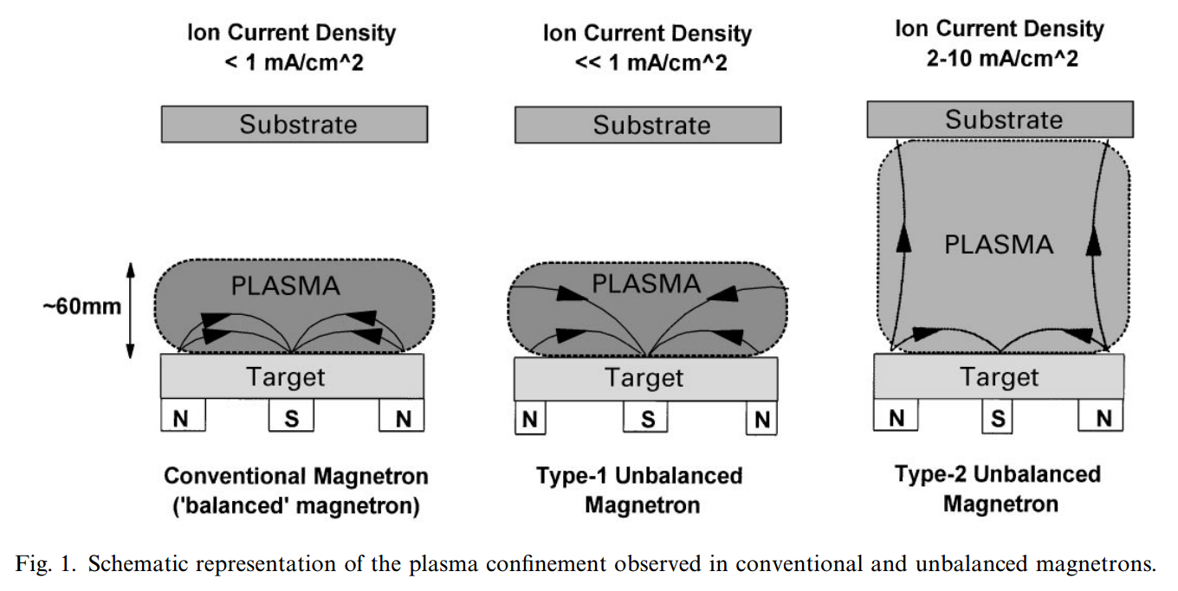
Unbalanced magnetron
Use magnetic field to bring electrons close to the substrate to create ions in its vincinity
Magnet holder
Cathode Power supply
Ceramic insulator
SmCo magnet
Cavity
N
S
N
N
S
N
Nb cathode
Cavity Bias (grounded)
Cylindrical cathode makes things a bit more complicated
Ceramic insulator
Pumping
P.J.Kelly et al, Magnetron sputtering: a review of recent developments and applications, Vacuum 56 (2000), 159-172

Slide 42
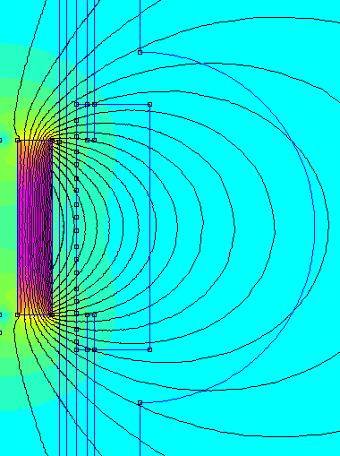
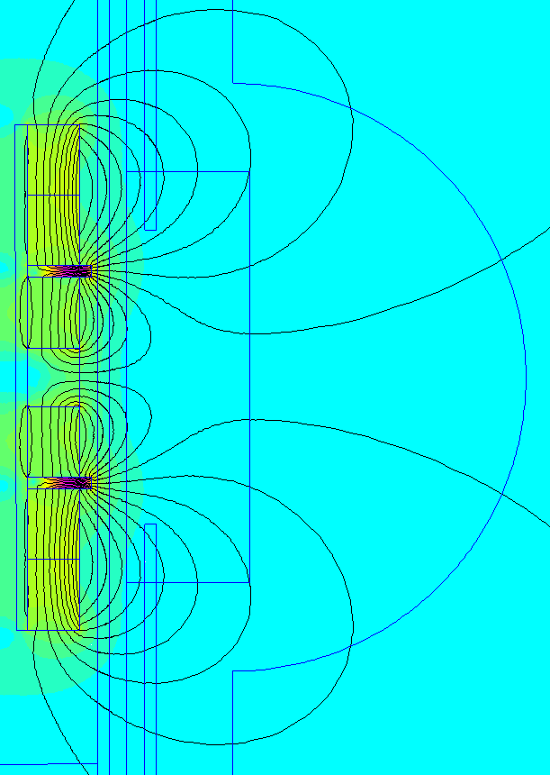
magnetic configuration
Standard
Strongly unbalanced
e⁻
e⁻
RFEA
RFEA
e⁻

Slide 43
Preliminary study
Ion flux vs magnetic configuration
MAGNET
350W
5.10⁻³ mbar
RFEA

Slide 44
Next steps
Extend ion flux analysis to bias and HiPIMS cases.
Investigate film morphology depending on magnetic configuration and bias
Identify a potential working point for 1.3 GHz cavity test → few RF characterization slots
Plasma simulation
A standard DCMS 1.3 GHz in characterization as baseline (WW48)

Slide 45
Outline
Introduction and HIE-ISOLDE production results
Surface treatment activities
LHC cavities and alternative materials/coating
Nb film R&D, simulations and collaborations

Slide 46
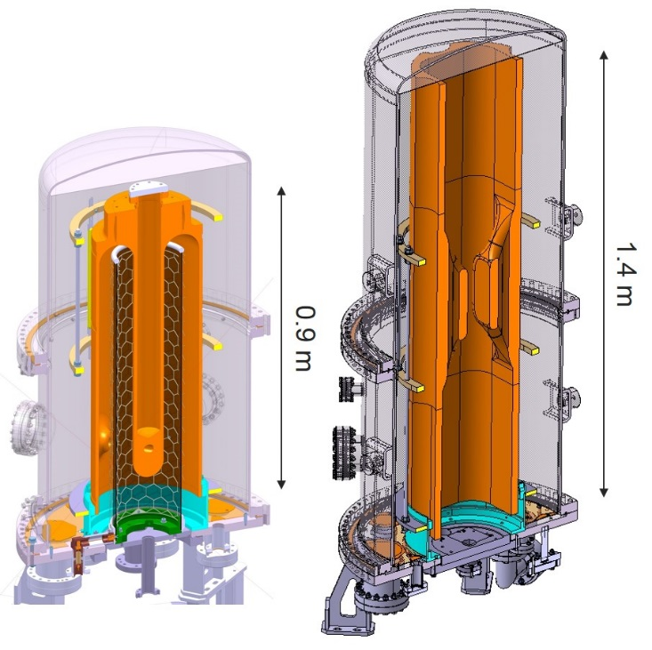
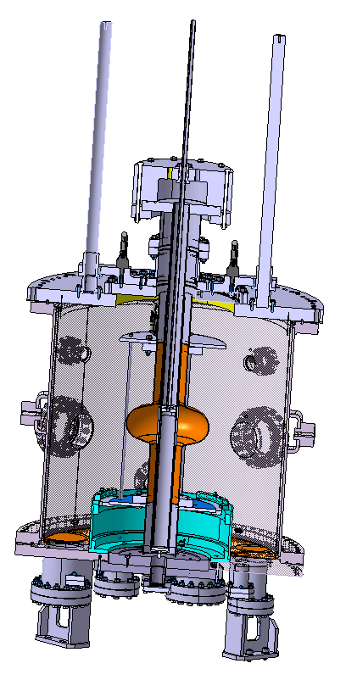
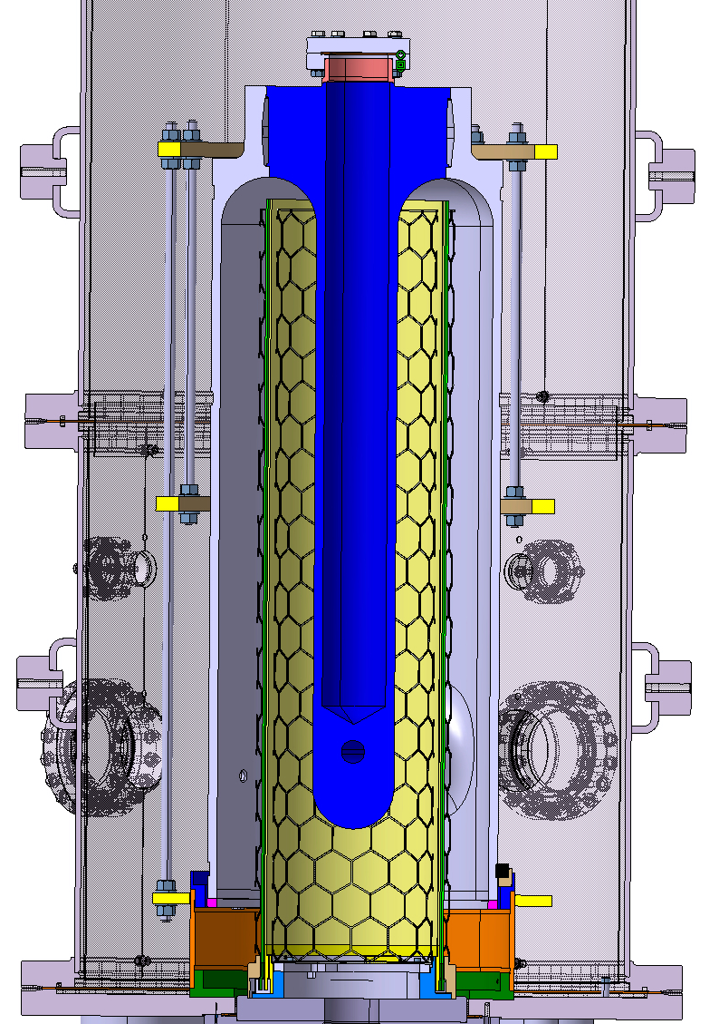
Nb film: if cavity is not the vacuum chamber
0.9 m
0.4 m
Double cathode
1.3 GHz high temperature
Crab Nb/Cu
Substrate biasing and process pressure investigation (2 tests done in 2015)
HIE-ISOLDE double cathode to decouple inner/outer conductor coating
and allow magnetron sputtering larger process window (ready Jan. 2016)
High temperature coating study and comparison on 1.3 GHz cavity (spring 2016)
Crab Nb/Cu Wide Open Waveguide WOW cavity preliminary study (started mid-2015), Cu brazing study, as an alternative to weld, started (evaluate compatibility with chemistry)

Slide 47
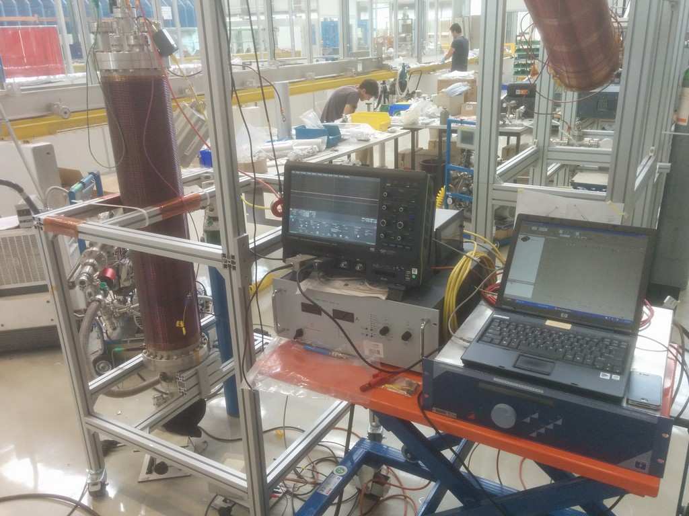
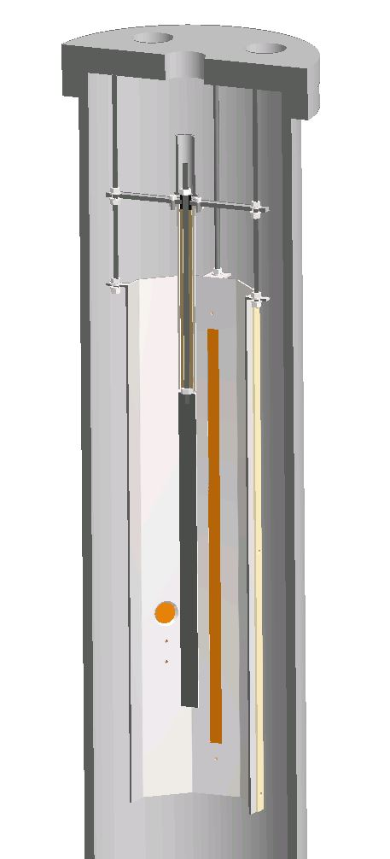
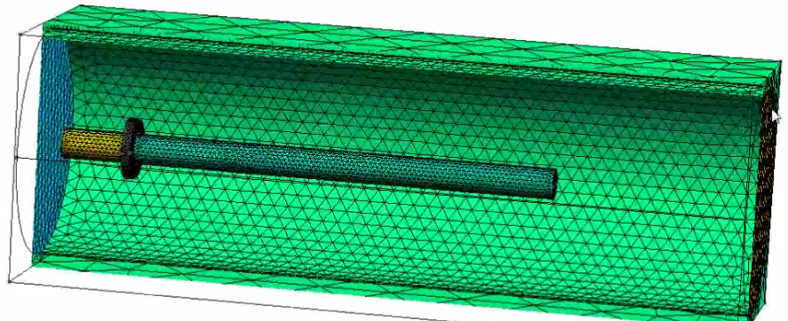





Plasma simulations
cathode
anode
Ar plasma
3D drawing
geometry mesh
Ar⁺ flux on the cathode
sputtered Nb distribution
Experimental reality
Numerical simulation
courtesy of A. Sapountzis T. Richard and A. Pflug
Case study finished summer 2015
Fraunhofer simulation code installed since fall 2015
Experiment/simulation benchmarking on going
Simulations of 1.3 GHz/HIE-ISOLDE/WOW/hollow cathode started, but need much more server stability
Plasma diagnostics: OES, Langmuir probe and RFEA
Benchmarking

Slide 48



HIE-ISOLDE 2D, very preliminary plasma and Nb transport simulation © Thibaut Richard
2D slice of HIE-ISOLDE cavity with periodic boundary conditions
Encouraging start, but… we are still in the learning phase
Limitation with server access stability (crashes), 3D model not yet realizable
Need better understanding/optimization of code and parameters

Slide 49






Collaborations
FCC (on going)
EPFL (Jan. 2015) → plasma simulations and diagnostics
LNL/STFC/CERN (Jun. 2015) → FCC 5 cells cavity, thin film R&D and characterization
Eucard3 (start 2017) → Thin film R&D (multilayers, Nb3Sn) and RF characterization
Fraunhofer (2016?): → simulation code

Slide 50
Summary
2014 objectives partially fulfilled
2015 production activities limited by the availability of the substrates
2016 multi-activities in parallel (LHC/HIE-ISOLDE/SPL/Crab…)
Surface treatment of SPL and Crab cavities on going
b.118 infrastructure/manpower limitations with growing activities
Launch of alternative treatments studies
LHC coating system ready and process requalified
HiPIMS/DCMS refurbished, plasma diagnostic study
Nb3Sn/V3Si activity launched, fellow started in Nov. 2015
Plasma simulations launched and PhD started in Jan. 2015
Double cathode for HIE-ISOLDE and high temperature coating R&D
New collaborations on the way

Slide 51
Thank you for your attention!
Acknowledgement to:
chemistry team, TTEs, HIE-ISOLDE coating team
RF and MME groups

Slide 53
TE - Thin Film & Surface Treatment SRF plan 2014

Slide 54

Materials
Nb₃Sn
A15 type
Tc ~ 18K
V₃Si
A15 type
Tc ~ 16K
Both materials exhibit very low surface resistance combined to high T_{c}

Slide 55


Magnet holder
Cathode Power supply
Ceramic insulator
Upper anode bias
SmCo magnet
Upper anode
Cavity)
Nb cathode
Lower anode
Cavity Bias (grounded)
Ceramic insulator
Lower anode bias
Pumping

Slide 56


RFEA

Slide 57


Q4.13: -120V bias + wide ring top cathode
FIB cross section – e9 sample (weld outer conductor)
Q4.13 e9, bias -120V, 4.28 um
DC-bias diode sputtering (no pores)
Q4.8 e9, bias -80V, 2.53 um
→ Baseline recipe
DC-bias diode sputtering
(1.0 % of volume porosity)
+70%
Dense and smooth layer (effect of larger bias)
Larger thickness (effect of top Nb ring)
BUT delamination on the antenna/ext. conductor middle samples
Bias optimum probably in between -120V and -80V

Slide 58




Q4.13: -120V bias + wide ring top cathode
SEM surface imaging – sample e9 (weld outer conductor)
Q4.8 / -80V bias
Q4.13 / -120V bias + top ring

Slide 59
Q4.14: 30% lower pressure DC-bias diode
Goal = lower process pressure (allowable with new power supply, HV up to 1.2 kV) to increase coating rate and get a more balanced in/out thickness
Hardware:
long cathode + 4 mm width/5 cm height ring at top (as already mounted for QS9)
Process compared to Q4.8 (baseline):
30% lower pressure → 0.14 mbar instead of 0.2 mbar
~ 50% shorter coating time → 176’ instead of 345’
Only 5 runs instead of 14
50% energy → 21.5 kWh instead of 43 kWh
Same power = 8 kW

Slide 60

Q4.14 vs Q4.8: deposition rate profile
As expected, ~ 25 to 50% larger deposition rate → to be tested for RF

Slide 61






Q4 weld issue after 14 coatings…
before
after re-weld
EB facility at main workshop
(T. Tardy/M. REDONDAS MONTESERIN)
Optical inspection
(USB microscope)
Cavity probably re-usable, presence of cracks somewhere else? → Chemistry test

Slide 62

HIE-ISOLDE 2D, very preliminary plasma and Nb transport simulation © Thibaut Richard
2D slice of HIE-ISOLDE cavity with periodic boundary conditions
Server connection lost after 72% of simulation, steady state not yet reached

Slide 63
HIE-ISOLDE 2D, parameter file

Slide 64
HIE-ISOLDE 2D, parameter file

