Slide 1


Scientific Workflow reusing and long term big data preservation
Salima Benbernou
Université Paris Descartes
Salima.benbernou@parisdescartes.fr
Project Mastodons CNRS Predon

Slide 2
Outline
Projet Square Predict
Scientific workflows
  Examples
  Existing systems and limitations
Using conventionnel workflow technologies in simulation/experiments
  Introduction
  Modeling using BPEL
Swf and Bog data
Reusing in scientific workflow
  Fragment reusing
  Privacy aware provenance

Slide 3






Square Predict
Prédiction financière:
Gestion de données assurances et open data

Slide 4
Square Predict
Collecte de données sur Teralab
Fusion de données sémantiques (RDFs):
-Evaluation de requêtes par réecriture distribuée sur Spark
-Requêtes virtuelles
-réutilisation des données pour d’autres requêtes
Qualité de données:inconsistance, l’incertitude
Prendre les Données en streaming
Clustering en streaming sur Spark
Visualisation

Slide 5
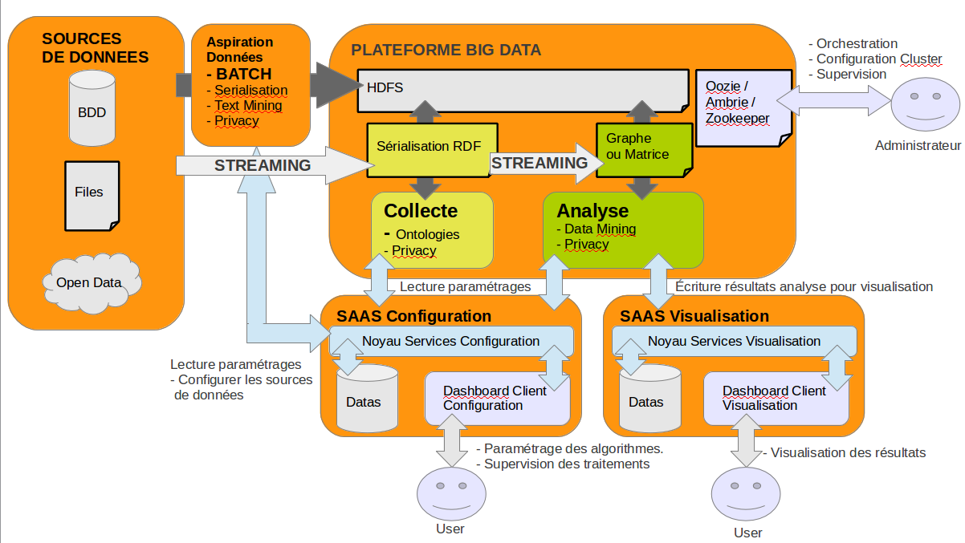
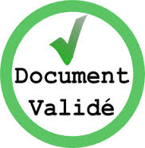
SP3.1 – Architecture fonctionnelle

Slide 6

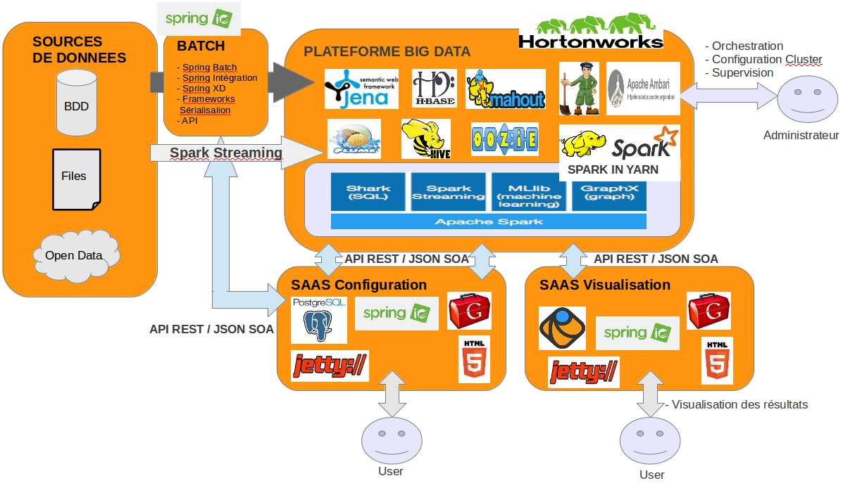






SP3.1 – Architecture technique

Slide 7
Scientific workflow

Slide 8
What are scientific workflows?
Scientific experiments/computations/simulation modeled and executed as workflows called scientific workflow (SWf).
Deal with intensive data, are long running, data driven, can integrate multiple data sources (i.e. sensors)

Slide 9
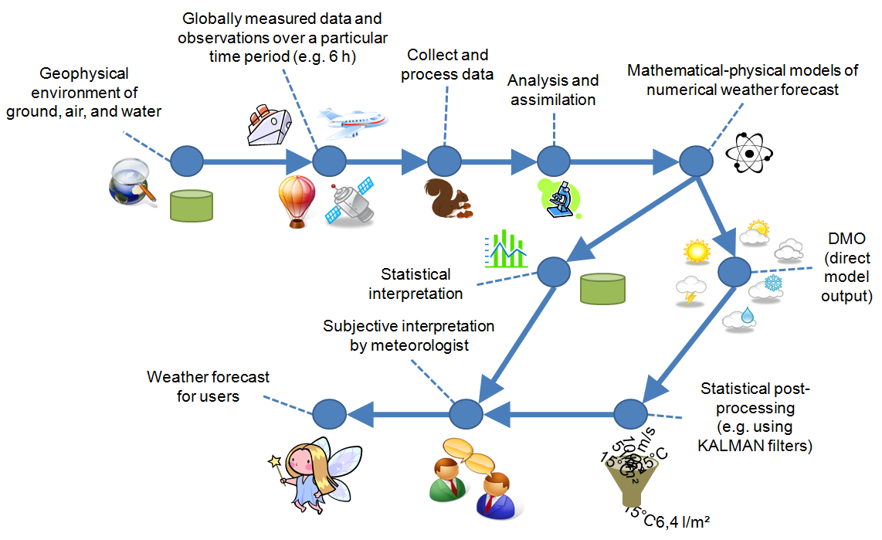
SWF Examples

Slide 10
SWF Examples
Source: Matt Coleman (LLNL)

Slide 11
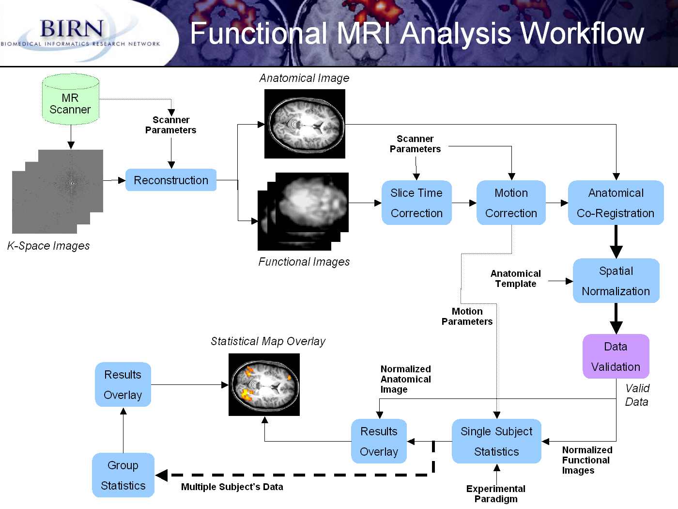
Source: NIH BIRN (Jeffrey Grethe, UCSD)

Slide 12
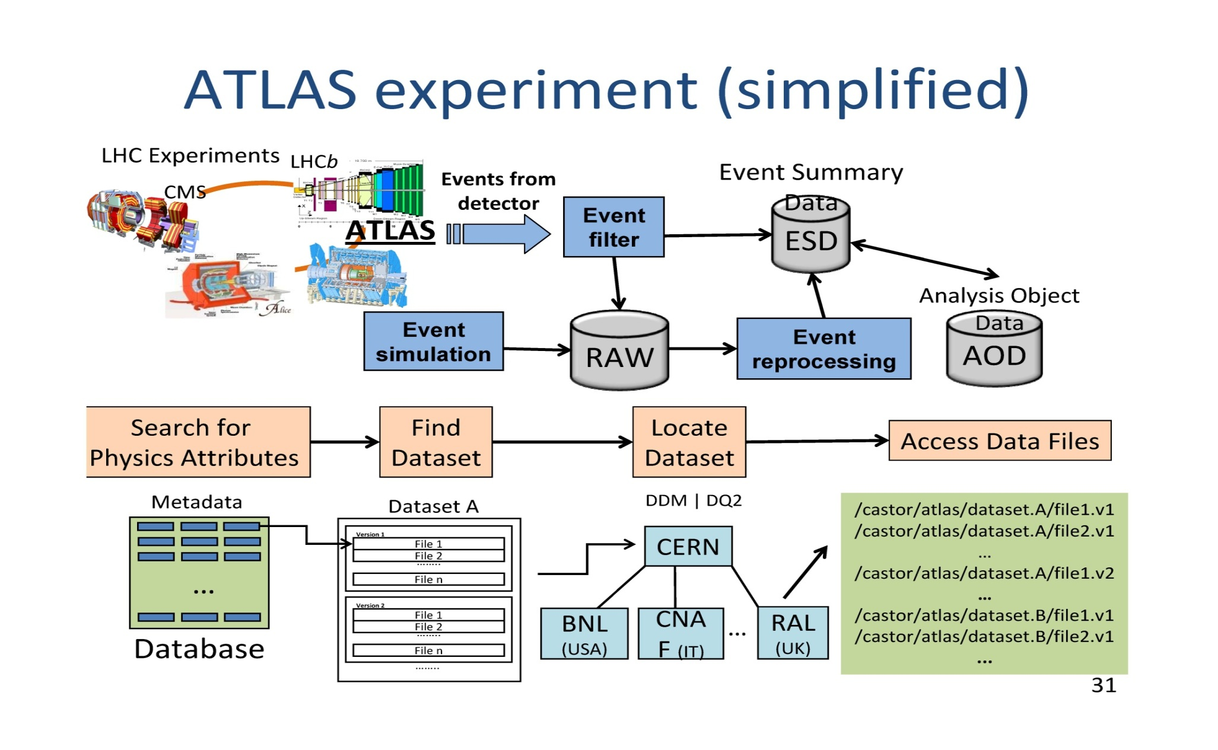
SWF Examples (cont)

Slide 13
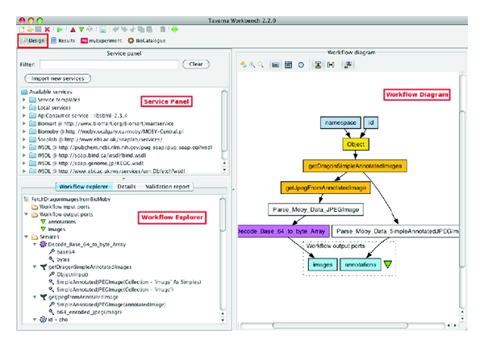
SWF Examples (cont)
A snapshot of the Taverna Workbench.

Slide 14
Scientific workflow systems
To be improved
  Robustness, fault handling
  Flexibility and adaptability
  Reusability
  Scalability
  Interaction with users, user-friendliness of tools
  science skills required from scientist
  No generic approach
  Domain specific solutions (in term of modeling and execution)
Workflow are already used in e-science
This is not always the conventional workflow technology
Some workflow systems in e-science: Kepler, Taverna, Pegasus, Trident, Simulink, Karajan …

Slide 15
Scientific workflow systems
Data-driven applications are more and more developed in science to exploit the large amount of digital data today available
Adequate workflow composition mechanisms are needed to support the complex workflow management process including workflow creation, workflow reuse, and modifications made to the workflow over time.
Use conventional technologies (Business processes)

Slide 16
Business workflows (i.e, BPEL)
independent of the application domain, can be used for every type of scenario
The concept of workflow models and instances is inherently capable of enabling parameter sweeps.
Asynchronous messaging features are predestinated for non-blocking invocation of long running scientific computations
Business workflows are usually based on agreed-upon standards for workflow modeling and execution as well as for integration technologies.
facilitate collaboration between scientists (e.g., with the help of Web services).
Services computing technology enables scientists to expose data and computational resources wrapped as publicly accessible Web services

Slide 17
Scientific workflows vs. Business workflows
Scientific “Workflows”
  Dataflow and data transformations
  Data problems: volume, complexity, heterogeneity
  Grid-aspects
    Distributed computation
    Distributed data
  User-interactions/WF steering
  Data, tool, and analysis integration
  ➔ Dataflow and control-flow are married!
Business Workflows
  Process composition
  Tasks, documents, etc. undergo modifications (e.g., flight reservation from reserved to ticketed), but modified WF objects still identifiable throughout
  Complex control flow, task-oriented: travel reservations; credit approval
  ➔ Dataflow and control-flow are divorced!

Slide 18
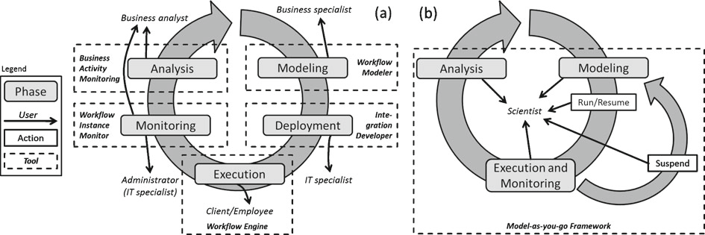
Business and scientific Lifecycles

Slide 19
Scientific workflow limitations
Scientific workflow life cycle: scientits’perspective
  Reflects how scientits actually work-trial and error fashion
  Hidden technical details
  « no » deployment phase
  Operations to control workflow execution
  Monitoring is the visualisation of the results only

Slide 20
Scientific workflow and the scalability
Service-Oriented Workflows on Cloud Infrastructures for reusing.
The service-oriented paradigm will allow large-scale distributed workflows to be run on heterogeneous platforms and the integration of workflow elements developed by using different programming languages. Web and Cloud services are a paradigm that can help to handle workflow interoperability,

Slide 21
SWF: Programmable and reproducible Scalability
Access and query data
Scale computational analysis
Increase reuse
Save time, energy and money
Formalize and standardize

Slide 22
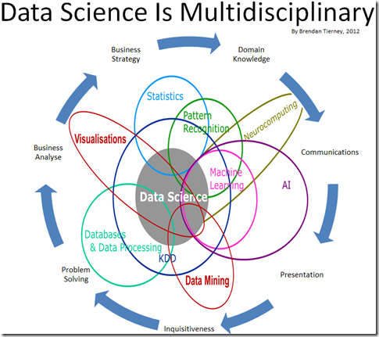
Workflow, data science and big data

Slide 23
Workflow, data science and big data (cont)
many SWfMSs are not prepared to handle large data sets because of inadequate support for distributed computing.
most SWfMSs that do support distributed computing only allow static task execution orders

Slide 24
Workflow, data science and big data (cont)
Develop new big data science technologies and infrastructure
Develop data science workflow application through combination of tools, technologies and best practices
Hands on consulting on workflow technologies for big data and cloud systems, e.g., MapReduce, Hdoop, Spark, Yann, Cascading.Oosie, Nova .
Technology briefings and applied classes on end-to-end support for data science.

Slide 25
Some challenges
Optimized execution on heterogeneous platforms.
Representing and reasoning data: semantic, quality (unconsistent, uncertain)
Increasing reuse within and across application domains
Querying and integration of workflow provenance data

Slide 26
BPaas vs SPaaS
Business process vs swf outsourcing to take advantage of the Cloud computing model.
Reusing process fragments to develop process-based service compositions and adapt the new swf according to the scientists (reusing a partial differential equation program)
privacy risks aware.
Sharing scientific process fragments and hide provenance.
Many works studied data provenance but not hide provenance.
Formal model of BPaaS vs Scientific Process as a Service (Icloud@vldb2012)

Slide 27
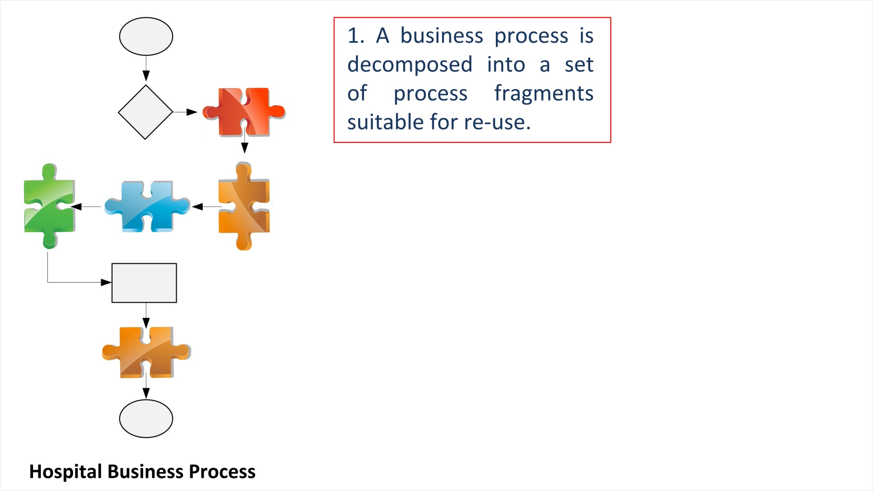
Decomposition of business process vs scientific process

Slide 28
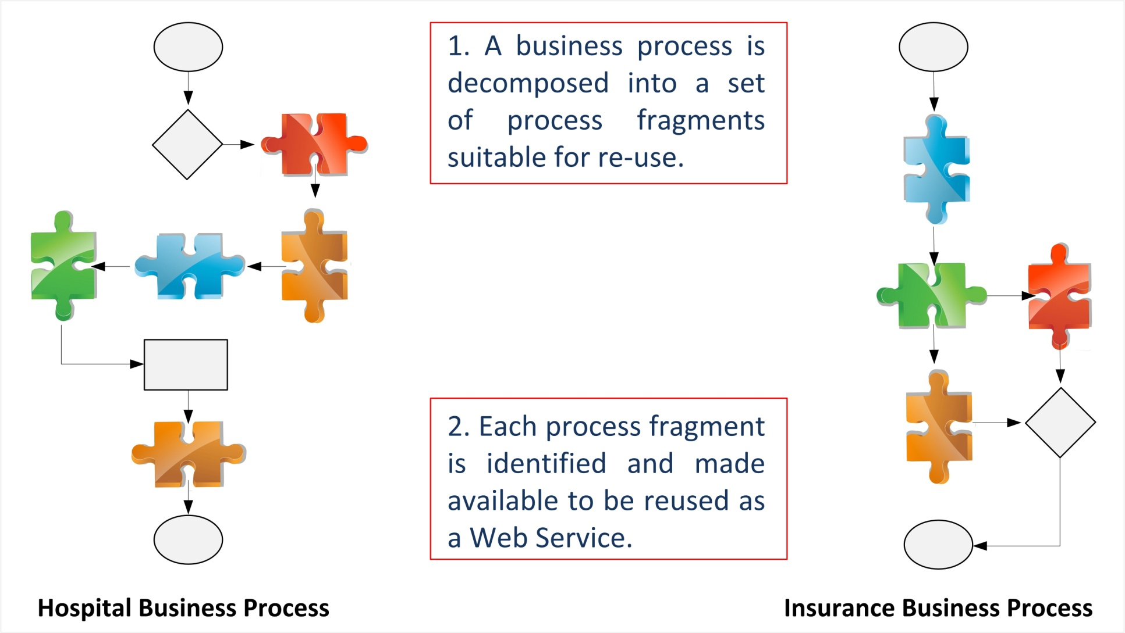
Identification of fragments

Slide 29
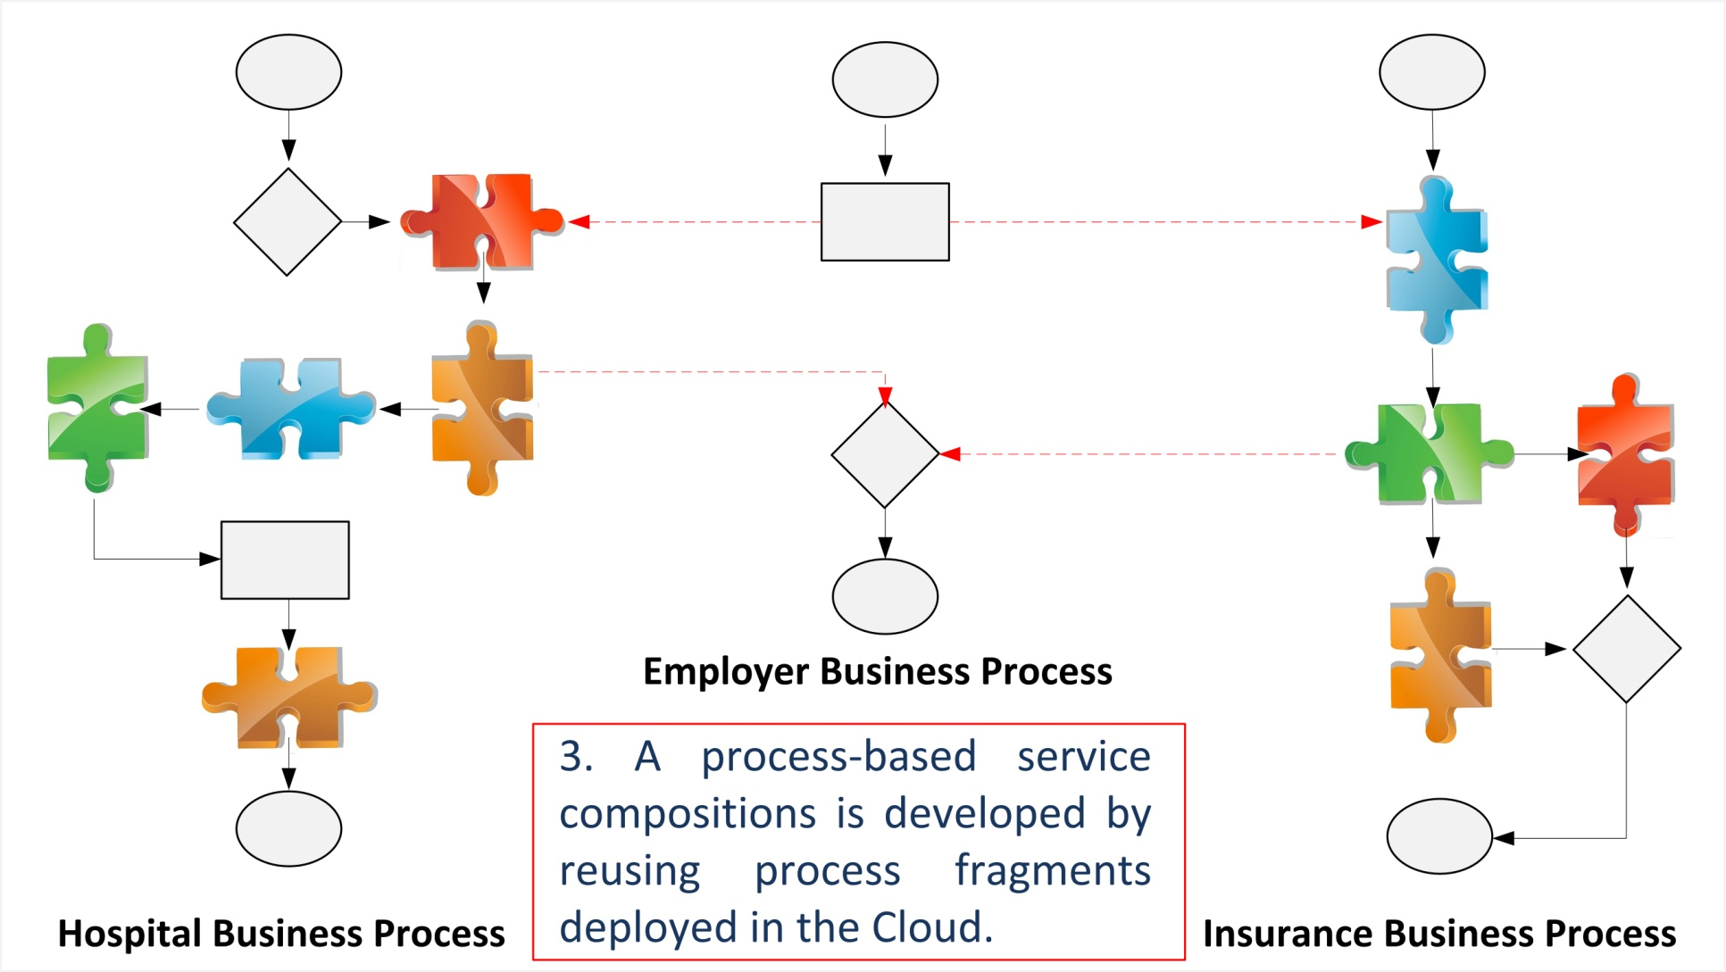
Development of processes

Slide 30
Provenance and privacy in SPaaS
An adversary (a curious) can discover the provenance of the reused process fragments.
Can infer connections between end-users and scientists that outsource fragments to the Cloud.
No related work!

Slide 31
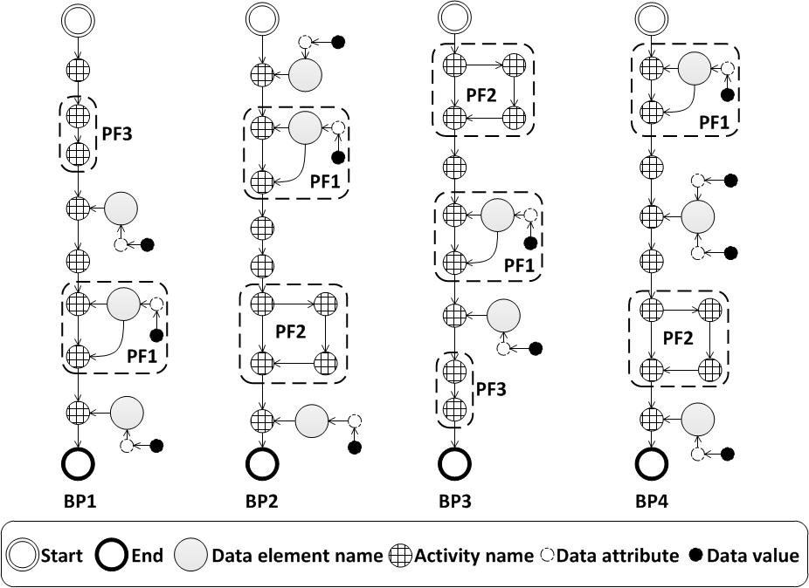
Formal model
Business Process: business graph. [Beeri,VLDB’06]
Process Fragment: business subgraph.
BPaaS: a finite set of business processes.
Reusing Function.

Slide 32

Anonymous Views
View on SPaaS:
A set of process fragments having the same objective (called clones).
Anonymous View on SPaaS:
View on SPaaS having at most K clones.
Objective : Make it hard for an adversary to know the provenance of a reused process fragment. (Anonyfrag)

Slide 33
Let P a business process to be developed in the SPaaS
For each Process Fragment F in P
not exists
Verify if F exists in the SPaaS
exists
Reuse F to develop P
P’ a process-based service compositions developed in the SPaaS

Slide 34
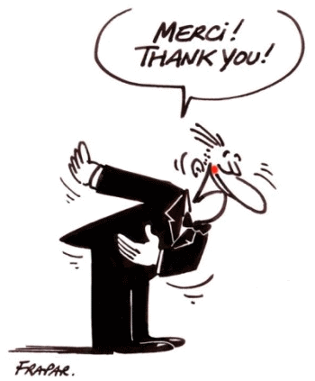

Slide 35
Workshop organisation
1st Workshop on LOng term Preservation for big Scientific data (LOPS) to be held in conjunction with ICDE 2014, Mach 31-April 4, Chicago , IL, USA
Lipade.math-info.univ-paris5.fr/lops/

