Slide 1
LHCb: Status before Data Taking and requests
On behalf of LHCb
Roberto Santinelli- GDB 14th October

Slide 2
Outline
Recap:
  Status as of STEP09 post mortem
  Activities run since then
Main issues spotted in the last months
  Service, middleware, deployment operations…
Current Status
Main messages & recommendations to WLCG

Slide 3
STEP’09 Summary
Data transfers for STEP’09 using FTS were successful
Data access is still a concern
  Backup solutions in DIRAC allowed us to proceed
    Downloading input data files is not a long term option
  dCache <-> Root incompatibilities should not be discovered in production
Oracle access via CORAL is not scalable (load on LFC)
  Workaround to bypass CORAL now in place
DIRAC meets the requirements of the LHCb VO
No distributed analysis was exercised beyond normal
user activity
Andrew Smith 09th July 2009

Slide 4
Activities since STEP
MC09 simulation production (at full steam)
  Large samples for preparing 2009-2010 data taking
  Samples requested
    10⁹ events minimum bias (10⁶ jobs)
      28 TB (no MC truth)
    Signal and background samples: from 10⁵ up to 10⁷ each
Stripping commissioning
FEST weeks (monthly basis)
  Commissioning ONLINE/OFFLINE
    HLT, transfer (70MB/s), reconstruction, reprocessing of previous FEST data…
  Last FEST week (complete with Stripping) end October then full data taking mode (cosmic)
Real user distributed analysis activity in parallel to scheduled activities

Slide 5
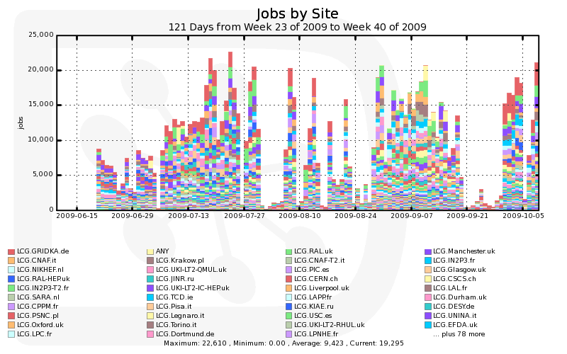
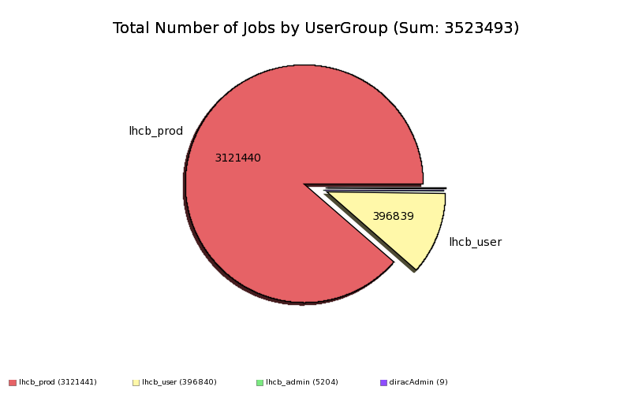
Some statistics
118 sites hit
23k concurrently running jobs hit
Since June:
  Over 3.5 million jobs
  11% are “real” analysis jobs

Slide 6
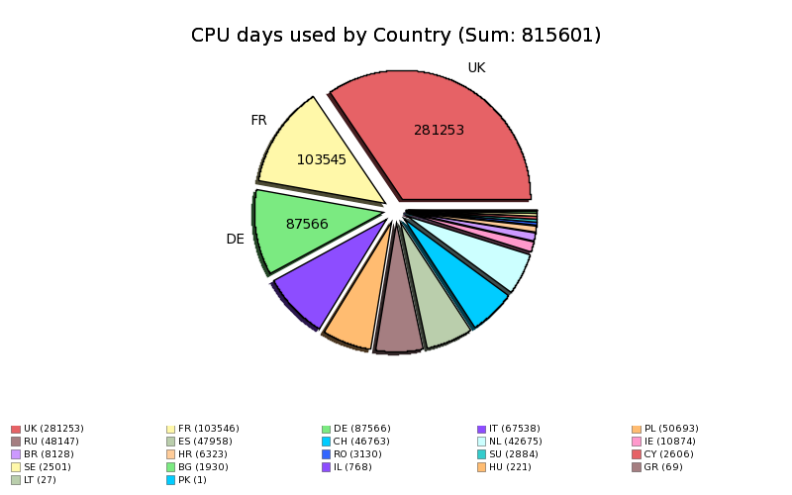
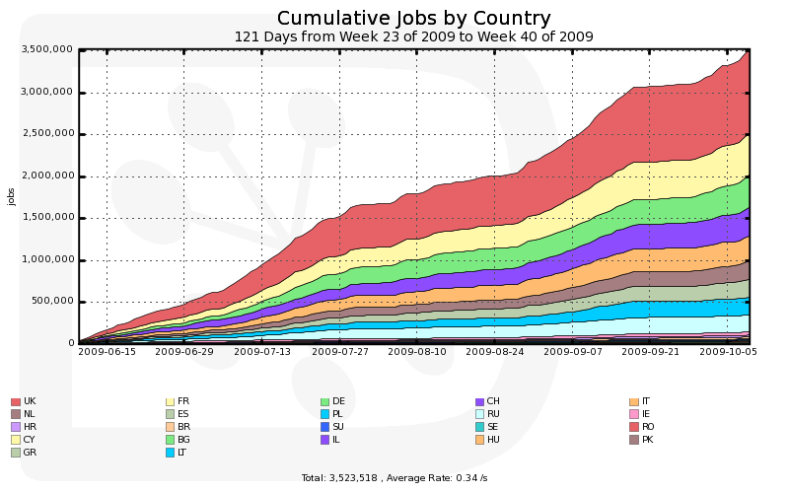
Some statistics (cont’d)
Over 45,000 jobs /day
23 countries

Slide 7
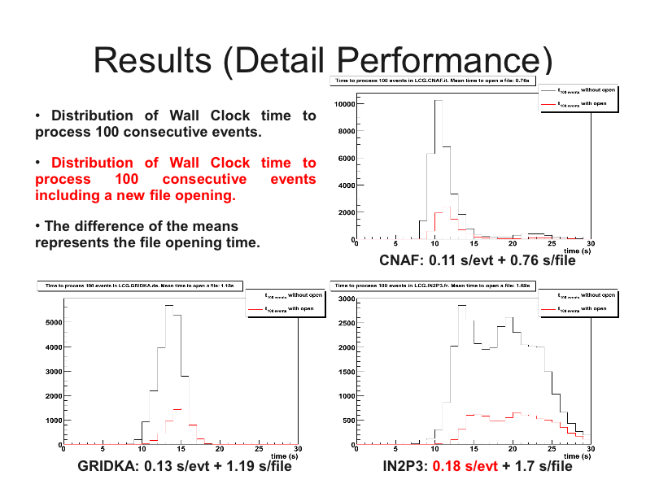
Analysis performance
Goal: improve data access for analysis
Presented at the May GDB (R.Graciani, A.Puig, Barcelona)
Understood feature
(2 sets of WNs)

Slide 8
Issues
Many of these operational/deployment/middleware issues have been already reported by Maarten et al. on his Technical Forum talk (EGEE’09)
Very difficult to list all GGUS/Savannah task/Savannah bugs/ Service Intervention Request/Remedy tickets these issues brought up.

Slide 9
DM issues
  File locality at dCache sites
    “Nearline” reported even after BringOnline (IN2P3/SARA)
  SRM overloads (all)
  gsidcap access problem (incompatibility with ROOT plugin)
    Fixed by quick release of dcache_client (and our deployment)
  SRM spaces configuration problems
    Fixed at site, need for a migration of files avoided to not interrupt the service (CNAF)
  Massive files loss at CERN
    7,000 files definitely lost (no replicas anywhere else)
    ~8000 files lost attempting to recover former 7000 ;-)
  Slowness observed deleting data at CERN (race condition with multiple stagers)
  Hardware reliability: sites need to be able to quickly give VOs the list of files that are affected by hardware / disk-server problems.
  On CASTOR sites globus_xio error rising when gridftp servers exhaust connections and new ones cannot be honored (incase a client is abruptly killed)
    (script in place to monitor and keep tidy gridftp servers)

Slide 10
DM issues (cont’d)
  Sites should follow dCache.org and WLCG prescriptions regarding versions than gLite releases
  Firewall issue in the file server causing jobs to not receive back data connection remaining stuck (IN2p3).
  dCache pool which got stuck and could not process any request. (PIC is with 1.9.5-3 fixed?)
  Zombie-dcap movers processes to be cleaned up (GridKA/SARA/IN2P3)
  Mis-configuration on the number of slots per server (SARA)
  Not adequately dimensioned servers with too few slots/connections defined per server
    sites should consider 2 requests: the amount of disk requests AND the necessary number of disk servers for serving all jobs _and_ for allowing redundancy, i.e. always more than one server on T1Dx spaces to allow recalling from tape missing file if a server is down.
  In general when the client is killed (whatever the reason), dcap does not close the connection with the server, which remains pending orphan. This reduces the number of available slots, which makes the lack of available slots issue to become even worse (and the vicious circle is started).

Slide 11
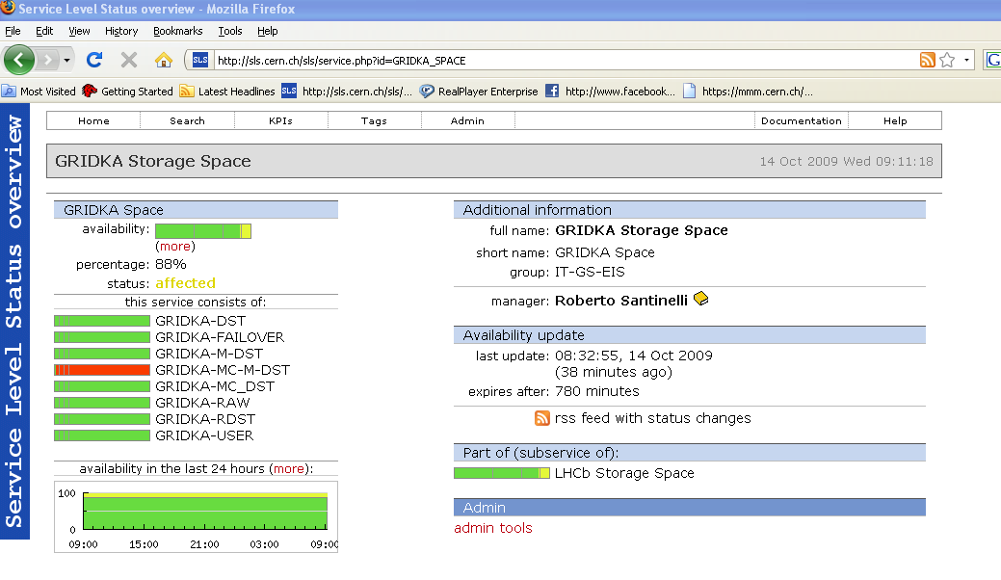
Storage space issues
SLS based alarming system in place since ~ month for lhcb operations
Mail sent also to T1-support mailing lists in case the following happens:
Free< 4TB AND
free/total < 15% AND
Total<pledged

Slide 12
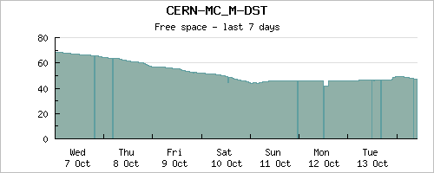
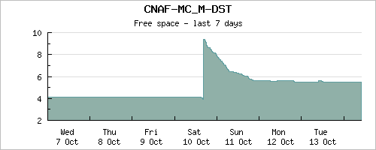
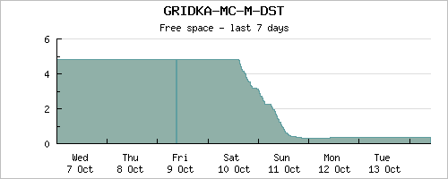
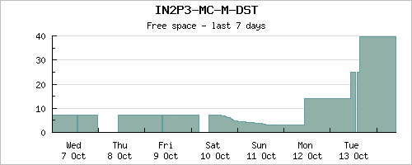
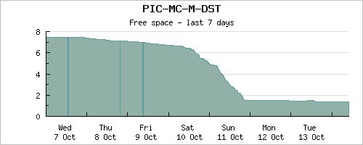
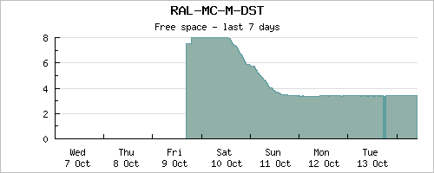
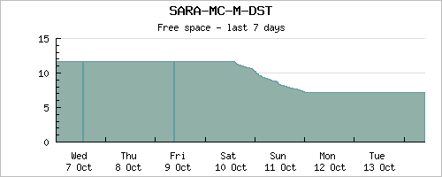
MC_M-DST: Custodial-online
400TB/400TB*
As of today: MC space token is the issue
  Reducing #of replicas at T1’s (now 3)
  Reshuffling allocated quotas on STs
  Guaranteeing the pledged in case are not
* allocated/pledged
33TB/30TB
30TB/40TB
70TB/65TB
38TB/15TB
29TB/40TB
30TB/65TB

Slide 13
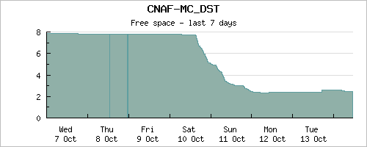
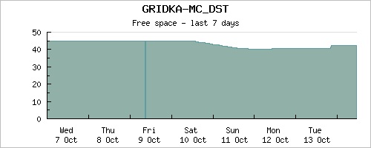
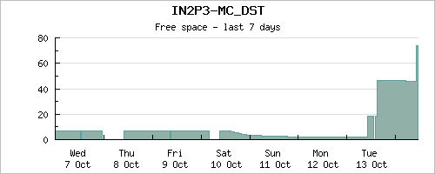
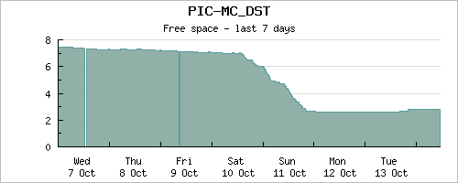
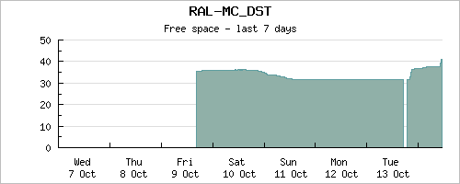
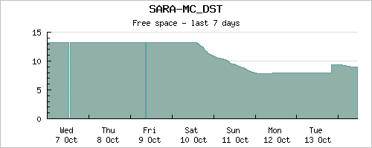
MC-DST:replica-online
75TB/75TB
33TB/55TB
47TB/25TB
110TB/125TB
136TB/75TB
39TB/115TB

Slide 14
WM issues
  WMS Condor Grid Monitoring is not VOMS aware.
    Same user (DN) but different credentials (FQAN) only some jobs get updated in their status messing the pilot status information
  WMS brokering of sites should only take into account VOView to avoid to have sites matched unwillingly
  WMS list match slow (fixed with 3.2 + WMproxy cache cleaning)
  WMS user proxy mix up issue (fixed in 3.2)
  Publication of queue information to the site bdii (→ top BDII)
    Load problems
    GIP misconfigured
    LRMS misconfigured
  Shared area: still a plague at many sites.May be the most important service at the site it has to scale with #slots.
    Tier2 most of the problem now!
  Locking mechanism for SQLite file access on shared area
    Workaround to copy the file locally on the WN first.
Notes:
In general, once lockd server can't complete one RPC, it waits forever, preventing any other locking to work. All clients which try lock will stall/timeout/crash depending on configuration and software versions.

Slide 15
Status: DIRAC and production system
Many releases of DIRAC bringing new features
  Optimization of pilot job submission (bulk) and user priorities
  New sandbox service in place as it was becoming a bottleneck with increased load
  Space user quota implemented
  Banning of SEs
  Prospects for new resources (OSG,ONLINE farm, DIRAC site)
  Improved monitoring of detailed performances
Production system
  Solid production life cycle
    Production integrity checks (on the catalogs and SEs)
    Production management with many steps defined (see EGEE09)
  Systematic merging of output data from simulation
    Performed on Tier1s, from data stored temporarily in T0D1
    Distribution policy performed on merged files
    Merged files of 5 GB (some even larger, up to 15 GB)
CERTIFIED ON SL5!

Slide 16
DM Messages
  The many operational issues reported indicate a very high probability that sites are mis-configured, whatever the point of failure is (network, dcap doors...) suggesting the need of (emphasized for ¾ dCache sites when under heavy load):
  Improving the monitoring tools on Storage Service to minimize the occurrences of these annoying incidents
  All sites should increase the number of slots per server to a reasonable number (several 100's depending on the size of disk-servers)
  All storage services must be adequately dimensioned for supporting peaks of activities
  Disk server unavailability are plagues for users
  dCache developers should implement an exit handler that releases the connection or they should set a timeout on idle connections shorter than what it is.
    There is a recovery of orphan connections but only after several (4?) hours.
Notes:
Just mention that two close in time and uncorrelated events happened at dCache sites for which all user and stripping jobs were failing hanging in opening files (or retrieving tURLs)
There is _no way_ that we can close this connection, as it is triggered by dcap_open() called by ROOT that is called by POOL that is called by Gaudi from within the application. When the process is killed, the connection should be closed by dcap as any file connection is deleted to e.g. a file in the file system. Therefore if there is a problem it should be escalated to dcache developers. I had the impression that there was a regular cleaning of pending connections but my memory may be wrong...

Slide 17
DM messages (cont’d)
    XROOT
      Looking for stability
      Hanging connection problem solution
      Introduced file opening delay (cfr analysis test, May GDB)
      Instances setup at CERN and various dCache sites
        Some evaluation activity soon
  SRM2.2 MoU: HOT topic : pre-staging strategies (being possible to pre-stage data at higher rate than one can process)
    Require pinning and releasing of files
    ACLs on space tokens available through SRM interface (and clients) instead of through technology-specific commands
    Possibility to list large directories (>1024) with gfal_ls.
      SRM must return the SRM_TOO_MANY_RESULTS code
  LFC: some bulk methods for query and deletion were requested since a long while(they were requiring to overload existing methods already in place for ATLAS).
  FTS: checksum on the fly (FTS2.2. reqs by ATLAS) also exploitable in DIRAC

Slide 18
WM Messages
  gLExec/SCAS : generic pilots
    gLExec has not been requested by LHCb but by the sites. LHCb will run generic pilot as soon as the site supports the Role=pilot
    Did not manage to run fully successfully the PPS gLExec/SCAS pilot for some configuration issues (cfr: Lyon)
    Spotted various bugs traceable in Savannah (cfr Antonio).
  CREAM:
    Submission through the WMS supported by DIRAC:
      when sites will start to publish the CEStatus=Production instead of “Special”?
      gLITE WMS 3.2 supporting it in place since not long time:
      All WMSes used by LHCb moved to this version
    Direct submission:
      CEMON cannot be used to inquiry for the queue overall status (in turn used to broker jobs to CEs). This is important for LHCb!
        Need to either query the IS or to keep a private BK as ALICE do
      Gridftpd mandatory incase of OSB: does LCG support Classical SEs anymore?
        CREAM CE as repository of OSB and clients to retrieve
        CREAM CE supporting SRM
  Shared Areas:
    Are critical services and have to be adequately dimensioned and monitored on the sites.
Notes:
The issues with gLite WMS interacting with BDII become less urgent if the following are addressed.

Slide 19
Summary
Preparation of 2009-2010 data taking is going on
  Simulation running full steam
  FEST regular activities
DIRAC : ready (just consolidation)
  More redundancy and scalability
  The final production H/W configuration to be addressed.
    Running at the limit of h/w capabilities → requested at least 5 times more to cope with (at least) doubled load and peaks.
Issues (addressed and traceable)
  Data access issues and instabilities of services are still the main problem.
  Preventing problems by improving site monitoring tools and interacting closely with VOs.
    Improved a lot since past years
Looking forward to use (not necessarily in the same order):
    Xroot as solution to file access problems
    CREAM Direct submission (limitations of gLIte WMS)
    Generic pilot and filling mode.

