Slide 1
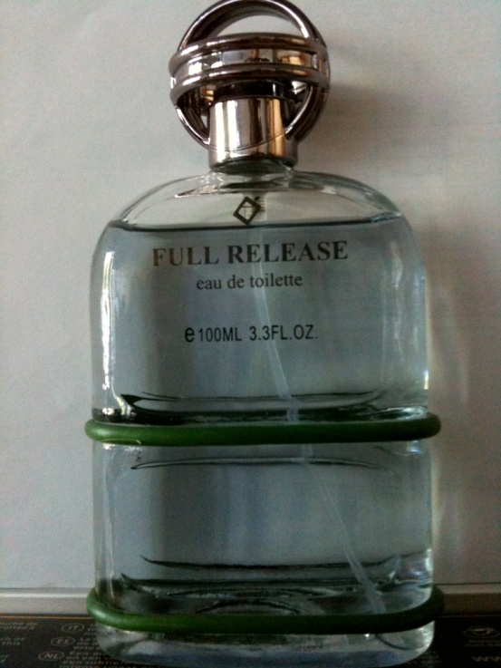
Middleware Update
Andreas Unterkircher
SA3 CERN

Slide 2
Content
SL5 migration
gLite3.2/SL5 releases since last GDB & upcoming releases
gLite3.1/SL4 releases since last GDB & upcoming releases

Slide 3
SL5 migration
WLCG MB endorses the move to SL5/x86_64
  https://twiki.cern.ch/twiki/bin/view/LCG/SL4toSL5wnMigration
All experiment-specific information should be found on the VO ID cards
Meta rpm to run SL4 HEP applications on SL5/x86_64 WNs
The meta rpm can be downloaded here:
  http://grid-deployment.web.cern.ch/grid-deployment/download/HEP/rpm/HEP_OSlibs_SL5-1.0.0-0.x86_64.rpm
Problems with installing this rpm on CentOS and RHEL have been reported (GGUS #52198)

Slide 4
Releases since last GDB
Less releases than planned
  EGEE 09 conference kept most of us busy for a week
  3 “high risk” security issues appeared in the meantime
    2 of them have been fixed with the latest CREAM releases
    1 affects many rpms/node types on all platforms; we nearly have all rpms in updated versions now available
  We started to implement changes to the release process required for the transition to EGI

Slide 5
gLite 3.2/SL5 releases
Releases since last GDB
  glite-VOBOX
  Yaim core & clients update
  GFAL 1.11.8-2, lcg_util 1.7.6-1 (fixes bugs #54259 & #52485)
  GLUE 2 enabled BDII v5.0.4

Slide 6
gLite 3.2/SL5 upcoming releases
SL5 Planning Wiki
  https://twiki.cern.ch/twiki/bin/view/EGEE/SL5Planning
GLEXEC_wn
  Certified but some rpms need to be updated for a security issue
CREAM
  Some problems were found, new rpms provided. Patch is again “Ready for Certification” (patch #3260)
LFC_oracle
DPM_disk
Argus
MPI_utils

Slide 7
gLite3.1/SL4 releases
Releases since last GDB
  Update to ICE (better WMS submission to CREAM)
  GFAL v1.11.8-2 (fixes bugs #54259 & #52485)
  Update to CREAM (two critical security fixes & many bug fixes)

Slide 8
gLite3.1/upcoming releases
Next production release
  VOMS Admin Client 2.0.10, Server 2.0.18
    Contains VOMS SAML codebase
    VOMSSAML service can be used to obtain a SAML assertion containing signed VOMS attributes
  GLUE 2 enabled BDII
  FTS 2.2
  Lcg-vomscerts

