Slide 1
Cryostats Systems Requirements on FSCF
Marzio Nessi
LBNF/DUNE DOE/SC CD-3a Director’s Review
October 27-29, 2015
Notes:
Good afternoon Ladies and Gentlemen, I am David Montanari from Fermilab and I will be presenting the Cryogenic Systems Requirements on the Far Site Facilities.

Slide 2
Who Am I and Where Have I Been?
Leader of the CERN Neutrino Platform.
Liaison between CERN and Fermilab on Neutrino projects.
Technical Coordinator of the ATLAS LHC project at CERN during construction and run1 operation.
Experience includes 27 years as a project manager and technical leader of a few very large projects. Large experience on detectors and complex systems.
Education as Particle Physicist (PhD). Physics Professor at the University of Geneva. At CERN, senior staff and leader of the Development and Innovation Unit in the DG-department. JINST director.
Notes:
I have been recently appointed as FSF L2 Manager for N2 Cryo Systems and Cryo Fluids, positioned occupied by Barry Norris who deserves all the credit for what I am about to present.
I have started as lead cryostat engineer for the 35 ton prototype and I have then been his deputy for the past 3 years in the Cryogenics Systems, starting from LBNE and then LBNF.
I am currently stationed at CERN acting as liaison between CERN and Fermilab.
My experience is a little shorter than that of some of the people that preceded me, it includes … READ.
I am also a certified PMP.

Slide 3
Outline
Requirements from science and design
Cryostats systems to meet science and scope requirements
Cryostats design and documentation
Summary
Prototype activities
Notes:
READ.

Slide 4
Requirements from science
Four large cryostats capable of hosting a new generation of neutrino detectors based on Liquid Argon Time Projection Chamber techniques (TPC).
Each cryostat capable of hosting a fiducial active detector mass of at least 10’000 tons of Liquid Argon (LAr).
Cryostat system thermally and electrically neutral to the external environment.
The cryostat and cryogenic systems shall provide a stable liquid argon environment for the detector.
The cryostat and cryogenic systems shall be designed to maintain a single phase in the entire liquid argon volume at a stable temperature. The chosen temperature is 88.3 K +/- 1 K.
The cryostat design shall be capable of handling all need services, cryogenics and detector signal penetrations from the outside to the inside of the cold volume.
It shall be possible to install the cryostat in the foreseen SURF environment.
The cryostat shall host on its surface all services, proximity cryogenics, front-end electronic racks and feed-throughs.
Same cryostat design for both TPCs technologies.
Notes:
This is the list of the requirements that have an impact of the CF work.
READ.
Full list is available here.

Slide 5
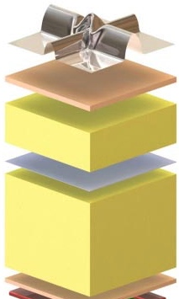
Design Requirements
Cold cryostats technology based on LNG transport techniques
Insulation : reinforced polyurethane foam (5-7 W/m²)
Warm structure : support structure
SS 1.2 mm primary membrane in contact with the liquid (primary containment)
secondary membrane : composite laminated material (secondary containment)
Notes:
This is the list of the requirements that have an impact of the CF work.
READ.
Full list is available here.

Slide 6
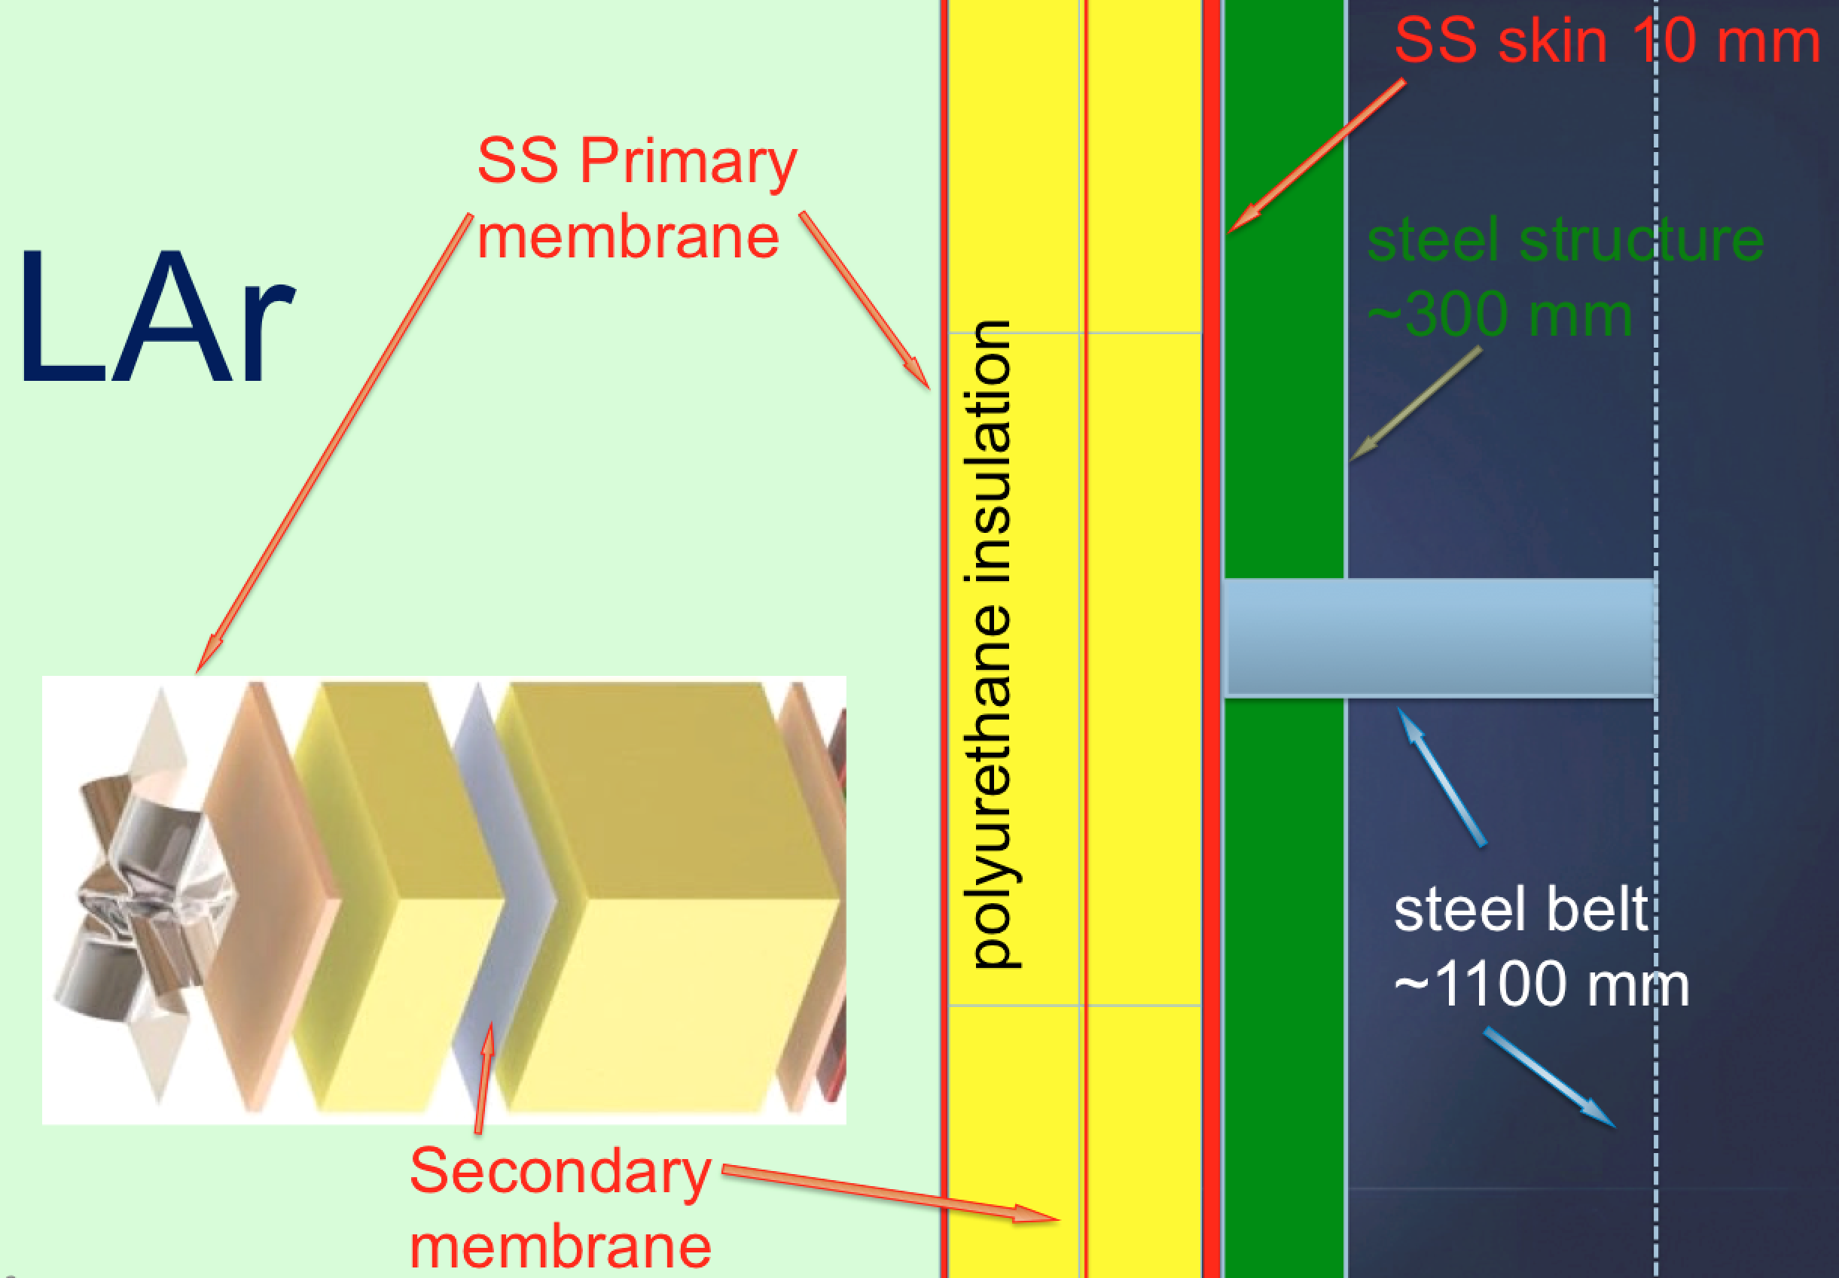
Design Requirements
Gas containment
Warm cryostats : Fe support structure
Notes:
This is the list of the requirements that have an impact of the CF work.
READ.
Full list is available here.

Slide 7
Design Requirements
Warm cryostats : Fe support structure
  Capable of standing the liquid hydrostatic pressure and the gas pressure (max 350 mbar).
  Supporting a SS 10 mm plate which supports the insulation and is gas tight (10⁻⁶ mbar/l/sec).
  Standalone structure with no connections to the cavern walls, floor load 68 tons/m² .
  Distance Fe-structure to cavern walls ~ 300 mm, to allow air circulation.
  Roof structure stable at the 1-2 mm level as a function of the variations in the atmospheric pressure.
  Structure fully inspectable from outside through platforms, stairs, …
  Monorail system necessary for the installation (15 tons individual hoists capacity).
  ~3’300 mm space to be allocated to the main LAr circulation pumps (towards the central drifts).
  Structure grounding connected to the cavern grounding network.
  Proximity cryogenics platform mezzanine connected to the cavern roof, not in contact with the cryostat Fe support structure.
Notes:
This is the list of the requirements that have an impact of the CF work.
READ.
Full list is available here.

Slide 8
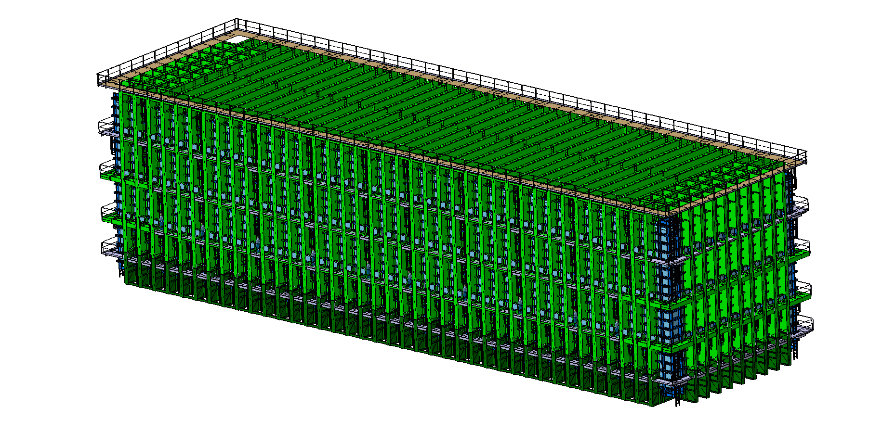
Design
Inner dimension (liquid+gas):
  L = 62.00 m
  W = 15.10 m
  H = 14.00 m
Notes:
This is the list of the requirements that have an impact of the CF work.
READ.
Full list is available here.

Slide 9
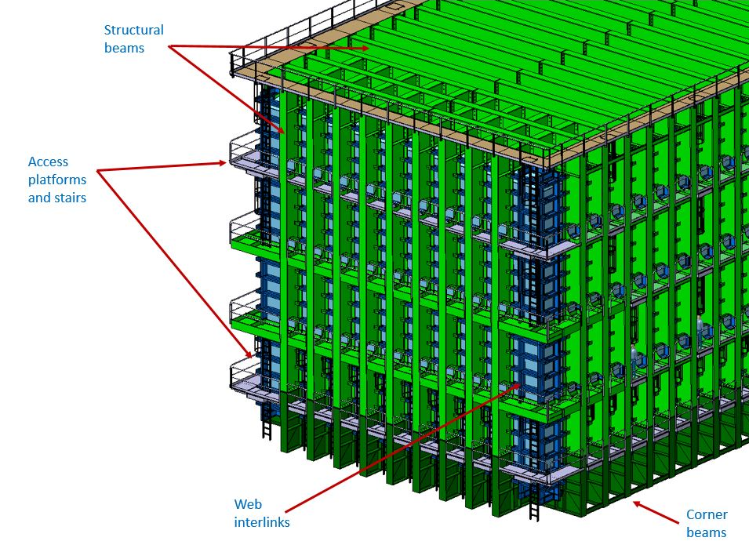
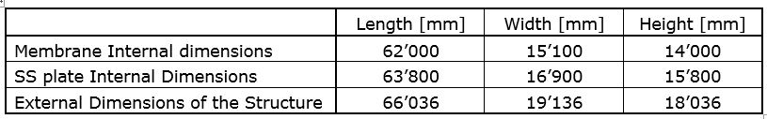
Design and dimensions
Notes:
This is the list of the requirements that have an impact of the CF work.
READ.
Full list is available here.

Slide 10
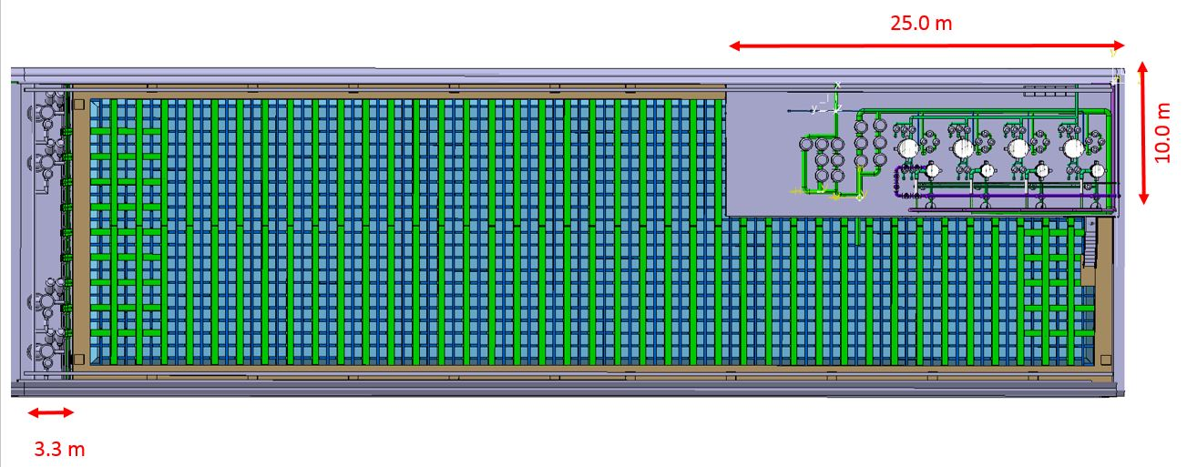
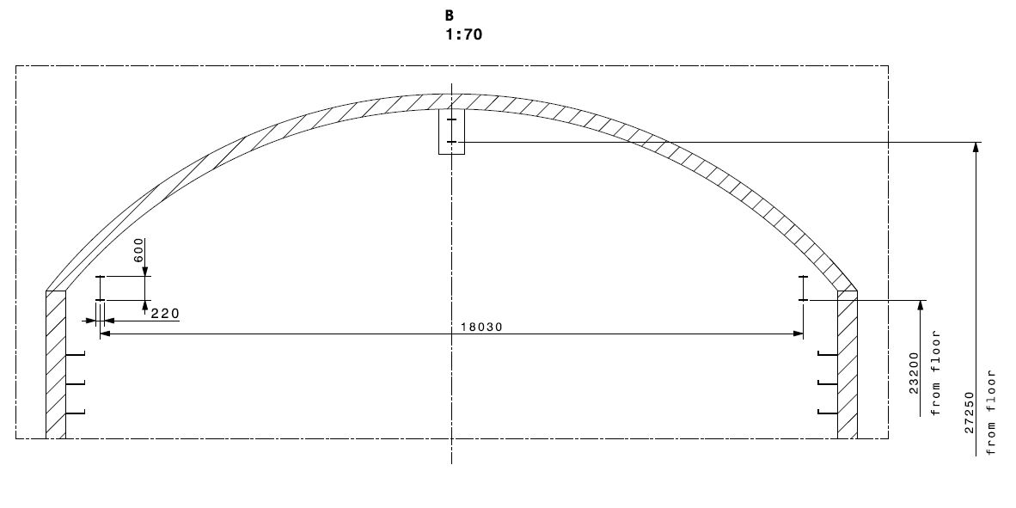
Design and dimensions
Notes:
This is the list of the requirements that have an impact of the CF work.
READ.
Full list is available here.

Slide 11
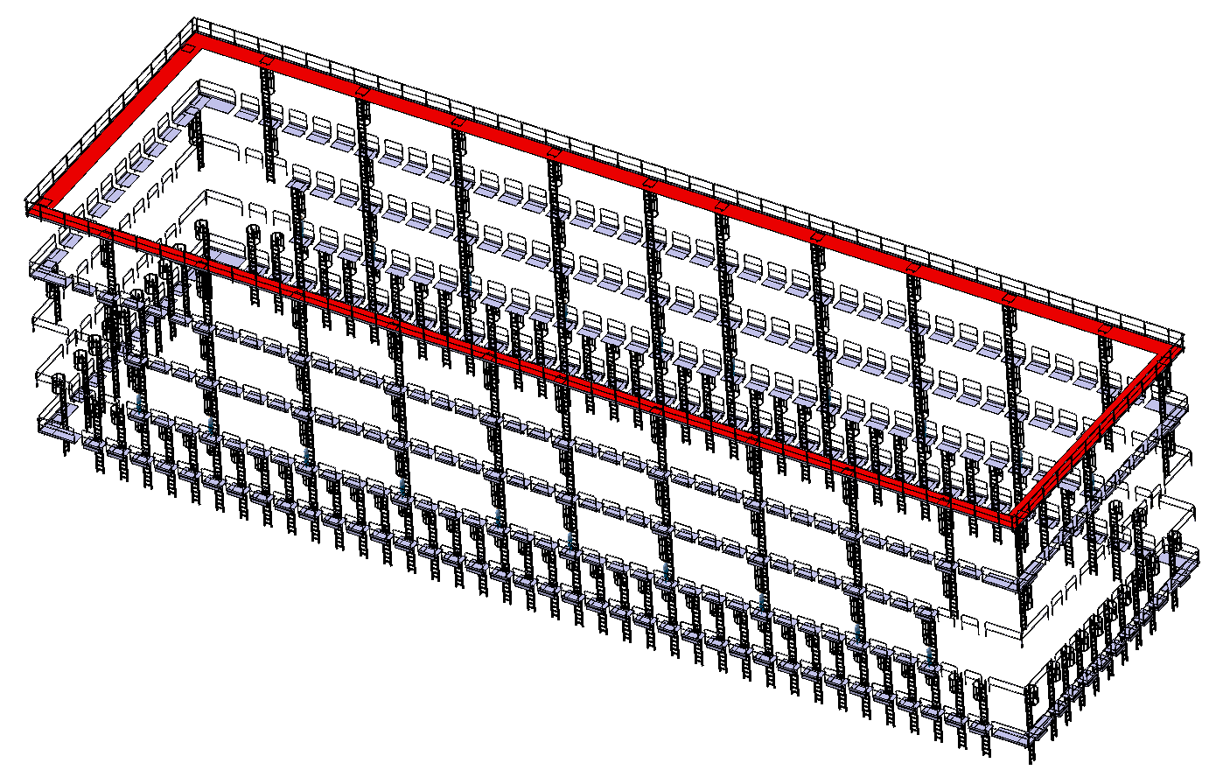
Access structure during assembly and operation
~ 900 m of gangways
~ 600 m of stairs
access platforms to the electronics racks and feed-throughs not yet designed
Notes:
This is the list of the requirements that have an impact of the CF work.
READ.
Full list is available here.

Slide 12
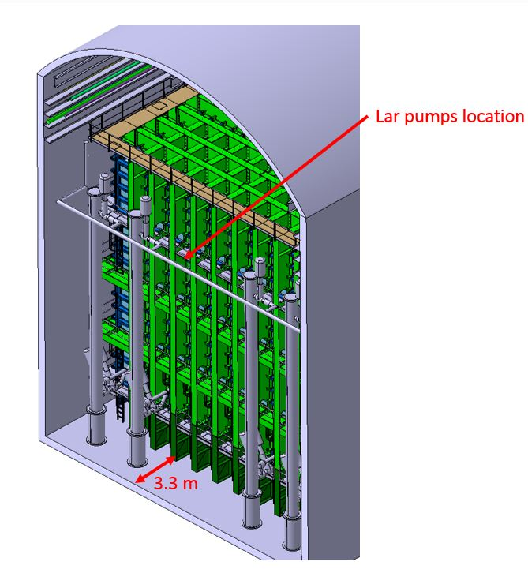
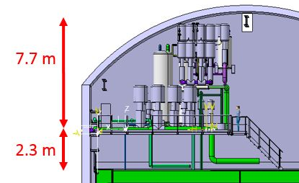
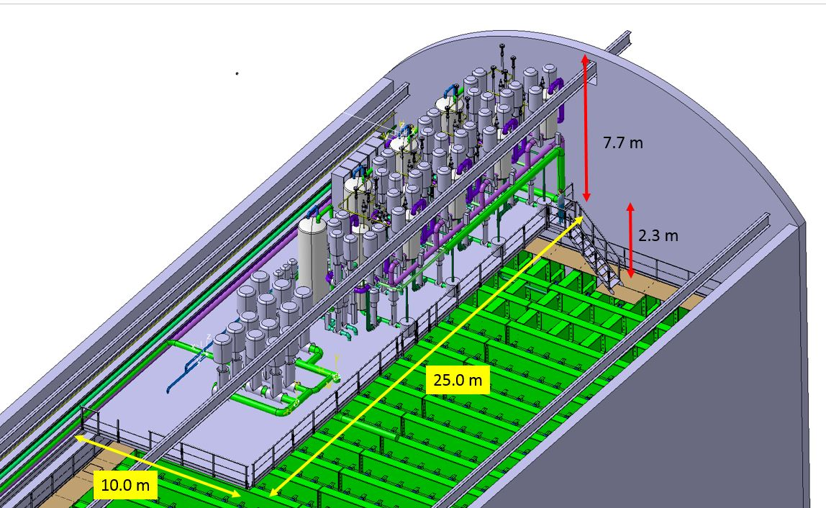
Design
Proximity cryogenics mezzanine
Notes:
This is the list of the requirements that have an impact of the CF work.
READ.
Full list is available here.

Slide 13
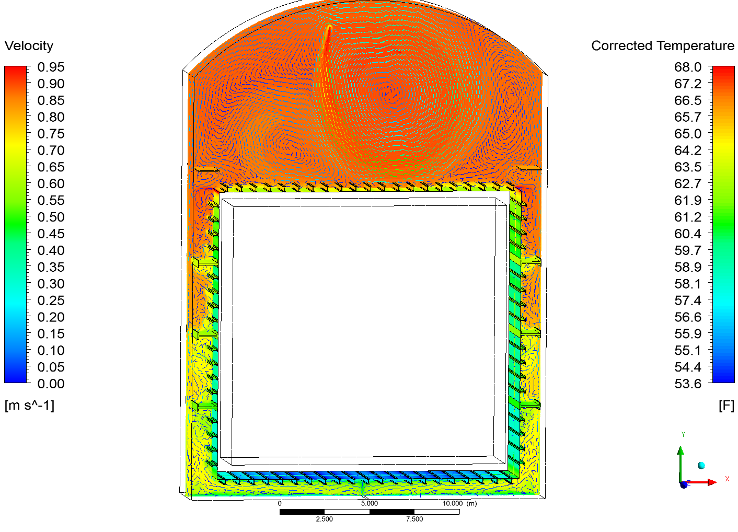
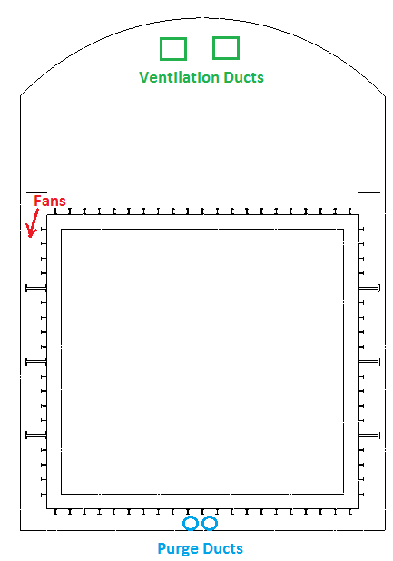
Open design issues : cavern ventilation and air circulation around the cryostat
1.) Fans on Top blowing air around cryostat.
2.) Duct(s) on bottom of cryostat
sucking in air and bringing it
back to the top of the cavern to be
removed.
3.) Duct(s) on bottom of cryostat
bringing warm air from top of
cavern to bottom of cryostat.
4.) Any Others?
Erik Voirin, FNAL
Notes:
This is the list of the requirements that have an impact of the CF work.
READ.
Full list is available here.

Slide 14
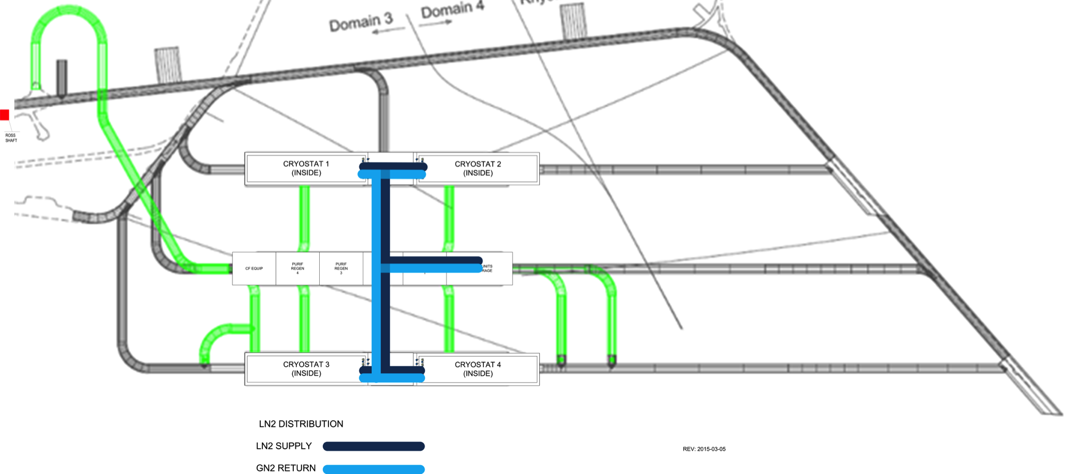
Material logistics and routing example during installation
Cryostat material path

Slide 15
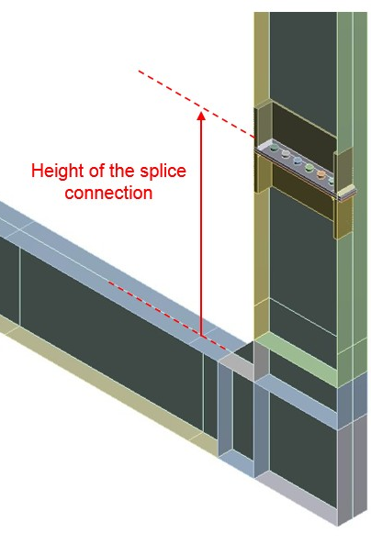
Installation Sequence (first approach)

Slide 16
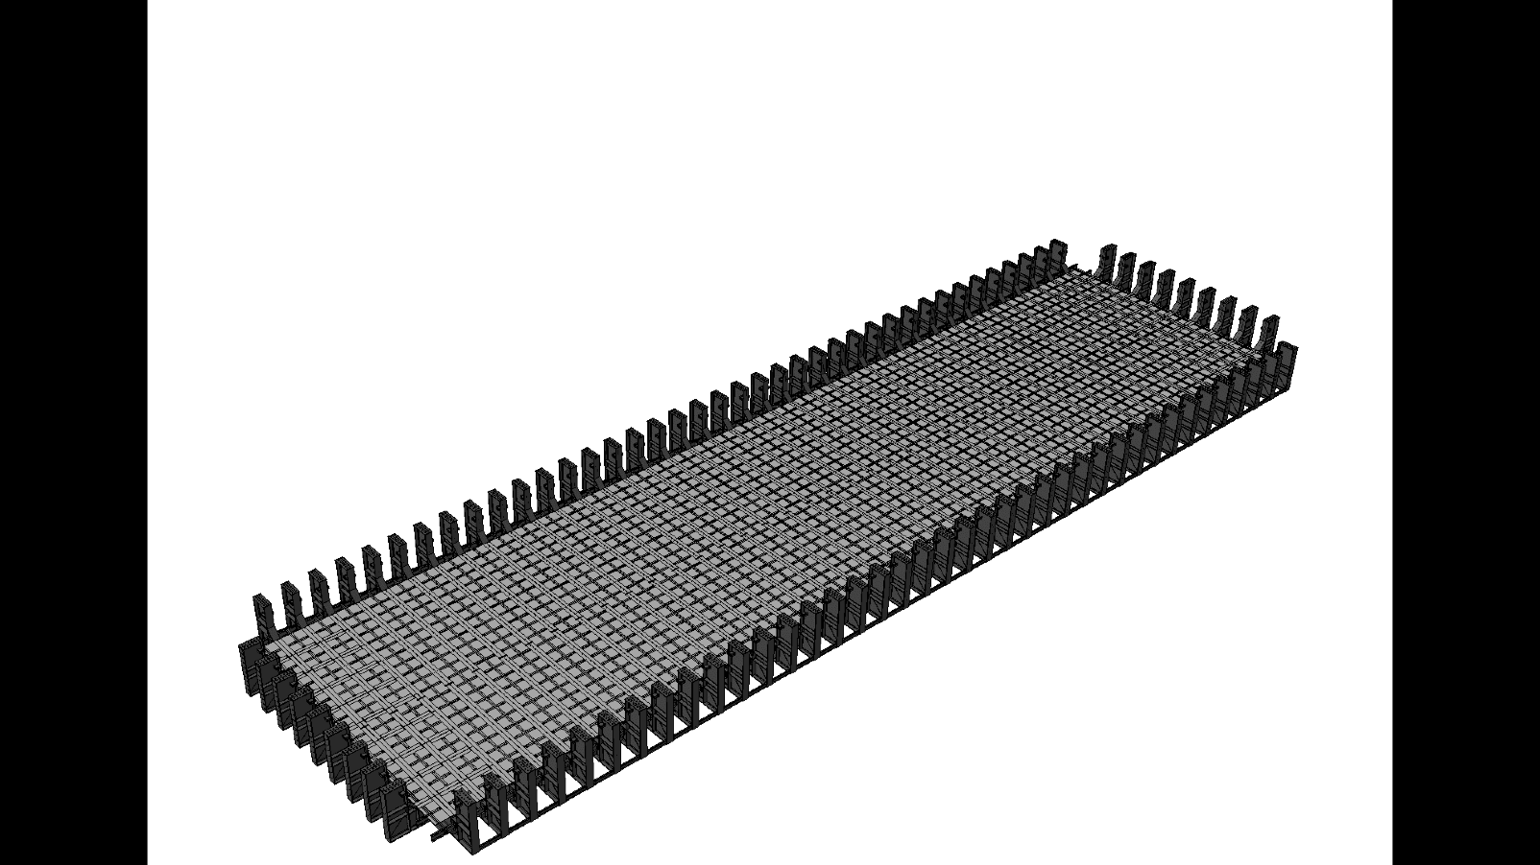

Slide 17
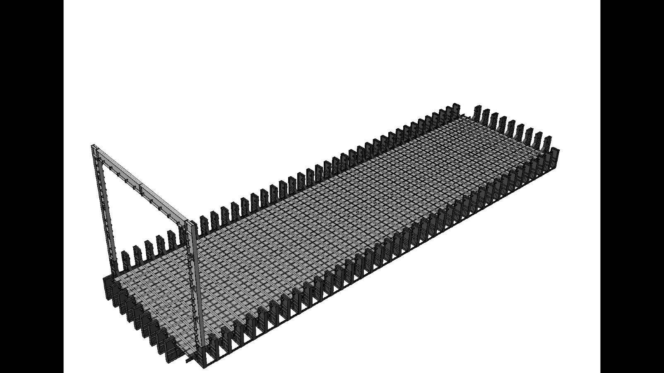

Slide 18
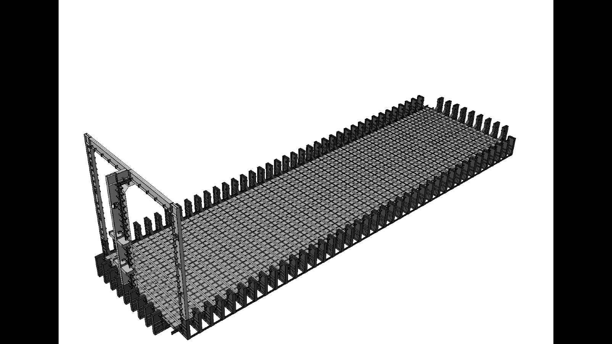

Slide 19


Slide 20
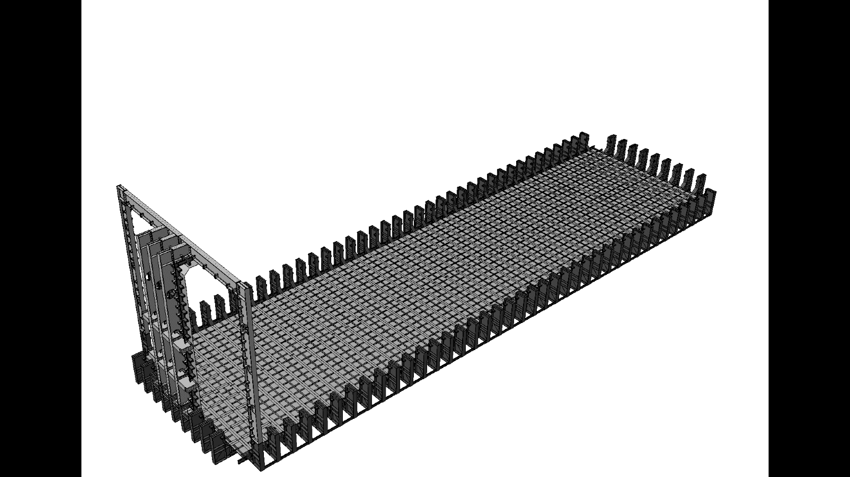

Slide 21
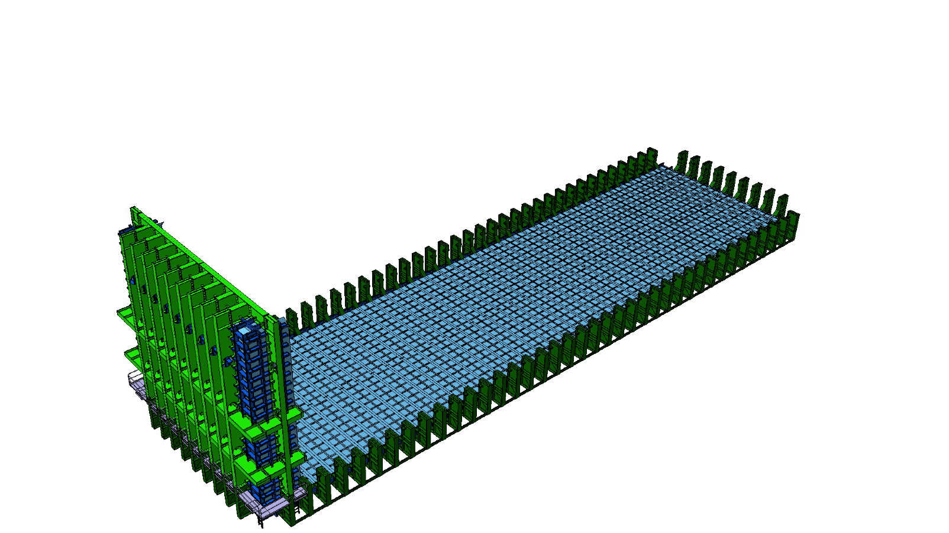

Slide 22
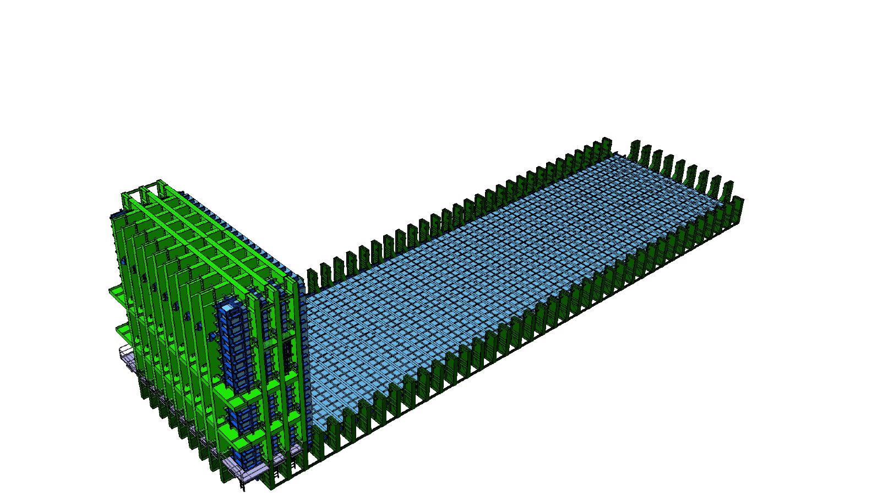

Slide 23
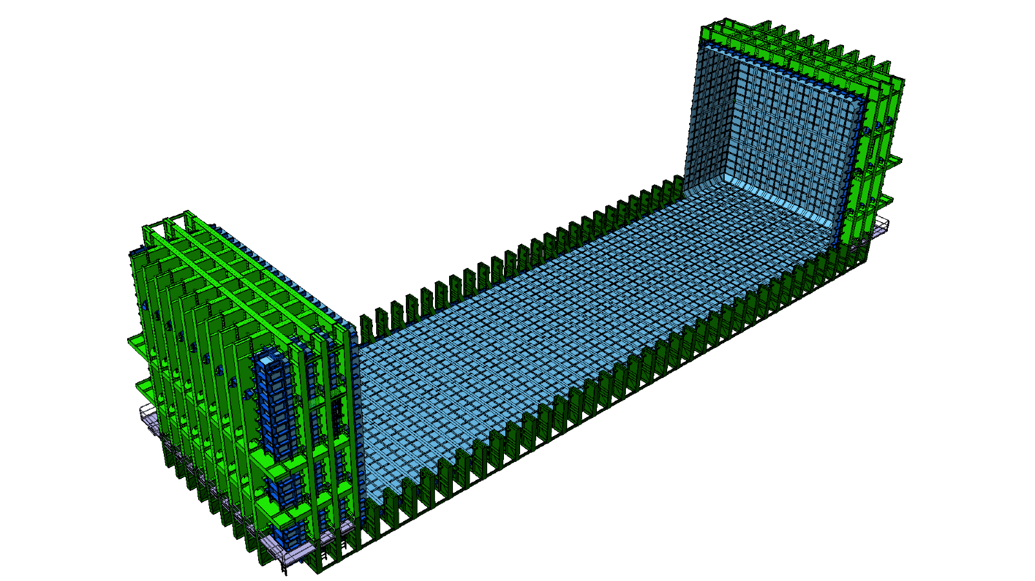

Slide 24
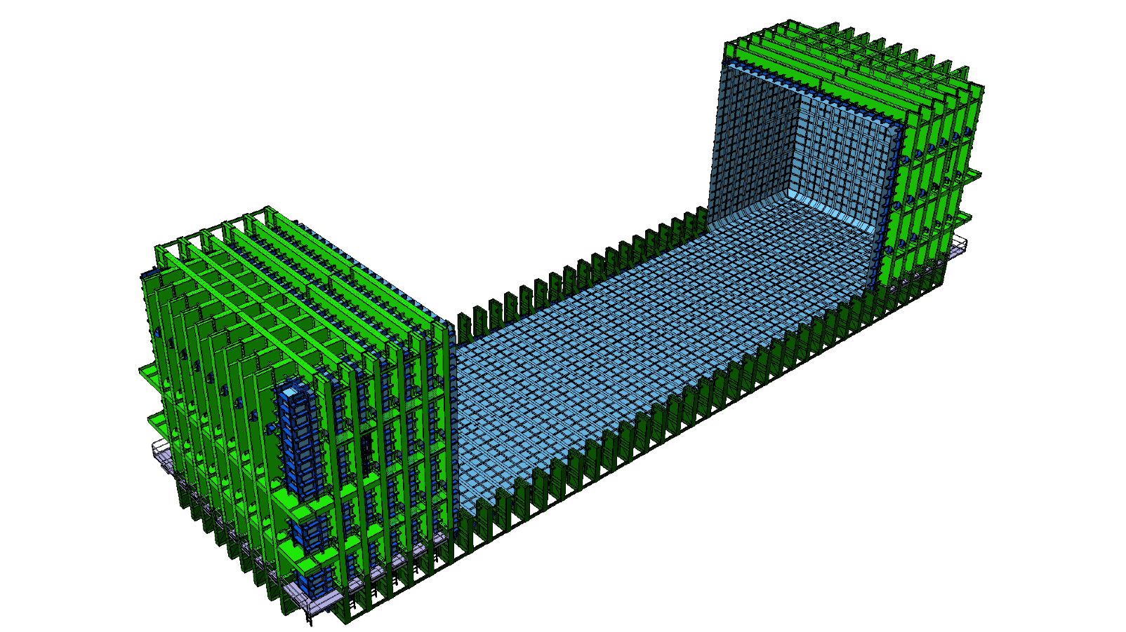

Slide 25
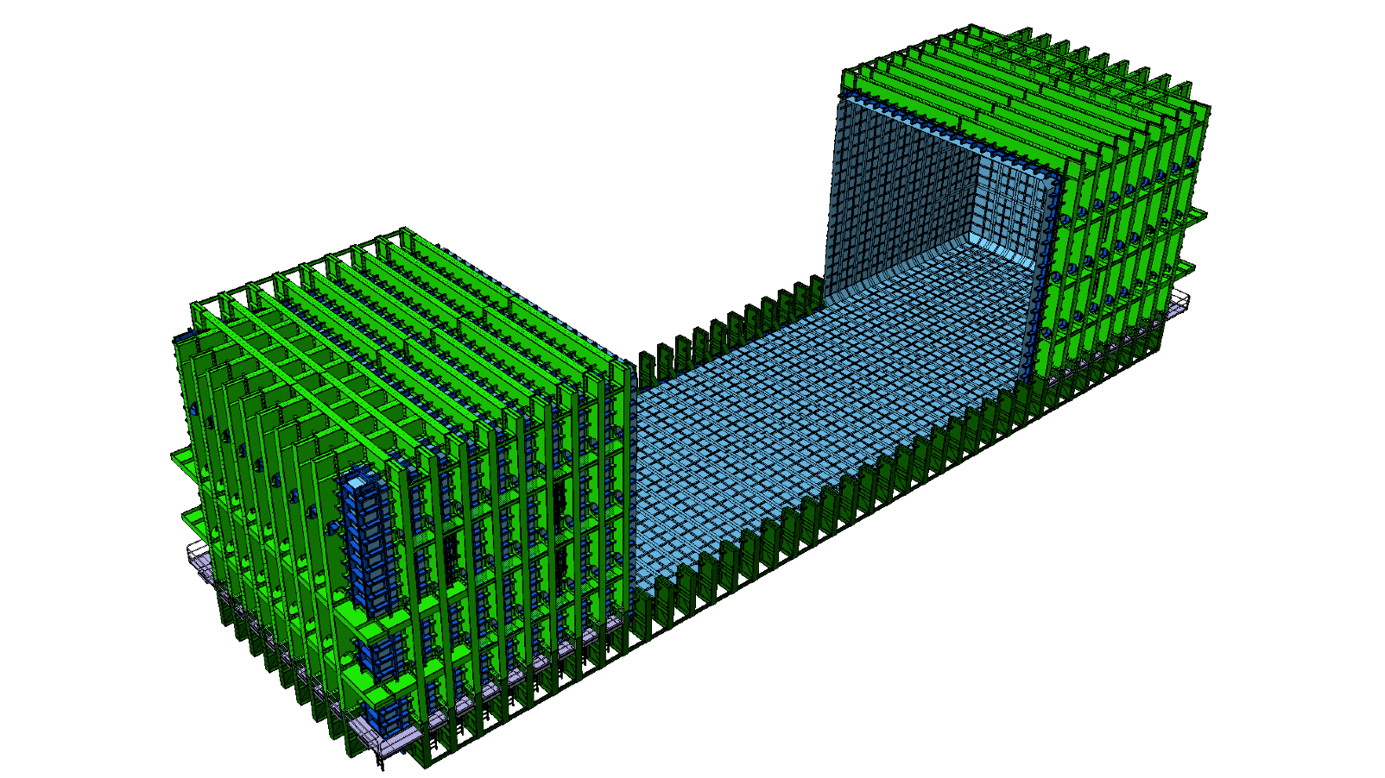

Slide 26
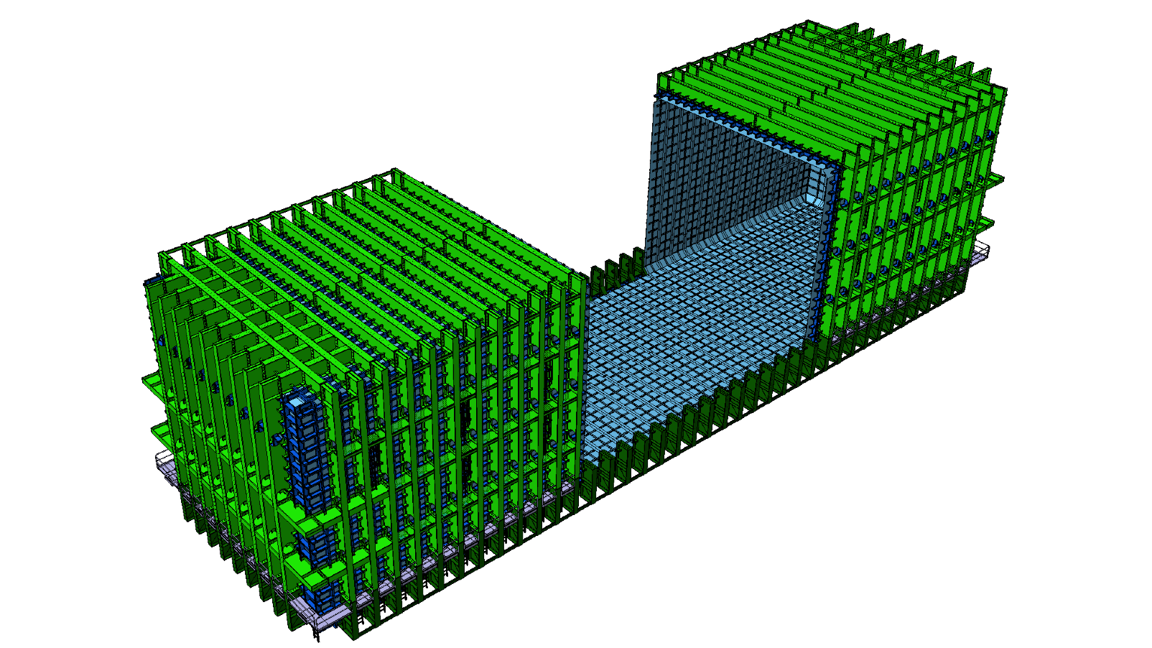

Slide 27
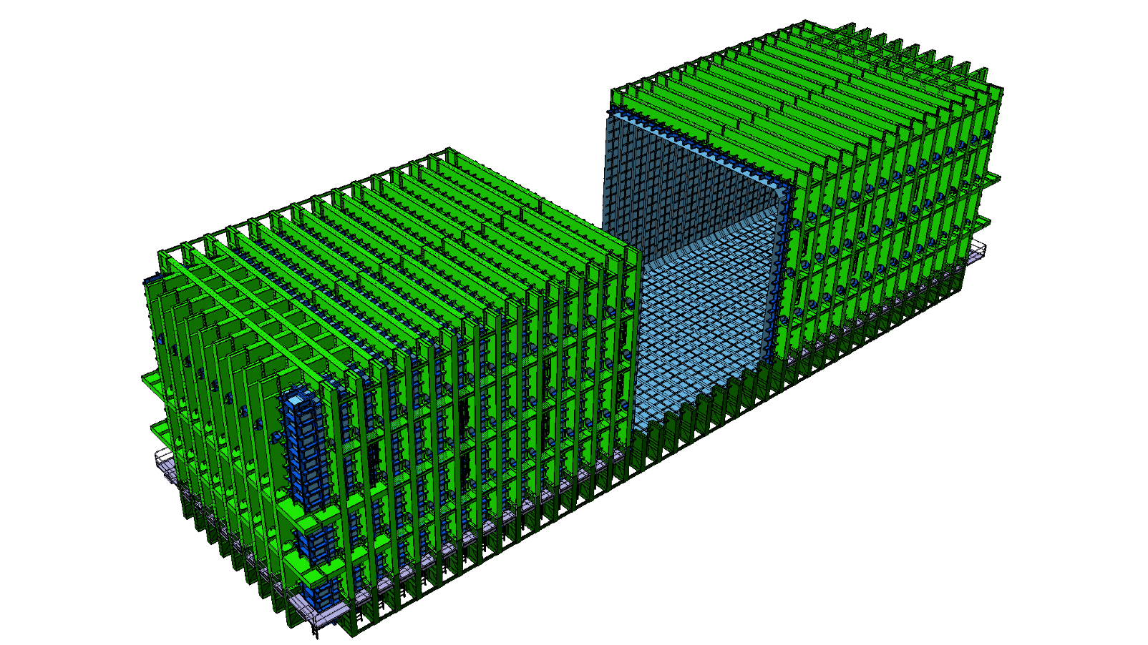

Slide 28
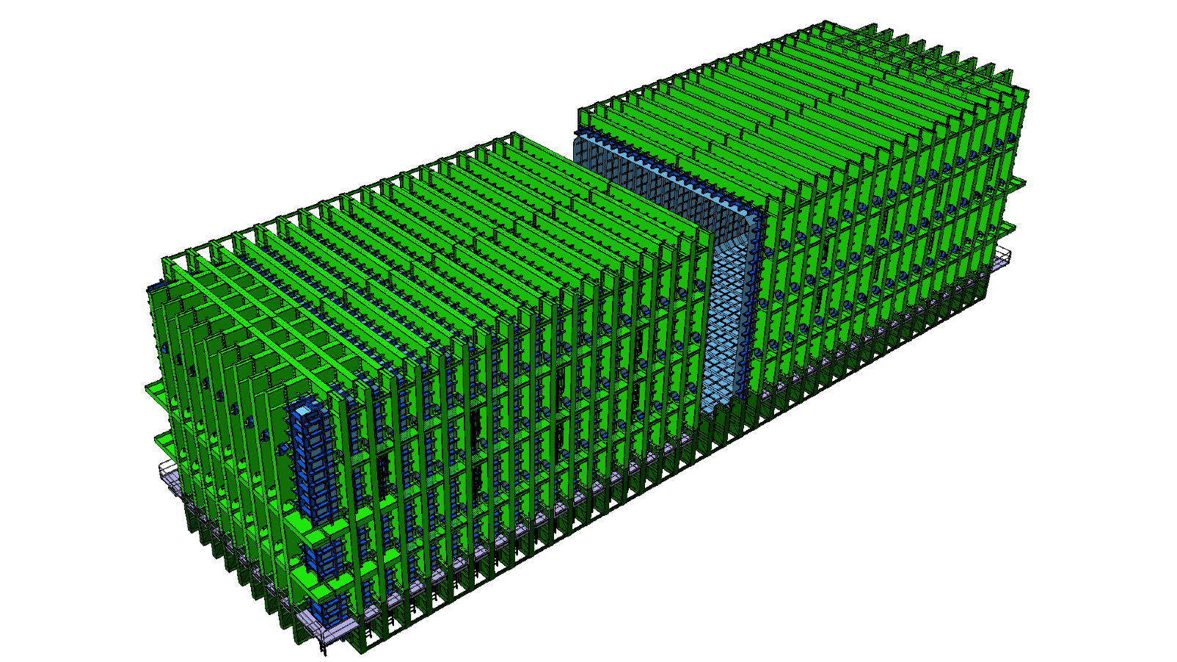

Slide 29
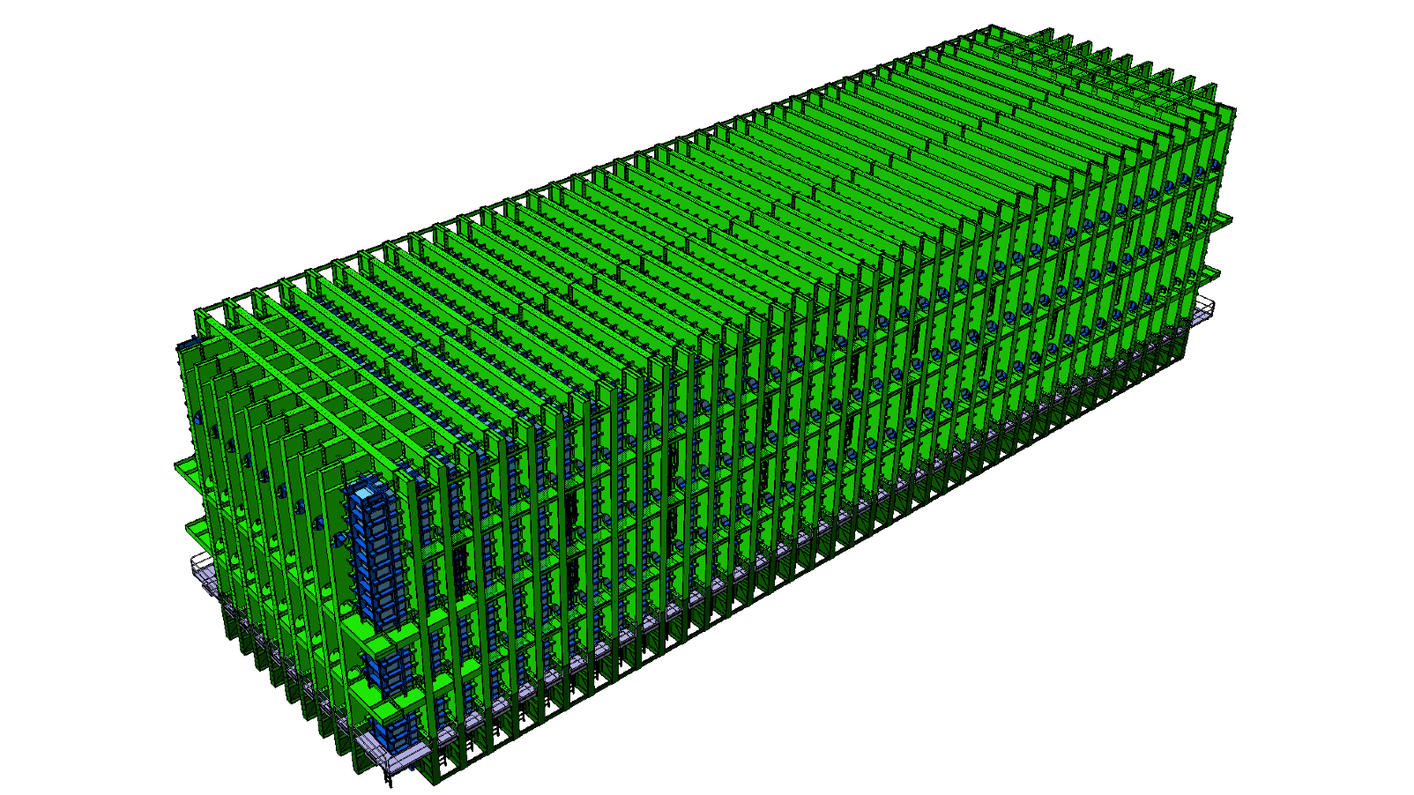

Slide 30
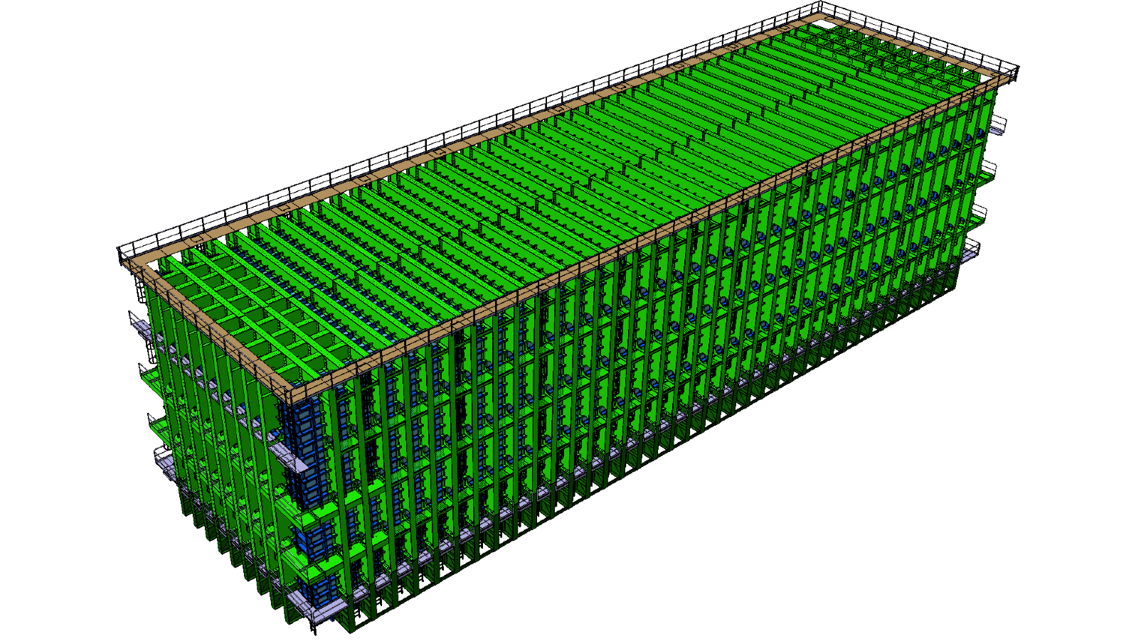

Slide 31
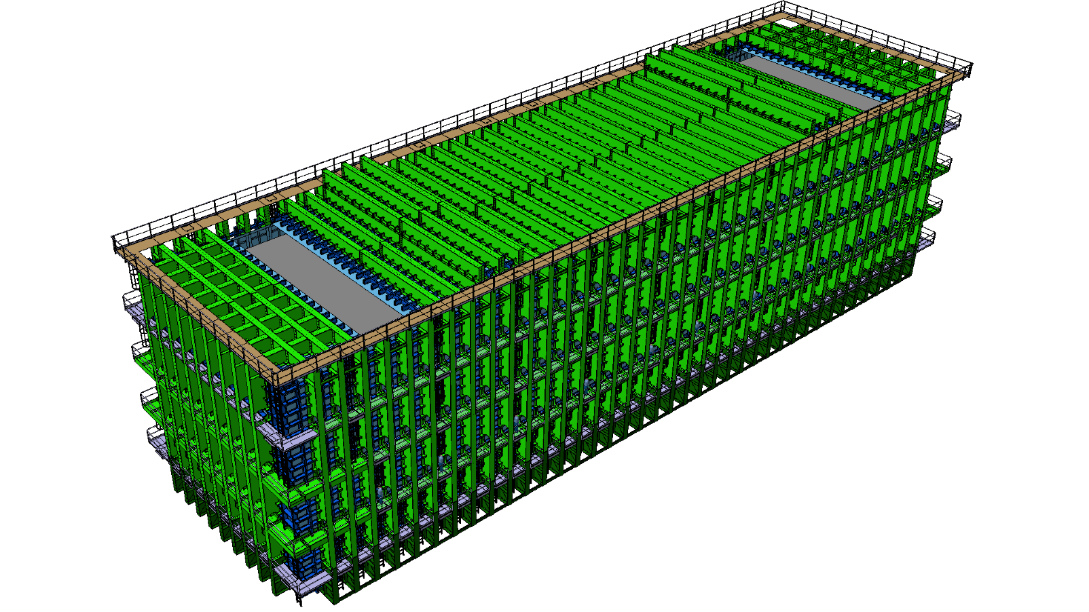

Slide 32
Available documentation
Structure Design summary: https://edms.cern.ch/document/1525169
CAD 3D model + drawings: https://edms.cern.ch/document/1531409
Structural analysis: https://edms.cern.ch/document/1531415
Concrete floor loading: https://edms.cern.ch/document/1531410
Cryostat floor deformations: https://edms.cern.ch/document/1531411
Dimension and weight of the components to be lowered in the caverns: https://edms.cern.ch/document/1531746
Cavern cranes requirements: https://edms.cern.ch/document/1551658
Notes:
This is the list of the requirements that have an impact of the CF work.
READ.
Full list is available here.

Slide 33
Summary
The Conceptual Design of the Cryostat is now a collaborative effort between Fermilab and CERN.
A full design study for the warm support structure has been done by CERN (CAD design + structural analysis).
Next step : independent structural verification by an external engineering firm.
Next step : full engineering design for the cold cryostat to be contracted to the firm GTT, which holds the IP for this technology.
Agreement reached between FNAL and CERN on the design and testing rules : https://edms.cern.ch/document/1554082
Prototypes approach step by step

Slide 34
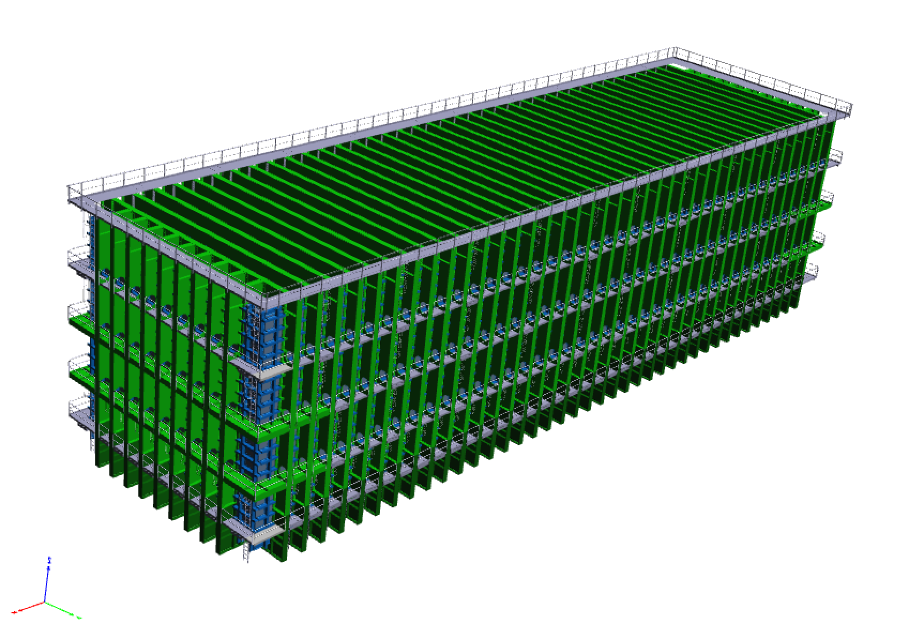
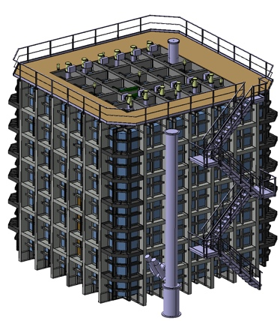
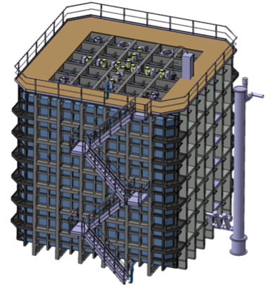
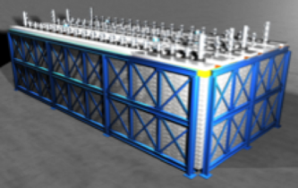
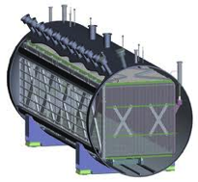
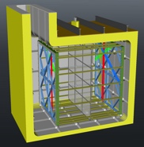
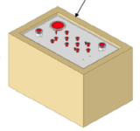

18’000 t
770 t
~770 t
first step
220 t
760 t
170 t
35 t
50 t
1-ph
1-ph
1-ph
1-ph LAr TPC
2-ph LAr TPC
2-ph
1-ph
CERN ν Platform
Short Baseline
NA61 Minerva ….
R&D
To succeed we need to proceed in steps (for cryostats, cryogenics and detectors)

Slide 35
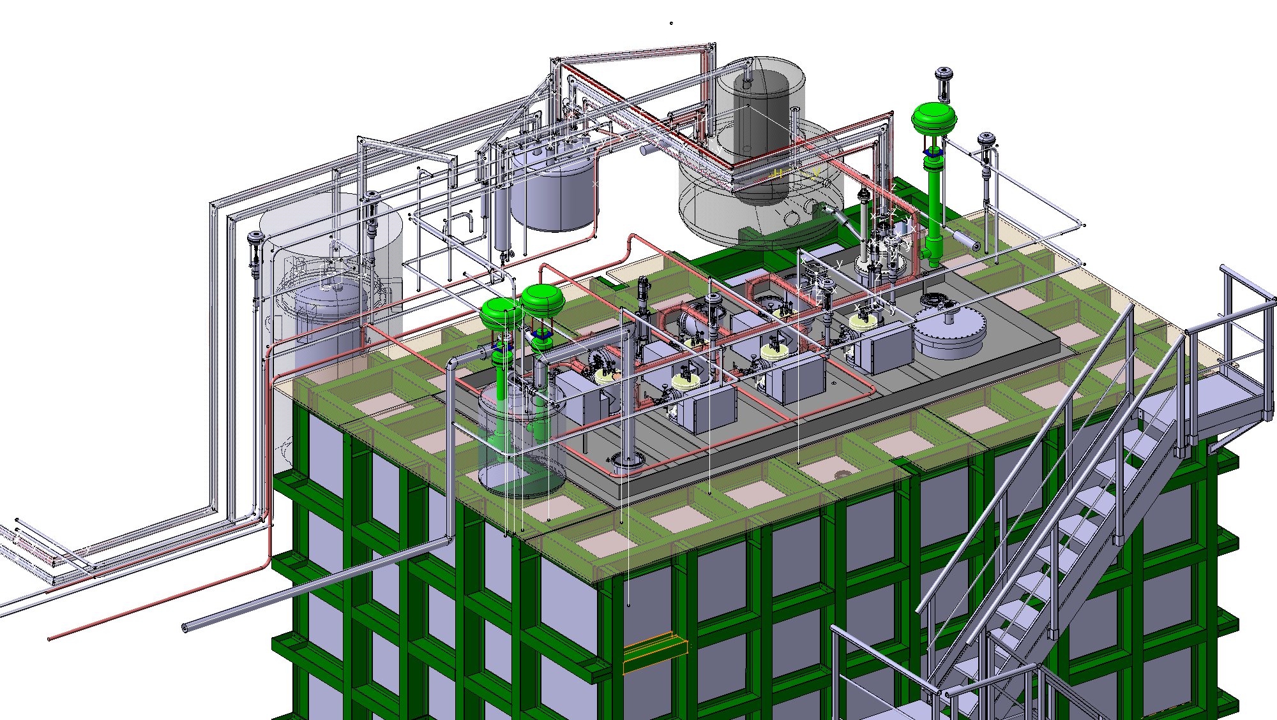
First step almost done

Slide 36
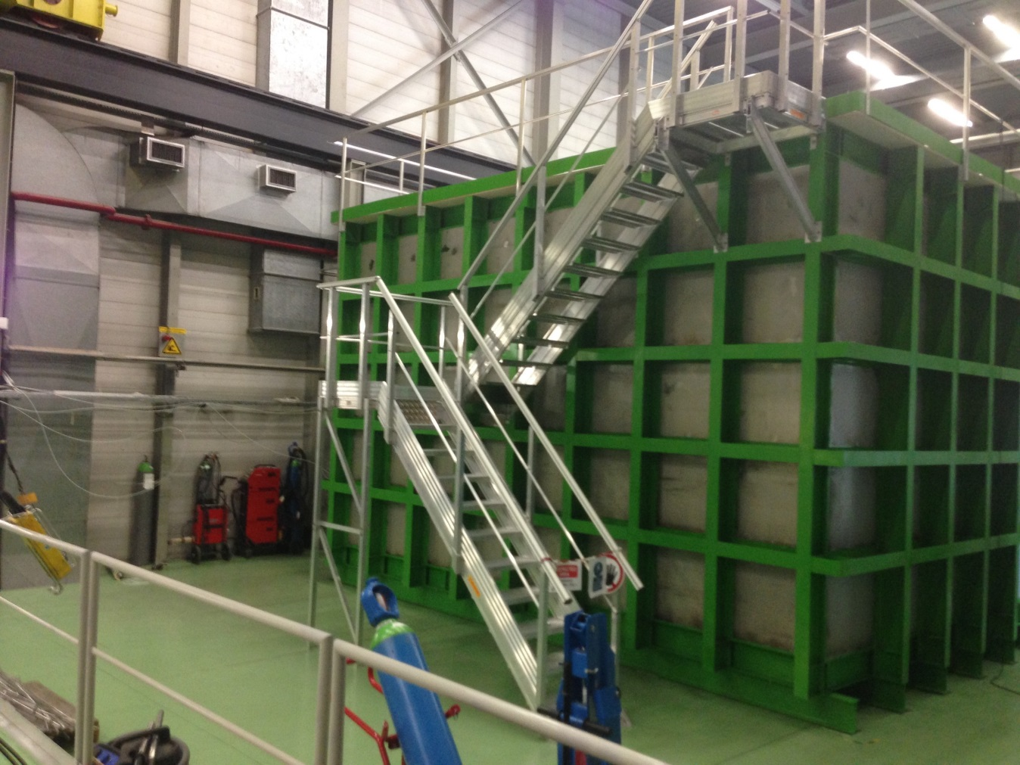
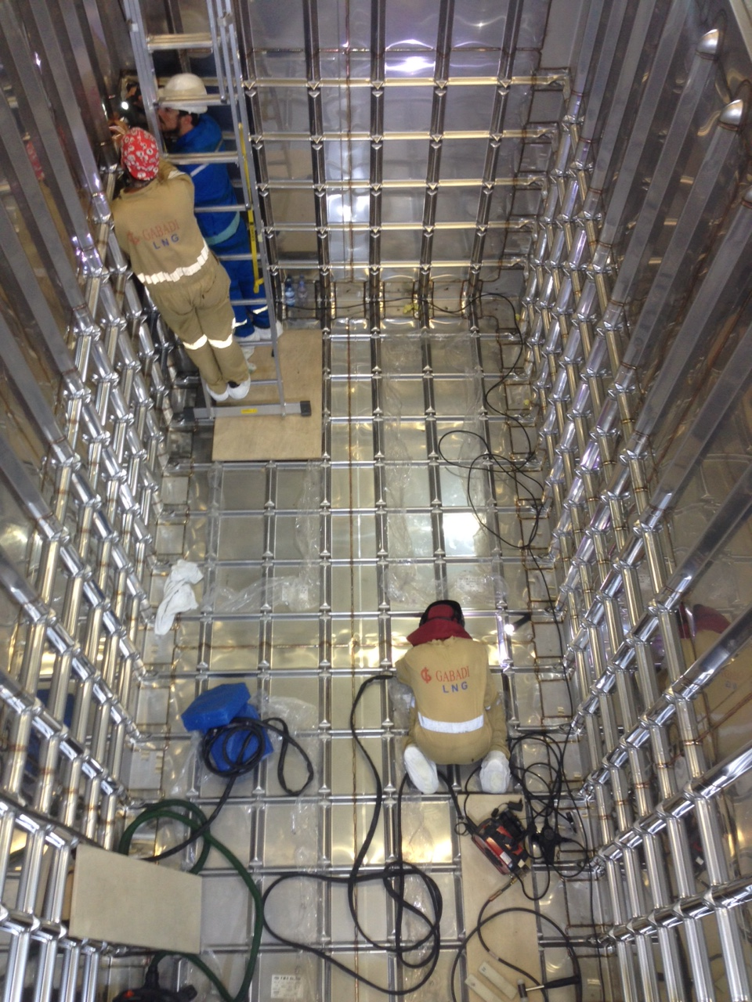
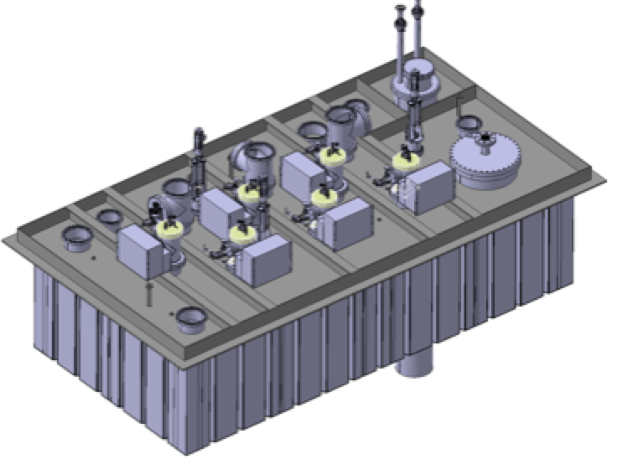
First step almost done

