Slide 1
Preliminary results on Copper filters, with FLIC test chamber
F. Pietropaolo, A. Zani, M. Meli
CENF General Meeting – 22/10/2015

Slide 2
Introduction
The ICARUS T600 detector has operated at LNGS with Oxysorb/Hydrosorb filters, for LAr purification.
Due to safety regulations, at FNAL we will need to change filters, using the Copper-based solution already used for LAPD and MicroBooNE.
We are now carrying on dedicated tests with a sample of such filter on the FLIC 50l prototype chamber at CERN, to:
evaluate the purity we can achieve;
estimate the amount of Oxygen needed to saturate the filter, in order to dimension it for the needs of the T600.
Last Monday we started the tests on our chamber, filling it with LAr, and by evening first tracks were visible. Qualitatively, there is no significant attenuation of the tracks. We are now collecting and analysing data in order to quantitatively estimate the charge attenuation in our drift.

Slide 3
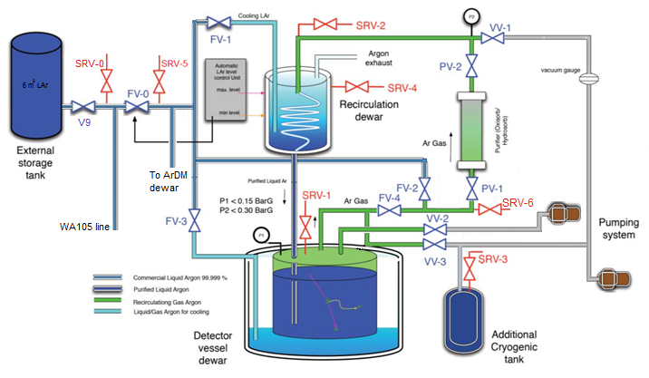
FLIC Cryo-set up
New filter with copper bed installed
BEFORE recondenser

Slide 4
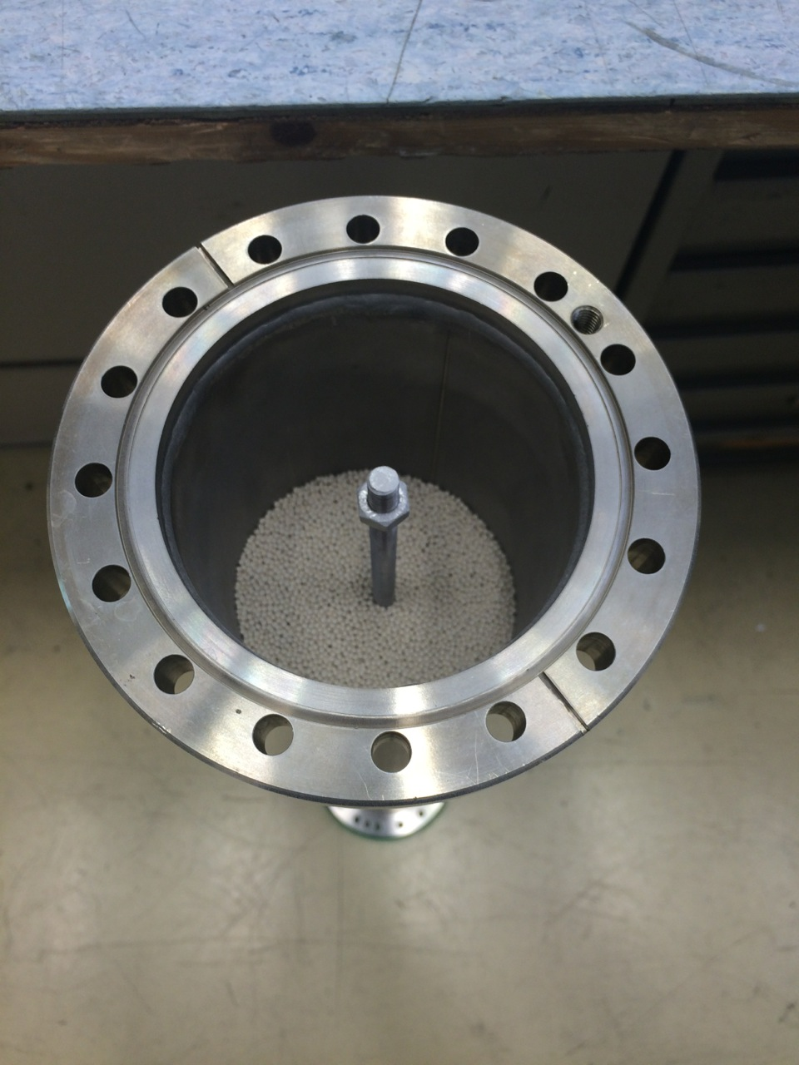
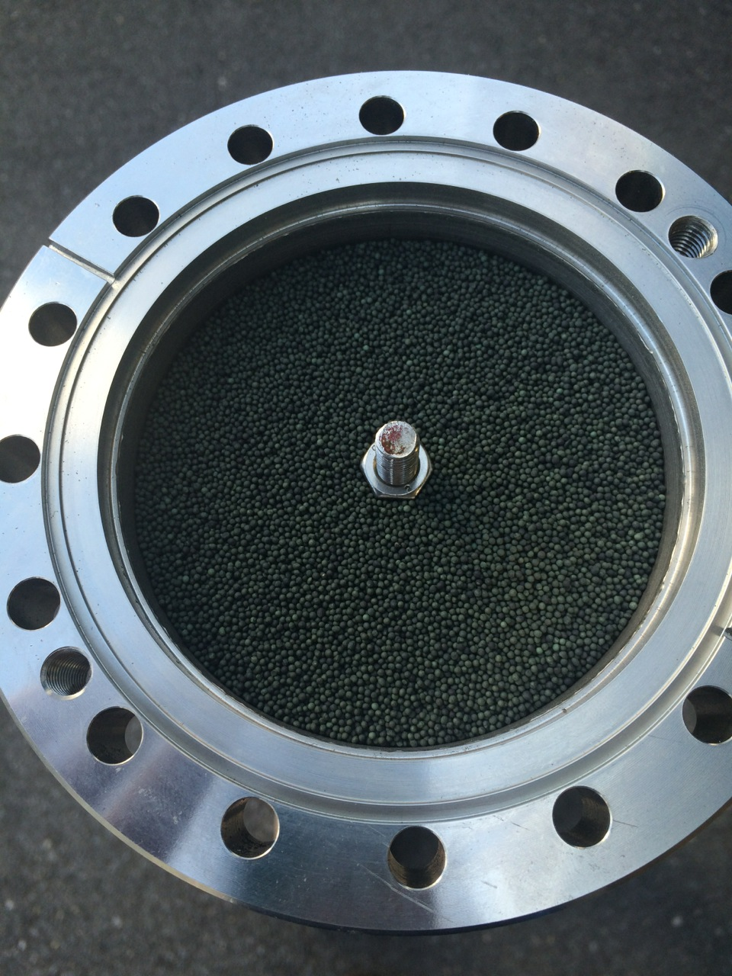
New filter composition:
  - Molecular Sieve (Type 4A 1.6-2.5 mm) —> 2.46 kg
  - Copper (BASF Cu-0226 S 14x28 mesh or Q-5)—> 2.96 kg
Adsorption capacity, as estimated at FNAL : 0.5 g_{O2}/kg

Slide 5
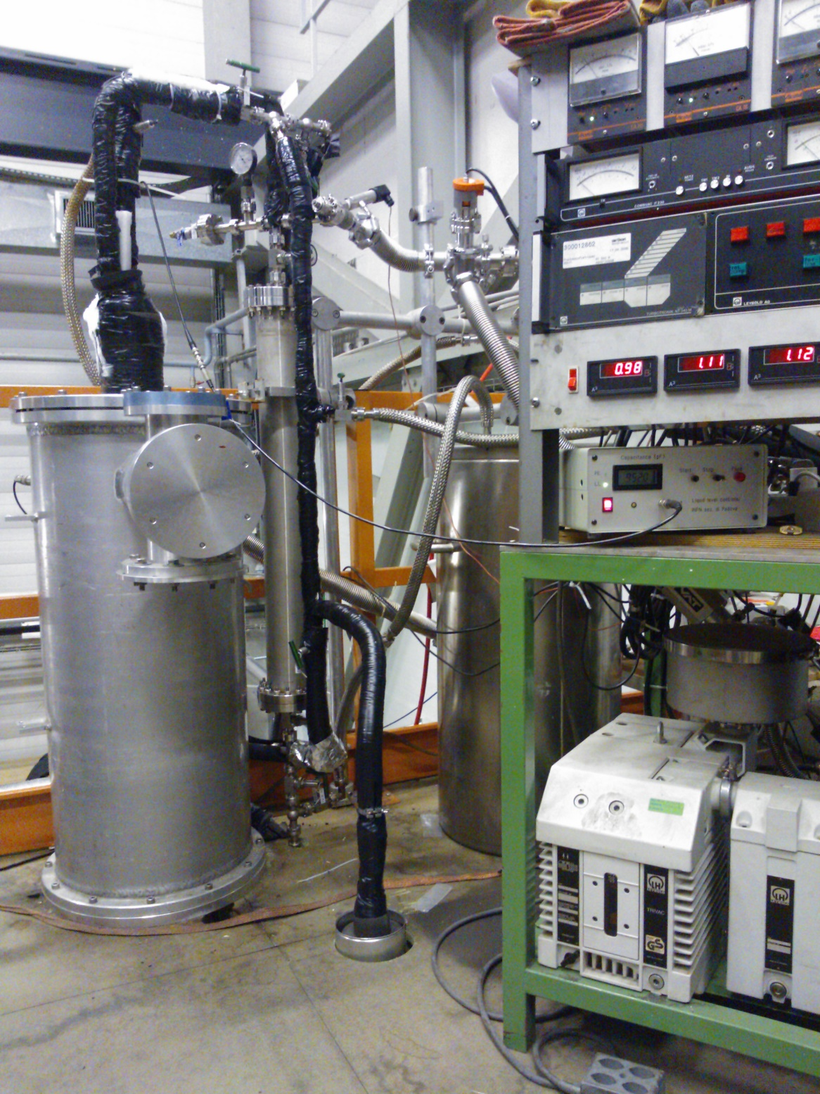
New filter installed in FLIC cryo system
Filling of chamber with LAr passing through filter before being injected.
Filling rate: ∼ 0.5 l/min.
Filter was prepared and regenerated by Cryolab group. According to other estimates, related to regeneration time and amount of GAr/H₂ mixture (98%/2%) used, we actually get uncertainty on adsorption capacity value, up to two orders of magnitude larger.
To be verified before injecting Oxygen.
RECONDENSER
MAIN
LAr
LINE

Slide 6
Track selection
FLIC: 50 l ICARUS chamber: 30x30 x 50 (drift) cm TPC
  2 wire planes: 1 COLLECTION, 1 INDUCTION
  HV = -25 kV → E_{drift} = 500 V/cm ( ~300 μs drift time)
  Induction plane kept at ground
  V_{coll} = +300 V ; Ind-Coll distance = 4 mm → E=750 V/cm (100% transparency)
Readout electronics:
  Coll: Cold front-end by BNL, with ASIC chips, followed by adapted ICARUS analog board, then digital board.
    Gain = 25 mV/fC; Peaking time = 3 μs
  Ind: Standard ICARUS@LNGS chain.
PMTs:
  One 14-dynode Hamamatsu R5912-mod02 inside chamber, in front of wire chamber. V = 900 V
  Two external PMTs coupled to scintillators, on opposite sides of TPC, along Coll. wire direction. V = 1700 V
Trigger: coincidence of the two external PMTs (later also internal PMT will be added to coincidence.

Slide 7
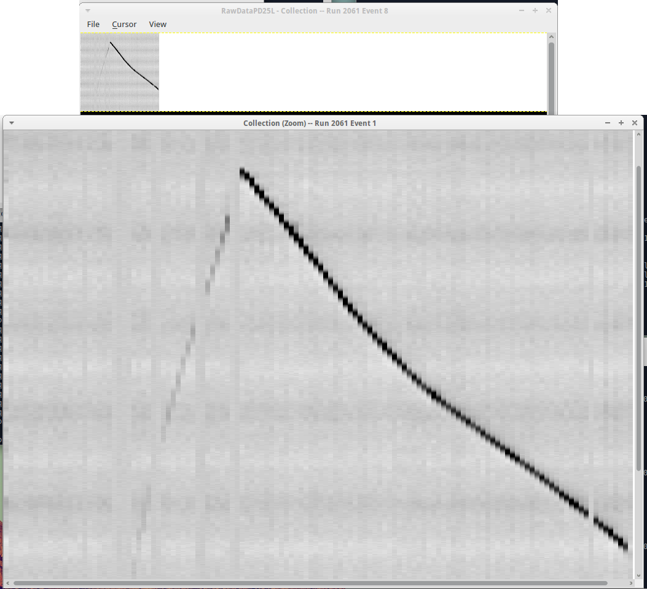
First tracks
(after filling completion)
COLLECTION VIEW
wire #
t-sample

Slide 8
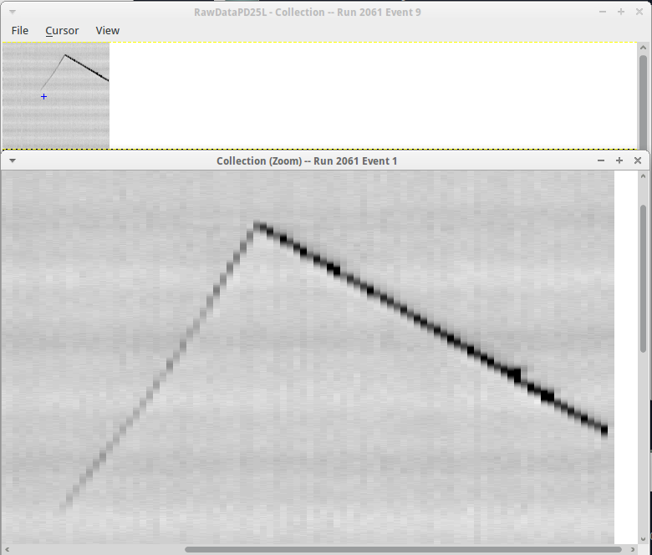
First tracks
(after filling completion)
COLLECTION VIEW
wire #
t-sample

Slide 9
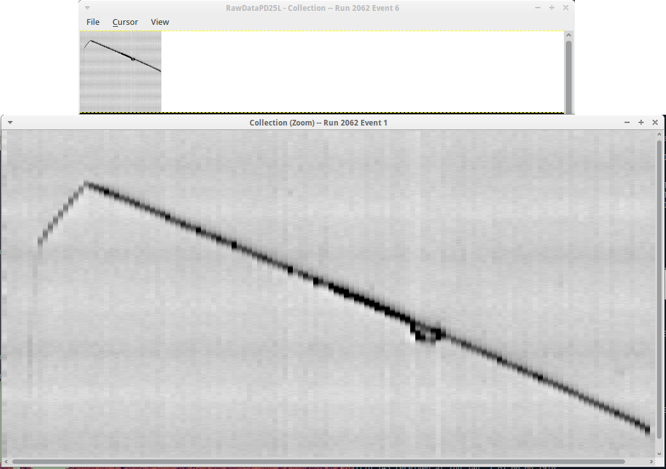
After ∼12 hours
COLLECTION VIEW
wire #
t-sample

Slide 10
Considerations
During first few days of data taking, no visible decrease in collected charge, as a function of drift, is detectable.
Analysis of “clean” (without δ-rays) muon tracks is on-going, to quantitatively evaluate purity. Few tracks have been selected for wire-by-wire signal reconstruction, but so far no significant decrease in collected charge can be appreciated. However :
refined calculations are needed;
more statistics has to be recorded
After purity estimation, we will try to saturate the filter, by injecting known amounts of Oxygen in the line, to simulate Argon contamination: a bottle of 90%Ar+10%O₂ mixture (~ 1400 g of O2 available) will be connected in parallel with recirculation system at filter input.
This measurement is requested to dimension the cartridges that will be used in the T600 purification plant.
Before starting this second phase, we need to clarify the point of adsorption capacity.

Slide 11
Next steps
Carry on with the data analysis, to quantitatively estimate the purity.
Saturate the filter of Oxygen, to measure its adsorption capacity.
Further down the road: modify our plant, and move the filter after the Ar re-condenser, in order to recirculate liquid and test the filter in that case as well.

