Slide 1
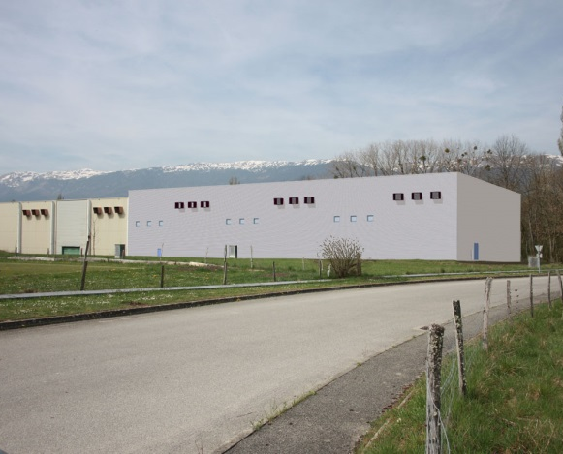
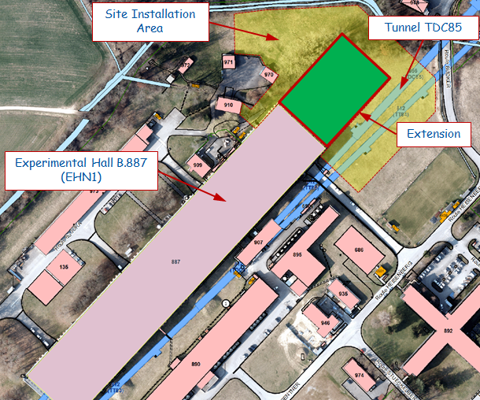
EHN1 civil engineering project status (SEPTEMBER)
Summary:
Updating of the activities carried out on-site (Done) in SEPTEMBER
List activities on going (Next steps) and scheduled for OCTOBER
Final consideration
Extension of Building 887 - Neutrino Platform General Meetings
N.Lopez – M.Manfredi
22 October 2015
1

Slide 2

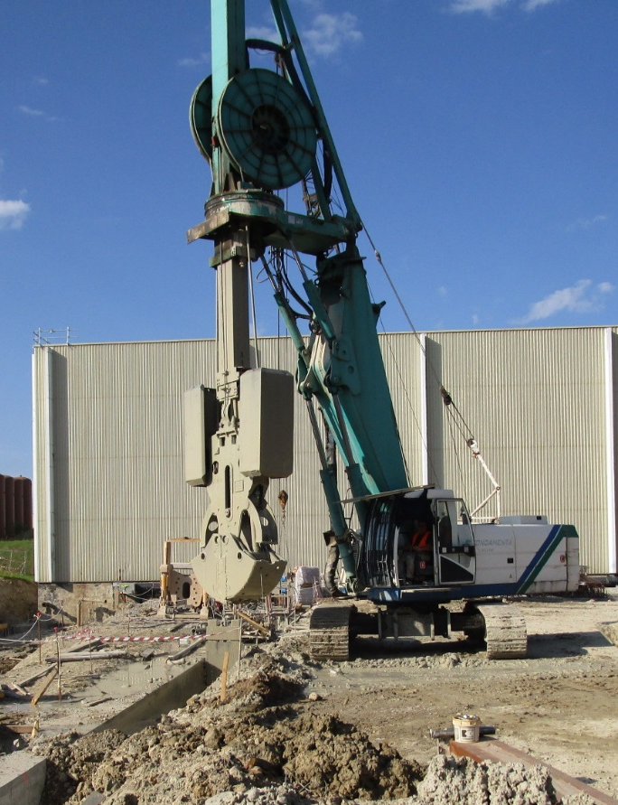
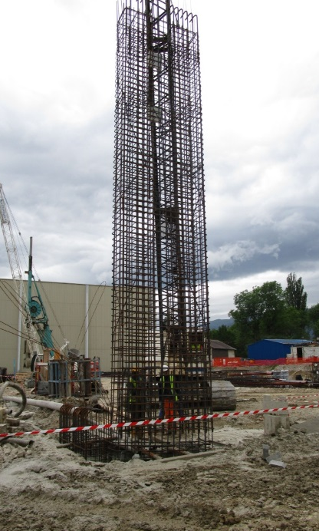
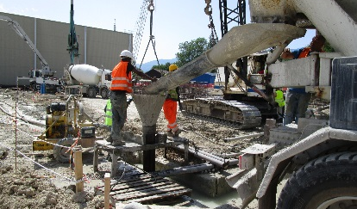
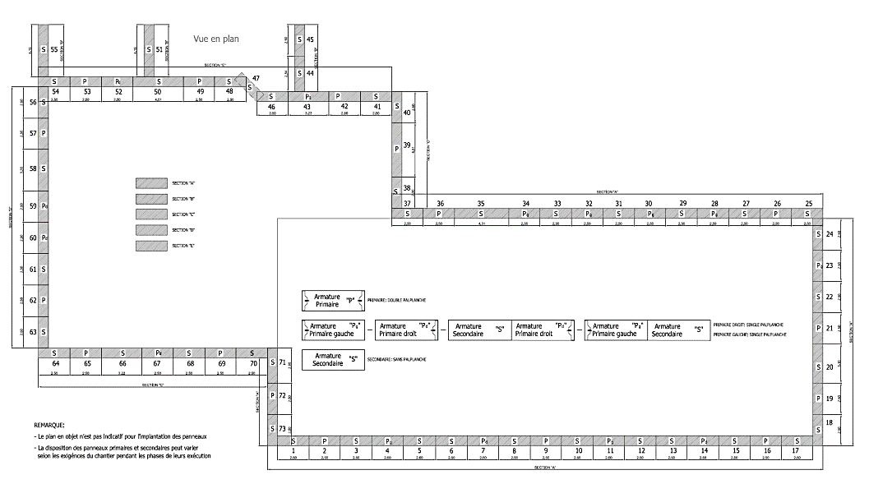
EHN1 civil engineering project status (SEPTEMBER)
Done (1/4):
Guide walls allowing DW excavation: (100% completed)
(1) DIAPHRAGM WALLS
-73 panels-
Execution EAST side: (100% completed)
Execution SOUTH/WEST side: (100% completed)
100% TOTAL PANELS
Execution NORTH/WEST side: (100% completed)
Problem for execution of panels close to EHN1 has generated ~4 weeks of delay to complete the task
and..
Construction defects discovered in other panels already casted came out during excavation to set up the crown beam
lead to..
About 4 weeks of delay on the overall planning as connected activities have been blocked
FTM under approval by MOE and CERN
Defects repaired during AUG/SEP
Impact on the current long term schedule under evaluation
S/W
N/W
TASK COMPLETED in AUGUST
EAST
Extension of Building 887 - Neutrino Platform General Meetings
N.Lopez – M.Manfredi
22 October 2015
2

Slide 3
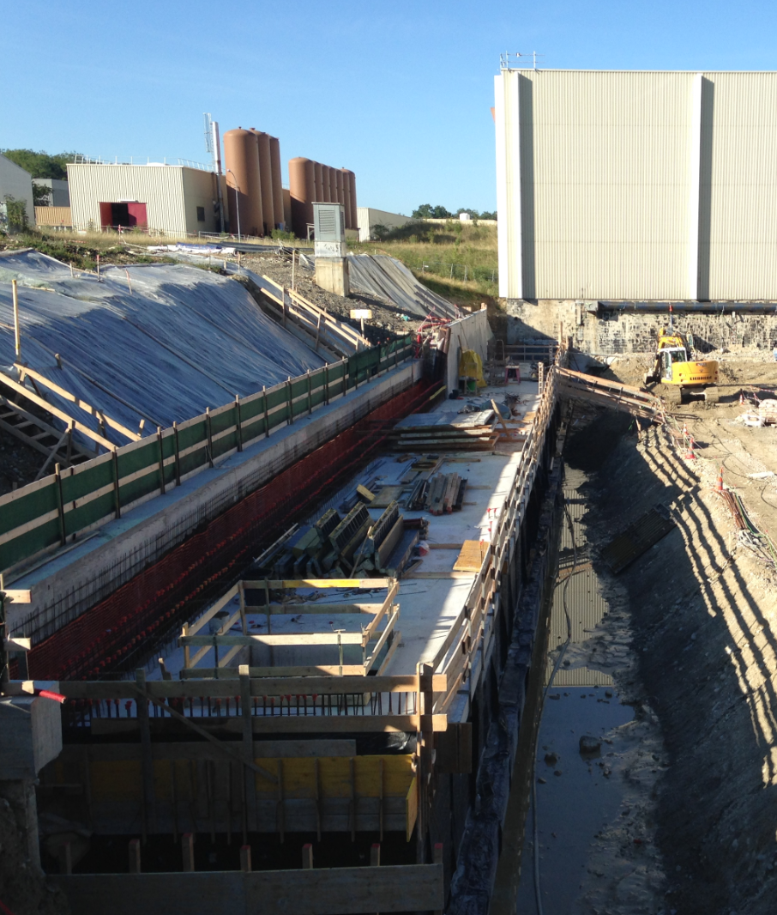
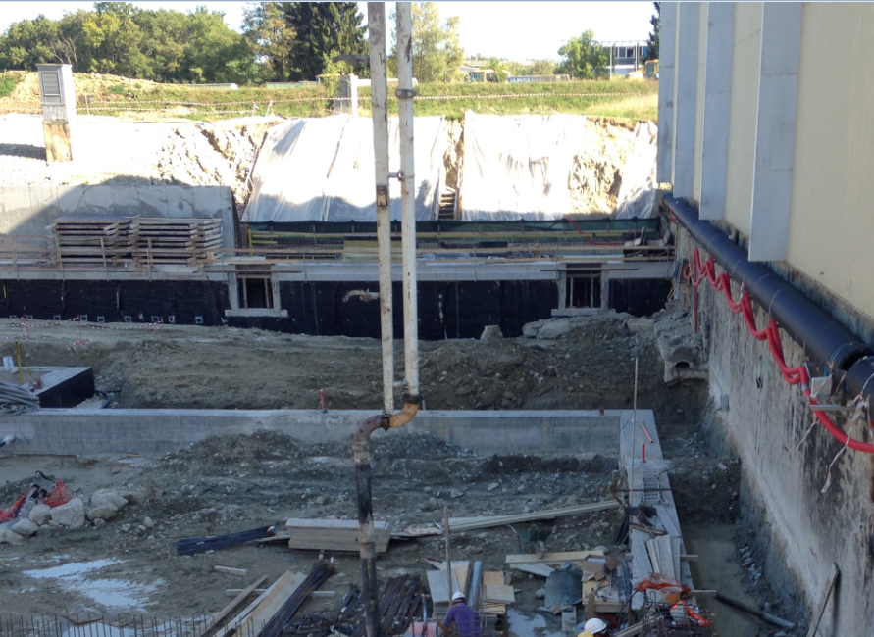
EHN1 civil engineering project status (SEPTEMBER)
Done (2/4):
Earthworks: (100% completed).
Execution TG: (90% completed). After T1 completion and EHN1 connection
(2) TECHNICAL GALLERY
-70 meters-
Backfilling: (25% completed). T1 and T3 portions are missing
Side retaining wall and backfilling foreseen later as not in the critical path. Priority given to other activities
Extension of Building 887 - Neutrino Platform General Meetings
N.Lopez – M.Manfredi
22 October 2015
3

Slide 4
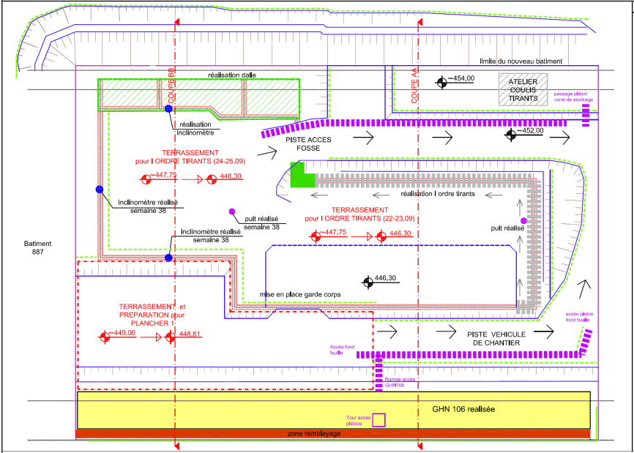
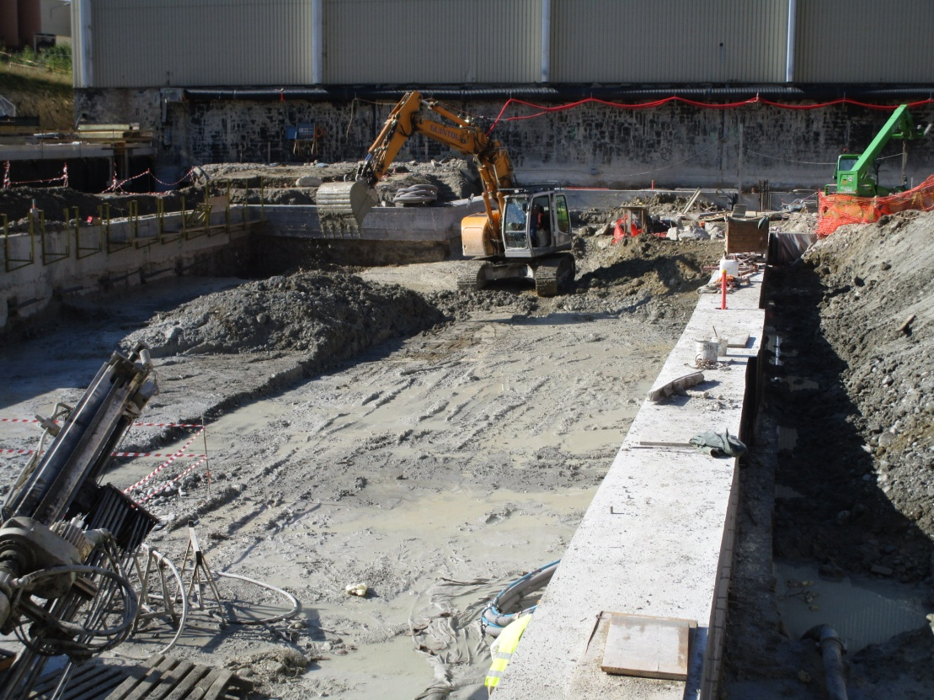
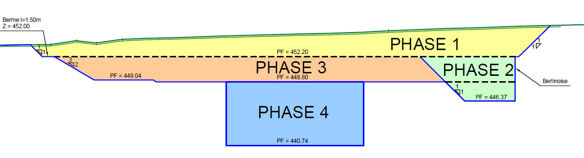
EHN1 civil engineering project status (SEPTEMBER)
Excavation head DW level: (100% completed).
Done (3/4):
Crown beam execution: (100% completed). After defects’ reparation.
Excavation first ties level: (50% completed). Only Pit B done.
(3) PITS EXECUTION
First ties level execution: (50% completed). Not yet in tension
-step by step-
Excavation second ties level: (0% completed). Only for certain DW panels
Second ties level execution: (0% completed).
Internal DW surface planing: (0% completed).
(...).
Extension of Building 887 - Neutrino Platform General Meetings
N.Lopez – M.Manfredi
22 October 2015
4

Slide 5
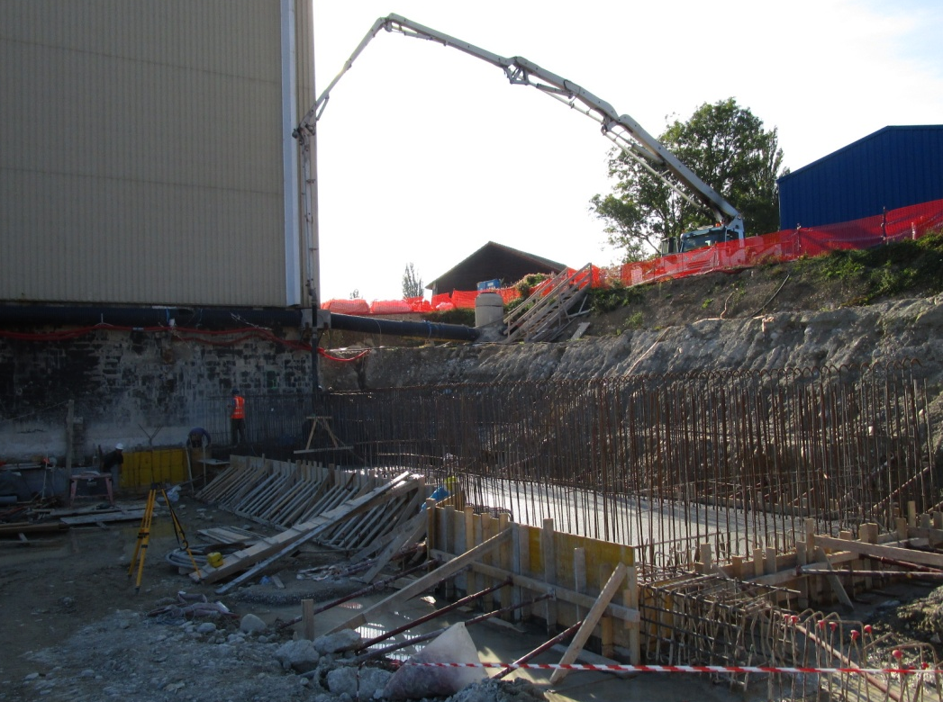
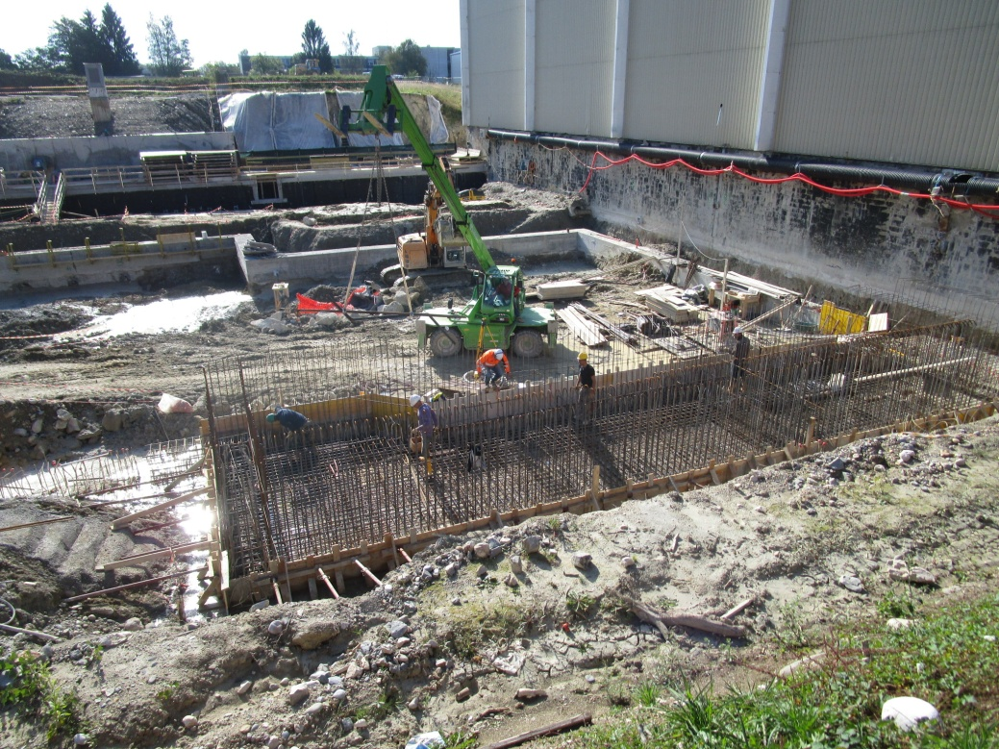
EHN1 civil engineering project status (SEPTEMBER)
Done (4/4):
Earthworks allowing site preparation: (75% completed)
Concreting process: (20% completed).
(4) SLAB SYSTEM
-Planche 1 of 6-
Fixation towards EHN1 structure: (0% completed).
Extension of Building 887 - Neutrino Platform General Meetings
N.Lopez – M.Manfredi
22 October 2015
5

Slide 6
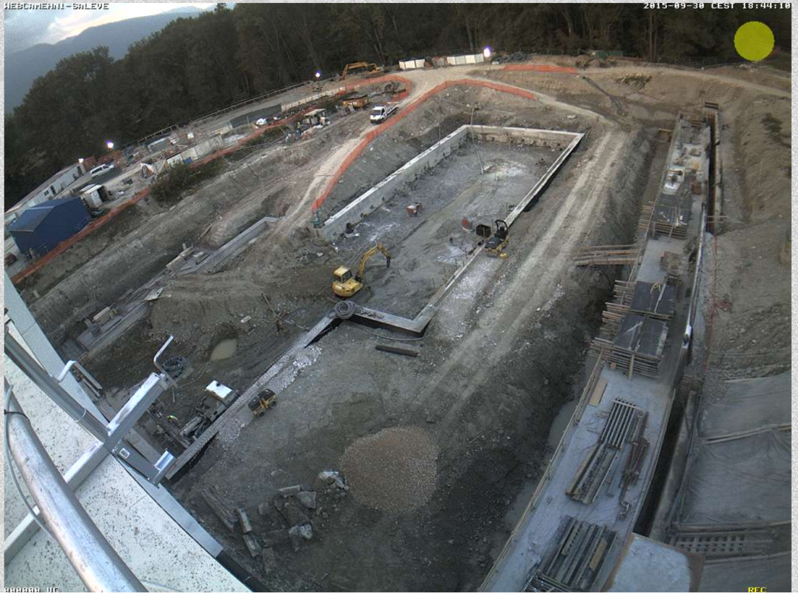
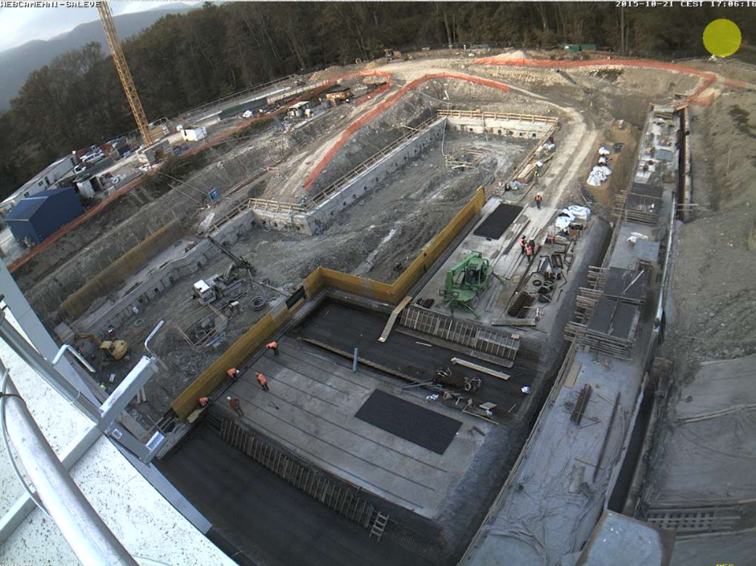
EHN1 civil engineering project status (SEPTEMBER)
Next Steps: Activities scheduled for October
30/09/2015
21/10/2015
(2) TG: No activities scheduled.
(3) PITS:
(B) Tensioning first ties level within mid-October. Excavation/Execution second ties order by end-October.
(A) Excavation/Execution ties within mid-October. Tensioning ties by end-October.
(A+B) Internal DW surface fixation in parallel. Pits excavation to start in November.
(4) SLAB SYSTEM: P1 completion 1st half October, P2 to start afterwards.
Extension of Building 887 - Neutrino Platform General Meetings
N.Lopez – M.Manfredi
22 October 2015
6

Slide 7
EHN1 civil engineering project status (SEPTEMBER)
Final Consideration:
The completion of the DW complex and reparation of defects led to ~4 weeks of delay on the general planning.
CE Contractor is re-organizing the worksite activities in order to minimize time lost (i.e. work during the weekend, add different workshop and internal resources, overlap several activities with metallic contractor).
Planning has been reviewed given the priority to the execution of the pits (critical path).
CE Handover unchanged for the moment (Jul-2016), but possibility to grant extra time, by delaying key-dates, is under discussion.
Coordination of the CE integration issues (3D Catia model updating, ECR draft, other requirements) will be finalized.
Next status of the works end-October.
Extension of Building 887 - Neutrino Platform General Meetings
N.Lopez – M.Manfredi
22 October 2015
7

