Slide 1
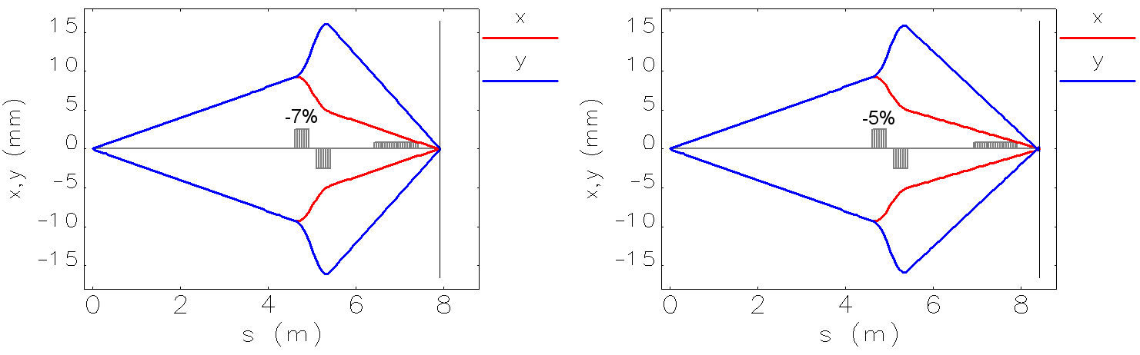
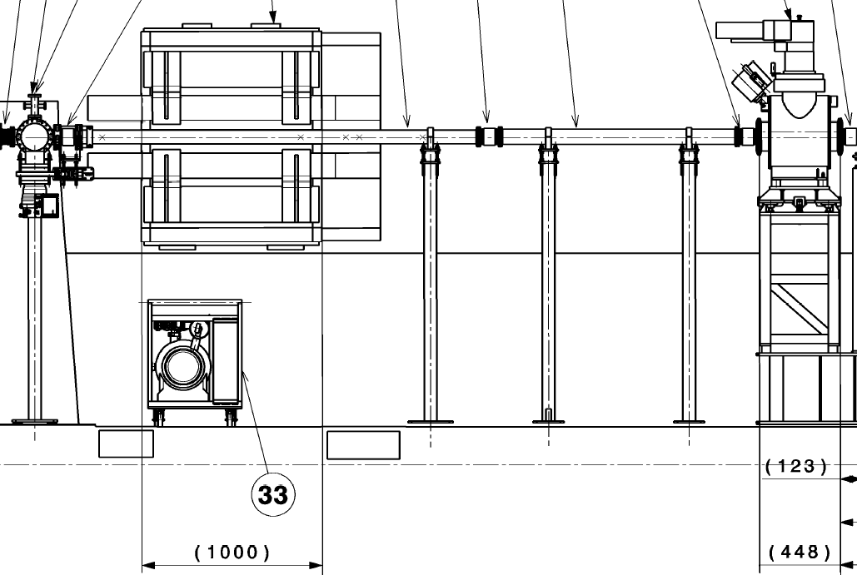
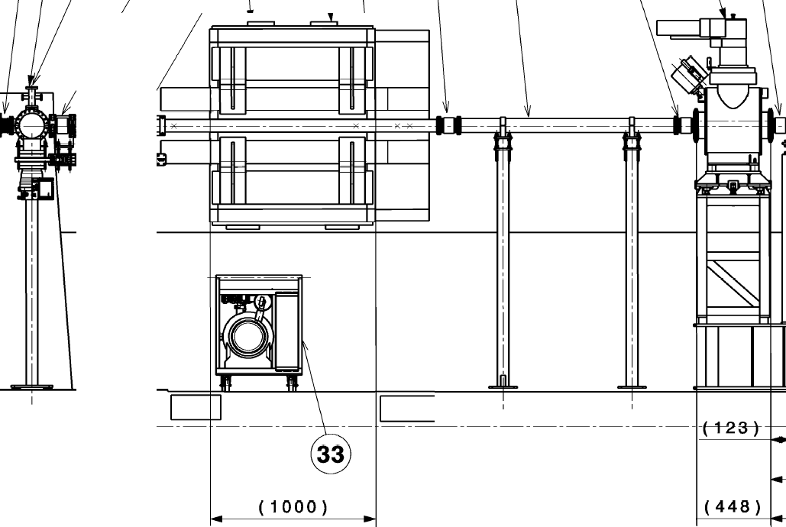
Can we shift the spectrometer dipole 50 cm further downstream?
Corrected optics @ 1.3 GeV
±2 mrad
Plasma exit
Spectrometer
Marlene’s BTV
A. Petrenko. 1st AWAKE Secondary Beam Line Meeting, 16.10.2015

Slide 2
