Slide 1

1st AWAKE Secondary Beam Line Meeting
CP6, 16 October 2015
CP Leader: Edda Gschwendtner, CERN
Scientific Secretary: Marlene Turner, CERN

Slide 2
AWAKE Collaboration
Collaboration Board (CB)
Management Board (MB)
Collaboration Spokesperson: Allen Caldwell
Deputy: Matthew Wing
Physics Coordinator: Patric Muggli
Technical Coordinator: Edda Gschwendtner
Simulation Coordinator: Konstantin Lotov
Physics and Experiment Board (PEB)
Technical Board (TB)
Collaboration Institutes
CERN AWAKE Project
Coordination Package:
CP: SPS Beam and Synchronization
CP: Proton and Electron Beam Lines
CP: Electron Source System
CP: Infrastructure, Global Integration and Installation
CP: Laser Beam System
CP: Secondary Beam Line
Coordination Package Institutes:
CPI: Experiment
CPI: Simulation
Work Packages CERN
Work Packages Institutes

Slide 3
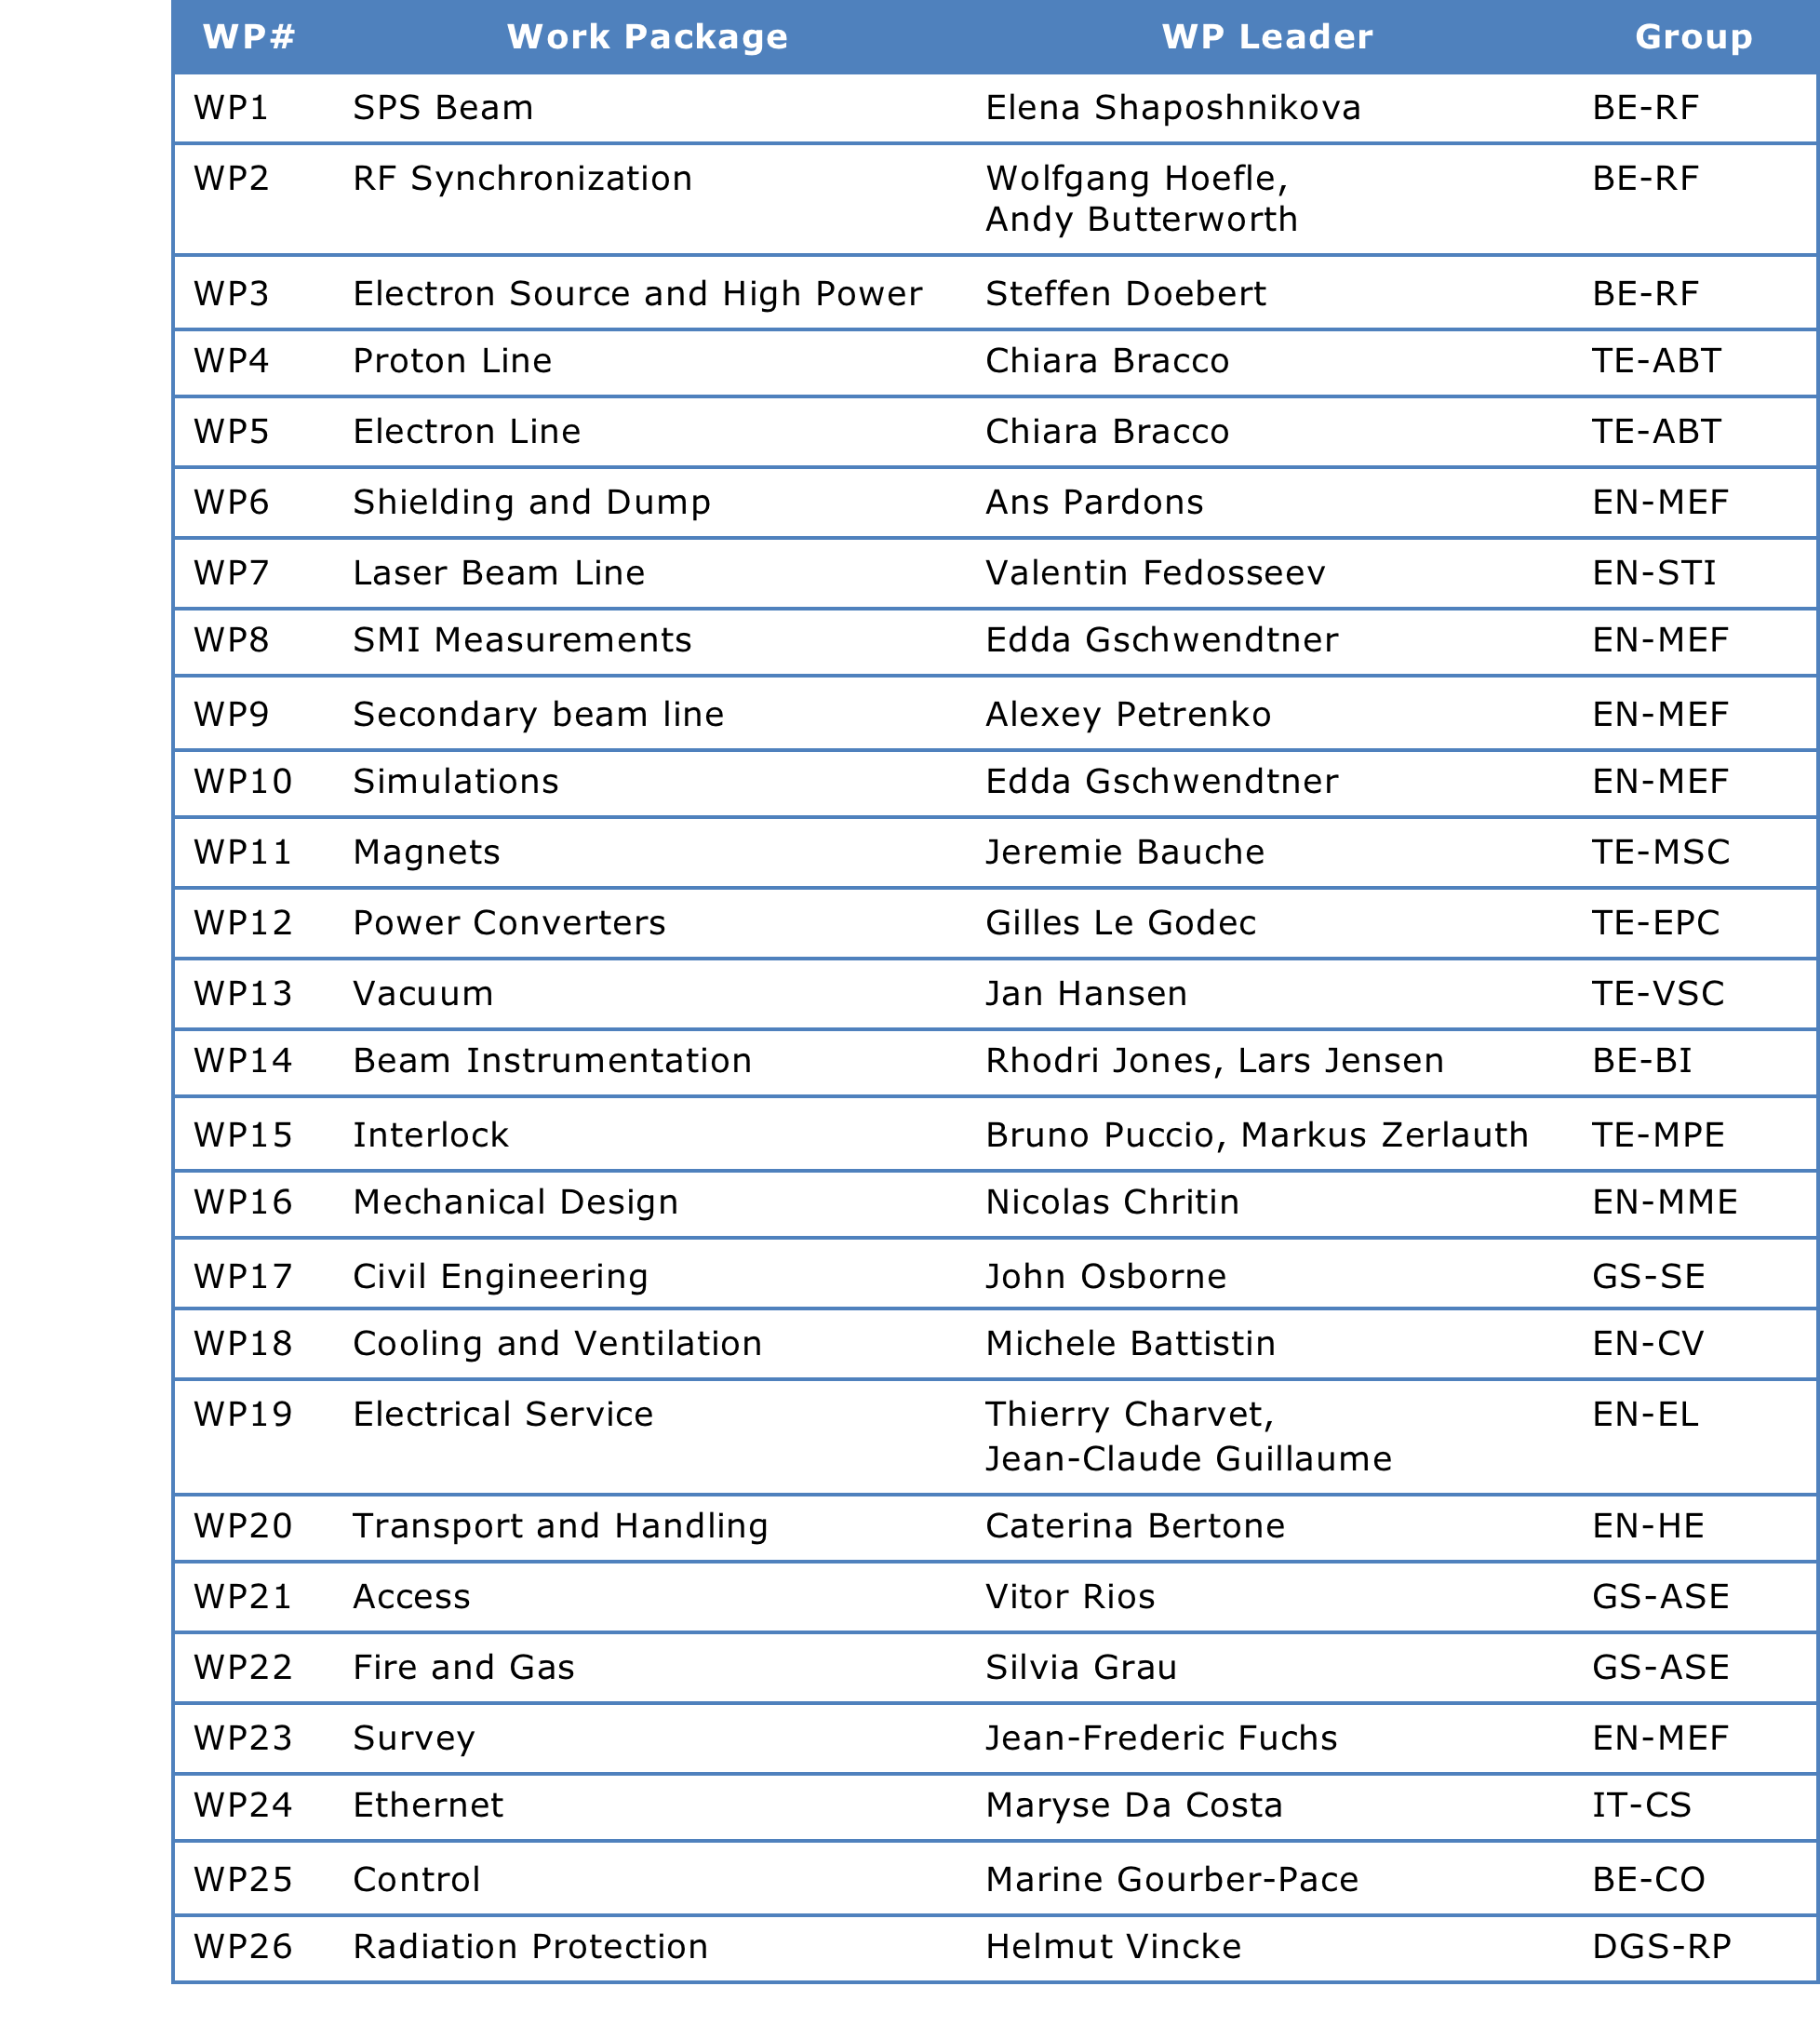
CERN Work Packages

Slide 4
Institutes Work Packages

Slide 5
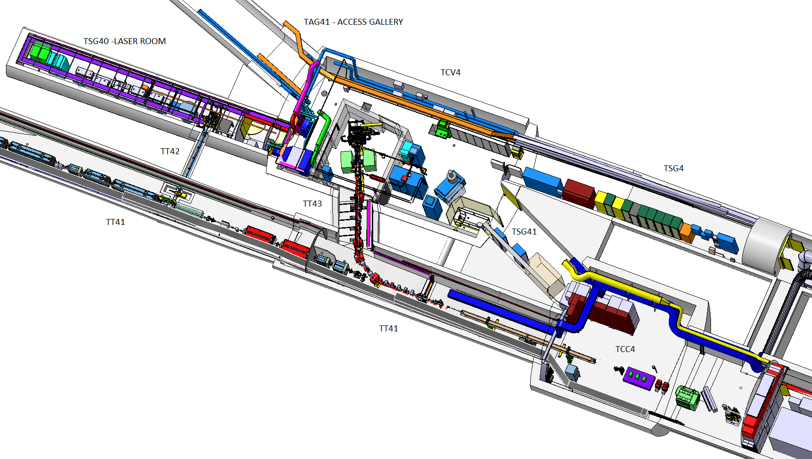
CERN AWAKE Project Organization
CERN AWAKE Project
Project Leader: Edda Gschwendtner
Deputy Project Leader: Chiara Bracco
Coordination Package Leaders:
Coordinate Work Packages that are associated to the areas and systems of the CP
Regular meetings, EDMS, indico
Report in project team meetings
Project Team:
CP1: SPS Beam and Synchronization : Elena Shaposhnikova
CP2: Proton and Electron Beam Lines: Chiara Bracco
CP3: Electron Source System: Steffen Doebert
CP4: Infrastructure, Global Integration and Installation: Ans Pardons
CP5: Laser Beam System: Valentin Fedosseev
CP6: Secondary Beam Line: Edda Gschwendtner
PO: Marzia Bernardini, RP: Helmut Vincke
26 Work Packages CERN
CP1: SPS & RF
CP4: Infrastr, Integr, Install
CP5: Laser beam system
CP3: e-source
CP2: proton and electron beam
CP6: sec beam

Slide 6
CP6 Secondary Beam Line
CERN AWAKE project Work Breakdown Structure, WBS (EDMS Nr. 1505432)
“The coordination package leader, CPL, is responsible for the design and commissioning of the secondary beam line (downstream the plasma cell), the interface between the CERN equipment in this area and the equipment delivered by the collaborating institutes (plasma cell, the experimental detectors and electron spectrometer).
The CGL follows up its integration and installation, follows up and coordinates the related studies and activities, follows up work progress and insures that milestones are achieved according to plan. “
Sofar, these issues could be covered in the other Coordination Packages, TB, PEB
Now, we need to follow that up in more details so that we are ready for physics in Q4 2016!

Slide 7
CP6 Issues to Cover
Integration of secondary beam line
  plasma cell, OTR, CTR, BTVs, laser shutter, quadrupoles, spectrometer, vacuum,…
Interface issues
  Integration, control
  What is needed from other CPs
Related studies and activities
  Simulations, tests (e.g. HiRadMat)
Control
  RF synchronization, timing, monitoring, interlocks
Commissioning of secondary beam line
  HW and beam commissioning
Planning

Slide 8
1st CP6 Meeting Today
Introduction (Edda)
Integration issues for OTR, CTR, plasma, alignment laser, quadrupoles (Karl, Misha, Patric, Alexey)
First ideas on commissioning steps and how to converge to a commissioning plan (all)
AOB

