Slide 1
HNSciCloud project & WLCG participation
Ian Bird, WLCG MB; 27th October 2015

Slide 2
WLCG and (commercial) clouds
WLCG (and HEP) must ensure its adaptability to new technologies and changing situations
How/when can commercial cloud services supplement or (partially) replace HEP-owned and managed facilities
  (When) will cost drive this?
What is the model?
  Cloud treated as a separate site like a Tier 1, or 2?
  Cloud treated as an extension of a site – as part of the pledge?
  Jointly procured large resource pool?

Slide 3
Science Cloud – past, present
  Many investigations of use of cloud resources via experiments, CERN, and other sites
  Helix Nebula EC project in Europe (together with other sciences)
CERN is doing 2 procurements to understand market prices and usage models:
  200 KCHF for compute (essentially simulation)
  400 KCHF for data intensive use cases (needs market survey)
  To be procured as extensions of the CERN cloud
  Eventual use cases – investigate dynamic expansion of CERN resources
  This capacity is in addition to pledges
PCP project has been approved and will start in January 2016
  Derogation of CERN procurement rules to allow compliance with EC procurement (EC member states) agreed by CERN Council last week
  Will allow a joint procurement across Tier 1s – understand if we can obtain economies of scale
  ➔ see next few slides

Slide 4
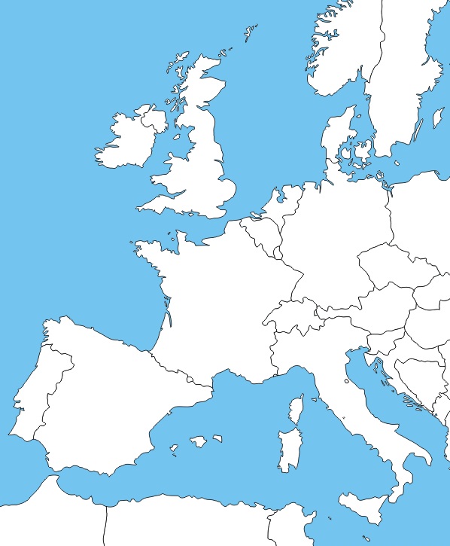









HNSciCloud H2020 PCP Project
The group of buyers have committed
~1.6M€ of funds
(generating ~6M€ total funds)
Manpower
Applications & Data
In-house IT resources
To procure innovative IaaS cloud services integrated into a hybrid cloud model
Commercial cloud services
European e-Infrastructures
  GEANT, eduGain, EGI
In-house IT resources
Procured services will be made available to end-users from many research communities
Notes:
Research organisations from 7 countries have proposed to work together to develop a cross-border joint procurement of innovative cloud services. This is an important change: never before have research organisations across Europe pooled their funds and resources to procure cloud services to support their scientific programmes.
eduGAIN federated identity mgmt. should include commercial identity providers taking into account multiple levels of assurance.

Slide 5
PCP project phases
Preparation
Analysis of requirements, current market offers and relevant standards
Implementation
Sharing
Best practises
Recommendations
Build stakeholder group
Training
Develop tender material
9 months
15 months
6 months
Design
Prototype
Pilot
Launch of tender
Pilots tested & assessed
Jan’16
Oct’16
Jan’18
Jun’18
All procuring organisations must sign letter to re-confirm commitment of funds

Slide 6




User Groups
The cloud resources procured will be made available to user groups during the pilot phase
  LHC experiments via WLCG
    Procured resources will count against the buyers’ pledges (during pilot phase)
    CERN will provide the interface via Tier-0 (OpenStack in tender spec.)
  ELIXIR
    Managed by EMBL-EBI via the ELIXIR Compute platform
  Other research communities via EGI Fed Cloud
    Request OCCI interface in tender spec.
  Local users at each buyers site
    Each buyer is responsible for integration
    Request web GUI interface in tender spec.
      Sites can also use OpenStack or OCCI interface as well
Each buyer decides what fraction of their procured resources is made available to each user group but cannot assign only to their local users
Collectively the users will form a user group with a role in the project to define requirements and provide feedback on pilot deployments
EGI: Access for large scale science projects, as well as
Long-tail

Slide 7
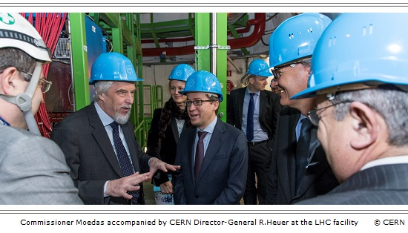
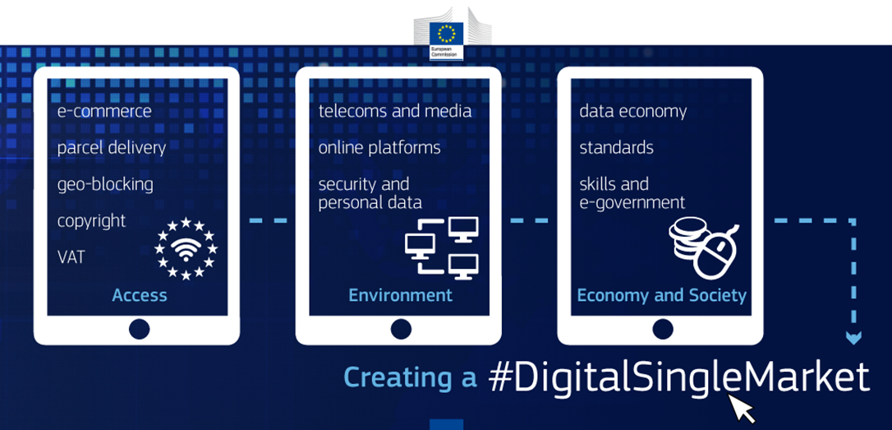
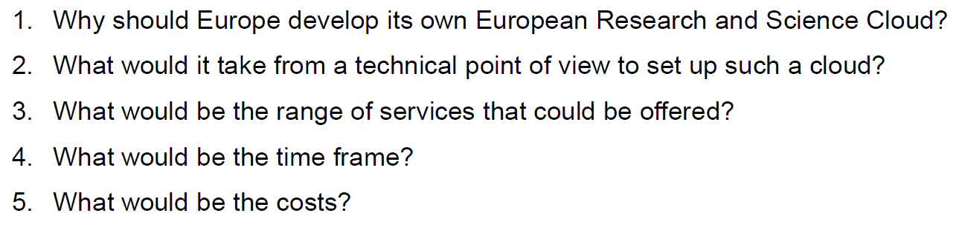
Open Science Cloud and the EC
Questions posed by RJ Smits during visit to CERN
with Commissioner Moedas in January 2015:
Commissioner Moedas announced in June 2015:
“The Commission will launch a European Cloud initiative including cloud services certification, contracts, switching of cloud services providers and a research open science cloud.”
The draft H2020 Work Programme 2016 – 2017 (annex 4) includes funding call INFRADEV-04-2016 European Open Science Cloud for Research (10M€)
CERN produced a paper Towards the European Open Science Cloud that answered these questions http://dx.doi.org/10.5281/zenodo.16001

Slide 8
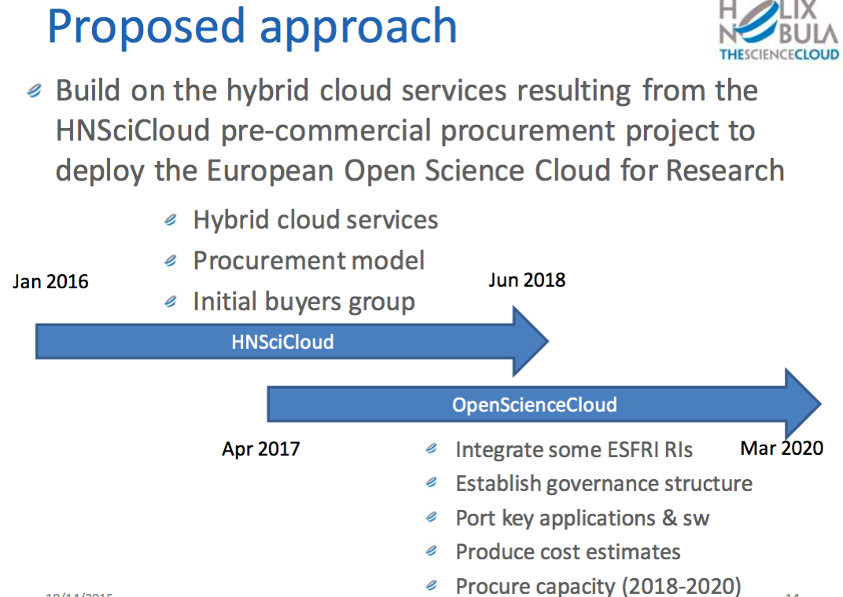

Slide 9
What WLCG needs to do
Provide use cases that we want the procured resources to address
Template attached to today’s agenda
Rather than have 4 experiments reproduce the same thing:
Propose a set of reasonably common and generic use cases, that will allow all 4 experiments to benefit:
  Simulation
  Reprocessing
  Organised analysis
Nominate a small group of experts from each experiment to complete template

